Slide 1
Chapter Two
Energy Balance Models

Slide 2
Outline
Types of climate model
EBM
zero dimensional EBM
one dimensional EBM
Building EBM

Slide 3
Types of climate model
Climate models
EBM
Emic
GCM
O-D EBM
1-D EBM
2-D Emic
3-D Emic
AGCM
AOGCM
ESM

Slide 4
Climate models may be classified in two ways:
Climate model classifications based on :
By their complexity in terms of the number of dimensions
0-DM
1-DM
By their scientific input in terms of the basic physical principles
EBM
2-DM
3-DM
RCM
GCM

Slide 5
Classification of climate models
Climate models may be classified in two ways:
By their complexity in terms of the number of dimensions
By their scientific input in terms of the basic physical principles

Slide 6
By their complexity in terms of the number of dimensions they describe:
Zero-Dimensional Models treat the Earth as a whole with no change by latitude, longitude, or height.
One-Dimensional Models allows for variation in one direction only.

Slide 7
Cont’d
Two-Dimensional Models allow for variations in two directions.
Three-Dimensional Models divide the Earth and the atmosphere into cubes, each cube has its own independent set of values for each of the climate parameters used in the model.

Slide 8
By their scientific input in terms of the basic physical principles they use:
Energy Balance Models work by calculating a balance between the radiation arriving at the planet and the energy leaving the planet.
This balance results in a characteristic temperature of the planet.

Slide 9
Cont’d
Radiative Convective Models are generally used as one-dimensional models to model the temperature profile up through the atmosphere by considering radiative and convective energy transport up to the atmosphere

Slide 10
Cont’d
General Circulation Climate Models are the most complex of climate models and are generally only formulated as three-dimensional models.
They involve solving a series of atmospheric equations and have the potential to model the atmosphere very closely.

Slide 11
EBM
Energy balance models are simple climate models that try to predict the average surface temperature of the Earth from solar radiation, emission of radiation to outer space, and Earth’s energy absorption and greenhouse effects.

Slide 12
Cont’d
EBMs simulate the two most fundamental processes governing the state of the climate:
The global radiation balance (i.e. between incoming solar and outgoing terrestrial radiation), and;
The latitudinal (equator-to-pole) energy transfer.

Slide 13
EBM
Based on dimension EBM divided in to Two
Zero dimensional EBM
One dimensional EBM

Slide 14
0-D EBMs
In 0-D EBMs, the Earth is considered as a single point in space, and in this case only the first process listed above is modeled.
The simplest model of the Earth's climate system is the 0-D EBM.
Earth is heated by absorption of solar radiation and cooled by radiating thermal (long wave) radiation back to space as shown in figure below.

Slide 15
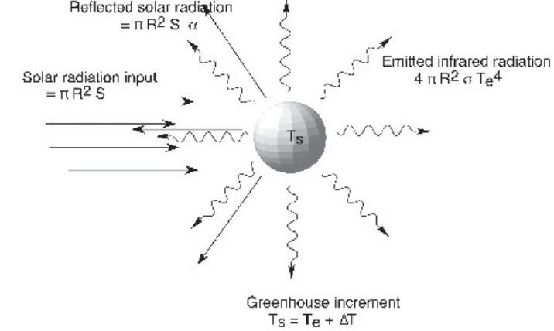
Cont’d
Figure 2.1: Heat absorbed and emitted by the Earth.

Slide 16
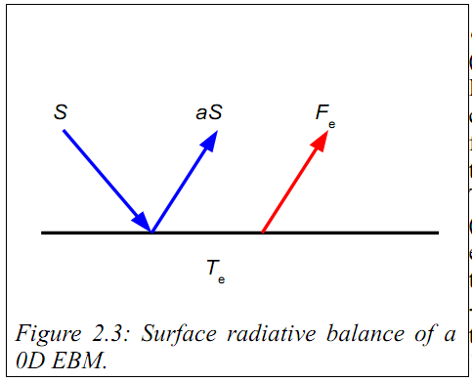
Cont’d

Slide 17
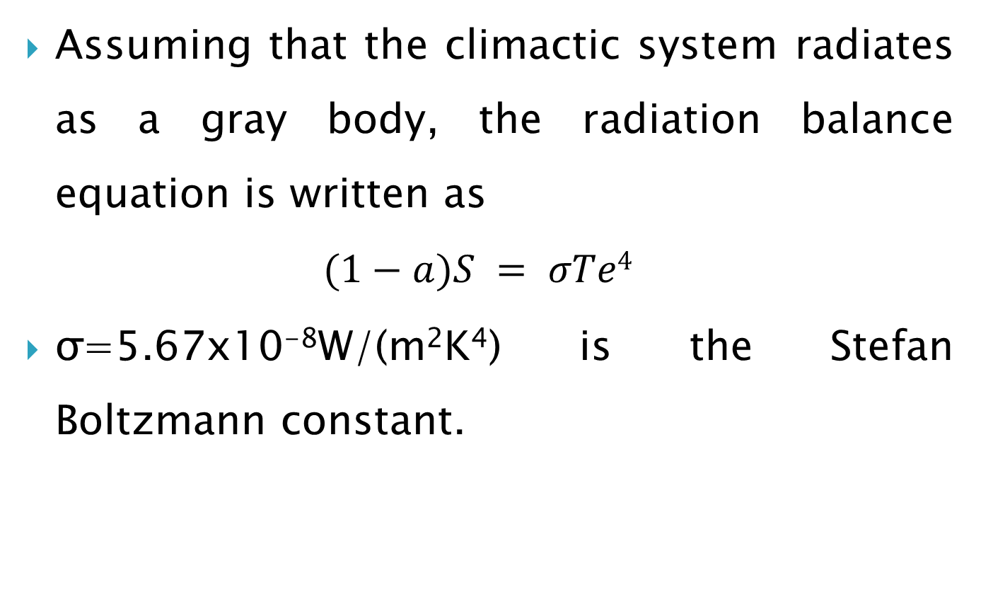
Cont’d
Assuming that the climactic system radiates as a gray body, the radiation balance equation is written as
$$(1−a)S = σTe4$$
σ=5.67x10⁻⁸W/(m²K⁴) is the Stefan Boltzmann constant.

Slide 18
Cont’d
However, gases in Earth's atmosphere, mainly water vapor and CO2, act like the glass of a greenhouse such that they absorb much of the long wave radiation emitted from the surface.
We can consider this by modifying our EBM as depicted in Fig. 2.4.

Slide 19
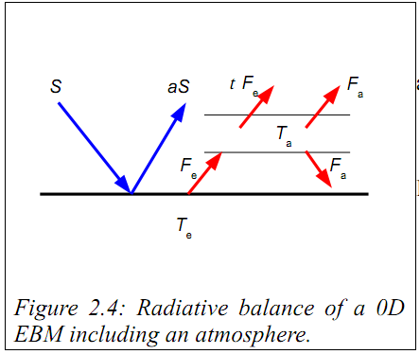
Cont’d

Slide 20
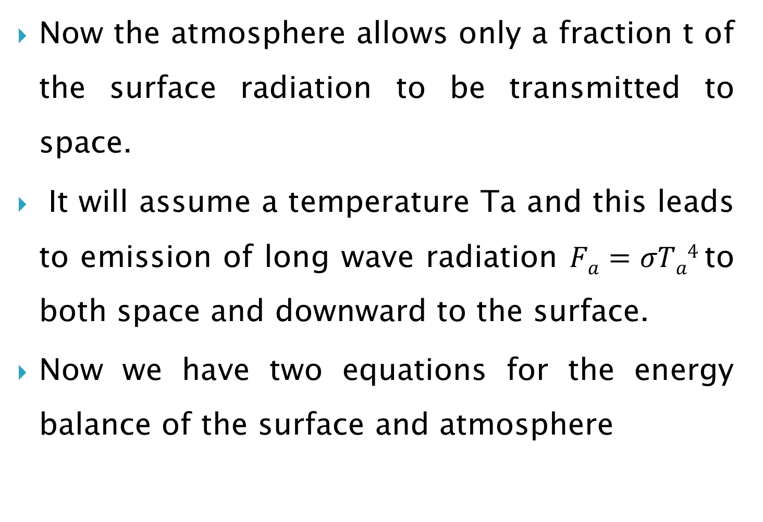
Cont’d
Now the atmosphere allows only a fraction t of the surface radiation to be transmitted to space.
It will assume a temperature Ta and this leads to emission of long wave radiation $Fa=σTa4$to both space and downward to the surface.
Now we have two equations for the energy balance of the surface and atmosphere

Slide 21
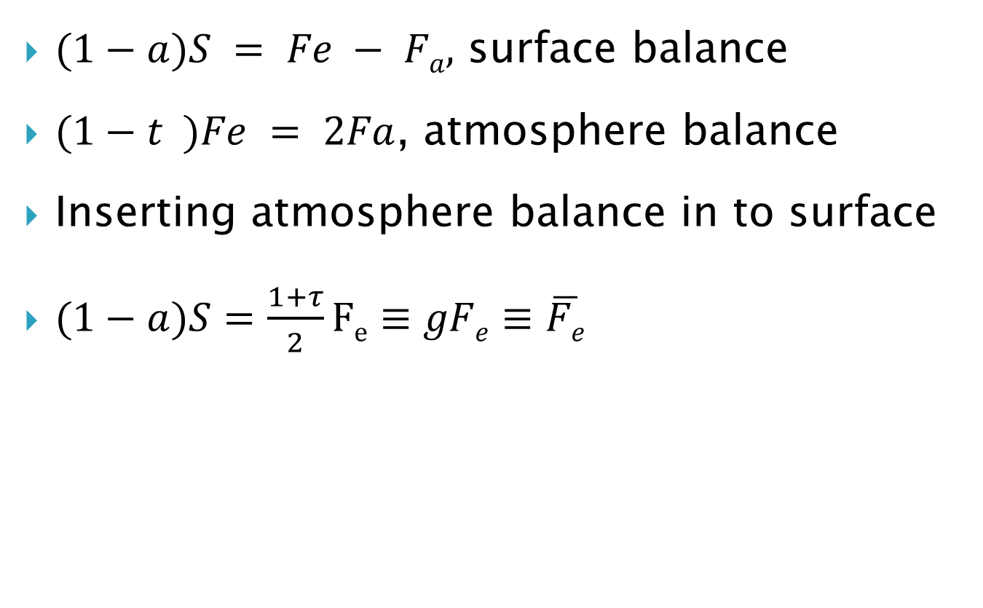
Cont’d
$(1−a)S = Fe − Fa,$ surface balance
$(1−t )Fe = 2Fa$, atmosphere balance
Inserting atmosphere balance in to surface
$(1−a)S=\frac{1+τ}{2}Fe≡gFe≡\overline{Fe}$

Slide 22
1-D EBM
In 1-D models, the dimension included is latitude.
Temperature for each latitude band is calculated using the appropriate latitudinal value for the various climatic parameters (e.g. albedo, energy flux etc.).

Slide 23
Cont’d
Latitudinal energy transfer is usually estimated from a linear empirical relationship based on the difference between the latitudinal temperature and the global average temperature.
Other factors that may be included in the model equation are the time-dependent energy storage and the energy flux into the deep ocean.

Slide 24
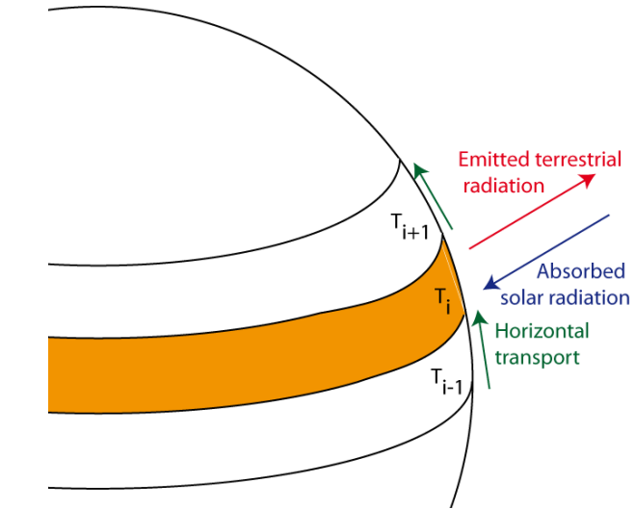
Cont’d

Slide 25
Cont’d
This models are more complex than the 0-D EBM because they include the effect of latitude on incoming solar energy.
The model includes the effect of energy transport from one zone to another and checks for glaciation

Slide 26

Cont’d
In the case where we consider each latitude zone independently,
Energy transport
Long wave out
Short wave in

Slide 27
Cont’d
where Ti represents the surface temperature of zone i.
Note that we now have an additional term F(Ti) which refers to the loss of energy by a latitude zone to its colder neighbor or neighbors.
Each of the terms in Equation (above) is a function of the predicted variable Ti.

Slide 28
Cont’d
The surface albedo is inﬂuenced by temperature in that it is increased drastically when ice and snow are able to form.
The radiation emitted to space is proportional to T⁴ although, over the temperature range of interest ( 250-300K), this dependence can be considered linear.

Slide 29

Cont’d
The horizontal ﬂux out of the zone is a function of the difference between the zonal temperature and the global mean temperature.
The albedo is described by a simple step function such that:

Slide 30

Cont’d
Above equation represents the albedo increasing at the snowline;
Tc, the temperature at the snowline, is typically between 10°C and 0°C.
Because of the relatively small range of temperatures involved, radiation leaving the top of the latitude zone can be approximated by:

Slide 31
Cont’d
where A and B are empirically determined constants designed to account for the greenhouse effect of clouds, water vapor and CO2.
The rate of transport of energy can be represented as being proportional to the difference between the zonal temperature and the global mean temperature by

Slide 32


Cont’d
where kt is an empirical constant(1.292x10⁻⁴)
Incorporation of Equations which can be rearranged to give:

Slide 33
EBM building process
Model
Build
Analyze
Real World
Predictions
Compare

Slide 34
Building EBM and analysis
Building a series of zero-dimensional energy balance models for the Earth's climate system.
In a zero-dimensional energy balance model, the Earth's climate system is described in terms of a single variable, namely the temperature of the Earth's surface averaged over the entire globe.

Slide 35
Cont’d
In general, this variable varies with time; its time evolution is governed by the amount of energy coming in from the Sun and the amount of energy leaving the Earth.

Slide 36
Example
We consider the Earth with its atmosphere, oceans, and all other components of the climate system as a homogeneous solid sphere, ignoring differences in the atmosphere's composition (clouds!), differences among land and oceans, di
fferences in topography(altitude), and many other things.

Slide 37
Observation
The climate system is powered by the Sun, which emits radiation .
This energy reaches the Earth's surface, where it is converted by physical, chemical, and biological processes to radiation in the infrared (IR).
This IR radiation is then reemitted into space.

Slide 38
Obs…cont’d
If the Earth's climate is in equilibrium (steady state), the average temperature of the Earth's surface does not change,
so the amount of energy received must equal the amount of energy re-emitted.

Slide 39
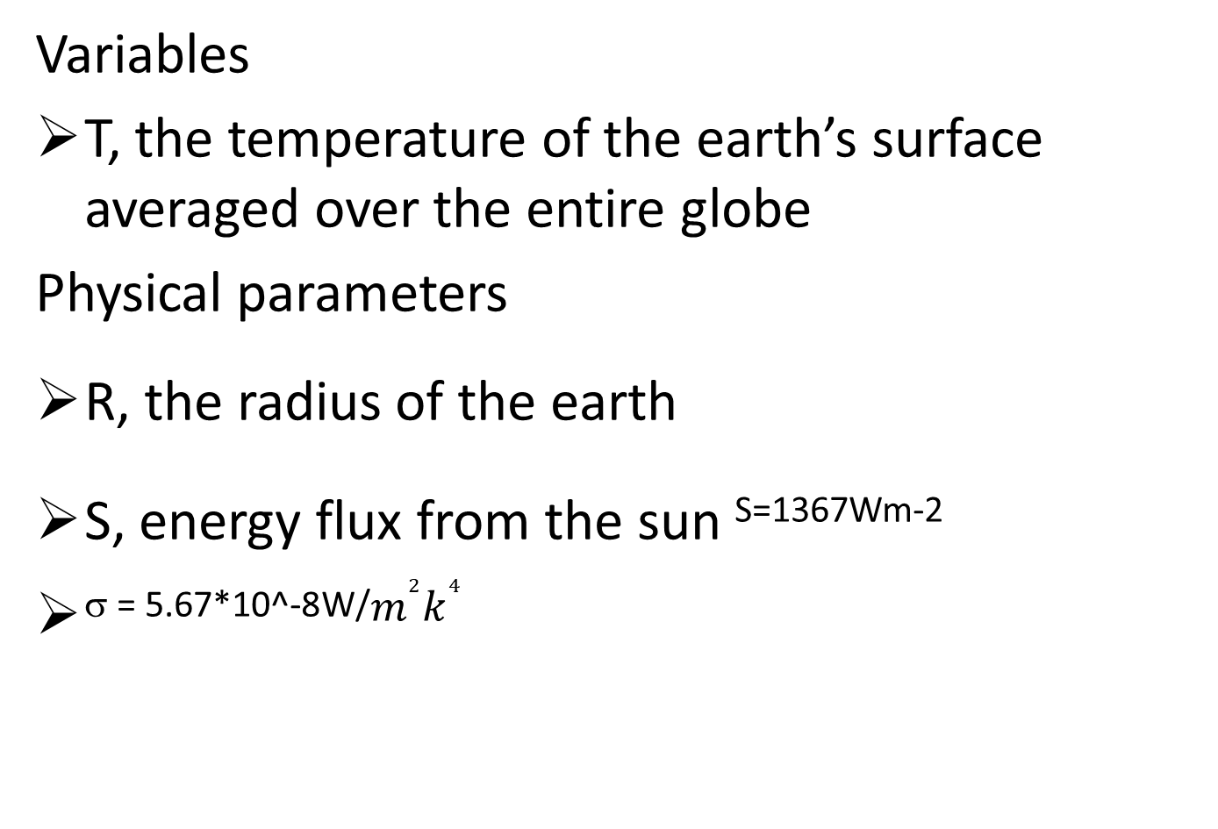
Modeling
Variables
T, the temperature of the earth’s surface averaged over the entire globe
Physical parameters
R, the radius of the earth
S, energy flux from the sun ^{S=1367Wm-2}
^{σ = 5.67*10^-8W/}$m^{2}k^{4}$

Slide 40
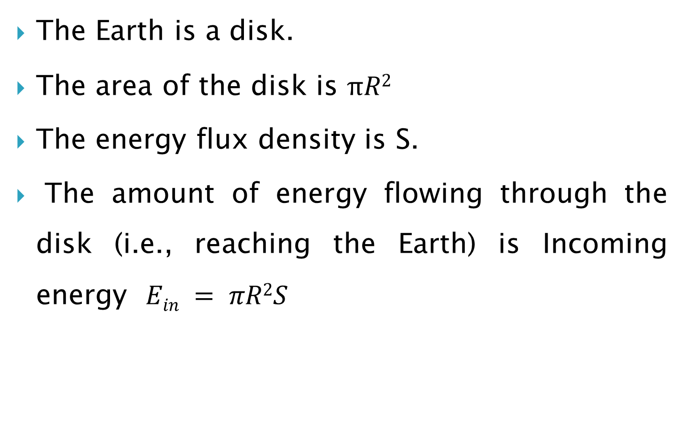
Building the model
The Earth is a disk.
The area of the disk is $πR2$
The energy flux density is S.
The amount of energy flowing through the disk (i.e., reaching the Earth) is Incoming energy $Ein = πR2S$

Slide 41
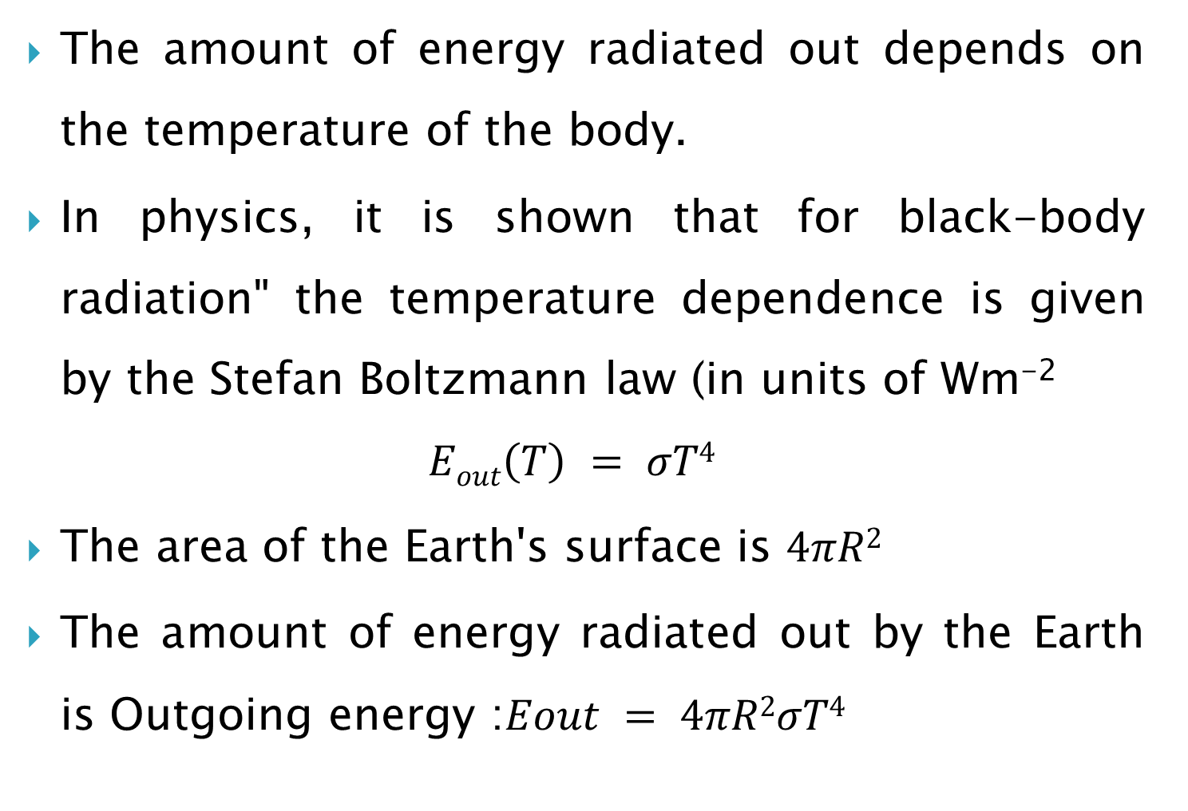
Cont’d
The amount of energy radiated out depends on the temperature of the body.
In physics, it is shown that for black-body radiation" the temperature dependence is given by the Stefan Boltzmann law (in units of Wm⁻²
$$Eout\left(T\right) = σT4$$
The area of the Earth's surface is $4πR2$
The amount of energy radiated out by the Earth is Outgoing energy :$Eout = 4πR2σT4$

Slide 42
Analysis
If the incoming energy is greater than the outgoing energy, the Earth's temperature increases.
If the incoming energy is lower than the outgoing energy, the Earth's temperature decreases.

Slide 43
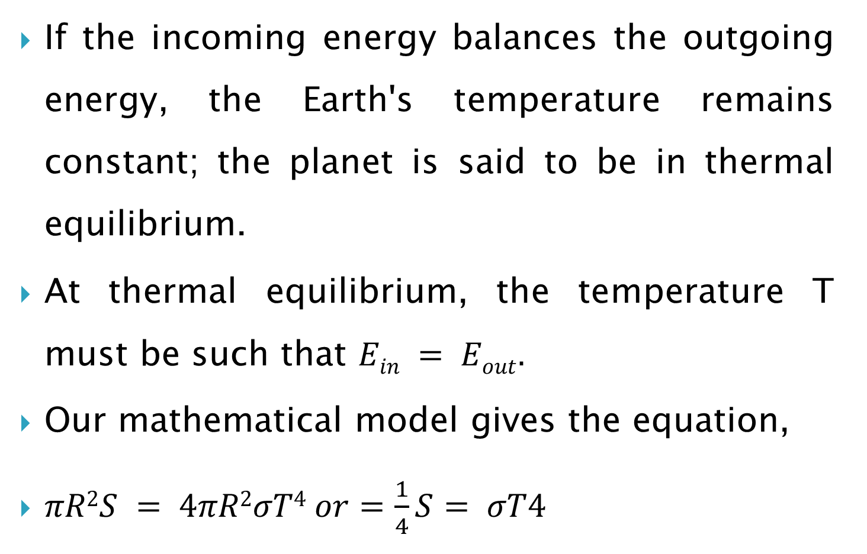
Cont’d
If the incoming energy balances the outgoing energy, the Earth's temperature remains constant; the planet is said to be in thermal equilibrium.
At thermal equilibrium, the temperature T must be such that $Ein = Eout.$
Our mathematical model gives the equation,
$πR2S = 4πR2σT4 or=\frac{1}{4}S= σT4$

Slide 44
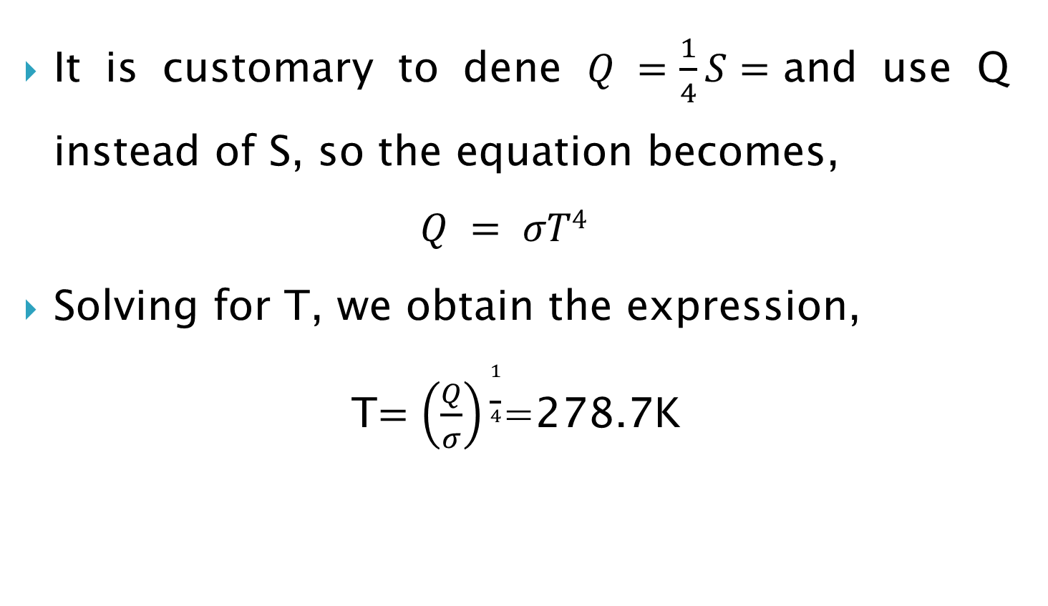
Cont’d
It is customary to dene $Q =\frac{1}{4}S=$and use Q instead of S, so the equation becomes,
$$Q = σT4$$
Solving for T, we obtain the expression,
T$=\left(\frac{Q}{σ}\right)\frac{1}{4}$=278.7K

Slide 45
conclusion
Model out put gives the average temperature at equilibrium about 5.5 degrees Celsius
The value T = 5.5 degrees Celsius seems reasonable but is not in agreement with the known average temperature of the Earth, which is about 15 degrees Celsius.
There fore; We need a better model.

Slide 46
Modeling 2
The first factor we want to add involves reflection some of the incoming energy from the Sun is reflected back out in to space.
Snow, ice, and clouds, for example, reflect a great deal of the incoming light from the Sun.
We use the term albedo to measure the Earth's reflectivity.
Albedo=0.3

Slide 47
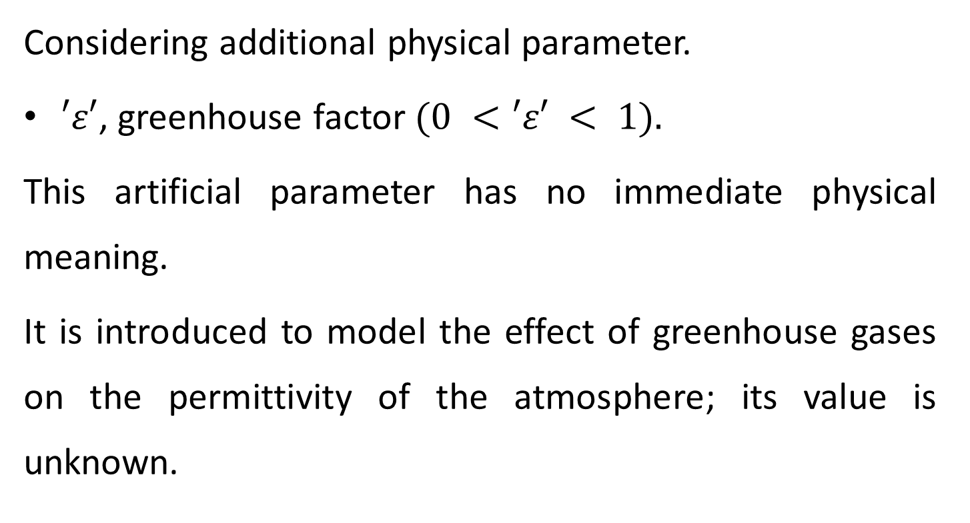
Modeling 3
Considering additional physical parameter.
$′ε′$, greenhouse factor $(0 <′ε′ < 1).$
This artificial parameter has no immediate physical meaning.
It is introduced to model the effect of greenhouse gases on the permittivity of the atmosphere; its value is unknown.

Slide 48
Assingnment-1
Build model for modeling 2 and 3 by calculating for temperature (T)
Do Analysis
Conclusion

