Slide 1
1. Introduction to water resource system
Earth is a blue planet. Three quarters of it are covered with water.
life began in water: in average human contains about 50 liters of water.
The movement of water on the earth has been one of the main causes in shaping the topography.
Water also has a high thermal inertia due to high specific heat and therefore the oceans have important influence on heat cycle of the earth.
It is well known that water is central to the climate of a place.
Along with all the benign features, water is also a paramount vehicle to convey the fury of nature.
The water centered hazards, like floods and droughts, are from water.

Slide 2
1.1. Need for water
The need for water is derived from a variety of activities.
These activities are vital for existence and development of human society.
Because usable water is limited in its availability, it has an economic value.
Furthermore, different activities require water of differing quality.
For example, water ofhigh quality is needed for domestic use while the quality may be compromised for sanitation use.
The utility of water lies in the various productive functions that it can perform.
Traditionally, municipal and agricultural water supply have been the usual uses. These two (particularly in an agrarian economy) are viewed as social objectives and cannot be given up even if alternate use of water gives a higher benefit.
Other important uses are hydropower, navigation, and recreation.

Slide 3
Cont.........................
The objectives of water resources development are more varied now.
Now a day:
Pollution control,
repulsion of saline water,
preservation of natural rivers,
beautification,
groundwater replenishment,
and a host of other equally non-quantifiable and competitive purposes now demand equal attention along with economic purposes.

Slide 4
AVAILABILITY OF WATER
For economic and optimum utilization, planning, design, and operation of water resources, the determination of the extent and availability of surface and ground water is the first requisite.
The distribution of waters on the continents varies greatly in space and time.
The human population, on the other hand, is distributed in
quite a different manner. For example, regions with an immense abundance of water may be sparsely populated
Our ability to use water also depends on the frequency and magnitude of floods and droughts.
In view of climate change, both are likely to become more severe.
Generally water is unevenly distributed on earth.

Slide 5
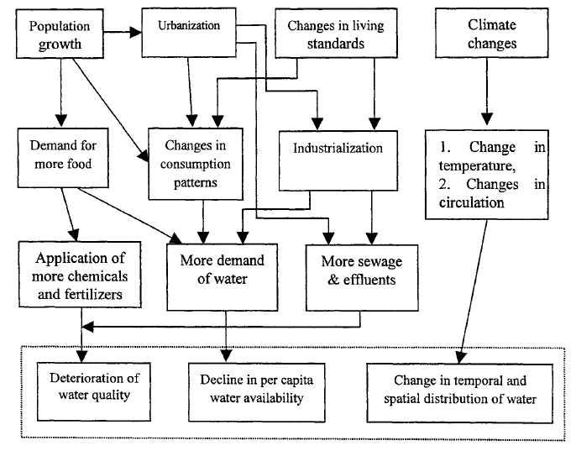
Cont.........
The following are major sources of water ;
Natural rivers. The rivers are fed by rainfall, or snow/glacier melt, or both. Their flows vary seasonally and in upland areas streamflow varies wildly ('flashy discharge').
Fig. 1. Major root causes of water resources problems and their effects.

Slide 6
Cont.....................
Natural lakes: These usually offer a limited supply, since their range of acceptable drawdown is severely constrained.
Reservoirs: Water is stored in a reservoir behind a dam for a number of uses.
In climates with distinct wet and dry seasons, water stored in a wet season is withdrawn for use in the dry season.
Reservoirs may be of the following types.
Direct supply reservoir. Most upland reservoirs supply water by pipeline or canals, often by gravity flow and offer good quality water.
River-regulating reservoirs, which are major water reserves and release water downstream to sustain its discharge in conditions of low natural flow.
Pumped storage, in which river water is pumped into a (sometimes off-channel) storage, for subsequent use.

Slide 7
Conti..............
Tube wells: are the main sources of ground water.
Springs: These occur where aquifers crop out above impermeable rock.
TECHNOLOGY FOR MEETING WATER NEEDS
Without a major technological innovation, there is little hope of meeting the ever-increasing water demands.
The traditional approach to capture rainfall has been to build dams which trap the excess river flows.
Ground water extraction methods, rainfall-runoff harvesting.
Reservoirs, Dams.

Slide 8
WATER RESOURCES PLANNING
Water resources planning and development is modifying the time and space availability of water for various purposes so as to accomplish:
certain basic national, regional and local objectives.
In most cases, the ability to achieve these objectives is limited due to;
non-uniform availability of water and other resources.
The water resources are distributed unevenly in space and time and the issue is how best to develop them.
The basic motivation for a government to plan and develop water resources usually lies;
in the improvement of national or regional welfare,
increase in national income,
national self-sufficiency and
preservation of the quality of the environment.

Slide 9
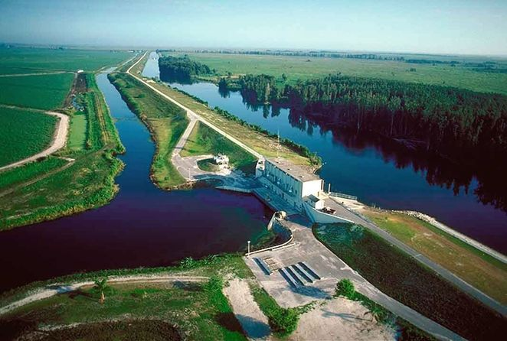

Slide 10
Cont.......................
The objective of water resources planning and management is to provide;
The supplies of water in accordance with the temporal and spatial distribution of demands through river regulation and distribution systems.
Water Resources Planning (WRP) serves Water Resources Management.
WRP addresses the functioning of the Water Resources System (WRS) in its integrated whole, taking into consideration its social, economic and environmental functions.
Planning (the formulation of development and management plans
and policies) is an important and often indispensable means to support and improve operational management.

Slide 11
WRP Cont................................
WRP provides an opportunity to (Loucks et al., 2005):
– assess the current state of the water resources and the conflicts
and priorities over their use, formulate visions, set goals and
targets, and thus orient operational management
– provide a framework for organizing policy relevant research
and public participation
increase the legitimacy, public acceptance of (or even support
for) the way the resources are to be allocated or controlled,
especially in times of stress
– facilitate the interaction, discussion and coordination among
managers and stakeholders, and generate a common point of
reference – a management plan or policy.

Slide 12
Common goals of WRPM
Reducing the frequency and/or severity of the adverse
consequences of droughts, floods and excessive pollution
Identification and evaluation of alternative measures that may;
increase the available water supplies or hydropower,
improve recreation and/or navigation, and
enhance the quality of water and aquatic ecosystems
Provide safe, reliable and affordable drinking water to people
without causing damage to environment
Allocate scarce water resources among competing users in an
equitable manner
Maximize net social and economic benefits from the operation
of a multipurpose dam while minimizing the environmental damage

Slide 13
Task of Water resources planning are;
to plan new water resources projects for least cost or optimum output, or
to plan enlargement of a system in an optimal way so as to meet its present functional requirements in a better way or to fulfill some new functions.

Slide 14
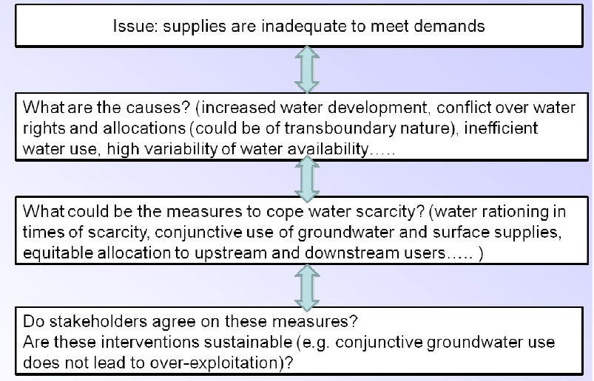
An example of planning process to address water scarcity

Slide 15
Scope of planning endeavors
Single purpose plan
Multi-purpose plan
Master plan –phased development plan. single or multi on a certain geographic area for a specific time.
Comprehensive or Integrated plan;
It is multi-unit, multipurpose and multi objective plan.
It include economical, financial, political, social, and environmental objectives.
Consider both structural and non-structural (institutional) alternative.
It does not include feasibility studies of individual projects
What is feasibility studies?

Slide 16
Scope of planning endeavors - in terms of areal extent
International plan
National plan
Regional plan
District plan
River basin plan –hydrological boundary

Slide 17
Spatial scale for water resource planning
• Generally, River Basin is considered most suitable spatial scale for water resources planning (from hydrological perspective).
• Within a basin, it is important to consider
– Upstream-downstream impacts
– Up-scaling and downscaling issues (e.g. from a farmer field to cropping system to catchment to basin and vice versa)
– Administrative boundaries
• Outside of a basin, there are also many important considerations:
– National/country perspective
– Inter-basin transfers
– International context
– Virtual water

Slide 18
Water Resources Development
In countries with limited water resources, comprehensive and rational water resources development is a necessary condition for;
Optimum social and
Economic growth.
There are various ways of classifying water resources projects;
Based on physical nature, the broad project categories are:
1. Surface storages: reservoirs, natural lakes with artificial control of outflows.
2. Channelization: irrigation canals, navigation canals, drainage works, dykes for flood protection, and erosion control measures.
3. Diversion of water: inter-basin water transfer projects.
4. Waste treatment and assimilation.
5. Ground water extraction and artificial recharge.
6. Catchment treatment for control of water yield and peaks.

Slide 19
WATER RESOURCES MANAGEMENT
Water resource management is the activity of;
Planning,
Developing,
Distributing and
Managing the optimum use of water resources.
It is a sub-set of water cycle management.
Ideally, water resource management planning has regard to all the competing demands for water and seeks to allocate water on an equitable basis to satisfy all uses and demands.
As with other resource management, this is rarely possible in practice.

Slide 20
Cont...........................
The field of water resources management will have to continue to adapt to the current and future issues facing the allocation of water.
With the growing uncertainties of global climate change and the long term impacts of management actions, the decision-making will be even more difficult.

Slide 21
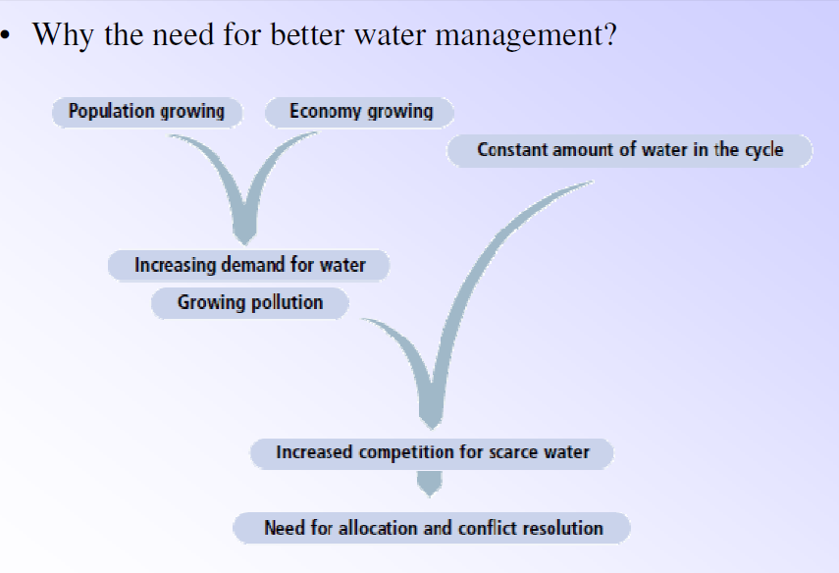
Cont.......

Slide 22
Concept of a System
System: Definition of a system (Dooge, 1973)
“any structure, device, scheme or procedure, real or abstract, that interrelates in a given time reference, an input, cause, or stimulus, of matter, energy, or information, and an output, effect or response, of information, energy or matter.”
In short form system can be defined as;
input
Process
output

Slide 23
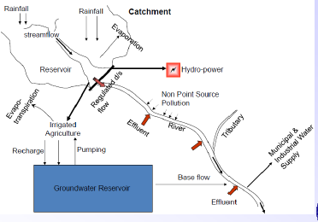
Cont.......
E.g. River basin system

Slide 24
A system is characterized by:
A system boundary: Rule that determines whether an element is a part of the system or the environment
Statement of input and output interactions with the environment
Statement of interrelationships between various elements of the system called feedback
State of the system: Conditions or indicates the activity in the system at a given time e.g.. water level in a reservoir, depth of flow.
Systems analysis, is a rational approach for arriving at the management decisions for a particular system,
based on the systematic and efficient organisation and analysis of relevant information.

Slide 25
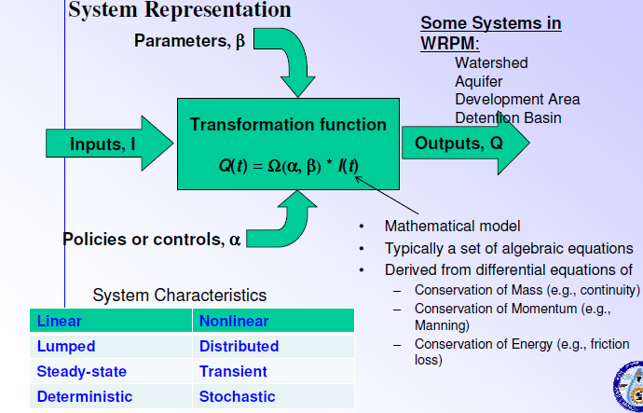
Cont...............

Slide 26
Classification of Systems
Linear and Nonlinear systems: A linear system is the one in which the output is a constant ratio of the input. In a linear system the output due to a combination of inputs is equal to the sum of the outputs from each of the inputs individually i.e principle of superposition.
Time-variant and Time-invariant systems: In a time invariant system the input-output relationship does not depend on the time of application of input. i.e. output is the same for the same input at all times. E.g. Unit hydrograph.
Deterministic system and Stochastic system: In a stochastic system the input-output relationship is probabilistic.
Continuous and Discrete systems: In continuous system the changes in the system take place continuously.

Slide 27
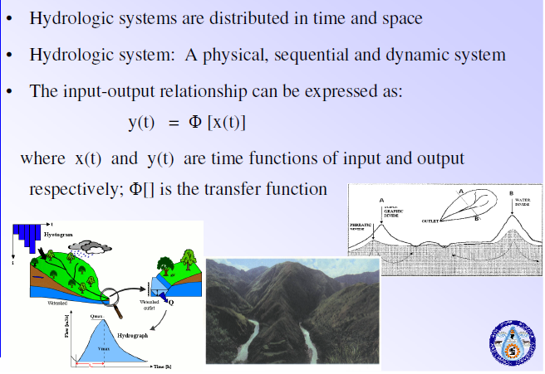
Hydrologic System

Slide 28
System analysis
An optimal plan is selected through a systematic search and evaluation of various alternatives that meet the objectives and constraints
• System analysis consists of five steps:
– Defining the problem
– Identifying the system and its elements
– Defining the objectives and constraints
– Identify feasible alternatives that satisfy the above said constraints
– Identify the most efficient alternative that best meets the objectives

Slide 29
Need for system approach
Water resource projects are large-scale and most of the times permanent ones
They have huge impact on both society and economy
They need the participation from various fields simultaneously
Require heavy capital investments and hence have a major effect on economy even a small improvement over traditional solution is desirable
Adoption of systems approach is better than conventional techniques based only on experience, to achieve an improved overall project output

Slide 30
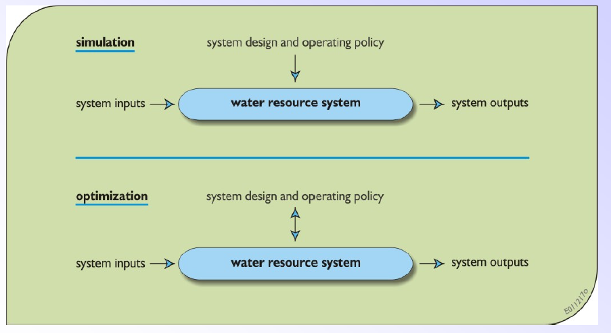
2. Modeling methods
Optimization vs simulation
Simulation models: Predict response to given design
• Optimization models: Identify optimal designs or policies

Slide 31
Optimization vs simulation
Optimization models eliminate the worst solutions.
Simulation tools evaluate the performance for various configurations of the system; but they are not effective for choosing the best config.
Simulation simply addresses ‘what-if’ scenarios – what may happen if a particular scenario is assumed.
Simulation is not feasible when there are too many alternatives for decision variables, which demand an enormous computational effort.
Optimization will determine the best decision; but the solution is often based on many limiting assumptions.
Full advantage of systems techniques: Optimization should be used to define a relatively small number of good alternatives that can later be tested, evaluated and improved by means of simulation.

Slide 32
Optimization
Basic components of an optimization problem :
An objective function expresses the main aim of the model which is either to be minimized or maximized.
Set of unknowns or variables which control the value of the objective function.
Set of constraints that allow the unknowns to take on certain values but exclude others.
Optimization problem is then to:
Find values of the variables that minimize or maximize the objective function while satisfying the constraints.

Slide 33
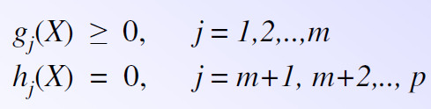
Cont........................
Identify the best through evaluation from a number of possible solutions
• Driving force in the optimization is the objective function (s)
• Optimal solution is the one which gives the best (either maximum or minimum) solution under all assumptions and constraints.
• An optimization model can be stated as:
Objective function: Maximize (or Minimize) f(X)
Subject to the constraints
X is the vector of decision variables; g(X) are the inequality
constraints; h(X) are the equality constraints.

Slide 34
Cont........
Optimization Classification based on constraints
• Constrained optimization problems: Subject to one or more constraints
• Unconstrained optimization problems: No constraints exist

Slide 35
Cont..............................
Optimization problems can be classified as
(i) Linear programming: Objective function and all the
constraints are ‘linear’ functions of the design variables
(ii) Nonlinear programming : Any of the functions among the objectives and constraint functions is nonlinear
(iii) Geometric programming : Objective function and constraints are expressed as polynomials
(iv) Quadratic programming: Best behaved nonlinear programming problem with a quadratic objective function and linear constraints and is concave (for maximization problems)

Slide 36
Cont..........................
Optimization problems can be classified as deterministic or stochastic programming problems
(i) Deterministic programming problem: In a deterministic system, for the same input, the system will produce the same output always.
In this type of problems all the design variables are deterministic.
(ii) Stochastic programming problem: In this type of problem, some or all the design variables are expressed probabilistically (non-deterministic or stochastic).

Slide 37
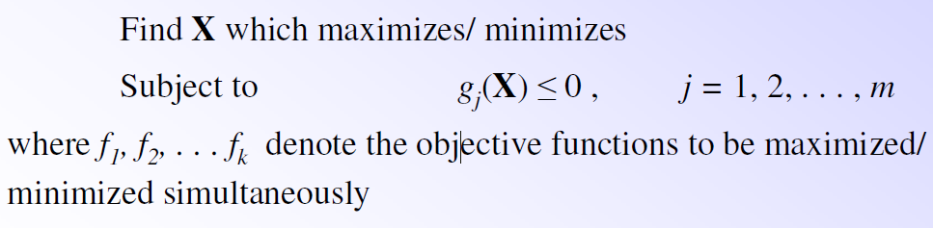
Cont.................................
Objective functions can be classified as single-objective and multi-objective programming problems.
(i) Single-objective programming: There is only a single
objective function.
(ii) Multi-objective programming: A multi-objective
programming problem can be stated as follows:

Slide 38
Simulation
Simulation is the evaluation of a large number of alternatives under different realistic scenarios identified by decision‐makers.
It is essential to understand that simulation supports decision making by evaluating predefined options, but it does not generate the best possible strategies.
It reproduces the response of the system to any future conditions
Operating policies can be tested through simulation before implementing in actual situations
Simulation model duplicates the system’s operation with a defined operational policy, parameters, time series of flows, demands etc
Design parameters and the operation policy are evaluated through the objective function or some reliability measures.

Slide 39
Steps in simulation
Problem definition: Define the goals of the study
System definition: Identify the WRS components. Identify the performance measures to be analyzed.
Model design: Decide the model structure by determining the variables describing the system, its interaction and various parameters of structures.
Data Collection: Determine the type of data to be collected.New/ Old data is collected/ gathered.
5. Validation: Test the model and apply the model to the problem.

Slide 40
Classification of simulation
i. Physical (e.g. a scale model of a spillway)
ii. Analog (system of electrical components such as resistors or capacitors arranged to act as an analog to the hydrological
components) or
iii. Mathematical (action of a system expressed as equations or logical statements.
• Simulation models can be
i. Static (fixed parameters and operational policy) or
ii. Dynamic (takes into account the change in the parameters of the system and the operational policy with time) in nature.
Simulation models can be deterministic or stochastic
Simulation models can be statistical or process oriented, or a mixture.

Slide 41
ECONOMICS IN WATER RESOURCES
Economics in engineering deals with applying economic criteria to select the best solution from a group of feasible alternatives or,
Evolving the best economic policy for planning and management of an engineering project.
The ranking and selection of alternatives are done based on the principles of engineering economics.
The magnitude of consequences expected from employing each alternative are assessed and converted into commensurable units for comparison.

Slide 42
Concepts used in economic analysis:
Cash flow diagram:
Assess the consequences of each alternative and assign a monetary value for each consequence.
The graphic representation of each monetary value with time is called a cash flow diagram.
The benefits are represented as upward arrows and costs as downward arrows.
It is drawn to convert the time stream of monetary value into an equivalent single number.
All cash flows are combined into an equivalent single lump sum at the end of a period.

Slide 43
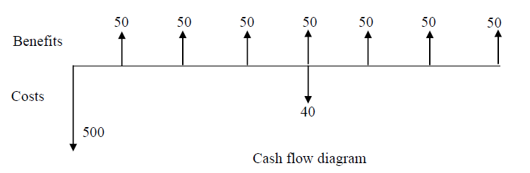
Cont...........
An example cash flow diagram is shown below.
At the beginning, a large expenditure is made. Benefits are received thereafter every year.

Slide 44
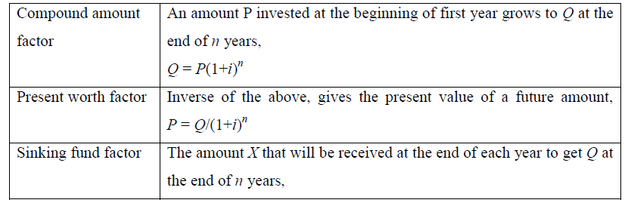
Discount factors:
The amounts at different times have different values.
In order to compare them, all monetary values are converted into equivalent amounts at some definite time using discount factors.
Many discount factors are used as given below.

Slide 45
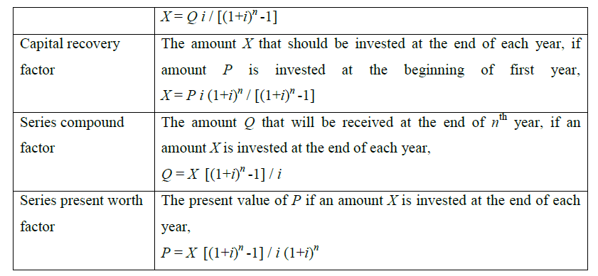
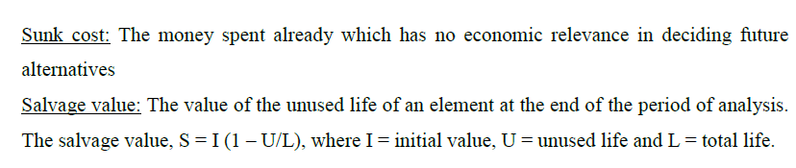
Cont............................

Slide 46
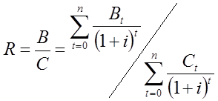
Discounting techniques
Discounting techniques are used to find the feasible one among various alternatives.
Commonly used discounting techniques are
Benefit-cost ratio method
Present worth method
Rate of return method and
Annual cost method. The first two methods are explained here.
Benefit – Cost (BC) ratio method
BC ratio, R is defined as the ratio of the present worth of benefits and the present worth of cost. It can be expressed as

Slide 47
Cont..............................
where , Bt and Ct are the monetary values of benefits and costs incurred at time t respectively.
i is the discount rate
n is the life of the project in time steps (years or months or weeks).
Steps for choosing the best alternative are:
Calculate the BC ratio for each alternative
Retain all alternatives with BC>1 and reject the rest. If sets of mutually exclusive alternatives are involved then go to steps 3, 4 and 5.
Rank the set of mutually exclusive alternatives in the order of increasing cost. Calculate the BC ratio using incremental cost and incremental benefit of the next alternative above the least costly alternative.
Choose the more costly alternative of the incremental BC >1. Otherwise choose the less costly alternative.
Repeat the analysis for all alternatives in the order of rank.

Slide 48
BC ratio: Example1
Two alternative plans are feasible. The estimated cost of 1st plan is 70 MB and the corresponding benefit is 80 million birr (MB). The cost for the 2nd plan is 85 MB and benefit is 100 MB. Which plan should be selected?
Solution
BC ratio for 1st plan = 80/70 = 1.14; BC ratio for 2nd plan = 100/85 = 1.176
Since BC ratios are >1, according to steps 3 and 4, rank the plans based on cost.
Plan 1 is ranked 1 and plan 2 is ranked 2.
Now, incremental cost (2nd plan over 1st plan) = 85 – 70 = 15; Incremental benefit (2nd plan over 1st plan) = 100 – 80 =20
Incremental BC ratio = 20/15 = 1.33; Since Incremental BC ratio > 1, the more costly alternative should be selected.
Therefore, plan 2 is chosen.

Slide 49
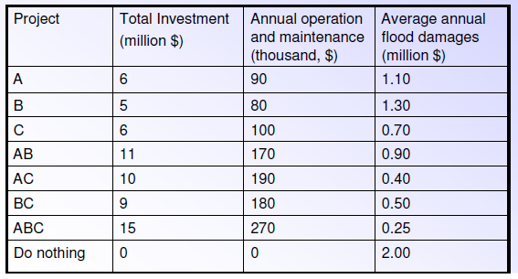
BC ratio: Example2
A flood control district can construct several alternative control works to alleviate flooding. These alternatives include the construction of dam A, dam B, and a system of levees C. Each of these works can be built to function alone or together with any other or all other projects. Thus we have a possibility of the following combinations: ABC, A, B, C, AB, AC, and BC. The life of each dam is 80 years and the life of the levee system is 60 years. The cost of capital is 4%. Information on total investment, operation and maintenance costs, and average annual flood damages is given in the table below.
Which flood control undertaking is the most economical?.

Slide 50
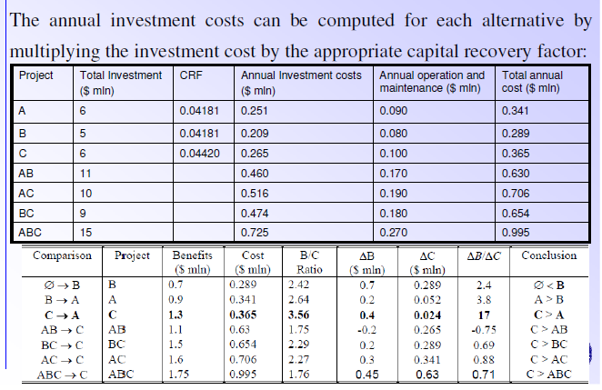
solution

Slide 51

Present worth method
Net worth (benefit – cost ) for each year is computed and discounted to the present with using the present worth factor – Net Present Value (NPV).
where B_{t} and C_{t} are the monetary values of benefits and costs incurred at time t respectively, i is the discount rate and n is the life of the project.
The steps for selecting the best alternative are:
Determine the NPV of each alternative.
Retain those alternatives with NPV > 0 and reject the rest. If there is any mutually exclusive alternative, then proceed to steps 3 and 4. Otherwise, stop.
Choose the one with greatest NPV from the set of mutually exclusive alternatives.
If in a set of mutually exclusive alternatives, some have benefits that cannot be quantified but are approximately equal, then choose the one with least cost.

Slide 52
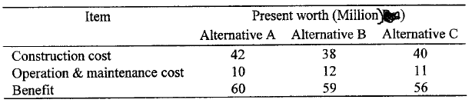
Example
There are three mutually exclusive alternatives for a water supply project. The present worth of costs and benefits associated with these alternatives is given below:
Compare the altenatives and suggest the best. Assume that all present worth figures have been obtained using the same discount rate and period of analysis.
Solution" Net present worth for alternative A = 60 - (42 + 10) = 8 million.
Net present worth for alternative B = 59 - (38 + 12) = 9 million.
Net present worth for alternative C = 56 - (40 + 11) = 5 million.
Thus, alternative B should be chosen, since its net present worth is the maximum.

Slide 53
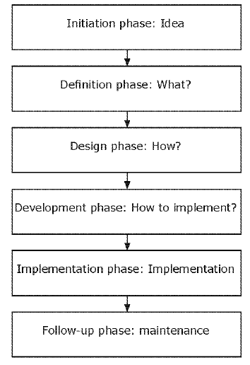
2. Phases of project management
Dividing a project into phases makes it possible to lead it in the best possible direction.
It includes six phases:
Initiation phase
Definition phase
Design phase
Development phase
Implementation phase
Follow-up phase

Slide 54
Cont...............
Initiation phase
The initiation phase is the beginning of the project. In this phase, the idea for the project is explored and elaborated.
The goal of this phase is to examine the feasibility of the project.
In addition, decisions are made concerning who is to carry out the project, which party (or parties) will be involved and whether the project has an adequate base of support among those who are involved.
Questions to be answered in the initiation phase include the following:
• Why this project?
• Is it feasible?
• Who are possible partners in this project?
• What should the results be?
• What are the boundaries of this project (what is outside the scope of the project)?

Slide 55
Cont.......
2. Definition phase
After the project plan (which was developed in the initiation phase) has been approved, the project enters the second phase: the definition phase.
In this phase, the requirements that are associated with a project result are specified as clearly as possible.
This involves identifying the expectations that all of the involved parties have with regard to the project result.
It is important to identify the requirements as early in the process as possible.
Wijnen (2004) distinguishes several categories of project requirements that can serve as a memory aid:
Preconditions
Functional requirements
Operational requirements
Design limitations

Slide 56
Cont..........................
3. Design phase
The list of requirements that is developed in the definition phase can be used to make design choices.
In the design phase, one or more designs are developed, with which the project result can apparently be achieved.
Depending on the subject of the project, the products of the design phase can include sketches, flow charts, etc.
4. Development phase
During the development phase, everything that will be needed to implement the project is arranged.
Potential suppliers or subcontractors are brought in, a schedule is made, materials and tools are ordered, instructions are given to the personnel and so forth.
The development phase is complete when implementation is ready to start.
The important point is that it must be clear what must be done in the implementation phase, by whom and when.

Slide 57
Cont..............................
5. Implementation phase
The project takes shape during the implementation phase. This phase involves the construction of the actual project result.
6. Follow-up phase
Although it is extremely important, the follow-up phase is often neglected. During this phase, everything is arranged that is necessary to bring the project to a successful completion.
E.g. In hydrological study project;
Initiation phase
Title
Objective
Problem statement
Definition phase
Data availability
Required data
Scope/ limitation
Design phase
Methods & materials
Conceptual framework/
Development phase
Data analysis
Prepare model/ modeling
Implementation phase
Run the model and get result. interpretation
Follow-up phase
Neglected in this case

Slide 58
Project evaluation overview
The project evaluation process
Steven et al. (1993), project evaluation is a combination of a number of activities ranging from;
setting indicators, developing model, defining measurable outcomes,
identifying key stakeholders and their interests,
selecting methodology for evaluation,
collecting information, analyzing data and disseminating evaluation results for further learning.
The evaluation process therefore concerns very much on data gathering and information analysis.
Fox and Baker (1985); suggest several criteria that companies should look at during the project evaluation process such as project cost, project impact, probability of project success, number of project generated and completion time.

Slide 59
b. The purposes of Project Evaluation process
the evaluation process plays an important role in the success of projects.
One of the major purposes of evaluation is to determine the worth or merit of projects, process or products under both internal and external constraints.
evaluation, as a risk management tool, allows project managers to reduce uncertainties when making decisions, especially before the project started.
Classification of project evaluation
Based on the life cycle of project, project evaluation classify in three phases which are planning phase, formative phase and summative phase.

Slide 60
a. Planning project evaluation phase
Planning project evaluation is taken at the very beginning of the project and prior to the project implementation.
It gives justification to choose projects among many others.
Many authors consider this process similar to the investment decision making as project actually is an investment.
The risk of failure , organizational and managerial aspects, political aspects, social acceptability, environmental problems, etc. evaluate in this phase.
b. Formative project evaluation
The second phase of project evaluation also called as formative evaluation, regards the progress and implementation evaluation.
The purpose of evaluating projects in such a phase is to enable the company to decide whether it is worth going ahead or is it better to kill the project.
There are different methods used to evaluate this phase of the project such as financial analyses e.g. cost-benefit analysis provide important information to evaluate the ongoing progress of a project and take the right decision.

Slide 61
c. Summative project evaluation phase
The third phase of project evaluation is done after project completion.
Summative phase is called as ‘ex-post’.
the main objective of such evaluation is
to determine a starting point for further activities in the same field,
to explore the relative cost, effectiveness and impact of alternative approach,
to identify common mistakes in comparable projects and
to quantify such effects and impact patterns.
this evaluation can be considered as learning tool for the organization such as,
improvement in productivity or career patterns in employment

Slide 62
Cont.......................
summative evaluation categorized into two phases such as,
‘testing phase’ aimed at confirming effectiveness of final version and
‘routine phase’ aimed at emphasizing quality assurance.

Slide 63
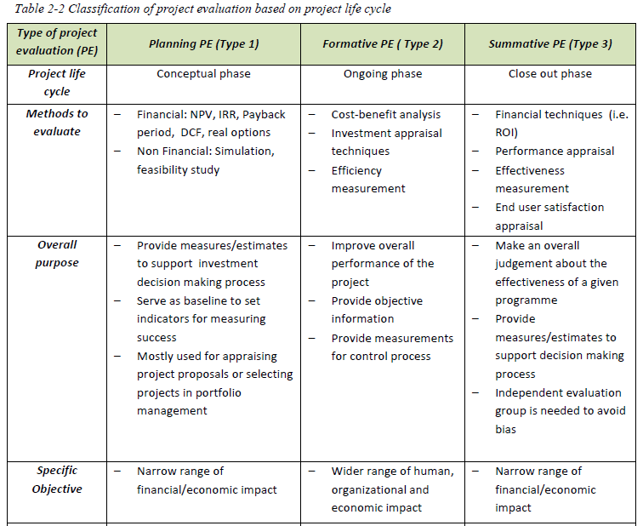

Slide 64
Project evaluation criteria
There are some criteria to be taken into consideration while evaluating the project. (Grabe, 1983)
‘First, project design and implementation must be relevant and remain relevant throughout the period of implementation.
Second, action taken under the project should be effective.
Third, it should have a significant impact, producing lasting change.
Finally, it should be efficient which means that it should produce the desired results, with a minimum of undesirable side-effects, at lowest possible cost (a high cost/effectiveness ratio)’.

Slide 65
water supply and demand assessment
WATER SUPPLY
Supplying water of the required quantity and quality is one of the most important objectives in water resources planning.
Determination of current water use and prediction of future water demands are necessary for water supply planning and management.
Domestic or municipal, industrial, and agricultural uses represent the major demands for water resources.
Hydropower generation, recreation, and fishing are other types of water use that do not require direct withdrawal from the resources and are called instream uses.
Each of these uses has different water quality requirements.
Surface and groundwater are two main sources of water supply.
Rivers and lakes are important resources for public water supplies but surface waters are being polluted by industrial and municipal wastes, agricultural return flow, and polluted runoffs.

Slide 66
Cont...................................
Wastewater reuse is an important alternative for water supply.
Wastewater reuse may be more attractive in arid areas where water is scarce and water losses are high.
Municipal wastewater is the best resource for water reuse in terms of its quantity and low variability.
Advanced wastewater treatment is required for direct municipal reuse.
In indirect wastewater reuse, wastewater usually is discharged to the groundwater aquifer and then is withdrawn for potable or other municipal uses.
Wastewater recycling and reuse in industries provides savings in energy and costs.
Return flows from irrigation are a reusable source for agricultural or industrial uses.

Slide 67
WATER DEMANDS
Different water demands and their priorities are the main constraints in reservoir operation optimization problems.
Water-use circulars prepared by the U.S. Geological Survey (USGS) identify the following water uses in the overall water accounting system (Solley et al., 1993):
Water withdrawal for offstream purposes
Water deliveries at point of use or quantities released after use
Consumptive use
Conveyance loss
Reclaimed wastewater
Return flow
Instream flow

Slide 68
Cont.......................................
Water demands in river–reservoir systems resulting from offstream uses include:
Domestic or municipal
Industrial
Agricultural
Part of the water withdrawn may return to the system, perhaps in another location with different quality and over a different period of time.
Water can also be allocated to instream uses that alter the distribution of flow in time and space (Loucks et al., 1981). Such uses include:
Reservoir storage, possibly for recreational uses or navigation
Flow augmentation for water quality control or for navigation
Hydroelectric power production

Slide 69
Cont..............................................
Water demands change from year to year and month to month.
Many physical, economical, social, and political reasons for these variations can be identified.
In recent years, significant climatic changes have been observed in many parts of the world, including more intense floods, greater precipitation, and even unusual droughts in some regions.
These changes have significantly affected the water demands in many parts of the world.

Slide 70
Water use categories
Water use is a general, non-specific term that describes any action through which water provides a service.
“water use” is synonymous with “water utilization”
In-stream and off-stream water use
In-stream water use refers to surface water resources and does not involve withdrawal as the use is provided directly in the river or lake in question.
Some examples of in-stream water use are navigation, hydropower generation, pollution dilution, tourism, freshwater capture fisheries and ecosystem maintenance.
Off-stream water use is called “withdrawal” e.g. Agricultural water withdrawal and Municipal water withdrawal. these are off-stream water uses.

Slide 71
Cont............................
Agricultural water withdrawal
Agricultural water withdrawal considers self-supplied irrigation and livestock watering requirements.
Water for the dairy and meat industries and industrial processing of harvested agricultural products is included under industrial water withdrawal, as they are industries.
Municipal water withdrawal
Municipal water withdrawal implies water that is provided by the public network system.
In the interest of clarification, municipal water withdrawal includes domestic water withdrawal, which is mainly used for drinking, cooking and cleaning, and has a very low consumption rate.
But because of its availability, municipal water in general is also used for urban industry, urban landscaping (including gardens) or urban irrigated agriculture.
The point at which the water is extracted (either the pump or the intake of a canal) is called the “point of withdrawal” or “source”,
while the location where the water is needed is referred to as the “point of delivery” or “point of use”.

Slide 72
Consumptive and non-consumptive water use
Consumptive water use implies a substantial reduction in the quantity or quality of the water that returns to the system after being withdrawn.
Non-consumptive water use does not substantially change the withdrawn water, almost all of it returning to the system, although a “substantial change” might be defined differently in different countries.
Also most in-stream water uses are non-consumptive.
E.g. Of non consumptive water use;
Water use in hydroelectric projects when the water is not diverted away from the natural confines of the river or stream channel.
Water use in some beautification ponds and fish hatcheries when the outflow is returned to the point of diversion, i.e., there is no bypass reach in the system.

Slide 73
OPTIMIZATION ALGORITHMS
Revision on optimization
basic components of an optimization problem
An objective function expresses the main aim of the model which is either to be minimized or maximized.
For example, 1.in a manufacturing process, the aim may be to maximize the profit or minimize the cost.
2.In comparing the data predicted by a user-defined model with the observed data, the aim is minimizing the total deviation of the predictions based on the model from the observed data.
3. In designing a bridge pier, the goal is to maximize the strength and minimize size.
A set of unknowns or variables control the value of the objective function.
A set of constraints are those which allow the unknowns to take on certain values but exclude others.
The optimization problem is then to;
Find values of the variables that minimize or maximize the objective function while satisfying the constraints.

Slide 74
Objective Function
Many optimization problems have a single objective function
The two interesting exceptions are:
No objective function: User does not particularly want to optimize anything so there is no reason to define an objective function. Usually called a feasibility problem.
Multiple objective functions. In practice, problems with multiple objectives are reformulated as single-objective problems by either forming a weighted combination of the different objectives or by treating some of the objectives by constraints.

Slide 75

Statement of an optimization problem
An optimization or a mathematical programming problem can be stated as follows:
To find X = which maximizes f(X)
Subject to the constraints
g_{i}(X) <= 0 , i = 1, 2,….,m
l_{j}(X) = 0 , j = 1, 2,….,p

Slide 76
Cont...................
where
X is an n-dimensional vector called the design vector
f(X) is called the objective function
g_{i}(X) and l_{j}(X) are inequality and equality constraints, respectively.
This type of problem is called a constrained optimization problem.
Optimization problems can be defined without any constraints as well Unconstrained optimization problems.

Slide 77
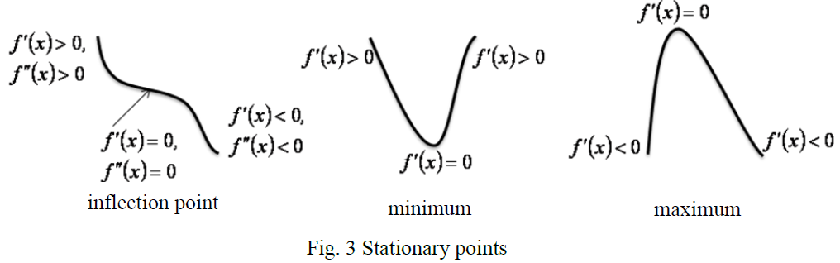
stationary points: functions of single and two variables
For a continuous and differentiable function f(x) a stationary point x* is a point at which the slope of the function vanishes, i.e. f ’(x) = 0 at x = x*, where x* belongs to its domain of definition.
A stationary point may be a minimum, maximum or an inflection point (Fig. 3).

Slide 78
Relative and Global Optimum
A function is said to have a relative or local minimum at x = x* if
for all sufficiently small positive and negative values of h, i.e. in the near vicinity of the point x.
A point x* is called a relative or local maximum if
for all values of h sufficiently close to zero.
A function is said to have a global or absolute minimum at x = x* if for all x in the domain over which f(x) is defined.
A function is said to have a global or absolute maximum at x = x* if for all x in the domain over which f (x) is defined.

Slide 79
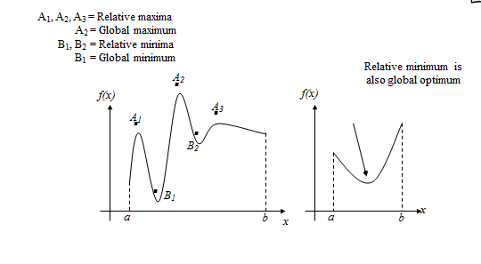
Cont...........................

Slide 80
Functions of a single variable
Consider the function f(x) defined for
To find the value of x* such that x* maximizes f(x) we need to solve a single-variable optimization problem.
Necessary condition : For a single variable function f(x) defined for x which has a relative maximum at x = x* , x* if the derivative f ‘(x) = df(x)/dx exists as a finite number at x = x* then
f ‘(x*) = 0.
Above theorem holds good for relative minimum as well.
Theorem only considers a domain where the function is continuous and derivative.
It does not indicate the outcome if a maxima or minima exists at a point where the derivative fails to exist. This scenario is shown in the figure below, where the slopes m₁ and m₂ at the point of a maxima are unequal, hence cannot be found as depicted by the theorem.

Slide 81
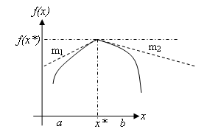
Cont............................................
Salient features:
Theorem does not consider if the maxima or minima occurs at the end point of the interval of definition.
Theorem does not say that the function will have a maximum or minimum at every point where f ’(x) = 0, since this condition
f ’(x) = 0 is for stationary points which include inflection points which do not mean a maxima or a minima.

Slide 82
Cont...........................
For the same function stated above let f ’(x*) = f ”(x*) = . . . = f ^{(n-1)}(x*) = 0, but f ^{(n)}(x*) ≠ 0, then it can be said that f (x*) is
(a) a minimum value of f (x) if f ^{(n)}(x*) > 0 and n is even
(b) a maximum value of f (x) if f ^{(n)}(x*) < 0 and n is even
(c) neither a maximum or a minimum if n is odd

Slide 83
Example 1
Find the optimum value of the function
and also state if the function attains a maximum or a
minimum.
Solution
For maxima or minima,
or x* = -3/2
is positive .
Hence the point x* = -3/2 is a point of minima and the function attains a minimum value of -29/4 at this point.

Slide 84
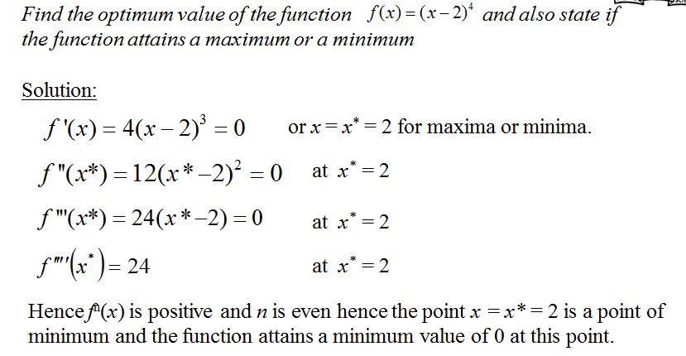
Example 2

Slide 85
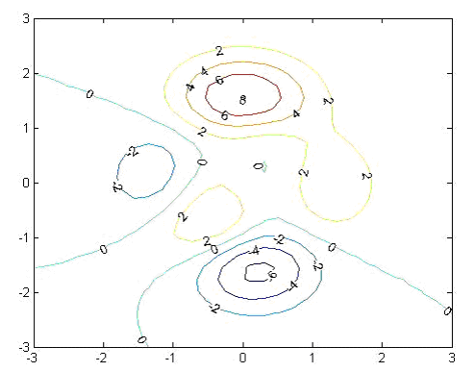
Functions of two variables
Concept discussed for one variable functions may be easily extended to functions of multiple variables.
Functions of two variables are best illustrated by contour maps, analogous to geographical maps.
A contour is a line representing a constant value of f(x) as shown in the following figure. From this we can identify maxima, minima and points of inflection.

Slide 86
Necessary conditions
From the above contour map, perturbations from points of local minima in any direction result in an increase in the response function f(x), i.e. the slope of the function is zero at this point of local minima.
Similarly, at maxima and points of inflection as the slope is zero, the first derivative of the function with respect to the variables are zero.
Which gives us at the stationary points. i.e. the
gradient vector of f(X), at X = X* = [x₁ , x₂] defined as follows, must equal zero:

Slide 87
Cont......................
Consider the following second order derivatives:
Hessian matrix defined by H is formed using the above second order derivatives.

Slide 88
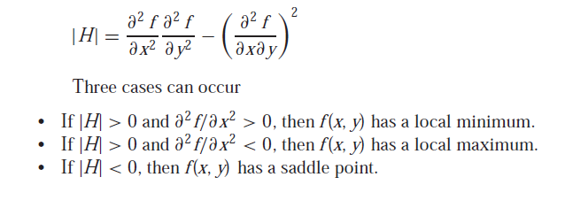
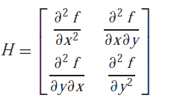
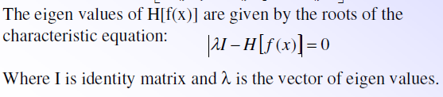
Cont..............................
The value of determinant of the H is calculated by
The quantity |H| is equal to the determinant of a matrix made up of the second derivatives,
where this matrix is formally referred to as the Hessian of f.

Slide 89
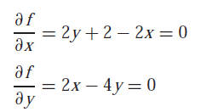
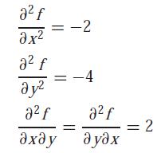
Example1
Maximize the following function:
f(x, y) = 2xy + 2x − x2 − 2y2 using initial guesses, x=−1 and y = 1.
First solve the partial derivatives as;
And we get the value of x = 2 and y = 1.
The second partial derivatives can also be determined and evaluated at the optimum as,

Slide 90


Cont...............................................
and the determinant of the Hessian is computed as,
Example2
Locate the stationary points of f(X) and classify them as relative maxima, relative minima or neither based on the rules discussed in the lecture.
Therefore, because |H| > 0 and ∂2 f/∂x2 < 0, function value f(2, 1) is a maximum.
Solution

Slide 91
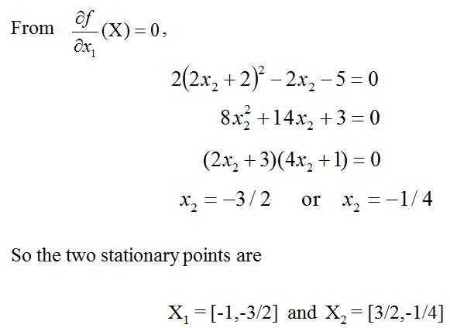
Cont.........

Slide 92
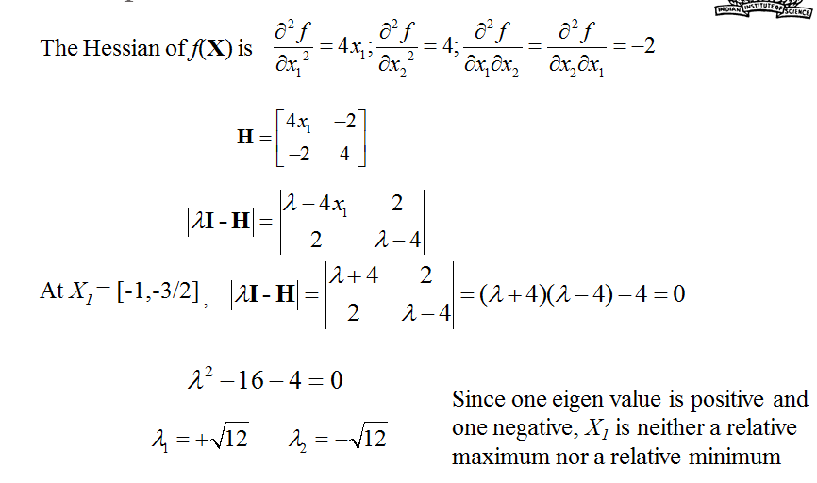
Cont................................................

Slide 93
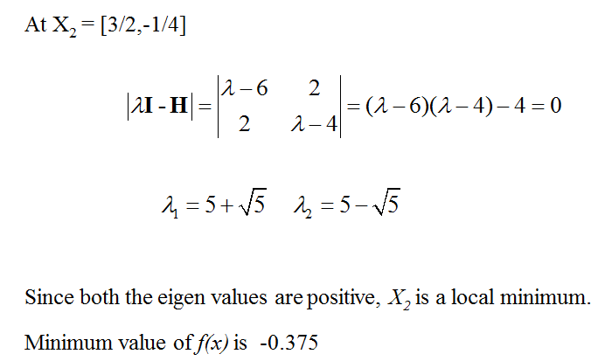
Cont.............................................

Slide 94
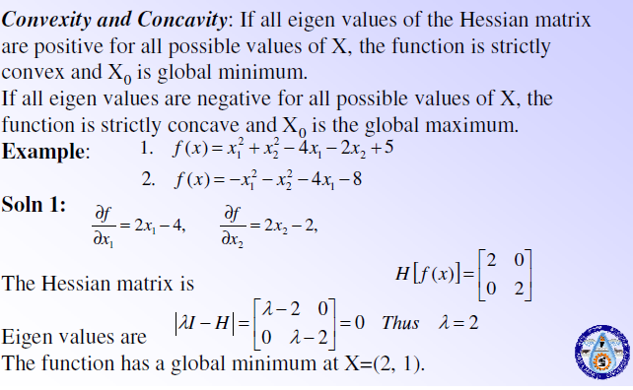

Slide 95
Local search methods
Many different optimization algorithms and computer codes are available.
which can be categorized as “local search” methods and “global search” methods.
Local search methods are designed to efficiently find the minimum of unimodal functions.
This functions are for any strategy that seeks to continuously proceed in a direction of improving function value and must eventually arrive at the location of the function minimum.
it is helpful to imagine that you are a blind person standing on the side of a mountain and must find a way from your present location to the lowest point of the valley. You would have to:
a) select a direction in which to move;
b) move some distance in that direction; and then
c) repeat the procedure over and over again until you are satisfied that no further improvement can be achieved.

Slide 96
Cont...........................................
Therefore, the procedure involves three main decisions:
(a) which direction to move,
(b) how far to move in that direction, and
(c) how to decide that no further improvement is possible.
Based on their method of decision local search methods can be classified as;
Direct search and gradient methods
Direct search methods
A direct search optimization strategy uses only (objective) function value information in the decision process described above.
A typical method is ; Starting at the initial point, the strategy selects some direction and step size and evaluates the function at the new point.
It may do this for more than one new point. The following are direct Search methods:
Simplex/ Nelder and Mead method (focus on this method)
Hooke and Jeeves method
Rosenbrock method
Particle swarm optimization

Slide 97
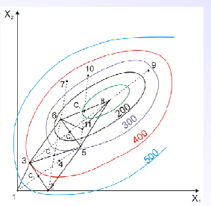
Simplex method:
The simplex represents a geometric figure formed by a set of n+1 points in n-dimensional space.
Thus in two dimensions the simplex is a triangle and in three dimensions it is a tetrahedron.
The basic idea is to compare the values of the objective function at the n + 1 vertices of a general simplex and move this simplex gradually towards the optimum point during the iterative process.

Slide 98
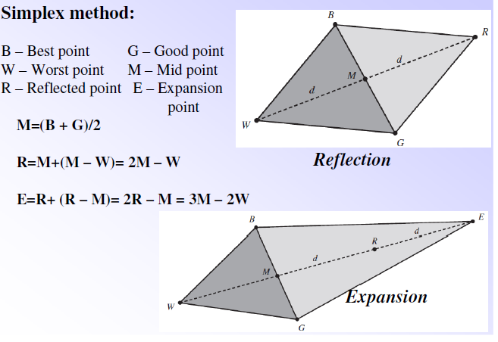
Cont..........................................

Slide 99
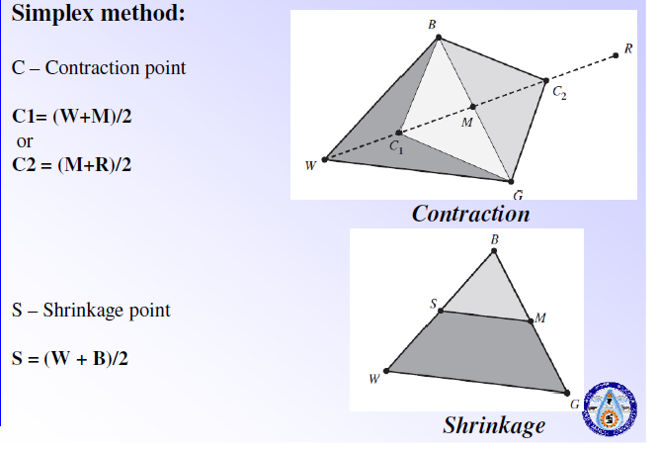
Cont..................................

Slide 100
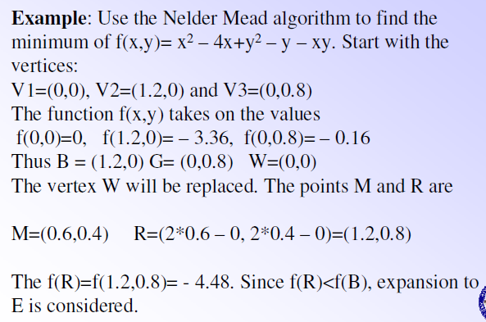

Slide 101
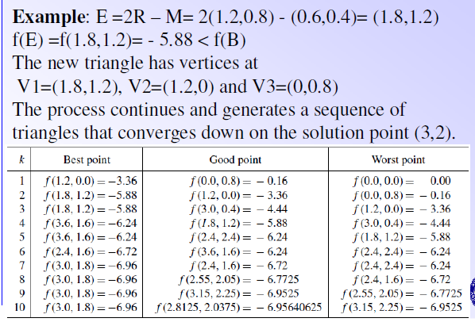

Slide 102
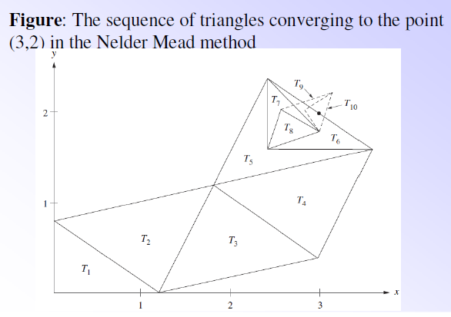

Slide 103
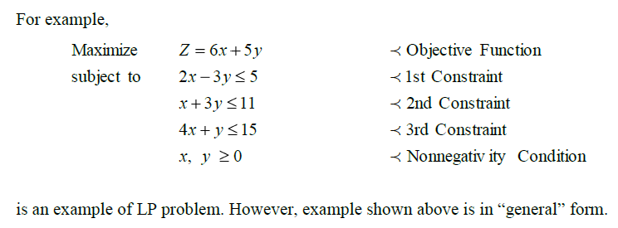
Linear Programming
INTRODUCTION
Linear Programming (LP) is the most useful optimization technique used for the solution of engineering problems.
The term „linear‟ implies that the objective function and constraints are „linear‟ functions of „nonnegative‟ decision variables.
Thus, the conditions of LP problems (LPP) are
1. Objective function must be a linear function of decision variables
2. Constraints should be linear function of decision variables
3. All the decision variables must be nonnegative

Slide 104
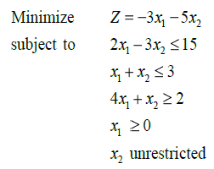
STANDARD FORM OF LPP
Standard form of LPP must have following three characteristics:
1. Objective function should be of maximization type
2. All the constraints should be of equality type
3. All the decision variables should be nonnegative
The procedure to transform a general form of a LPP to its standard form is discussed below.
Let us consider the following example.

Slide 105
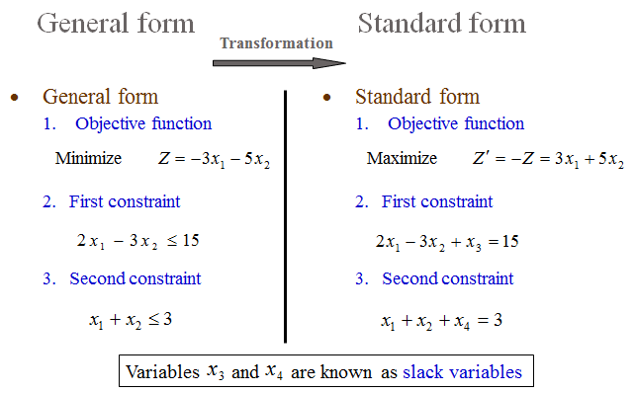
Cont..............................................
Violating points for standard form of LPP:
Objective function is of minimization type
Constraints are of inequality type
Decision variable, x₂, is unrestricted, thus, may take negative values also.

Slide 106
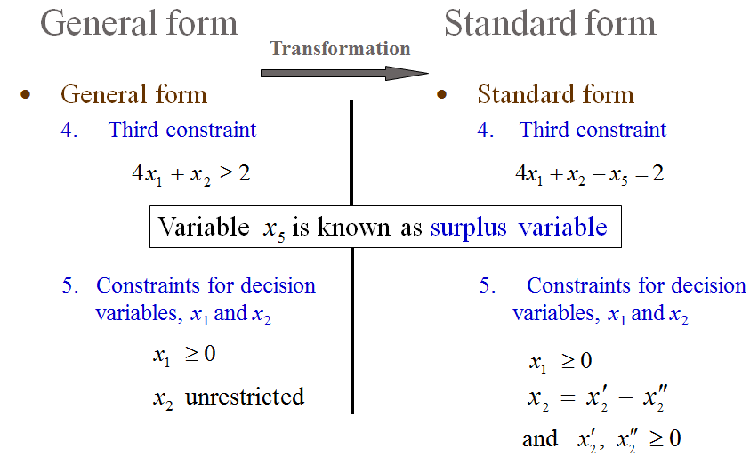
Cont..........................................................

Slide 107
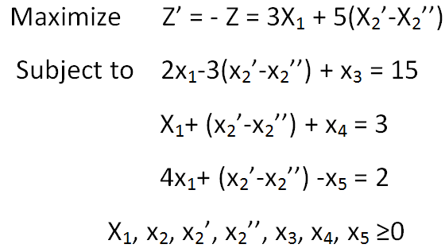
Cont..........................................
Thus, the standard form of above LPP is as follows:

Slide 108
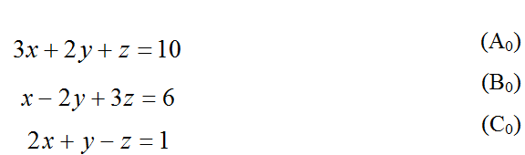
Canonical form of LP Problems
Canonical form of standard LPP is a set of equations consisting of the „objective function‟ and all the „equality constraints‟ (standard form of LPP) expressed in canonical form.
Understanding the canonical form of LPP is necessary for studying simplex method; Which is the most popular method of solving LPP
Canonical form of a set of linear equations
Let us consider the following example of a set of linear equations
The system of equation will be transformed through ‘Elementary Operations’.

Slide 109
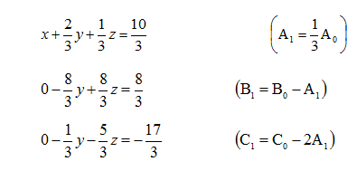
Cont.....................................................
The following operations are known as elementary operations:
Any equation E_{r} can be replaced by kE_{r}, where k is a nonzero constant.
Any equation E_{r} can be replaced by E_{r} + kE_{s}, where E_{s} is another equation of the system and k is as defined above
Note: Transformed set of equations through elementary operations is equivalent to the original set of equations. Thus, solution of transformed set of equations is the solution of original set of equations too.
Transformation to Canonical form: An Example;
Set of equation (A₀, B₀ and C₀) is transformed through elementary operations (shown inside bracket in the right side)

Slide 110
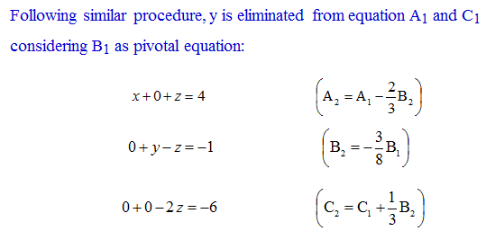
Cont................................................
Note that variable x is eliminated from B₀ and C₀ equations to obtain B₁ and C₁. Equation A₀ is known as pivotal equation.

Slide 111
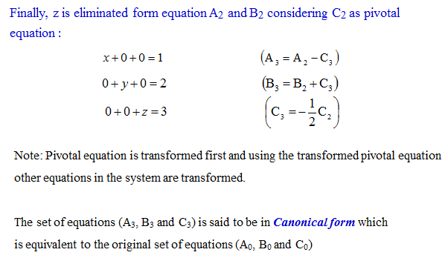
Cont..............................................

Slide 112
Pivotal Operation
Operation at each step to eliminate one variable at a time, from all equations except one, is known as pivotal operation.
Number of pivotal operations are same as the number of variables in the set of equations.
Three pivotal operations were carried out to obtain the canonical form of set of equations in last example having three variables.

Slide 113
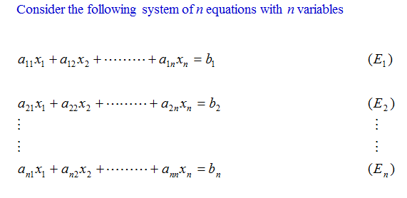
Transformation to Canonical form: Generalized procedure

Slide 114

Cont........................................

Slide 115

Cont..............................................

Slide 116

Transformation to Canonical form: More general case

Slide 117

Cont.............................................

Slide 118

Basic variable, Non-basic variable, Basic solution, Basic feasible solution

Slide 119
Simplex method in LPP
All the basic solutions need not (and, in general, will not) be feasible.
A basic solution which is also feasible is called as the Basic Feasible Solution.
All the corner points of the feasible space are basic feasible solutions.
The possible no. of basic feasible solutions can be too large to be enumerated completely.
The goal would be, starting with an initial basic feasible solution, to generate better and better basic feasible solutions until the optimal basic feasible solution is obtained.
Initial basic feasible solution: The basic feasible solution used as an initial solution in the simplex method. This is the solution in which all the n decision variables are set to zero. Obviously slack variables yield an initial basic feasible solution.

Slide 120

Cont.........................................
The general procedure is:
1. Express the given LP problem in the standard form, with equality constraints and non-negative right hand side values.
2. Identify the starting solution and construct the simplex table.
3. Check for optimality of the current solution. The solution will be optimal if all the coefficients in the z-row are non-negative. Else, an iteration is needed.
4. Identify the entering variable. This is the non-basic variable with the most negative coefficients in the z-row.
5. Identify the departing variable. This is the basic variable in the current solution in row i for which
6. Perform the row transformation (Gauss-Jordan transformation) and get the new solution.
7. Repeat step 3 to 6 until optimal solution is obtained.

Slide 121


Consider the following Example
Express the given LP problem in standard form

Slide 122

Cont............................................

Slide 123
Cont.......................................
The current non-basic variable to be made basic is called the entering variable while the current basic variable to be made non-basic is called the leaving variable.
For a maximization problem, an entering variable is selected, based on the optimality condition, as the non-basic variable having the most negative coefficient in the X0 equation (Z-row) of the simplex tableau.
The one with the largest negative value is selected because it has the greatest potential to improve the objective function value.
On the other hand the rule of selecting the entering variable for a minimization problem is reversed, that is choose the non-basic variable with the largest positive coefficient in the objective function row of the simplex tableau.
Next, one of the current basic variables must be chosen to become non-basic.
The selection of the leaving variable is governed by the feasibility condition to ensure that only feasible solutions are enumerated during the course of the iterations.

Slide 124
Cont........................................
Identify the coefficients which are positive in the column of the entering variable, known as the pivot column, except the objective function row, of the current solution.
If all the coefficients are non-positive thus the problem is ill posed (it has unbounded solution).
Compute the ratio of the RHS (solution column) to the positive coefficient under the pivot column for each row.
Pick the row with least of these ratios and mark as the pivot row. The basic variable in the current solution corresponding to this row in the simplex table will be the leaving variable.
The coefficient which is common to the pivot row and the pivot column is the pivot coefficient.

Slide 125

Cont..........................................

Slide 126
Cont............................................
Next, row operation (or Gauss Jordan transformation) is applied to update the variables in the basic and non-basic variable list.
The new pivot row is obtained by dividing the elements of each old row by the pivot coefficient.
New pivot row = old pivot row/pivot coefficient
The rows other than the pivot row are transformed as;
New row = old row – (pivot column coefficient) (New pivot row) Similarly the new z row is computed.
This completes the first iteration. This solution would have been optimal if all the coefficients of the z row were non-negative.
Thus another iteration is performed until this requirement is met.

Slide 127

Cont...........................................

Slide 128

Cont.............................................

Slide 129

Try this LPP

Slide 130
LP Applications: Water Resources Problems
LP has been applied to formulate and solve several types of problems in engineering field
LP finds many applications in the field of water resources which include
Planning of urban water distribution
Reservoir operation
Crop water allocation
Example - Irrigation Allocation
Consider two crops 1 and 2. One unit of crop 1 brings four units of profit and one unit of crop 2 brings five units of profit. The demand of production of crop 1 is A units and that of crop 2 is B units. Let x be the amount of water required for A units of crop 1 and y be the same for B units of crop 2.

Slide 131

Cont...............................................
The linear relations between the amounts of crop produced (i.e., demands A and B) and the available water (i.e., x and y) for two crops are shown below;
A = 0.5(x - 2) + 2
B = 0.6(y - 3) + 3

Slide 132


Cont...........................................

Slide 133

Cont.................................................

Slide 134

LINEAR PROGRAMMING SOFTWARES
MMO, MATLAB, LINGO
LINGO
Tool to solve linear, nonlinear, quadratic, stochastic and integer optimization models
Can be downloaded from http://www.lindo.com example, lingo
Key benefits of LINGO are:
Easy model expression
Convenient data options
Powerful solvers
Extensive documentation and help.

Slide 135

Cont.........................................

Slide 136
Reservoirs operation
Introduction
water storage reservoirs may be created by constructing a dam across a river, along with suitable appurtenant structures.
Fundamentally, a reservoir serves to store water and the size of the reservoir is governed by the volume of the water that must be stored, which in turn is affected by the variability of the inflow available for the reservoir.
Reservoirs are of two main categories:
(a) Impounding reservoirs into which a river flows naturally, and
(b) Service or balancing reservoirs receiving supplies that are pumped or channeled into them artificially.
In general, service or balancing reservoirs are required to balance supply with demand.
Reservoirs of the second type are relatively small in volume because the storage required by them is to balance flows for a few hours or a few days at the most.

Slide 137

Reservoir storage zone and uses of reservoir
The storage capacity in a reservoir is nationally divided into three or four parts (Figure 1) distinguished by corresponding levels.

Slide 138
Cont.................................................
These specific levels and parts are generally defined as follows:
Full Reservoir Level (FRL): It is the level corresponding to the storage which includes both inactive and active storages and also the flood storage, if provided for. In fact, this is the highest reservoir level that can be maintained without spillway discharge or without passing water downstream through sluice ways.
Minimum Drawdown Level (MDDL): It is the level below which the reservoir will not be drawn down so as to maintain a minimum head required in power projects.
Dead Storage Level (DSL): Below the level, there are no outlets to drain the water in the reservoir by gravity.
Maximum Water Level (MWL): This id the water level that is ever likely to be attained during the passage of the design flood. It depends upon the specified initial reservoir level and the spillway gate operation rule. This level is also called sometimes as the Highest Reservoir Level or the Highest Flood Level.
Live storage: This is the storage available for the intended purpose between Full Supply Level and the Invert Level of the lowest discharge outlet.

Slide 139
Cont.............................................
Dead storage: It is the total storage below the invert level of the lowest discharge outlet from the reservoir. It may be available to contain sedimentation, provided the sediment does not adversely affect the lowest discharge.
Outlet Surcharge or Flood storage: This is required as a reserve between Full Reservoir Level and the Maximum Water level to contain the peaks of floods that might occur when there is insufficient storage capacity for them below Full Reservoir Level.
Some other terms related to reservoirs are defined as follows:
Buffer Storage: This is the space located just above the Dead Storage Level up to Minimum Drawdown Level. As the name implies, this zone is a buffer between the active and dead storage zones and releases from this zone are made in dry situations to cater for essential requirements only. Dead Storage and Buffer Storage together is called Interactive Storage.
Within-the-Year Storage: This term is used to denote the storage of a reservoir meant for meeting the demands of a specific hydrologic year used for planning the project.
Carry-Over Storage: When the entire water stored in a reservoir is not used up in a year, the unused water is stored as carry-over storage for use in subsequent years.

Slide 140
Cont.....................................
Silt / Sedimentation zones: The space occupied by the sediment in the reservoir can be divided into separate zones.
Freeboard: It is the margin kept for safety between the level at which the dam would be overtopped and the maximum still water level. This is required to allow for settlement of the dam, for wave run up above still water level and for unforeseen rises in water level.
The functions of reservoirs are to provide water for one or more of the following purposes. Reservoirs that provide water for a combination of these purpose, are termed as ‘Multi Purpose’ reservoirs.
Human consumption and/or industrial use:
Irrigation: usually to supplement insufficient rainfall.
Hydropower: to generate power and energy whenever water is available or to provide reliable supplies of power and energy at all times when needed to meet demand.
Pumped storage hydropower schemes: in which the water flows from an upper to a lower reservoir, generating power and energy at times of high demand through turbines, which may be reversible, and the water is pumped back to the upper reservoir when surplus energy is available.

Slide 141
Cont...........................................
Flood control: storage capacity is required to be maintained to absorb foreseeable flood inflows to the reservoirs, so far as they would cause excess of acceptable discharge spillway opening. Storage allows future use of the flood water retained.
Amenity use: this may include provision for boating, water sports, fishing, sight seeing.

Slide 142
Reservoir Operation policies
Reservoir operation policies are developed to enable the operator to take appropriate decision.
The reservoir operation policy indicates the amount of water to be released based on the state of the reservoir, demands and the likely inflow to the reservoir.
The release from a single purpose reservoir can be done with the objective of maximizing the benefits.
For multi-purpose reservoirs, there is a need to optimally allocate the releases among purposes.
The simplest of the operation policies is the standard operation policy (SOP).
According to SOP, if the water available (storage, St+ inflow, It) at a particular period is less than the demand Dt, then all the available water is released.
If the available water is more than the demand but less than demand + storage capacity K, then release is equal to the demand.

Slide 143

Cont...............................................
If after releasing the demands, there is no space for extra water, then the excess water is also released. This is shown graphically in figure 1.

Slide 144
Cont................................................
Along OA: Release = water available; reservoir will be empty after release.
Along AB: Release = demand; excess water is stored in the reservoir (filling phase).
At A: Reservoir is empty after release.
At B: Reservoir is full after release.
Along BC: Release = demand + excess of availability over the capacity (spill)
The releases according to the SOP need not be optimum. The optimization of reservoir operation is done often by linear programming (LP) and dynamic programming (DP).

Slide 145

Derivation of optimal operating policy using LP
Consider a reservoir of capacity K.
The optimization problem is to determine the releases Rt that optimize an objective function satisfying all the constraints.
The objective function can be a function of storage volume or release.
The typical constraints in a reservoir optimization model include conservation of mass and other hydrological and hydraulic constraints, minimum and maximum storage and release, hydropower and water requirements as well as hydropower generation limitations.

Slide 146

Cont.......................................................
Consider the objective of meeting the demands to the extent possible i.e., maximizing the releases. The optimization model can be formulated as:

Slide 147
Cont......................................................................
Reservoir capacity
S_{t} ≤ K – K_{d} for all t, where K_{d} is the dead storage
or simply S_{t} ≤ K
S_{t} ≥ 0 for all t.
Target demand
R_{t} ≤ D_{t} for all t.
R_{t} ≥ 0 for all t.
Large LP problems can be solved very efficiently using LINGO - Language for INteractive General Optimization, LINDO Systems Inc, USA

Slide 148

example
Derive an optimal operating policy for a reservoir which have 17.6 m3 initially to meet a long-term objective. Single reservoir operation with deterministic inflows. K = 400.

Slide 149

Cont...........................................

Slide 150

Cont..................................................

Slide 151

Cont..............................................
Rule curve derived is shown below:

Slide 152

Rule curve
Guides for reservoir operation and apply to reservoirs to be operated in a steady state condition
Indicates the desired reservoir release or storage volume at a given time of the year. (rules identify storage volume targets that the operator is to maintain, and others identify storage zones, each associated with a particular release policy)

Slide 153

Reservoir Sizing
In many situations, annual demand may be less than the total inflow to a particular site.
However, the time distribution of demand and inflows may not match
Surplus in some periods and deficit in some other periods
Hence, there is a need of storage structure i.e., reservoir to store water in periods of excess flow and make it available when there is a deficit.
In order to enable regulation of the storage to best meet the specified demands, the reservoir storage capacity should be enough.
The problem of reservoir sizing involves determination of the required storage capacity of the reservoir when inflows and demands in a sequence of periods are given. Reservoir capacity can be determined using two methods:

Slide 154
Mass diagram method
Developed by W. Rippl (1883)
Mass curve: Plot of the cumulative flow volumes as a function of time.
Mass curve analysis - Graphical method called Ripple’s method
It involves finding the maximum positive cumulative difference between a sequence of pre-specified (desired) reservoir releases R_{t} and known inflows Q_{t}.
One can visualize this as starting with a full reservoir, and going through a sequence of simulations in which the inflows and releases are added and subtracted from that initial storage volume value.
Doing this over two cycles of the record of inflows will identify the maximum deficit volume associated with those inflows and releases. This is the required reservoir storage.

Slide 155

Cont......................................................

Slide 156

Cont....................................

Slide 157

Cont.....................................

Slide 158

Sequent Peak Algorithm

Slide 159


Slide 160


Slide 161
Example 2
A storage project is proposed on the Little River. The recorded stream flows provide only 5 years of hydrologic record. The annual flows are: 2, 7, 9, 10, 2 (1000 ac-ft). Based on this hydrologic record:
What is the maximum firm yield that can be delivered (ignore losses)? Maximum = average over time = 6K Ac-ft/yr.
What volume of storage is required to get the maximum, ignoring losses?
Start with Kt = 0 (this implies we are starting with filling the reservoir, not with a full reservoir. We could alternatively assume that the reservoir is full or some other assumption).

Slide 162

Cont..............................................
Example 3.
A storage project is proposed that will meet the increasing needs in a basin. It is desired to build a reservoir that can ultimately meet 90% of the maximum firm yield, but the demand would increase linearly from 50% of the maximum in year 1 to 90% of the maximum in year 5. Ten years of hydrologic record are available: 2, 1, 3, 7, 6, 9, 7, 10, 2, 3 (units 10,000 ac-ft) . What is the minimum storage needed in the reservoir?

Slide 163

Cont...........................................

Slide 164
Performance measures
In water resources planning and operation, the alternatives are compared based on their risks.
Risk is usually a measure of the (i) probability of occurrence of a specified undesirable outcome or
(ii) number of undesirable occurrences over a specified time period or
(iii) expected number of undesirable occurrences during a specified time period.
While analyzing the performance of hydrosystems, it is common that all undesirable outcomes (or failures) are given equal importance.

Slide 165
Cont.................................................
Performance Criteria are used to evaluate the system performance in simulation.
The commonly used performance measures are reliability, resilience and vulnerability.
Consider two time series with same mean and variance as shown in figure 1. x = [10, 40, 0, 50, 80, 85, 90, 60, 30, 10] and y = [80, 50, 90, 40, 10, 10, 0, 30, 60, 85].
Let the threshold be at 20. The occurrences below threshold are considered as failures. Even though the two series have same mean and variance, the impacts are different as can be inferred from the figure. For the second time series, the failures occur for a continuous long period.

Slide 166

Cont...............................................

Slide 167

Reliability
Measure of how often the system is in satisfactory state
Probability of the system being in satisfactory state
Can also be defined as the number of data/periods in a satisfactory state divided by the total number of data/ periods in the simulation
Reliability[X] = [number of time periods t such that X_{t} ≥ X^{T}] / n
where X^{T} is the threshold value which determines the failures.
For the first time series (shown in red),
there are 3 failures out of 10 occurrences.
Reliability[X] = 0.7.
For the second series also (shown in blue),
number of failures is 3.
Reliability[Y] = 0.7.

Slide 168
Resiliency
Measure of the capacity of the system to return to a satisfactory state after failure
Can be expressed as the probability that if a system is in an unsatisfactory state, the next state will be satisfactory
Resilience is an indicator of ‘How quickly a system recovers from failure’
It is the conditional probability of the system being in satisfactory state in period t+1 when it was not in a satisfactory state in period t.
Resiliency [X] =
[number of times a satisfactory value follows an unsatisfactory value] / [number of times an unsatisfactory value occurred]

Slide 169

Cont.....................................
For the first time series (shown in red),
resilience is 1/3.
For the second series (shown in blue),
resilience is 2/2 = 1.
This is calculated by avoiding the failure at period 10 since there is no observation at period 11.
Resilience is not defined if there are no unsatisfactory values.

Slide 170
Vulnerability
It is necessary to examine the damage caused by a failure, even though there are a few failures
Vulnerability measures the severity of failure
It is an indicator of ‘How serious is the failure’
It is a measure of the extent of the differences between the threshold value and the unsatisfactory time series values
Common measures used to calculate vulnerability are expected values, maximum observed values, and probability of exceedance.
Assuming an expected value measure of vulnerability is to be used:
Vulnerability [X] = [sum of positive values of (X^{T}-X_{t})]/
[number of times an unsatisfactory value occurred]

Slide 171
Cont................................................
For the first time series (shown in red),
the expected vulnerability is
[(20-10) + (20-10) + (20-0)]/3 =13.33.
For the second series also (shown in blue),
the expected vulnerability is
[(20-10) + (20-0) + (20-10)]/3 =13.33.
The reliability and vulnerability of both series are equal
However, the resilience of the second series is more than that of the first
This shows the typical tradeoffs one can define using these three measures of system performance

Slide 172
Thank you!
End of class

