Slide 1
Aquatic Science and Wetland Management Lecture
Unit 1

Slide 2
Aquatic Science
Aquatic science - studies about aquatic ecosystems.
Aquatic ecosystems are ecological systems of the watery environment.
Level of organization of organisms
Cell→tissue → organ→system→organism population→community→ecosystem and Biosphere
An organism’s environment has both abiotic and biotic components.
Abiotic components are nonliving chemical and physical factors such as temperature, light, water, and nutrients.
Biotic components are living factors such as other organisms.
Ecosystem: Includes interaction of all organisms living in an area, and the physical environment with which these organisms interact.

Slide 3
Ecosystems are organized communities of producers, consumers, and decomposers together with the abiotic factors that influence growth, reproduction and dispersal.
It is classified into two main categories, depending on presence or absence of water
Major Ecosystem Types (Biomes)
Aquatic Terrestrial (e.g. Desert)

Slide 4
What is the difference between these ecosystems?
Terrestrial ecosystems: Terrestrial ecosystems contain organisms that depend on physical environment on land masses of continents.
Aquatic ecosystems: Aquatic ecosystems are ecosystems composed of living organisms and non-living organisms interacting in a watery environment
Comparison
Aquatic ecosystem
There exist plenty of water
Desiccation is not a problem
Transport is by simple diffusion
Locomotion is through floating or swimming

Slide 5
General characteristics of terrestrial ecosystems
Organisms are much denser than air and require much energy to walk and fly
Need strong skeletal material (animals: bones; trees: trunks) for support.
Water is a scarce resource and desiccation is a main problem
Light energy substantially higher than in aquatic systems, low absorption by air

Slide 6
The Hydrologic Cycle
hydrological cycle : continuous flow of water among different compartments in the globe, including in atmosphere, water bodies, living organisms and in the soil
Hydrodynamics is the variations in the movement of water and changes in its distribution in time and space in particular place.

Slide 7
The Hydrologic Cycle is driven largely by the energy from solar radiation, Earth’s gravity, the rotation of the Earth (Coriolis Effect), Gravity of Moon and Sun (ocean tides).
Solar energy drives evapotranspiration
Solar energy and winds drive water movement, via thermal density differences and wave propagation, respectively.
Coriolis Effect influences the direction of wind and ocean circulation.
Earth’s gravity influences precipitation and surface and subsurface flow.

Slide 8
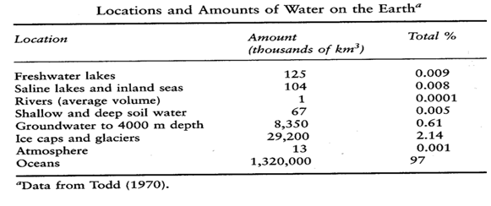
How Much Water? Where?

Slide 9
Ecological Functions and Services of Aquatic Ecosystems
Biological productivity
Homes Home for varied organisms
Regulate local climate
Economic values
They are also used for human recreation
Power generation, irrigation etc

Slide 10
Disturbance and Its Effects to Aquatic Ecosystems
An aquatic ecosystem can be degraded as a result of miss-use or over-exploitation of the environmental resources.
Human populations can impose excessive stresses - to physical, chemical and biological alteration of the environment.
The major consequences of aquatic ecosystems degradation include:
Collapse of fisheries and other water resources
Water pollution thereby lack of pure water for utilization
Drying out of wetlands, rivers and lakes eg. Lake Haromaya
Loss of surface and ground water
Global warming.
All these result in loss of aquatic ecosystem goods and services.

Slide 11
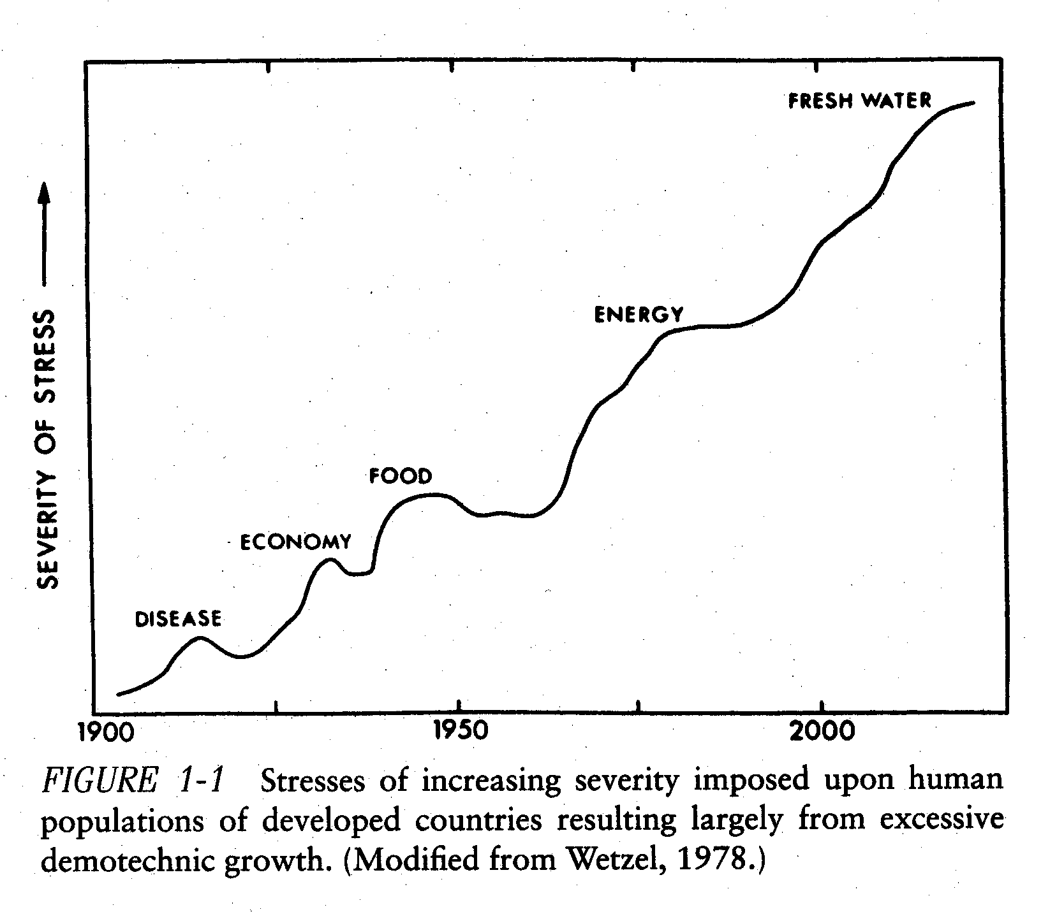
What is our need for understanding “inland aquatic ecology”
Resource crises in developing nations is increasing with freshwater as a primary concern. Human population in developing nations is simply not coping with increasing resource limitation. (Wetzel, 2001; Fig 1-1)
“Among the many things I learnt as a president, was the centrality of water in social, political and economic affairs of the country, the continent and the world.” (Nelson Mandela)
“

Slide 12
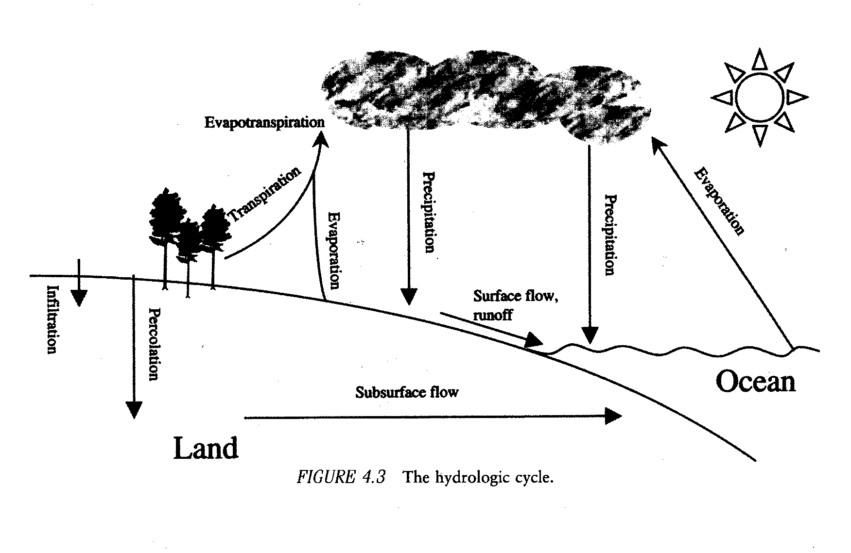

Slide 13
Unit 2: Types of Aquatic Ecosystems
Aquatic Ecosystems: are classified into two major aquatic biomes:
2.1. Freshwater biomes: with salt concentration of < 3 gm/l or 3 (ppt.),
Standing (lentic) - lakes, ponds and inland wetlands
moving (lotic) -rivers and streams.
Lakes are large, natural bodies of standing water which could be fresh or saline.
Lakes are formed when precipitation, runoff, groundwater seepage fills depressions in earth’s surface.
1. glaciation (Great Lakes, NA)
2. tectonic or crustal displacement (Lake Victoria, East Africa; Lake Baikal, Russia; Rift valley lakes)
3. volcanic activity (Bishoftu crater lakes)

Slide 14
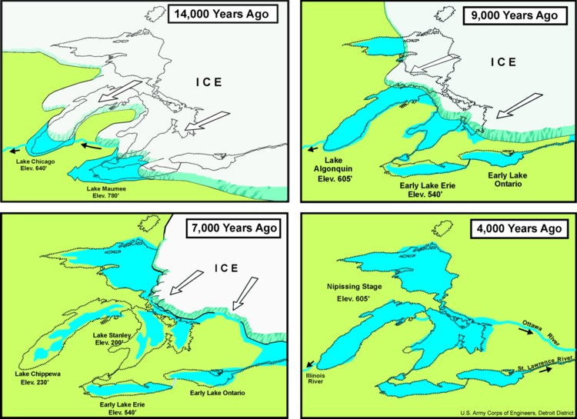

Slide 15
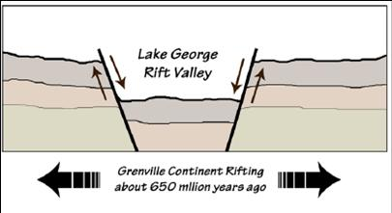

Slide 16
. There are 4 zones in lakes, determined by depth and distance from shore
The littoral zone is the shallow area close to shore. It is usually rooted and floating plants flourish,
The limnetic zone is the open surface water, farther from shore, extending to depth penetrated by light. It is occupied by phytoplankton, zooplankton, higher animals and produces food and oxygen that supports most of lake’s consumers.
The profundal zone consists of deep, aphotic regions which are too dark for photosynthesis, and where oxygen and temperature levels are low.
The benthic zone is the bottom of the lake and is inhabited by organisms that can tolerate cool temperatures and low oxygen levels.

Slide 17
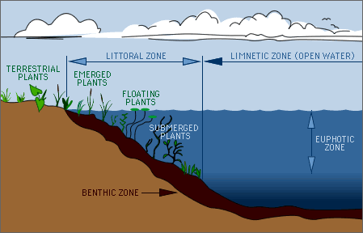
profundal

Slide 18
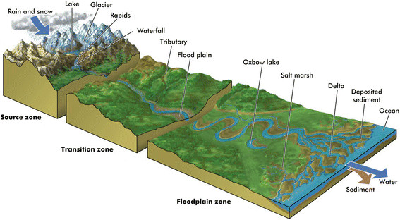
Rivers and streams
These are bodies of water moving continuously in one direction (have current).
The flow can originate from two sources: downward flow of surface water and groundwater flow from mountain highland to lower elevations.
Source zone
Transition zone
Floodplain zone

Slide 19
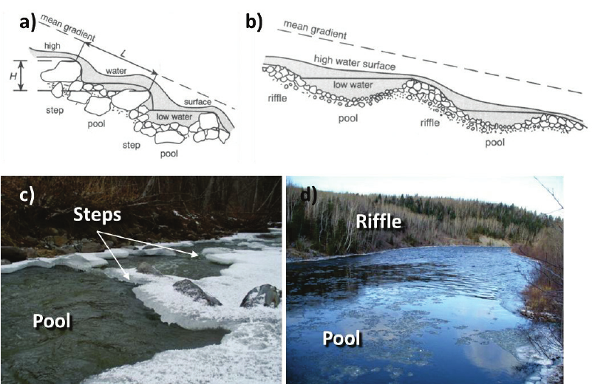

Slide 20
An area covered with water at some point in year that supports aquatic plants.
It ranges from periodically flooded regions to soil that is permanently saturated.
Wetland conditions favor specially adapted plants called hydrophytes and characteristic bird and mammal fauna live in wetlands.
Wetlands can be freshwater or saltwater. Some of the wetland types include:
1. Marshes which are usually covered with water year-round and the dominant plants are emergent (stems and leaves extending above surface)
2. Swamps are dominated by woody plants
3. Bogs are dominated by sphagnum mosses and are acidic.

Slide 21
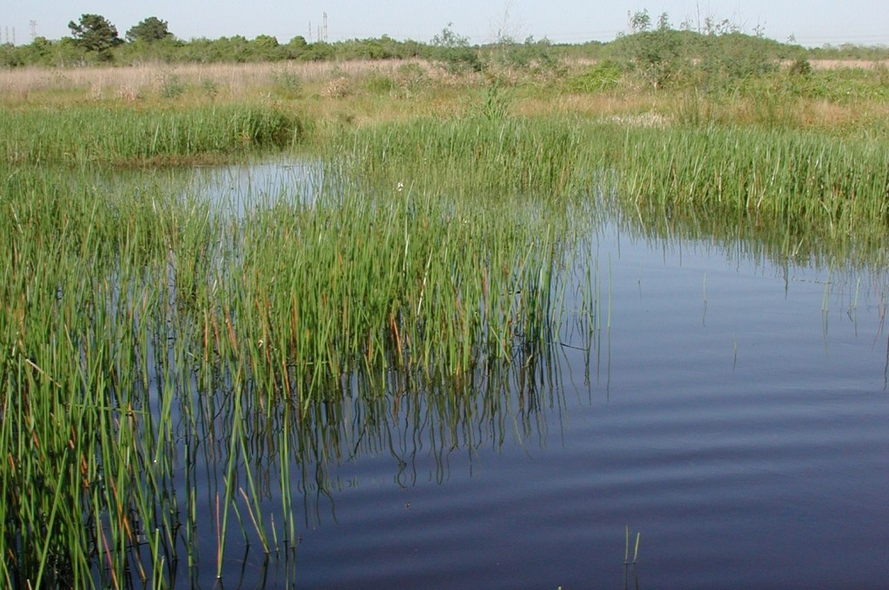
Wetlands – areas of marsh, peatland or water, natural or artificial, permanent or temporary, with water that is static or flowing, brackish or freshwater, including marine areas which low tide doesn’t exceed 6m

Slide 22
Saline or salty water biomes
2.2. Estuaries where freshwater (stream or river) merges with ocean fig .
Salinity within the estuary varies from nearly fresh water to ocean water; varies daily in areas due to rise and fall of tides.
Estuarine waters are often known as brackish water.
Estuaries are very productive due to nutrients brought in by rivers and have a diverse flora and fauna.
Salt marsh grasses, algae, and phytoplankton are the major producers.

Slide 23
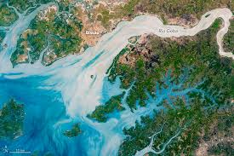

Slide 24
2.3. Marine biomes (Sea and Ocean)
salt concentration exceed 35 ppt or gm/l.
include 5 general zones
Intertidal zone IT : is where land meets water.
The Neritic zone NZ extends beyond intertidal and includes shallow regions over the continental shelves.
The oceanic pelagic zone extends past continental shelves, can be very deep, is the open water and includes most of the ocean’s water.
The benthic zone consist of the ocean bottom below neritic and oceanic pelagic zones. The main food source are the dead organic matter and nutrients "rain" down from above
The abyssal zone is the deepest part of the ocean below 4 km and is home of deep benthic communities.

Slide 25
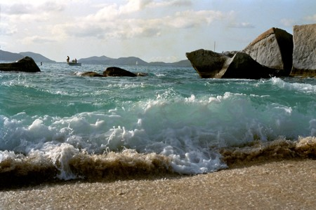

Slide 26
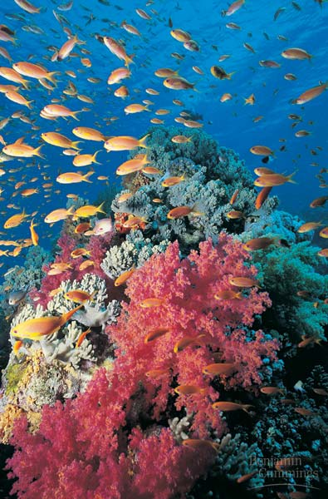

Slide 27
Aquatic Science and Wetland Managment Lecture
Unit-3

Slide 28
UNIT 3: Basics of Aquatic Ecosystem
3.1. Physical component
3.1.1 Light
Light is the first variable to control primary production but solar radiation can only penetrate to a certain depth (photic zone).
Solar radiation that penetrates the water column is absorbed by plants during photosynthesis
However, more than 50% of solar radiation is absorbed in the atmosphere
Infrared radiation (>780nm) and ultraviolet radiation (<380nm) are rapidly scattered or absorbed and converted to heat at the near surface. PAR
Only light from the range of (400-700nm) (PAR) can penetrate deeper into water column.

Slide 29
Factors that affect the irradiance received by water:
The amount of cloud cover: full cloud cover reduces the incident solar radiation by about 30% whereas fog reduces radiation 80% over that obtained under cloudless condition.
Surrounding topography; Tall trees (canopy), mountains
Atmospheric condition: Dust, air pollution, gas, water droplets

Slide 30
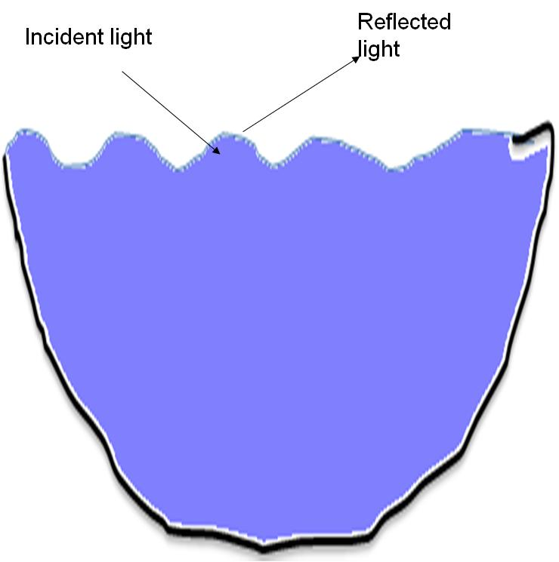
Scattered light
Absorbed light

Slide 31
Fate of light in water
(a) Absorption
PAR entering the water is attenuated (absorbed) by:
Organic particles
Colored DOM (yellow-red; suspended particles)
Small silt-clay sized inorganic particles
Water molecules
In transparent lakes and in the open ocean, the red end (600-700nm) is largely attenuated.
As a lake becomes more eutrophic, more blue and red wavelength is absorbed and relatively more green is transmitted and reflected.

Slide 32
b) Scattering is the of deflection of photons
short wavelength light is result more scatterd than long wavelengths
That is why transparent lakes (oligotrophic lakes) and open oceans looks like blue
Total underwater irradiance – represent the total amount of light available to photosynthetic organisms
Light attenuation coefficient (K): measuring vertical profile of light attenuation through the water column then determining the slope of the log transformed data.
Secchi disk: is flat plate, with 20-30 cm diameter painted with black and white quadrats and is used to measure the total underwater irradiance.

Slide 34
T⁰ influence the solubility of DO and other materials in water column.
Increased Tº increase the amount of O2.
Human sources of pollutants can impact water temperature
A large portion of irradiance is in the infrared portion of the solar spectrum and has major thermal effects on the aquatic system.
Heat has two functions in water bodies: 1. Regulates rates of chemical and biological process
2. Thermal stratification
Vertical stratification is based on physical and chemical variables,
1. light whose intensity decreases rapidly with depth.
2. temperature. Lakes can be divided into 3 layers based on the temperature and density profile

Slide 35
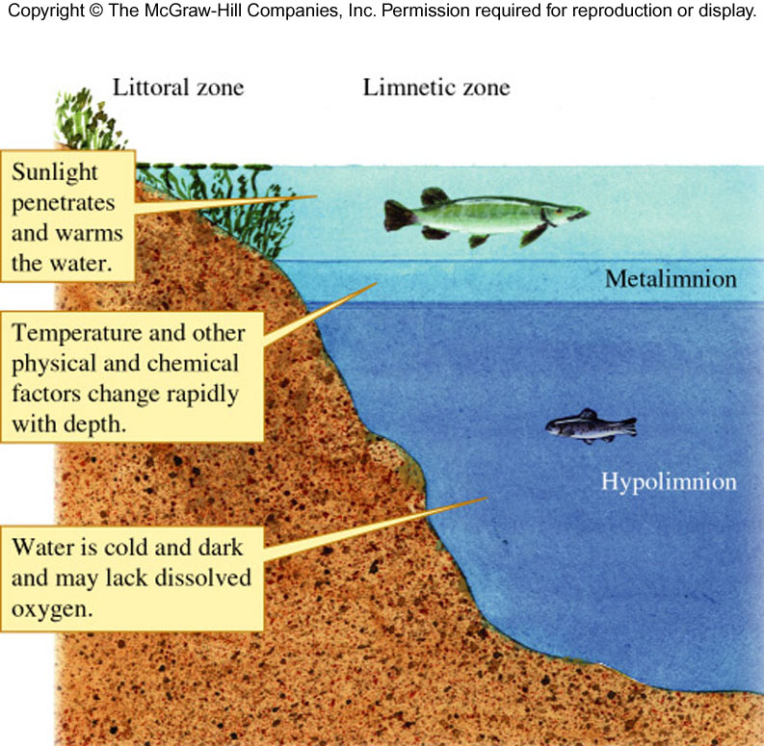

Slide 36
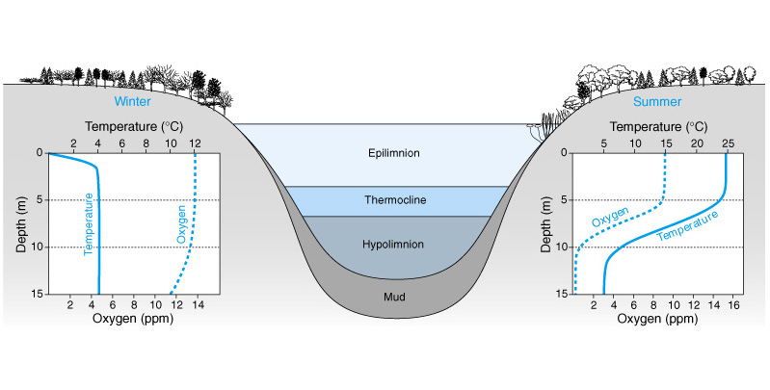

Slide 37
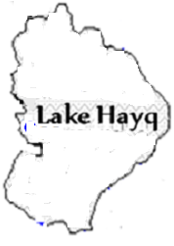

Slide 38
Surface area (A) – total area enclosed by shoreline
length of shoreline (L) - It is the perimeter of the lakeaa
Shore line development index (D_{L})- It is calculated as D_{L} = L ÷ 2·sqrt(π·A_{o})
DL is equal to 1, for cone shaped, circular lakes such as crater; little littoral area
If DL > 1 littoral area increases
DL >= 3.5 for reservoirs, irregular shores, high littoral area, and most likely productive

Slide 39
Subsurface dimension
Maxmum depth (Z_{m}): Depth is designated by the symbol Z. Z_{mean} = V ÷ A_{o}
Volume (V): the total amount of water contained in a lake
Unit: km³, m³, liter

Slide 40
Chemical component
Based on their chemical conditions or productivity, aquatic habitats (specially lakes) can be classified into three states.
Oligotrophic : deep, cold, nutrient-poor, phytoplankton are sparse, not very productive and don’t contain much life and often well oxygenated. oligo
Eutrophic lakes are shallow, warm, with large surface area relative to depth, nutrient-rich; phytoplankton more plentiful and productive. eutro
Mesotrophic lakes have moderate nutrient content and moderate amount of phytoplankton and are reasonably productive.

Slide 41
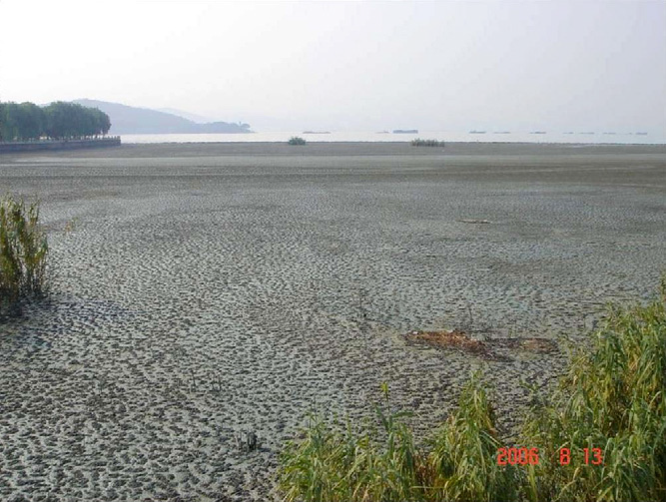

Slide 42
Chemical factors
Dissolved oxygen (DO) refers to the volume of oxygen that is contained in water
It can enter water from air, released as result of photosynthesis or by mixing from wave action.
Oxygen depletion can result from a number of factors.
It is caused most often due to pollution and eutrophication
The amount of oxygen used by decomposers to break down a specific amount of organic matter is referred to as biochemical oxygen demand (BOD).
The condition of having low oxygen in the water is referred as Hypoxia where as when O₂ is completely absent from the water, the condition is referred as Anoxia.

Slide 43
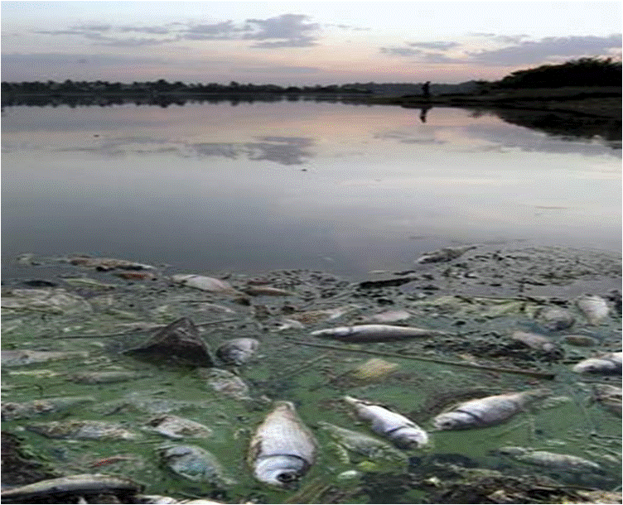

Slide 44
Salinity is the mass of salts in a water. (mg L⁻¹ or g L⁻ or ppt)
is the sum of ionic compounds dissolved in the water,
4 cations --- Na⁺, K⁺, Ca⁺⁺, Mg⁺⁺
4 anions– HCO₃⁻, CO₃²⁻, SO₄²⁻, Cl⁻
Effect of salinity on organisms
salinity affects osmoregulation
Some tolerate by making their internal salt isotonic with the external environment (Osmoconformation).
Others survive in fresh water environment and regulate their water body content by expelling excess water (Osmoregulation).
Seawater is about 2.5 percent denser than fresh water and it make the water more bouyant.

Slide 45
pH and Alkalinity: In lakes, rivers etc, certain volume of water (H₂0) molecules dissociate.
If the relative proportion of H⁺ is greater than OH⁻, then the water is defined as being acidic. If the hydroxyl (OH⁻) ions, dominate, then the water is defined as alkaline.
Alkalinity is related to concept that is commonly used to indicate a system’s capacity to buffer against acid impact
There are three kinds of alkalinity: hydroxide (OH⁻), normal (mono) carbonate (CO₃) and bicarbonate (HCO₃); the three are summed as total alkalinity.
Alkalinity is determined by titrating a water sample with a strong acid

Slide 46
Inorganic carbon: Carbon is the currency of energy exchange in aquatic ecosystems.
Importance
1. Determines the amount of carbon available for photosynthesis
Organic compounds produced from inorganic carbon through photosynthesis
6CO₂ + 12H₂O C₆H₁₂O₆ + 6H₂O + 6O₂
2. It buffers freshwaters against rapid changes in pH, meaning it enables water bodies to resist rapid changes in pH
3. Make large contribution to anion concentration
Carbon dioxide (CO₂)
Bicarbonate (HCO₃⁻)
Carbonate (CO₃²⁻)

Slide 47
Sources of CO₂ in water:
1. Respiration – plants, animals
2. Atmospheric CO2 – 0.033% (350 ppm by volume)
Rain water dissolves CO2 to H2CO3
Dissolve when it come in contact with surface water
3. Fossil fuel burning: Global warming due to “green house effect”
4. Geologic weathering of CO₃²⁻
5. Decomposition of organic matter by bacteria

Slide 48
Nutrients:
are elements essential to life.
The major nutrients, or macronutrients, required for metabolism and growth of organisms include C, N, H, O, P, K, S, Mg, Ca.
There are also many micronutrients required for metabolism and growth of organisms
Nitrogen and Phosphorous
Compounds of nitrogen and phosphorous are major cellular components of organisms.
Productivity of aquatic ecosystem can be managed by regulating direct or indirect inputs of nitrogen and phosphorous with the aim of either reducing or increasing primary production.

Slide 49
Phosphorous is present in natural waters primarily as phosphates,
Source of phosphorous
Natural weathering of minerals in drainage basins
Biological decomposition
Runoff
Rain
Nitrogen fixation, converts dissolved molecular N₂ to ammonium NH₄⁺.
Aerobic bacteria convert NH₄⁺ to NO₃⁻ and NO₂ through nitrification.
Anaerobic bacteria convert NO₃⁻ and NO₂ to N₂ through denitrification.
Primary producers assimilate inorganic N as NH₄⁺ and NO₃
Phosphorous and Nitrogen are considered to be the primary drivers of eutrophication of aquatic ecosystems,

Slide 50
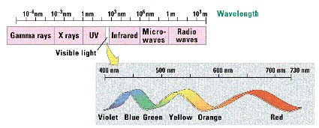

Slide 51

Reflected light
Incident light
Scattered light
Absorbed light

Slide 53
A
h

Slide 54
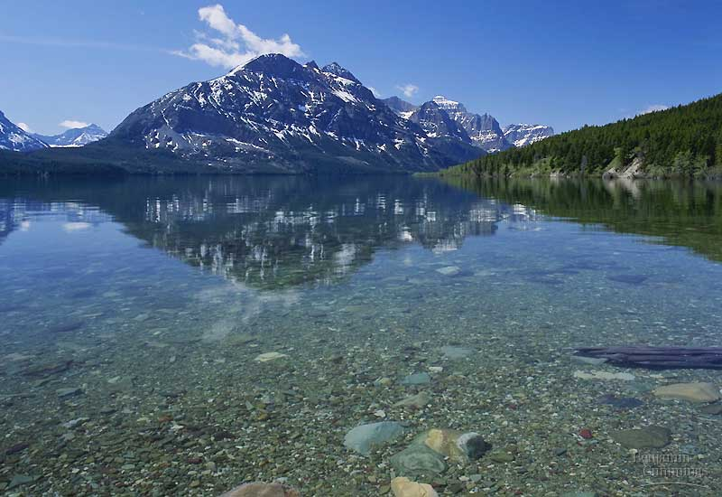
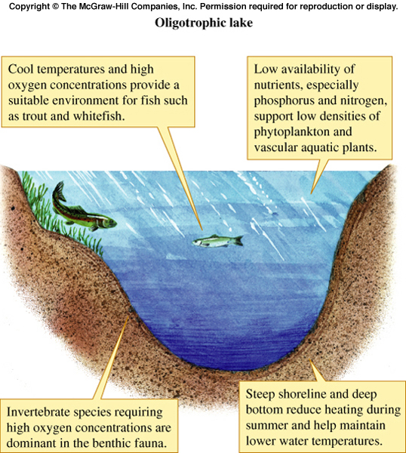

Slide 55
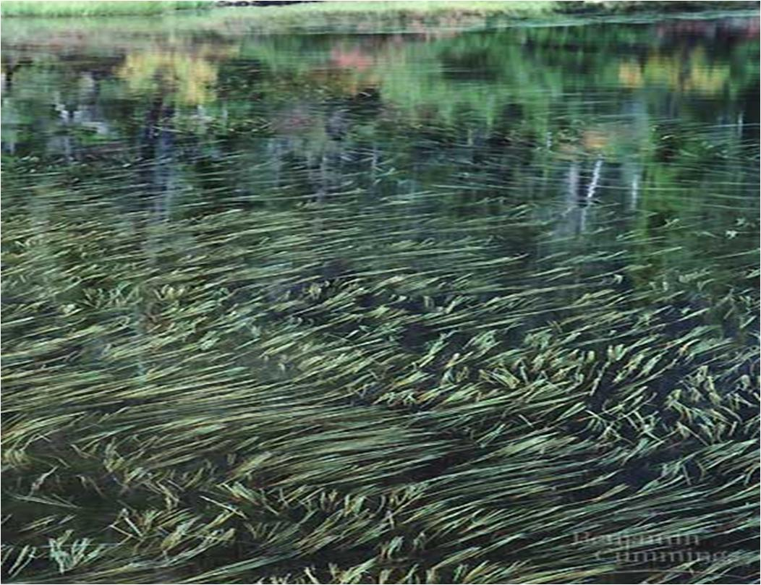

Slide 56
UNIT 4
Biological Component

Slide 57
Plankton
organisms floating freely in water.
They are mostly microscopic, but they can include larger species.
They provide a crucial source of food to larger, more familiar aquatic organisms such as fish.
three main types: 1. plant plankton, also called phytoplankton
2. animal plankton, or zooplankton
3. bacteria, which usually feed on dead organisms

Slide 58
Phytoplankton
derived from two Greek words, phyton (plant) and planktos (to drift)
Phytoplankton are the main primary producers
Some phytoplankton are prokaryotic bacteria while others are eukaryotic algae
Phytoplankton (algae) show diversity in size and morphology

Slide 59
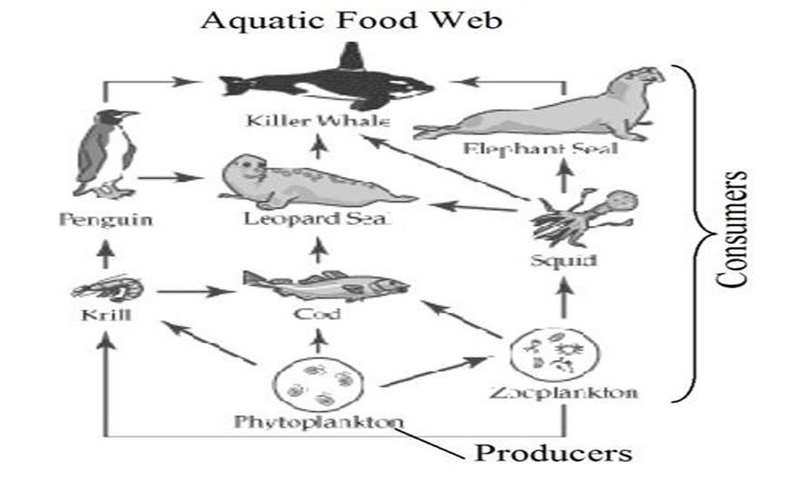
Some benefits of phytoplankton
primary producers in aquatic food web (food source, carbon dioxide recycle and oxygen release
primary producers in aquatic food web (food source, carbon dioxide recycle and oxygen release)

Slide 60
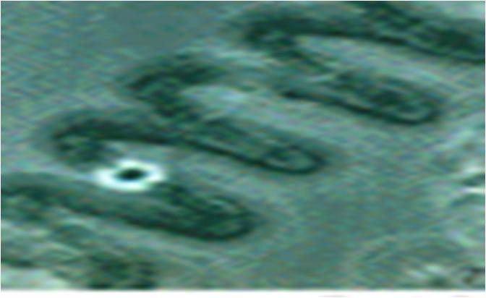
Several species of phytoplankton have been used as food and valuable chemical sources
Algae-based biofuel production has now received worldwide interest in developing green economy
E.g Botryococcus braunii, Nannochloropsis, Hantzschia, Chlorella, Scenedesmus, Cyclotella, Nitzschia

Slide 61
Phytoplankton are sensitive and quickly respond to changes in water quality and thus can serve as bioindicators
Phytoplankton are nowadays considered useful organisms in algae-based treatment of various kinds of municipal and industrial wastewaters.
based on their cell size : picoplankton (< 2 μm), nanoplankton (2 – 20 μm), microplankton (20 – 200 μm) and macroplankton (>200 μm).
Phytoplankton also show taxonomic diversity and the major divisions, for example, include Chlorophyta (green algae), Cyanophyta (blue-greens), Dinophyta (dinoflagellates), Bacillariophyta (diatoms) and so on.

Slide 62
Zooplankton
pelagic animals which are unable to maintain their position by swimming against the physical movement of water.
Zooplankton feed on phytoplankton and transfer the energy to higher animals (fish); so they are the link between higher trophic level and phytoplankton.
There are 3 major groups of zooplankton
1. Copepods: Phylum Arthropoda, Class Crustacean, found in both inland water bodies and oceans
Sub order: i. Calanoida---- freshwater and marine
Cyclopoida ---- fresh water and marine
Harpacticoids ---- mainly marine/saline
2. Cladocera: Phylum Arthropoda, Class Crustacean
Largely fresh water
3. Phylum Rotifera: have more species in freshwater

Slide 63
Zooplankton communities are divided into two groups based on size:
Microzooplankton < 200 µm --- Rotifers
Macrozooplankton > 200 µm --- copepods and cladocerans
Copepoda
They are characterized by a cylindrical body;
They have conspicuous 1st antenna, and single, simple anterior eye
Their size ranges between 0.2 and 2 mm long
The sub-order are:
Calanoida--- can be seen with naked eyes (L. Arenguade, Tana)
Good swimmers than others: large antennae provide a gliding movement
Has egg mass carried medially

Slide 64
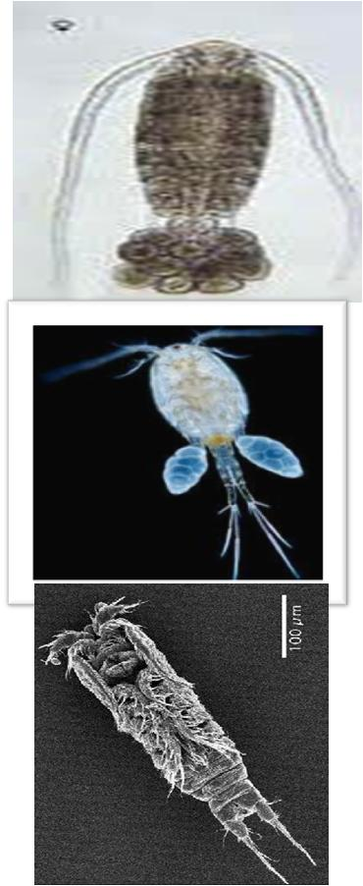
Calanoid
Cyclopod
The antenna is short
Has two egg sacs carried laterally
Herpacticoids
Anterior part of body is not much broader than posterior
The first antenna - very short and thick
Have one egg sack carried medially

Slide 65
Cladocera (water fleas): Phylum Arthropoda, Class Crustacea; Order – Cladocera
Cladocerans are extremely important zooplankton in lakes
Fairly large in size that ranges from 0.2 – 3mm. Some can be seen with naked eyes.
The thorax has 4 to 6 pairs of legs that beat continuously and create water currents that bring in algae, protozoa, and detritus.
The food is filtered onto the many fine setae on the legs and move towards the mouth.
The appendages generate feeding and respiratory currents

Slide 66
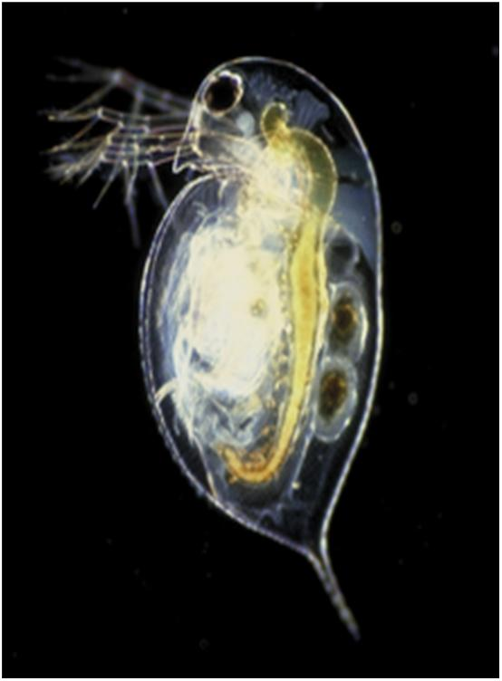
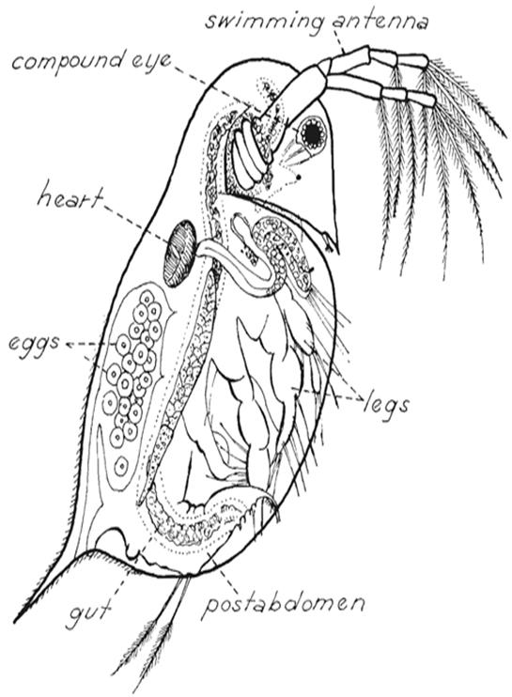

Slide 67
Rotifer (Wheel animal). Phylum Rotifera
2000 speceis of rotifers occur in freshwaters.
They can be found in all freshwater habitats.
They are small in size– small metazoans (20—200 µm long).
Distinguished by a ciliated head region (corona) that moves water in a circular fashion– that is why they are called wheel animal.
They are omnivorous, feeding on picoplankton, small flagellates and small ciliates (<20 µm).
They have different shape, no typical shape of rotifer

Slide 68
Macrophyte

Slide 69
Introduction
Macrophytes are aquatic plants which are visible to the naked eyes
Macrophytes are characterized into functional groups based on growth forms which occur in different depths.
1. Emergent macrophytes are rooted in the bottom and their leaves extend above the water surface .
They are found in the shallowest waters and occur on water-saturated soil (0.5m -1.5m )

Slide 70
2. Submerged macrophytes are rooted in the bottom but not extending out of the water.
Leaves are entirely submerged below the water surface.
These growth forms are found at all depths within the photic zone.
3. Floating-Leaved macrophytes are rooted in the bottom with leaves floating on the surface of the water.
These plants are usually found at about 0.5 – 3 m of water depth.
Reproductive organs are usually floating or aerial.

Slide 71
4. Free floating not rooted in the bottom but live unattached within or upon the water
Their reproductive organs are floating or aerial but rarely could be submerged.

Slide 72


Slide 73
Beneficial Aspects of macrophytes
produce oxygen through photosynthesis, which assists in overall lake functioning
are important spawning ground, site of egg deposition and food source for some fishes
help maintain water quality by stabilizing sediments and buffering nutrient influx
used in phytoremediation cw
used as animal fodder
Reeds such as Arundo donax and Phragmite spp have been used as a source of energy and for production of paper and pulp

Slide 74
Some harmful aspects of macrophytes
Some Invasive/exotic plants have special abilities to become abundant within short period of time (e.g. Water hyacinth).
The leaves of water hyacinth evapotranspire at high rate so that it aggravates high amount of water loss
It also causes oxygen deficiencies, and interrupt local subsistence fishing, transportation
interfere irrigation and blocks supply intakes for hydroelectric plant etc
Mass growth of some macrophytes (e.g. Pistia stratiotes) is responsible for an increase in the chance for the spread of several diseases,

Slide 75
Controlling Nuisance Macrophytes
Physical methods – involves mechanical removal such as hand pulling, cutting and harvesting, and dredging (dredgers).
Chemical methods - involves applications of herbicides such as copper, 2,4-D or glyphosate and other chemicals.
Biological methods – uses grazers and is relatively widely favored method. For example, three species of weevil ( Neochetina bruchi, N. eichhoriniae, and Sameodes albiguttalis )

Slide 76
Macroinvertebrate
Invertebrate could occupy diversified habitats
Moreover, the majority of invertebrates live in aquatic environment
There are more than 30 invertebrate phyla
Among invertebrates, benthic macroinvertebrates are frequently used to assess the quality of the water
tend to remain in their original habitats

Slide 77
MEASURES OF STREAM HEALTH
Many stream invertebrates are insect larvae.
macroinvertebrates are sensitive to pollution and can survive only in clean or slightly polluted water.
Still others are tolerant of pollution and can live in any water condition, even heavily polluted water.
The unpolluted stream ecosystems will likely exhibit biodiversity, whereas polluted stream will not

Slide 78
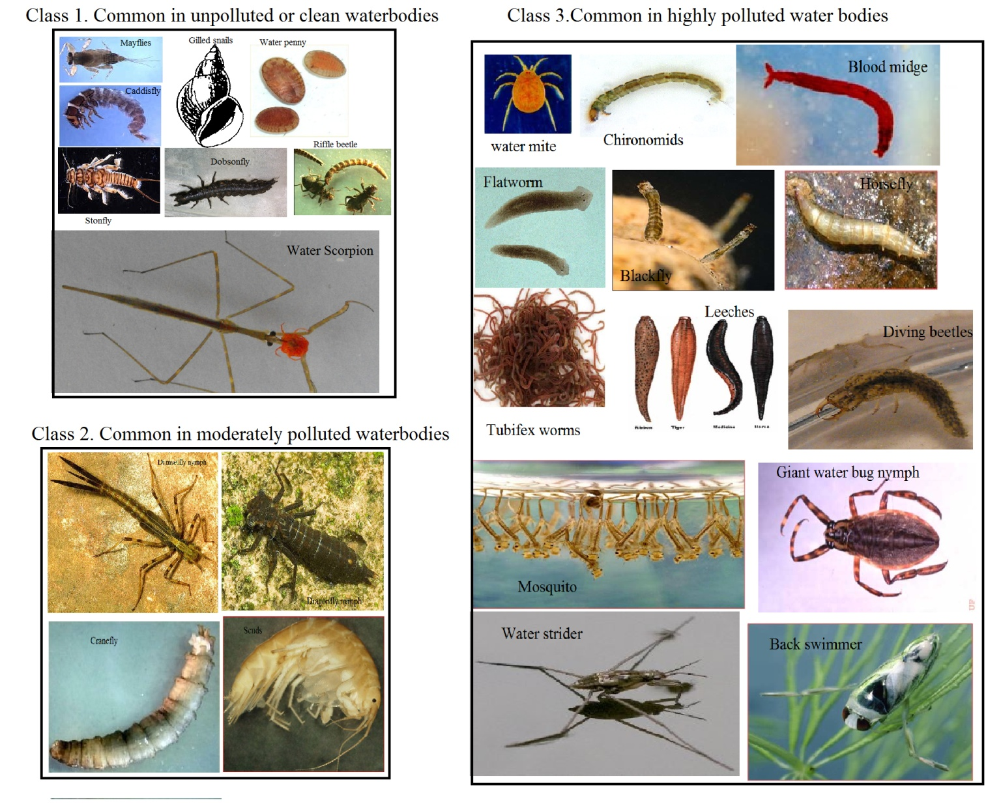

Slide 79
Fish
cold-blooded vertebrates, mostly breathe by gills, live in water and move with the help of fins
There are about 36,000 species, which represent the 40% of the total vertebrates present

Slide 81
FISH DIVERSITY IN ETHIOPIA
freshwater fish diversity is relatively high
recent collections and reviews showed that 180 indigenous and 11 introduced species distributed in 24 families (Abebe Getahun, 2013)
Cyprinid fishes are the most diverse, 39%, followed by mochokids (10.4%), and mormyrids (9.1%).

Slide 82
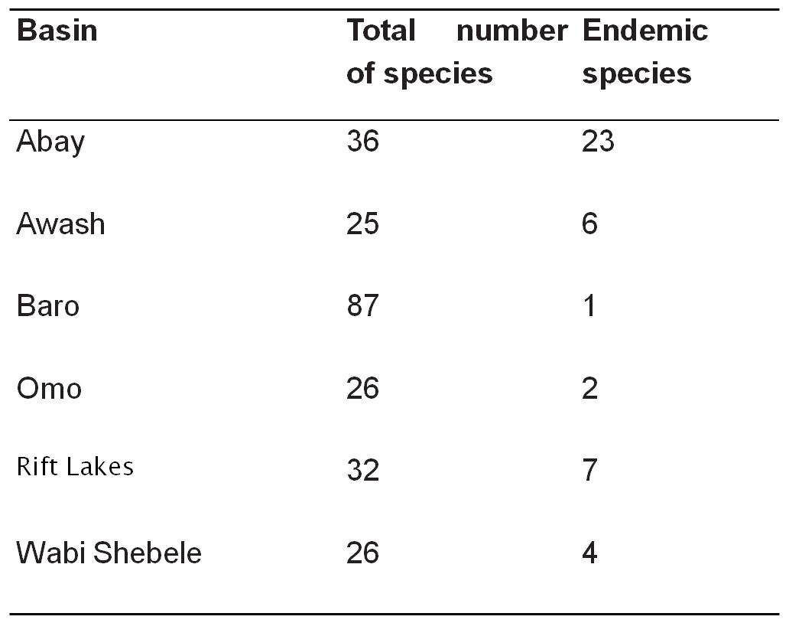

Slide 83
AQUACULTURE
Global community faces multiple interlinked challenges e.g. economic crisis, greater climate change vulnerabilities, extreme weather events
Pressing food and nutrition with growing population
Fisheries make crucial contributions to the world’s wellbeing and prosperity
However, there is now little doubt that the world’s capture fisheries are in crisis.
Fish farming offers a solution to meeting the growing demand of food that capture fisheries cannot provide.

Slide 84
Capture fisheries and aquaculture supplied about 148 million tonnes of fish in 2010
In 2011 production increased to 154 million tones
Aquaculture, farming aquatic animals and plants, now accounts for roughly 1/3 of the world’s total supply
Asia - 88.8 % of global aquaculture production by quantity in 2008.
Fish production (aquaculture) and consumption was lowest in Africa,
nearly 9 million tones per year
Africa’s global contribution in 2008 was 1.8%.
Aquaculture in Ethiopia is at an infant stage.

Slide 85
UNIT 5
Water pollution is the contamination of water bodies
Water pollution occurs when pollutants are discharged directly or indirectly into water bodies.
Pollution could be caused naturally,
Sources and effects of water pollution
Pollution can come from a number of different sources.
If the pollution comes from a single source, such as an oil spill, it is called point-source pollution.

Slide 86
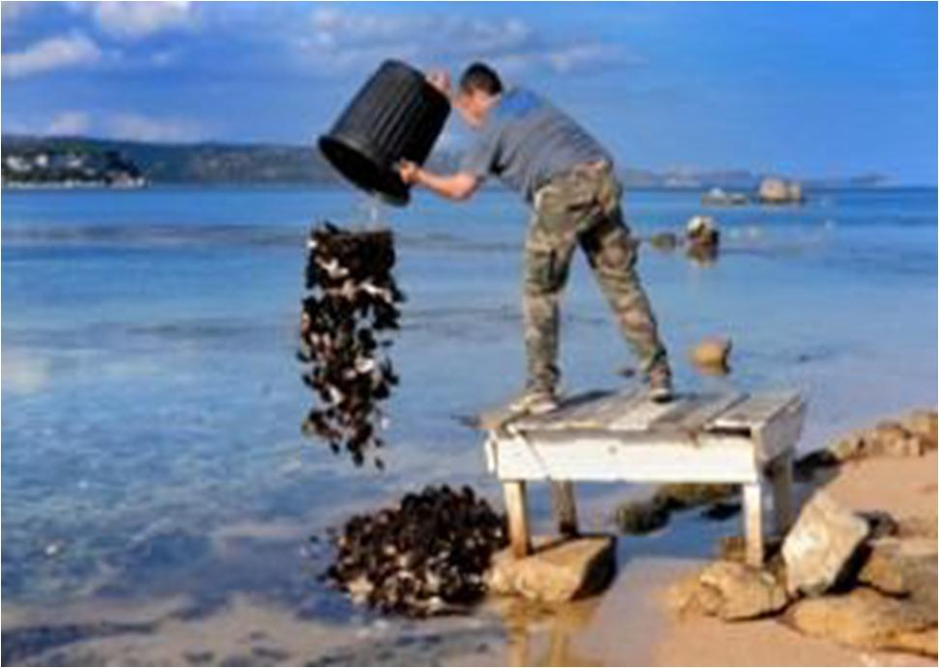

Slide 87
If the pollution comes from many sources, it is called nonpoint-source pollution.
Most types of pollution affect the immediate area surrounding the source.
Sometimes the pollution may affect the environment hundreds of miles away from the source, such as nuclear waste, this is called transboundary pollution.

Slide 88
Point Source pollution
the point source impurity enters the water resource at an easily identifiable, distinct location though a direct route.
Because of these properties, point sources are somewhat easier to control;
Examples : factories, commercial businesses and wastewater treatment plants, underground mines, oil wells, oil tankers etc.

Slide 89
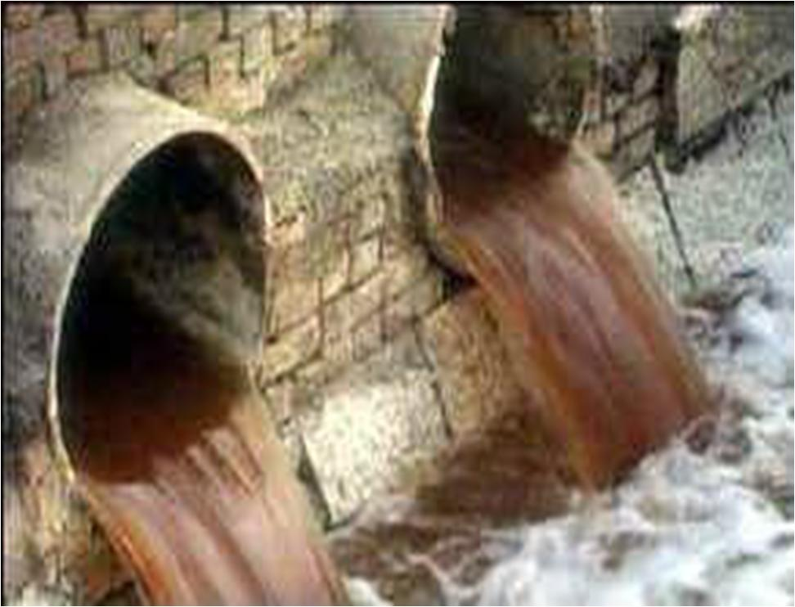

Slide 90
Non-point source water pollution
Discharges from nonpoint sources are usually intermittent, associated with a rainfall or snowmelt event,
Nonpoint sources of pollution are often difficult to identify, isolate and control.
Examples of NPS pollution include: acid deposition from the air, runoff from parking lots; runoff from agricultural fields, and runoff from construction, mining etc.
Most NPS pollutants fall into six major categories: sediment, nutrients, acid and salts, heavy metals, toxic chemicals and pathogens.

Slide 91
Types of pollution 1. Eutrophication
Nitrates and phosphates, enter the water through sewage, livestock and fertilizer runoff, as well as from industry wastes.
When there is too much N or P in water suply (0.3 parts per million/ppm for N & 0.01 ppm for P), it causes a problem called Eutrophication.
Excessive algal bloom or eutrophication disrupts normal ecosystem functioning and causes many problems.
o Excessive weed and algae growth in water can cause a contamination of drinking water.
o The algae may use up all the oxygen in the water, leaving none for other aquatic life.
o The bloom of algae may also block sunlight
o Some algae produce toxins

Slide 92
2. Thermal Pollution/ Heat
It is pollution due to Heat or rise in the water temperature.
As water temperature increases, the amount of dissolved oxygen decreases.
Thermal pollution can be natural, in case of hot springs, or human-induced, in the case of discharged water that has been used to cool power plants or other industrial equipments or due to global warming.
3. Heavy metals
Heavy metals from industrial processes can accumulate in nearby lakes and rivers.
This can sometimes contaminate groundwater and end up in our drinking water supply.
Heavy metals can slow development, result in birth defects, and cause cancer due to their carcinogenic nature.
They can also give unpleasant odors and tastes to the drinking water.

Slide 93
Afforestation and Water Quality
Forest maintain high water quality
1. by minimizing soil erosion thus reducing sediments in water bodies
2. Through trapping or filtering other water pollutants

Slide 94
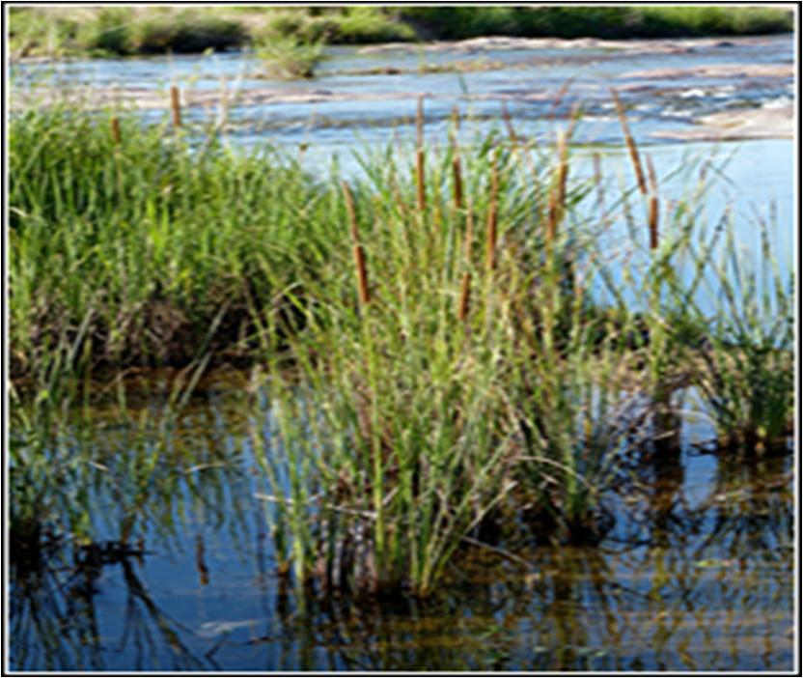

Slide 95
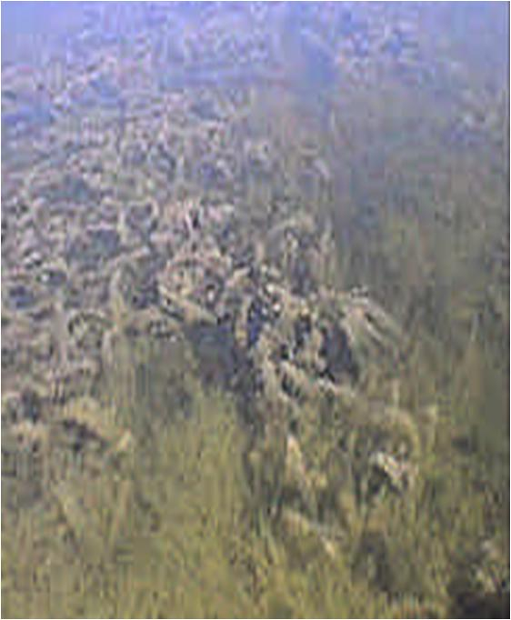
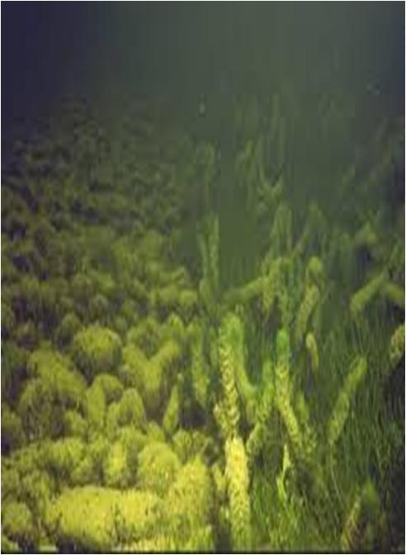

Slide 96
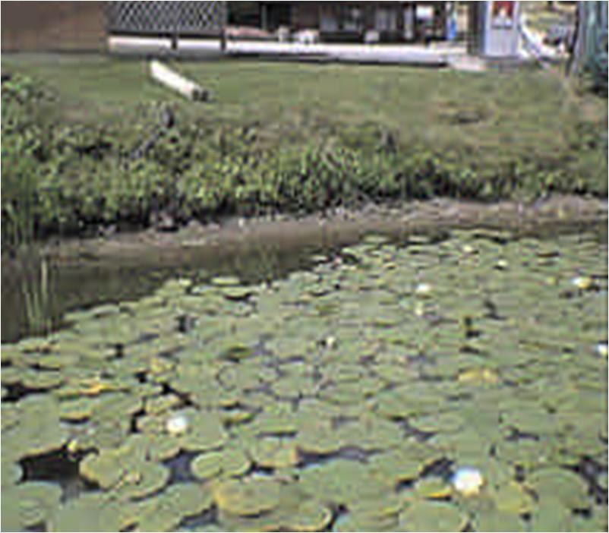

Slide 97
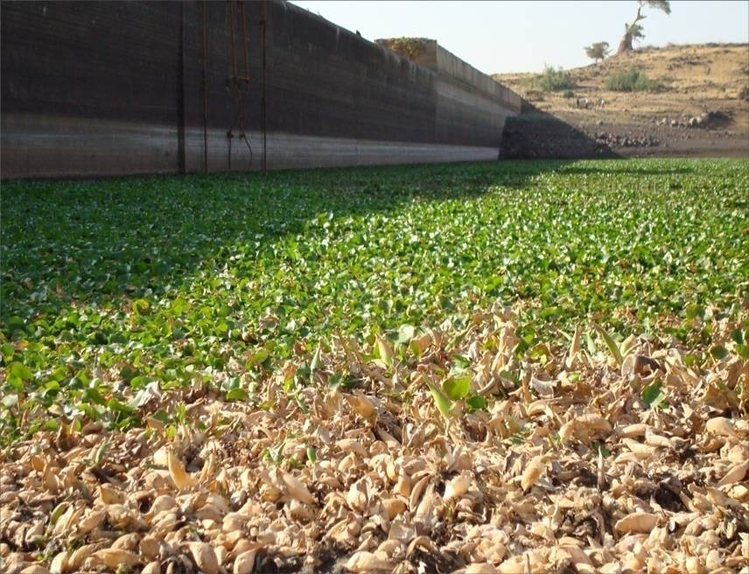

Slide 98
Unit 6 Water Quality Assessment
Water quality is the physical, chemical and biological characteristics of water.
It is the potential of water to support human, other organisms and activities
The level of water quality and/or pollutant loading is based upon the evaluation of measured quantities and parameters.
Water quality assessment is the overall process of evaluation of the physical, chemical and biological nature of water in relation to natural quality, human effects and intended uses,

Slide 99
Monitoring is a long term, standardized measurement and observation of the aquatic environment in order to define status and trends.
logical sequence consisting of three components: monitoring, followed by assessment, followed by management.

Slide 100
How Water Quality is Assessed?
Samples are taken from water bodies and test in laboratory.
Data from the field measurement and Lab results then correlated with standards
E.g. colonies of coliform bacteria; these are indicators for drinking or swimming water quality.

Slide 101
Physico-chemical and biological attributes of a water quality and surveillance
Physical Attributes of a Water Quality parameters
Measurements of a stream's physical attributes can also serve as indicators of some forms of pollution.
Temperature
governs to a large extent the biological species present and their rates of activity.
has an effect on most chemical reactions that occur in natural water systems.
has a pronounced effect on the solubility of gasses
An increases water temperature favors the conversion of ammonium ion (NH₄⁺) in to ammonia (NH₃)

Slide 102
Turbidity: a measure of the extent to which light is either absorbed or scattered by suspended material in water. turbid
It can be measured by using a device known as Turbidimeter.
Chemical Attributes of Water Quality Parameters
Chemical attributes of water can affect aesthetic qualities such as how water looks, smells, and tastes.
Chemical attributes of water can also affect its toxicity and whether or not it is safe to use.
pH, conductivity, DO, COD, BOD, alkalinity, NO₃, NO₂and NH₄⁺, and TP.

Slide 103
pH: is the way of expressing the hydrogen ion
The intensity of the acidic character of a solution is indicated by pH = - log[H⁺].
pH of the aquatic habitats could vary on a daily basis.
During the day time (when concentration of CO₂is relatively less due to more photosynthesis) pH may rise

Slide 104
Conductivity: a measure of the ability of the aqueous solution to conduct an electric current.
depends on the presence of ions or salts, their concentration and mobility, and temperature.
It is measured using conductivity meter on site and expressed as microSiemen percentimeter (µS/cm). E.g. Ziway (444 µS/cm); Lake Tana (152-230 µS/cm)
Pure water often has less conductivity than polluted water.

Slide 105
Dissolved Oxygen (DO)
Natural levels of DO range from 7 mg/L to 14mg/L,
Organic pollutants in water stimulate bacterial growth, which inturn consume organics, helping to purify the water.
During the degradation of organic pollutants, bacteria consume dissolved oxygen.
Dissolved oxygen in the natural waters can be measured directly on site using appropriate digital oxygen meter or in situ
in the lab using titration methods such as Winkler method.
A

Slide 106
Biochemical oxygen demand (BOD)
The OM concentration is measured by determining the rate at which oxygen is depleted from a test sample.
The amount of oxygen remaining after 5 days gives a measurement of the organic matter present.
BOD = Dot₀- DOt₅
Chemical oxygen demand (COD)
The Chemical Oxygen Demand (COD) is the amount of oxygen needed to chemically oxidize wastes
The primary advantage of COD over BOD is that it is relatively fast, taking 2 to 3 hours.

Slide 107
Biological Attributes of Water Quality Parameters
bacteria, algae, macroinvertebrates, protozoa, macrophytes and fish.
Various biotic scores or biotic indices (biotic indexes) are used in order to determine pollution
Bacteriological Analysis
This is a microbiological analytical procedure of analyzing water to identify the type or estimate the number of bacteria present
Chlorophyll a Analysis
Chlorophyll a is the most abundant and important pigment which generally constitutes 2 to 5% of the dry weight of an algal cell.

Slide 108

Benthic Macroinvertebrates
various groups of invertebrates including flatworms (e.g. planaria), mollusks (e.g. snail) and mainly insects (e.g.caddisflies, dragonflies, etc) that inhabit the floor of the aquatic habitats.

Slide 109
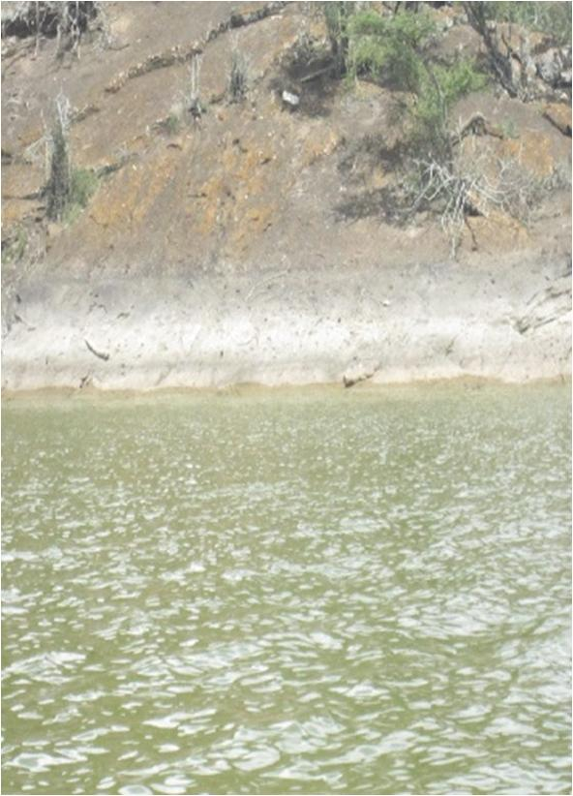
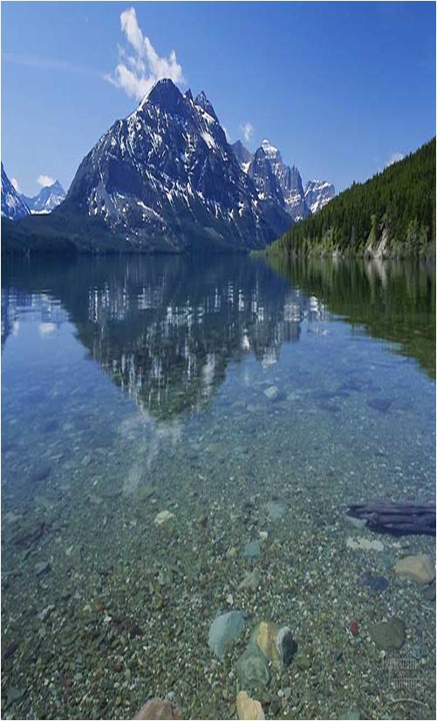

Slide 110
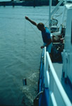
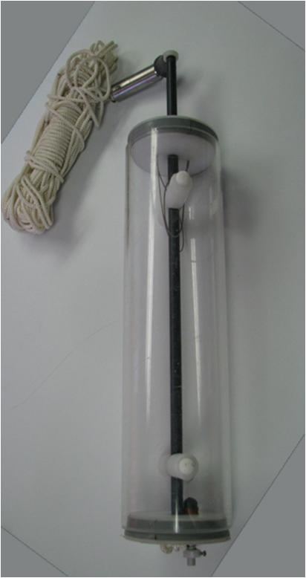

Slide 111
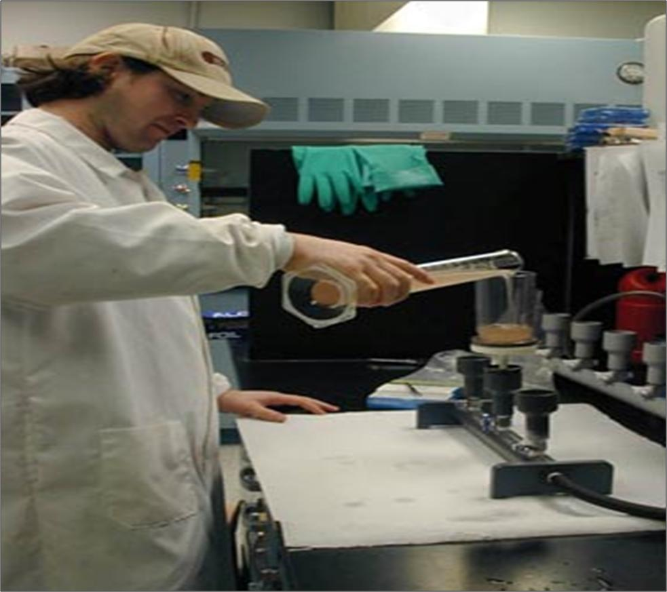

Slide 112
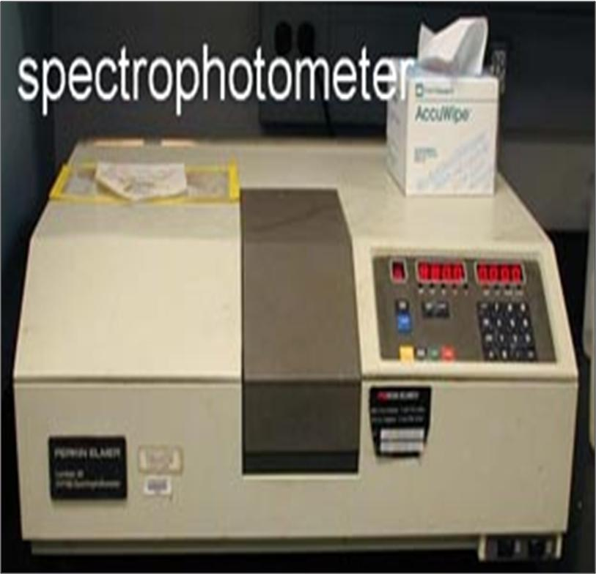

Slide 113
The concentration of Chl a is calculated by :
Where: E665= extinction at 665 nm
E750= extinction at 750 nm
Ve= volume of extract (in ml)
Vs= volume of sample filtered (in liters)
Z= path length of the cuvette (in cm)

Slide 114
6.2. Sampling surface water and Measurement of Water Quality Indicators /Parameters

Slide 115
Sampling water
The most accurate measurements are made on-site, because water exists in equilibrium with its surroundings.
Quality of aquatic environment
Quantitative (Physico-chemical)
Qualitative (Speciesnventories, odor)

Slide 116
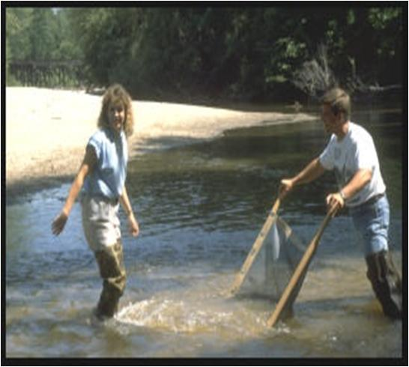
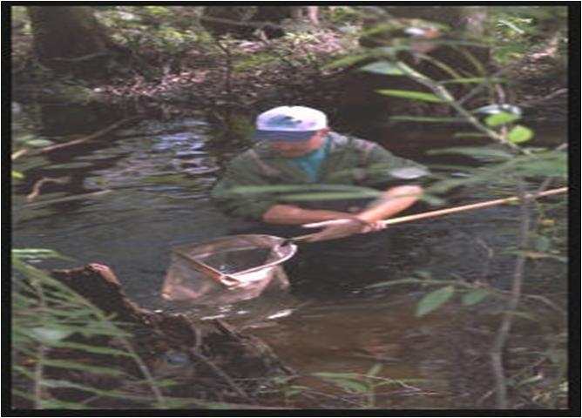
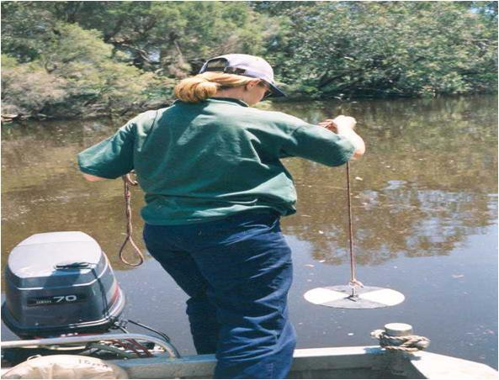
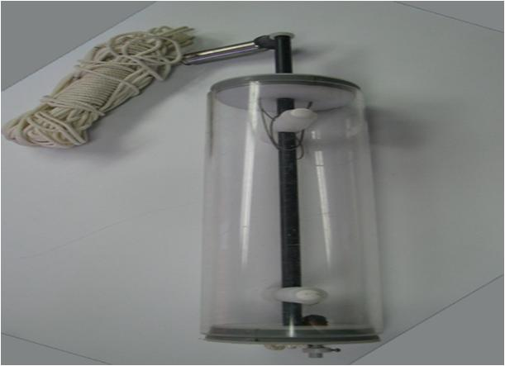

Slide 117
Biological data Analysis
Pollution index (i.e. Biotic Index or "Family Biotic Index") is a scale for showing the quality of an environment by indicating the types of organisms present in it.
It is measured from 1 to 10 and corresponds to the four basic water quality (Excellent, Good, Fair or Poor).
Biotic Index is based on categorizing macroinvertebrates into categories depending on their response to organic pollution.
E.g. Hilsenhoff Biotic Index

Slide 118
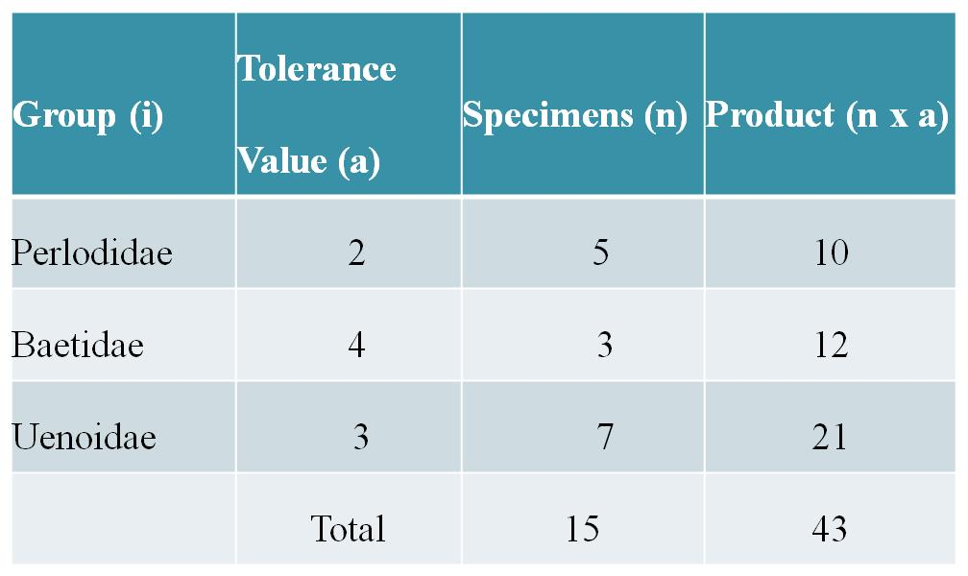
HBI = 43 ÷ 15 = 2.87

Slide 119
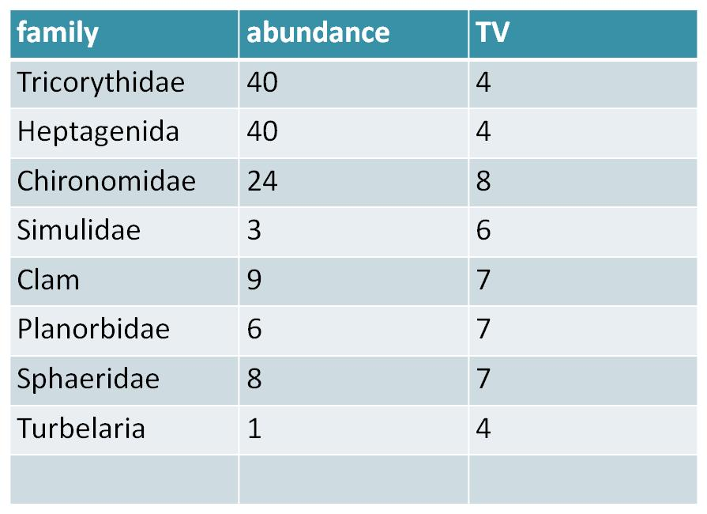
Assignment 1. Caculate the Hilsenhoff biotic index

Slide 120

Their main advantage is in summarizing large amount of data which can be easily used by wide variety of people
is a quantitative measure that reflects how many different (species) there are in a dataset, and how evenly they are distributed among those types.
The value of a diversity index increases both when the number of types increases and when evenness increases
E.g. Shanon and Weiner Index
H’ = -SUM[(pi) * ln(pi)]

Slide 122
Assignment 2
Assume a lake has five types of fish species with abundance of 60, 10, 25, 1 and 4. Calculate the fish diversity using Shannon and Weiner diversity index.

Slide 123
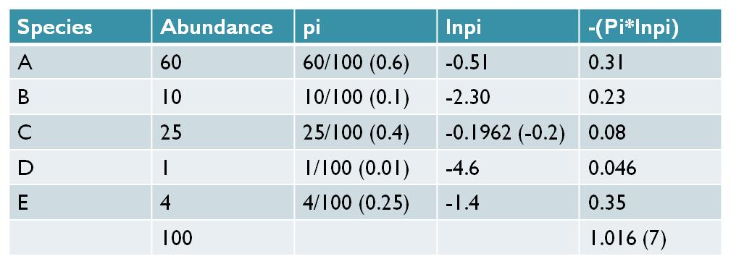

Slide 124
UNIT 7. Aquatic ecosystem and their catchment
Catchment area or drainage basin watershed is an area drained by a stream or other body of water.
The amount of water reaching the river, reservoir, or lake from its catchment area depends on
i. the size of the area,
ii. the amount of precipitation, and the loss through evaporation and
iii. through absorption by the earth or by vegetation;
absorption is greater when the soil or rock is permeable
A permeable layer over an impermeable layer may act as a natural reservoir, supplying the river or lake in very dry seasons.

Slide 125
Drainage system
is a system of network of streams, rivers, standing water bodies (e.g. lakes) and wetlands together with the catchment area.
ethiopian drainage
In the world the three largest river drainage basins (by area), from largest to smallest, are the
Amazon basin,
the Congo basin, and
the Mississippi basin.
Endorheic drainage basins are inland or closed basins that do not drain out into an ocean whereas
Exorheic drainage basins are characterized by external drainage.

Slide 126
Catchment characteristics
7.1. Catchment size
Determine the amount of water reaching the river, as the larger the catchment the greater the potential for flooding.
Moreover, the bigger the catchment means relatively there will be more contact with soil before water reaches the lake.
7.2. Catchment soil type and vegetation:
Sandy soils are very free draining and rainfall on sandy soil is likely to be absorbed by the ground.
However, soils containing clay can be almost impermeable and therefore rainfall on clay soils will run off and contribute to flood volumes.

Slide 127
Catchment vegetation cover is important in reducing surface run off into the water body from the catchment area and thus contributes to good water quality of the water body
Moreover, human practices such as farming, cattle grazing, and industries of various types all can contribute to some sort of pollutants that can reach the water body.
Catchment geomorphology (rock or soil type) influences the water quality characteristics, such as the nutrients, total suspended solids (TSS) and conductivity, of the water body (river or lake) located in the basin.

Slide 128
UNIT 8. Water Basin Management and Monitoring Programs

Slide 129
Water uses for agriculture, irrigation, hydropower generation, drinking water supply, navigation, recreation etc
All these multiple-uses on water demand coordinated action and management to ensure sustainability of the water resource.
Water management and development should be based on a participatory approach, involving users, planners, policy makers and all other stakeholders and users at all levels.

Slide 130
Water Resources Management
Integrated Water Resource Management (IWRM) is a comprehensive, participatory planning and implementation tool which promotes the coordination for managing and developing water resources :
Balances social and economic needs, and
Ensures the protection and sustainability of for future
IWRM approaches involve applying knowledge from various disciplines and implement sustainable solutions to water and development problems.
This approach is very important especially in the management of transboundary water resources.

Slide 131
The Nile River Agreements
The Nile Water Agreement of 1929 and 1959
The Nile Basin Initiative, and
The Nile Basin Initiative Agreement of May 14th, 2010

Slide 132
The Nile Water Agreement of 1929 and 1959
This is a Nile treaty which Britain signed on behalf of its east African colonies with Sudan and Egypt.
Any projects that could threaten the volume of water reaching Egypt are forbidden.
The agreement gives Egypt the right to inspect the entire length of the Nile.
Egypt has a right to use about 75 % of the water while Sudan has 11 % and the rest of the countries share 14 %.
The other riparian countries have to first seek permission from Egypt and Sudan before planning for any large scale development projects on the river that would affect the level and flow of the waters.

Slide 133
The Nile Basin Initiative (NBI)
The struggle for fair and equitable utilization of the Nile River continued to be a stance of most of the riparian countries.
Accordingly, the Nile Basin Initiative was established by the riparian countries in 1999.
NBI is a transitional arrangement established by the Nile Basin States at the meeting of their Council of Ministers held in Dar-es-Salaam, Tanzania, on 22nd February, 1999.
Is responsible to foster cooperation and sustainable development of the Nile River for the benefit of the inhabitants of the riparian countries.
Seeks to develop the river in a cooperative manner, share substantial socioeconomic benefits, and promote regional peace and security.

Slide 134
The New Nile Basin Framework of 2010
The nine riparian countries (Egypt, Sudan, Ethiopia, Democratic Congo, Uganda, Tanzania, Kenya, Rwanda, and Eritrea ) have been negotiating to draft a new treaty on the usage of the Nile waters.
All the countries agreed on the framework which will reduce Egypt and Sudan's right to use more than 85 percent of the water.
Ultimately the Nile Basin Initiative Agreement was signed among four Nile basin countries (Ethiopia, Rwanda, Tanzania, and Uganda) who signed the Agreement on the “Nile River Basin Cooperative Framework” in Uganda on 14th May, 2010.

Slide 135
Some of the reasons for reaching the Nile Basin Initiative Agreement on the “Nile River Basin Cooperative Framework” in May, 2010 include:
1. The old colonial treaty signed among Britain, Egypt and Sudan was not fair and does not entail equitable utilization of the Nile River Basin.
2. The riparian countries are now independent states and thus have equal rights as Egypt to use the Nile waters.
3. The upstream countries are in dire need of using the water to generate hydropower and irrigation following persistent drought

Slide 136
The Water Framework Directive
WFD is a European Union water legislation which commits member states to achieve good qualitative and quantitative status of all water bodies by 2015.
It was made on 23 October 2000 and came into force 22 December 2000.
The following are some of the important points about the Directive:
establishes a framework for the European Community action in the field of water policy
it prescribes steps to reach the common goal
The directive defines 'surface water status' as the general expression of the status of a body of surface water,

Slide 137
Convention on Wetlands Management
Sustainable management of wetlands involves consideration of three important factors: Environmental, Socio-economic and Policy factors.
Wetlands Management in Ethiopia
Generally in Ethiopia, wetland management has been given little attention until a non governmental organization namely Ethio Wetlands and Natural Resources Association (EWNRA)
initiated research in southwest Ethiopia, Illubabor zone, Oromia regional state, for the sustainable management of wetlands.

Slide 138
Wetlands Management at International Level
Ramsar Convention on Wetlands Management is an international intergovernmental treaty adopted on 2 February 1971 in the Iranian city of Ramsar
to address global concerns regarding wetland loss and degradation.
The Convention entered into force in 1975 and as of December 2006 has 153 Contracting Parties, or member States, in all parts of the world.
Ethiopia is not among the Ramsar Convention Member State.
The primary purposes of the treaty are to list wetlands of international importance and to promote their wise use, with the ultimate goal of preserving the world's wetlands.

Slide 139
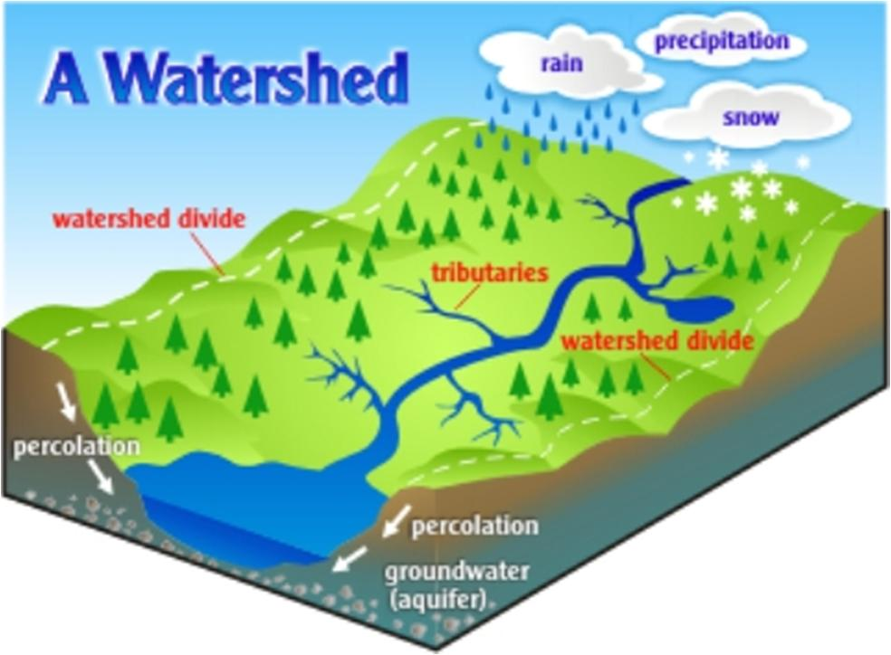

Slide 140


Slide 141
UNIT 9. Major freshwater bodies and wetlands of Ethiopia

Slide 142
Ethiopia, often called the water tower of northeast Africa, is endowed with some 7000 km length of flowing water and some 7000 km² of standing water.
Ethiopia, with its various geologic formations and climatic conditions, is endowed with considerable freshwater resources and wetlands.

Slide 143
The major Ethiopian drainage systems
The Western drainage system
Tekeze, Abay (Blue Nile), Baro-Akobo and Gibe-Omo Drainage
This is an exorheic system in which the rivers in the system ultimately drain into the Mediterranean Ocean.
The South-eastern drainage system
It includes Wabishebele and Ghenale Drainage
This is also an exorheic system in which the rivers in this system ultimately drain into the Indian Ocean.
The Rift valley drainage system:
It includes Awash drainage basin and major lakes such as Ziway, Shala, Abijata, Awassa, Abaya and Chamo are located in the Rift Valley. Drainage
This is generally an endorheic or closed system with no external flow.

Slide 144


Slide 145
Lakes
The Ethiopian lakes -7000 km² area.
The formation of most of the natural lakes is associated with tectonic and volcanic activities.
The high land lakes include Lake Tana, Lake Hayq (near Dessie), Ashengie, Lake Wonchi (near Ambo), and Bishoftu (Debrezeit) Lake groups (such as Lake Hora, Lake Bishoftu, Lake Kuriftu and Lake Arenguade, etc).
The Rift Valley lakes include lakes in:
The northern rift valley lakes: Awassa, Langano, Abijata, Sahlla and Ziway
The southern rift valley lakes: Abaya, and Chamo and Chew Bahir
The man made lakes known as reservoirs include Koka Reservoir, Fincha Reservoir, Melka Wakena Reservoir, Gilgel Gibe Reservoir, Tekeze Reservoir, etc.

Slide 146


Slide 147
The economically important families of Ethiopian fish
1. Family Cichlidae (Cichlids)
This family is known to include three species of tilapias in Ethiopia.
These are Oreochromis niloticus, T.zilli and T. galilaea. O. niloticus is found in most Ethiopian freshwaters and commonly known as Qoroso, St. Peter fish, Chogofe, etc. fishes
O. niloticus is the predominant fish in most of the Ethiopian fisheries.
2. Family Centropomidae (Centropomids)
Most members are marine and only genus Lates is a freshwater form both in Ethiopia and Africa.
L. niloticus (commonly called Nile perch) is the major species of the genus and found in Ethiopian Lakes such as Chamo, Abaya, Gambella lakes and Baro River. fishes
L.niloticus is carnivorous on other fish and thus it not good to introduce them into other water bodies than their natural habitats.

Slide 148
3. Family Claridae (Clarids)
The common example is Clarias gariepinus (commonly Catfish, “Ambaza”) found in L. Tana, L. Abaya and Awash River. fishes
C. gariepinus can be easily recognized by their elongated body and long hair like barbells around their mouth.
4. Family Cyprinidae (Cyprinids)
It includes genera such as Barbus (commonly in Nech asa), Labeo and Carp. Barbus is more common in rivers than in lakes and is much common in L. Tana among the lakes. fishes
Three carp species (Common carp, grass carp and silver carp) are introduced species belonging to this family.

Slide 149
The Ethiopian Fisheries
Most of the Ethiopian freshwater capture fisheries come from the rift valley lakes and Tana Lake, and Baro and Akobo rivers (riverine fisheries).
Rift Valley lakes and the Awash River are poor in fish species being dominated by the Nile tilapia, the African catfish (Clarias gariepinus) and a few cyprinids mostly Barbus sp.
Capture fishery potential of 30,000-50,000 tons of fish per anum for the lakes and 5,000 tons of fish per anum for the rivers.
However, fish production is below the potential despite the crucial need for food supply in the country.

Slide 150
The following are some of the reasons for the under development of the Ethiopian capture fisheries.
• Lack of tradition in fish consumption or eating leading to less market demand
• Lack of trained man power - only traditional fishing
• Lack of modern fishing gears and vessels (boats). Only Lake Tana has got some motorized fishing boats
• Less attention given by the planners, policy makers, etc
• Lack of aid or government fund for the sector

Slide 151
Rivers
The Ethiopian rivers are more than 7000 km long.
Ethiopian rivers are characterized by:
Extreme seasonal fluctuation due to the marked seasonality of the rainfall:
They carry only small amount of water and some even dry up along part of their courses during dry season.
High volume and run off during wet seasons
flowing from highlands of over 2,000-3,000 meters to a low land of an elevation less than 500 meters
The rivers have high erosive power due to their steep flow

Slide 152


Slide 153
Many Ethiopian rivers including Abay are difficult for fisher activities primarily due to:
The steep gorge of the rivers that extends for a large portion of the basin
The presence of crocodiles in many segments of the rivers
Moreover many of the tributaries dry or their volumes are highly reduced during the dry seasons.
The Ethiopian rivers generally flow into:
Mediterranean Ocean: Which drainage system belongs here?
Indian Ocean: Which drainage system belongs here?
Close (inland) flow .i.e. with no external flow: Which drainage system belongs here?

Slide 154
Wetlands
In Ethiopia -ranging from the lowlands of salt lakes in the Afar depression to - freshwater shallow lakes at Bale and Semen Mountains.
They are estimated to constitute 2% of the total area of the country.
Swamps and marshes are the predominant forms
Marshes are periodically saturated, flooded, or opened with water and characterized by herbaceous vegetation
Swamps are, however, fed primarily by surface water inputs and are dominated by trees and shrubs.

Slide 155
Wetlands are most productive environments important in:
Maintaining key ecological processes (reduce siltation, purifies water, ground water recharge and discharge, etc)
Supporting high biodiversity
Providing socio-economic benefits to local communities
In Ethiopia, the socio-economic benefits of wetlands include:
Provision of clean water supplies throughout the year
“cheffe”, reeds, palms, bamboos, etc used for roofing and making of various crafts including boats.
The other wetland plants, such as Hygrophila auriculata (locally known as balanworanti) are used for medicinal purpose
Most wetlands are used for cattle grazing and watering
Wetlands are also used to cultivate maize and other edible plants during dry season.

Slide 156
Threats and Causes of Wetlands Loss in Ethiopia
Many wetland ecosystems are regarded as wastelands and continue to be depleted at alarming rate throughout Ethiopia.
National economic policies that prioritize crop production, severely affects sensitive wetlands ecosystems
The causes of wetland degradation include the conversion of wetlands for intensive irrigation agriculture, the expansion of human settlements,
industrial pollution, pesticides and fertilizers, salinization and water diversion for drainage and the construction of dams.
The construction of dams and mechanized irrigated agricultural activities in particular has emerged as controversial development issues in recent years.

Slide 157
Question1. A researcher sampled macroinvertebrates from two rivers (A and B). In river A, he was able to sample Corixidae (n=8, Tv=9), Heptagenidae (n=2, TV =4), Philopotamidae (n=3, Tv=3) and Chornomidae (n=18, Tv =6) where as in river B, he sampled Culicidae (n=90, Tv=8), Syrphidae (n =4, TV =10), Tabanidae (n=5, Tv =6), Clam (n=4, Tv=7) and Red chironomidae (n=5, Tv=8).
By calculating Hilsenhoff Family Biotic Index and Shanon and weiner Index, show which river is more polluted
Question 2. Describe how wetland drainage can impact climate change

Slide 158
CONSERVATION AND MANAGEMENT OF AQUATIC ECOSYTEM
Aquatic ecosystems are parts of the biosphere that serve several ecological and socioeconomic functions.
However, nowadays, they have been under stress
Aquatic ecosystems will be able to provide all the socioeconomic and ecological functions, only if they are conserved, utilized sustainably and restored when they are stressed.
The main focus of conservation is preventing loss, whereas restoration activities tend to focus on recovery.
The equitable sharing of natural resources could ensure the benefits of both intragenerations and intergeneration.

Slide 159
Conservation Challenges
Although recognition of the threatening freshwater crisis is growing, freshwater systems and their inhabitants are often still forgotten
due to the hidden nature of many freshwater species – they are literally ‘out of sight and out of mind’ underneath the water’s surface.
Additionally, many freshwater species are indistinct and small and thus do not produce the same emotional response
Knowledge about inland water (limnology) and habitats also lags behind that of their terrestrial counterparts.

Slide 160
An even greater challenge to the sustainability of freshwater ecosystems is the direct competition that they are under with human societies for water resources.
Conservation of freshwater ecosystems requires an idea different from that which guides terrestrial conservation activities.
E.g. Freshwater are more of continuous by their nature than terrestrial habitats

Slide 161
Some conservation and management systems for aquatic resources
Restoration
It involves recreating key features of a stream’s ecological processes that have been impaired or lost, and potentially reintroducing species that have become locally extinct.
Restoration techniques are many and varied.
E.g. fencing out stock, fencing
re-vegetating riparian zones with indigenous plants (helps filter nutrients, reduce erosion, improve habitat, and shade the water).
Top down Vs Bottom Up against algal bloom

Slide 162
Protected areas – defined as ‘areas of land and/or sea especially dedicated to the protection and maintenance of biological diversity, and of natural and associated cultural resources, and managed through legal or other effective means’
protected area
3. Prevention Pollution
The first component of the pollution prevention concept is to eliminate the initial production of pollutants at the source, which is termed source reduction
if wastes and pollutants are generated, the second component is to treat wastes and pollutants in an environmentally sound manner

Slide 163



Lake Taihu

Slide 164
4. Education, Laws and Economics
Making people aware of the problem is the first task to solve the problem.
One of the biggest problems with water pollution is its trans-boundary nature.
Pollution discharged by factories in one country can cause problems in neighbouring nations.
As a result, environmental laws can make it effective to operate cross-national and international borders.
Most environmental experts agree that « the polluter pay » principle could be the best way to tackle water pollution.
e.g. BP in gulf of mexico

Slide 165


Slide 166





Slide 167




Slide 168
THANK YOU!

