Slide 1
CHAPTER 4
FINITE DIFFERENCES

Slide 2
FINITE DIFFERENCES

Slide 3
Higher Differences

Slide 4
Cont’d

Slide 5
Cont’d

Slide 6
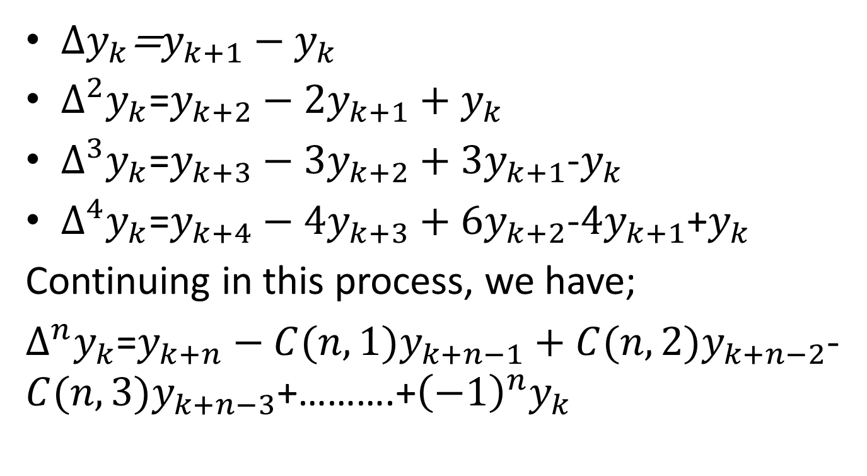
contd
$∆y_{k}$=$y_{k+1}−y_{k}$
$∆^{2}y_{k}$=$y_{k+2}−2y_{k+1}+y_{k}$
$∆^{3}y_{k}$=$y_{k+3}−3y_{k+2}+{3y}_{k+1}$-$y_{k}$
$∆^{4}y_{k}$=$y_{k+4}−4y_{k+3}+{6y}_{k+2}$-${4y}_{k+1}$+$y_{k}$
Continuing in this process, we have;
$∆^{n}y_{k}$=$y_{k+n}−C(n,1)y_{k+n−1}+{C(n,2)y}_{k+n−2}$-${C(n,3)y}_{k+n−3}$+……….+${\left(−1\right)}^{n}y_{k}$

Slide 7
Backward difference operator

Slide 8
Central difference operator

Slide 9
Shifting or displacement or translation operator (E)

Slide 10
Inverse operator (E⁻¹)

Slide 11
Cont’d

Slide 12
Relations between the operators

Slide 13
Cont’d

Slide 14
Cont’d

Slide 15
Cont’d

Slide 16
Forward Difference Table

Slide 17
Backward Difference Table

Slide 18
Cont’d

Slide 19
Example 1

Slide 20
Solution (cont’d)

Slide 21
Example 2

Slide 22
Cont’d

Slide 23
Example 3

Slide 24
Solution (cont’d)

Slide 25
Example 4

Slide 26
Example 4

Slide 27
Example 4

Slide 28
Exercise
1. Estimate the production for 1964 and 1966 from the following data:
Year: 1961 1962 1963 1964 1965 1966 1967
Production: 200 220 260 - 350 - 430
2. Find the missing term in the following
x : 1 2 3 4 5 6 7
y : 2 4 8 - 32 64 128

