Slide 1
Jimma University
Department of sport science
Racket Games /SpSc 2121/
By: Zewge Hailu

Slide 2
Objectives
Explain the world history of racket games.
Describe the rules of tennis, badminton and table tennis.
List and describe the techniques of tennis, badminton and table tennis.
State the benefits of racket games.
Suggest possible strategies to develop racket games in Ethiopia.

Slide 3
Chapter one
  Historical background of Tennis table ,Tennis and Badminton
  A Brief History of table tennis
Table Tennis is a direct descendent of the game of royal tennis. Most historians believe tennis began in the 12th century when French religious played a game they called “jeu de paume” [game of the hand].
The religious would call out “tenez” [Take this! Or Play!] as they hit the ball at their opponent to start the game. The original ball was made of wood and later, the ball was a wad of hair, wool, or cork wrapped in string and cloth or leather

Slide 4
conti
The game was played indoors with players hitting the ball into door jams and other imperfections in the walls strategically trying to outjoke their opponent. The “net” was usually a rope tied across the court five feet high at the sides and drooping to three feet at the middle. The game was played at first with the hand and as time passed gloves were used, and then paddles with webbing, and eventually a handle was added to form a primitive racket.

Slide 5
conti
Through the 18th century, the game was very popular in France with most noblemen and royalty taking to the game. At this time the game was called “royal tennis” or “Real Tennis” and it was played indoors.
The game of tennis as we know it today started in 1850 when Charles Goodyear invented a vulcanization process for rubber and the bouncing ball was invented. People began experimenting by playing the game outdoor on grass. In 1874, Major Walter Clopton Wingfield patented the game “Lawn Tennis” [“Modern Tennis”] and its rules

Slide 6
conti
The original court was an hourglass shape and many of the rules were difficult. Many rule changes took place over the years but by 1882 the court, net, and rules of play had become standardized.

Slide 7
Tennis
Tennis is a racket sport that can be played individually against a single opponent (singles) or between two teams of two players each (doubles). Each player uses a tennis racket that is strung with cord to strike a hollow rubber ball covered with felt over or around a net and into the opponent's court. The object of the game is to play the ball in such a way that the opponent is not able to play a valid return. The player who is unable to return the ball will not gain a point, while the opposite player will.

Slide 8
conti
Tennis is an Olympic sport and is played at all levels of society and at all ages. The sport can be played by anyone who can hold a racket, including wheelchair users. The modern game of tennis originated in Birmingham, England, in the late 19th century as "lawn (grass) tennis”. It had close connections both to various field ("lawn") games such as croquet and bowls as well as to the older racket sport of real tennis
During most of the 19th century, in fact, the term "tennis" referred to real tennis, not lawn tennis

Slide 9
conti
The rules of tennis have changed little since the 1890s. Two exceptions are that from 1908 to 1961 the server had to keep one foot on the ground at all times, and the adoption of the tiebreak in the 1970s. A recent addition to professional tennis has been the adoption of electronic review technology attached with a point challenge system, which allows a player to contest the line call of a point, a system known as Hawk-Eye.

Slide 10
conti
Historians believe that the game's ancient origin lay in 12th century northern France, where a ball was struck with the palm of the hand. Louis X of France was a strong player of "game of the palm", which evolved into real tennis, and became famous as the first person to construct indoor tennis courts in the modern style. Louis was unhappy with playing tennis outdoors and accordingly had indoor, enclosed courts made in Paris "around the end of the 13th century”

Slide 11
conti
It wasn't until the 16th century that rackets came into use, and the game began to be called "tennis", from the French term tenez, which can be translated as "hold!", "receive!" or "take!", an interjection used as a call from the server to his opponent. It was popular in England and France, although the game was only played indoors where the ball could be hit off the wall. Henry was a big follower of this game, which is now known as real tennis

Slide 12
conti
In 1954, Van Alen founded the International Tennis Hall of Fame, a non-profit museum in Newport, Rhode Island. The building contains a large collection of tennis memorabilia as well as a hall of fame honoring prominent members and tennis players from all over the world. Each year, a grass court tournament and an induction ceremony honoring new Hall of Fame members are hosted on its grounds.

Slide 13
Badminton
Badminton is a racquet sport played using racquets to hit a shuttlecock across a net. Although it may be played with larger teams, the most common forms of the game are "singles" (with one player per side) and "doubles" (with two players per side). Badminton is often played as a casual outdoor activity in a yard or on a beach; formal games are played on a rectangular indoor court. Points are scored by striking the shuttlecock with the racquet and landing it within the opposing side's half of the court.

Slide 14
History of badminton
The game of badminton originated in Siam, China over 2,000 years ago. It was brought to England in 1870 and was played somewhat like tennis. After being played in Canada, badminton arrived in America and has been popular since 1929. Since 1992, badminton has been an Olympic sport, with bird speeds reaching

Slide 15
conti
The game developed in British India from the earlier game of battledore and shuttlecock. European play came to be dominated by Denmark but the game has become very popular in Asia, with recent competition dominated by China. Since 1992, badminton has been a Summer Olympic sport with five events: men's singles, women's singles, men's doubles, women's doubles, and mixed doubles. At high levels of play, the sport demands excellent

Slide 16
conti
The Badminton Association of England published these rules in 1893 and officially launched the sport at a house called "Dunbar" in Portsmouth on 13 September. The BAE started the first badminton competition, the All England Open Badminton Championships for gentlemen's doubles, ladies' doubles, and mixed doubles, in 1899. Singles competitions were added in 1900 and an England—Ireland championship match appeared in 1904.

Slide 17
conti
England, Scotland, Wales, Canada, Denmark, France, Ireland, the Netherlands, and New Zealand were the founding members of the International Badminton Federation in 1934, now known as the Badminton World Federation. India joined as an associate in 1936. The BWF now governs international badminton. Although initiated in England, competitive men's badminton has traditionally been dominated in Europe by Denmark. Worldwide, Asian nations have become dominant in international competition. China, Denmark, India, Indonesia, Malaysia, and South Korea are the nations which have consistently produced world-class players in the past few decades, with China being the greatest force in men's and women's competition recently

Slide 18
Con’t….
Rules of Tennis

Slide 19
.
ITF

Slide 20
Rules of Tennis
RULES
RULES
THE COURT
PERMANENT FIXTURES
THE BALL
THE RACKET
SCORE IN A GAME
SCORE IN A SET
SCORE IN A MATCH
SERVER & RECEIVER
CHOICE OF ENDS & SERVICE
CHANGE OF ENDS
BALL IN PLAY
BALL TOUCHES A LINE
BALL TOUCHES A PERMANENT FIXTURE
ORDER OF SERVICE ORDER OF RECEIVING IN DOUBLES
THE SERVICE
SERVING
FOOTFAULT
SERVICE FAULT
SECOND SERVICE
WHEN TO SERVE & RECEIVE
THE LET DURING A SERVICE
THE LET
PLAYER LOSES POINT
A GOOD RETURN
HINDRANCE
CORRECTING ERRORS
ROLE OF COURT OFFICIALS
CONTINUOUS PLAY
COACHING
PLAYER ANALYSIS TECHNOLOGY

Slide 21
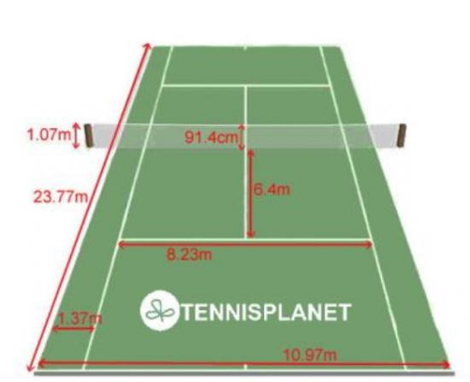
1. The court…

Slide 22
2.PERMANENT FIXTURES
the backstops and side stops,
the spectators, the stands and seats for spectators,
all other fixtures around and above the court,
the chair umpire, line umpires, net umpire and ball persons when in their recognised positions.
In a singles match played with a doubles net and singles sticks, the net posts and the part of the net outside the singles sticks are permanent fixtures and are not considered as net posts or part of the net.
The net dividers separating courts at indoor facilities are considered to be permanent fixtures, irrespective of their distance from the doubles sideline.

Slide 23
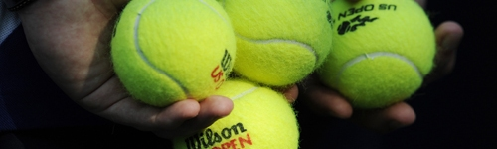
3.Ball
The ball is yellow in color and 56.69 grams in weight.
The event organisers must announce in progress of the event:

Slide 24
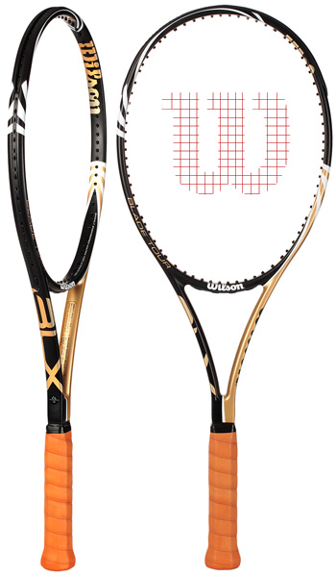
4.Racket
Length: the frame of the tennis racket shall not exceed 29 inches (73.7 cm) in overall length, including the handle.
Width: the frame of the tennis racket shall not exceed 12.5 inches (31.7 cm) in overall width.
Hitting Surface: the hitting surface shall not exceed 15.5 inches (39.4 cm) in overall length and 11.5 inches (29.2 cm) in overall width.

Slide 25
Cont’d…
Case 1: During a point, a player accidentally breaks the strings. Can the player continue to play another point with this racket?
Decision: Yes, except where specifically prohibited by event organisers.
Case 5: Is a player allowed to use more than one racket at any time during play?
Decision: No.

Slide 26
5.SCORE IN GAME
a. Standard game A standard game is scored as follows with the server’s score being called first:
No point - “Love”
First point - “15”
Second point - “30”
Third point - “40” Fourth point - “Game”
b. Tie-break game During a tie-break game, points are scored “Zero”,“1”, “2”, “3”, etc. The first player/team to win seven points wins the “Game” and “Set”, provided there is a margin of two points over the opponent(s). If necessary, the tie-break game shall continue until this margin is achieved.

Slide 27
6. SCORE IN A SET
There are different methods of scoring in a set.
The two main methods are the “Advantage Set” and the “Tie-break Set”. Either method may be used provided that the one to be used is announced in advance of the event. If the “Tie-break Set” method is to be used, it must also be announced whether the final set will be played as a “Tie-break Set” or an “Advantage Set”.
a. “Advantage Set” The first player/team to win six games wins that “Set”, provided there is a margin of two games over the opponent(s). If necessary, the set shall continue until this margin is achieved.
b. “Tie-break Set” The first player/team to win six games wins that “Set”, provided there is a margin of two games over the opponent(s). If the score reaches six games all, a tie-break game shall be played.

Slide 28
Rules cont’d…
7. SCORE IN A MATCH
A match can be played to the best of 3 sets (a player/team needs to win 2 sets to win the match) or to the best of 5 sets (a player/team needs to win 3 sets to win the match).
8. SERVER & RECEIVER
The players/teams shall stand on opposite sides of the net.
The server is the player who puts the ball into play for the first point.
The receiver is the player who is ready to return the ball served by the server.

Slide 29
9. CHOICE OF ENDS & SERVICE
The choice of ends and the choice to be server or receiver in the first game shall be decided by toss before the warm-up starts.
The player/team who wins the toss may choose:
a. To be server or receiver in the first game of the match, in which case the opponent(s) shall choose the end of the court for the first game of the match; or
b. The end of the court for the first game of the match, in which case the opponent(s) shall choose to be server or receiver for the first game of the match; or
c. To require the opponent(s) to make one of the above choices.

Slide 30
10. CHANGE OF ENDS
The players shall change ends at the end of the first, third and every subsequent odd game of each set. The players shall also change ends
at the end of each set unless the total number of games in that set is even, in which case the players change ends at the end of the first game of the next set.
During a tie-break game, players shall change ends after every six points.

Slide 31
Rules cont’d…
11. BALL IN PLAY
Unless a fault or a let is called, the ball is in play from the moment the server hits the ball, and remains in play until the point is decided.
12. BALL TOUCHES A LINE
If a ball touches a line, it is regarded as touching the court bounded by that line.
13. BALL TOUCHES A PERMANENT FIXTURE
If the ball in play touches a permanent fixture after it has hit the correct court, the player who hit the ball wins the point.
If the ball in play touches a permanent fixture before it hits the ground, the player who hit the ball loses the point.

Slide 32
14. ORDER OF SERVICE
At the end of each standard game, the receiver shall become the server and the server shall become the receiver for the next game.
In doubles, the team due to serve in the first game of each set shall decide which player shall serve for that game. Similarly, before the second game starts, their opponents shall decide which player shall serve for that game.
The partner of the player who served in the first game shall serve in the third game and the partner of the player who served in the second game shall serve in the fourth game. This rotation shall continue until the end of the set.

Slide 33
15. ORDER OF RECEIVING IN DOUBLES
The team which is due to receive in the first game of a set shall decide which player shall receive the first point in the game. Similarly, before the second game starts, their opponents shall decide which player shall receive the first point of that game.
The player who was the receiver’s partner for the first point of the game shall receive the second point and this rotation shall continue until the end of the game and the set.
After the receiver has returned the ball, either player in a team can hit the ball.

Slide 34
16. THE SERVICE
Immediately before starting the service motion, the server shall stand at rest with both feet behind (i.e. further from the net than) the baseline and within the imaginary extensions of the centre mark and the sideline.
The server shall then release the ball by hand in any direction and hit the ball with the racket before the ball hits the ground.
The service motion is completed at the moment that the player’s racket hits or misses the ball
. A player who is able to use only one arm may use the racket for the release of the ball.
Note: The Server may use an underhand or overhead service at his discretion.

Slide 35
17. SERVING
When serving in a standard game, the server shall stand behind alternate halves of the court, starting from the right half of the court in every game.
In a tie-break game, the service shall be served from behind alternate halves of the court, with the first served from the right half of the court.
The service shall pass over the net and hit the service court diagonally opposite, before the receiver returns it.

Slide 36
18. FOOT FAULT
During the service motion, the server shall not:
a. Change position by walking or running, although slight movements of the feet are permitted; or
b. Touch the baseline or the court with either foot; or
c. Touch the area outside the imaginary extension of the sideline with either foot; or
d. Touch the imaginary extension of the centre mark with either foot.
Case 1: In a singles match, is the server allowed to serve standing behind the part of the base line between the singles sideline and the doubles sideline?
Decision: No.
Case 2: Is the server allowed to have one or both feet off the ground?
Decision: Yes.

Slide 37
19. SERVICE FAULT
The service is a fault if:
a. The server breaks rules 16, 17 or 18; or
b. The server misses the ball when trying to hit it; or
c. The ball served touches a permanent fixture, singles stick or net post before it hits the ground; or
d. The ball served touches the server or server’s partner,
Case 1: During a singles match played on a court with net posts and singles sticks, the ball served hits a singles stick and then hits the correct service court. Is this a fault?
Decision: Yes.

Slide 38
Rule is cont’d…
20. SECOND SERVICE
If the first service is a fault, the server shall serve again without delay from behind the same half of the court from which that fault was served, unless the service was from the wrong half.
21. WHEN TO SERVE & RECEIVE
The server shall not serve until the receiver is ready. However, the receiver shall play to the reasonable pace of the server and shall be ready to receive within a reasonable time of the server being ready.
A receiver who attempts to return the service shall be considered as being ready. If it is demonstrated that the receiver is not ready, the service cannot be called a fault.

Slide 39
22. THE LET DURING A SERVICE
The service is a let if:
a. The ball served touches the net, strap or band, and is otherwise good; or, after touching the net, strap or band, touches the receiver
or the receiver’s partner or anything they wear or carry before hitting the ground; or
b. The ball is served when the receiver is not ready.
In the case of a service let, that particular service shall not count, and the server shall serve again, but a service let does not cancel a previous fault.

Slide 40
23. THE LET
In all cases when a let is called, except when a service let is called on a second service, the whole point shall be replayed.
Case 1: When the ball is in play, another ball rolls onto court. A let is called. The server had previously served a fault. Is the server now entitled to a first service or second service?
Decision: First service. The whole point must be replayed.

Slide 41
24. PLAYER LOSES POINT
The point is lost if:
The player serves two consecutive faults; or
The player does not return the ball in play before it bounces twice consecutively; or
The player returns the ball in play so that it hits the ground, or before it bounces, an object, outside the correct court; or
The player returns the ball in play so that, before it bounces, it hits a permanent fixture; or
The receiver returns the service before it bounces; or
The player deliberately carries or catches the ball in play on the racket or deliberately touches it with the racket more than once; or/and others

Slide 42
25. A GOOD RETURN
It is a good return if:
a. The ball touches the net, net posts/singles sticks, cord or metal cable, strap or band, provided that it passes over any of them and hits the ground within the correct court; except as provided in Rule 2 and 24 (d); or
b. After the ball in play has hit the ground within the correct court and has spun or been blown back over the net, the player reaches over the net and plays the ball into the correct court, provided that the player does not break Rule 24; or
c. The ball is returned outside the net posts, either above or below the level of the top of the net, even though it touches the net posts, provided that it hits the ground in the correct court; except as provided in Rules 2 and 24 (d); or /and others

Slide 43
26. HINDRANCE
If a player is hindered in playing the point by a deliberate act of the opponent(s), the player shall win the point. However, the point shall be replayed if a player is hindered in playing the point by either an unintentional act of the opponent(s), or something outside the player’s own control (not including a permanent fixture).
Case 3: A ball in play hits a bird flying over the court. Is this a hindrance?
Decision: Yes, the point shall be replayed.

Slide 44
27. CORRECTING ERRORS
As a principle, when an error in respect of the Rules of Tennis is discovered, all points previously played shall stand. Errors so discovered shall be corrected as follows:
a. During a standard game or a tie-break game, if a player serves from the wrong half of the court, this should be corrected as soon as the error is discovered and the server shall serve from the correct half of the court according to the score. A fault that was served before the error was discovered shall stand.
b. During a standard game or a tie-break game, if the players are at the wrong ends of the court, the error should be corrected as soon as it is discovered and the server shall serve from the correct end of the court according to may be used score. And the other correcting other

Slide 45
28 : Officials role
The referee is the final authority on all questions of tennis law and the referee's decision is final.
In matches where a chair umpire is assigned, the chair umpire is the final authority on all questions of fact during the match.
Total 11 officials are needed!

Slide 46
29. CONTINUOUS PLAY
As a principle, play should be continuous, from the time the match starts (when the first service of the match is put in play) until the match finishes.
Between points, a maximum of twenty (20) seconds is allowed.
If, for reasons outside the player’s control, clothing, footwear or necessary equipment (excluding the racket) is broken or needs to be replaced, the player may be allowed reasonable extra time to correct the problem.
No extra time shall be given to allow a player to recover condition. However, a player suffering from a treatable medical condition may be allowed one medical time-out of three minutes for the treatment of that medical condition.

Slide 47
Rules cont’d…
30. COACHING
Coaching is considered to be communication, advice or instruction of any kind and by any means to a player.
31. PLAYER ANALYSIS TECHNOLOGY
The International Tennis Federation shall rule on the question of whether any such equipment is approved, or not approved. Such ruling may be taken on its own initiative or upon application by any party with a bona fide interest therein, including any player, equipment manufacturer or National Association or members thereof. Such rulings and applications shall be made in accordance with the applicable Review and Hearing Procedures of the International Tennis Federation.

Slide 48
2. SKILL AND TECHNIQUES OF TENNIS
2.1 The grip
The Continental Grip (Chopper grip or Hammer grip)
The Semi-Western Forehand Grip
The Double-Handed Forehand Grip
The Eastern Backhand Grip
The Semi-Western Backhand grip
The Double-Handed Backhand Grip

Slide 49
2.3 TENNIS SHOTS
There are six basic shots in the game of tennis, these are:-
serve
forehand
backhand
volley
overhead smash
lob

Slide 50
.
BWF

Slide 51
Con’t
Rules of Badminton

Slide 52
LAWS OF BADMINTON
DEFINITIONS
Player
Any person playing Badminton.
Match
The basic contest in Badminton between opposing sides each of one or two players.
Singles
A match where there is one player on each of the opposing sides.
Doubles
A match where there are two players on each of the opposing sides.
Serving side
The side having the right to serve.
Receiving side
The side opposing the serving side.
Rally
A sequence of one or more strokes starting with the service, until the shuttle ceases to be in play.
Stroke
A movement of the player’s racket with an intention to hit the shuttle.

Slide 53
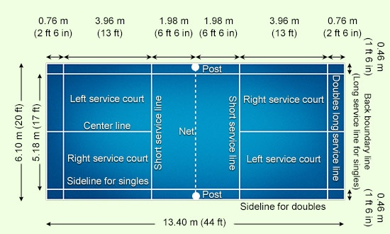
1. COURT AND COURT EQUIPMENT

Slide 54
2. SHUTTLE
2.1 The shuttle shall be made of natural and / or synthetic materials. From whatever material the shuttle is made, the flight characteristics generally shall be similar to those produced by a natural feathered shuttle with a cork base covered by a thin layer of leather.
3 TESTING A SHUTTLE FOR SPEED
3.1 To test a shuttle, a player shall use a full underhand stroke which makes contact with the shuttle over the back boundary line. The shuttle shall be hit at an upward angle and in a direction parallel to the side lines.
3.2 A shuttle of correct speed will land not less than 530 mm and not more than 990 mm short of the other back boundary line

Slide 55
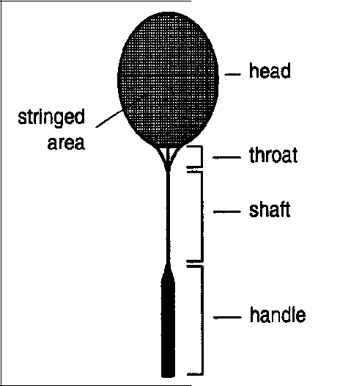
4. RACKET
4.1 The racket shall be a frame not exceeding 680 mm in overall length and 230 mm in overall width consisting of the main parts

Slide 56
5. EQUIPMENT AND COMPLIANCE
5.1 Compliance
The BWF shall rule on any question of whether any racket, shuttle or equipment or any prototype used in the playing of Badminton complies with the specifications. Such ruling may be undertaken on the Federation’s initiative or on application by any party with a bona fide interest, including any player, technical official, equipment manufacturer or Member Association or member thereof.
5.2 Additional equipment for Para-Badminton
For Para-badminton, a wheelchair or a crutch may be used.
5.2.1A player’s body may be fixed to the wheelchair with an elastic belt.
5.2.2A wheelchair may be equipped with supporting wheels, which may extend beyond the main wheel.
5.2.3The player’s feet must be fixed to the footrest of the wheelchair

Slide 57
6.TOSS
6.1 Before play commences, a toss shall be conducted and the side winning the toss shall exercise the choice in either Law 6.1.1 or 6.1.2:
6.1.1 to serve or receive first;
6.1.2 to start play at one end of the court or the other.
6.2 The side losing the toss shall then exercise the remaining choice.

Slide 58
7. SCORING SYSTEM
7.1 A match shall consist of the best of three games, unless otherwise arranged.
7.2 A game shall be won by the side which first scores 21 points, except as provided in Law 7.4 and 7.5.
7.3 The side winning a rally shall add a point to its score. A side shall win a rally, if the opposing side commits a ‘fault’ or the shuttle ceases to be in play because it touches the surface of the court inside the opponent’s court.
7.4 If the score becomes 20-all, the side which gains a two point lead first, shall win that game.
7.5 If the score becomes 29-all, the side scoring the 30th point shall win that game.
7.6 The side winning a game shall serve first in the next game.

Slide 59
8. CHANGE OF ENDS
8.1 Players shall change ends:
8.1.1 at the end of the first game;
8.1.2 at the end of the second game, if there is to be a third game; and
8.1.3 in the third game when a side first scores 11 points.
8.2 If the ends are not changed as indicated in Law 8.1, it shall be done so as soon as the mistake is discovered and when the shuttle is not in play. The existing score shall stand.

Slide 60
9.SERVICE
9.1 In a correct service,
9.1.1 neither side shall cause undue delay to the delivery of the service once the server and the receiver are ready for the service.
9.1.2 on completion of the backward movement of the server’s racket head, any delay in the start of the service (Law 9.2) shall be considered to be an undue delay;
9.1.3 the server and the receiver shall stand within diagonally opposite service courts (Diagram A) without touching the boundary lines of these service courts;
9.1.4 some part of both feet of the server and the receiver shall remain in contact with the surface of the court in a stationary position from the start of the service (Law 9.2) until the service is delivered (Law 9.3);
9.1.5 the server’s racket shall initially hit the base of the shuttle;

Slide 61
Conti….
9.1.6 the whole shuttle shall be below the server’s waist at the instant of being hit by the server’s racket. The waist shall be considered to be an imaginary line round the body, level with the lowest part of the server’s bottom rib
9.1.7 the shaft and the racket head of the server’s racket at the instant of hitting the shuttle shall be pointing in a downward direction;
9.1.8 the movement of the server’s racket shall continue forwards from the start of the service (Law 9.2) until the service is delivered (Law 9.3);
9.1.9 the flight of the shuttle shall be upwards from the server’s racket to pass over the net so that, if not intercepted, it shall land in the receiver’s service court (i.e. on or within the boundary lines); and
9.1.10 in attempting to serve, the server shall not miss the shuttle.

Slide 62
Cont ….
9.2 Once the players are ready for the service, the first forward movement of the server’s racket head shall be the start of the service.
9.3 Once started (Law 9.2), the service is delivered when the shuttle is hit by the server’s racket or, in attempting to serve, the server misses the shuttle.
9.4 The server shall not serve before the receiver is ready. However, the receiver shall be considered to have been ready if a return of the service is attempted.
9.5 In doubles, during the delivery of service (Law 9.2, 9.3), the partners may take up any positions within their respective courts, which do not unsight the opposing server or receiver.

Slide 63
10. SINGLES
10.1 Serving and receiving courts
10.1.1 The players shall serve from, and receive in, their respective right service courts when the server has not scored or has scored an even number of points in that game.
10.1.2 The players shall serve from, and receive in, their respective left service courts when the server has scored an odd number of points in that game.
10.2 Order of play and position on court
10.2.1 In a rally, the shuttle may be hit by the server and the receiver alternately, from any position on that player’s side of the net, until the shuttle ceases to be in play (Law 15).
10.3 Scoring and serving
10.3.1 If the server wins a rally (Law 7.3), the server shall score a point. The server shall then serve again from the alternate service court.
10.3.2 If the receiver wins a rally (Law 7.3), the receiver shall score a point. The receiver shall then become the new server

Slide 64
11. DOUBLES
11.1 Serving and receiving courts
11.1.1 A player of the serving side shall serve from the right service court when the serving side has not scored or has scored an even number of points in that game.
11.1.2 A player of the serving side shall serve from the left service court when the serving side has scored an odd number of points in that game.
11.1.3 The player of the receiving side who served last shall stay in the same service court from where he served last. The reverse pattern shall apply to the receiver’s partner.
11.1.4 The player of the receiving side standing in the diagonally opposite service court to the server shall be the receiver.
11.1.5 The players shall not change their respective service courts until they win a point when their side is serving.
11.1.6 Service in any turn of serving shall be delivered from the service court corresponding to the serving side’s score, except as provided in Law 12

Slide 65
Cont …..
11.2 Order of play and position on court
After the service is returned, in a rally, the shuttle may be hit by either player of the serving side and either player of the receiving side alternately, from any position on that player’s side of the net, until the shuttle ceases to be in play (Law 15).
11.3 Scoring and serving
11.3.1 If the serving side wins a rally (Law 7.3), the serving side shall score a point. The server shall then serve again from the alternate service court.
11.3.2 If the receiving side wins a rally (Law 7.3), the receiving side shall score a point. The receiving side shall then become the new serving side.

Slide 66
Cont …..
11.4 Sequence of serving
In any game, the right to serve shall pass consecutively:
11.4.1 from the initial server who started the game from the right service court
11.4.2 to the partner of the initial receiver.
11.4.3 to the partner of the initial server
11.4.4 to the initial receiver,
11.4.5 to the initial server and so on.
11.5 No player shall serve or receive out of turn, or receive two consecutive services in the same game, except as provided in Law 12.
11.6 Either player of the winning side may serve first in the next game, and either player of the losing side may receive first in the next game.

Slide 67
12. SERVICE COURT ERRORS
12.1 A service court error has been made when a player:
12.1.1 has served or received out of turn; or
12.1.2 has served or received from the wrong service court;
12.2 If a service court error is discovered, the error shall be corrected and the existing score shall stand.

Slide 68
13. FAULTS
It shall be a ‘fault’:
13.1 if a service is not correct (Law 9.1);
13.2 if, in service, the shuttle:
13.2.1 is caught on the net and remains suspended on its top;
13.2.2 after passing over the net, is caught in the net; or
13.2.3 is hit by the receiver’s partner;
13.3 if in play, the shuttle:
13.3.1 lands outside the boundaries of the court (i.e. not on or within the boundary lines);
13.3.2 fails to pass over the net;
13.3.3 touches the ceiling or side walls;
13.3.4 touches the person or dress of a player

Slide 69
Cont ….
13.3.5 touches any other object or person outside the court;
(Where necessary on account of the structure of the building, the local badminton authority may, subject to the right of veto of its Member Association, make bye-laws dealing with cases in which a shuttle touches an obstruction).
13.3.6 is caught and held on the racket and then slung during the execution of a stroke;
13.3.7 is hit twice in succession by the same player. However, a shuttle hitting the head and the stringed area of the racket in one stroke shall not be a ‘fault’;
13.3.8 is hit by a player and the player’s partner successively; or
13.3.9 touches a player’s racket and does not travel towards the opponent’s court;

Slide 70
13.4 if, in play, a player:
13.4.1 touches the net or its supports with racket, person or dress;
13.4.2 invades an opponent’s court over the net with racket or person except that the striker may follow the shuttle over the net with the racket in the course of a stroke after the initial point of contact with the shuttle is on the striker’s side of the net;
13.4.3 invades an opponent’s court under the net with racket or person such that an opponent is obstructed or distracted; or
13.4.4 obstructs an opponent, i.e. prevents an opponent from making a legal stroke where the shuttle is followed over the net;

Slide 71
Cont…..
13.4 if, in play, a player:
13.4.1 touches the net or its supports with racket, person or dress;
13.4.2 invades an opponent’s court over the net with racket or person except that the striker may follow the shuttle over the net with the racket in the course of a stroke after the initial point of contact with the shuttle is on the striker’s side of the net;
13.4.3 invades an opponent’s court under the net with racket or person such that an opponent is obstructed or distracted; or
13.4.4 obstructs an opponent, i.e. prevents an opponent from making a legal stroke where the shuttle is followed over the net;

Slide 72
Cont …..
13.4.5 deliberately distracts an opponent by any action such as shouting or making gestures;
13.4.6 in Wheelchair Badminton
13.4.6.1 at the moment the shuttle is hit no part of the players’ trunk is in contact with the seat of the wheelchair.
13.4.6.2 if the fixation of a foot to the footrest is lost.
13.4.6.3 during play, the player touches the floor with any part of the feet.
13.5 if a player is guilty of flagrant, repeated or persistent offences under Law 16.

Slide 73
14. LETS
14.1 ‘Let’ shall be called by the umpire, or by a player (if there is no umpire), to halt play.
14.2 It shall be a ‘let”, if:
14.2.1 the server serves before the receiver is ready (Law 9.4);
14.2.2 during service, the receiver and the server are both faulted;
14.2.3 after the service is returned, the shuttle is:
14.2.3.1 caught on the net and remains suspended on its top, or
14.2.3.2 after passing over the net is caught in the net;

Slide 74
Cont ….
14.2.4 during play, the shuttle disintegrates and the base completely separates from the rest of the shuttle;
14.2.5 in the opinion of the umpire, play is disrupted or a player of the opposing side is distracted by a coach;
14.2.6 a line judge is unsighted and the umpire is unable to make a decision; or
14.2.7 any unforeseen or accidental situation has occurred.
14.3 When a ‘let’ occurs, play since the last service shall not count and the player who served last shall serve again.

Slide 75
15. SHUTTLE NOT IN PLAY
A shuttle is not in play when:
15.1 it strikes the net or post and starts to fall towards the surface of the court on the striker’s side of the net;
15.2 it hits the surface of the court; or
15.3 a ‘fault’ or a ‘let’ has occurred.

Slide 76
16. CONTINUOUS PLAY, MISCONDUCT & PENALTIES
16.1 Play shall be continuous from the first service until the match is concluded, except as allowed in Laws
16.2 and 16.3, and, for Wheelchair Badminton, 16.5.3.
16.2 Intervals:
16.2.1 not exceeding 60 seconds during each game when the leading score reaches 11 points; and
16.2.2 not exceeding 120 seconds between the first and second game, and between the second and third game shall be allowed in all matches.
(For a televised match, the Referee may decide before the match that intervals as in Law 16.2 are mandatory and of fixed duration).

Slide 77
Cont …….
16.3 Suspension of play
16.3.1 When necessitated by circumstances not within the control of the players, the umpire may suspend play for such a period as the umpire may consider necessary.
16.3.2 Under special circumstances the Referee may instruct the umpire to suspend play. In Para-badminton, repair of additional equipment for Para-badminton (Law 5.2) may be considered a special circumstance.
16.3.3 If play is suspended, the existing score shall stand and play shall be resumed from that point.
16.4 Delay in play
16.4.1 Under no circumstances shall play be delayed to enable a player to recover strength or wind or to receive advice.
16.4.2 The umpire shall be the sole judge of any delay in play.

Slide 78
Cont ….
16.5 Advice and leaving the court
16.5.1 Only when the shuttle is not in play (Law 15), shall a player be permitted to receive advice during a match.
16.5.2 No player shall leave the court during a match without the umpire’s permission, except during the intervals as described in Law 16.2.
16.5.3 In Wheelchair Badminton, a player may be allowed to leave the court for one additional interval during a match in order to catheterize. The player shall be accompanied by any BWF appointed Technical Official.
16.6 A player shall not:
16.6.1 deliberately cause delay in, or suspension of, play;
16.6.2 deliberately modify or damage the shuttle in order to change its speed or its flight;
16.6.3 behave in an offensive manner; or
16.6.4 be guilty of misconduct not otherwise covered by the Laws of Badminton.

Slide 79
Cont …..
16.7 Administration of breach
16.7.1 The umpire shall administer any breach of Law 16.4.1, 16.5.2 or 16.6 by:
16.7.1.1 issuing a warning to the offending side; or
16.7.1.2 faulting the offending side, if previously warned; or
16.7.1.3 faulting the offending side in cases of flagrant offence or breach of Law 16.2.
16.7.2 On faulting a side (Law 16.7.1.2 or 16.7.1.3), the umpire shall report the offending side immediately to the Referee, who shall have the power to disqualify the offending side from the match.

Slide 80
17. OFFICIALS AND APPEALS
17.1 The Referee shall be in overall charge of the tournament or championship(s) of which a match forms part.
17.2 The umpire, where appointed, shall be in charge of the match, the court and its immediate surrounds. The umpire shall report to the Referee.
17.3 The service judge shall call service faults made by the server should they occur (Law 9.1.2 to 9.1.9).
17.4 A line judge shall indicate whether a shuttle landed ‘in’ or ‘out’ on the line(s) assigned.
17.5 An official’s decision shall be final on all points of fact for which that official is responsible except that if,

Slide 81
Cont…
17.5.1 in the opinion of the umpire, it is beyond reasonable doubt that a line judge has clearly made a wrong call, the umpire shall overrule the decision of the line judge.
17.5.2 an Instant Review System is in operation, the Referee shall decide on any line call challenge using the system (Appendix 7).
17.6 An umpire shall:
17.6.1 uphold and enforce the Laws of Badminton and, especially, call a ‘fault’ or a ‘let’ should either occur;
17.6.2 give a decision on any appeal regarding a point of dispute, if made before the next service is delivered;
17.6.3 ensure players and spectators are kept informed of the progress of the match;

Slide 82
Cont …….
17.6.4 appoint or replace line judges or a service judge in consultation with the Referee;
17.6.5 where another technical official is not appointed, arrange for that official’s duties to be carried out;
17.6.6 where an appointed official is unsighted, carry out that official’s duties or play a ‘let’;
17.6.7 record and report to the Referee all matters relating to Law 16; and
17.6.8 refer to the Referee all unsatisfied appeals on questions of law only. (Such appeals must be made before the next service is delivered or, if at the end of the match, before the side that appeals has left the court.)

Slide 83
2.BASIC TECHNIQUES OF BADMINTON
1. Badminton Grip (forehand & Backhand)
2. Badminton Footwork (skipping, shuffling, gliding, lunging and even bouncing)
3. Serving (high, low, flick, drive)
4. Clears (send the shuttle to the back of the court)
5. Drop Shots (force your opponent closer into the forecourt)
6. The Smash (downward shot that comes down steeply into your opponents fore or mid court area)
7. The Drive (If the ball is too low for a smash)
8. Badminton Net Play (done with just a wrist movement)

Slide 84
Con’t
Rules of
Table Tennis

Slide 85
ITTF

Slide 86
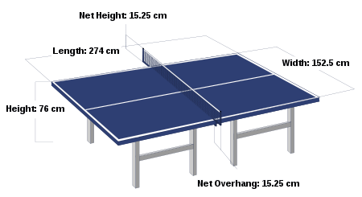
THE RULES OF TABLE TENNIS
1. THE TABLE

Slide 87
2. THE NET ASSEMBLY
2.2.1 The net assembly shall consist of the net, its suspension and the supporting posts, including the clamps attaching them to the table.
2.2.2 The net shall be suspended by a cord attached at each end to an upright post 15.25cm high, the outside limits of the post being 15.25cm outside the side line.
2.2.3 The top of the net, along its whole length, shall be 15.25cm above the playing surface.
2.2.4 The bottom of the net, along its whole length, shall be as close as possible to the playing surface and the ends of the net shall be attached to the supporting posts from top to bottom.

Slide 88
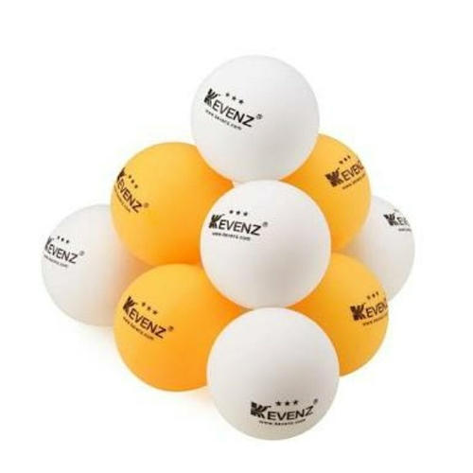
3. THE BALL
2.3.1 The ball shall be spherical, with a diameter of 40mm.
2.3.2 The ball shall weigh 2.7g.
2.3.3 The ball shall be made of celluloid or similar plastics material and shall be white or orange, and matt.

Slide 89
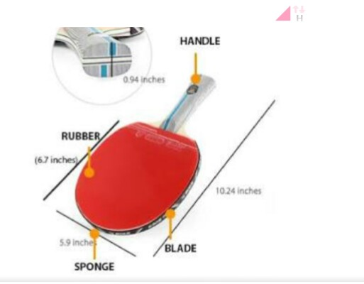
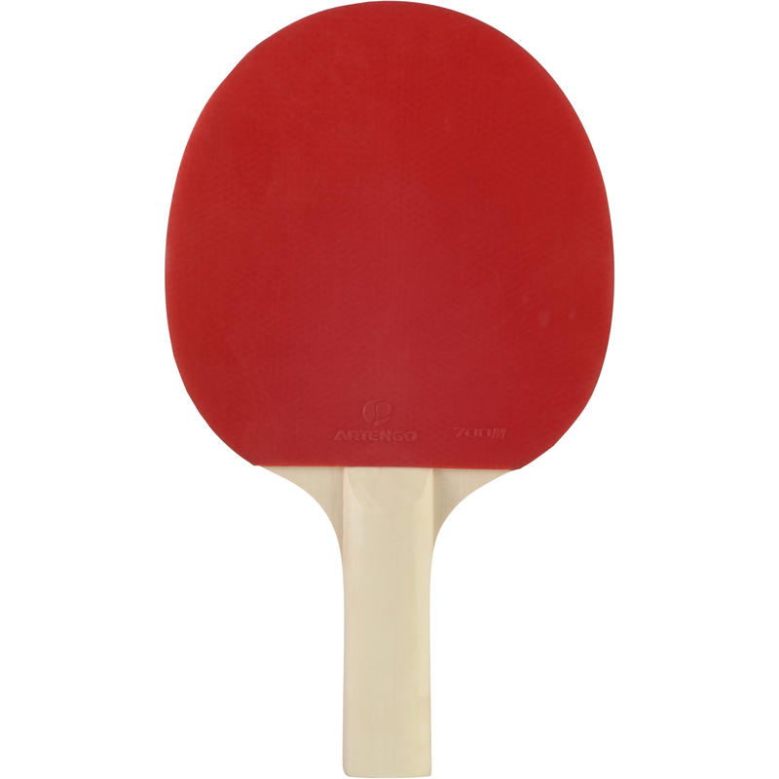
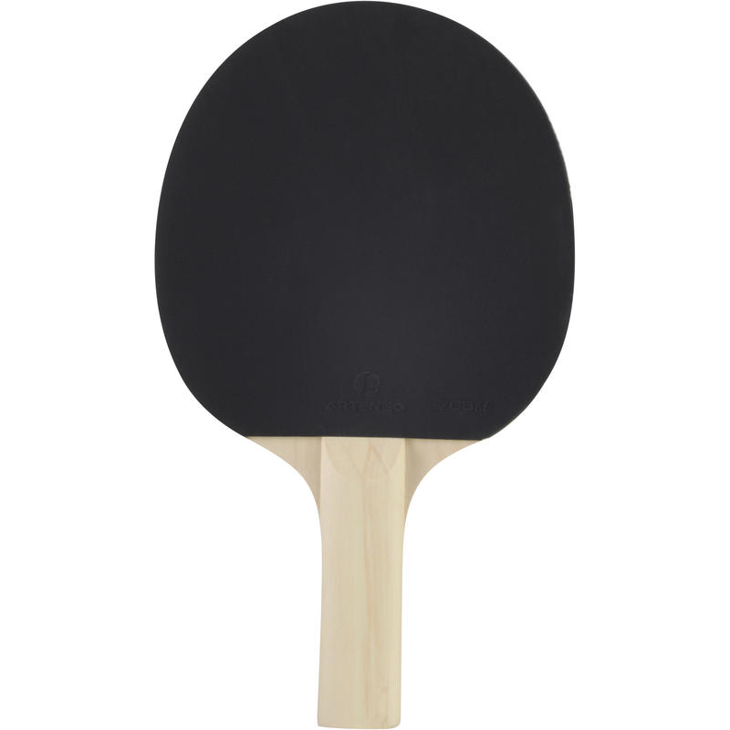
4. THE RACKET

Slide 90
5. DEFINITIONS
2.5.1 A rally is the period during which the ball is in play.
2.5.2 The ball is in play from the last moment at which it is stationary on the palm of the free hand before being intentionally projected in service until the rally is decided as a let or a point.
2.5.3 A let is a rally of which the result is not scored.
2.5.4 A point is a rally of which the result is scored.
2.5.5 The racket hand is the hand carrying the racket.
2.5.6 The free hand is the hand not carrying the racket; the free arm is the arm of the free hand.

Slide 91
Cont …
2.5.7 A player strikes the ball if he or she touches it in play with his or her racket, held in the hand, or with his or her racket hand below the wrist.
2.5.8 A player obstructs the ball if he or she, or anything he or she wears or carries, touches it in play when it is above or travelling towards the playing surface, not having touched his or her court since last being struck by his or her opponent.
2.5.9 The server is the player due to strike the ball first in a rally.
2.5.10 The receiver is the player due to strike the ball second in a rally.

Slide 92
Cont …..
2.5.11 The umpire is the person appointed to control a match.
2.5.12 The assistant umpire is the person appointed to assist the umpire with certain decisions.
2.5.13 Anything that a player wears or carries includes anything that he or she was wearing or carrying, other than the ball, at the start of the rally.
2.5.14 The end line shall be regarded as extending indefinitely in both directions.

Slide 93
2.6 THE SERVICE
2.6.1 Service shall start with the ball resting freely on the open palm of the server's stationary free hand.
2.6.2 The server shall then project the ball near vertically upwards, without imparting
spin, so that it rises at least 16cm after leaving the palm of the free hand and then falls without touching anything before being struck.
2.6.3 As the ball is falling the server shall strike it so that it touches first his or her court and then touches directly the receiver's court; in doubles, the ball shall touch successively the right half court of server and receiver.

Slide 94
Cont …
2.6.4 From the start of service until it is struck, the ball shall be above the level of the playing surface and behind the server's end line, and it shall not be hidden from the receiver by the server or his or her doubles partner or by anything they wear or carry.
2.6.5 As soon as the ball has been projected, the server’s free arm and hand shall be removed from the space between the ball and the net. The space between the ball and the net is defined by the ball, the net and its indefinite upward extension.
2.6.6 It is the responsibility of the player to serve so that the umpire or the assistant umpire can be satisfied that he or she complies with the requirements of the Laws, and either may decide that a service is incorrect.

Slide 95
2.6.6.1 If either the umpire or the assistant umpire is not sure about the legality of a service he or she may, on the first occasion in a match, interrupt play and warn the server; but any subsequent service by that player or his or her doubles partner which is not clearly legal shall be considered incorrect.
2.6.7 Exceptionally, the umpire may relax the requirements for a correct service where he or she is satisfied that compliance is prevented by physical disability.
2.7 THE RETURN
2.7.1 The ball, having been served or returned, shall be struck so that it touches the opponent's court, either directly or after touching the net assembly.

Slide 96
2.8 THE ORDER OF PLAY
2.8.1 In singles, the server shall first make a service, the receiver shall then make a return and thereafter server and receiver alternately shall each make a return.
2.8.2 In doubles, except as provided in 2.8.3, the server shall first make a service, the receiver shall then make a return, the partner of the server shall then make a return, the partner of the receiver shall then make a return and thereafter each player in turn in that sequence shall make a return.
2.8.3 In doubles, when at least one player of a pair is in a wheelchair due to a physical disability, the server shall first make a service, the receiver shall then make a return but thereafter either player of the disabled pair may make returns.

Slide 97
2.9 A LET
2.9.1 The rally shall be a let:
2.9.1.1 If in service the ball touches the net assembly, provided the service is otherwise correct or the ball is obstructed by the receiver or his or her partner;
2.9.1.2 If the service is delivered when the receiving player or pair is not ready, provided that neither the receiver nor his or her partner attempts to strike the ball;
2.9.1.3 If failure to make a service or a return or otherwise to comply with the Laws is due to a disturbance outside the control of the player;
2.9.1.4 If play is interrupted by the umpire or assistant umpire;
2.9.1.5 If the receiver is in wheelchair owing to a physical disability and in service the ball, provided that the service is otherwise correct,

Slide 98
Cont ….
2.9.1.5.1 After touching the receiver’s court returns in the direction of the net;
2.9.1.5.2 comes to rest on the receiver's court;
2.9.1.5.3 In singles leaves the receiver’s court after touching it by either of its sidelines.
2.9.2 Play may be interrupted
2.9.2.1 To correct an error in the order of serving, receiving or ends;
2.9.2.2 To introduce the expedite system;
2.9.2.3 To warn or penalize a player or adviser;
2.9.2.4 Because the conditions of play are disturbed in a way which could affect the outcome of the rally.

Slide 99
2.10 A POINT
2.10.1 Unless the rally is a let, a player shall score a point
2.10.1.1 If an opponent fails to make a correct service;
2.10.1.2 If an opponent fails to make a correct return;
2.10.1.3 If, after he or she has made a service or a return, the ball touches anything other than the net assembly before being struck by an opponent;
2.10.1.4 if the ball passes over his or her court or beyond his or her end line without touching his or her court, after being struck by an opponent;
2.10.1.5 if the ball, after being struck by an opponent, passes through the net or between the net and the net post or between the net and playing surface;

Slide 100
Cont ….
2.10.1.6 If an opponent obstructs the ball;
2.10.1.7 If an opponent deliberately strikes the ball twice in succession;
2.10.1.8 If an opponent strikes the ball with a side of the racket blade whose surface does not comply with the requirements of 2.4.3, 2.4.4 and 2.4.5;
2.10.1.9 If an opponent, or anything an opponent wears or carries, moves the playing surface;
2.10.1.10 if an opponent, or anything an opponent wears or carries, touches the net assembly;
2.10.1.11 if an opponent's free hand touches the playing surface;

Slide 101
Cont ….
2.10.1.12 if a doubles opponent strikes the ball out of the sequence established by the first server and first receiver;
2.10.1.13 as provided under the expedite system (2.15.4).
2.10.1.14 if both players or pairs are in a wheelchair due to a physical disability and
2.10.1.14.1 his or her opponent does not maintain a minimum contact with the seat or cushion(s), with the back of the thigh, when the ball is struck;
2.10.1.14.2 his or her opponent touches the table with either hand before striking the ball;
2.10.1.14.3 his or her opponent’s footrest or foot touches the floor during play.
2.10.1.15 if, where an opposing doubles pair includes at least one player in a wheelchair, any part of the wheelchair or a foot of a standing player crosses an imaginary extension of the centre line of the table

Slide 102
2.11 A GAME
2.11.1 A game shall be won by the player or pair first scoring 11 points unless both players or pairs score 10 points, when the game shall be won by the first player or pair subsequently gaining a lead of 2 points.
2.12 A MATCH
2.12.1 A match shall consist of the best of any odd number of games.

Slide 103
2.13 THE ORDER OF SERVING, RECEIVING AND ENDS
2.13.1 The right to choose the initial order of serving, receiving and ends shall be decided by lot and the winner may choose to serve or to receive first or to start at a particular end.
2.13.2 When one player or pair has chosen to serve or to receive first or to start at a particular end, the other player or pair shall have the other choice.
2.13.3 After each 2 points have been scored the receiving player or pair shall become the serving player or pair and so on until the end of the game, unless both players or pairs score 10 points or the expedite system is in operation, when the sequences of serving and receiving shall be the same but each player shall serve for only 1 point in turn.

Slide 104
Cont …
2.13.4 In each game of a doubles match, the pair having the right to serve first shall choose which of them will do so and in the first game of a match the receiving pair shall decide which of them will receive first; in subsequent games of the match, the first server having been chosen, the first receiver shall be the player who served to him or her in the preceding game.
2.13.5 In doubles, at each change of service the previous receiver shall become the server and the partner of the previous server shall become the receiver.
2.13.6 The player or pair serving first in a game shall receive first in the next game of the match and in the last possible game of a doubles match the pair due to receive next shall change their order of receiving when first one pair scores 5 points.
2.13.7 The player or pair starting at one end in a game shall start at the other end in the next game of the match and in the last possible game of a match the players or pairs shall change ends when first one player or pair scores 5 points.

Slide 105
2.14 OUT OF ORDER OF SERVING, RECEIVING OR ENDS
2.14.1 If a player serves or receives out of turn, play shall be interrupted by the umpire as soon as the error is discovered and shall resume with those players serving and receiving who should be server and receiver respectively at the score that has been reached, according to the sequence established at the beginning of the match and, in doubles, to the order of serving chosen by the pair having the right to serve first in the game during which the error is discovered.

Slide 106
Cont …..
2.14.2 If the players have not changed ends when they should have done so, play shall be interrupted by the umpire as soon as the error is discovered and shall resume with the players at the ends at which they should be at the score that has been reached, according to the sequence established at the beginning of the match.
2.14.3 In any circumstances, all points scored before the discovery of an error shall be reckoned.

Slide 107
2.15 THE EXPEDITE SYSTEM
2.15.1 Except as provided in 2.15.2, the expedite system shall come into operation after 10 minutes’ play in a game or at any time when requested by both players or pairs.
2.15.2 The expedite system shall not be introduced in a game if at least 18 points have been scored.
2.15.3 If the ball is in play when the time limit is reached and the expedite system is due to come into operation, play shall be interrupted by the umpire and shall resume with service by the player who served in the rally that was interrupted;

Slide 108
Cont …..
if the ball is not in play when the expedite system comes into operation, play shall resume with service by the player who received in the immediately preceding rally.
2.15.4 Thereafter, each player shall serve for 1 point in turn until the end of the game, and if the receiving player or pair makes 13 correct returns in a rally the receiver shall score a point.
2.15.5 Introduction of the expedite system shall not alter the order of serving and receiving in the match, as defined in 2.13.6.
2.15.6 Once introduced, the expedite system shall remain in operation until the end of the match.

Slide 109
THE TECHNIQUES OF TABLE TENNIS
Grips (pen hold, shake hand)
STROCKES
4.1 Offensive strokes
4.1.1 Speed drive(the racket is primarily perpendicular to the direction of the stroke)
4.1.2 Loop (racket is much more parallel to the direction of the stroke)
4.1.3 Counter-drive (high loop drives immediately after hitting the table)
4.1.4 Flip (to attack a ball that has not bounced beyond the edge of the table)
4.1.5 Smash (a ball that bounces too high or too close to the net)

Slide 110
.
4.2 Defensive strokes
4.2.1 Push (used for keeping the point alive and creating offensive opportunities)
4.2.2 Chop(a bigger, heavier push, taken well back from the table)
4.2.3 Block (executed by simply placing the racket in front of the ball right after the ball bounces)
4.2.4 Lob (simply lifting the ball to an enormous height before it falls back to the opponent's side of the table)

Slide 111
.
Spin
5.1 Effects of spin (Adding spin onto the ball causes major changes in table tennis game play)
5.2 Types of spin
5.2.1 Backspin (imparted by striking the base of the ball with a downward movement)
5.2.2 Topspin (performed from top of the ball)
5.2.3 Sidespin (predominantly employed during service)
5.2.4 Cork spin (almost exclusively employed in service)

