Slide 1
Human resource management
Chapter one

Slide 2
Why is human resource important?
Affects the quality of goods and service produced
Is the driving force in organizational life cycle
is responsible for managing other resources of an organization
Prerequisite for organizational learning
Employees are scarce resources that should be acquired effectively, utilized, developed and retained.
Provides an organization with competitive advantage
Notes:
Without HR creativity, innovation, teamwork, and high-performance which will withstand pressure from competitors
An employee is a rare resource, immutable, non-substitutable, and valuable

Slide 3
Definition of human resource management
Human resource management refers to the management of an organization’s most valued assets – the people working there who individually and collectively contribute to the achievement of its objectives.
Human Resource Management is the process of achieving organizational goal by attracting, developing, and retaining and properly using talented human resource.
Human resource management can be defined as a strategic, integrated and coherent approach to the employment, development and well-being of the people working in organizations.
Is about having the best human resources who are best utilized to produce cheaper and better quality goods and services
The process of managing human talent to achieve an organization’s objectives

Slide 4
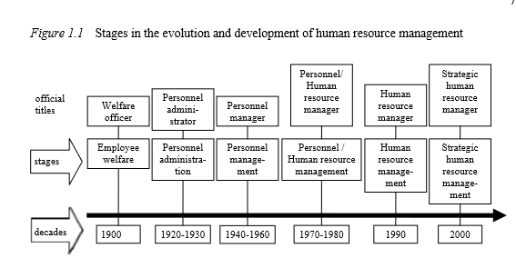
Evolution of human resource management

Slide 5
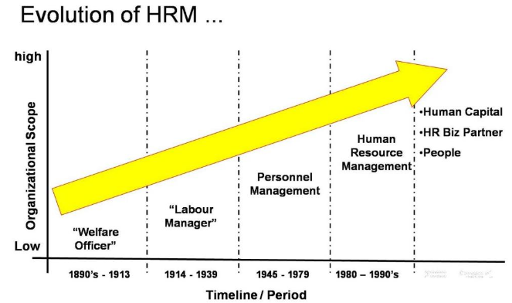
Evolution of human resource management
Notes:
Personnel management – HRM-Human capital management –People management

Slide 6
Recap questions
What does human resource management means?
Do you think human resource management is more important than other resources? Why?

Slide 7
….Evolution of human resource management
Personnel management | Human resource management
Short term ,routine, reactive | Strategic, proactive
Compliance | Commitment
Pluralist, collective, low trust | Unitarist, individual, high trust
Bureaucratic | Organic
Activity based | Solution based
Internally focused | Externally focused
Specialized/professional | Largely integrated into line management
Cost minimization , human’s are seen as liabilities | Maximum utilization (human asset)

Slide 8
Philosophies of human resource management
Human resource management is and has to be owned and driven by the top management in the interests of the key stakeholders. the top management owns and drives the agenda for effective people management in an organization.
Business or organizational strategies form the basis for human resource strategies, and there should be a strategic fit.
Investment in people, like any other capital investment, is necessary for better returns in the future.
Employees are capable of producing added value. It is the role of the management to obtain such added value through human resource development and performance management systems.
Organizational success comes from the employees’ total commitment to the organizational mission, goals, objectives, and values.
Building a strong organizational culture that gives managers an advantage in stimulating employees’ commitment through effective communication, training, coaching, mentoring and performance management processes

Slide 9
Objective of human resource management
The overall objective of human resource management is to ensure organizational success through people.
ensure that the organization has competent people it needs
support the organization achieve its goal
contribute to the development of high-performance culture
create a positive employment relationship between management and employees
encourage the application of an ethical approach to manage human resource.

Slide 10
Major HRM functions
Procurement functions
  focus on availing the right type and number of employees required for achieving organizational goals.
Development functions
  Focus on enhancing knowledge , skill and values of employees to perform their current and future responsibilities competently.
Integration functions
  Focuses on reconciling organizational goals with individual goals.
Maintenance functions
  Focuses on maintaining physical and mental health of employees.

Slide 11
Procurement functions
Job analysis- is the process of obtaining information about jobs by determining their duties, tasks, or activities, skills and qualifications needed to perform it successfully
Human resource planning- is the process by which an organisation attempts to ensure that it has the right number of qualified people in the right jobs at the right time.

Slide 12
…Procurement functions
Employee recruitment and selection
  Recruitment - is the process of seeking and attracting a pool of applicants from which qualified candidates for job vacancies within an organisation can be selected.
  Employee selection- involves choosing from the available candidates the individual predicted to be most likely to perform successfully in the job.
  Placement- on the other hand, is the assignment of an employee to a new or different job.
  Orientation- is the formal process of familiarizing new employees with the organization, their jobs, their work units and employees.

Slide 13
Development functions
Career development – involves Planning careers and managing individuals careers.
Training and development- activities help employees learn how to perform their jobs, improve their performance and prepare themselves for more senior positions.
Performance appraisal- is concerned with determining how well employees are doing their jobs, communicating that information to the employees and establishing a plan for performance improvement.

Slide 14
Integration functions
Employee disciplining
Compensation refers to all types of rewards that employees receive in return for their services.

Slide 15
Maintenance functions
Safety- involves protecting employees from injuries caused by work-related accidents.
Health- devising schemes that enhance employees' physical and mental well being.
Creating conducive working environment
Promoting smooth working relationship between management and employees

Slide 16
Strategic importance of human resource management
If managed strategically HRM can bring organizational excellence through:-
  Becoming partner with top and line managers of an organization in strategy execution
  Organizing work efficiently to ensure costs are reduced without compromising quality
  Becoming representative of employees by representing employees concern to top management and by working on ways to increase employee commitment.
  Become an agent of continuous change by shaping process and organizational culture.

Slide 17
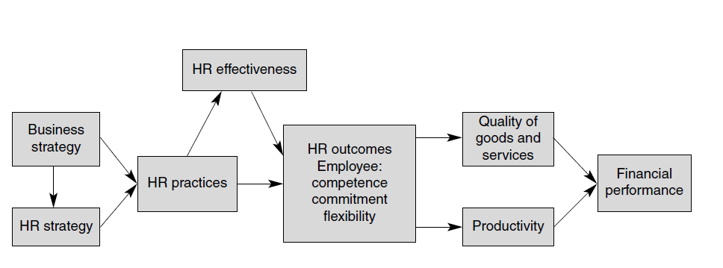
The link between HRM and firm performance

Slide 18
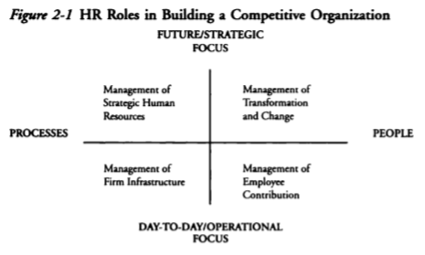
HRM Role in delivering result( Dave Ulrich model)
Notes:
The two axes represent focus and activity

Slide 19
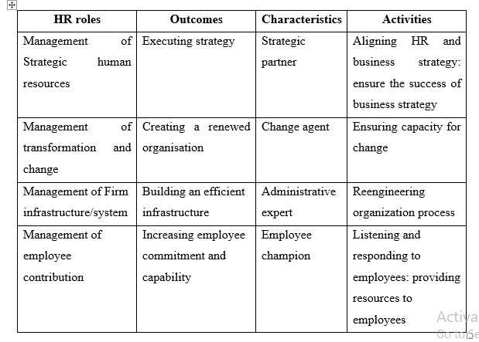
Definition of HR roles
Notes:
Administrative cost minimization and efficiency

Slide 20
….HRM Role in delivering result
The strategic HR role
  Focuses on aligning HR strategies and practices with business strategy.
  Requires to conduct organizational diagnosis to identify the strength and weakness of organizations.

Slide 21
….HRM Role in delivering result
Management of firm infrastructure role
  Focuses on designing and delivering efficient HR process for attracting, retaining , developing, promoting, appraising and other HR process to ensure administrative efficiency.
  Administrative efficiency comes from continues improvement of HR processes and from ensuring HR professional’s have the right competency.

Slide 22
….HRM Role in delivering result
Management of employee contribution role
  Encompasses involvement in the day to day problems, concerns and needs of employees.
  Required understanding employees needs and working to met those needs in order to increase employees contributions.
  Focuses on developing employees competences to deliver results.

Slide 23
….HRM Role in delivering result
Management of transformation and change role
  HR professionals are expected to play cultural guardian's and cultural catalyst role.
  Help employees let go of the past way of doing things and adapt to the new way of doing things.
  Ensure the change occurs as intended by defining value and behavioral requirements of the change.

Slide 24
Reading assignment
Read models of human resource management (Armstrong human resource management practice page 4-8)

Slide 25
The Michigan/Matching Model
Emphasizes more on “tight fit” between the HR strategy and the business strategy.
Business strategy is the main focus
Human resources are taken like any other resource which must be fully utilized together with the other resources to achieve organizational objectives.
This model emphasizes more on the hard side of HRM
HR systems and the organization structure should be managed in a way that is congruent with organizational strategy

Slide 26
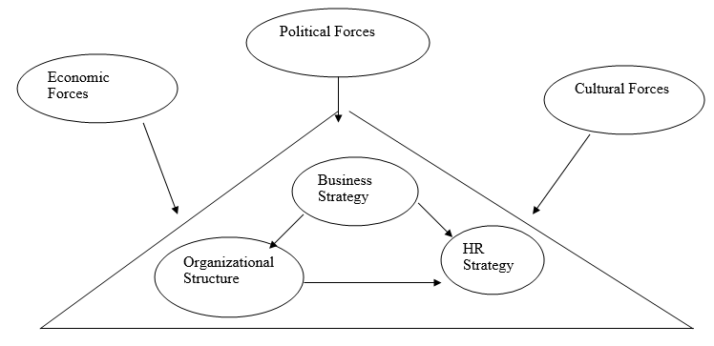
The Michigan/Matching Model

Slide 27
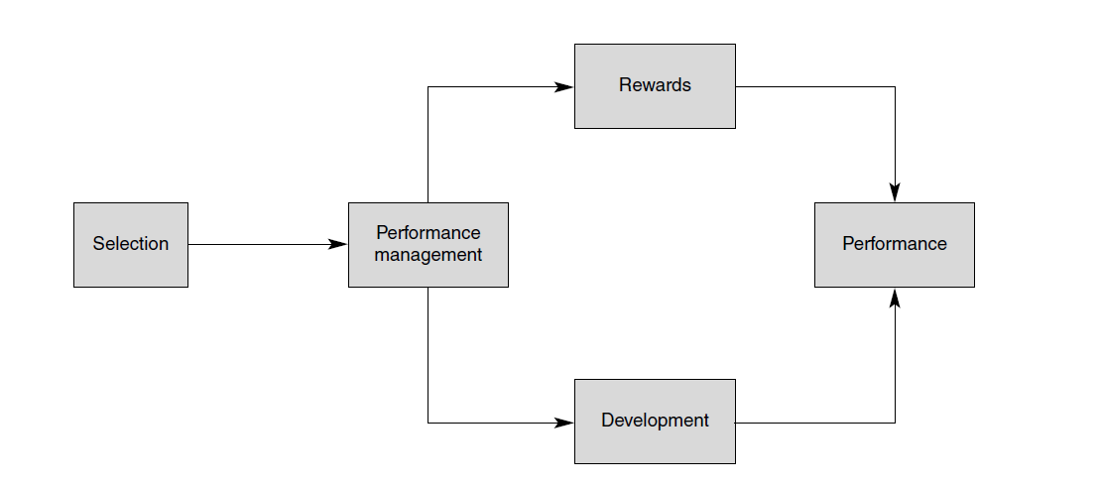
The human resource cycle

Slide 28
Harvard model of HRM
The Harvard model acknowledges the existence of multiple stakeholders within the organization.
  shareholders
  management
  employees,
  government and
  the community at large
interest of the various groups must be fused and factored in the creation of HRM strategies and ultimately the creation of business strategies.
This model emphasizes more on the human/soft side of HRM
Emphasizes the importance of employees like any other stakeholder in influencing organizational outcomes.

Slide 29
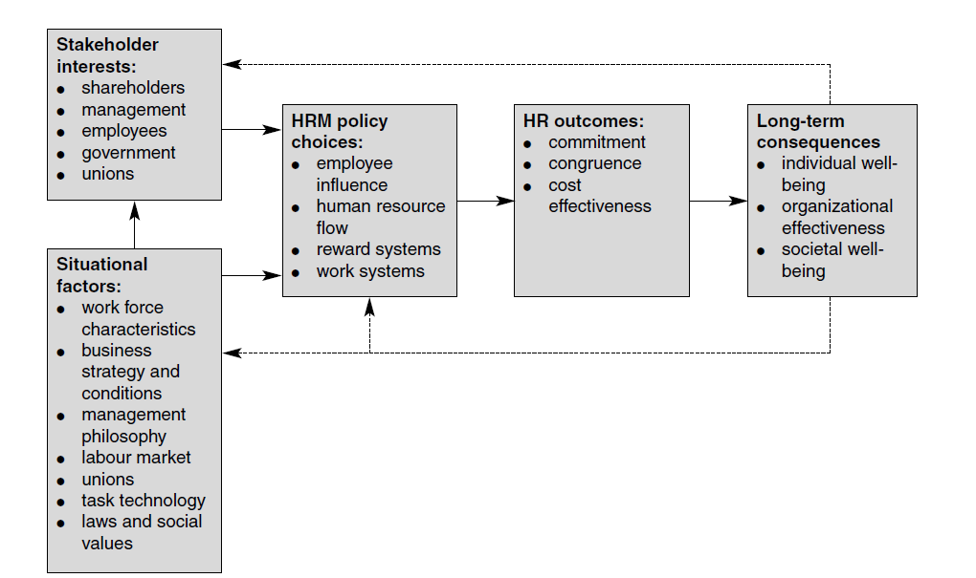
The Harvard Framework

Slide 30
Characteristics of HRM in Harvard Framework
Line managers accept more responsibility for ensuring the alignment of competitive strategy and HRM policy
HRM has the mission of setting policies that govern how HR activities are developed and implemented in ways that make them more mutually reinforcing
HRM is the concern of management in general rather than the HRM function in particular.

Slide 31
Guest model of HRM
This model is a fusion of hard and a soft approach of HRM.
Guest proposes 4 crucial components that underpin organizational effectiveness.
Strategic Integration
This is the ability of organizations to maintain a fit between the HRM strategy and the business strategy. In other words, there must be congruence between business strategy and the HR strategy for the organization to achieve its goals.

Slide 32
Guest model of HRM
Flexibility
the ability of the organization and its people to adapt to the changing business and work environment.
High Commitment
attitudinal commitment- which is reflected through a strong identification with the organization.
behavioral commitment- the ability to go an extra mile, and
Quality
Quality is based on the assumption that provision of high quality goods and services results from a quality way of managing people.

