Slide 1
Job analysis and design
Chapter three

Slide 2
Job Analysis Terminologies
Job: a group of tasks, duties and responsibilities that need to be performed to achieve the organization’s goal.
Duty: a larger work segments composed of several tasks performed by an individual.
Task: is the smallest units of analysis or identifiable work activities composed of motions.
Position: a collection of task ,duties and responsibilities performed by one person.
Job title: brief description of a job, it also Indicate the relative level of the jobholder

Slide 3
Reflection
In a work unit/department consisting of a department head, two senior analysts, one secretary what are the numbers of jobs and work positions?

Slide 4
Job Analysis Terminologies…
Note:
Job may require a service of one or more person
Example:
Human resource manager service of one person
Human resource expert service of more than one person
Position require the service of only one person

Slide 5
Definition of job analysis
Systematic process of determining Duties, Skills, & Knowledge required for performing a job.
Job analysis is the process of determining the work activities and requirements,
systematic process of collecting information about all of the parameters of a job:
  basic responsibilities,
  Required behaviors,
  skills, and
  the physical and mental requirements of the people who do it.

Slide 6
When to conduct Job Analysis
During establishment of organizations
when new jobs are created
when jobs are changed significantly

Slide 7
Who performs job analysis
HRM department
Manager
External consultant

Slide 8
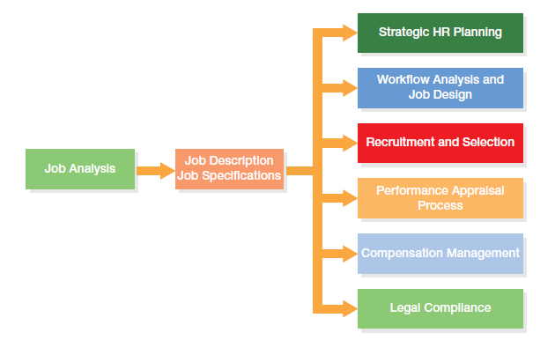
Job analysis is the foundation of all HRM activities

Slide 9
Source of data for job analysis
Jobholder
Immediate supervisor/manager
Diaries- Jobholders will record information about their job for some specific period.
Secondary data (old job description, specifications, Films of workers on the job, reports etc…)

Slide 10
job analysis Methods
Questionnaire
Structured questionnaires given to employees to be filled by both jobholder and immediate supervisor.
Saves time and is economical
  However, employees might exaggerate the significance of their tasks

Slide 11
job analysis Methods
Observation
Job analyst learn about the job by observing the jobholder at action
Used primarily to gather information on jobs emphasizing manual skills
Often insufficient when used alone
Difficult when mental skills are dominant in a job
Notes:
Job analysts use the observation method to watch the worker perform job tasks and records their observations.
This method is used primarily for jobs emphasizing manual skills, although it can help identify interrelationships between physical and mental tasks. Observation alone is not sufficient for conducting job analyses where mental skills are dominant.

Slide 12
job analysis Methods
Diaries
Jobholders will record information about their job for some specific period.
Employees describe daily work activities in diary or log
Valuable in understanding highly specialized jobs
Problem: Employees might exaggerate job importance
Notes:
Sometimes, job analysis information is gathered by having employees describe their daily work activities in a diary or log.
This recording method helps resolve the problem of employees exaggerating job importance and gives valuable insight into highly specialized jobs, such as that of a recreational therapist.

Slide 13
job analysis Methods
Interview
Interview both employee and supervisor
Interview employee first, helping him or her describe duties performed
After interviews, analyst normally contacts supervisor for additional information
Notes:
Sometimes, job analysis information is gathered by having employees describe their daily work activities in a diary or log.
This recording method helps resolve the problem of employees exaggerating job importance and gives valuable insight into highly specialized jobs, such as that of a recreational therapist.

Slide 14
How to ensure data correctness
check with immediate supervisor/manager
Ask more than one employee

Slide 15
Job descriptions and specifications
A job description- is a written statement about the overall tasks, duties, and responsibilities of a job. ..\sample JD.docx..\
A job specification- is incorporated into the job description document and spells out the minimum acceptable qualifications a person needs to perform a particular job.

Slide 16
Content of Job descriptions
Need to be clear and specific ,to give direction for the jobholder
Job Identification – Job title, department, reporting relationship, date analyzed and job number or code
Job Statement – Brief listing of major job duties or Job summary or concise overview of a job
Essential functions– Essential functions and responsibilities of a job holder or major duties of a job
Job specification– job specifications, skills, knowledge and attitude requirements

Slide 17
Steps in job analysis
Identify the scope of the analysis
Review relevant background information such as organizational chart, process chart and old job descriptions in order to understand the general context of the job
Select benchmarking jobs
Identify source of data and data collection method

Slide 18
Steps in job analysis…
Analyze the job
Verify the job analysis information with the worker and immediate supervisor.
Develop the job description and job specification.

Slide 19
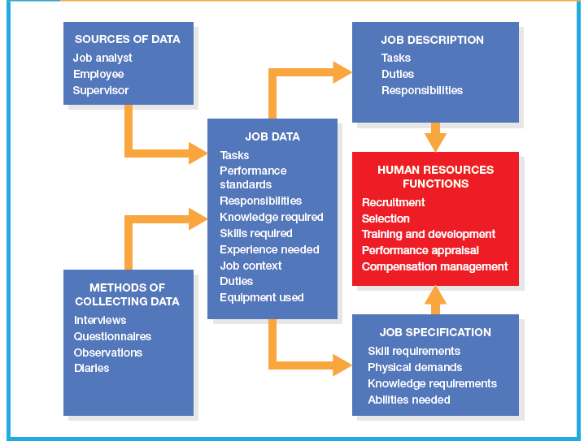
Process of Job Analysis

Slide 20
Reading assignment
Read about Job design Scott, S. A. & Bohlander , G. W., 2012. Managing human resource.

Slide 21
Job design
An outgrowth of job analysis that improves jobs through technological and human considerations in order to enhance organization efficiency and employee job satisfaction.
Job design specifies the contents, methods and relationships of jobs in order to satisfy work requirements for productivity, efficiency and quality, meet the personal needs of the job holder and thus increase levels of employee engagement.
Is about determine the optimal way in which a job should be performed.

Slide 22
Major elements of Job design
Aligning jobs with organizational objectives
Consideration of Technological to increase job efficiency
Ergonomics concerns- which refers to the process of studying and designing equipment and systems that are easy and efficient for people to use and that ensure their physical well-being.
Behavioral concerns that influence an employee’s job satisfaction.

Slide 23
Job design theory
Scientific management theory
focused on the belief that making people work as hard as they could was not as efficient as optimizing the way the work was done.
Job characteristics model
A job design theory that significances that three psychological states (experiencing meaningfulness of the work performed, responsibility for work outcomes, and knowledge of the results of the work performed) of a jobholder result in improved work performance, internal motivation, and lower absenteeism and turnover.

Slide 24
job characteristics that lead to three psychological states are:
Skill variety: The degree to which a job entails a variety of different activities, which demand the use of a number of different skills and talents by the jobholder
Task identity: The degree to which the job requires completion of a whole and identifiable piece of work, that is, doing a job from beginning to end with a visible outcome
Task significance: The degree to which the job has a substantial impact on the lives or work of other people, whether in the immediate organization or in the external environment

Slide 25
The five job characteristics that lead to three psychological states are:
Autonomy: The degree to which the job provides substantial freedom, independence, and discretion to the individual in scheduling the work and in determining the procedures to be used in carrying it out
Feedback: The degree to which carrying out the work activities required by the job results in the individual being given direct and clear information about the effectiveness of his or her performance

Slide 26
Job design techniques
Job enlargement
The process of adding a greater variety of tasks to a job. Horizontal expansion.
Job rotation
The process whereby employees rotate in and out of different jobs.
job enrichment
Enhancing a job by adding more meaningful tasks and duties to make the work more rewarding or satisfying. Vertical expansion.
Employee empowerment
Granting employees power to initiate change, thereby encouraging them to take charge of what they do

Slide 27
Empowering employees through:
1. Participation
2. Innovation: encouraging people to explore new paths
3. Access to information
4. Accountability

Slide 28
Job design techniques
job crafting
A naturally occurring phenomenon whereby employees mold their tasks to fit
their individual strengths, passions, and motives better
Dejobbing
refers to a process of structuring organizations not around jobs but around
projects that are constantly changing.

Slide 29
work schedules and conditions
Flexible work schedules
Flextime - give employees the option to choose daily starting and finishing
time provided that they work a set number of hours per day or
week.
Compressed Workweek -the number of days in the workweek is shortened by
lengthening the number of hours worked per day.

Slide 30
work schedules and conditions
Working conditions
Job Sharing - an arrangement to share a job between employees.
telecommuting
Use of personal computers, networks, and other communications technology such as fax machines to do work in the home that is traditionally done in the workplace.

Slide 31
Discussion
Discuss advantages of Telecommuting.

