Slide 1
Chapter FOUR
HUMAN RESOURCE PLANNING

Slide 2
Human Resource Planning
Definition
HRP is the process of reviewing HR requirement to ensure that the required number and type of employees are available when they are needed.
HRP is the process of analyzing an organization’s human resource needs and developing plans, policies, and systems to satisfy those needs.
HRP is the process of anticipating and providing for the movement of people into, within, and out of an organization.

Slide 3
Human Resource Planning
Definition of HRP
HRP is a process used to determine what and how many position have the firm to fill and how to fill them
HRP is an activity that managers engage in to forecasting their current and future needs of human resources.

Slide 4
Hard and soft human resource planning
Hard Human resource planning is based on quantitative analysis in order to ensure that the right number of the right sort of people are available when needed.
Soft human resource planning is concerned with ensuring the availability of people with the right type of attitudes and motivation who are committed to the organization and engaged in their work, and behave accordingly.

Slide 5
Importance of Human resource planning
ensure the organization has the right number of human resources, with the right capabilities, at the right times in the right places
anticipate the problems of potential surpluses or deficits of people
Help managers to predicate future net human resource requirements of the organization
Serves as a base for the performance of other HRM functions

Slide 6
Importance of Human resource planning
help managers deploy their human resources as effectively as possible, where and when they are needed, to accomplish the organization’s goals.
reduces dependence on external recruitment when key skills are in short supply by formulating retention, as well as employee development strategies

Slide 7
Strategic Human resource planning
What is strategy?
Strategy is derived from the Greek word “strategia” which connotes the art & science of directing military forces (Around 400 BC)
meaning the “art of being a general” or “the art of the general”, In this context, strategy refers to an important plan to deploy the available resources in a manner to defeat the enemy

Slide 8
Strategic Human resource planning
What is strategy?
  Strategy is a tool to organize & allocate an organization’s resources in a viable way based on its internal competencies , shortcomings and anticipated changes in the environment.
  Strategy is the use of entity’s resources in the pursuit of its objectives against competition from rival organizations.

Slide 9
Strategic planning
Strategic planning involves a set of procedures for making decisions about the organization’s long-term goals and strategies.
It focus on how the organization will position itself relative to its competitors in order to ensure its long-term survival, create value, and grow.
Strategic planning is the process of defining an organizational strategy, or direction, and making decisions on allocating the resources of the organization to pursue this strategy.

Slide 10
Highlight of strategic planning
Direction/Objective Setting Process
Strategy Formulation
Internal
Analysis
Mission
Objective
Setting
Strategy
Identification
&
Selection
Vision
External
Analysis

Slide 11
Strategic Planning and HR Planning
Human resources planning relates to strategic planning into fundamental level: strategy formulation and strategy implementation.
Human resources planning provides a set of inputs into the strategy formulation process in terms of what is possible, that is, whether a firm has the types and numbers of people available to pursue a given strategy.

Slide 12
Strategic Planning and HR Planning
In addition to strategy formulation, HRP is important in terms of strategy implementation. Once the firm has devised its strategy, the HRM function must do its part to ensure the strategy’s success, thereby helping the organization to achieve its objectives.

Slide 13
Options to align HR strategy with business strategic plan
Aligning HR strategy with business strategy can be done in one of the following ways:
  Start with organizational strategy and then create HR strategy
  Start with HR competencies and then craft corporate strategies based on these competencies
  Do a combination of both

Slide 14
Characteristics of Human Resource Planning
  Guide and coordinate all human resource management activities
  Proactive
  Responsive for changes in the internal and external environment
  Linked with high level of organizational plan instead of being performed in isolation

Slide 15
Human resource planning process
Capturing underlying business philosophy and focus of the strategic plan of the organization
Preparing human resource inventory of the company’s current human resources that consists of up-to-date information concerning each employees knowledge, skills and experience, age…

Slide 16
Human resource planning process
Scenario Planning-an assessment of the environmental changes that are likely to affect the organization so that a prediction can be made of the possible situations that may have to be dealt with in the future.

Slide 17
Human resource planning process
Forecasting future people needs (demand forecasting)- determine the type and number of human resource required in the future
Forecasting human resource supply: require anticipation of supply of people who will be available in the future from within the organization and in the external labor market

Slide 18
Human resource planning process
Comparing forecasts of demand and internal supply
  Surplus= HR demand < HR supply
  Shortage= HR demand > HR supply
  Balanced= HR demand = HR supply

Slide 19
Human resource planning process
Drawing up plans to match supply to demand
a. If surplus is projected, plan must be made to:
encourage early retirement
Reduce working hour
Restrict hiring
Promotion
Training and development
transfer
lay off

Slide 20
Human resource planning process
Drawing up plans to match supply to demand
b. If shortage is projected, plan must be done to:
  Allow overtime work/part time
To extend retirement
Introduce labor saving technology
Job enrichment/enlargement
Recruit and select employees

Slide 21
Human resource planning process
Implement the action plan
Monitoring and evaluation

Slide 22
Recap Questions
What is HRP? What do you think is the importance of for an organization?
What are the basic steps of developing HRP (you can take your prior experience, if any)?
As a manager what action will you take if you face surplus of human resources?

Slide 23
Human Resource Planning Process model
External Environment
Internal Environment
Strategic Planning
Human Resource Planning
Forecasting Human Resource Requirements
Comparing Requirements and supply
Determine Human Resource Supply
Demand = Supply
Surplus of Workers
Shortage of Workers
No Action
Take action
Take action
Notes:
This slide illustrates the human resource planning process.
Human resource planning has two components: requirements and availability, which determine if the firm needs to hire or reduce the number of its employees and how.

Slide 24
Human resource planning(HRP)
Human resource planning translates the organization’s overall goal into the number and types of workers needed to meet those goals.
focus on answering how the organization intend to use its HR to achieve business strategy
  e.g. If an organization is pursuing a diversification strategy the HRP should focus on developing new organizational structure, recruitment and selection, training etc.

Slide 25
Forecasting: A Critical Element of Planning
Human resource forecasting includes anticipating future human resource demand (requirement) and supply (availability).
Managers must continually forecast both the needs and the capabilities of the firm for the future in order to do an effective job.
Can be defined as ascertaining the net requirement for personnel by determining the demand for and supply of human resources now and in the future.
Poor forecasting will lead to unfilled job vacancies that lead to lost efficiency and unnecessary layoffs.

Slide 26
Demand forecasting
Demand forecasting answers how many people need to be working and in what jobs to implement organizational strategies and attain organizational objectives.
is the process of estimating the future numbers of people required and the likely competences they will need.

Slide 27
Approaches to Demand forecasting
Trend analysis - predicts the demand for labor based on projections of past relationship patterns over a number of years.
Identify business factor – e.g., sales volume
Plot a historical trend of the business factor- e.g., overall sales volume for the last five years

Slide 28
Approaches to Demand forecasting
Compute the productivity ratio for at least the past five years. e.g., sales/employee
Calculate human resources demand by dividing the business factor
by the productivity ratio
Project the firm’s human resources demand out to the target year.

Slide 29
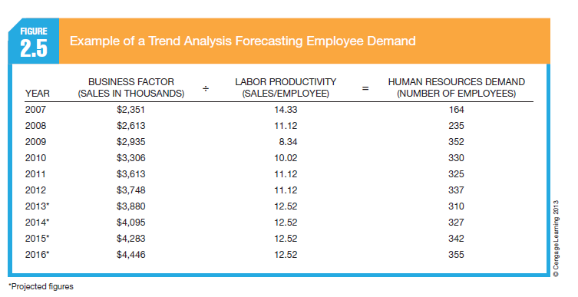

Slide 30
…Approaches to Demand forecasting
Key predictive factors
Identifying one major variable with which total human resource is highly correlated
e.g. using number of patients as key predictive factor to determine number of doctors

Slide 31
…Approaches to Demand forecasting
Management forecasting/expert judgment
are the opinions (judgments) of supervisors, department managers or experts, who are very familiar with the entire nature of the jobs in the organization.

Slide 32
…Approaches to Demand forecasting
Zero based forecasting
Using current level of employees as a starting point to determine future staffing needs
Whenever vacancies exist due to retirement, layoff, death, or resignation, the vacant the position is not automatically filled. analysis determines whether the firm can justify filling it.

Slide 33
…Approaches to Demand forecasting
Bottom up approach
In the bottom-up forecast, each successive level in the organization, starting with the lowest, forecasts its requirements to provide an aggregate forecast of employees needed.
This process is highly interactive as the estimated requirements from the previous level are discussed, negotiated, and re-estimated with the next level of management.

Slide 34
…Approaches to Demand forecasting
work standard data
This is a means of determining the relationship between tasks and the number of employees needed to perform the tasks.
The technique is useful only in cases where the volume of work can be satisfactorily quantified.
Activities | Estimate activity time (1) | Frequency (2) | Total time required to complete the activity (1×2) | Total time required to complete the job / standard working hr = HR requirement

Slide 35
Forecasting Human Resource Supply
Supply forecasting estimates future sources of human resources that are likely to be available from inside and outside the organization.
supply options are two internal and external supply.

Slide 36
Forecasting Human Resource Supply
  Internal supply- which refers to current members of the organizational workforce who can be retrained, promoted, transferred, etc., to fill anticipated future HR requirements.
  The major tool used to assess the current supply of employees is skills inventory.
  Purpose: to note what kind of skills, abilities, experiences, and training the employees currently have.

Slide 37
Components of skills inventory
Content of skills inventory can be put into three components as follows:
Data summarizing the employees past
Data summarizing status of present skills
Data that focus on the future

Slide 38
Data summarizing the employees past
Title and brief job description highlighting positions held over the years either in the organization or previous organizations
skills developed in these positions
Educational achievements
significant accomplishments

Slide 39
Data summarizing the status of the present skills
Skill related highlights last three performance appraisals
Employee perception of his/her competencies
Employees supervisor perception of employees competencies

Slide 40
Data that focus on the future
Personal career goals – identify specific positions and aspiration, one year, three years.
View of the individuals present supervisors as to what he or she could be prepared to become.
Specify training and development efforts that the individual is motivated to undertake – on the job, off the job, classroom or experiential

Slide 41
Forecasting Human Resource Supply
External supply- which refers to potential employees who are currently undergoing training or working for competitors, or currently are in a transitional stage, between jobs, self employed or unemployed.

Slide 42
Approaches to supply Forecasting
Supply forecasting process involves both tracking current employee levels and making future projections about those levels.
Staffing tables are graphic representations of all organizational jobs, along with the numbers of employees currently occupying those jobs

Slide 43
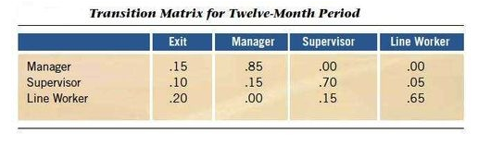
Approaches to supply Forecasting
Markov analysis- shows the percentage (and actual number) of employees who remain in each of a firm’s jobs from one year to the next, as well as the proportions of those who are promoted, demoted, or transferred, or who exit the organization.

Slide 44
Forecasting human resource supply
quality of fill - a metric designed to measure how well new hires that fill positions are performing on the job.
Replacement charts- Listings of current jobholders and people who are potential replacements if an opening occurs.

Slide 45
Forecasting human resource supply
Succession planning- the process of identifying, developing, and tracking key individuals for executive positions.

Slide 46
Factors to consider In supply forecasting
Turnover - The analysis of the numbers of people leaving the organization provides data for use in supply forecasting, so that calculations can be made on the number of people lost who may have to be replaced.
Number of leavers in a specified period (usually 1 year) * 100
Average number of employees during the same period

Slide 47
Factors to consider In supply forecasting
survival rate- the proportion of employees engaged within a certain period who remain with the organization after so many months or years of service.

Slide 48
Factors to consider In supply forecasting
Stability index - provides an indication of the tendency for longer service employees to remain with the company, and therefore shows the degree to which there is continuity of employment.
Number with 1 year’s service or more * 100
Number employed 1 year ago

Slide 49
Reading assignment
Read about recruitment and selection

