Slide 1
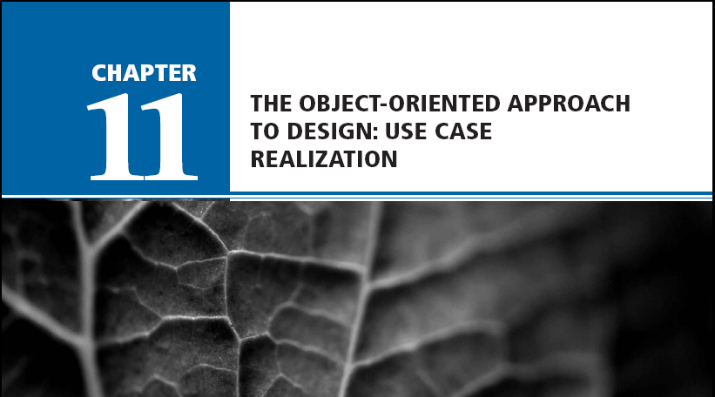
Chapter 11: The Object-Oriented Approach to Design: Use Case Realization
Systems Analysis and Design in a Changing World, Fourth Edition

Slide 2
Learning Objectives
Explain the purpose and objectives of object-oriented design
Develop design class diagrams
Develop interaction diagrams based on the principles of object responsibility and use case controllers

Slide 3
Learning Objectives (continued)
Develop detailed sequence diagrams as the core process in systems design
Develop communication diagrams as part of systems design
Document the architectural design using package diagrams

Slide 4
Overview
Primary focus of this chapter is how to develop detailed object-oriented design models
Programmers use models to code the system
Two most important models are design class diagrams and interaction diagrams (sequence diagrams and communication diagrams)
Class diagrams are developed for domain, view, and data access layers
Interaction diagrams extend system sequence diagrams

Slide 5
Object-Oriented Design—The Bridge Between Analysis and Programming
Bridge between users’ requirements and new system’s programming
Object-oriented design is process by which detailed object-oriented models are built
Programmers use design to write code and test new system
User interface, network, controls, security, and database require design tasks and models

Slide 6
Overview of Object-Oriented Programs
Set of objects that cooperate to accomplish result
Object contains program logic and necessary attributes in a single unit
Objects send each other messages and collaborate to support functions of main program
OO systems designer provides detail for programmers
Design class diagrams, interaction diagrams, and some state machine diagrams

Slide 7
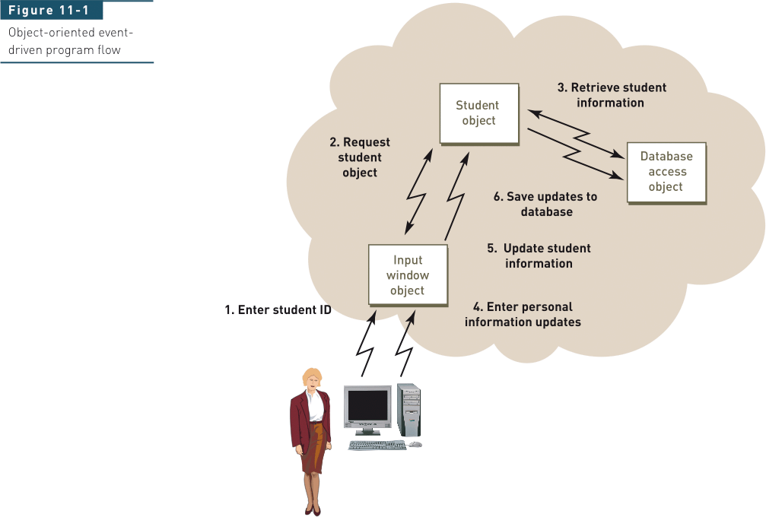
Object-Oriented Three-Layer Program

Slide 8
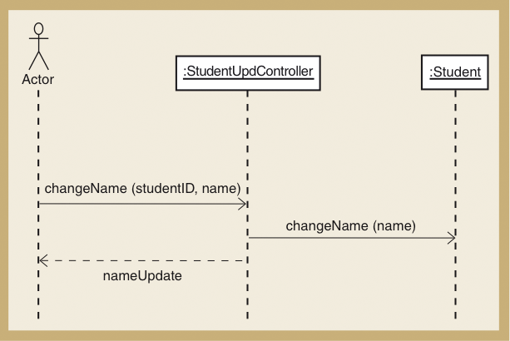
Sequence Diagram for Updating Student (Figure 11-2)

Slide 9
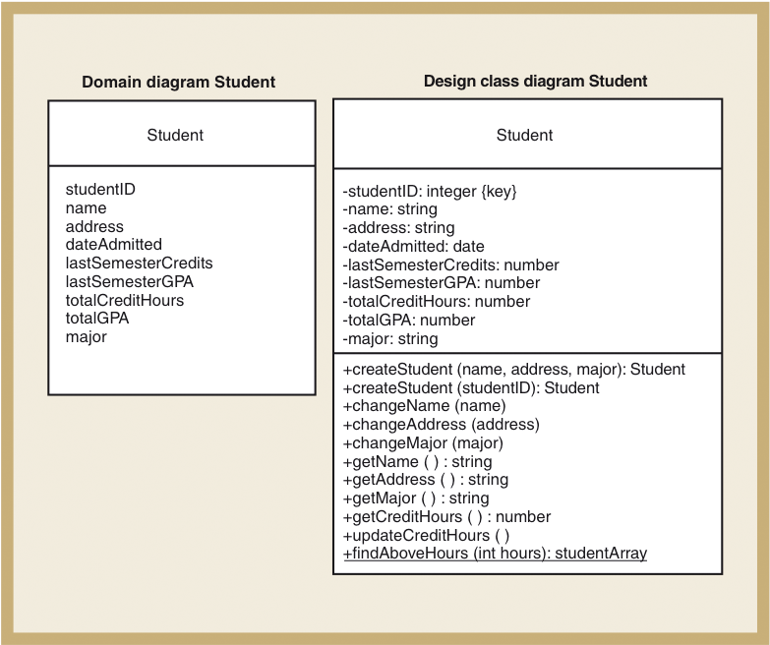
Student Class Examples for the Domain Class and the Design Class Diagrams (Figure 11-3)

Slide 10
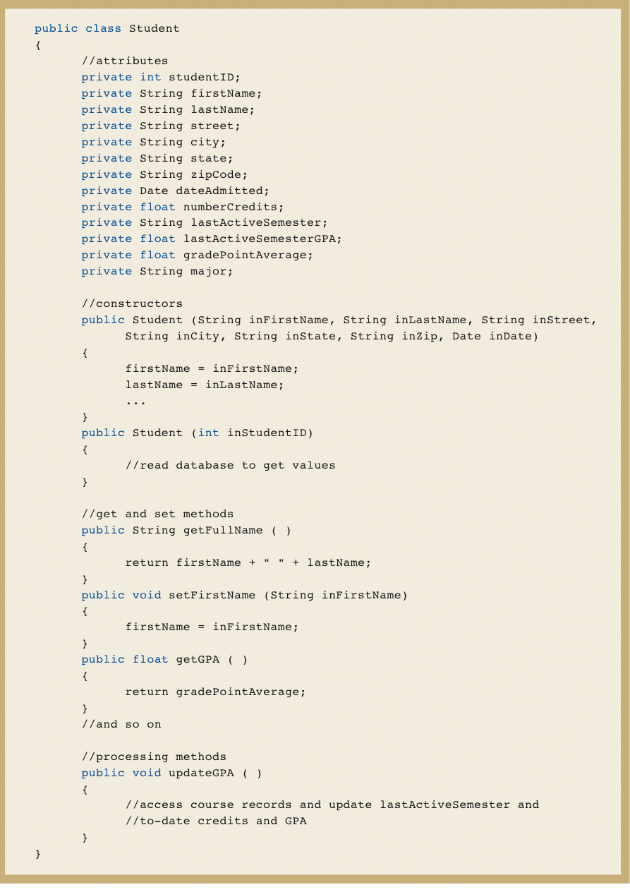
Example Class Definition in Java for Student Class (Figure 11-4a)

Slide 11
Object-Oriented Design Processes and Models
Diagrams developed for analysis/requirements
Use case diagrams, use case descriptions and activity diagrams, domain model class diagrams, and system sequence diagrams
Diagrams developed for design
Interaction diagrams and package diagrams
Design class diagrams – include object-oriented classes, navigation between classes, attribute names, method names, and properties needed for programming

Slide 12
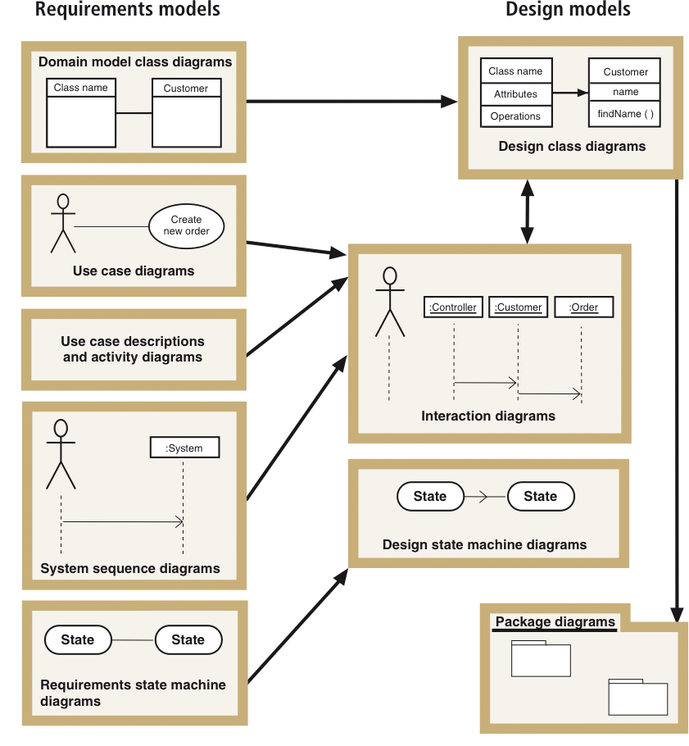
Design Models with Their Respective Input Models (Figure 11-5)

Slide 13
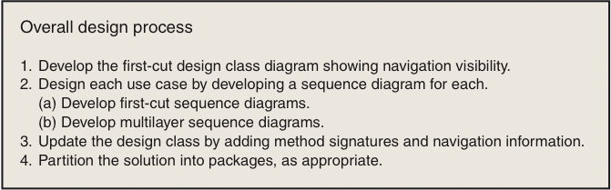
Iterative Process of OO Design— Design Steps (Figure 11-6)
Realization of use case – specialization of all detailed system processing for each use case

Slide 14
Design Classes, Interaction, and Design Process
Design class diagrams and detailed interaction diagrams
Use each other as inputs and are developed in parallel
First-cut design class diagram is based on domain model and system design principles
First-cut sequence diagram for use case is extended from system sequence diagram (SSD)
Shows interacting objects
Sequence diagram is completed layer by layer
Problem domain, data access, and view layers
Design class diagram is updated based on sequence diagram

Slide 15
Design Class Symbols
UML does not distinguish between design class notation and domain model notation
Domain model class diagram shows conceptual classes in users’ work environment
Design class diagram specifically defines software classes
UML uses stereotype notation to categorize a model element by its characteristics

Slide 16
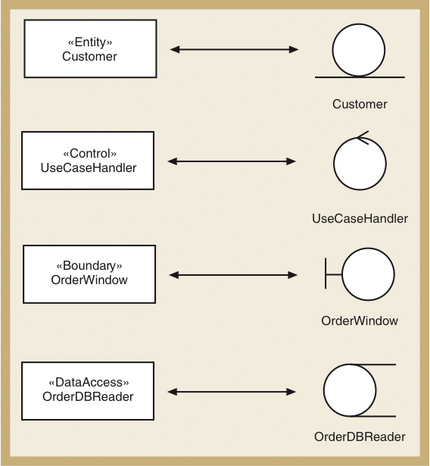
Standard Stereotypes Found in Design Models (Figure 11-7)

Slide 17
Standard Design Classes
Entity – design identifier for problem domain class
Persistent class – exists after system is shut down
Control – mediates between boundary and entity classes, between the view layer and domain layer
Boundary – designed to live on system’s automation boundary, touched by users
User interface and windows classes
Data access – retrieves data from and sends data to database

Slide 18
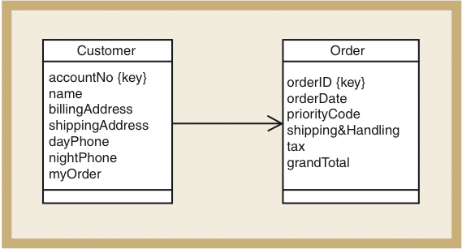
Navigation Visibility
A design principle in which one object has reference to another object
Can interact with other object by sending messages

Slide 19
Design Class Notation
Name – class name and stereotype information
Attribute visibility (private or public) – attribute name, type-expression, initial-value, property
Method signature – information needed to invoke (or call) the method
Method visibility, method name, type-expression (return parameter), method parameter list (incoming arguments)
Overloaded method – method with same name but two or more different parameter lists
Class-level method – method associated with class instead of each object (static or shared method), denoted by an underline

Slide 20
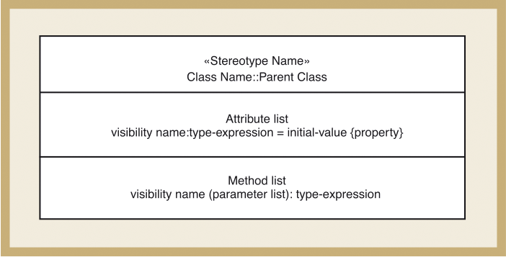
Notation Used to Define a Design Class (Figure 11-8)

Slide 21
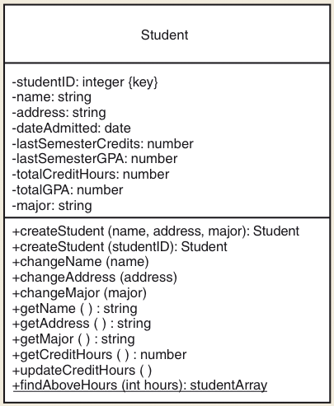
Student Design Class Example

Slide 22
Developing the First-Cut Design Class Diagram
Extend domain model class diagram
Elaborate attributes with type and initial value information
Detailed design proceeds use case-by-use case
Interaction diagrams implement navigation
Navigation arrows are updated to be consistent
Method signatures are added to each class

Slide 23
Developing First-Cut Design Class Diagram (Continued)
Choose classes involved with the use case
Add use case controller
Elaborate attributes
Visibility, type-expression, initial-value, property
Establish first-cut navigation visibility
One-to-many relationships usually navigated from superior to subordinate
Mandatory relationships usually navigated from independent to dependent
When an object needs information from another object, navigation arrow points to the object itself or to its parent in hierarchy
Navigation can be in both directions (arrows bidirectional)

Slide 24
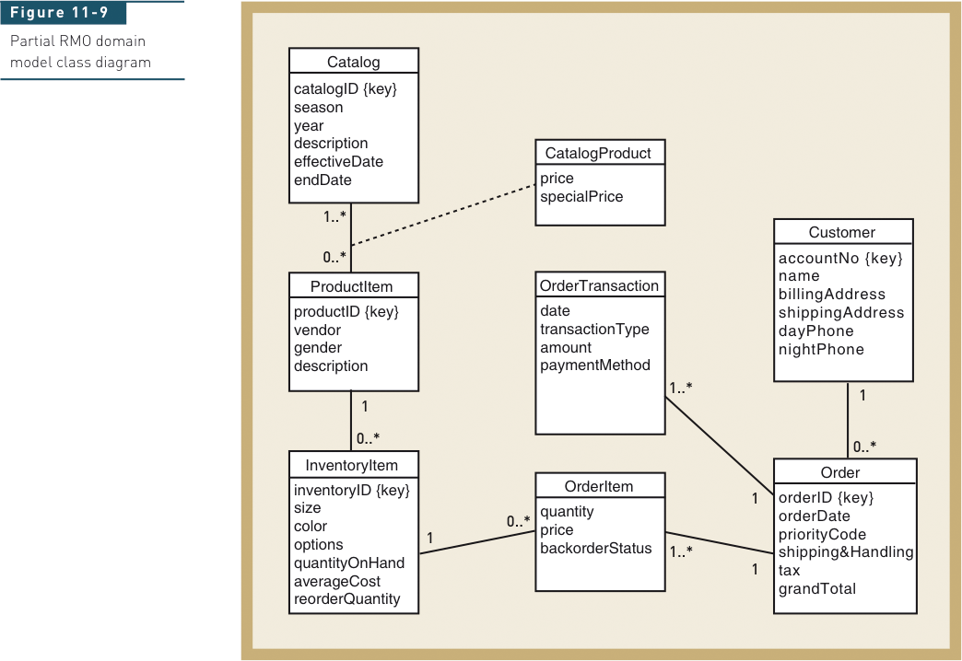
Start with Domain Model Class Diagram

Slide 25
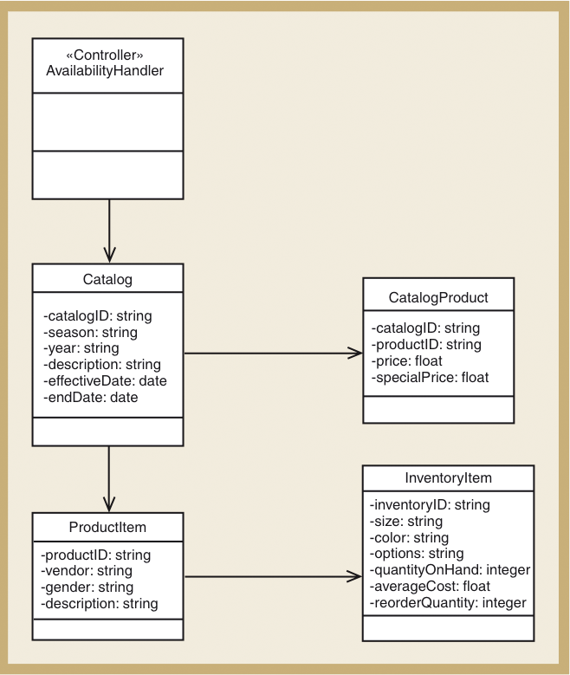
First-Cut RMO Design Class Diagram for Look Up Item Availability Use Case (Figure 11-11)

Slide 26
Design Patterns and the Use Case Controller
Design pattern
A standard solution template to a design requirement that facilitates the use of good design principles
Use case controller pattern
Design requirement is to identify which problem domain class should receive input messages from the user interface for a use case
Solution is to choose a class to serve as a collection point for all incoming messages for the use case. Controller acts as intermediary between outside world and internal system
Artifact – a class invented by a system designer to handle a needed system function, such as a controller class

Slide 27
Some Fundamental Design Principles
Encapsulation – each object is self-contained unit that includes data and methods that access data
Object reuse – designers often reuse same classes for windows components
Information hiding – data associated with object is not visible to outside world
Protection from variations – parts of a system that are unlikely to change are segregated from those that will
Indirection – an intermediate class is placed between two classes to decouple them but still link them

Slide 28
Some Fundamental Design Principles (Continued)
Coupling – qualitative measure of how closely classes in a design class diagram are linked
Number of navigation arrows in design class diagram or messages in a sequence diagram
Loosely coupled – system is easier to understand and maintain
Cohesion – qualitative measure of consistency of functions within a single class
Separation of responsibility – divide low cohesive class into several highly cohesive classes
Highly cohesive – system is easier to understand and maintain and reuse is more likely

Slide 29
Realizing Use Cases and Defining Methods —Designing with Sequence Diagrams
Realization of use case done through interaction diagram development
Determine what objects collaborate by sending messages to each other to carry out use case
Sequence diagrams and communication diagrams represent results of design decisions
Use well-established design principles such as coupling, cohesion, separation of responsibilities

Slide 30
Object Responsibility
Objects are responsible for system processing
Responsibilities include knowing and doing
Knowing about object’s own data and other classes of objects with which it collaborates to carry out use cases
Doing activities to assist in execution of use case
Receive and process messages
Instantiate, or create, new objects required to complete use case
Design means assigning responsibility to the appropriate classes based on design principles and using design patterns

Slide 31
Designing with Sequence Diagrams
Sequence diagrams used to explain object interactions and document design decisions
Document inputs to and outputs from system for single use case or scenario
Capture interactions between system and external world as represented by actors
Inputs are messages from actor to system
Outputs are return messages showing data

Slide 32
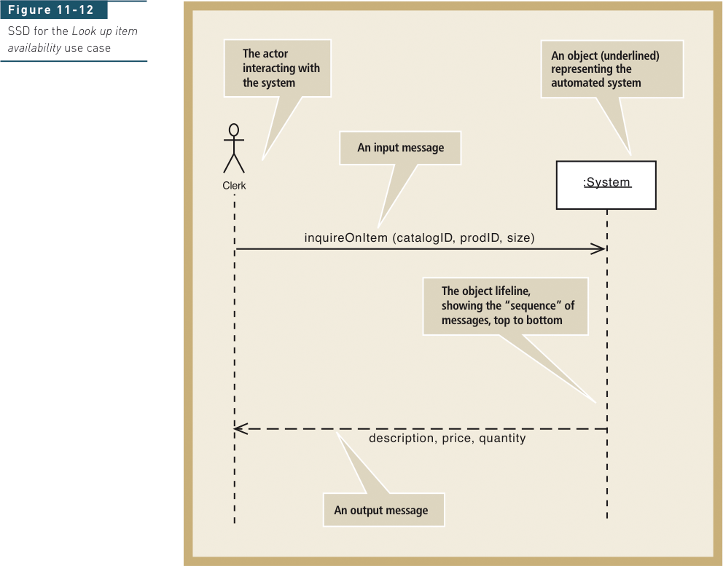
Annotated System Sequence Diagram (SSD) for the Look Up Item Availability Use Case (from Chapter 7)

Slide 33
First-Cut Sequence Diagram
Start with elements from SSD
Replace :System object with use case controller
Add other objects to be included in use case
Select input message from the use case
Add all objects that must collaborate
Determine other messages to be sent
Which object is source and destination of each message?

Slide 34
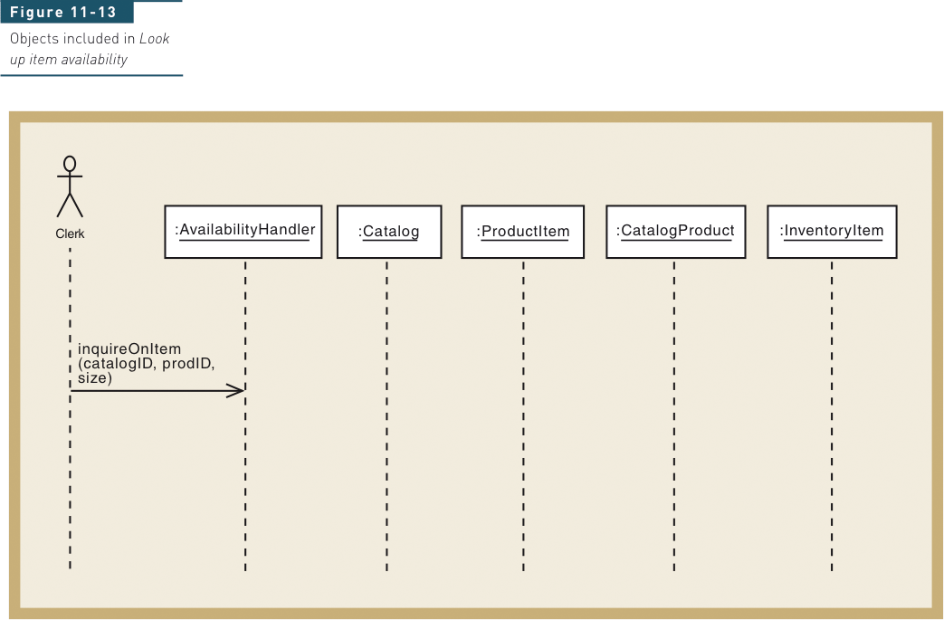
Objects included in Look Up Item Availability

Slide 35
Guidelines for Sequence Diagram Development for Use Case
Take each input message and determine internal messages that result from that input
For that message, determine its objective
Needed information, class destination, class source, and objects created as a result
Double check for all required classes
Flesh out components for each message
Iteration, guard-condition, passed parameters, return values

Slide 36
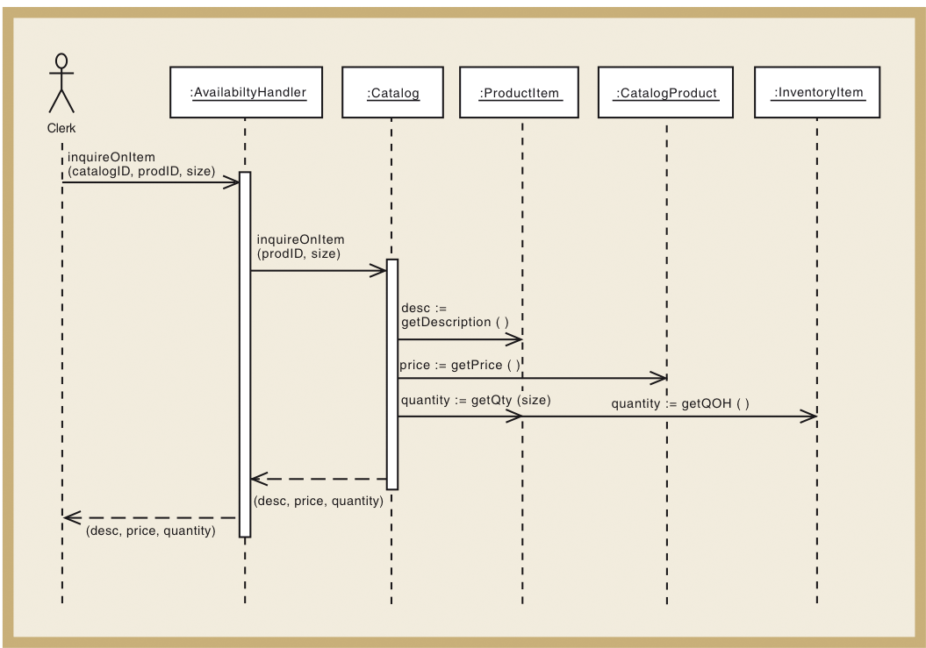
First-Cut Sequence Diagram for the Look Up Item Availability Use Case (Figure 11-14)

Slide 37
Assumptions About First-Cut Sequence Diagram
Perfect technology assumption
Don’t include system controls like login/logout (yet)
Perfect memory assumption
Don’t worry about object persistence (yet)
Assume objects are in memory ready to work
Perfect solution assumption
Don’t worry about exception conditions (yet)
Assume happy path/no problems solution

Slide 38
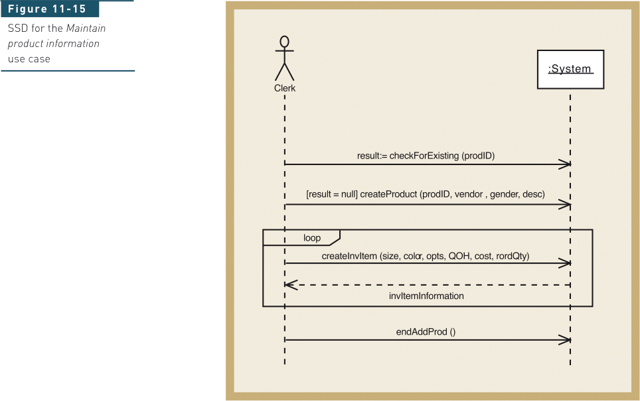
Maintain Product Information Use Case— Start with SSD

Slide 39
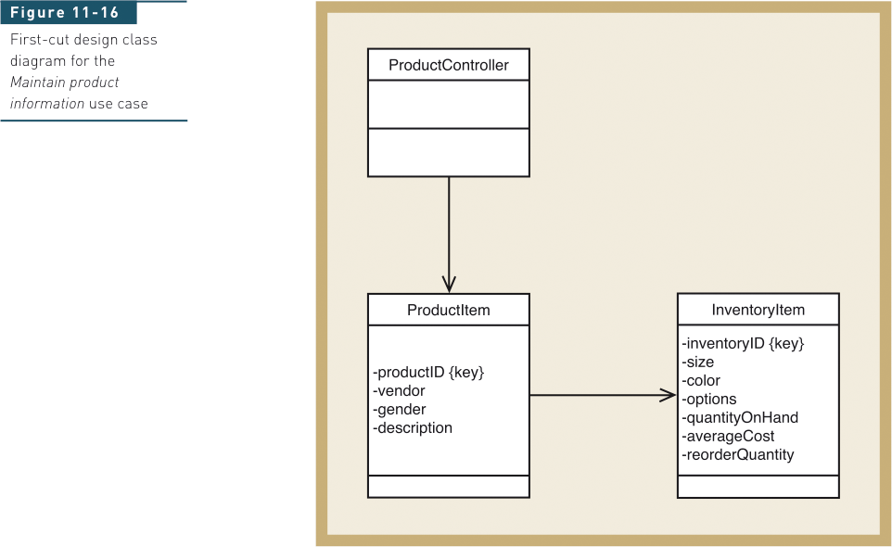
Add Controller and Identify Domain Classes and Navigation Visibility

Slide 40
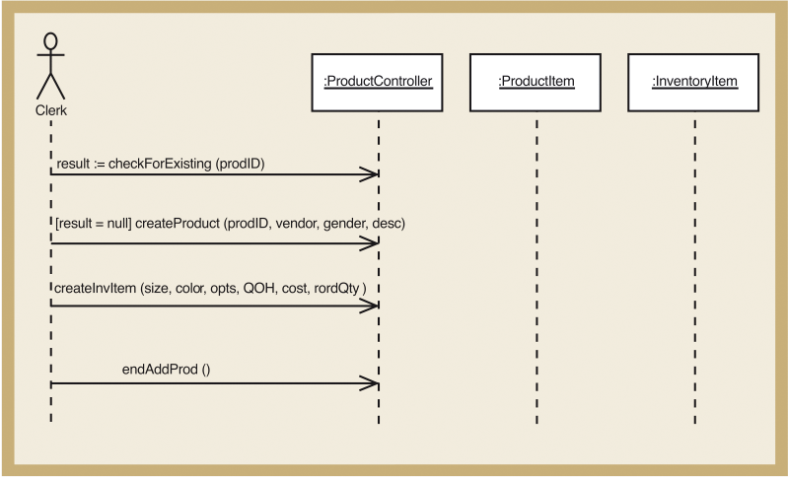
Replace :System Object in SSD with Controller and Domain Objects (Figure 11-17)

Slide 41
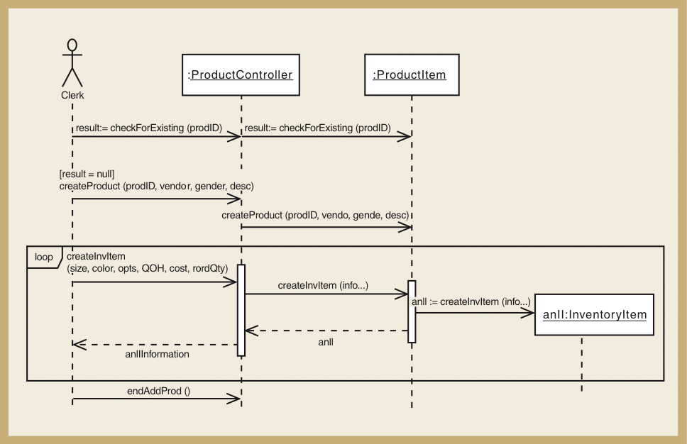
First-Cut Sequence Diagram for Maintain Product Information Use Case (Figure 11-18)

Slide 42
Developing a Multilayer Design
First-cut sequence diagram – use case controller plus classes in domain layer
Add data access layer – design for data access classes for separate database interaction
No more perfect memory assumption
Separation of responsibilities
Add view layer – design for user-interface classes
Forms added as windows classes to sequence diagram between actor and controller

Slide 43
Approaches to Data Access Layer

Slide 44
Approaches to Data Access Layer (Continued)
Create data access class for each domain class
CustomerDA added for Customer
Database connection statements and SQL statements separated into data access class. Domain classes do not have to know about the database design or implementation
Approach (a) – controller instantiates new customer aC; new instance asks DA class to populate its attributes reading from the database
Approach (b) – controller asks DA class to instantiate new customer aC; DA class reads database and passes values to customer constructor
Two following examples use this approach

Slide 45
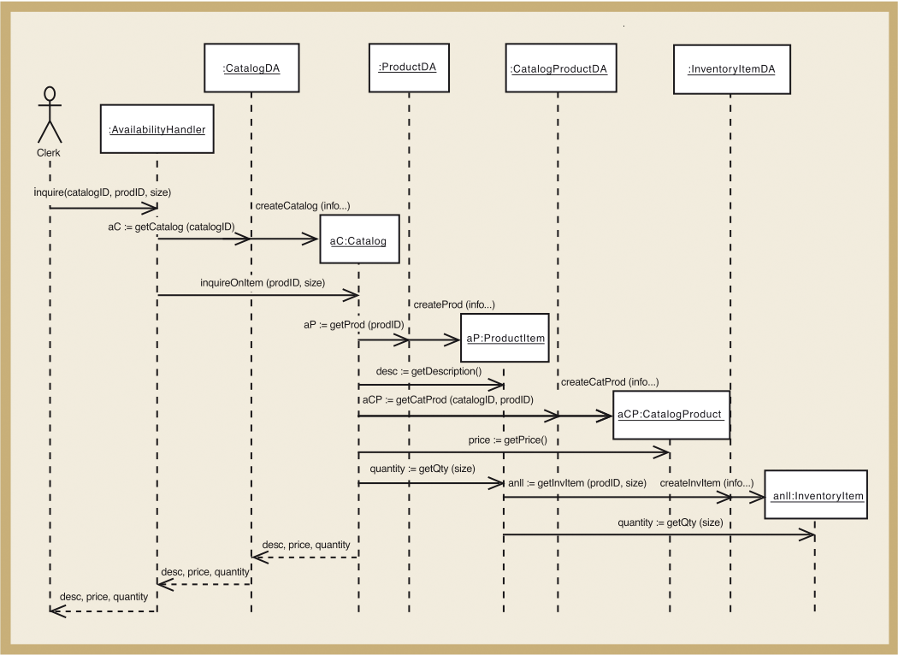
Adding Data Access Layer for Look Up Item Availability Use Case (Figure 11-20)

Slide 46
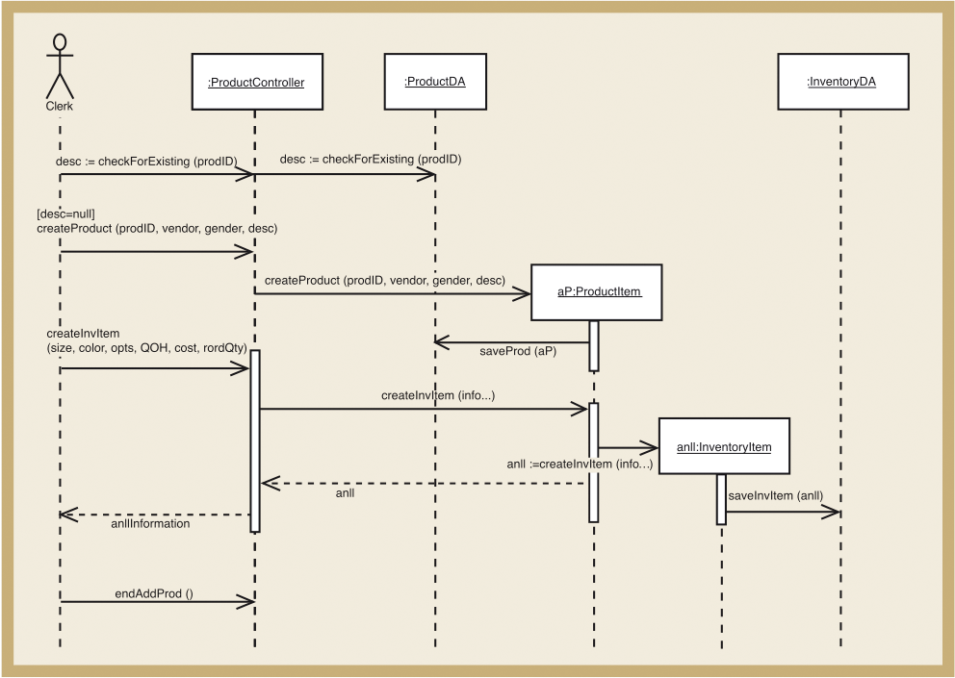
Adding Data Access Layer for Maintain Product Information Use Case (Figure 11-21)

Slide 47
Designing the View Layer
Add GUI forms or Web pages between actor and controller for each use case
Minimize business logic attached to a form
Some use cases require only one form; some require multiple forms and dialog boxes
View layer design is focused on high-level sequence of forms/pages – the dialog
Details of interface design and HCI in Chapters 13 and 14

Slide 48
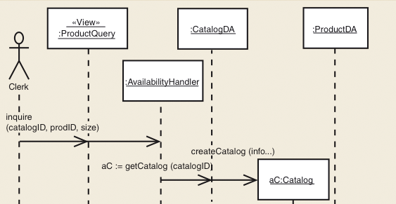
<<View>> ProductQuery Form Added for Look Up Item Availability Use Case

Slide 49
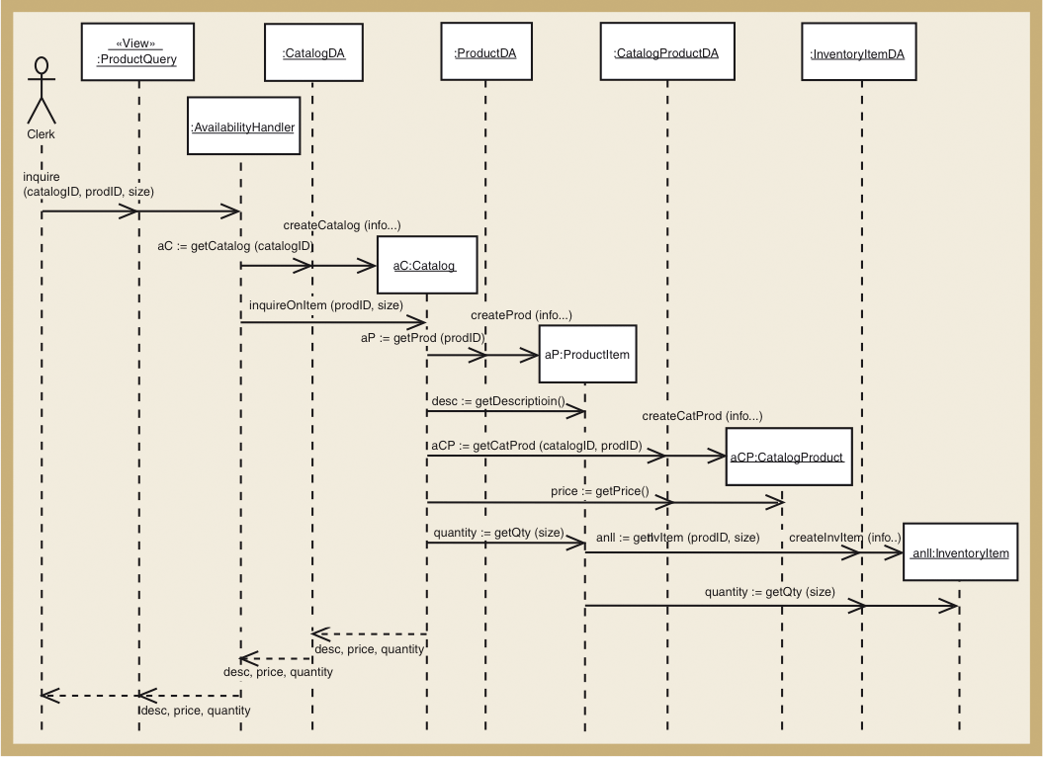
Complete Look Up Item Availability Use Case with View Layer (Figure 11-22)

Slide 50
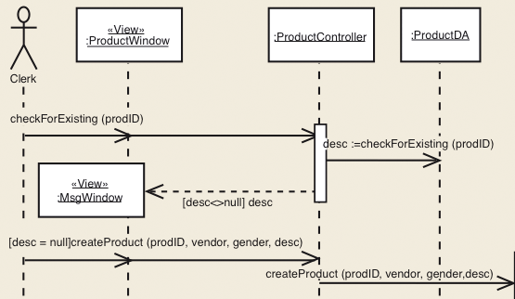
ProductWindow and MsgWindow for Maintain Product Information Use Case

Slide 51
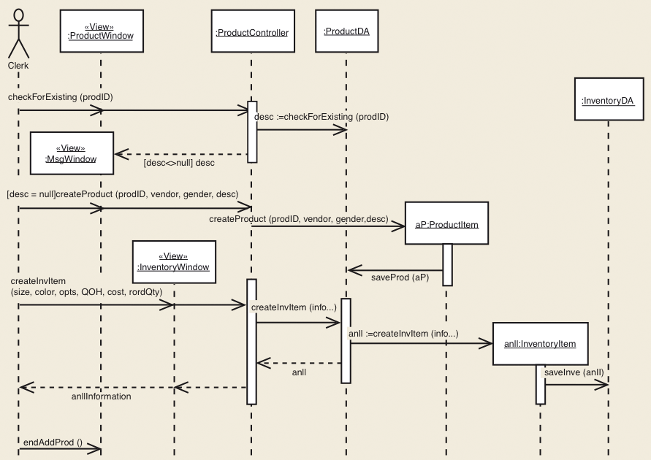
Complete Maintain Product Information Use Case Use Case with View Layer (Figure 11-23)

Slide 52
Designing with Communication Diagrams
Communication diagrams and sequence diagrams
Both are interaction diagrams
Both capture same information
Process of designing is same for both
Model used is designer’s personal preference
Sequence diagram – use case descriptions and dialogs follow sequence of steps
Communication diagram – emphasizes coupling

Slide 53
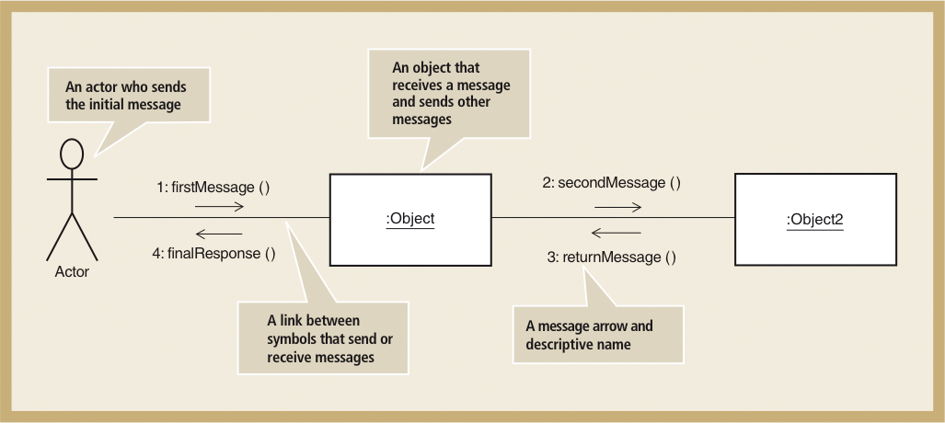
The Symbols of a Communication Diagram (Figure 11-24)

Slide 54
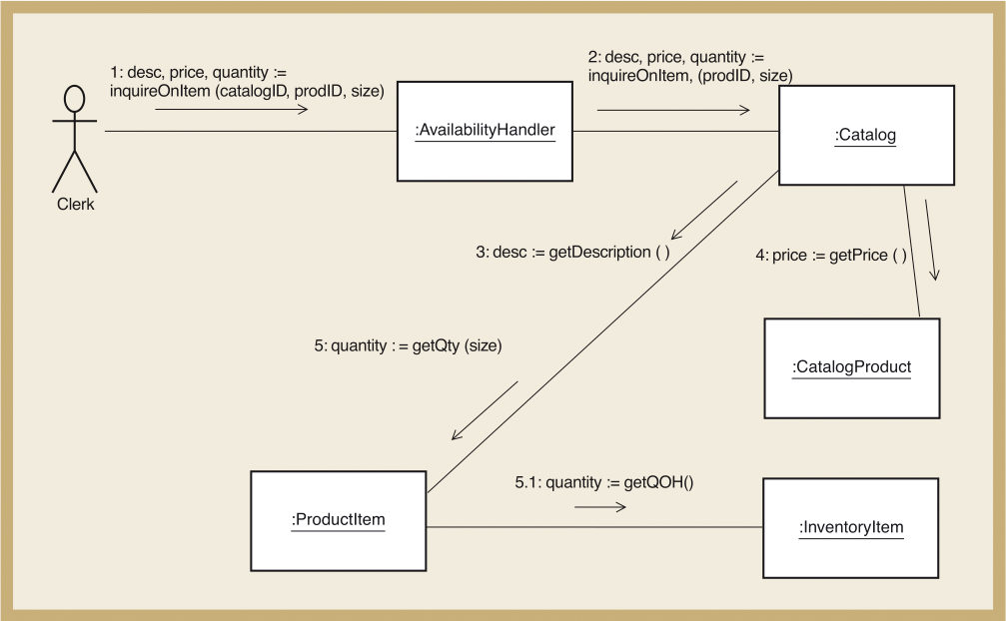
A Communication Diagram for Look Up Item Availability (Figure 11-25)

Slide 55
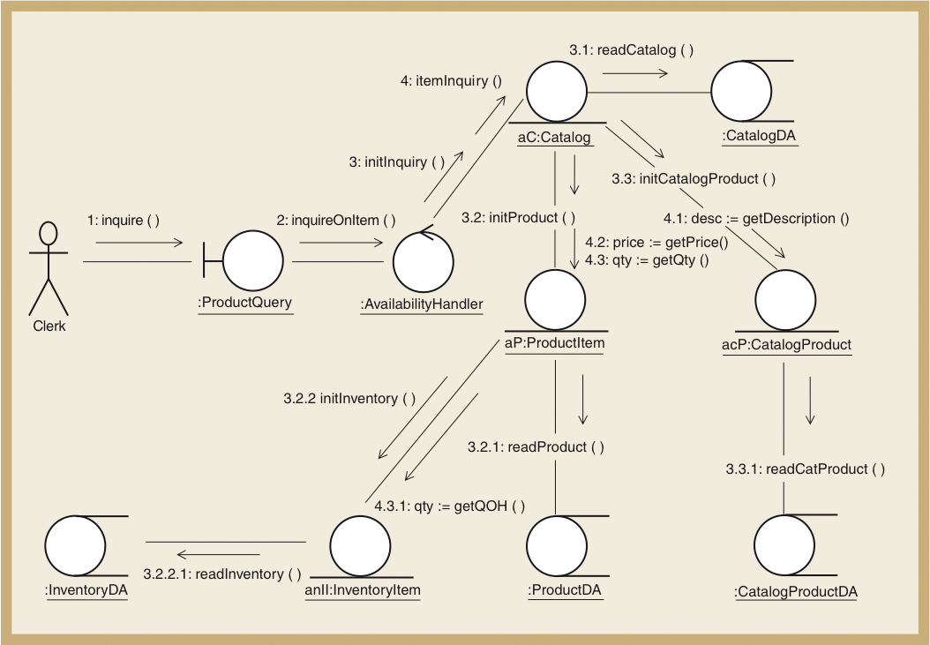
Look Up Item Availability Use Case Using Iconic Symbols (Figure 11-26)

Slide 56
Updating the Design Class Diagram
Design class diagrams developed for each layer
New classes for view layer and data access layer
New classes for domain layer use case controllers
Sequence diagram’s messages used to add methods
Constructor methods
Data get and set method
Use case specific methods

Slide 57
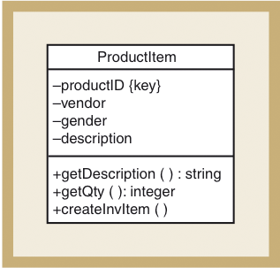
Design Class with Method Signatures, for the ProductItem Class (Figure 11-27)

Slide 58
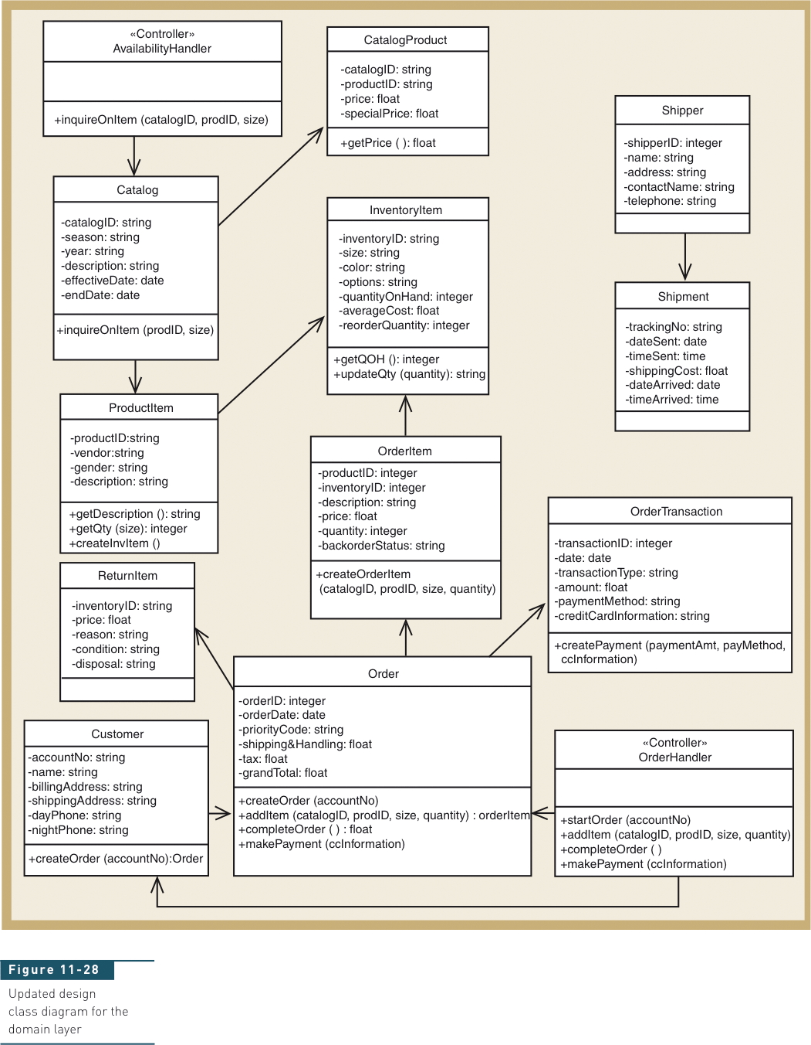
Updated Design Class Diagram for the Domain Layer (Figure 11-28)

Slide 59
Package Diagram—Structuring the Major Components
High-level diagram in UML to associate classes of related groups
Identifies major components of a system and dependencies
Determines final program partitions for each layer
View, domain, data access
Can divide system into subsystem and show nesting within packages

Slide 60
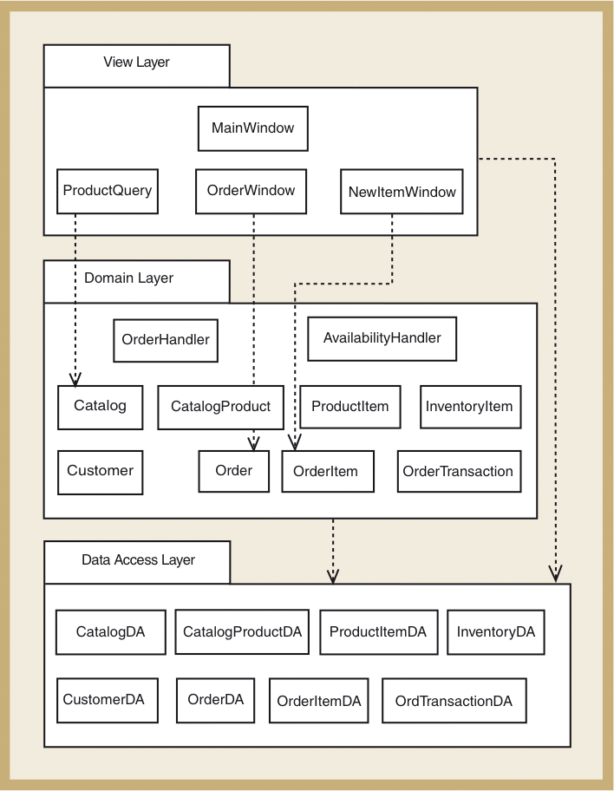
Partial Design of Three-Layer Package Diagram for RMO (Figure 11-29)

Slide 61
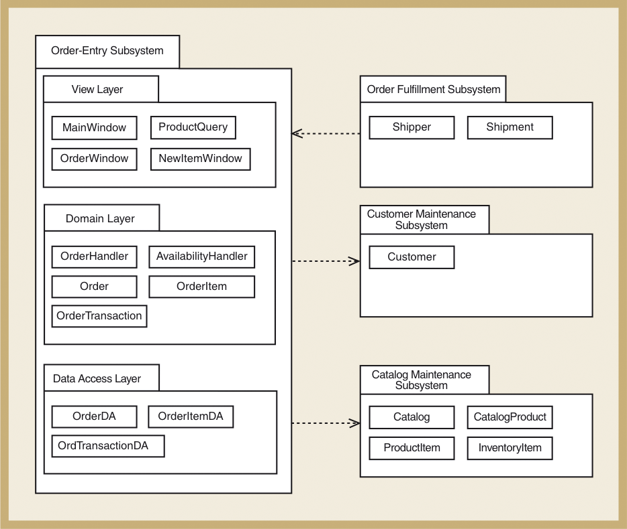
RMO Subsystem Packages (Figure 11-30)

Slide 62
Implementation Issues for Three-Layer Design
Construct system with programming
Java or VB .NET or C# .NET
IDE tools (Visual Studio, Rational Application Developer, JBuilder)
Integration with user-interface design, database design, and network design
Use object responsibility to define program responsibilities for each layer
View layer, domain layer, data access layer

Slide 63
Summary
Object-oriented design is the bridge between user requirements (in analysis models) and final system (constructed in programming language)
Systems design is driven by use cases, design class diagrams, and sequence diagrams
Domain class diagrams are transformed into design class diagrams
Sequence diagrams are extensions of system sequence diagrams (SSDs)

Slide 64
Summary (continued)
Object-oriented design principles must be applied
Encapsulation – data fields are placed in classes along with methods to process that data
Low coupling – connectivity between classes
High cohesion – nature of an individual class
Protection from variations – parts of a system that are unlikely to change are segregated from those that will
Indirection – an intermediate class is placed between two classes to decouple them but still link them
Separation navigation – access classes have to other classes
Three-layer design is used because maintainable

