Slide 1

JIMMA UNIVERSITY
COLLEGE OF NATURAL SCIENCES
DEPARTMENT OF CHEMISTRY
Inorganic chemistry II (Chem 2032)
By Kirubel Teshome(MSc)
April, 2020
Jimma. Ethiopia

Slide 2
PRESENTATION CONTENTS
CHAPTER ONE
Chemistry of d-block elements
CHAPTER TWO
Chemistry of f-block elements
CHAPTER THREE
Coordination Chemistry of Transition Metals

Slide 3
CHAPTER ONE
Chemistry of d-block elements
Iron, copper, silver and gold are among the transition elements that have played important roles in the development of human civilization.
The d–block occupies the large middle section flanked by s– and p– blocks in the periodic table.
The terms transition metal (or element) and d block element are sometimes used as if they mean the same thing, but ‘d-block metal’ and ‘transition element’ are not interchangeable.

Slide 4
A transition element is defined as the one which has incompletely filled d-orbitals in its ground state or in any one of its oxidation states.
Zinc, cadmium and mercury of group 12 have full d¹⁰ configuration in their ground state as well as in their common oxidation states and hence, are not regarded as transition metals.

Slide 5
However, being the end members of the three transition series, their chemistry is studied along with the chemistry of the transition metals.
The presence of partly filled d or f-orbitals in their atoms sets the study of the transition elements and their compounds apart from that of the main group elements.

Slide 6
Various precious metals such as silver, gold and platinum and industrially important metals like iron, copper and titanium form part of the transition metals.
The d–orbitals of the penultimate energy level in their atoms receive electrons giving rise to the three rows of the transition metals, i.e., 3d, 4d and 5d.
The fourth row of 6d is still incomplete.

Slide 7
Electronic Configurations of the d-Block Elements
In general the electronic configuration of these elements is (n-1)d^{1–10}ns^{1–2}.
The (n–1) stands for the inner d-orbitals which may have one to ten electrons and the outermost ns orbital may have one or two electrons.
However, this generalization has several exceptions because
of very little energy difference between (n-1)d and ns orbitals.
Furthermore, half and completely filled sets of orbitals are relatively more stable.

Slide 8
A consequence of this factor is reflected in the electronic configurations of Cr and Cu in the 3d series.
Consider the case of Cr, for example, which has 3d⁵4s¹ instead of 3d⁴4s²;
the energy gap between the two sets (3d and 4s) of orbitals is small enough to prevent electron entering the 3d orbitals.
Similarly in case of Cu, the configuration is 3d¹⁰4s¹ and not 3d⁹4s².
This is something that you are just going to have to accept.
There is no simple explanation for it which is usable at this level.

Slide 9
Any simple explanation which is given is faulty!
People sometimes say that a half-filled d level as in chromium is stable, and so it is - sometimes!
But you then have to look at why it is stable.
But you only have to look at the electronic configuration of tungsten (W) to see that this apparently simple explanation doesn't always work.
Tungsten has the same number of outer electrons as chromium, but its outer structure is different, 5d⁴6s².

Slide 10
The obvious explanation is that chromium takes up this structure because separating the electrons minimizes the repulsions between them,
otherwise it would take up some quite different structure.
But you only have to look at the electronic configuration of tungsten (W) to see that this apparently simple explanation doesn't always work.
Tungsten has the same number of outer electrons as chromium, but its outer structure is different, 5d⁴6s².

Slide 11
Again the electron repulsions must be minimised - otherwise it wouldn't take up this configuration.
But in this case, it isn't true that the half-filled state is the most stable - it doesn't seem very reasonable, but it's a fact!
The real explanation is going to be much more difficult than it seems at first sight.
Transition metal ions
You have already come across the fact that when the Periodic Table is being built, the 4s orbital is filled before the 3d orbitals.

Slide 12
This is because before filling orbitals, 4s orbitals have a lower energy than 3d orbitals.
However, once the electrons are actually in their orbitals,
the energy order changes, and in all the chemistry of the transition elements, the 4s orbital behaves as the outermost, highest energy orbital.
To write the electronic structure for Co²⁺:
Co: [Ar]3d⁷4s²
Co²⁺: [Ar]3d⁷

Slide 13
The 2+ ion is formed by the loss of the two 4s electrons.
To write the electronic structure for V³⁺:
V: [Ar] 3d³4s², V³⁺: [Ar] 3d²
The 4s electrons are lost first followed by one of the 3d electrons.
To write the electronic structure for Cr³⁺:
Cr: 1s²2s²2p⁶3s²3p⁶3d⁵4s¹
Cr³⁺: 1s²2s²2p⁶3s²3p⁶3d³
The 4s electron is lost first followed by two of the 3d electrons.

Slide 14
General properties of Transition Metals Physical
General physical properties of the elements
Nearly all the transition elements display typical metallic properties such as high tensile strength, ductility,
malleability, high thermal and electrical conductivity and metallic lustre.
With the exceptions of Zn, Cd, Hg and Mn, they have one or more typical metallic structures at normal temperatures.

Slide 15
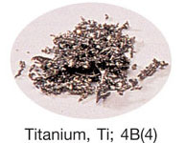
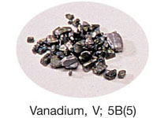
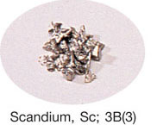
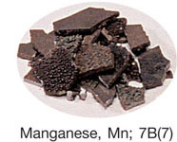
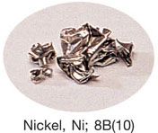
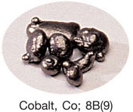
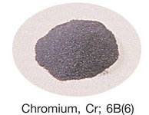
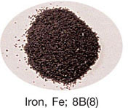
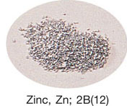
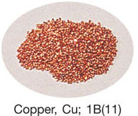

Slide 16
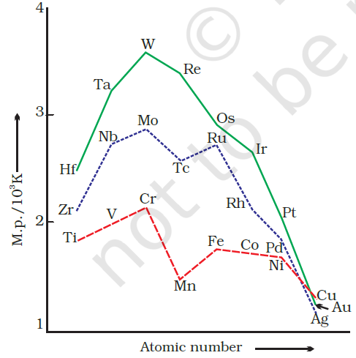
The transition metals (with the exception of Zn, Cd and Hg) are very much hard and have low volatility.
Their melting and boiling points are high.
Trends in melting points of transition elements

Slide 17
The high melting points of these metals are attributed to the involvement of greater number of electrons from (n-1)d in addition to the ns electrons in the interatomic metallic bonding.
In any row the melting points of these metals rise to a maximum at d⁵ except for anomalous values of Mn and Tc and fall regularly as the atomic number increases.
They have high enthalpies of atomisation.
The maxima at about the middle of each series indicate that one unpaired electron per d orbital is particularly favourable for strong interatomic interaction.

Slide 18
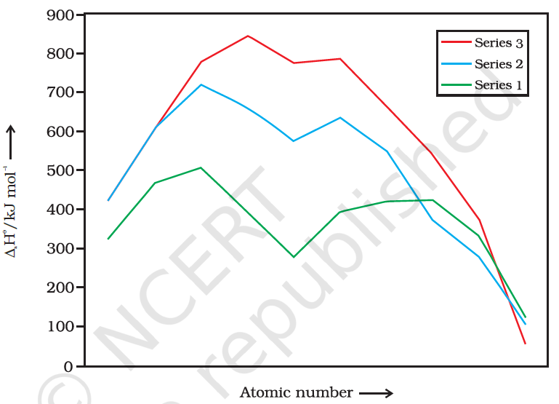

Slide 19
In general, greater the number of valence electrons, stronger is the resultant bonding.
Since the enthalpy of atomisation is an important factor in determining the standard electrode potential of a metal,
metals with very high enthalpy of atomisation (i.e., very high boiling point) tend to be noble in their reactions.
Another generalisation that may be drawn from the figure is that the metals of the second and third series have greater enthalpies of atomisation than the corresponding elements of the first series;

Slide 20
This is an important factor in accounting for the occurrence of much more frequent metal– metal bonding in compounds of the heavy transition metals.
Variation in Atomic and Ionic Sizes of Transition Metals
In general, ions of the same charge in a given series show progressive decrease in radius with increasing atomic number.
This is because the new electron enters a d orbital each time the nuclear charge increases by unity.
The same trend is observed in the atomic radii of a given series.

Slide 21
It may be recalled that the shielding effect of a d electron is
not that effective, hence the net electrostatic attraction between the nuclear charge and the outermost electron increases and the ionic radius decreases.
However, the variation within a series is quite small.
An interesting point emerges when atomic sizes of one series are compared with those of the corresponding elements in the other series.

Slide 22
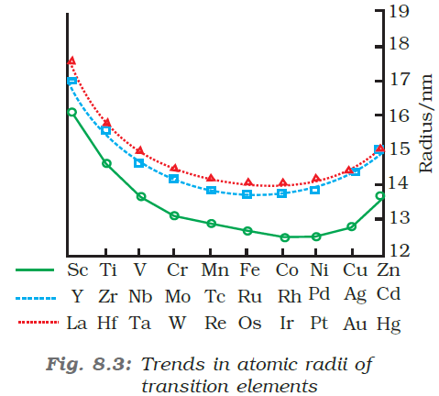

Slide 23
The curves in the above figure show an increase from the first (3d) to the second (4d) series of the elements but the radii of the third (5d) series are virtually the same as those of the corresponding members of the second series.
This phenomenon is associated with the intervention of the 4f orbitals which must be filled before the 5d series of elements begin.
The filling of 4f before 5d orbital results in a regular decrease in atomic radii called Lanthanoid contraction which essentially compensates for the expected increase in atomic size with increasing atomic number.

Slide 24
The net result of the lanthanoid contraction is that the second and the third d series exhibit similar radii (e.g., Zr 160 pm, Hf 159 pm)
and have very similar physical and chemical properties much more than that expected on the basis of usual family relationship.
The factor responsible for the lanthanoid contraction is the imperfect shielding of one electron by another in the same set of orbitals.

Slide 25
The decrease in metallic radius coupled with increase in atomic mass results in a general increase in the density of these elements.
Ionisation Enthalpies
Due to an increase in nuclear charge which accompanies the filling of the inner d orbitals,
there is an increase in ionization enthalpy along each series of the transition elements from left to right.
However, many small variations occur.

Slide 26
The magnitude of the increase in the second and third ionisation enthalpies for the successive elements, in general, is much higher.
The irregular trend in the first ionisation enthalpy of the 3d metals can be accounted by considering that the removal of one electron alters the relative energies of 4s and 3d orbitals.
The successive enthalpies of these elements do not increase
as steeply as in the main group elements.
So the unipositive ions have d^{n} configurations with no 4s electrons.

Slide 27
There is thus, a reorganization energy accompanying ionization with some gains in exchange energy as the number of electrons increases and from the transference of s electrons into d orbitals.
There is the generally expected increasing trend in the values as the effective nuclear charge increases.
However, the value of Cr is lower because of the absence of any change in the d configuration and the value for Zn is higher because it represents an ionization from the 4s level.

Slide 28
The lowest common oxidation state of these metals is +2.
To form the M²⁺ ions from the gaseous atoms, the sum of the first and second ionization energies is required in addition to the enthalpy of atomization for each element.
The dominant term is the second ionization enthalpy which shows unusually high values for Cr and Cu where the d⁵
and d¹⁰ configurations of the M⁺ ions are disrupt with considerable loss of exchange energy.

Slide 29
The value for Zn is correspondingly low as the ionization consists of the removal of an electron which allows the production of the stable d¹⁰ configuration.
The trend in the third ionization enthalpies is not complicated by the 4s orbital factor and shows the greater difficulty of removing an electron from the d⁵ (Mn²⁺) and d¹⁰ (Zn²⁺) ions superimposed upon the general increasing trend.
In general, the third ionization enthalpies are quite high and there is a marked break between the values for Mn²⁺ and Fe²⁺.

Slide 30
Also the high values for copper, nickel and zinc indicate why it is difficult to obtain oxidation state greater than two for these elements.
Electro negativity increases within a group from Period 4 to 5, then generally remains unchanged from Period 5 to 6.
The heavier elements often have high EN values.
Although atomic size increases slightly down the group, nuclear charge increases much more, leading to higher EN values.

Slide 31
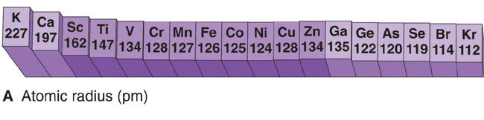
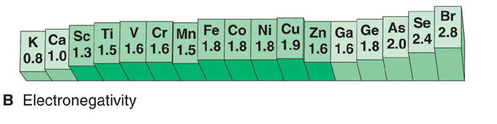
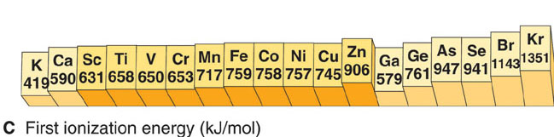

Slide 32
Density increases dramatically down a group since atomic volumes change little while atomic masses increase significantly.
General chemical properties
The inherent variable oxidation states
One of the key features of transition metal chemistry is the wide range of oxidation states that the metals can show.
Most transition metals have multiple oxidation states.
It would be wrong, though, to give the impression that only transition metals can have variable oxidation states.

Slide 33
For example, elements like S or N or Cl have a very wide range of oxidation states in their compounds and these obviously aren't transition metals.
However, this variability is less common in metals apart from the transition elements.
Of the familiar metals from the main groups of the Periodic Table, only lead and tin show variable oxidation state to any extent.
The transtion elements which give the greatest number of oxidation states occur in or near the middle of the series.

Slide 34
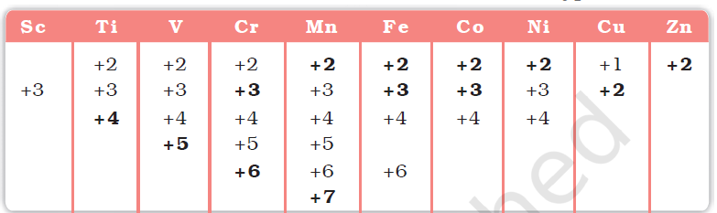

Slide 35
The highest oxidation state for elements in Groups 3B(3) through 7B(7) equals the group number.
These states are seen when the elements combine with the highly electronegative oxygen or fluorine.
Elements in Groups 8B(8), 8B(9) and 8B(10) exhibit fewer oxidation states.
The higher oxidation state is less common and never equal to the group number.
The +2 oxidation state is common because the ns² electrons are readily lost.

Slide 36
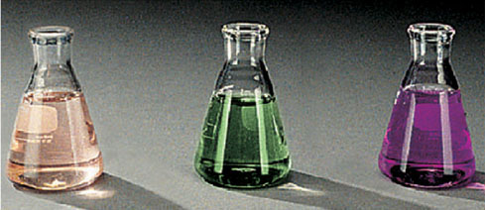
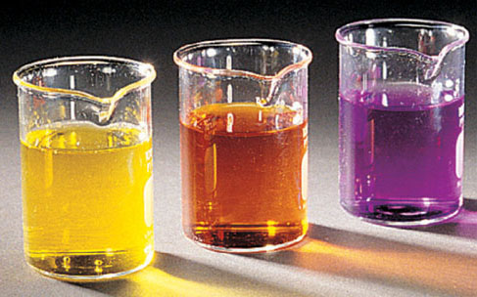
+2
+6
+7
Mn²⁺
MnO₄²⁻
MnO₄⁻
The highest oxidation state for Mn equals its group number.
+5
+6
+7
VO₄³⁻
Cr₂O₇²⁻
MnO₄⁻
Transition metal ions are often highly colored.

Slide 37
The maximum oxidation states of reasonable stability correspond in value to the sum of the s and d electrons upto manganese.
Although in the p–block the lower oxidation states are favoured by the heavier members (due to inert pair effect), the opposite is true in the groups of d-block.
For example, in group 6, Mo(VI) and W(VI) are found to be more stable than Cr(VI).
Thus Cr(VI) in the form of dichromate in acidic medium is a strong oxidising agent, whereas MoO₃ and WO₃ are not.

Slide 38
Low oxidation states are found when a complex compound has ligands capable of π-acceptor character in addition to the σ-bonding.
For example, in Ni(CO)₄ and Fe(CO)₅, the oxidation state of nickel and iron is zero.
Explaining the variable oxidation states in the transition metals
We'll look at the formation of simple ions like Fe²⁺ and Fe³⁺.
When a metal forms an ionic compound, the formula of the compound produced depends on the energetics of the process.

Slide 39
On the whole, the compound formed is the one in which most energy is released.
The more energy released, the more stable the compound.
There are several energy terms to think about, but the key ones are:-
The amount of energy needed to ionise the metal (the sum of the various ionisation energies)
The amount of energy released when the compound forms.
This will either be lattice enthalpy if you are thinking about solids, or the hydration enthalpies of the ions if you are thinking about solutions.

Slide 40
The more highly charged the ion, the more electrons you have to remove and the more ionisation energy you will have to provide.
But off-setting this, the more highly charged the ion, the more energy is released either as lattice enthalpy or the hydration enthalpy of the metal ion.
Thinking about a typical non-transition metal (calcium)
If you tried to make CaCl, (containing a Ca⁺ ion), the overall process is slightly exothermic.
By making a Ca²⁺ ion instead, you have to supply more ionisation energy, but you get out lots more lattice energy.

Slide 41
There is much more attraction between chloride ions and Ca²⁺ ions than there is if you only have a 1+ ion.
The overall process is very exothermic.
Because the formation of CaCl₂ releases much more energy than making CaCl, then CaCl₂ is more stable and so forms instead.
What about CaCl₃?
This time you have to remove yet another electron from calcium.
The first two come from the 4s level.

Slide 42
The third one comes from the 3p.
That is much closer to the nucleus and therefore much more difficult to remove.
There is a large jump in ionisation energy between the second and third electron removed.
Although there will be a gain in lattice enthalpy, it isn't anything like enough to compensate for the extra ionisation energy, and the overall process is very endothermic.
It definitely isn't energetically sensible to make CaCl₃!

Slide 43
Thinking about a typical transition metal (iron)
Here are the changes in the electronic structure of iron to make the 2+ or the 3+ ion.
Fe: [Ar] 3d⁶4s²
Fe²⁺: [Ar] 3d⁶
Fe³⁺: [Ar] 3d⁵
The 4s orbital and the 3d orbitals have very similar energies.
There isn't a huge jump in the amount of energy you need to remove the third electron compared with the first and second.

Slide 44
The figures for the first three ionisation energies (in kJ mol⁻¹) for iron compared with those of calcium are:
There is an increase in ionisation energy as you take more electrons off an atom because you have the same number of protons attracting fewer electrons.
However, there is much less increase when you take the third electron from iron than from calcium.
Metal | 1st IE | 2nd IE | 3rd IE
Ca | 590 | 1150 | 4940
Fe | 762 | 1560 | 2960

Slide 45
In the iron case, the extra ionisation energy is compensated more or less by the extra lattice enthalpy or hydration enthalpy evolved when the 3+ compound is made.
The net effect of all this is that the overall enthalpy change isn't vastly different whether you make, say, FeCl₂ or FeCl₃.
That means that it isn't too difficult to convert between the two compounds.
Metallic Behavior of Transition Metals
The lower the oxidation state of the transition metal, the more metallic its behavior.

Slide 46
Ionic bonding is more prevalent for the lower oxidation states, whereas covalent bonding occurs more frequently for higher oxidation states.
Metal oxides become less basic as the oxidation state increases.
A metal atom in a positive oxidation state has a greater attraction for bonded electrons, and therefore a greater effective electronegativity, or valence-state electronegativity, than in the zero oxidation state.
This effect increases as its oxidation state increases.

Slide 47
Trends in the M^{2+/}M Standard Electrode Potentials
Half-Reaction
E°(V)
Ti²⁺(aq) + 2e⁻ Ti(s)
-1.63
V²⁺(aq) + 2e⁻ V(s)
-1.19
Cr²⁺(aq) + 2e⁻ Cr(s)
-0.91
Mn²⁺(aq) + 2e⁻ Mn(s)
-1.18
Fe²⁺(aq) + 2e⁻ Fe(s)
-0.44
Co²⁺(aq) + 2e⁻ Co(s)
-0.28
Ni²⁺(aq) + 2e⁻ Ni(s)
-0.25
Cu²⁺(aq) + 2e⁻ Cu(s)
0.34
Zn²⁺(aq) + 2e⁻ Zn(s)
-0.76

Slide 48
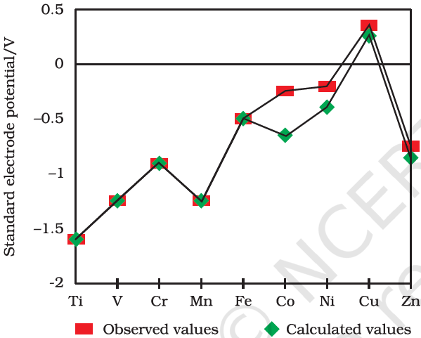

Slide 49
The unique behaviour of Cu, having a positive E^{ʘ}, accounts for its inability to liberate H₂ from acids.
Only oxidising acids (nitric and hot concentrated sulphuric) react with Cu, the acids being reduced.
The high energy to transform Cu(s) to Cu²⁺(aq) is not balanced by its hydration enthalpy.
The general trend towards less negative E^{ʘ} values across the series is related to the general increase in the sum of the first and second ionisation enthalpies.

Slide 50
It is interesting to note that the value of E^{ʘ} for Mn, Ni and Zn are more negative than expected from the trend.
Why is Cr²⁺reducing and Mn³⁺ oxidising when both have d⁴ configuration?
Cr²⁺ is reducing as its configuration changes from d⁴ to d³, the latter having a half-filled t_{2g} level.
On the other hand, the change from Mn³⁺ to Mn²⁺ results in the half-filled (d⁵) configuration which has extra stability.

Slide 51
Trends in the M^{3+/}M²⁺ Standard Electrode Potentials
An examination of the E^{ʘ} (M³⁺/M²⁺) values shows the varying trends.
The low value for Sc reflects the stability of Sc³⁺ which has a noble gas configuration.
The highest value for Zn is due to the removal of an electron from the stable d¹⁰ configuration of Zn²⁺.
The comparatively high value for Mn shows that Mn²⁺(d⁵) is particularly stable, whereas comparatively low value for Fe shows the extra stability of Fe³⁺ (d⁵).

Slide 52
The comparatively low value for V is related to the stability of V²⁺ (half-filled t_{2g} level).
Chemical Reactivityand E^{ʘ} Values
Transition metals vary widely in their chemical reactivity.
Many of them are sufficiently electropositive to dissolve in mineral acids, although a few are ‘noble’ that is, they are unaffected by single acids.
The metals of the first series with the exception of copper are relatively more reactive and are oxidised by 1M H⁺,
though the actual rate at which these metals react with oxidising agents like hydrogen ion (H⁺) is sometimes slow.

Slide 53
For example, titanium and vanadium, in practice, are passive to dilute non oxidising acids at room temperature.
The E^{ʘ} values for M²⁺/M indicate a decreasing tendency to form divalent cations across the series.
This general trend towards less negative E^{ʘ} values is related to the increase in the sum of the first and second ionisation enthalpies.
It is interesting to note that the E^{ʘ} values for Mn, Ni and Zn are more negative than expected from the general trend.

Slide 54
Whereas the stabilities of half-filled d subshell (d⁵) in Mn²⁺ and completely filled d subshell (d¹⁰) in zinc are related to their E^{ʘ} values;
for nickel, E^{ʘ} value is related to the highest negative enthalpy of hydration.
Magnetic Properties
When a magnetic field is applied to substances, mainly two types of magnetic behaviour are observed: diamagnetism and paramagnetism.

Slide 55
Diamagnetic substances are repelled by the applied field while the paramagnetic substances are attracted.
Substances which are attracted very strongly are said to be ferromagnetic.
In fact, ferromagnetism is an extreme form of paramagnetism.
Many of the transition metal ions are paramagnetic.
Paramagnetism arises from the presence of unpaired electrons,
each such electron having a magnetic moment associated with its spin angular momentum and orbital angular momentum.

Slide 56
For the compounds of the first series of transition metals, the contribution of the orbital angular momentum is effectively quenched and hence is of no significance.
For these, the magnetic moment is determined by the number of unpaired electrons and is calculated by using the ‘spin-only’ formula, i.e.,
where n is the number of unpaired electrons and μ is the magnetic moment in units of Bohr magneton (BM).

Slide 57
A single unpaired electron has a magnetic moment of 1.73 Bohr magnetons (BM).
The magnetic moment increases with the increasing number of unpaired electrons.
Thus, the observed magnetic moment gives a useful indication about the number of unpaired electrons present in the atom, molecule or ion.

Slide 58
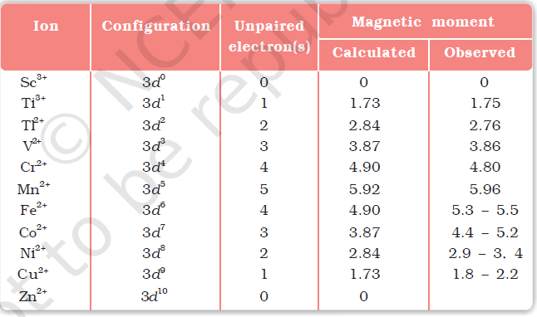

Slide 59
Calculate the magnetic moment of a divalent ion in aqueous solution.
Formation of Coloured Ions
When an electron from a lower energy d orbital is excited to a higher energy d orbital, the energy of excitation corresponds to the frequency of light absorbed.
This frequency generally lies in the visible region.
The colour observed corresponds to the complementary colour of the light absorbed.

Slide 60
The frequency of the light absorbed is determined by the nature of the ligand.
Catalytic Properties
The transition metals and their compounds are known for their catalytic activity.
This activity is ascribed to their ability to adopt multiple oxidation states and to form complexes.
Vanadium(V) oxide (in Contact Process), finely divided iron (in Haber’s Process), and nickel (in Catalytic Hydrogenation) are some of the examples.

Slide 61
Catalysts at a solid surface involve the formation of bonds between reactant molecules and atoms of the surface of the catalyst.
This has the effect of increasing the concentration of the reactants at the catalyst surface and also weakening of the bonds in the reacting molecules.
Also because the transition metal ions can change their oxidation states, they become more effective as catalysts.
For example, iron(III) catalyses the reaction between iodide and persulphate ions.

Slide 62
An explanation of this catalytic action can be given as:
Catalytic cycle for the hydrogenation of RCH=CH₂ using Wilkinson’s catalyst, RhCl(PPh₃)₃.

Slide 63
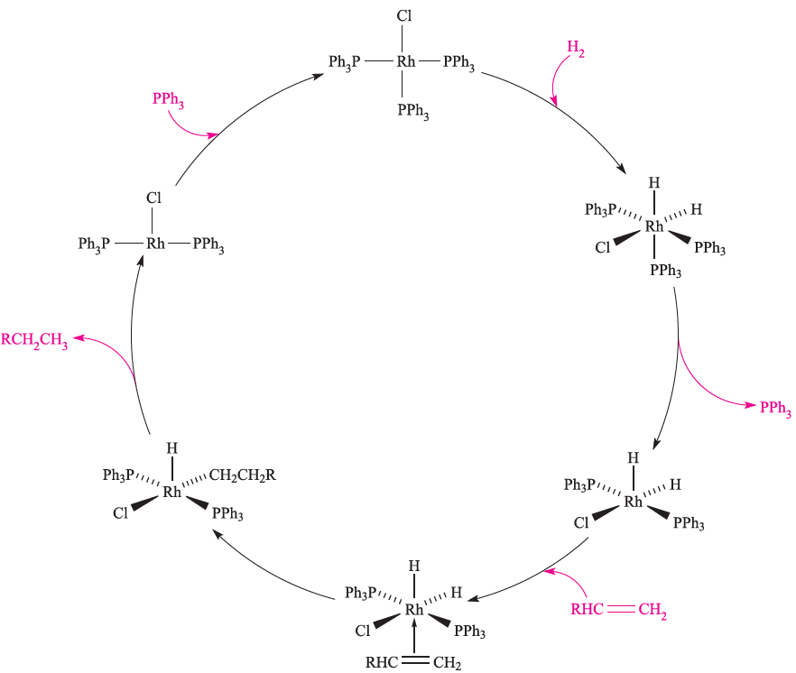

Slide 64
Non-stoichiometric compounds
Interstitial compounds are those which are formed when small atoms like H, C or N are trapped inside the crystal lattices of metals.
They are usually non stoichiometric and are neither typically ionic nor covalent, for example, TiC, Mn₄N, Fe₃H, VH_{0.56} and TiH_{1.7}, etc.
The formulas quoted do not, of course, correspond to any normal oxidation state of the metal.

Slide 65
Because of the nature of their composition, these compounds are referred to as interstitial compounds.
The principal physical and chemical characteristics of these compounds are as follows:
(i) They have high melting points, higher than those of pure metals.
(ii) They are very hard, some borides approach diamond in hardness.
(iii) They retain metallic conductivity.
(iv) They are chemically inert.

Slide 66
Descriptive Chemistry first series transition metals
Chemistry of Titanium
Properties
Titanium is Soft, silver-white metal with melting and boiling points of 1814K and 3104K respectively.
Titanium has the electronic structure [Ar] 4s²3d².
Titanium does not react with alkalis and does not dissolve in mineral acids at room temperature.
It is attacked by hot HCl, forming Ti(III) and H₂, and hot HNO₃ oxidizes the metal to hydrous TiO₂.
Titanium reacts with most non-metals at elevated temperatures; with C, O₂, N₂ and halogens.

Slide 67
The binary hydrides, carbide, nitride and borides are all inert, high-melting, refractory materials.
Ti exhibits the common oxidation numbers: +2, +3 and +4. +4 is the most stable state and corresponds to the group number.
This oxidation state is represented by the solid and ionic TiO₂ and the liquid covalent TiC₄.
The ionic character of the former means that it contains Ti⁴⁺ ions, of [Ar] configuration.
This and its high lattice energy account for its stability.
However, the high polarizing power of Ti⁴⁺, makes it energetically more favorable to form the tetrahedral covalent TiCl₄.

Slide 68
Ti(II) compounds are the least stable and liberate hydrogen from water.
On the other hand, Ti(III) compounds in acidified solution can be stored and handled in an inert atmosphere.
The d¹ configuration of Ti³⁺ give colour, and its visible absorption spectrum, unlike the colourless Ti(IV).
Occurrence and extraction of Titanium
The main ore of titanium is ilmenite (FeTiO₃), and it also occurs as three forms of TiO₂ (anatase, rutile and brookite) and perovskite.

Slide 69
Production of Ti involves conversion of rutile or ilmenite to TiCl₄ (by heating in a stream of Cl₂ at 1200K in the presence of coke) followed by reduction using Mg.
Titanium(IV) oxide is also purified via TiCl₄ in the chloride process.
Importance and compounds of titanium
Titanium metal is resistant to corrosion at ambient temperatures, and is lightweight and strong, making it valuable as a component in alloys, e.g. in aircraft construction.
Superconducting magnets (used, for example, in MRI equipment) contain NbTi multicore conductors.

Slide 70
Titanium(IV) halides can be formed from the elements; industrially, TiCl₄ is prepared by reacting TiO₂ with Cl₂ in the presence of carbon.
Titanium(IV) fluoride is a hygroscopic white solid which forms HF on hydrolysis.
Both TiCl₄ and TiBr₄ hydrolyzed more readily than TiF₄.
At 298K, TiCl₄ is a colourless liquid and TiBr₄ a yellow solid.
The tetra-iodide is a red-brown hygroscopic solid which sublimes in vacuo at 473K to a red vapor.
Tetrahedral molecules are present in the solid and vapor phases of TiCl₄, TiBr₄ and TiI₄.

Slide 71
Each tetra-halide acts as a Lewis acid; TiCl₄ is the most important, being used with AlCl₃ in Ziegler–Natta catalysts for alkenes Polymerization and as a catalyst in a variety of other organic reactions.
Dissolving dry TiO₂ in acids is difficult, but the hydrous form (precipitated by adding base to solutions of Ti(IV) salts) dissolves in HF, HCl and H₂SO₄ giving fluoro, chloro and sulfato complexes respectively.
There is no simple aqua ion of Ti⁴⁺. The reaction of TiO₂ with CaO at 1620K gives the titanate.

Slide 72
Titanium(III) fluoride is prepared by passing H₂ and HF over Ti or its hydride at 970 K; it is a blue solid (m.pt 1473 K) with a structure related to ReO₃.
The trichloride is commercially available; it is used as a catalyst in alkenes polymerization and is a powerful reducing agent.
In air, TiCl₃ is readily oxidized, and disproportionate above 750K.
2TiCl₃ TiCl₄ + TiCl₂

Slide 73
Titanium tribromide is made by heating TiBr₄ with Al, or by reaction of BBr₃ with TiCl₃
When aqueous solutions of Ti(IV) are reduced by Zn, the purple aqua ion [Ti(H₂O)₆]³⁺ is obtained.
This is a powerful reductant and is used in titrimetric analyses of Fe(III) and nitro groups (reduced to NH₂ groups); aqueous solutions of Ti(III) must be protected from aerial oxidation.

Slide 74
Chemistry of Vanadium
Properties
Ground state electronic configuration of vanadium [Ar]4s²3d³.
Vanadium is Soft, ductile, bright white metal.
It melts at 2183K and boils at 3650K. In many ways, vanadium metal is similar to Ti.
Vanadium is a powerful reductant but is passivated by an oxide film.
V²⁺ + 2e⁻ V E⁰ = -1.18V

Slide 75
The metal is insoluble in non-oxidizing acids (except HF) and alkalis, but is attacked by HNO₃, aqua-regia and peroxodisulfate solutions.
On heating, V reacts with halogens and combines with O₂ to give V₂O₅, and with B, C and N₂ to yield solid state materials.
Vanadium, like the other 3d transition metals, exhibits the common low oxidation state of +2 by the loss of its two s electrons.
In the highest oxidation state of +5, which corresponds to the group number, all the valence electrons are involved in bonding.

Slide 76
Vanadium, like the other 3d transition metals, exhibits the common low oxidation state of +2 by the loss of its two s electrons.
In the highest oxidation state of +5, which corresponds to the group number, all the valence electrons are involved in bonding.
As usual, Ο or F stabilizes this state and the oxide V₂O₅ is the most common oxide and is more ionic than the only +5 halide: VF₅.
Thermodynamically the +3 state is the most stable.
However, it is susceptible to oxidation in air.

Slide 77
The +4 state is stable in air. V(II) compounds are strong reductant whereas V(V) compounds are mild oxidants.
All the oxides representing the four oxidation states are known.
As the oxidation number and electro negativity increase, the basic character of the oxide decreases and its acidic character increases.
Thus VO and V(OH)₂ are basic whereas V₂O₄ is amphoteric and so is V₂O₅ although it is more acidic than V₂O₄.
The only binary halide of vanadium(V) is VF₅ (equation 2.2); it is a volatile white solid which is readily hydrolyzed and is a powerful fluorinating agent.

Slide 78
The oxohalides VOX₃ are made by halogenations of V₂O₅. Reaction of VOF₃ with (Me₃Si)₂O yieldsVO₂F, and treatment of VOCl₃ with Cl₂O gives VO₂Cl.
Vanadium(V) oxide is amphoteric, being sparingly soluble in water but dissolving in alkalis to give a wide range of vanadates, and in strong acids to form complexes of [VO₂]⁺.
Occurrence and extraction of Vanadium
Vanadium occurs in several minerals including vanadinite (Pb₅(VO₄)₃Cl), carnotite (K₂(UO₂)₂(VO₄)₂.3H₂O), roscoelite(a vanadium-containing mica) and the polysulfide patronite (VS₄).

Slide 79
It also occurs in phosphate rock and in some crude oils. It is not mined directly and extraction of vanadium is associated with that of other metals.
Roasting vanadium ores with Na₂CO₃ gives water soluble NaVO₃ and from solutions of this salt, the sparingly soluble [NH₄][VO₃] can be precipitated.
This is heated to give V₂O₅, reduction of which with Ca yields V.

Slide 80
Importance and compounds of Vanadium
The steel industry consumes about 85% of world supplies of V and ferrovanadium (used for toughening steels) is made by reducing a mixture of V₂O₅ and Fe₂O₃ with Al; steel–vanadium alloys are used for spring and high-speed cutting-tool steels.
Vanadium(V) oxide is used as a catalyst in the oxidations of SO₂ to SO₃ and of naphthalene to phthalic acid.

Slide 81
Chemistry of Chromium
Properties
Ground state electronic configuration of chromium is [Ar]4s¹3d⁵.
chromium is hard; blue-white metal with melting and boiling points of 2180 K and 2945 K respectively.
At ordinary temperatures, Cr metal is resistant to chemical attack (although it dissolves in dilute HCl and H₂SO₄).
Nitric acid renders Cr passive, and Cr is resistant to alkalis.

Slide 82
At higher temperatures the metal is reactive: it decomposes steam and combines with O₂, halogens, and most other non-metals.
Borides, carbides and nitrides exist in various phases (e.g. CrN, Cr₂N, Cr₃N, Cr₃N₂) and are inert materials (e.g. CrN is used in wear-resistant coatings).
The black sulfide Cr₂S₃ is formed by direct combination of the elements on heating; a range of other sulfides are known, but methods of synthesis vary.
The main oxidation states of chromium are +6, +3 and +2.

Slide 83
Although the ground state electronic configuration of Cr: 3d⁵4s¹ suggests the formation of Cr(I) compounds, it is energetically more favorable to form Cr²⁺ ions in solution or in solid compounds.
However, oxidation states of +1 or lower are stabilized in presence of π-bonding ligands.
The +2 is the lowest common oxidation state of Cr but Cr(II) compounds are powerful reductants which are readily oxidized to Cr(III): the most stable state.
A few compounds of Cr(V) and Cr(IV) are known, but are unstable with respect to disproportionation.

Slide 84
Occurrence and extraction of Chromium
The major ore of chromium is chromite (FeCr₂O₄) which has a normal spinel structure.
Chromite is reduced with carbon to produce ferrochromium for the steel industry; stainless steels contain Cr to increase their corrosion resistance.
For the production of Cr metal, chromite is fused with Na₂CO₃ in the presence of air to give water-soluble Na₂CrO₄ and insoluble Fe₂O₃.
Extraction with water followed by acidification with H₂SO₄ gives a solution from which Na₂Cr₂O₇ can be crystallized.

Slide 85
Importance and compounds of Chromium
The corrosion resistance of Cr leads to its widespread use as a protective coating (chromium plating); the metal is deposited by electrolysing aqueous Cr₂(SO₄)₃, produced by dissolving Cr₂O₃ in H₂SO₄.
After the steel industry, the next major consumer of Cr (25%) is the chemical industry; applications include pigments (e.g. chrome yellow), tanning agents, mordants, catalysts and oxidizing agents.
Chromite is used as a refractory material, e.g. in refractory bricks and furnace linings.
Chromium compounds are toxic; chromates are corrosive to skin.

Slide 86
The only halide of chromium(VI) to have been reported is yellow CrF₆, produced by fluorination of the metal at 670K and 200 bar followed by rapid chilling.
The material so prepared reacts violently in moist air and decomposes at 173K into CrF₅ and F₂.
The oxohalides CrO₂F₂ and CrO₂Cl₂ are much more stable. Chromium(VI) oxide (‘chromic acid’), CrO₃, separates as a purple-red solid when concentrated H₂SO₄ is added to a solution of a dichromate(VI) salt; it is a powerful oxidant with uses in organic synthesis.

Slide 87
It melts at 471K and at slightly higher temperatures decomposes to Cr₂O₃ and O₂ with CrO₂ formed as an intermediate.
Chromium(VI) oxide dissolves in base to give yellow solutions of [CrO₄]²⁻.
Chromium(VI) is a powerful oxidizing agent in acidic solution.
Both Na₂Cr₂O₇ and K₂Cr₂O₇ are manufactured on a large scale; K₂Cr₂O₇ is less soluble than Na₂Cr₂O₇.
Both are widely used as oxidants in organic syntheses.

Slide 88
Chromium(VI) compounds are highly toxic (suspected carcinogens) and must be stored away from combustible materials.
Unlike CrF₆, CrF₅ is well established.
It is a red, volatile solid (mp 303 K), formed by direct combination of the elements at around 570K.
The vapour is yellow and contains distorted trigonal bipyramidal CrF₅ molecules.
It is a strong oxidizing and fluorinating agent.
For Cr(V), the fluoride is the only halide known.
Pure CrF₄ can be made by fluorination of Cr using HF/F₂ under solvothermal conditions.

Slide 89
The pure material is violet, but the colour of samples prepared by different routes varies (green, green-black, brown) with descriptions being affected by the presence of impurities.
Chromium(IV) chloride and bromide have been prepared but are unstable. Chromium(IV) oxide, CrO₂, is usually made by controlled decomposition of CrO₃.
It is a brown-black solid which has the rutile structure and is a metallic conductor.
The +3 oxidation state is the most stable for chromium in its compounds and octahedral coordination dominates for Cr(III) centres.

Slide 90
Anhydrous CrCl₃ (red-violet solid, mp 1425 K) is made from the metal and Cl₂, and is converted to green CrF₃ by heating with HF at 750 K.
Solid CrF₃ is isostructural with VF₃, and CrCl₃ adopts a BiI₃ structure.
The dark green tribromide and triiodide can be prepared from Cr and the respective halogen and are isostructural with CrCl₃.
Chromium(III) trifluoride is sparingly soluble and may be precipitated as the hexahydrate.
Although pure CrCl₃ is insoluble in water, addition of a trace of Cr(II) (e.g. CrCl₂) results in dissolution.

Slide 91
Chromium(III) oxide is made by combination of the elements at high temperature, or by reduction of CrO₃.
Anhydrous CrF₂, CrCl₂ and CrBr₂ are made by reacting Cr with HX (X=F, Cl, Br) at >850 K; CrI₂ is formed by heating the elements.
Crystals of CrCl₂ are colourless but dissolve in water to give blue solutions of the strongly reducing hexaaqua ion.
Solutions of [Cr(H₂O)₆]²⁺ are usually obtained by dissolving Cr in acids or by reduction (Zn amalgam or electrolytically) of Cr(III)-containing solutions.
Hydrated salts such as Cr(ClO₄)₂.6H₂O, CrCl₂.4H₂O and CrSO₄.7H₂O may be isolated from solution, but cannot be dehydrated without decomposition.

Slide 92
Chemistry of Manganese
Properties
Ground state electronic configuration of manganese is [Ar]4s²3d⁵.
Manganese is Hard; lustrous silver-blue metal with melting and boiling points of 1519 K and 2235K respectively.
Metallic Mn is slowly attacked by water and dissolves readily in acids.
The finely divided metal is pyrophoric in air, but the bulk metal is not attacked unless heated.
At elevated temperatures, it combines with most non-metals, halogens, N₂, C, Si and B.

Slide 93
Manganese exhibits the widest range of oxidation states of any of the first row d-block metals and more common oxidation numbers than the other 3d transition metals.
The lowest common oxidation state of +2, represented by Mn²⁺, is the most stable especially in acidic solution.
This stability is related to its exactly haif-filled d⁵ sub level. The lowest states are stabilized by -acceptor ligands.
All oxidation states above Mn(II) are powerful oxidizing agents.

Slide 94
Occurrence and extraction of Manganese
Several oxides of manganese occur naturally, the most important being pyrolusite (β-MnO₂); South Africa holds 80% of the world’s ore reserves but mine production in China, South Africa and Ukraine is currently at similar levels.
Little recycling of Mn currently takes place.
Manganese nodules containing up to 24% of the metal have been discovered on the ocean bed.

Slide 95
Importance and compounds of Manganese
The main use of the element is in the steel industry; pyrolusite is mixed with Fe₂O₃ and reduced with coke to give ferromanganese (80%Mn).
Almost all steels contain some Mn; those with a high Mn content (up to 12%) possess very high resistance to shock and wear and are suitable for crushing, grinding and excavating machinery.
Manganese metal is produced by the electrolysis of MnSO₄ solutions. Manganese(IV) oxide is used in dry cell batteries.

Slide 96
The strong oxidizing power of KMnO₄ makes this an important chemical; Mn is an essential trace element for plants, and small amounts of MnSO₄ are added to fertilizers.
Binary halides of Mn(VII) have not been isolated.
The oxohalides MnO₃F and MnO₃Cl may be made by reacting KMnO₄ with HSO₃X at low temperature; both are powerful oxidants and decompose explosively at room temperature.
Manganese(VII) chemistry is dominated by the manganate(VII) ion (permanganate).
The potassium salt, KMnO₄, is a strong oxidizing agent and is corrosive to human tissue; it is manufactured on a large scale by conversion of MnO₂ to K₂MnO₄ followed by electrolytic oxidation.

Slide 97
Solid KMnO₄ forms dark purple-black crystals and is isostructural with KClO₄.
Aqueous solutions of KMnO₄ deposit MnO₂ on standing.
Potassium permanganate is intensely coloured owing to charge transfer from O to Mn.
No binary halides of Mn(VI) have been isolated, and the only oxohalide is MnO₂Cl₂.
It is prepared by reducing KMnO₄ with SO₂ at low temperature in HSO₃Cl, and is a brown liquid which readily hydrolyses and decomposes at 240 K.
Salts of dark green [MnO₄]²⁻ are made by fusing MnO₂ with group one metal hydroxides in the presence of air.

Slide 98
Manganate(VI) is unstable with respect to disproportionation in the presence of even weak acids such as H₂CO₃ and is therefore not formed in the reduction of acidified [MnO₄]⁻.
3[MnO₄]²⁻ + 4H⁺ 2[MnO₄]⁻ + MnO₂ + 2H₂O
The only binary halide of Mn(IV) is MnF₄, prepared from the elements.
It is an unstable blue solid which decomposes at ambient temperatures.

Slide 99
Manganese(IV) oxide is polymorphic and often markedly non-stoichiometric.
It acts as an oxidizing agent when heated with concentrated acids.
The only binary halide of Mn(III) is the red-purple MnF₃ which is made by the action of F₂ on Mn(II) halides at 520 K.
It is thermally stable but is immediately hydrolysed by water.
The solid state structure of MnF₃ is related to those of TiF₃, VF₃, CrF₃, FeF₃ and CoF₃.
The red aqua ion [Mn(H₂O)₆]³⁺ can be obtained by electrolytic oxidation of aqueous Mn²⁺ and is present in the alum CsMn(SO₄)₂.12H₂O.

Slide 100
Chemistry of Iron
Properties
Ground state electronic configuration of iron is [Ar]4s²3d⁶.
Iron is Hard; lustrous silver-blue metal with melting and boiling points of 1811K and 3023K respectively.
Finely divided Fe is pyrophoric in air, but the bulk metal oxidizes in dry air only when heated.
In moist air, Fe rusts, forming a hydrated oxide Fe₂O₃.xH₂O.
Iron reacts with halogens at 470–570K to give FeF₃, FeCl₃, FeBr₃ and FeI₂, respectively.

Slide 101
The metal dissolves in dilute mineral acids to yield Fe(II) salts, but concentrated HNO₃ and other powerful oxidizing agents make it passive; it is unaffected by alkalis.
When powdered iron and sulfur are heated together, FeS is produced.
The chemistry of iron is less extensive than that of manganese. After group 7, transition metals become reluctant to achieve high oxidation states.
The common oxidation states of iron are +2, +3 and +6.
The latter is only stable as the tetrahedral [FeO₄]²⁻ in alkaline solution and quickly liberate O₂ at lower pH values.

Slide 102
Iron (II) is represented by the non-stoichiometric oxide and numerous salts and complexes.
Although it has a d⁶ configuration, most of its complexes are high spin.
Most of the chemistry of Fe involves Fe(II) or Fe(III), with Fe(IV) and Fe(VI) known in a small number of compounds; Fe(V) is rare.
Ligands capable of π bonding stabilize oxidation states lower than 2.

Slide 103
Occurrence and extraction of Iron
Iron is the most important of all metals and is the fourth most abundant element in the Earth’s crust.
The Earth’s core is believed to consist mainly of iron and it is the main constituent of metallic meteorites.
The chief ores are haematite (α-Fe₂O₃), magnetite (Fe₃O₄), siderite (FeCO₃), goethite (α-Fe(O)OH) and lepidocrocite (ɤ-Fe(O)OH).
While iron pyrites (FeS₂) and chalcopyrite (CuFeS₂) are common, their high sulfur contents render them unsuitable for Fe production.

Slide 104
Pure Fe (made by reduction of the oxides with H₂) is reactive and rapidly corrodes; finely divided iron is pyrophoric.
Importance and compounds of Iron
Although pure iron is not of commercial importance, steel production is carried out on a huge scale.
α-Iron(III) oxide is used as a polishing and grinding agent and in the formation of ferrites; iron oxides are important commercial pigments: α-Fe₂O₃ (red), ɤ-Fe₂O₃ (red-brown), Fe₃O₄ (black) and Fe(O)OH (yellow).

Slide 105
Iron is of immense biological importance, and is present in, for example, haemoglobin and myoglobin (O₂ carriers), ferredoxins and cytochromes (redox processes), ferritin (iron storage), acid phosphatase (hydrolysis of phosphates), superoxide dismutases (O₂ dismutation) and nitrogenase (nitrogen fixation).
A deficiency of iron in the body causes anaemia, while an excess causes haemochromatosis

Slide 106
Chemistry of Cobalt
Ground state electronic configuration of cobalt is [Ar]4s²3d⁷.
Cobalt is Hard; brittle; lustrous blue-white metal with melting and boiling points of 1768 K and 3143 K respectively.
Cobalt is less reactive than Fe and its chemistry is simpler than that of iron ; Co does not react with O₂ unless heated, and in very finely divided form it is pyrophoric.
It dissolves slowly in dilute mineral acids, but concentrated HNO₃ makes it passive; alkalis have no effect on the metal.

Slide 107
Cobalt reacts at 520K with F₂ to give CoF₃, but with Cl₂, Br₂ and I₂, CoX₂ is formed.
Even when heated, cobalt does not react with H₂ or N₂, but it does combine with B, C, P, As and S.
The trend in decreasing stability of high oxidation states on going from Mn to Fe continues along the row.
The +6 state is the highest oxidation state but it is of far less importance than Co(III) and Co(II).
Although the two common oxidation states of +2 and +3 are known, Co³⁺ is not stable in aqueous solution, liberating oxygen from water.

Slide 108
Cobalt (I) and lower oxidation states are stabilized in organometallic species by-acceptor ligands.
Occurrence and extraction of Cobalt
Cobalt occurs as a number of sulfide and arsenide ores including cobaltite (CoAsS) and skutterudite ((Co,Ni)As₃ which contains planar As4-units).
Production of the metal generally relies on the fact that it often occurs in ores of other metals (e.g. Ni, Cu and Ag) and the final processes involve reduction of Co₃O₄ with Al or C followed by electrolytic refining.

Slide 109
Importance and compounds of Cobalt
Pure Co is brittle but it is commercially important in special steels, alloyed with Al, Fe and Ni(Alnico is a group of carbon-free alloys) in permanent magnets, and in the form of hard, strong, corrosion-resistant non-ferrous alloys (e.g. with Cr and W) which are important in the manufacture of jet engines and aerospace components.
Cobalt compounds are widely used as pigments (blue hues in porcelain, enamels and glass, catalysts and as additives to animal feeds.

Slide 110
Vitamin B₁₂ is a cobalt complex, and a range of enzymes require B₁₂ coenzymes.
The artificial isotope ⁶⁰Co is used as a tracer.
Few Co(IV) species have been established.
Yellow Cs₂[CoF₆] is obtained by fluorination of a mixture of CsCl and CoCl₂ at 570 K.
Cobalt(IV) oxide is prepared by oxidizing Co(II) using alkaline hypochlorite and it is poorly defined.
Several mixed oxides are known: Ba₂CoO₄ and M₂CoO₃ (M=K, Rb, Cs).

Slide 111
There are few binary compounds of Co(III) and only a limited number of Co(III) compounds are commercially available.
The only binary halide is brown CoF₃ which is isostructural with FeF₃.
It is used as a fluorinating agent, e.g. for preparing perfluorinated organics, and is corrosive and an oxidant.
The reaction of N₂O₅ with CoF₃ at 200K gives the dark green, anhydrous Co(NO₃)₃.
Although reports of Co₂O₃ are found in the literature, the anhydrous compound probably does not exist.

Slide 112
In contrast to Co(III), Co(II) forms a variety of simple compounds and all four Co(II) halides are known.
Reaction of anhydrous CoCl₂ with HF at 570K gives sparingly soluble pink CoF₂ which crystallizes with the rutile structure.
Blue CoCl₂ is made by combination of the elements and has a CdCl₂ lattice.
It turns pink on exposure to moisture and readily forms hydrates.
The dark pink hexahydrate is commercially available and is a common starting material in Co(II) chemistry.
In aqueous solutions of CoCl₂, the major species are [Co(H₂O)₆]²⁺, [CoCl(H₂O)₅]⁺ and [CoCl₄]²⁻, and the minor species are [CoCl₂(H₂O)₄] and [CoCl₃(H₂O)]⁻.

Slide 113
Chemistry of Nickel
Properties
Ground state electronic configuration of nickel is [Ar]4s²3d⁸.
Nickel is Hard; malleable and ductile; grey-white metal with melting and boiling points of 1728 K and 3005 K respectively.
It is attacked by dilute mineral acids, made passive by concentrated HNO₃, and is resistant to aqueous alkalis.
The bulk metal is oxidized by air or steam only at high temperatures, but Raney nickel is pyrophoric.

Slide 114
Nickel reacts with F₂ to give a coherent coating of NiF₂ which prevents further attack; hence the use of nickel and its alloy Monel metal in apparatus for handling F₂ or xenon fluorides.
With Cl₂, Br₂ and I₂, Ni(II) halides are formed.
At elevated temperatures, Ni reacts with P, S and B and a range of different phosphide, sulfide and boride phases are known.
Nickel(II) is far the most important oxidation state for the metal.

Slide 115
The +2oxidation state dominates the chemistry of nickel.
Low oxidation states are most common in organometallic species, but other Ni(0) species include [Ni(PF₃)₄] and [Ni(CN)₄]⁴⁻.
Yellow K₄[Ni(CN)₄] is made by reduction of K₂[Ni(CN)₄] in liquid NH₃ using excess K, but oxidizes immediately on exposure to air.
Occurrence and extraction of Nickel
Like cobalt, nickel occurs as sulfide and arsenide minerals, e.g. pentlandite, (Ni,Fe)₉S₈.

Slide 116
Roasting such ores in air gives nickel oxide which is then reduced to the metal using carbon.
The metal is refined electrolytically or by conversion to Ni(CO)₄ followed by thermal decomposition.
This is the Mond process which is based on the fact that Ni forms a carbonyl derivative more readily than any other metal.
Importance and compounds of Nickel
Nickel is used extensively in alloys, notably in stainless steel, other corrosion-resistant alloys such as Monel metal, and coinage metals.

Slide 117
Electroplated Ni provides a protective coat for other metals.
Nickel has widespread use in batteries; recently, this has included the production of ‘environmentally friendly’ nickel–metal hydride batteries which out-perform NiCd cells as rechargeable sources of power in portable appliances.
Nickel is an important catalyst, e.g. for the hydrogenation of unsaturated organic compounds and in the water–gas shift reaction

Slide 118
Chemistry of Copper
Properties
Its ground state electronic configuration is [Ar]4s¹3d¹⁰.
Copper is Malleable and ductile; reddish metal with melting and boiling points of 1358 K and 2840 K respectively.
Copper is the least reactive of the first row metals.
It is not attacked by non-oxidizing acids in the absence of air, but it reacts with hot concentrated sulfuric acid and with HNO₃ of all concentrations.
In the presence of air, Cu reacts with many dilute acids and also dissolves in aqueous NH₃ to give [Cu(NH₃)₄]²⁺.
When heated strongly, Cu combines with O₂.

Slide 119
Heating Cu with F₂, Cl₂ or Br₂ produces the corresponding dihalide.
Copper is the only first row d-block metal to exhibit a stable +1 oxidation state.
In aqueous solution, Cu(I) is unstable by a relatively small margin with respect to Cu(II) and the metal.
Copper(I) can be stabilized by the formation of an insoluble compound like CuCl or a complex Cu(CN)₄]³⁻.
Copper(0) is rarely stabilized; the unstable Cu₂(CO)₆ has been isolated in a matrix at low temperature.
The highest oxidation state attained for copper is +4.

Slide 120
Occurrence and extraction of Copper
Copper is, by a considerable margin, the most noble of the first row metals and occurs native in small deposits in several countries.
The chief ore is chalcopyrite (CuFeS₂) (80% of world copper production); others include chalcanthite (CuSO₄.5H₂O), atacamite (Cu₂Cl(OH)₃), cuprite (Cu₂O) and malachite (Cu₂(OH)₂CO₃).
Polished malachite is widely used for decorative purposes.
The first step in Cu production is to roast chalcopyrite in a limited air supply to give Cu₂S and FeO; the latter is removed by combination with silica to form a slag, and Cu₂S is converted to Cu by reaction with oxygen.

Slide 121
Importance and compounds of Copper
Being corrosion-resistant, Cu is in demand for water and steam piping and is used on the exterior of buildings, e.g. roofing and flashing, where long-term exposure results in a green patina of basic copper sulfate or carbonate.
Alloys of Cu such as brass (Cu/Zn), bronze (Cu/Sn), nickel silver (Cu/Zn/Ni) and
coinage metal (Cu/Ni) are commercially important.
Copper(II) sulfate is used extensively as a fungicide.
Copper has a vital biochemical role, e.g. in cytochrome oxidase (involved in reduction of O₂ to H₂O) and haemocyanin (an O₂-carrying copper protein in arthropods).

Slide 122
Copper compounds have numerous catalytic uses, and analytical applications include the biuret test and use of Fehling’s solution.
Chemistry of Zinc
Properties
Its ground state electronic configuration is [Ar]4s²3d¹⁰.
Zinc is Brittle at 298K; malleable 373–423K; Lustrous blue-white metal with melting and boiling points of 693 K and 1180 K respectively.
Zinc is not attacked by air or water at room temperature, but the hot metal burns in air and decomposes steam, forming ZnO.

Slide 123
Zinc is much more reactive than Cu, liberating H₂ from dilute mineral acids and from alkalis.
On heating, Zn reacts with all the halogens to give ZnX₂, and combines with elemental S and P.
The first (Sc) and last (Zn) members of the first row of the d-block exhibit a more restricted range of oxidation states than the other metals.
The zinc group metals: Zn, Cd and Hg form the M²⁺ ions by losing the two s electrons, the elements which have a completed sub-shell.

Slide 124
This stable configuration explains the prominence of the +2 oxidation state in binary and complex compounds.
This configuration also accounts for the diamagnetism of the compounds and the absence of d-d bands in their electronic spectra.
The +1 oxidation state is significant for Hg but becomes much less significant in Cd and is hardly observed in Zn.
The chemistry of Zn is confined to that of Zn(II).

Slide 125
Occurrence and extraction of Zinc
The principal ores of zinc are sphalerite (zinc blende, ZnS), calamine (hemimorphite, Zn₄Si₂O₇(OH)₂H₂O) and smithsonite (ZnCO₃).
Extraction from ZnS involves roasting in air to give ZnO followed by reduction with carbon.
Zinc is more volatile (bp 1180 K) than most metals and can be separated by rapid chilling (to prevent reversing the reaction) and purified by distillation or electrolysis.
Recycling of Zn has grown in importance, providing a secondary source of the metal.

Slide 126
Importance and compounds of Zinc
Zinc is used to galvanize steel and Zn alloys are commercially important, e.g. brass (Cu/Zn) and nickel silver (Cu/Zn/Ni).
Dry cell batteries use zinc as the anode.
A recent development is that of the zinc–air battery for use in electrically powered vehicles.
Binary halides are best made by action of HF, HCl, Br₂ or I₂ on hot Zn; ZnF₂ is also prepared by thermal decomposition of Zn(BF₄)₂.
Solid ZnF₂ adopts a rutile structure and has a high lattice energy and melting point.

Slide 127
Evidence for significant covalent character is apparent in the structures and properties of ZnCl₂, ZnBr₂ and ZnI₂ which possess layer lattices, have lower melting points than ZnF₂ and are soluble in a range of organic solvents.
The water solubility of ZnF₂ is low, but ZnCl₂, ZnBr₂ and ZnI₂ are highly soluble.
ZnO is its most important compound.
It is a white solid with the wurtzite structure at 298 K.
It turns yellow on heating and in this form is a semiconductor owing to loss of oxygen and production of some interstitial Zn atoms.

Slide 128
Zinc oxide is amphoteric, dissolving in acids to give solutions containing [Zn(H₂O)₆]²⁺ or derivatives there of (some anions coordinate to Zn²⁺), but hydrolysis of [Zn(H₂O)₆]²⁺ occurs to give various solution species resulting from H⁺ loss.
In alkalis, ZnO forms zincates such as [Zn(OH)_{4]}²⁻.
This ion also forms when Zn(OH)₂ dissolves in aqueous alkalis.
Zinc hydroxide is water-insoluble and thermodynamically the most stable.
Zinc sulfide occurs naturally as the minerals zinc blend and, more rarely, wurtzite; these are structural prototypes.

Slide 129
The conversion of ZnS to ZnO by roasting in air is the commercial method of producing the oxide.
Other Zn(II) compounds that are commercially available include the carbonate, sulfate and nitrate.
The sulfate is very soluble in water; crystals of ZnSO₄.7H₂O form on evaporating solutions from reactions of Zn, ZnO, Zn(OH)₂ or ZnCO₃ with aqueous H₂SO₄.
Zinc nitrate can be obtained as one of several hydrates, of which Zn(NO₃)₂.6H₂O is the most common.
Anhydrous Zn(NO₃)₂ is made from Zn and N₂O₄ since heating the hydrates yields hydroxy salts.

Slide 130
CHAPTER TWO
Chemistry of f-block elements
The elements constituting the f -block are those in which the 4f and 5f orbitals are progressively filled in the latter two long periods;
these elements are formal members of group 3 from which they have been taken out to form a separate f-block of the periodic table.
The f-block consists of the two series, lanthanoids (the fourteen elements following lanthanum) and actinoids (the fourteen elements following actinium).

Slide 132
Because lanthanum closely resembles the lanthanoids,
it is usually included in any discussion of the lanthanoids for which the general symbol Ln is often used.
Similarly, a discussion of the actinoids includes actinium besides the fourteen elements constituting the series.
The lanthanoids resemble one another more closely than do the members of ordinary transition elements in any series.

Slide 133
They have only one stable oxidation state and their chemistry provides an excellent opportunity to examine the effect of small changes in size and nuclear charge along a series of otherwise similar elements.
The chemistry of the actinoids is, on the other hand, much more complicated.
The complication arises partly owing to the occurrence of a wide range of oxidation states in these elements and partly because their radioactivity creates special problems in their study.

Slide 134
The Lanthanoids
Electronic Configurations
It may be noted that atoms of these elements have electronic
configuration with 6s² common but with variable occupancy of 4f level.
However, the electronic configurations of all the tripositive
ions (the most stable oxidation state of all the lanthanoids) are of the form 4f^{n} (n = 1 to 14 with increasing atomic number).

Slide 135
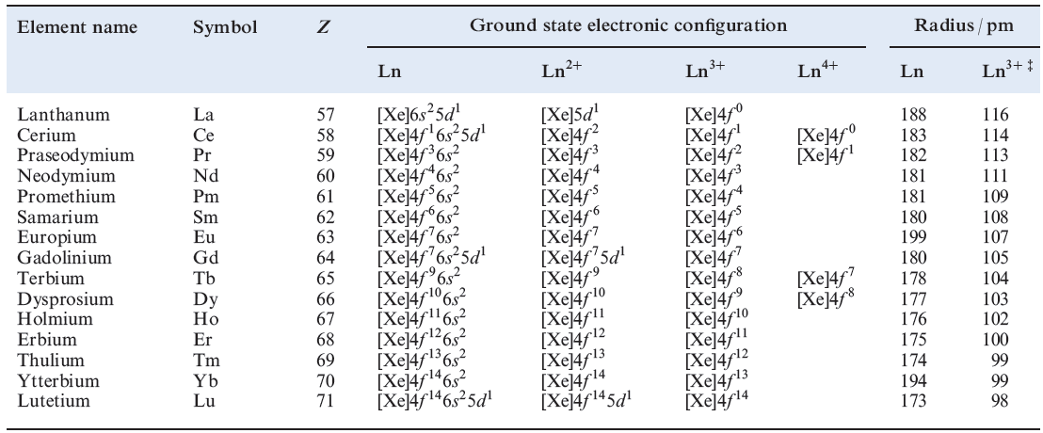

Slide 136
Atomic and Ionic Sizes
The overall decrease in atomic and ionic radii from lanthanum to lutetium (the lanthanoid contraction) is a unique feature in the chemistry of the lanthanoids.
The decrease in atomic radii (derived from the structures of
metals) is not quite regular as it is regular in M³⁺ ions.

Slide 137
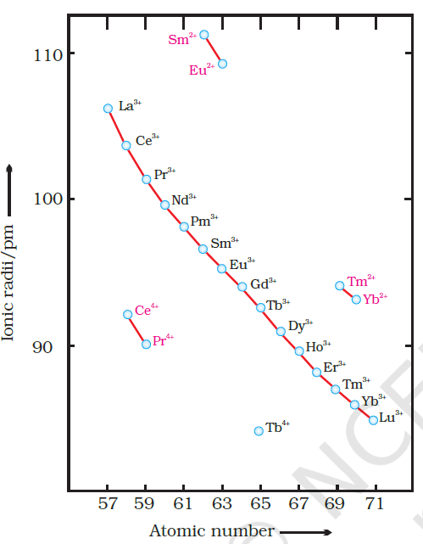

Slide 138
Oxidation States
In the lanthanoids, La(II) and Ln(III) compounds are predominant species.
However, occasionally +2 and +4 ions in solution or in solid compounds are also obtained.
This irregularity arises mainly from the extra stability of empty, half-filled or filled f subshell.
Thus, the formation of Ce^{IV} is favoured by its noble gas configuration, but it is a strong oxidant reverting to the common +3 state.

Slide 139
The Eº value for Ce⁴⁺/ Ce³⁺ is +1.74 V which suggests that it can oxidise water.
However, the reaction rate is very slow and hence Ce(IV) is a good analytical reagent.
Pr, Nd, Tb and Dy also exhibit +4 state but only in oxides, MO₂.
Eu²⁺ is formed by losing the two s electrons and its f⁷ configuration accounts for the formation of this ion.
However, Eu²⁺ is a strong reducing agent changing to the common +3 state.
Similarly Yb²⁺ which has f ¹⁴ configuration is a reductant.

Slide 140
The behaviour of samarium is very much like europium, exhibiting both +2 and +3 oxidation states.
General physical and chemical properties
All the lanthanoids are silvery white soft metals and tarnish rapidly in air.
The hardness increases with increasing atomic number, samarium being steel hard.
Their melting points range between 1000 to 1200 K but samarium melts at 1623 K.

Slide 141
They have typical metallic structure and are good conductors of heat and electricity.
Density and other properties change smoothly except for Eu and Yb and occasionally for Sm and Tm.
Many trivalent lanthanoid ions are coloured both in the solid state
and in aqueous solutions.
Colour of these ions may be attributed to the presence of f electrons.

Slide 142
Neither La³⁺ nor Lu³⁺ ion shows any colour but the rest do so.
However, absorption bands are narrow, probably because of the excitation within f level.
The lanthanoid ions other than the f⁰ type (La³⁺ and Ce⁴⁺) and the f¹⁴ type (Yb²⁺ and Lu³⁺) are all paramagnetic.
The paramagnetism rises to maximum in neodymium.

Slide 143
The first ionisation enthalpies of the lanthanoids are around
600 kJ mol^{–1}, the second about 1200 kJ mol^{–1} comparable with those of calcium.
In general, the earlier members of the series are quite reactive similar to calcium but, with increasing atomic number, they behave more like aluminium.
The metals combine with hydrogen when gently heated in the gas.
The carbides, Ln₃C, Ln₂C₃ and LnC₂ are formed when the metals are heated with carbon.

Slide 144
They liberate hydrogen from dilute acids and burn in halogens to form halides.
They form oxides M₂O₃ and hydroxides M(OH₎₃.
The hydroxides are definite compounds, not just hydrated oxides.
They are basic like alkaline earth metal oxides and hydroxides.

Slide 145
The Actinoids
The actinoids include the fourteen elements from Th to Lr.
The actinoids are radioactive elements and the earlier members have relatively long half-lives,
the latter ones have half-life values ranging from a day to 3 minutes for lawrencium (Z =103).
The latter members could be prepared only in nanogram quantities.
These facts render their study more difficult.

Slide 146
Electronic Configurations
All the actinoids are believed to have the electronic configuration of 7s² and variable occupancy of the 5f and 6d subshells.
The fourteen electrons are formally added to 5f, though not in thorium (Z = 90) but from Pa onwards the 5f orbitals are complete at element 103.
The irregularities in the electronic configurations of the actinoids,
like those in the lanthanoids are related to the stabilities of the f⁰, f ⁷ and f¹⁴ occupancies of the 5f orbitals.

Slide 147
Thus, the configurations of Am and Cm are [Rn] 5f ⁷7s² and [Rn] 5f⁷6d¹7s².
Although the 5f orbitals resemble the 4f orbitals in their angular part of the wave-function,
they are not as buried as 4f orbitals and hence 5f electrons can participate in bonding to a far greater extent.
Ionic Sizes
The general trend in lanthanoids is observable in the actinoids as well.

Slide 148
There is a gradual decrease in the size of atoms or M³⁺ ions across the series.
This may be referred to as the actinoid contraction (like lanthanoid contraction).
The contraction is, however, greater from element to element in this series resulting from poor shielding by 5f electrons.
Oxidation States
There is a greater range of oxidation states, which is in part attributed to the fact that the 5f, 6d and 7s levels are of comparable energies.

Slide 149
The actinoids show in general +3 oxidation state.
The elements, in the first half of the series frequently exhibit higher oxidation states.
For example, the maximum oxidation state increases from +4 in Th to +5, +6 and +7 respectively in Pa, U and Np but decreases in succeeding elements .
The actinoids resemble the lanthanoids in having more compounds in +3 state than in the +4 state.
However, +3 and +4 ions tend to hydrolyse.

Slide 150
Because the distribution of oxidation states among the actinoids is so uneven and so different for the former and later elements,
it is unsatisfactory to review their chemistry in terms of oxidation states.
General Properties and Comparison with Lanthanoids
The actinoid metals are all silvery in appearance but display
a variety of structures.

Slide 151
The structural variability is obtained due to irregularities in metallic radii which are far greater than in lanthanoids.
The actinoids are highly reactive metals, especially when finely divided.
The action of boiling water on them, for example,
gives a mixture of oxide and hydride and combination with most non metals takes place at moderate temperatures.
HCl attacks all metals but most are slightly affected by nitric acid owing to the formation of protective oxide layers; alkalies have no action.

Slide 152
The magnetic properties of the actinoids are more complex than those of the lanthanoids.
Although the variation in the magnetic susceptibility of the actinoids with the number of unpaired 5f electrons is roughly parallel to the corresponding results for the lanthanoids,
the latter have higher values.
It is evident from the behaviour of the actinoids that the ionisation enthalpies of the early actinoids, though not accurately known,
but are lower than for the early lanthanoids.

Slide 153
This is quite reasonable since it is to be expected that when 5f orbitals are beginning to be occupied, they will penetrate less into the inner core of electrons.
The 5f electrons, will therefore, be more effectively shielded from the nuclear charge than the 4f electrons of the corresponding lanthanoids.
Because the outer electrons are less firmly held, they are available for bonding in the actinoids.

Slide 154
A comparison of the actinoids with the lanthanoids,
with respect to different characteristics as discussed above,
reveals that behaviour similar to that of the lanthanoids is not evident until the second half of the actinoid series.
However, even the early actinoids resemble the lanthanoids in showing close similarities with each other and in gradual variation in properties which do not entail change in oxidation state.

Slide 155
The lanthanoid and actinoid contractions, have extended effects on the sizes, and therefore, the properties of the elements succeeding them in their respective periods.
The lanthanoid contraction is more important because the chemistry of elements succeeding the actinoids are much less known at the present time.
Properties of Lanthanoids
Lanthanum and the lanthanoids, except Eu, crystallize in one or both of the close-packed structures; Eu has a bcc lattice.

Slide 156
All the lanthanoids are soft white metals.
The later metals are passivated by an oxide coating and are kinetically more inert than the earlier metals.
All the metals liberate H₂ from dilute acids or steam.
They burn in air to give Ln₂O₃ with the exception of Ce which
forms CeO₂.
When heated, lanthanoids react with H₂ to give a range of compounds between metallic (i.e. conducting) hydrides LnH₂ (best formulated as Ln³⁺(H⁻)₂(e⁻)) and saline hydrides LnH₃.

Slide 157
Non-stoichiometric hydrides are typified by ‘GdH₃’ which actually has compositions in the range GdH_{2.85-3}.
Europium forms only EuH₂.
The alloy LaNi₅ is a potential ‘hydrogen storage vessel’ since it reversibly absorbs H_{2.}
The carbides Ln₂C₃ and LnC₂ are formed when the metals are heated with carbon.
The LnC₂ carbides adopt the same structure as CaC₂, but the CC bonds (128 pm) are significantly lengthened (119pm in CaC₂).

Slide 158
Occurrence and separation of the lanthanoides
All the lanthanoides except Pm occur naturally.
The most stable isotope of promethium, 147Pm (β-emitter) is formed as a product of the fission of heavy nuclei and is obtained in mg amounts from products of nuclear reactors.
Bastnasite and monazite are the main ores for La and the lanthanoids.
All the metals (excluding Pm) can be obtained from monazite, a mixed phosphate (Ce, La, Nd, Pr,Th,Y . . .)PO₄.

Slide 159
Bastnasite, (Ce, La . . .)CO₃F, is a source of the lighter lanthanoids.
The first step in extraction of the metals from monazite is removal of phosphate and thorium.
The ore is heated with caustic soda, and, after cooling, Na₃PO₄ is dissolved in water.
The residual hydrated Th(IV) and Ln(III) oxides are treated with hot, aqueous HCl; ThO₂ is not dissolved, but the Ln(III) oxides give a solution of MCl₃ (M = La, Ce. . .) which is then purified.

Slide 160
Starting from bastnasite, the ore is treated with dilute HCl to remove CaCO₃, and then converted to anaqueous solution of MCl₃ (M = La, Ce . . .).
The similarity in ion size and properties of the lanthanoids makes separation difficult.
The actinoid metals
The artificial nature of all but two of the actinoid metals affects the extent of knowledge of their properties, and this is reflected in the varying amounts of information that we give for each metal.
The instability of the actinoids with respect to radioactive decay has already been mentioned

Slide 161
All the actinoids are highly toxic, the ingestion of long-lived a-emitters such as ²³¹Pa being extremely hazardous; lethal doses are extremely small.
Properties
Actinium is a soft metal which glows in the dark.
It is readily oxidized to Ac₂O₃ in moist air, and liberates H₂ from H₂O.
Thorium is relatively stable in air, but is attacked slowly by H₂O and rapidly by steam or dilute HCl.

Slide 162
On heating, Th reacts with H₂ to give ThH₂, halogens to give ThX₄, and N₂ and C to give nitrides and carbides; it forms alloys with a range of metals (e.g. Th₂Zn, CuTh₂).
Protactinium is ductile and malleable, is not corroded by air, but reacts with O₂, H₂ and halogens when heated, and with concentrated HF, HCl and H₂SO₄.
Uranium corrodes in air; it is attacked by water and dilute acids but not alkali.
With O₂, UO₂ is produced, but on heating, U₃O₈ forms.

Slide 163
Neptunium is a reactive metal which quickly tarnishes in air.
It reacts with dilute acids liberating H₂, but is not attacked by alkali.
Despite the fact that the critical mass of plutonium is <0.5 kg and it is extremely toxic, its uses as a nuclear fuel and explosive make it a much-studied element.
It reacts with O₂, steam and acids, but is inert towards alkali; on heating, Pu combines with many non-metals to give, for example, PuH₂, PuH₃, PuCl₃, PuO₂ and Pu₃C₂.

Slide 164
Americium is a very intense α- and ɤ-emitter.
It tarnishes slowly in dry air, reacts with steam and acids, and on heating forms binary compounds with a range of non-metals.
Curium corrodes rapidly in air; only minute quantities can be handled (<20mg in controlled conditions).
Berkelium and californium behave similarly to Cm, being attacked by air and acids, but not by alkali.
Curium and the later elements are handled only in specialized research laboratories.

Slide 165
Occurrence and separation of actinoids
With the exception of Th and U, the actinoids are manmade, produced by nuclear reactions .
Radiation hazards of all but Th and U lead to technical difficulties in studying actinoid compounds, and conventional experimental techniques are not generally applicable.
Uranium and thorium are isolated from natural sources.
Thorium is extracted from monazite as ThO₂, and the most important source of uranium is pitchblende (U₃O₈).

Slide 166
The uranium ore is heated with H₂SO₄ in the presence of an oxidizing agent to give the sulfate salt of the uranyl cation, [UO₂]²⁺, which is separated on an anionexchange resin, eluting with HNO₃ to give [UO₂][NO₃]₂.
After further work-up, the uranium is precipitated as the oxo-peroxo complex UO₂(O₂).2H₂O or as ‘yellow cake’ (approximate composition [NH₄]₂[U₂O₇]).
Thermal decomposition gives yellow UO₃ which is converted to UF₄; reduction with Mg yields U metal.
The isotopes ²²⁷Ac and ²³¹Pa can be isolated from the decay products of ²³⁵U in pitchblende, but are better synthesized by nuclear reactions.

Slide 167
CHAPTER THREE COORDINATION CHEMISTRY OF TRANSITION METALS
Coordination chemistry concerns compounds in which a small number of molecules or ions called ligands surround a central metal atom or ion.
Each ligand (from the Latin ligare, meaning “to bind”) shares a pair of its electrons with the metal.
The metal ligand bond, often represented as M :L, is an example of a coordinate-covalent bond in which both the electrons come from one atom.

Slide 168
The History of Coordination Compounds
At the very end of the eighteenth century, Tassaert-a French chemist observed that ammonia combined with a cobalt ore to yield a reddish-brown product.
This was most likely the first known coordination compound.
Throughout the first half of the nineteenth century, many other, often beautifully crystalline examples of various cobalt ammonates were prepared.

Slide 169
These compounds were strikingly colored, and the names given to them, for example, roseo-, luteo- (from the Latin luteus, meaning “deep yellow”), and purpureocobaltic chlorides reflected these colors.
The Cobalt Ammonate Chlorides

Slide 170
In the second half of the century, other ammonates, particularly those of chromium and platinum, were prepared.
Despite various attempts, however, no theoretical basis was developed to account satisfactorily for these wondrous compounds.
Given the success of organic chemists in describing the structural units and fixed atomic valences found in carbon-based compounds, it was natural that these ideas be applied to the ammonates.
The results, however, were disappointing.

Slide 171
The formulas used in the last few decades of the nineteenth century indicated the ammonia-to-cobalt mole ratio but left the nature of the bonding between them to the imagination.
This uncertainty (or lack of knowledge about the bonding) was reflected in the dot used in the formula to connect, for example, CoCl₃ to the appropriate number of ammonias.
The compound with a 3:1 ammonia-to-cobalt ratio proved difficult to prepare.
The corresponding iridium compound was used instead.

Slide 172
Conductivities measured when these compounds were dissolved in water are given qualitatively.
Conductivity was just then starting to be taken as a measure of the number of ions produced in solution.
The “number of chloride ions precipitated” was determined by the addition of aqueous silver nitrate.
Now how might you explain such data?

Slide 173
More important, from a historical point of view, how did the chemists of the late 1860s,
who had been schooled in the relatively new but extraordinarily successful ideas of organic chemistry, explain such data?
It seemed to have been fairly well established by then that each element has a valence, sometimes called a combining capacity, which is a single fixed value.

Slide 174
Furthermore, many workers had found that organic compounds could be pictured as vast chains of carbon atoms composed of radicals and groups of various types that also appeared to have fixed valences.
For example, hexane, CH₃–CH₂–CH₂–CH₂–CH₂–CH₃, with its chain of six carbon atoms,
could be pictured as containing monovalent methyl (CH₃–) groups on the ends with four divalent methylene (–CH₂–) groups in the middle.

Slide 175
The Blomstrand–Jørgensen Chain Theory
In 1869 Christian Wilhelm Blomstrand first formulated his chain theory to account for the cobalt ammonate chlorides and other series of ammonates.
Blomstrand, knowing that the fixed valence of cobalt was established at 3, chained together cobalt atoms,
divalent ammonia groups, and monovalent chlorides to produce a picture of CoCl₃· 6NH₃, something like that shown in Figure below.

Slide 176
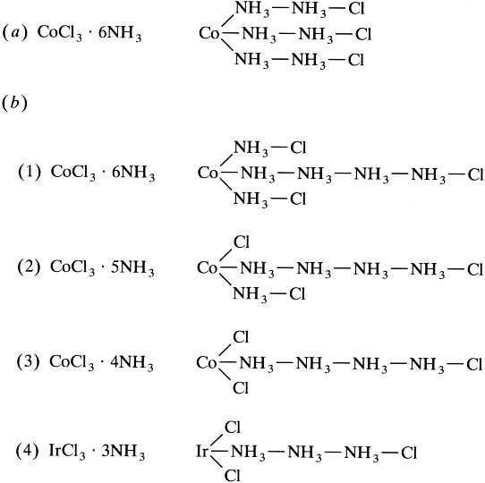

Slide 177
Based on the prevailing ideas of the time, this was a perfectly reasonable structure.
The divalent ammonia he proposed was consistent with a view of ammonium chloride written as H–NH₃–Cl.
The valence of 3 for cobalt was satisfied, nitrogen atoms were chained together much like carbon was in organic compounds,
and the three monovalent chlorides were far enough removed from the cobalt atom to be available to be precipitated by aqueous silver nitrate.

Slide 178
In 1884 Sophus Mads Jørgensen, a student of Blomstrand’s, proposed some amendments to his mentor’s picture.
First, he had new evidence that correctly indicated that these compounds were monomeric.
Second, he adjusted the distance of the chloride groups from the cobalt to account for the rates at which various chlorides were precipitated.
The first chloride is precipitated much more rapidly than the others and so was put farther away and therefore less under the influence of the cobalt atom.

Slide 179
Note that, in the second compound, one chloride is now directly attached to the cobalt and therefore, Jørgensen assumed, unavailable to be precipitated by silver nitrate.
In the third compound, two chlorides are similarly pictured.
These changes significantly improved the chain theory, but a number of unanswered questions remained.
For example, why are there only 6 ammonia molecules? Why not 8 or 10?

Slide 180
Why do we not see ammonia molecules that are chemically different depending on their positions in the chain?
On balance, however, it appeared that the Blomstrand-Jørgensen theory of the cobalt ammonates was on the right track.
But was there a compound with only three ammonias?
The chain theory predicted that it should exist and, furthermore, should have one ionizable chloride.
But this critical compound was not available.

Slide 181
Jørgensen set out to prepare it to test his version of the chain theory.
Try as he might, this excellent synthetic chemist could not come up with the desired cobalt compound.
He did, however, manage to prepare, after considerable time and effort, the analogous iridium ammonate chloride.
Alas, it was found to be a neutral compound with no ionizable chlorides.
With no small amount of irony, the chain theory was in trouble-thanks to the considerable efforts of one of its principal proponents.

Slide 182
The Werner Coordination Theory
Alfred Werner, a German-Swiss chemist, was torn between organic and inorganic chemistry.
His first contributions (the stereochemistry, or spatial arrangements, of atoms in nitrogen compounds) were in the organic field, but so many intriguing inorganic questions were being raised in those days that he decided that this was the area in which he would work.

Slide 183
He observed the difficulties that inorganic chemists were having in explaining coordination compounds,
and he was aware that the established ideas of organic chemistry seemed to lead only into blind alleys and dead ends.
In 1892, when Werner was only 26 years old, his coordination theory came to him in a dream.
He woke up and started to write it down, and by five o’clock in the morning it was essentially complete.

Slide 184
But his new theory broke with the earlier traditions, and he had essentially no experimental proof to support his ideas.
Jørgensen, Blomstrand, and others considered Werner to be an impulsive young man and his theory to be audacious fiction.
Werner spent the rest of his life directing a systematic and thorough research program to prove that his intuition was correct.
Werner decided that the idea of a single fixed valence could not apply to cobalt and other similar metals.

Slide 185
Working with the cobalt ammonates and other related series involving chromium and platinum,
he proposed instead that these metals have two types of valence, a primary valence and a secondary valence.
The primary, or ionizable, valence corresponded to what we call today the oxidation state; for cobalt, it is the 3+ state.
The secondary valence is more commonly called the coordination number ; for cobalt, it is 6.
Werner maintained that this secondary valence was directed toward fixed geometric positions in space.

Slide 186
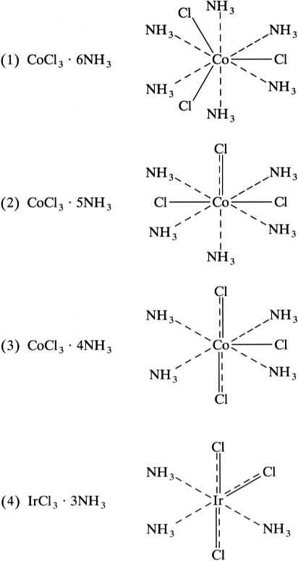

Slide 187
Werner said that the cobalt must simultaneously satisfy both its primary and secondary valences.
The solid lines show the groups that satisfy the primary valence, and the dashed lines,
always directed toward the same fixed positions in space, show how the secondary valence was satisfied.
In compound (1), all three chlorides satisfy only the primary valence, and the six ammonias satisfy only the secondary.

Slide 188
In compound (2), one chloride must do double duty and help satisfy both valences.
The chloride that satisfies the secondary valence (and is directly bound to the Co³⁺ ion) was concluded to be unavailable for precipitation by silver nitrate.
Compound (3) has two chlorides doing double duty and only one available for precipitation.
Compound (4), according to Werner, should be a neutral compound with no ionizable chlorides.
This was exactly what Jørgensen had found with the iridium compound.

Slide 189
Werner next turned to the geometry of the secondary valence (or coordination number).
As shown in Table 2.2, six ammonias about a central metal atom or ion might assume one of several different common geometries, including hexagonal planar, trigonal prismatic, and octahedral.
The table compares some information about the predicted and actual number of isomers for a variety of substituted coordination compounds.
Isomers are defined here as compounds that have the same numbers and types of chemical bonds but differ in the spatial arrangements of those bonds.

Slide 190
The number of predicted isomers refers to the number of theoretically possible geometric arrangements in space.
For example, for the octahedral MA₅B case, there is only one possible geometry, even though there are numerous ways to draw it.
In each case, the same configuration has simply been oriented differently in space so that the one B ligand is either up in the axial position or in a different equatorial position.
In other words, all six octahedral positions are equivalent, and it does not matter which position is occupied by the one B ligand.

Slide 191
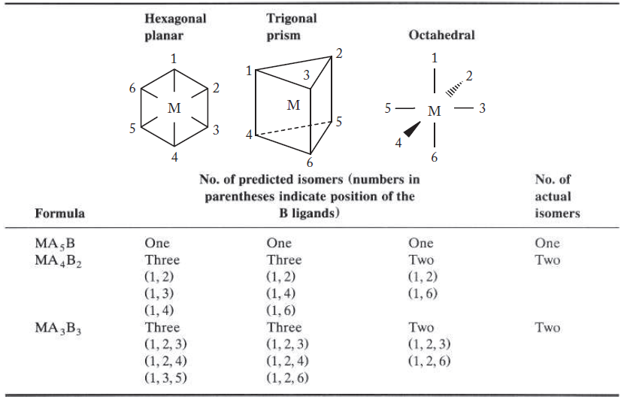

Slide 192
Given these results (obtained by analyzing a large number of series of coordination compounds),
Werner could predict that two isomers would be found for the CoCl₃.4NH₃ case.
These proved somewhat difficult to prepare, but in 1907 Werner was finally successful.
He found two isomers, one a bright green and the other a vivid violet.
Now although all this would be considered “negative” evidence by a philosopher of science (it was the absence of an isomer that constituted the evidence), the case for the coordination theory was growing stronger.

Slide 193
The “negative” proof, however, was enough for Jørgensen.
In 1907 he dropped his opposition to Werner’s “audacious” coordination theory.
Blomstrand and Jørgensen tried to extend the established ideas of organic chemistry to account for the newer coordination compounds.
In doing so, one could argue, they actually impaired progress in the understanding of this branch of chemistry.
The trick, of course, is to know when to stick to the established ideas and when to break away from them.

Slide 194
Werner chose the latter course and, 20 years later in 1913, received the Nobel Prize in chemistry.
THE MODERN VIEW OF COORDINATION COMPOUNDS
Today, the molecular formulas of coordination compounds are represented in a manner that makes it clearer which groups are part of the coordination sphere and which are not.
As indicated in the introduction to this chapter, the metal atom or ion and the ligands coordinated to it are enclosed in brackets.

Slide 195
It follows that the cobalt ammonate chlorides can be represented as
The ammonia molecules and chloride ions inside the brackets satisfy the coordination number of cobalt.
The chlorides in the coordination sphere do double duty, also helping to satisfy the 3+ oxidation state of the cobalt.

Slide 196
The chlorides outside the brackets, sometimes called counter ions, help satisfy only the oxidation state.
They are the only ionic chlorides available to be precipitated by silver nitrate.
For example, if compound (2) is placed in water and treated with aqueous silver ions, the resulting reaction would be that represented by Equation below:
[Co(NH₃)₅Cl]Cl₂(s) + 2Ag⁺(aq) 2AgCl(s) + [Co(NH₃)₅Cl]²⁺(aq)
Although cobalt compounds were the most prevalent subject of his research program, Werner and his collaborators worked with other metals as well.

Slide 197
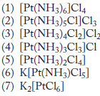

Slide 198
Coordination compounds
Coordination compounds are molecules that possess a metal center that is bound to ligands.
They are also known as complex ions or coordination complexes because they are Lewis acid-base complexes.
These complexes can be neutral or charged.
When the complex is charged, it is stabilized by neighboring counter-ions.
They are distinct chemical species.

Slide 199
Their properties and behavior are different from the metal atom/ion and ligands from which they are composed.
They retain their identity in solid state as well as in dissolved state.
Each ligand shares a pair of its electrons with the metal.
The metal ligand bond, often represented as M :L, is an example of a coordinate covalent bond in which both the electrons come from one atom.
A typical formula might be [ML₆]X_{n} or M’_{n}[ML₄], where the M’ is a simple metal cation and X might be any of a variety of anions.

Slide 200
Note that in the first formula, the coordination sphere and the metal M constitute a cation, whereas in the second they make an anion.
Such coordinated metal ions are sometimes referred to as complex cations or anions.
Ligands are the neutral molecule or ions which are directly attached to the central metal ion or atom through coordinate bonds in the complex ion.

Slide 201
Almost all anions such as F⁻, Cl⁻, CN⁻, OH⁻, SCN⁻, NO₂⁻, etc can act as ligands.
A large number of neutral molecules such as H₂O, NH₃, CO, amines, phosphines, sulfides, ethers, etc. can also function as ligands.
A few cations (e.g., H₂N–NH₃⁺) also have sites that can bind to metal ions by electron pair donation.
Ligands should have lone pair of electrons.
The Ligand is Lewis base and central metal ion is a Lewis acid.

Slide 202
Ligands donate the lone pair to the central metal atom or ion forming coordinate covalent bond.
Types of ligands
Monodentate ligands: defined as one that shares only a single pair of electrons with a metal atom or ion.
The word monodentate comes from the Greek monos and the Latin dentis and, not unexpectedly, literally means “one tooth.”
A monodentate ligand, then, has only one pair of electrons with which to “bite” the metal.

Slide 203
2. Bidentate ligand: ligand having two donor atoms. Ethylenediamine is a bidentate ligand.
Notice that both of the nitrogen atoms in this compound have a lone pair of electrons that can be shared with a metal.
Notice also that when both electron pairs interact with the same metal, the resulting configuration rather resembles a crab clutching at its prey.

Slide 204
3. Polydentate ligands: these are ligands having more than two donor atoms(tridentate, tetradentate, pentadentate, hexadentate, etc).
Multidentate ligands that form one or more rings with a metal atom in this manner are called chelates or chelating agents, terms derived from the Greek chele, meaning “claw.”
Chelating ligands generally forms a ring structure around the central metal ion.
Denticity of a ligand: the number of pairs of electrons it shares with a metal atom or ion.

Slide 205
4.Ambident ligands: A monodendate ligand which binds with the metal ion through more than one site.
If we represent this type of ligand as :AB:, then it can form one of two possible coordinate-covalent bonds, either
M :AB: or :AB: M, with a metal atom.
Common ambidentate ligands include cyanide, thiocyanate, and nitrite.
Bridging ligands: those containing two pairs of electrons shared with two metal atoms simultaneously.

Slide 206
The interaction of such ligands with metal atoms can be represented as M : L: M.
Ligands of the bridging type include amide (NH₂⁻), carbonyl (CO), chloride (Cl⁻), cyanide (CN⁻), hydroxide (OH⁻), nitrite (NO₂⁻), oxide (O²⁻), peroxide (O₂²⁻), sulfate (SO₄²⁻) and thiocyanate (SCN⁻).

Slide 208
Coordination number: the total number of coordinate bonds formed between a central metal ion and its ligands.
Inner coordination sphere or the first sphere refers to ligands that are directly bound to the central metal.
Outer coordination sphere or the second sphere refers to other ions that are attached to the complex ion.
In [Pt(NH₃)₆]Cl₄, NH₃ is the inner sphere ligand, Cl is the outer sphere ligand.
Charge of a complex
In the formula of the complex ion: square brackets group together the species making up the complex ion.

Slide 209
the overall charge is shown outside the brackets.
The overall charge is the sum of the individual charges of the transition metal ion and those of the ligands present in the complex.
Worked examples
1. State the formula and charge of the complex ion made from one titanium(III) ion and six water molecules. [Ti(H₂O)₆]³⁺
The formula shows that six H₂O ligands are bonded to one titanium(III) ion.

Slide 210
As water is a neutral ligand, the overall charge on the ion is the same as the transition metal ion, which is +3.
2. What is the oxidation number of the transition metal in the complex ion [Co(H₂O)₅Cl]⁺?
This complex ion has five neutral water ligands with no charge, and one chloride ligand with a charge of –1.
Overall the complex ion has a 1+ positive charge.
In [Co(H₂O)₅Cl]⁺, cobalt must have the oxidation state +2 to give the overall charge of +1.

Slide 211
COORDINATION NUMBER AND SHAPE
Coordination complexes adopt a limited number of basic shapes.
Previously you have developed a predictive set of molecular shapes evolving from an electrostatic model of the distributions predicted for from two to six point charges dispersed on a spherical surface.
These shapes, evolving from a modification of the VSEPR model that was itself developed initially for main group compounds,
are satisfactory as models for many of the basic shapes met experimentally for complexes throughout the Periodic Table.

Slide 212
The original VSEPR model and its electron counting rules have limited predictive value for shape in complexes of d-block elements compared with its application for p-block elements.
This relates to the defined directional properties of lone pairs in p-block elements, whereas in transition elements nonbonding electrons play a much reduced role in defining shape.
Rather, it is simply the number of donor groups bound about the metal that is the key to shape in transition metal complexes.

Slide 213
This is recognized in the Kepert model,
which is a variation of the VSEPR concept developed for transition elements that ignores nonbonding electrons and considers only the set of donor groups represented as point charges on a surface.
This essentially electrostatic model has limitations,
as shape is influenced by other factors such as inherent ligand shape and steric interactions between ligands,
as well as the size and valence electron set of the central metal ion.

Slide 214
There are in fact several effects that contribute to the outcome of metal–ligand assembly.
Overall, stereochemistry and coordination number in complexes appear to depend on four key factors:
1. Central metal–ligand electronic interactions, particularly influenced by the number of d(or f) electrons of the metal ion;
2. Metal ion size and preferred metal–ligand donor bond lengths;
3. ligand–ligand repulsion forces;
4. Inherent ligand geometry and rigidity.

Slide 215
One Coordination (ML)
This unlikely coordination number suffers from the fact that a single donor bound to the metal would still leave the metal highly exposed,
a situation that would most likely lead to additional ligands adding and thus increasing the coordination number.
It is nevertheless prudent to describe it as extremely rare,
because there is a small possibility that a suitably bulky and appropriately shaped ligand may achieve one-coordination.

Slide 216
It may be more practicable in the gas phase under high dilution conditions, where metal–ligand encounters are limited.
As a consequence, it is not surprising that there appears to be only one isolated structure claimed.
This is of the indium(I) and thallium(I) complexes with a single M-C bond from a δ-bonded benzene anion that carries two bulky tri-substituted benzene substituents in ortho positions.

Slide 217
An extremely rare one-coordinate complex
Two Coordination (ML₂)
Two coordination is the lowest stable coordination number that is well reported.
We expect a ML₂ molecule to be linear, with the two donor groups disposed as far away from each other as possible on opposite ends of a line joining them and passing through the metal centre.

Slide 218
Deviation from prediction may arise in this case simply by bond angle deformation, with the usual 180◦ L-M-L bond angle reduced to <180◦ through bending.
Experimentally, ML₂ complexes are overwhelmingly linear.
Both electron pair repulsion and simple steric arguments favour this shape.
If bending occurs, it brings the two ligands closer towards each other,
providing greater opportunity for repulsive interaction between the ligands; this would seem both unreasonable and unlikely, yet bent molecules do occur.

Slide 219
‘Bent’ geometries are well known in p-block chemistry, of course,
where lone pairs play an important directional role.
Water is the classical example, with its two lone pairs and two bond pairs around the oxygen centre leading to a bent
H O H as a result of its inherently tetrahedral shape (on including lone pairs) as well as additional effects due to differing repulsions between the lone pairs and bond pairs.

Slide 220
Where such bending is seen in metal complexes,
it can often be assigned to a higher pseudo-coordination number shape with nonbonding orbitals present contributing and occupying some region of space.
X-ray crystallography defines atomic centres but cannot readily detect regions of electron density that do not involve atoms.
Lone pairs are effectively not observable directly; the presence of directed nonbonding electron density can only be inferred,
as a result of an influence on structure through repulsive terms, seen experimentally as changes in bond angles.

Slide 221
Possible shapes for two-coordination, and (at right) an example of a linear complex cation, [Au(PR₃)₂]⁺ (where R = CH₃).
Examples of complexes with two-coordination, including both linear and bent species.

Slide 222
The ML₂ geometry is rare for all but metal ions rich in d electrons, particularly d¹⁰ and d⁹ metal ions.
This is a recurring theme in coordination number for transition metal complexes – as a very rough rule,
the more electrons in the valence shell, the lower the coordination number.
Complexes which are two-coordinate include those of the d¹⁰ cations Ag(I) and Au(I), for example the [Ag(NH₃)₂]⁺ and [Au(CN)₂]⁻ complexes, which have linear N-Ag-N and C-Au-C cores respectively.

Slide 223
Three Coordination (ML₃)
The VSEPR-predicted shape, trigonal planar, is well represented amongst this relatively rare coordination number.
ML₃ is (like ML₂) favoured by transition metal ions with lots of d electrons (d⁸, d⁹, d¹⁰).
Two other shapes are known, however; one is called T-shape (for obvious reasons), and the other called trigonal pyramidal.
These latter two can be seen to arise from distortions of the ‘parent’ trigonal planar shape.

Slide 224
It is usual for different shapes for a particular coordination number to be able to interconvert without any bond breaking,
simply through rearrangements such as those exemplified below.

Slide 225
molecules may adopt a shape that is intermediate or part-way along the process of changing from one basic shape to another.
Four Coordination (ML₄)
Coordination number four (ML₄) is common and has two major forms, tetrahedral and square planar.
The former is the shape predicted by the electron pair repulsion model;
the latter is a different shape observed experimentally, with many examples known.

Slide 226
These are ideal or limiting structures, in the sense that they represent the perfect shapes which lie at the structural limits for this coordination number.
ideal structures are relatively rare in coordination chemistry, and distorted or intermediate geometries are more likely met.
The two limiting geometries can be converted one into the other by displacement of groups without any bond breaking being involved.

Slide 227
Five Coordination(ML₅)
Although once considered rare, growth in coordination chemistry has led to five-coordination becoming met almost as frequently as four-coordination.
Examples of ML₅ are found for all of the first row transition metal ions, as well as some other metal ions.
Five-coordination is commonly met in complexes of the lighter, smaller transition metals ions.
The amended VSEPR model predicts two forms of five-coordination, and experimental chemistry has clearly identified many examples of both forms.

Slide 228
These limiting structures are square-based pyramidal (or, simply, square pyramidal) and trigonal bipyramidal.
In reality, almost no complexes exhibit this classical square-based pyramidal shape, but rather adopt a distorted square pyramidal shape.

Slide 229
Considering electron pair repulsion alone, this distorted shape is actually more stable than the form created by simply truncating an octahedron,
and is only slightly less stable than the trigonal bipyramidal geometry.
it is possible to convert from one form to the other through bond angle changes without any bond-breaking.
Both geometries are common, but in practice there are many structures that are intermediate between these two.
The two limiting structures are of similar energy and as predicted, some complexes display an equilibrium between the two.

Slide 230
Six Coordination (ML₆)
ML₆ is the most common coordination type by far that is met for transition metal elements (seen for all configurations from d⁰ to d¹⁰),
and also is often met for complexes of metal ions from s and p blocks of the Periodic Table.
Of the two limiting shapes, the octahedral geometry is by far the most common, though a few examples of the other limiting shape, trigonal prismatic, exist.

Slide 231
Because the six donor atoms come into closer contact in the trigonal prismatic than in the octahedral geometry, trigonal prismatic is predicted to be less stable.
However, many structures show distortion that places them as intermediate between ideal octahedral and the ideal trigonal prismatic form.

Slide 232
Factors Influencing Shape
Metallic Genetics – Metal Ion Influences
If we focus first on the central atom or ion, there are two of the four key factors mentioned earlier that we can consider metal-centric. These are:
the number of d electrons on the metal ion; and
metal ion size and preferred metal ion–ligand donor group bond length.
Each metal in a particular oxidation state brings a unique character, almost like a gene, to play in its complexes.

Slide 233
Examples of the way the size and bond distances vary across the d block are given below

Slide 234
The M-L distances are averages only, as distances vary over a range of at least 20 pm,
influenced by the specific type of donor group for a particular type of donor atom, the ligand shape and associated strain energy,
as well as influences of other donors in the coordination sphere.
Moreover, the spin state of the central metal plays a role (e.g. M-O distances for high spin Mn(III) are typically 20 pm longer than for low-spin compounds).

Slide 235
As mentioned above, distances vary for any particular metal ion depending on the character of the donor, influences from the ligand framework itself, and influences of other ligands bound to the same complex.
there is a modest relationship between bond distances and the size of the metal ion.
The increase in metal cation size from the first to the second and third row of the Periodic Table is accompanied by usually longer M-L distances.

Slide 236
Overall, metal–donor distances fall within a range of ≈160–260 pm,
with the smaller distances found where highly charged metal ions, small anionic ligands and/or multiple bonding operate.
Ligand Influences
there are also two of the four key factors mentioned earlier that we can consider ligand-centric.
These are:
ligand–ligand repulsion forces; and
ligand rigidity or geometry.

Slide 237
Obviously, each ligand is unique in its shape and size.
The effect of repulsion between ligands can be termed as nonbonding interactions.
Two PH₃ molecules may bind in a square planar shaped complex with little preference for trans over cis geometry,
whereas two very bulky P(C₆H₅)₃ molecules may exhibit strong preference for coordination in a trans geometry, where they are much further apart.

Slide 238
Another way that two cis-disposed bulky ligands can relieve ligand–ligand repulsion is for the complex to undergo distortion from square planar towards tetrahedral,
which leads to the two ligands moving further apart in space.
Some ligands are structurally so rigid that they can bind to a metal ion in only one manner.
The aromatic porphyrin molecule is completely flat, and large amounts of energy are required to distort it.

Slide 239
Therefore, when it binds to a metal, it seeks to retain this shape, and will simply use the square-shaped array of four N-donors to wrap around a metal ion in a planar manner.
Not only aromatic ligands are rigid; some polycyclic fused-ring aliphatic molecules may be sufficiently rigid and require a particular shape.
An example of a cyclic rigid four nitrogen donor ligand that can bind effectively only with the square-shaped array of four N-donors in the plane about the metal ion contrasts with the flexible aliphatic ligand also shown, which can bind in a flat or ‘bent’ arrangement.

Slide 241
The more rigid ligands on the right do not permit folding,
whereas the more flexible ones on the left can accommodate folding and thus offer options when coordinating to an octahedral metal ion.

Slide 242
NOMENCLATURE OF COORDINATION COMPOUNDS
Here we consider the basics of naming ligands (including multidentate, ambidentate, and bridging) that occur in simple neutral as well as ionic coordination compounds.
Note that the name of anionic ligands is modified by removing the –ide suffix of halides, oxides, hydroxides,
and so forth, or the last -e of an -ate or –ite ending and replacing these with -o.
Accordingly, fluoride becomes fluoro, nitrate becomes nitrato, sulfite becomes sulfito, and so forth.

Slide 243
As usual in nomenclature, there are a few exceptions; for example, amide becomes amido and the N-bonding form of the ambidentate nitrite becomes nitro.
The very few positive ligands are modified by adding an -ium suffix to the root name.
The names of neutral ligands are usually not modified, but a few common neutral ligands have special names.
For example, water becomes aqua, ammonia is called ammine, carbon monoxide is carbonyl, and nitrogen oxide is nitrosyl.

Slide 244
Molecular oxygen and nitrogen are referred to as dioxygen and dinitrogen, respectively.
In naming a coordination compound, the cation is named first and then the anion (just as for ordinary salts—for example, sodium chloride or ammonium nitrate).
For a given complex, the ligands are always named first in alphabetical order, followed by the name of the metal.
The oxidation state of the metal is indicated by Roman numerals in parentheses after the name.
An oxidation state of zero is indicated by a numeral zero, 0, in the parentheses.

Slide 245
If the complex is an anion, the -ate suffix is added to the name of the metal.
Occasionally, the -ium or other suffix has to be removed from the name of the metal before the -ate is added.
For example, chromium becomes chromate, manganese becomes manganate, and molybdenum becomes molybdenate.
Some metals, such as copper, iron, gold, and silver, retain the Latin stem for the metal and become cuprate, ferrate, aurate, and argentate, respectively, in an anionic setting.

Slide 246
Note that there are two sets of prefixes,
one (di-, tri-, tetra-, etc.) for monoatomic ions, polyatomic ions with short names, or the special neutral ligands noted previously,
and a second (bis-, tris-, tetrakis-, etc.) for ligands that already contain a prefix from the first list-for example, ethylenediamine or triphenylphosphine- or for ligands whose names commonly appear in parentheses.
Generally, neutral ligands without special names and ionic ligands with particularly long names are enclosed in parentheses.

Slide 247
So, for example, acetylacetonato is generally enclosed in parentheses, whereas oxalato is not.
There are two ways to handle ambidentate ligands.
One is to use a slightly different form of the name, depending on the atom that is donating the electron pair to the metal.
The second is to put the symbol of the donating atom before the name of the ligand.
So –SCN might be called thiocyanato or S-thiocyanato, whereas –NCS would be isothiocyanato or N-thiocyanato.
–NO₂ and –ONO, however, are most always referred to as nitro and nitrito, respectively.

Slide 248
Bridging ligands are designated by placing the Greek letter m before the name of the ligand.
So a bridging hydroxide (OH–), amide (NH₂–), or peroxide (O₂^{2–}) ligand becomes µ-hydroxo, µ -amido, or µ -peroxo, respectively.
If there is more than one of a given bridging ligand, the prefix indicating the number of ligands is placed after them.
For example, if there are two bridging chloride ligands, they are indicated as µ-dichloro.

Slide 249
If there are two or more different bridging ligands, they are given in alphabetical order.
Example 1: [Pt(NH₃)₄]Cl₂
There are two negative chloride ions outside of the complex, so the complex itself must have the formula [Pt(NH₃)₄]²⁺.
The ammonia ligands are neutral; thus, the platinum must have an oxidation state of +2. As a result, we start with the stem name platinum(II).
The ligand is ammonia, which has the name ammine.

Slide 250
But there are four ammonia ligands, so the prefix is added to give tetraammine.
Finally, the chloride anions must be included.
They are free, uncoordinated chloride ions, so they are called chloride, not chloro.
We do not identify the number of chloride ions because the oxidation state of the metal ion enables us to deduce it.
Hence, the full name is tetraammineplatinum(II)chloride.

Slide 251
Example 2: [PtCl₂(NH₃)₂]
This is a non-ionic species, so it will have a one word name.
Again, to balance the two chloride ions, the platinum is in the 12 oxidation state, so we start with platinum(II).
The ligands are named ammine for ammonia and chloro for chloride.
Alphabetically, ammine comes before chloro; thus, we have the prefix diamminedichloro.
The whole name is diamminedichloroplatinum(II).

Slide 252
Example 3: K₂[PtCl₄]
Again, two words are needed , but in this case, the platinum is in the anion, [PtCl4]²⁻.
The metal is in the +2 oxidation state, so the anionic name will be platinate(II) .
There are four chloride ligands, giving the prefix tetrachloride and the separate potassium cations.
The complete name is potassium tetrachloroplatinate(II).
Example 4: [Co(en)₃]Cl₃
The complex ion is [Co(en)₃]³⁺.

Slide 253
Because (en), H₂NCH₂CH₂NH₂, is a neutral ligand, the cobalt must be in a +3 oxidation state.
The metal, then, will be cobalt(III).
The full name of the ligand is 1,2-diaminoethane and contains a numerical prefix, so we use the alternate prefix set to give tris(1,2-diaminoethane) parentheses are used to separate the ligand name from the other parts of the name.
Finally, we add the chloride anions.
The full name is tris(1,2-diaminoethane)cobalt(III) chloride.

Slide 254
Example 5: [Co(NH₃)₄Cl₂]Cl.
We start by naming the complex cation.
The ligands are named alphabetically with ammine first and then chloro.
There are four ammonias and two chlorides, so the prefixes tetra- and di- are used.
The cobalt oxidation state is determined by tracing the charges back as follows:
The net charge on the complex cation must be 1+ to balance the one 1- chloride anion.

Slide 255
Since there are two chlorides in the coordination sphere, the cobalt must be 3+ in order for the net charge on the cation to come out as 1+.
Example 6: (NH₄)₂[Pt(NCS)₆]
Here we have a platinum-containing complex anion and the common ammonium ion, NH₄⁺, as the cation.
Given that the ligand is written with the N symbol first, we know that it is the isothiocyanato (or, alternatively, N-thiocyanato) form of the ambidentate ligand.
There are six of these ligands, so we use the hexa- prefix.

Slide 256
The anion must have a net charge of 2- to balance the two 1+ ammonium cations.
Since the thiocyanate ion is also 1-, the platinum oxidation state must be 4+ to give a net 2- charge on the anion.
Because the platinum is contained in a complex anion, its-um suffix is removed and replaced with -ate.
Accordingly, the full name of the compound is ammonium hexaisothiocyanatoplatinate(IV).
Example 7: Write the formula for the compound triamminechloro(ethylene)nitroplatinum(IV) phosphate.

Slide 257
This compound has four different types of ligands in the coordination sphere: NH₃, Cl₂, C₂H₄, and NO₂⁻(bonded through the nitrogen).
The only real difficulty in constructing this formula is figuring out how many cations and anions there must be.
The cation has a net charge of 2+, and the anion is 3-.
Therefore, there must be three cations and two anions to ensure electrical neutrality.
The formula for this compound is [Pt(NH₃)₃Cl(C₂H₄)NO₂]₃(PO₄)₂

Slide 258
Example 8: Write the formula for the compound (acetylacetonato)tetraaquacobalt(II) chloride.
The acac and four waters constitute the coordination sphere that with the cobalt(II) cation are set apart in brackets.
The net charge on the complex cation is 1+ (because the acac is 1-), so one chloride counteranion is needed.
The e formula of the compound is [Co(acac)(H₂O)₄]Cl .
Exercise
(i) Name the following coordination complexes.
(a) [Cr(NH₃)₅(H₂O)](NO₃)₃

Slide 259
(b) [Cr(NH₃)₄Cl₂]Cl
(c) [Ag(NH₃)(CH₃NH₂)]₂[PtCl₂(ONO)₂]
(d) [Pt(NH₃)₄Cl₂]SO₄
(e) K₃[Mo(CN)₆F₂]
(f) [Ni(acac){P(C₆H₅)₃}₄]NO₃
(ii) Determine the formulas of the following compounds.
(a) potassium hexacyanoferrate(II)
(b) tris(ethylenediamine)chromium(III) chloride
(c) Aquabis(ethylenediamine)thiocyanatocobalt(III) nitrate
(d) Tetrakis(pyridine)bis(triphenylarsine)cobalt(III) chloride
(e)Diamminebis(triphenylphosphine)palladium(II) bis(oxalato)aurate(III)

Slide 260
ISOMERISM IN TRANSITION METAL COMPLEXES
In the early history of coordination chemistry,
the existence of pairs of compounds with the same formula yet different properties proved to be very perplexing to inorganic chemists.
Werner was among the first to realize that the different properties represented different structural arrangements (isomers).
Isomers can be categorized as structural isomers and stereoisomers.

Slide 261
For stereoisomers, the bonds to the metal ion are identical, whereas the bonds of structural isomers are different.
These categories can be further subdivided, as shown below.

Slide 262
Stereoisomers are species with the same structural formula but with a different arrangement of the atoms in space.
In transition element chemistry, it is possible to have stereoisomers from complexes containing all types of ligands.
Structural Isomerism
Structural isomerism has four common types:
linkage isomerism, ionization isomerism, hydration isomerism, and coordination isomerism.

Slide 263
Ionization and hydration isomerism are sometimes categorized together as coordination-sphere isomerism because in both cases it is the identity of the ligands that differs.
Linkage isomerism:- Some ligands can form bonds through more than one atom.
For example, the thiocyanate ion, NCS⁻, can bond through either the nitrogen or the sulfur.
This particular ambidentate ligand is a borderline base, since the choice of ligating atom depends in part on the hard-soft acid nature of the metal ion.

Slide 264
A classic example of linkage isomerism involves the nitrite ion,
which can form bonds through the nitrogen atom,⁻NO₂, referred to as nitro, or through one of the oxygen atoms, -ONO, referred to as nitrito.
A pentamminecobalt(III) complex, Co(NH₃)₅Cl₂(NO₂), conveniently illustrates this isomerism since the two isomers have different colors.
One of these, the red form, contains the [Co(ONO)(NH₃)₅]²⁺ ion, in which one of the oxygen atoms of the nitrite ion is bonded to the cobalt(III) ion.

Slide 265
The other isomer, the yellow form, contains the [Co(NO₂)(NH₃)₅]²⁺ ion, in which the nitrogen atom is bonded to the cobalt(III) ion.
The two linkage isomers of the pentamminecobalt(III) nitrite complex: (a) the nitrito form, (b) the nitro form.

Slide 266
2. Ionization isomerism:- Ionization isomers give different ions when dissolved in solution.
Again, there is a classic example: Co(NH₃)₅Br(SO₄).
If barium ion is added to a solution of the red-violet form, a white precipitate of barium sulfate forms.
Addition of silver ion has no effect.
Hence, the complex ion must have the formula [CoBr(NH₃)₅]²⁺, with an ionic sulfate ion.

Slide 267
A solution of the red form, however, does not give a precipitate with barium ion; instead, a cream-colored precipitate is formed with silver ion.
Hence, this complex ion must have the structure of [CoSO₄(NH₃)₅]⁺, with an ionic bromide ion.
3. Hydration isomerism:- Hydration isomerism is very similar to ionization isomerism in that the identity of the ligand species is different for the two isomers.
In this case, rather than different types of ions, it is the proportion of coordinated water molecules that differs between isomers.

Slide 268
The three structural isomers of formula CrCl₃.6H₂O provide the best example.
In the violet form, the six water molecules are coordinated; hence, the formula for this compound is more correctly written as [Cr(OH₂)₆] Cl₃.
As evidence, all three chloride ions are precipitated from solution by silver ion.
In the light green form, one of the chloride ions is not precipitated by silver ion; hence, the complex is assigned the structure [CrCl(OH₂)₅]Cl₂.H₂O.

Slide 269
Finally, only one chloride ion can be precipitated by silver ion from a solution of the dark green form;
hence, this compound must have the structure [CrCl₂(OH₂)₄]Cl.2H₂O.
4. Coordination isomerism:-Coordination isomerism occurs when both the cation and the anion are complex ions.
The ligands interchange between the cation and anion, leading to different coordinated ligands.
For example, [Cr(NH₃)₆][Co(CN)₆] and [Co(NH₃)₅CN][Co(CN)₅(NH₃)] are coordination isomers.

Slide 270
Two coordination isomers of a bridged cation.

Slide 271
Stereoisomerism
The two types of inorganic stereoisomers, geometric isomers and optical isomers,
are parallel to those found in organic chemistry except that in inorganic chemistry,
optical isomerism is most common for a metal ion in an octahedral environment rather than for the tetrahedral environment of organic carbon compounds.
1. Geometric isomerism:- Inorganic geometric isomers are analogous to organic geometric isomers that contain carbon-carbon double bonds.

Slide 272
Geometric isomers must have two different ligands, A and B, attached to the same metal, M.
For square planar compounds, geometric isomerism occurs in compounds of the form MA₂B₂, such as [PtCl₂(NH₃)₂].
The term cis is used for the isomer in which ligands of one kind are neighbors, and trans is used to identify the isomer in which ligands of one kind are opposite each other.
Geometric isomers also exist for square planar complexes of the form MA₂BC,
where cis refers to ligands A being neighbors and trans to ligands A being opposite each other.

Slide 273
There are two formulas of octahedral compounds having only two kinds of ligands for which geometric isomers are possible.
Compounds with the formula MA₄B₂ can have the two B ligands on opposite sides or as neighbors.
Hence, these, too, are known as trans and cis isomers.
Cis–trans isomerism in [Co(NH₃)₄Cl₂]⁺

Slide 274
The geometric isomers of an octahedral MA₄B₂ arrangement.
Octahedral compounds with the formula MA₃B₃ also can have geometric isomers.
Cis–trans isomerism is also possible in some four-coordinate complexes with a square planar shape

Slide 275
Optical isomerism:- Again, inorganic optical isomerism is analogous to that of organic chemistry.
Optical isomers are pairs of compounds in which one isomer is a non superimposable mirror image of the other.
One of the characteristics of optical isomers is that they rotate the plane of polarized light,
one isomer rotating the light in one direction and the other isomer in the opposite direction.
Compounds that exist as optical isomers are called chiral compounds.

Slide 276
Such molecules are known as optical isomers or enantiomers.
The word enantiomer comes from the Greek words enantios, meaning “opposite,” and meros, meaning “part,”
so that enantiomers are the matched left and right-handed forms of a given chiral molecule.
These enantiomers always have identical melting points, boiling points, dipole moments, solvent capabilities, and so forth, but one property that distinguishes them is the ability to rotate the plane of polarized light in opposite directions.

Slide 277
Optical isomerism can be seen in the structures of the two isomers of [Ni(NH₂CH₂CH₂NH₂)₃]^{2+.}
Optical isomers of [Ni(NH₂CH₂CH₂NH₂)₃]²⁺Exercise
1. Draw diagrams showing the structures of and name all the stereoisomers of [CoCl₂(en)₂]Cl.

Slide 278
2. The complex [Pt(NH₃)₂(SCN)₂] forms two stereoisomers, whereas the complex [Pt(en)(SCN)₂] forms only one.
What, if anything, does this prove about the geometry of these complexes? Explain.
As part of your answer, sketch and name these three isomers.
3. Draw the two linkage isomers of pentamminethiocyanatocobalt(III) chloride.
One of these is orange, the other violet. Speculate on the color of each isomer. Provide a brief rationalization of your answer.

Slide 279
4.Trans-bis(ethylenediamine)dithiocyanatocopper(II) forms three linkage isomers.
Write structural formulas and name each isomer.
5. How many coordination isomers could be formed starting with [Cu(NH₃)₄][PtBr₄]?
Write the formula for and name each isomer.

Slide 280
Bonding in d-block Metal Complexes:
Valence bond theory
VBT was developed by Pauling in the 1930s
It uses hybridization schemes to describe the bonding in d-block metal complexes;
an empty hybrid orbital on the metal centre can accept a pair of electrons from a ligand to form a σ-bond.
280

Slide 281
Applying VB theory
consider an octahedral complexes of Cr(III) (d³) and Fe(III) (d⁵) and octahedral, tetrahedral and square planar complexes of Ni(II) (d⁸)
The Cr³⁺ ion has:-
3d 4s 4p
With the electrons from the ligands included, the diagram becomes:
3d 281 d²sp³ 281

Slide 282
For octahedral Fe(III) complexes, we must account for the existence of both high- and low-spin complexes. Fe³⁺ ion has:
3d 4s 4p
For a low-spin octahedral complexes; the diagram becomes:
3d d²sp³
For a high-spin octahedral complex such as [FeF₆]³⁻; the diagram becomes:
3d 282 sp³d²
282

Slide 283
This scheme, however, is unrealistic b/c the 4d orbitals are at a significantly higher energy than the 3d atomic orbitals.
Nickel(II) (d⁸) forms paramagnetic tetrahedral and octahedral complexes, and diamagnetic square planar complexes.
tetrahedral
3d sp³
octahedral
3d sp³d²
diamagnetic SP
3d dsp² 4p
283

Slide 284
VBT rationalizes stereochemical and magnetic properties at only a simplistic level.
the use of the very high energy 4d orbitals seems unlikely, and the results do not lend themselves to a good explanation of the electronic spectra of complexes (serious shortcoming).
The model implies a misleading distinction between high- and low-spin complexes.
Finally, it can’t tell us why certain ligands are associated with the formation of high- (or low-)spin complexes.
284

Slide 285
Crystal Field Theory(CFT)
CFT was first proposed in 1929 by Hans Bethe.
It assumes that the only interaction between the metal ion and the ligands is an electrostatic one.
Ligands are considered as point charges and there are no metal–ligand covalent interactions.
In order to understand clearly the interactions that are responsible for crystal or ligand field effects in transition metal complexes, it is necessary to have a firm grasp of the geometrical relationships of the d orbitals. 285

Slide 286
The five d orbitals in an isolated, gaseous metal ion are degenerate.
286

Slide 287
If a spherically symmetric field of negative charges is placed around the metal, the orbitals will remain degenerate, but all of them will be raised in energy as a result of the repulsion between the negative field and the negative electrons in the orbitals.
But, under the influence of ligands, the degeneracy of the d orbitals will be removed.
It is this splitting of d orbital energies and its consequences that are at the heart of CFT.
287

Slide 289
The octahedral crystal field
There is an electrostatic attraction between the metal ion and ligands.
However, there is also a repulsive interaction between electrons in the d orbitals and the ligand point charges.
If the electrostatic field (CF) were spherical, then the energies of the five 3d orbitals would be raised(destabilized) by the same amount.
289

Slide 290
However, the d_{z}2 and d_{x}²-_{y}² atomic orbitals point directly at the ligands(destabilized) while the d_{xy}, d_{yz} and d_{xz} atomic orbitals point between them(stablized).
dz² and dx²-y² orbitals have e_{g} symmetry, while the d_{xy}, d_{yz} and d_{xz} orbitals possess t_{2g} symmetry.
The energy separation between them is Δ_{oct} (‘delta oct’) or 10Dq.
The overall stabilization of the t_{2g} orbitals equals the overall destabilization of the e_{g} set.
290

Slide 291
Thus, orbitals in the e_{g} set are raised by 0.6Δ_{oct} with respect to the barycentre while those in the t_{2g} set are lowered by 0.4Δ_{oct}.
291

Slide 292
The magnitude of Δ_{oct} is determined by the strength of the crystal field, the two extremes being called weak field and strong field.
Δ_{oct}(weak field) < Δ_{oct}(strong field)
Factors governing the magnitude of Δ_{oct} are: the identity and oxidation state of the metal ion and the nature of the ligands. For octahedral complexes, Δ_{oct} increases along the following spectrochemical series of ligands.

Slide 293
The occupation of the 3d orbitals in weak and strong field Fe³⁺ (d⁵) complexes.
293

Slide 294
Crystal field stabilization energy
For a given d^{n} configuration, the CFSE is the difference in energy between the d electrons in an octahedral crystal field and the d electrons in a spherical crystal field.
For a d¹ system, the ground state corresponds to the configuration t_{2g}¹.
With respect to the barycentre, there is stabilization energy of -0.4Δ_{oct}; this is the so-called CFSE. For a d² ion, the ground state configuration is t_{2g}² and the CFSE = -0.8Δ_{oct} .
294

Slide 295
A d³ ion (t_{2g}³) has a CFSE = -1.2Δ_{oct}. For a d⁴ ion, two arrangements are available(t_{2g}3e_{g}¹and t_{2g}⁴ )
The preferred configuration is that with the lower energy and depends on P.
Two terms contribute to the electron-pairing energy, P, the loss in the exchange energy which occurs upon pairing the electrons; the coulombic repulsion between the spin-paired electrons.
295

Slide 296
For a low-spin d⁴ configuration, the CFSE consists of two terms:a -1.6Δ_{oct} term, and a pairing energy, P.
Now consider a d⁶ ion, high-spin d⁶ configuration (t_{2g}⁴e_{g}²).
CFSE = -(4x 0.4)Δ_{oct} +(2x 0.6)Δ_{oct} = 0.4Δ_{oct}
For a low-spin d⁶ configuration (t_{2g}⁶e_{g}⁰), the six electrons in the t_{2g} orbitals give rise to a -2.4Δ_{oct} term.
A pairing energy term of 2P is added to -2.4Δ_{oct} in excess of the one in the high-spin configuration.
296

Slide 297
For high-spin: Δ_{oct} < P
For low-spin: Δ_{oct} > P
Strong field ligands such as [CN]⁻ favour the formation of low-spin complexes, while weak field ligands such as halides tend to favour high-spin complexes.
However, we cannot predict whether high- or low-spin complexes will be formed unless we have accurate values of Δ_{oct} and P.
297

Slide 298
Octahedral crystal field stabilization energies (CFSE) for d n configurations; pairing energy, P, terms are included where appropriate. 298

Slide 299
On the other hand, with some experimental knowledge in hand, we can make some comparative predictions.
If we know from magnetic data that [Co(H₂O)₆]³⁺ is low-spin, then from the spectrochemical series we can say that [Co(CN)₆]³⁻ will be low-spin.
The only common high-spin cobalt(III) complex is [CoF₆]³⁻.
299

Slide 300
The tetrahedral crystal field

Slide 301
The figure shows a convenient way of relating a tetrahedron to a Cartesian axis set.
With the complex in this orientation, none of the metal d orbitals points exactly at the ligands, but the d_{xy}, d_{yz} and d_{xz} orbitals come nearer to doing so than the d_{z}² and d_{x}²_{-y}² orbitals.
For a regular tetrahedron, the splitting of the d orbitals is inverted compared with that for a regular octahedral structure, and the energy difference (Δ_{tet}) is smaller.
301

Slide 302
Δ_{tet} =4/9Δ_{oct}≈1/2Δ_{oct}
Since Δ_{tet} is significantly smaller than Δ_{oct}, tetrahedral complexes are high-spin.
Corresponding octahedral and tetrahedral complexes often have different colours.
302

Slide 303
The square planar crystal field
A square planar arrangement of ligands can be formally derived from an octahedral array by removal of two transligands.
If we remove the ligands lying along the z axis, then the d_{z}² orbital is greatly stabilized; the energies of the d_{yz} and d_{xz} orbitals are also lowered.
303

Slide 304
The fact that square planar d⁸ complexes such as [Ni(CN)₄]²⁻ are diamagnetic is a consequence of the relatively large energy difference between the d_{xy} and d_{x2_y2} orbitals.
304

Slide 305
Jahn–Teller distortions
Octahedral complexes of d⁹ and high-spin d⁴ ions are often distorted.
305

Slide 306
For a high-spin d⁴ ion, one of the e_{g} orbitals contains one electron while the other is vacant.
If the singly occupied orbital is in the dz², the complex suffers elongation along the z axes.
Conversely, occupation of the dx²-y² orbital would lead to elongation along the x and y axes as in structure.
A similar argument can be put forward for the d⁹ configuration.
306

Slide 307
The corresponding effect when the t_{2g} set is unequally occupied is expected to be very much smaller.
Distortions of this kind are called Jahn–Teller distortions.
The Jahn–Teller theorem states that any non-linear molecular system in a degenerate electronic state will be unstable and will undergo distortion to form a system of lower symmetry and lower energy, thereby removing the degeneracy.
307

Slide 308
Crystal field theory: uses and limitations
CFT can bring together structures, magnetic and electronic properties.
Trends in CFSEs provide some understanding of thermodynamic and kinetic aspects of d-block metal complexes.
CFT is surprisingly useful when one considers its simplicity.
However, it has limitations.
308

Slide 309
For example, although we can interpret the contrasting magnetic properties of high- and low-spin octahedral complexes on the basis of the positions of weak- and strong-field ligands in the spectrochemical series,
CFT provides no explanation as to why particular ligands are placed where they are in the series.
309

Slide 310
Molecular Orbital Theory(MOT)
In contrast to CFT, the MOM considers covalent interactions between the metal centre and ligands.
Complexes with no metal–ligand π–bonding
consider an octahedral complex such as[Co(NH₃)₆]³⁺ in which metal–ligand σ -bonding is dominant.
For a first row metal, the valence shell atomic orbitals are 3d, 4s and 4p.
Under O_{h} symmetry, the s orbital has a_{1g} symmetry, the p orbitals are degenerate with t_{1u} symmetry, and the d orbitals split into e_{g} and t_{2g} symmetries. 310

Slide 311
Each ligand provides one orbital and derivation of the ligand group orbitals for the O_{h} L₆ fragment is analogous to those for the F₆ fragment in SF₆.
These LGOs have a_{1g}, t_{1u} and e_{g} symmetries.
Symmetry matching between metal orbitals and LGOs allows the construction of a MO diagram.
The metal d_{xy}, d_{yz} and d_{xz} atomic orbitals have t_{2g} symmetry and are non-bonding.
The a_{1g} and t_{1u} MOs are stabilized to a greater extent than the e_{g} MOs. 311

Slide 312
In an O_{h} complex with no 𝜋-bonding, the energy difference between the t_{2g} and e_{g}* levels corresponds to Δ_{oct} in CFT.
312

Slide 313
In low-spin [Co(NH₃)₆]³⁺, 18 electrons occupy the a_{1g}, t_{1u}, e_{g} and t_{2g} Mos.
Whether a complex is high- or low-spin depends upon the energy separation of the t_{2g} and e_{g}* levels.
Notionally, in a σ-bonded O_{h} complex, the 12 electrons supplied by the ligands are considered to occupy the a_{1g}, t_{1u} and e_{g} orbitals.
Occupancy of the t_{2g} and e_{g}* levels corresponds to the number of valence electrons of the metal ion, just as in CFT. 313

Slide 314
Complexes with metal–ligand π -bonding
The metal d_{xy}, d_{yz} and d_{xz} atomic orbitals are nonbonding in an [ML₆]^{n+}, σ-bonded complex and these orbitals may overlap with ligand orbitals of the correct symmetry to give π - interactions.
Two types of ligand must be differentiated: π-donor and π–acceptor ligands.
π- donor ligands donates electrons to the metal centre in an interaction that involves a filled ligand orbital and an empty metal orbital.

Slide 315
A π–acceptor ligand accepts electrons from the metal centre in an interaction that involves a filled metal orbital and an empty ligand orbital.
π-donor ligands include Cl⁻, Br⁻ and I⁻ and the metal–ligand π-interaction involves transfer of electrons from filled ligand p orbitals to the metal centre.
π-acceptor ligands are CO, N₂, NO and alkenes, and the metal–ligand π-bonds arise from the back donation of electrons from the metal centre to vacant antibonding orbitals on the ligand. 315

Slide 316
π-bond formation in a linear L-M-L unit in which the metal and ligand donor atoms lie on the x axis:
between metal d_{xz} and ligand p_{z} orbitals as for ( a), an example of a π-donor ligand; and
between metal d_{xz} and ligand π-orbitals as for L = CO, an example of a π-acceptor ligand. 316

Slide 317
π-acceptor ligands can stabilize low oxidation state metal complexes.
The interaction of ligand π-orbitals with the metal t_{2g} atomic orbitals leads to bonding (t_{2g}) and antibonding (t_{2g}*) MOs.
The energy separation between the t_{2g}* and eg* levels corresponds to Δ_{oct}.
In the interaction between a metal ion and six π-acceptor ligands:- the vacant ligand π*-orbitals lie significantly higher in energy than the ligand -orbitals.
Orbital interaction leads to B(t_{2g}) and AB(t_{2g}*) MOs as before, but now the t_{2g}* MOs are at high energy.
317

Slide 318
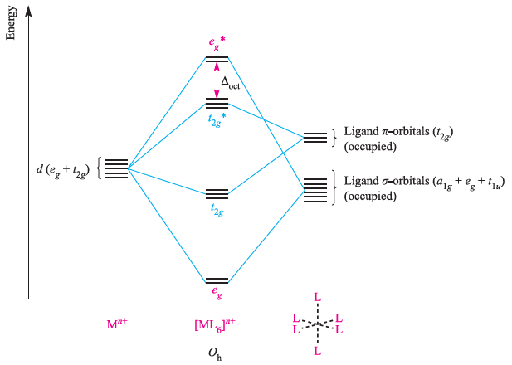
Δ_{oct} is identified as the energy separation between the t_{2g} and e_{g}* levels.
π-donor ligands diagram
318

Slide 319
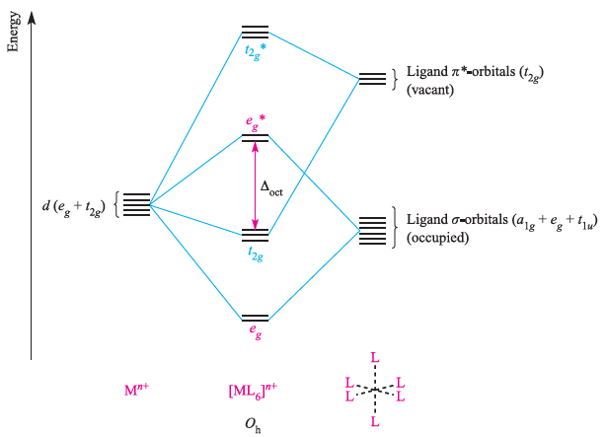

Slide 320
π-acceptor ligands diagram

Slide 321
The above figures reveal important differences between octahedral [ML₆]^{n+} complexes containing σ-donor, π-donor and π –acceptor ligands:
Δ_{oct} decreases in going from a σ-complex to one containing π-donor ligands;
for a complex with π-donor ligands, increased π–donation stabilizes the t_{2g} level and destabilizes the t_{2g}*, thus decreasing Δ_{oct}; Δ_{oct} values are relatively large for complexes containing π-acceptor ligands, and such complexes are likely to be low-spin. 321

Slide 322
For a complex with π -acceptor ligands, increased π -acceptance stabilizes the t_{2g} level, increasing Δ_{oct}.
Occupancies of the MOs in above figures
Six π- donor ligands provide 18 electrons (12 σ- and six π-electrons)
and these can notionally be considered to occupy the a_{1g}, t_{1u}, e_{g} and t_{2g} orbitals of the complex.
The occupancy of the t_{2g}* and eg* levels corresponds to the number of valence electrons of the metal ion.
Six π-acceptor ligands provide 12 electrons and, formally, we can place these in the a_{1g}, t_{1u} and e_{g} orbitals of the complex. 322

Slide 323
The metal valence electrons then corresponds to the occupancy of the t_{2g} and e_{g}* levels.
Since occupying antibonding MOs is detrimental to metal π–ligand bond formation, it follows that, for example, O_{h} complexes with π-acceptor ligands will not be favoured for metal centres with d⁷, d⁸, d⁹ or d¹⁰ configurations.
d-block metal organometallic and related complexes tend to obey the effective atomic number rule or 18-electron rule.
323

