Slide 1
Unit Four:
Leading health care

Slide 2
Learning Objectives
At the end of this session you will be able to:
Define leadership
Describe the leadership practices.
Discuss different leadership theories, types & styles.
Explain the differences between leader and manager.
Describe on different types of power

Slide 3
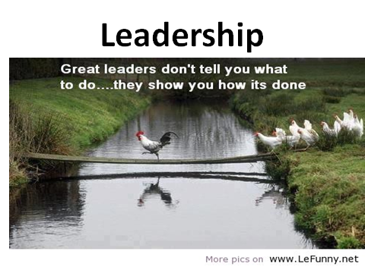

Slide 4
Leadership
“I am more afraid of an army of 100 sheep led by a lion than an army of 100 lions led by a sheep”
Talleyrand

Slide 5
What is Leadership?
Multidimensional concept that can be defined in different ways,
The ability to influence a group toward the achievement of goals.
leadership is Enabling Groups to Make Progress in Complex Conditions. Management sciences for health (2006)
Leadership is not domination, but the art of persuading people to work toward a common goal. Goleman and Daniel,1995.

Slide 6
Leadership…
Leadership is always exercised in relationship with others.
The true test of effective leadership is the visible progress towards the realization of vision,
inspire others to follow.
Leadership involves unequal distribution of power between the leader and group members.

Slide 7
Leadership…
The leader must win the willingness of the workers to accept directions.
Leaders are agents of change, persons whose acts affect other people more than other people’s acts affect them.
Leadership is an activity that takes place at all levels, not a position of authority

Slide 8
Leadership is about:
Influencing
Motivating
Inspiring
Taking people to greater heights
Working with participants on the how and helping them figure out the what and why
Encouraging them to push themselves to achieve the highest possible performance
Action
Enabling, not telling

Slide 9
Who is a leader?
A leader is an individual in a team influencing group activities towards goal formulation and achievement.
In other words, a leader is someone who has a vision, and the ability to make it a reality.

Slide 10
Who is a leader?
To achieve
objectives
Influence
followers
behavior

Slide 11
Dimensions of leadership
Leadership involves not just “doing” but “being”
Leadership is exercised with others.
Leadership is responsibility, not rank, title, privilege, or money.
Leadership and management are both necessary.
Leadership is about enabling people to face challenges.

Slide 12
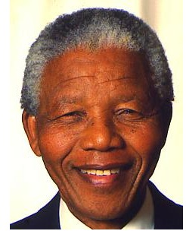
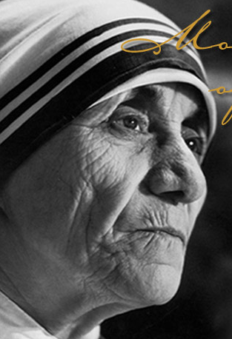
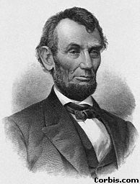
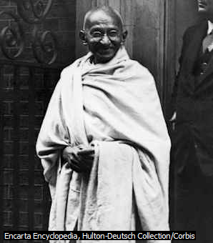
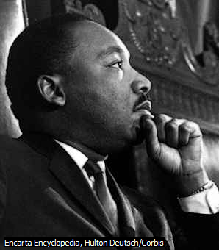
Some of the Great leaders

Slide 13
Leading Practices
Four Leadership Practices
Scanning
Focusing
Aligning/Mobilizing
Inspiring

Slide 14
Leadership Practice: Scanning
Leaders encourage their teams to scan their internal & external environments, organizations, teams, and themselves.
Identify client & stakeholder need & priorities
Recognize trends, opportunities, & risks that affect organizations.
Identify staff capacities & constraints.
Know yourself, your staff, & your organization values, strengths, & weakness.

Slide 15
Leadership Practice: Focusing
Using information from scanning, focus on a response.
Leaders focus their limited time, energy, and resources on the people and things that are most important.
Articulate the organization’s mission & strategy
Identify critical challenges
Link goals with the overall organizational strategy
Determine key priorities for action

Slide 16
Leadership Practice: Aligning/Mobilizing
A leader aligns and mobilizes others to achieve objectives.
This means seeking out other groups or people whose objectives are in line with yours and getting them to work alongside you.
You should align and mobilize stakeholders’ and staff time and energies as well as the material and financial resources to support organizational goals and priorities.
Facilitate teamwork.

Slide 17
Leadership Practice: Inspiring
Helps staff to face challenges creatively.
They are the people whose example moves us to follow in their footsteps.
Inspiring involves demonstrating:
Values through actions as role model & supporting staff
“Walking the talk” - matching deeds with words.
Trust & confidence in staff, acknowledging their contribution
Be a model of creativity, innovation ,learning& supporting staff.

Slide 18
Manager Vs Leader
Sometimes used interchangeably.
A person emerges as a leader.
A manager is put in to his position by appointment.
If a manager cannot influence others he is not a good leader; though he is a manager.
There are good leaders who are not managers.

Slide 19
Managers | Leaders
Cope with system complexity Plan and budget Control and solve problem | Seeks change Set direction and shared values Motivate people
Administers A copy Maintains Focuses on systems &structure Relies on control Short- range view Asks how and when Eye on the bottom line Imitates Does things right | Innovates An original Develops Focuses on people Inspires trust Long-range perspective Asks what and why Eye on the horizon Originates Does the right thing

Slide 20
Approaches to leadership
1. The trait approach(Theory):
It was assumed that some people are set apart from others by virtue of their possession of some quality or qualities of ‘greatness’ and that it is these people who become leaders.
This approach to leadership suggests that it is personal characteristics, or traits, that differentiate leaders from those they lead.
“Leaders are born but not made”

Slide 21
The trait approach…
These leadership traits include
personality characteristics (adaptability, dominance, self-confidence),
physical characteristics (above-average height, medium weight, attractive appearance), and
ability (intelligence, task expertise, sensitivity in dealing with others).

Slide 22
2. The behavioral approach(Theory):
Assumptions:
- Leaders can be made, rather than are born.
- Successful leadership is based in definable, learnable behavior.
Description:
Behavioral theories of leadership do not seek inborn traits or capabilities. Rather, they look at what leaders actually do.
• Studied behavioral characteristics of leaders;
• What they do and how they interact with the subordinates;

Slide 23
3. The contingency approach:
Leadership could vary with the situation or circumstances.
Focuses on task requirements.
No single trait has been shown to be common to all effective leaders and no single style has been found to be effective in improving staff performance in all situations.
The management technique that best contributes to the attainment of organizational goals might vary in different types of situations or circumstances.

Slide 24
Types of leaders
1. Transactional leaders
Identify the expectations of their followers
Act managerially by establishing a close link between effort and reward.
They evaluate, correct and train staff whenever staff performance needs to be improved, and they reward appropriately when the required outcomes are achieved.
Power is given to the leader to evaluate and reward the followers.

Slide 25
2. Transformational leaders
Transformational leaders, as defined by Bass (1985) support their staff and encourage them to ‘do more than they originally expected to do’.
Transformational leaders motivate staff to do better.
Transformational leaders provide encouragement and support to followers.
show trust and respect for them as individuals.
They build self-confidence and heighten personal development.

Slide 26
Types of Leaders…
3. Charismatic leaders
Max Weber, a sociologist, defined charisma (from the Greek for “gift”) more than a century ago as “a certain quality of an individual personality, by virtue of which he or she is set apart from ordinary people.”
Charismatic leaders rely on their personality, their inspirational qualities and their aura/ characteristic.
Key Characteristics of a Charismatic Leader
Vision and articulation
Willing to take on high personal risk
Sensitive to follower needs

Slide 27
Types of Leaders
4. Situational leaders
Is one who can adopt different leadership styles depending on the situation.
Effective leaders are versatile/Adapt in being able to move between the styles according to the situation, so there is no one right style.

Slide 28
Leadership styles
It is the typical pattern of behavior that a leader uses to influence their employees to achieve organizational goals.
1. Autocratic Leaders:
Make decisions and announce them.
There is also a clear division between the leader and the followers.
“ Do just what I say” or “ Don’t touch the hot iron”.
Subordinates carry out orders
Believe that money is the only reward that will motivate staffs.

Slide 29
Styles of Leadership
2. Democratic /participative Leaders:
Democratic leaders, also known as participative leaders, encourage group members to participate.
Democratic leaders keep staff informed about everything that affects their work and share decision-making and problem-solving responsibilities.
Group members feel engaged in the process and thus are more motivated and creative.
Permit subordinates to make decisions
Ideas are bilaterally proposed
What do you think? “Let’s do together”

Slide 30
Democratic /participative Leaders…
This style is most successful
when used with highly skilled or experienced staff or
when implementing operational changes or resolving individual or group problems.
This is a popular style because when it is done well it creates a harmonious, productive and developing work force.

Slide 31
Styles Leadership….
3. Laissez – faire Leaders:
Laissez-faire leadership is a style where the leader provides little or no direction and gives staff as much freedom as possible.
All authority or power is given to the staff and they determine goals, make decisions, and resolve problems on their own.
The laissez-faire leader promotes a strong sense of competence and expertise in team members and allows others to rise to their performance potential.
This style can lack accountability for team failures.
Type I
Leaders have little or no confidence in their ability
“Do as you like”
Have no concern for both staffs and the work output.

Slide 32
Laissez – faire Leaders ….
Type II:
Leaders are extremely confident about their staffs.
Subordinates may be high in their academic position.
Every staff knows the objectives of his / her organization.
Able to plan and implement independently.

Slide 33
You are a leader if:
You create something of a value that did not exist before
You exhibit positive energy
You actualize
You welcome change

Slide 34
Leadership use of power and authority
Leaders influence people to do things through the use of power and authority.

Slide 35
Leadership use of power and authority…
‘Authority’ is the formal right to get people to do things or the formal right to control resources.
Factors within a person, such as talent or charm, help them achieve power.
Power is the ability to influence decisions and control resources.
Powerful people have the potential to exercise influence, and they exercise it frequently.
Only the organization can confer authority.

Slide 36
Types of Power
Leaders use various types of power to influence others.
However, power can also be exercised upwards by the behavior of group members or staff, and this acts as a constraint on how much power leaders can employ in practice.
The list that follows describes the types of power exercised by leaders and sometimes by group members (French and Raven, 1960).

Slide 37
Five types of power
1. Legitimate power
It is a result of the position a person holds in the organization hierarchy.
It is the easiest type of influence for most staff to accept.
For example, virtually all employees accept the manager’s authority to conduct a performance evaluation.

Slide 38
2. Reward power
Emanates/issue from the leaders ability to reward desirable behavior.
It stems partly from the legitimate power.
Reward includes pay increase, promotions, work schedule, recognitions of accomplishment, etc

Slide 39
3. Coercive power
is the opposite of reward power
based on the leader’s ability to punish or prevent them from obtaining desired rewards.
Organizational punishments include assignment to undesirable working hours, demotion, and firing.
Effective leaders generally avoid heavy reliance on coercive power.

Slide 40
4. Expert power
It derives from a leader’s job-related knowledge as perceived by group members.
This type of power stems from having specialized skills, knowledge, or talent.
Expert power can be exercised even when a person does not occupy a formal leadership position.

Slide 41
5. Referent power
It refers to control based on loyalty to the leader and the group members’ desire to please that person.
Having referent power contributes to being perceived as charismatic, but expert power also enhances charisma.
Part of the loyalty to the leader is based on identification with the leader’s personal characteristics.

Slide 42
Thank you!!

