Slide 1
Unit 8
Health service coverage and Quality health care services

Slide 2
Reflective Question
What is Health system ?

Slide 3
Health service coverage
Objectives
At the end of this session students be able to
Understand what health service coverage mean
Explain different stages of health service coverage
Describe factor affecting health service coverage

Slide 4
Health service coverage
Health service coverage is considered as the extent of un limited interaction b/n the service and the people for whom it is intended.

Slide 5
Coverage…
For the measurement of coverage, several
key stages are first identified and defined for each stage, namely the ratio between the number of people for whom the condition is met and the target Population.

Slide 6
Coverage …
In many developing countries high priority has
been given to basic health services or primary health care.
One is the development of new resources
and technologies
The other is the effective use of available resources and technologies

Slide 7
Coverage…
The fundamental issues in the management of a basic health service are:
How should resources be allocated and services be organized in order to serve as many people as possible?
Is the service reaching the people it should serve ?
Has the service been effective in meeting the people's needs?

Slide 8
Comprehensive view of health service coverage
Health service coverage depends on the ability of a health service organization to interact with the service users (the target population).

Slide 9
Coverage …
This transformation process involves a variety of factors, such
as availability of resources and manpower,
distribution of facilities,
supply logistics, and
people's attitudes to health and health care

Slide 10
Coverage…
Coverage is normally expressed by the proportion
of the target population who can receive or have
received the service.
The number of people for whom the service can be provided expresses the service capacity or indicates the potential of the service.

Slide 11
Coverage …
On the other hand, the number of people who have received the service indicates the service output and the actual performance of the service.
It defines the coverage related to service capacity as potential coverage and that related to service output as actual coverage.
The relationship between service capacity and output is called service utilization (ratio between output and service capacity).

Slide 12
Coverage…
Utilization refers only to the service, and its measurement is only indirectly related to the size of the target population; on the other hand, coverage expresses a relationship between the service and the target population.
Eg. A high utilization of service facilities does not necessarily imply satisfactory coverage and could in fact imply the contrary.

Slide 13
Coverage…
Looking at this process from the point of view of service provision, it is possible to identify five important stages that successively lead to a desired health intervention and to define measurements of coverage appropriate to these stages.

Slide 14
1. Availability coverage
Some resources like manpower, facilities, drugs, etc.-are always required, the availability of such resources limits the maximum capacity of the services for target population. The ratio between this capacity and the size of the target population is called availability coverage.

Slide 15
2. accessibility coverage.
Even if all the necessary resources are available, the service must be located within reasonable reach of the people. Here, the capacity of the service is limited by the number of people who can reach and use it.
The coverage based on this capacity called accessibility coverage.

Slide 16
3. Acceptability coverage
Once the service is accessible, it still needs to be acceptable to the population.
This " acceptability " may be influenced by such factors as the cost of the service to the user, the form of religion he/she follows, etc.
Here, service capacity is limited by the number of people who are willing to use the accessible service, and the measurement of coverage called acceptability coverage.

Slide 17
4.Contact coverage
This is the process of service provision or actual contact between the service provider and the user.
The number of people who have contacted the service is a measurement of service output; the ratio between this and the size of the target population gives is called contact coverage.

Slide 18
5. Effective coverage
The contact between the service provider and the user doesn’t be always guarantee for successful intervention related to the user's health problem.
The measure, for number of people who have received satisfactory service is called effectiveness coverage.

Slide 19
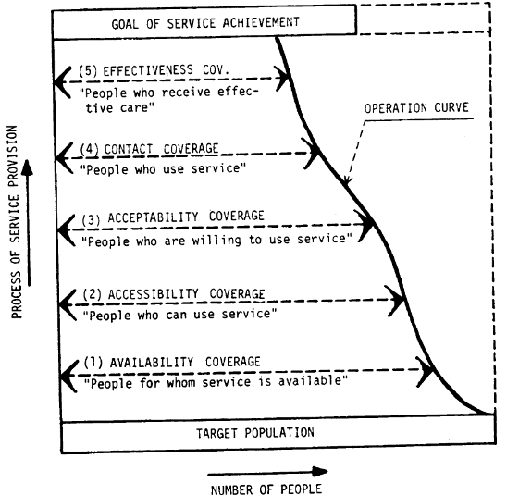
Coverage diagram-illustrating relationships between the process of service provision and coverage measurements.

Slide 20
Universal health coverage
UHC is defined as ensuring that all people have access to needed health services (preventive , promotive, curative, rehabilitative and palliative) in a sufficient quality and ensuring that the use of these services does not expose the users for financial hardship.

Slide 21
Health care quality
Objectives:
At the end of this class, students will be able to:
  Define quality in the context of healthcare
  Identify perspectives in the definition and measurement of HC quality
  Describe the components of quality in healthcare
  Differentiate between different components of QM:QA,QC and QI
  Describe different models of quality management in healthcare: Licensing, Certification, Accreditation, CQI

Slide 22
Concepts of Quality in healthcare
Increasing attention to quality during the last few decades
However, the concept is among those lacking standard definition and description.
What constitutes quality in healthcare? What is quality of Health Care for you?
  Definitions depend on what people value more.

Slide 23
IOM(1990), National Academy of Sciences
Definitions con’t…
Quality of health care is the degree to which health services for individuals and populations increase the likelihood of desired health outcomes and are consistent with current professional knowledge.
Important concepts:
Quality can be assessed both at individuals and population level
Quality can be assessed from the current professional practices
Notes:
IOM-Institute of Medicine
-An independent, non-profit organization helping to lead the improvement of healthcare throughout the world.
-A private, nonprofit organization created by the federal government(USA) to provide science based advice on matters of medicine and health
The expanded definition incorporating both the concept of W.Edward Demings concept:
“Quality consists of the degree to which health services for individuals and populations increase the likelihood of desired health outcomes (quality principles), are consistent with current professional knowledge (professional practitioner skill), and meet the expectations of healthcare users (the marketplace).”

Slide 24
Important concepts in the definitions
Quality of healthcare is about:
  Achieving positive health outcomes
  Economical/Efficient health care
  Limiting the negative consequences of health care(balancing risk and benefits)
  Complying with scientific recommendations/Current knowledge
  Addressing beneficiaries’ needs and expectations

Slide 25
Components of healthcare Quality
Different dimensions of health care quality by different scholars or organization
But the most widely accepted being Donabedian dimension/component of quality
According to Donabedian, quality of healthcare has seven pillars/components

Slide 26
Q
Efficacy
Effectiveness
Efficiency
Legitimacy
Optimality
Acceptability
Equity

Slide 27
Components con’t…
Efficacy:
  Is the ability of the science and art of healthcare to bring about improvement in health and well being under best circumstances.
  What constitutes “best circumstances” is always difficult to define and Controlling other factors is always challenging
  Therefore, a more realistic definition could substitute “specified circumstances” for “best circumstances”
Notes:
Efficacy-the ability of care at its best to improve health. It is the ability of science and art of health care to bring about improvement in health and well being under most favorable condition. The relative efficacy of alternative strategies of care is established by well controlled clinical research or technology assessment.

Slide 28
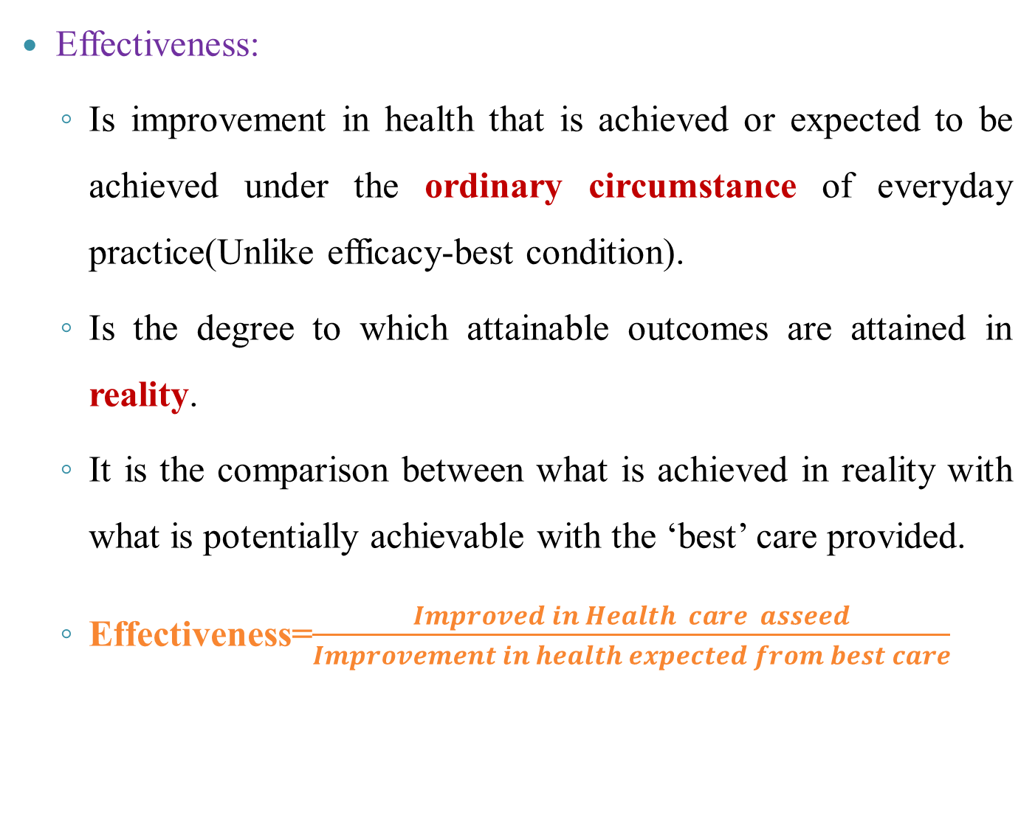
Components con’t…
Effectiveness:
  Is improvement in health that is achieved or expected to be achieved under the ordinary circumstance of everyday practice(Unlike efficacy-best condition).
  Is the degree to which attainable outcomes are attained in reality.
  It is the comparison between what is achieved in reality with what is potentially achievable with the ‘best’ care provided.
  Effectiveness=$\frac{Improved in Health care asseed}{Improvement in health expected from best care}$
Notes:
Effectiveness-In contrast to efficacy is improvement in health that is achieved or can be expected to be achieved under the ordinary circumstance of everyday practice. In effectiveness no mention of cost; the effect of health is considered only the sum of whatever improvement or damage health care produced or can be expected produce.
***When cost is introduced we consider two other pillars: Efficiency and optimality.

Slide 29
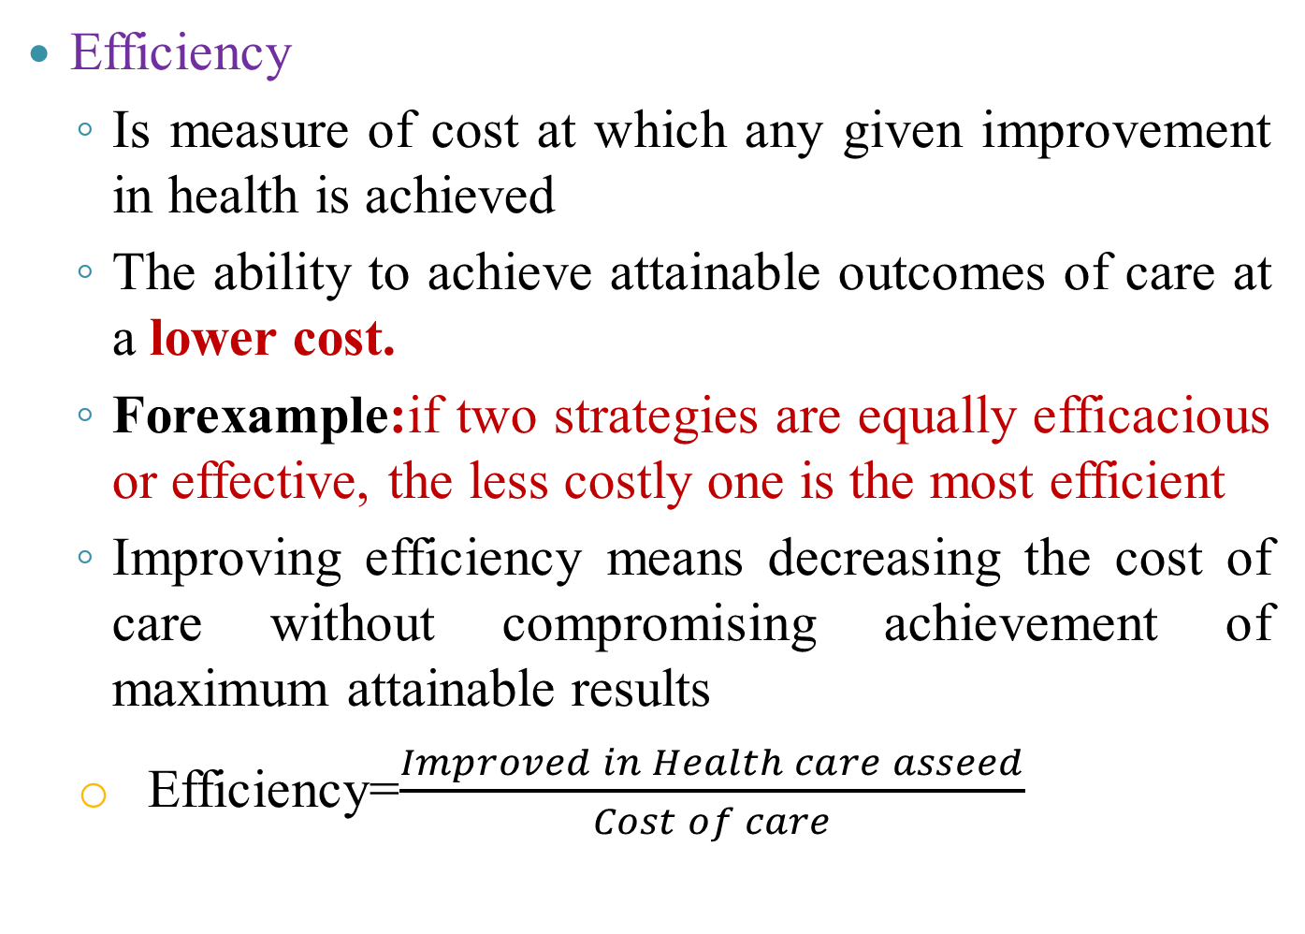
Components con’t…
Efficiency
  Is measure of cost at which any given improvement in health is achieved
  The ability to achieve attainable outcomes of care at a lower cost.
  Forexample:if two strategies are equally efficacious or effective, the less costly one is the most efficient
  Improving efficiency means decreasing the cost of care without compromising achievement of maximum attainable results
    Efficiency=$\frac{Improved in Health care asseed}{Cost of care}$
Notes:
Efficiency-is the ability to obtain the greatest health improvement at the lowest cost.

Slide 30
Components con’t…
Optimality
  the balancing of improvements in health against the cost and other negative consequences of such improvements
  becomes relevant when the effect of care are valued not in absolute terms, but relative to the cost of care.
  The most advantageous balancing of cost and benefits is optimizing benefits
Notes:
Optimality-becomes relevant when the effect of care are valued not absolute terms, but relative to the cost of care. The most advantageous balancing of cost and benefits.
A=Optimally effective care
B=Maximally effective care
Top panel: the consequence of making progressive additions to care. Despite increase in cost of care; there is flattening feature in benefit of care.
Lower panel: shows the consequence of relating cost and benefit. Beyond a certain point in progression of care; the balance between cost and benefit becomes adverse.

Slide 31
Components con’t…
Acceptability
  Is the level of conformity of care to the wishes, desires and expectations of patients and their families
  Usually related to what beneficiaries of healthcare value more including:
    Accessibility of care/services
    Patient-practitioner relationship
    Amenities of care(Time, expense, physical comfort to receive services)
    Pt preferences regarding the effectiveness & cost of care
Notes:
Sub-dimensions of acceptability:
Accessibility of care-the ability to obtain care when needed and to obtain it easily and conveniently.
Patient-practitioner relationship-patients wishes to treated with considerations and respect, to have their questions answered and their conditions explained and to have an opportunity to participate decisions about their own health and welfare. Improves patient satisfaction and in turn effectiveness through increasing patient cooperation in care.
Amenities of care-the properties of setting in which care is given making them convenient ,comfortable and pleasing.
Patient preferences regarding the effectiveness of care-patients often value the consequence of care as they affect their own health differently from the valuation of professionals. Patients choose among different alternatives based on effect.
Patient preferences to the costs of care-In case when the method of treatment is the same, patients may differ in how much they have to pay.

Slide 32
Components con’t…
Legitimacy
  Is acceptability of care to the society or community at large.
  Is the conformity of healthcare to social preferences as expressed in ethical principles, values, norms, laws and regulations
  Is the equivalent of acceptability as applied to the society
  Sometimes what is best care for individuals couldn’t becomes best care for the society.
  Society considers more issues: indirect and intangible costs; effect at society level
Notes:
****When individuals receive care or fail to receive it, they are not necessarily the ones that benefits or suffer. When there is benefit or harm to others, society will view the appropriateness of care differently from individuals.E.g.Genetic counseling, family planning,immunization,reporting of communicable diseases, and aggressive behaviours,and health supervision of those who, if their capacity fail might endanger others.
***When the effect of care confined to individuals society might not value them as highly as individuals do.For example: society may give more concern for children than elderly in care.
***In view of cost society differs from individuals.

Slide 33
Components con’t…
Equity
  Conformity to a principle that determines what is just and fair in the distribution of healthcare and its benefits among members of the population
  Do interventions facilitate the fair distribution of health services and benefits out of health care fairly among different segments of the population?
  Equity is part of what makes care acceptable to individuals and society legitimate
  So can able to stand as separate pillar of quality
Notes:
Q.What is Horizontal and Vertical equity???Discuss.
Equity addresses:
What individuals consider fair
What society considers fair
Distribution of access to care
Distribution of quality of subsequent care and of it consequences

Slide 34
Other dimensions of quality
IOM(2001):
    Safety-care intended to help patient that shouldn’t harm them
Effectiveness: Care should be based on scientific knowledge and provided to patients who could benefit. In other words, underuse and overuse should be avoided.
Patient centeredness-Care should be respectful of and responsive to individual patient preferences, needs, and values, and patient values should guide all clinical decisions

Slide 35
Other dimensions of quality
IOM(2001):
Timeliness—Care should be provided promptly when the patient needs it.
Efficiency—Waste, including equipment, supplies, ideas, and energy, should be avoided.
Equity—The best possible care should be provided to everyone, regardless of age,sex, race, financial status, or any other demographic variable.

Slide 36
Other dimensions of quality
Dimensions of WHO:
Safe
Equitable
Acceptable/Patient centered
Accessible
Efficient
Effective

Slide 37
Quality management

Slide 38
Quality Management: Why?
Three areas of gaps in healthcare:
  Overuse of healthcare
  Underuse of healthcare
  Misuse of healthcare

Slide 39
A
B
Services needed
Services provided
A: Underuse
B: Overuse
C: Misuse
C: How?

Slide 40
Quality Management: Why?
Overuse of healthcare:
  Refers to providing health care for peoples who are not eligible for it.
  Occur when drug or treatment given without medical justification.
    Consequences include
      Direct cost of services
      Opportunity costs of delivering useless services
      Side effects of services provided without indication
    Examples
      Prescribing antibiotics for common cold or other simple infections.
Notes:
Q.What is direct cost of health care? What is opportunity cost of health care?

Slide 41
Quality Management: Why?
Underuse of services
Refers to Missed opportunities for provision of services(at facility level)
Occurs when doctors or hospitals neglect to give patients medically necessary care or to follow proven health care practices
  Result in low coverage of services at population level
  Examples
    Patients with TB not tested for HIV
    ANC/FP clients not tested for HIV
    Low coverage of interventions for carcinogenic cases
    Mothers visiting OPD not screened for breast cancer

Slide 42
Quality Management: Why?
Misuse of services
  Inappropriate application of the science and technology of healthcare resulting in:
    Low effectiveness
    High cost
    Discomfort and injury to patients
  Examples
    Diagnosis – Treatment mismatch, procedural/medical errors

Slide 43
Quality Management: Why?
In general the need for quality management increased due to:
High cost of health care services
Regulatory pressures
Excessive variation in medical practices
Growing power of the purchaser
Malpractice incidents
Declining morale among health care providers
Notes:
Q.What is the relationship between cost of care and quality of care????Discuss with evidences.
How is quality related to cost?
What is the cost of good quality healthcare?
What is the cost of poor quality healthcare?

Slide 44
Components of QM:Quality terms
QM have four componments:quality plan, quality control, quality assurance and quality improvement.
Quality plan: A document or set of documents that describe the standards, quality practices, resources and processes pertinent to a specific product, service or project.
Quality Control: is the ongoing effort to maintain the integrity of a process to maintain the reliability of achieving an outcome.
Quality Assurance: is the planned or systematic actions necessary to provide enough confidence that a product or service will satisfy the given requirements.
Quality Improvement: can be distinguished from Quality Control in that Quality Improvement is the purposeful change of a process to improve the reliability of achieving outcome.

Slide 45
….Quality terms
Quality Management
Quality Assurance
Quality Control

Slide 46
….Quality terms
QA Vs. QC:
Although QA and QC are closely related concepts, and are both aspects of quality management, they are fundamentally different in their focus:
QC is used to verify the quality of the output; QA is the process of managing for quality.
Quality control is a product-oriented process;QA is a process-oriented practice.
QC makes sure the end product meets the quality requirements, QA makes sure that the process of manufacturing the product does adhere to standards.
QC can be noted as a reactive process;QA can be identified as a proactive process
QC involves detection and correction; QA involves prevention.
Notes:
For example: organizations can define their own internal quality standards, processes and procedures; the organization will develop these over time and then relevant stakeholders will be required to adhere by them.
The process of making sure that the stakeholders are adhered to the defined standards and procedures is called quality control. In quality control, a verification process takes place. Certain activities and products are verified against a defined set of rules or standards.
Every organization that practices QC needs to have a Quality Manual. The quality manual outlines the quality focus and the objectives in the organization. The quality manual gives the quality guidance to different departments and functions. Therefore, everyone in the organization needs to be aware of his or her responsibilities mentioned in the quality manual.
In quality assurance, a constant effort is made to enhance the quality practices in the organization. Therefore, continuous improvements are expected in quality functions in the company. For this, there is a dedicated quality assurance team commissioned.

Slide 47
Quality Management Models
There are different models of QM in healthcare:
  Licensing
  Certification
  Accreditation
  Continuous quality improvement
Most of the time, countries implement a combination of these models.
No single model can effectively improve healthcare quality, a combination of models is usually important.

Slide 48
Licensing
Is a process by which a governmental authority grants permission to an individual practitioner or health care organization to operate or engage in an occupation or profession.
Licensure reflects fulfillment of minimum requirements
No individual or organization can be engaged in service provision without a license.

Slide 49
Certification
Certification reflects the capability of an individual to provide services additional to minimum requirements.
Certification provides added credential to an entity’s qualification.
Examples.
  Certification of a GP to perform C/S in Ethiopia
  Certification of a general hospital to provide some specialized services

Slide 50
Accreditation
Is a formal process by which a recognized body usually a non-governmental organization, assesses and recognizes that a health care organization meets applicable pre-determined and published standards.
Participation is voluntary but advantageous
Assessment involves self assessment and external assessment by a team of peers

Slide 51
Continuous quality improvement …
It is a continuous process with a goal of doing the right things right the first time, every time.
  Doing the right things: investing resources on activities proven to achieve desired benefits
  Doing things right: implementing designed interventions in a way that is acceptable to beneficiaries, at the lowest cost possible and inline with current professional knowledge.
  Doing things right the first time, every time: achieving these as an institutional culture.

Slide 52
CQI con’t…
CQI includes two important components and a supporting infrastructure:
  Quality Measurement
  Quality Improvement
52

