Slide 1
Gynecology For Midwives
Mihretu Molla (MSC)

Slide 2
Unit I: Reproductive Basics
Definition
Approach to the Patient
The role of imaging techniques in gynecology
Embryology of the urogenital system &congenital Anomalies of the female Genitalia
Genetic disorders & sex chromosome abnormalities
Gynecological assessment and diagnostic procedures

Slide 3
Gynecology definition
The word "gynaecology" comes from of Greek words , (gyne), "woman", and -logia, "study".
Is the branch of medicine dealing with the health of the female reproductive systems (vagina, uterus, and ovaries) and the breasts.

Slide 4
Approach to the Patient
Session objectives
At the end of this session, the students will be able to
Develop interpersonal and communication skills that promote patient– midwife interaction and trust
Take proper gynecologic history
Perform proper gynecologic physical examination
Identify common diagnostic procedures in gynecology
Explain the role of imaging techniques in gynecology

Slide 5
Approach to the Patient
The practice of gynecology requires many skills.
In addition to medical knowledge, the midwife should develop interpersonal and communication skills that promote patient– midwife interaction and trust.
After a dialogue has been established, the patient assessment proceeds with obtaining a complete history and performing a physical examination.
The assessment should include any apparent medical condition as well as the psychological, social, and family aspects of her situation.

Slide 6
Gynecologic History Taking
A) Identification
Name
Age
Martial status
Religion
Educational status
Occupation
Date of admission

Slide 7
Gynecologic History Taking ….
B) Chief complaints
The patient may come the following gynecologic complaints
  Cessation of menses ( Amenorrhea)
  Vaginal bleeding and discharge
  Lower abdominal pain or deep pelvic pain
  Pain during intercourse( dyspareunia)
  Pain during menstruation( dysmenorrhea)

Slide 8
Gynecologic History Taking ….
Chief complaints…….
Protruding mass out per vagina
Genital ulcer
Urinary incontinence
Abdominal swelling and distention
Abnormal hair growth ( Hirsutism)
Sexual Assault

Slide 9
Gynecologic History Taking ….
C) History of present illness
  parity and Abortion
  Detail of each complaint
  Localization
  Duration
  Date and time of on set
  Aggravating and relieving factors
  Sequence of symptoms

Slide 10
Gynecologic History Taking ….
  History of present illness……
  Measures taken
  Interference with life style
  Relation to menstrual cycle
  LNMP should be included details of menstrual history if pertinent to the complaints
  Negative and positive statements pertinent to the presenting complaints

Slide 11
Gynecologic History Taking ….
D) Menstrual history:-
      Age of menarche
      Interval between period
      Duration of flow
      Amount and character of flow
      Dysmenorrea, premenstrual symptoms
      Age of menopause

Slide 12
Gynecologic History Taking ….
E) Gynecologic history:-
Contraception- use, type, duration and side effects
Sexual history- Assess risk of STD and HIV/AIDS
Gynecology operation- Like female genital mutlation, D and C , MVA, E and C, Laparatomy

Slide 13
Gynecologic History Taking ….
F)Past obstetric history:-
  All previous pregnancies in chronological order
  Date of gestation
  Birth weight
  Fetal out come
  Fetal presentation
  Mode of delivery
  Complication- Antepartum, Intrapartum and Postpartum

Slide 14
Gynecologic History Taking ….
G) Past medical and surgical history:-
Chronic medical conditions
Blood transfusion
Drugs intake
Maternal Infection- TORCH infection

Slide 15
Gynecologic History Taking ….
H) Personal, family and social history
Childhood development
Educational status
Habits like alcohol, smoking
Occupation- Exposure to radiation, Anesthesia...
Income- low socio-economic states
Family History- Dm, HTN, .....

Slide 16
Gynecologic Physical Examination
Preparation
Consent
Privacy and reassurance
Empty bladder
Examining instruments
Inputs for sample collection
Chaperon (for male examiner)

Slide 17
Gynecologic Physical Examination…
General appearance
V/S
HEENT
LGS

Slide 18
Gynecologic Physical Examination…
Breast examination- inspection, palpation and look for lymph nodes
Chest- CVS- for heart sound ,S1 and S2 sound .

Slide 19
Abdomen- Inspection, Auscultation, Palpation and percussion
Gus- Costovertebral angle and Suprapubic tenderness

Slide 20
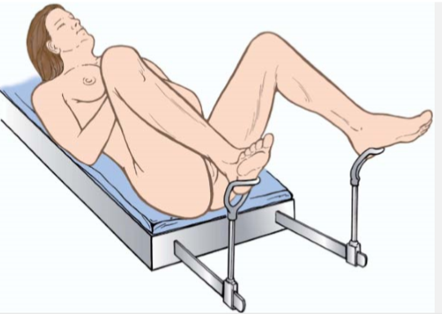
Pelvic examination
Most important in gynecology
Lithotomy position is ideal for examination

Slide 21
External genitalia
Inspection
Pubic hair- distribution
Labia major and minora-for ulcer, swelling.
Discharge from Urethra and Vaginal introitus

Slide 22
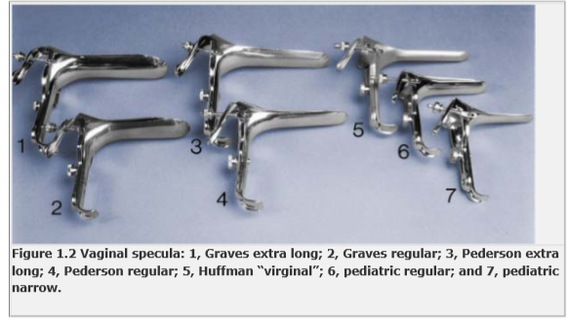
Speculum Examination

Slide 23
Cont--
Speculum Examination
Vagina- color, rugae folds, dischrge, laceration
Cervix- color, Os dilatation, effacement, bleeding and mass

Slide 24
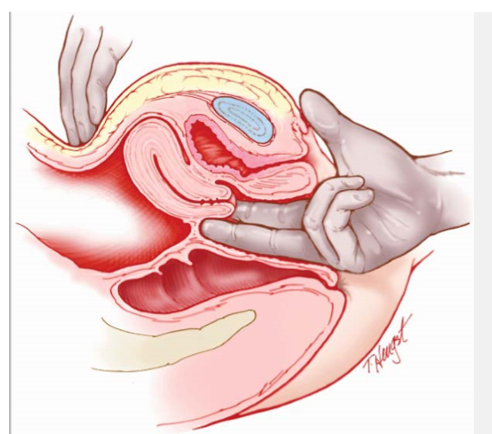
Digital vaginal and bimanual pelvic examination

Slide 25
Digital vaginal and bimanual pelvic examination
Vagina- mass and tenderness
Cervix- closed normally, move 2-3 cm with out discomfort and it is smooth surface like tip of nose in consistency
Uterus- Normally non- tender, mobile, pear shaped smooth and firm.
Adnexa- not palpable except in thin women with soft abdomen

Slide 26
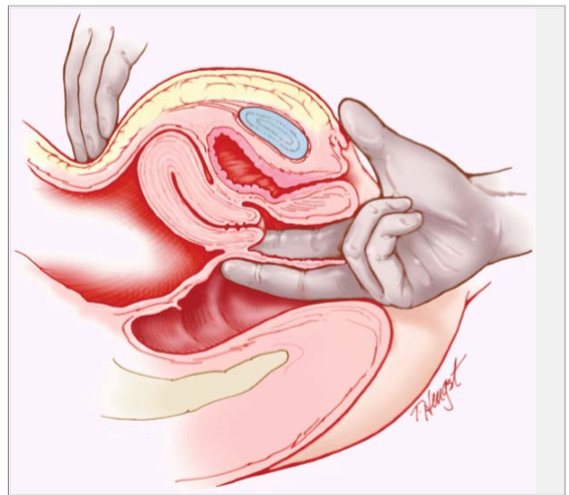
Recto-Vaginal Examination

Slide 27
Recto-vaginal examination….
The tone and symmetry of the sphincter are determined.
The parametrial tissue is then palpated between the index finger in the vagina and the middle finger in the rectum.
Finally, the posterior uterine surface, adnexal areas, uterosacral ligaments, and pouch of Douglas, along with the ano-rectal area, are palpated.
The rectovaginal examination enhances the evaluation of cul-de-sac or ovarian pathology.
Particles of hard fecal material may interfere with an accurate examination.
a separate rectal examination is indicated for children and/or virgins where vaginal examination is impossible.

Slide 28
Recording of pelvic examination findings
Perineum—lacerations, scarring
External genitalia—stage of development, color, lesions, Bartholin glands
Vestibule—Skene glands, urethral orifice, hymenal ring
Vagina—color, lesions, leucorrhea, tone, rugae
Cervix—shape, consistency, mobility, parity, lesions
Uterus—position, mobility, size, shape, consistency
Adnexa—position, mobility, masses, tenderness
Rectovaginal examination—confirmation of pelvic findings
Rectal examination—additional findings, occult blood

Slide 29
Physical examination ….
Integumentary- for hyper pigmentation and rash
Extremities- check for edema and dilated vessels
CNS
Assessment:-
Plan ( plan for investigation and management)

Slide 30
Diagnostic procedures
Tests for vaginal infection
  Direct microscopic examination of swabs.
  Urinalysis
  Urine culture
Tests for pregnancy

Slide 31
Diagnostic procedures…
Endometrial/vulvar Biopsy
Helps to evaluate benign and malignant conditions
Endometrial sampling is of greatest value in the evaluation of abnormal bleeding when diffuse rather than focal endometrial changes are suspected.

Slide 32
Diagnostic procedures…
Ovulation Detection and Prediction
determination of a biphasic temperature pattern by recording the basal body temperature (BBT).
Serial ultrasonographic studies of follicular growth and disappearance and subsequent formation of a corpus luteum.
Using home test kits for detecting the mid cycle surge of luteinizing hormone (LH) in urine.

Slide 33
Diagnostic procedures…
Hysteroscopy
  Is the visual examination of the uterine cavity through fiberoptic instrument
  Used to evaluate endocervical canal, endometrial cavity and tubal ostia
  The procedure is often coupled with sight directed biopsy or followed by endometrial curettage to evaluate for endometrial pathology.
  Unlike ultrasonography, hysterosalpingography (HSG) or endometrial biopsy it has unique advantage of combining thorough diagnostic procedures with treatment.

Slide 34
Diagnostic procedures…
Papanicolaou smear of cervix (pap smear)
Helps to diagnose precancerous lesions of the cervix
standard method of screening for cervical cancer.
can be also used to assess hormonal status and to assist in identifying sexually transmitted pathogens, such as herpes simplex, HPV, Chlamydia trachomatis, and Trichomonas vaginalis.

Slide 35
Diagnostic procedures…
Colposcopy
Aids in examining the visible portion of the female reproductive tract (i.e., vulva, vagina, cervix)
complements cytologic evaluation and localizes the source of abnormal cells seen on cytologic examination guiding selective biopsy.
Vulvar diseases amenable to colposcopic evaluation include HPV infections, Herpes genitalis, and preinvasive cancers.

Slide 36
Diagnostic procedures…
Culdocentesis
  Involves the introduction of a spinal needle through the vagina into the peritoneal space of pouch of douglas to aspirate peritoneal fluid.
  The type of fluid obtained indicates the type of intraperitoneal lesion.
  Ex. Bloody with a ruptured ectopic pregnancy. Pus with acute salpingitis or ascetic with malignant cells in cancer.

Slide 37
Diagnostic procedures…
Radiographic diagnostic procedures
  May be helpful in the diagnosis of pelvic conditions.
Ultrasonography
  Record high-frequency sound waves as they are reflected from anatomic structures.
  U/S is a simple and painless procedure that has added advantage of freedom from any radiation hazard.
  Can be helpful in the diagnostics of almost any pelvic abnormality, as all structures, normal and abnormal.

Slide 38
Reading Assignment
The role of imaging techniques in gynecology

Slide 39
Thank you!!

