Slide 1
Benign and malignant conditions of the breast

Slide 2
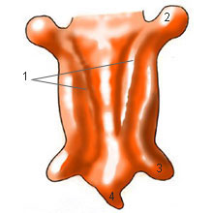
Anatomy and Physiology of the Breast
Development
The milk line as the primitive structure
Around 6th week of gestational age
9th week involutes sparing the chest area

Slide 3
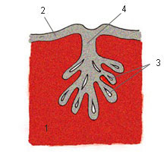
Development
Around the 12th week, epithelium starts to in grow and form the mammary pit.
Giving origin to lactiferous sinus, ducts and lobules.

Slide 4
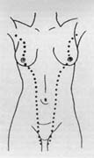
Development
2 – 6% Failure to involutes
Presents with super numeracy breasts and nipples
This can occur all the way along the milk line.

Slide 5
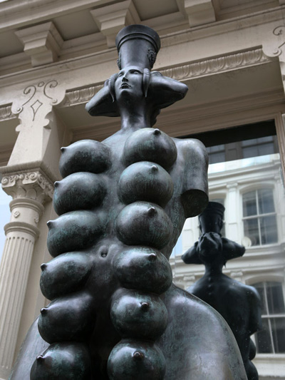
Development
Extrammamary tissue
(polimastia)

Slide 6
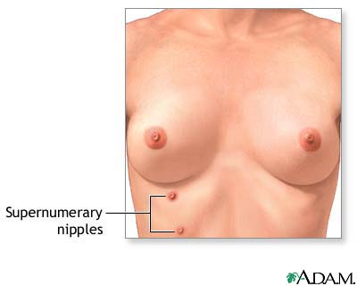
Development
Accessory nipples (Polythelia)

Slide 7
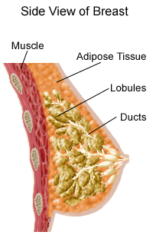
Female Breast Anatomy
Muscles
underneath
the breasts
separating them
from the ribs
Breast has
no
muscle tissue

Slide 8
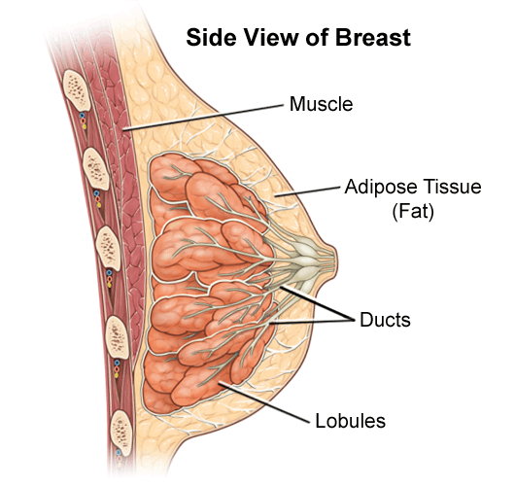
Breasts consist mainly of fatty tissue interspersed with connective tissue
There are also less conspicuous parts
  lobes
  ducts
  lymph nodes

Slide 9
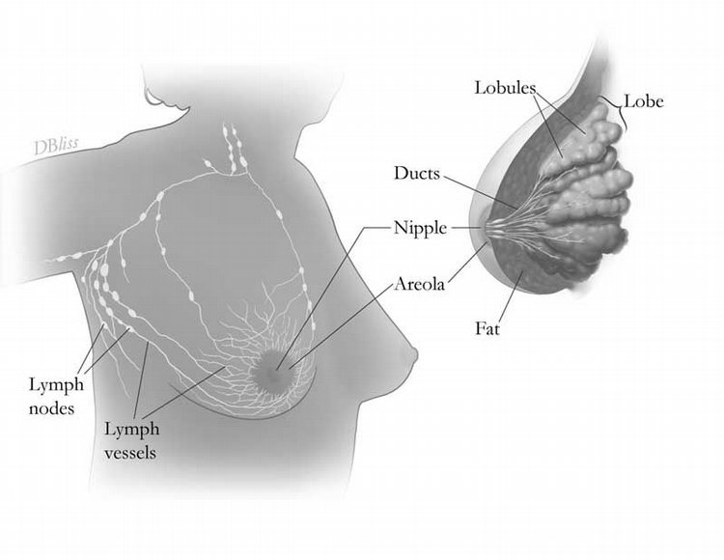
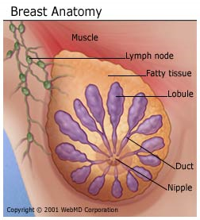

Breast Gland
Each breast has 15 to 20 sections (lobes) arranged like the petals of daisy
Inside each lobe are many smaller structures called lobules
At the end of each lobule are tiny sacs (bulbs) that can produce milk

Slide 10
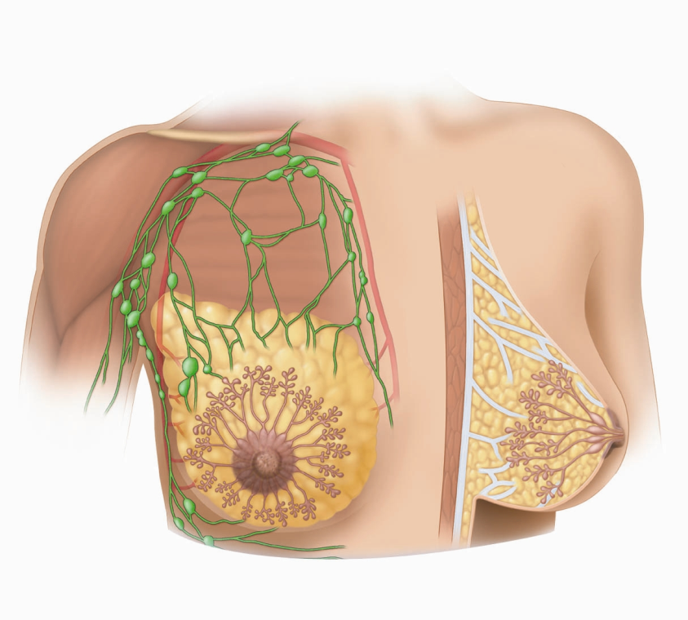
Ducts
Ducts carry
milk from bulbs
toward dark area
of skin in the
center of the
breast (areola)
Lobes, lobules,
and bulbs are
Linked by a
network of thin
tubes (ducts)
2
1
Ducts join together
into larger ducts ending
at the nipple, where
milk is delivered
Areola
3

Slide 11
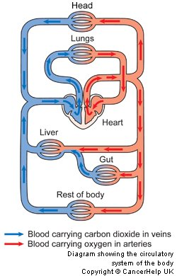
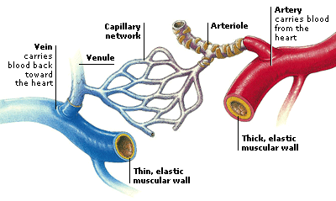
Blood Vessels
Oxygen, nutrients, and other life-sustaining nourishment are delivered to breast tissue by the blood in the arteries and capillaries.

Slide 12

Lymphatic System
Lymph ducts: Drain fluid that carries white blood cells (that fight disease) from the breast tissues into lymph nodes under the armpit and behind the breastbone
Lymph nodes: Filter harmful bacteria and play a key role in fighting off infection
Lymph node
Lymph duct
A network of vessels

Slide 13
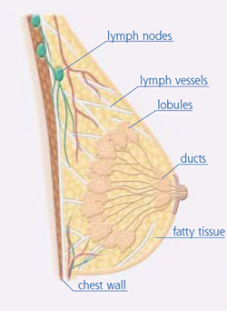
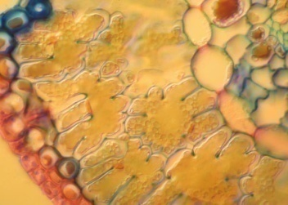

Three Types of Vessels
1
Lobules
Ducts
Nipple
Milk
3
Lymph
Nodes
Lymph
Vessels
Waste products
Bacteria
2
Blood
Vessels
Nourishment
Cell life

Slide 14
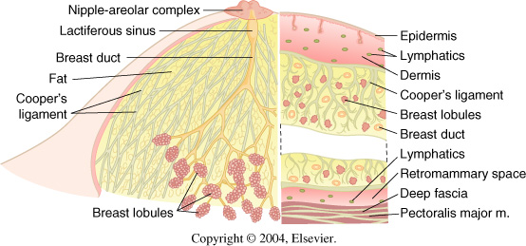
Anatomy
The mature breast lies in adipose tissue between the subcutaneous fat layer and the superficial pectoral fascia.
The retromammary space, between the breast and pectoralis major, contains lymphatics and small vessels.

Slide 15
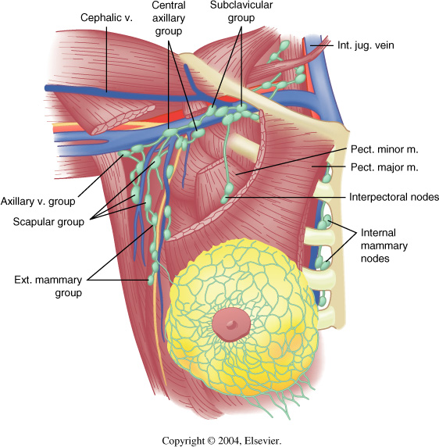
Anatomy
Lymphatic drainage
75% drains to the axilla.
Five groups of lymphnodes.
  Subclavicular nodes
  Supraclavicular nodes
  Internal mamary nodes
  Interpectoral nodes
  External mammary nodes

Slide 16
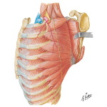
Anatomy
Close to the chest wall on the medial side of the axilla is the long thoracic nerve.
Provides innervation to the anterior serratus muscle.
Division of this results in winged scapula

Slide 17
Anatomy
The second major nerve trunk is the thoracodorsal nerve.
Runs at the lateral border of the axilla
Innervates the latissimus dorsi muscle
The medial pectoralis nerves innervate the pectoralis major muscle and are part of the neurovasvular bundle, best landmark for the axillary vein.

Slide 18
Anatomy
Microscopic anatomy
A mature breast is composed of 3 principal tissue types:
  Glandular epithelium
  Fibrous stroma and supporting structures
  Fat
Epithelium and stroma being replaced by fat in postmenopausal women.

Slide 19
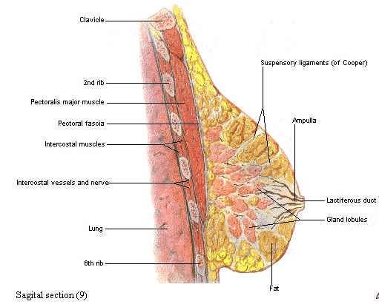
Anatomy
The glandular apparatus is composed of a branching system of ducts, organized in radial pattern spreading outward and downward.
Subareolar ducts widen to form lactiferous sinuses which exit through 10-15 orifices on the nipple.
The ducts end blindly in clusters of spaces called acini. (milk forming glands)

Slide 20
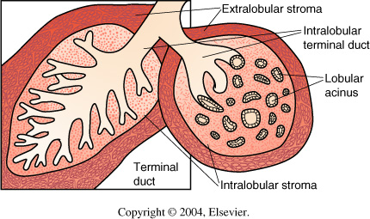
Anatomy
Under the luminal epithelium, the ductal system is surrounded by specialized myoepithelial cells that have contractile properties and serve to propel milk from the lobules to the nipple.
Outside the epithelial a myoepithelial layers the ducts are surrounded by basal membrane.

Slide 21
Development and physiology
During pre puberty the breast is composed primarily of dense fibrous stroma and scattered ducts lined with epithelium.
Raised serum stradiol concentrations promote fat deposition, formation of new ducts by branching and elongation.
Trophic effects of Insulin and thyroid hormones.

Slide 22
Development and physiology
Post pubertal mature or resting breast contains fat, stroma, lactiferous ducts and lobular units.
The epithelium and stroma undergo cyclic stimulation.
Hypertrophy and morphology alteration rather than hyperplasia.

Slide 23
Development and physiology
During pregnancy
  Diminution of fibrous stroma
  Formation of new acini or lobules
Changes promoted by influence of progesterone, estrogen, placental lactogen, prolactin and chorionic gonadotropin.

Slide 24
Development and physiology
Placental lactogen and sex hormones maintain the mammary epithelium in a pre-secretory phase by antagonizing the effects of prolactin.
The abrupt withdrawal upon delivery leaves the breast under the influence of prolactin.
In the presence of GH, Insulin and Cortisol, prolactin converts the epithelial cells to a secretory phase, resulting in the production of milk by alveolar cells.

Slide 25
Development and physiology
Colostrum
Milk production starts by day 4 or 5
Prolacting is maintained and stimulated by suckling.

Slide 26
Development and physiology
Oxytocin, released from the posterior pituitary in response to nipple/areolar stimulation, causes the ductal myoepithelial cells to contract and eject milk.
Post lactational involution occurs typically 3 months after weaning.
Menopause results in involution, decrease epithelial elements of resting breast, increased fat deposition, diminished connective tissue and disappearance of lobular units.

Slide 27
Benign conditions of the breast

Slide 28
Benign Clinical Conditions
Mastalgia
70% present pain, only 3% seek treatment.
Commonly cyclic and premenstrual.
Detail Hx&P/E, location, relation with menstrual period, duration, association masses or skin changes.
Commonly cysts and infection.
Treatment→ no caffeine, minimize salt, NSAIDs, Vitamins E and B6.

Slide 29
Benign Clinical Conditions
Nipple Discharge
Relatively common 5% of referrals
95% has a benign cause
Likelihood of malignacy increases women age
  Younger than 40→ 3%
  Ages 40-60→ 10%
  Older than 60→ 32%
All get mammogram

Slide 30
Benign Clinical Conditions
Nipple discharge cont…
Determine if physiologic or pathologic
Physiologic
  Non spontaneous, bilateral and multiple ducts.
  Color white, yellow, green, brown or black-bluish.
  Most common benign causes of bloody discharge are intra-ductal papiloma, peri-ductal mastitis .

Slide 31
Benign Clinical Conditions
Pathological discharge
  Spontaneous
  Unilateral
  Single duct
If associated with a mass, excision or biopsy is indicated.

Slide 32
Benign Clinical Conditions
Breast abscess/mastitis
Mastitis is cellulitis of the breast, commonly during lactation:-Causes
  Staph Aureus
  Streptococcus
  Treat with heat/ice pads, Ab.
  Breast pump if patient lactating.
If abscess is present→ incise and drainage + IV Ab

Slide 33
Benign Clinical Conditions
Simple breast Cysts
Epithelial-lined cavities that contain fluid
7% of women Can have cyclic fluctuation
Firm and mobile and well demarcated
Aspiration:-
  If bloody
  Recurrence
  Persistence
Excisional biopsy is warranted

Slide 34
Benign Clinical Conditions
Fibroadenoma
Most common cause of breast masses in younger than 25yrs
Pseudo encapsulated and mobile, smooth or slightly lobulated.
Epithelial and stromal elements.
Solitary and painless masses.
Older than 30 get biopsied.
Definitive diagnosis by FNA, core needle or excision.

Slide 35
Benign Clinical Conditions
Hematomas
Well-defined masses on exam and mammogram.
Composed of combination of fibrous stroma, ducts, lobules, adipose tissue and occasional smooth muscle.

Slide 36
Benign Clinical Conditions
Fat necrosis
Can mimic carcinoma, clinically and mammographycally
Round, firm tumor that may have cavitations to liquefactive necrosis.
Micro→ Early lesions have cystic space with lipid laden macrophages .
Later lesions have fibroplastic proliferation with deposition of collagen.

Slide 37
Benign Clinical Conditions
Fibrocystic changes
Spectrum of mammographic and histologic findings
Forth and fifth decades of life
Exagerated response of breast stroma and epithelium to circulating and locally produced hormones
Breast pain, tenderness and nodularity
Premenstrual cyclic mastalgia

Slide 38
Benign Clinical Conditions
Mammographycally apears as diffuse of focal radiologically dense tissue.
Palpable cysts or multiple small cysts are typical
Depending on the presence of epithelial hyperplasia is classified:-
  Non proliferative
  Proliferative with /with out atypical

Slide 39
Benign Clinical Conditions
Galactocele
Milk-filled cysts that are round, well circunscribed and easily movable.
Up to 6-10 months after breast-feeding has stopped.
Unknown pathogenesis, though to be due to milk within ducts.
Centrally located under the nipple.
Can be aspirated and surgery reserved for those that become infected.

Slide 40
Breast Cancer

Slide 41
Objective
Describe Female Breast Anatomy
Distinguish common variations and abnormal changes of the breasts.
Discuss methods of teaching breast self-examination to patients.
Identify risk factors for breast cancer.
Describe the diagnostic method of breast cancer

Slide 42
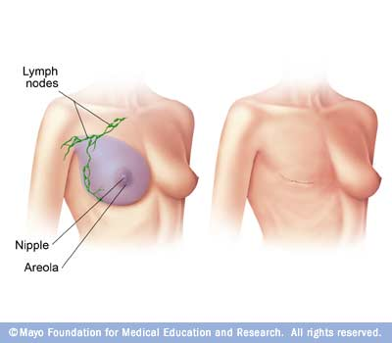
What is Breast Cancer
An abnormal, uncontrolled cell growth arising in the breast tissue
Breast cancer is second only to lung cancer as a cause of cancer deaths in American women

Slide 43
Risk factors of breast cancer
Personal or family history
Not having children
Having first child after age 30
Radiation therapy to chest/upper body
Overweight or obese
Age
Late menopause
Diets high in saturated fat
Estrogen replacement therapy

Slide 44
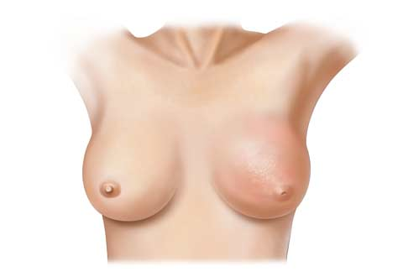
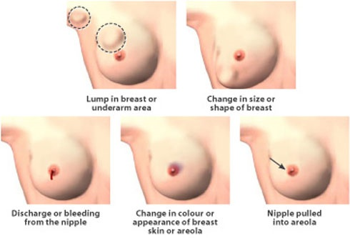
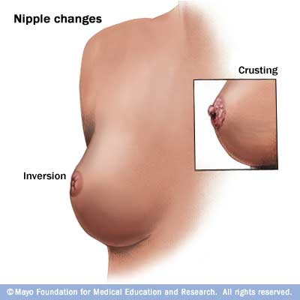
Signs and Symptoms
Most common: lump or thickening in breast. Often painless
Discharge or bleeding
Redness or pitting of skin over the breast, like the skin of an orange
Change in size or contours of breast
Change in color or appearance of areola

Slide 45
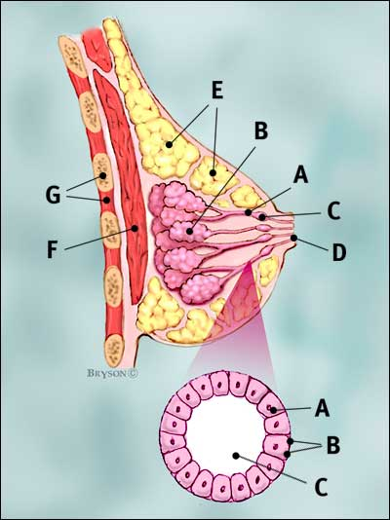
Normal Breast
Breast profile
A | ducts
B | lobules
C | dilated section of duct to hold milk
D | nipple
E | fat
F | pectoralis major muscle
G | chest wall/rib cage
Enlargement
A | normal duct cells
B | basement membrane (duct wall)
C | lumen (center of duct)
Illustration © Mary K. Bryson

Slide 46
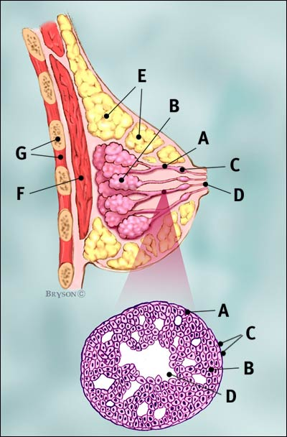
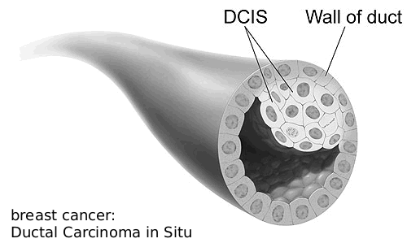
Ductal Carcinoma in situ (DCIS)
Ductal cancer cells
Normal ductal cell
Carcinoma refers to any cancer that begins in the skin or other tissues that cover internal organs
Illustration © Mary K. Bryson

Slide 47
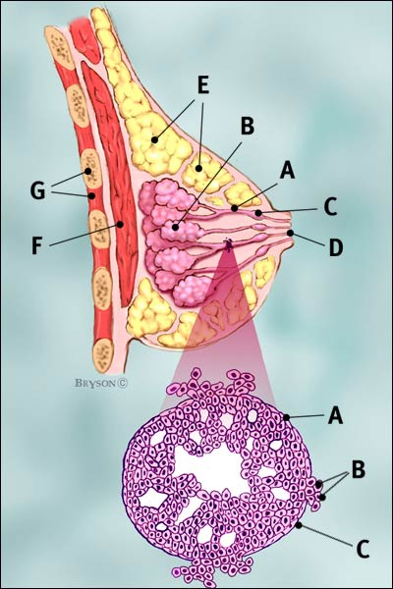
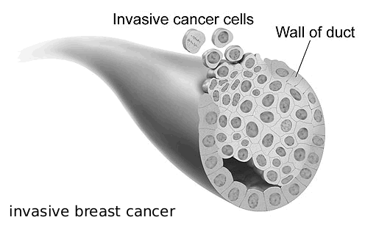
Invasive Ductal Carcinoma (IDC – 80% of breast cancer)
Ductal cancer cells breaking through the wall
The cancer has spread to the surrounding tissues
Illustration © Mary K. Bryson

Slide 48
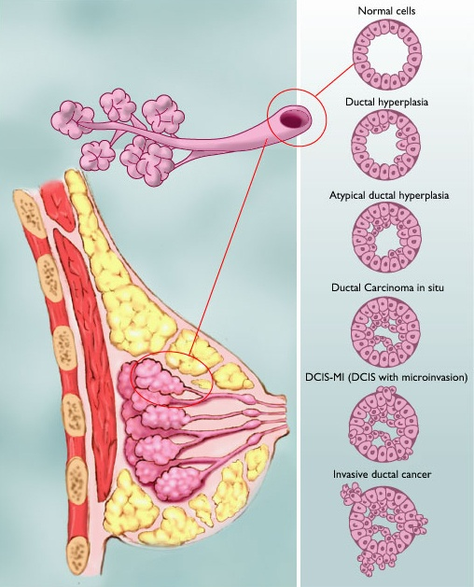
Range of Ductal Carcinoma in situ
Illustration © Mary K. Bryson

Slide 49
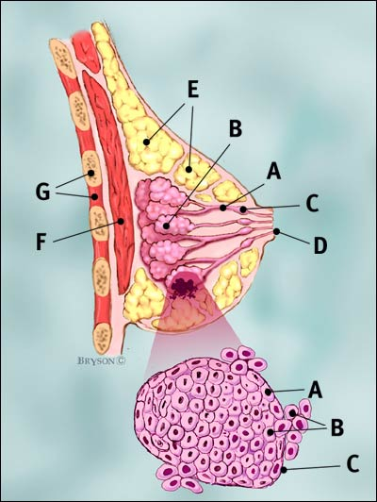
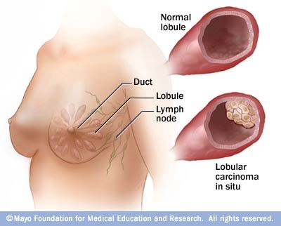
Invasive Lobular Carcinoma (ILC)
Lobular cancer cells breaking through the wall
Illustration © Mary K. Bryson

Slide 50
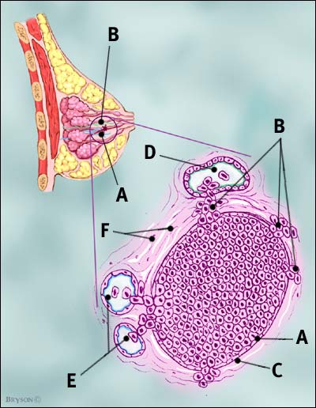
Cancer Can also Invade Lymph or Blood Vessels
Cancer cells invade lymph duct
Cancer cells invade blood vessel
Illustration © Mary K. Bryson

Slide 51
diagnosis
Early detection is the key!
  Self/Doctor examinations
  Mammography
  Ultrasound
  MRI
  Biopsy
  Self VS Mammography VS Ultrasound VS MRI VS Biopsy

Slide 52
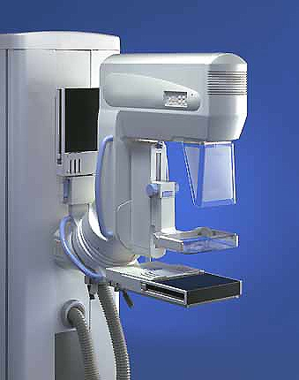
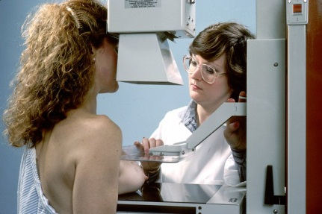
Mammography
Use a low-dose x-ray system to examine breasts
Digital mammography replaces x-ray film by solid-state detectors that convert x-rays into electrical signals. These signals are used to produce images that can be displayed on a computer screen (similar to digital cameras)
Mammography can show changes in the breast up to two years before a physician can feel them

Slide 53
Computer-Aided Diagnosis
Mammography allows for efficient diagnosis of breast cancers at an earlier stage
Radiologists misdiagnose 10-30% of the malignant cases
Of the cases sent for surgical biopsy, only 10-20% are actually malignant
National Cancer Institute

Slide 54
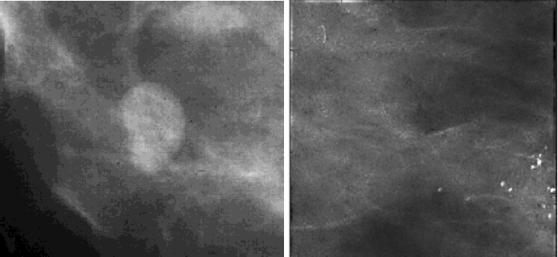
What Mammograms Show
Two of the most important mammographic indicators of breat cancers
  Masses
  Microcalcifications: Tiny flecks of calcium – like grains of salt – in the soft tissue of the breast that can sometimes indicate an early cancer.

Slide 55
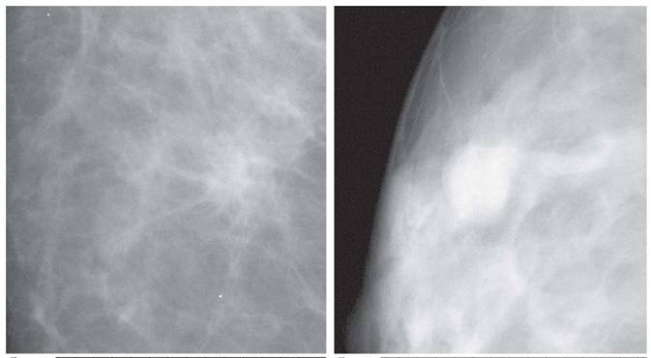
Detection of Malignant Masses
Malignant masses have a more spiculated appearance
benign
malignant

Slide 56
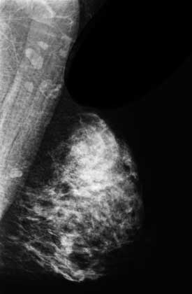
Mammogram – Difficult Case
Heterogeneously dense breast
Cancer can be difficult to detect with this type of breast tissue
The fibroglandular tissue (white areas) may hide the tumor
The breasts of younger women contain more glands and ligaments resulting in dense breast tissue

Slide 57
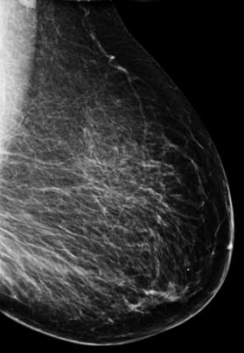
Mammogram – Easier Case
With age, breast tissue becomes fattier and has fewer glands
Cancer is relatively easy to detect in this type of breast tissue

Slide 58
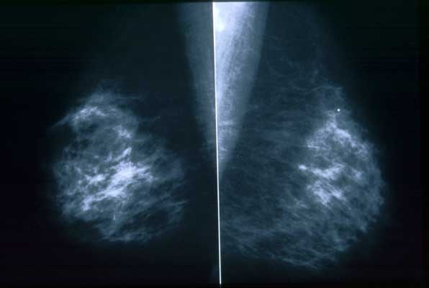
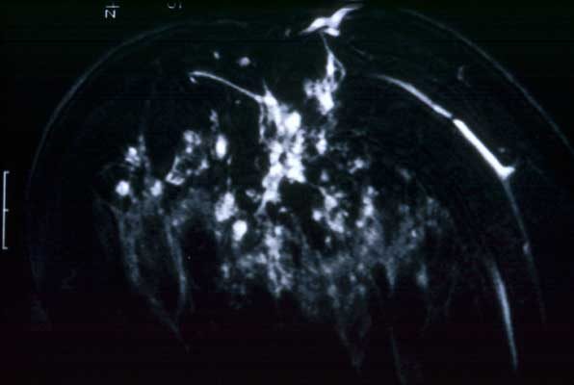
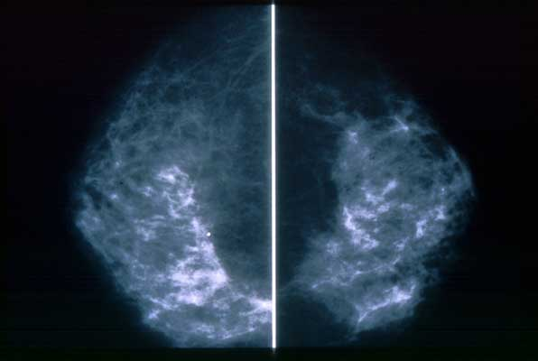
Different Views
MRI - Cancer can have a unique
appearance – many small irregular
white areas that turned out to be
cancer (used for diagnosis)
Side-to-Side
Top-to-Bottom

Slide 59
Treatment
-Breast cancer is best treated in a multidisciplinary environment that includes:
Surgery and radiation therapy are aimed at eliminating all local or regional tumor
making systemic treatment with chemotherapy, hormone manipulation, or targeted therapies the primary approach for
reducing the risk of metastases and death

