Slide 1
Benign & malignant disorders of the ovary
Getachew (MD)
Feb 2013

Slide 2
Objectives
Describe benign conditions of the ovary
Explain the clinical presentations of benign disorders and their management
Describe malignant conditions of the ovary
Explain the clinical presentations of malignant disorders and their management

Slide 3
Introduction
Benign Disorders
Benign adnexal masses are common in women in the reproductive age group
caused by physiologic cysts or benign neoplasms
The management of these benign masses is dictated by their presentation
-hemorrhage of a ruptured cyst or ovarian torsion

Slide 4
Int...
Neoplastic Vs non neoplastic
Ovarian cyst Vs Cystic ovary
- cellular proliferation Vs accumulation of intracystic fluids
Causes of non neoplastic enlargement include:
Follicular cysts
Corpus luteum cyst
Theca Leutin cysts
PCOS
Endometrioma ( checolate cysts)
Infectious, TOA

Slide 5
Int...
Features of functional cyst:
Temporarily related to hormonal disorders
Complicated rarely
Sometimes confused with neoplasia

Slide 6
Int...
Follicular Cysts
-common and vary in diameter from 3 to 8 cm
-Histologically, they are seen to be lined by an inner layer of granulosa cells and an outer layer of theca interna cells that may or may not be luteinized
-result from a failure in ovulation
-typically they are asymptomatic, although bleeding and torsion can occur
-AUB associated with a disturbance of the ovulatory pattern

Slide 7
Int...
most disappear spontaneously within 60 days without treatment.
use of OCPs has often been recommended to help establish a normal rhythm; however, recent data show that this practice may not produce more rapid resolution than expectant management.

Slide 8
Int...
Corpus Luteum (Granulosa Lutein) Cysts
-thin-walled unilocular cysts ranging from 3–11 cm in size
-occur during over activity of corpus luteum
-often occurs with pregnancy
-uncommon in those taking COC b/c one MOA of coc is by inhibition of ovulation and if no ovulation ,no c. luteum
-spontaneous resolution is common
-laparatomy in cases of acute abdomen

Slide 9
Int...
Theca Lutein Cysts
-Usually bilateral
-Caused by excess hcG( like in case of GTD) or follow administration of gonadotropins or clomiphene(both used for ovulation induction)
-Spontaneous resolution with removal of the causes

Slide 10
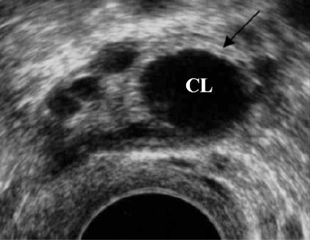

Slide 11
Ovarian neoplasms
75% of ovarian neoplasms are benign
Classification is full of confusion
Classification is based on morphological characteristics, histological features & clinical behaviors

Slide 12
Ovarian neoplasms…
The ovary is a complex structure with principal ovarian tissue components :
Epithelial cells derived from coelomic epithelium
Oocytes derived from primitive germ cells
Mesenchymal elements from gonadal stroma

Slide 13
Classification of ovarian neoplasms
Based on clinical behaviors:
Benign
Borderline
Malignant
Based on morphologic characteristics:
Cystic
Mixed
Solid

Slide 14
Classification…
Based on histological features:
Epithelial tumor: benign, border line or malignant
Serous tumor
Mucinous tumor
Endometroid tumor
Mesonephroid (clear cell)
Brenner tumors
Mixed epithelial tumors
Undifferentiated carcinoma
Unclassified epithelial tumors

Slide 15
Classification…
Germ cell tumors of the ovary
Dysgerminoma
Endodermal sinus tumor
Teratoma: mature, immature, monodermal
Embryonal carcinoma
Polyembroyoma
Choriocarcinoma
Mixed germ cell tumors

Slide 16
Classification…
Sex-cord stromal tumors:
Granulosa cell tumors
Tumors of thecoma-fibroma group
Androblastoma: Sertoli cell tumors
Unclassified
Lipid cell tumor
Gonadoblastoma
Unclassified
Secondaries(metastatic tumor to ovary)

Slide 17
Benign ovarian neoplasms
serous and mucinous cystadenomas (surface epithelial neoplasia group) and
mature cystic teratomas (germ cell family) are by far the most common beenign ovarian tumors

Slide 18
Serous cystadenoma
Arises from totipotent surface epithelium
Common
Accounts for 40% of ovarian tumors
Bilateral in 10-15 %
Chance of malignancy is 40%
Pathology: not as big as mucinous variant
Focal proliferation of the underlying stroma may produce firm papillary projections into the cyst
hemorrhage in to the cyst is common
No abundant secretion

Slide 19
Serous…
Naked eye appearance:
smooth, shiny & grayish wall
Papillary projections
commonly unilocular
Fluid content is clear & rich in proteins –albumin & globulin

Slide 20
Serous…
Microscopic features:
Lining is single layer of cuboidal epithelium
Presence of ciliated, secretary cells resembling fallopian tube lining
Papillary structures have broad dense fibrous tissue

Slide 21
Mucinous cystadenoma
typically found in women in their 30s through 50s
bilateral in 8–10%
largest tumors found in the human body(70kg)
the more massive the tumor, the greater the possibility that it is mucinous

Slide 22
Mucinous…
Pathology
Nacked eye
Lobulated smooth wall with whitish or bluish white appearance
Cut section shows a content of thick, viscid mucin which is a glycoprotein & multiloculated
Colorless fluid

Slide 23
Mucinous…
Microscopic features:
Lined by single layer of columnar epithelium
Dark stained basal nucleus
No cilia
Cells are characteristic of endocervix

Slide 24
Mature Cystic Teratoma (Benign Cystic Teratoma ,Dermoid Cyst)
Origin:
Germ cells arrested after 1st meiotic division(46xx)
Pathology:
10 to 25 %of all ovarian neoplasms
60 % of all benign ovarian neoplasms
Bilateral in 15-20%
Accounts for 20-40 % of ovarian tumors in pregnancy
Torsion is most common complication (15-20%)
Chance of malignancy is 1-2%

Slide 25
Dermoid Cyst…
Naked eye appearance:
Moderate size cyst
Smooth & tense capsule
Content is predominantly of sebaceous material
Solid area of projection called as Rokitansky protuberance, dermoid plug, dermoid process, dermoid mamilla, or embryonal rudiment ,this protuberance may occasionally be absent or multiple

Slide 26
Dermoid Cyst…
Microscopic features:
Lining epithelium is stratified squamous epithelium & at places with granulation tissue
Most common tissue is ectoderm
Dermoid tumor is a misnomer as it encompasses all germ cell layers

Slide 27
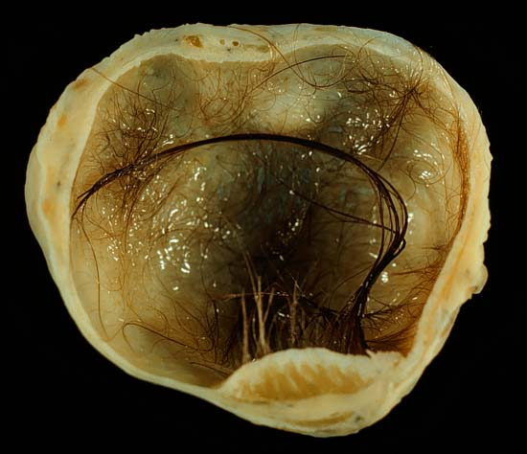
Mature Cystic Teratoma

Slide 28
Clinical features of benign tumors
Commonly seen in late child bearing age group(30-45) while malignant ovarian tumor are commonly seen b/n age 55-60
Dermoid cyst & mucinous cystadenoma are common in reproductive age group
Dermoid cyst & serous cystadenoma are common during pregnancy
No association to parity

Slide 29
Clinical features…
Most are asymptomatic
Heaviness in the lower abdomen
Gradually increasing mass in the lower abdomen, may also fill the lower abdomen like in case of mucineous cystadenoma
Dull aching lower abdominal pain due to pressure effect or acute abdomen like in case of serous cystadenoma and dermoid cyst
No effect on menses

Slide 30
Clinical features…
Signs:
General condition remain unaffected
Cachexia in mucinous cystadenoma
There may be pitting edema in lower extremities.
Abdominal mass either central or in one side
Cystic/ tense cystic feel or solid/firm

Slide 31
Clinical features…
Signs:
Mass freely mobile from side to side but not from above to downwards
Usually smooth surface
Non-tender
Dull at the center & resonant at the flanks
Positive fluid thrill

Slide 32
Clinical features…
Meig’s Syndrome/ pseudomeig’s syndrome -Meigs' syndrome refers to the occurrence of an ovarian fibroma, ascites, and pleural effusion, which collectively mimic the presentation of ovarian cancer
There may be friction rub at the mass
Pelvic examination:
-Mass felt separate from the uterus -b/c the mass donot move while doing bimanual examin. with one hand on the mass and the dominant hand in the cervix
-Groove between mass & uterus
-Movement of cervix fails to move the mass

Slide 33
Investigations for benign ovarian tumors
Ultrasound with / without color Doppler studies: helps to
Measure the size of the tumor, Nature , consistency of tumor
Associated ascites
Septation & thickness
Blood flow-increased blood flow indicate malignant tumor
Plain x-ray
EUA (examination under anesthesia)in doubtful cases
Laparoscopy/laparatomy and doing Cytology or Histology

Slide 34
Differential diagnosis of lower abdominal mass
Fibroid
Functional cyst
Inflammatory mass
Pregnancy with or without fibroid
Mesenteric cyst
Para-ovarian cyst
Full bladder

Slide 35
Complications
Torsion of the pedicle
Intracystic hemorrhage
Infection
Rupture
Pseudomyxoma peritonei
malignancy

Slide 36
Ovarian torsion
Incidence: 10-15 % at operation
Common in tumors:
Moderate size with round contour
Moderate weight/ dermoid cyst
Free mobility
Long pedicle
More common in dermoid & serous cystadenoma

Slide 37
Ovarian torsion…
Causes:
Trauma
Intestinal peristalsis
Violent physical movement
Contraction with pregnant uterus

Slide 38
Ovarian torsion…
Clinical features
Symptoms depend on the extent of interference with blood supply
Sudden onset lower abdominal pain
Complete occlusion manifests with severe pain
Low grade fever
Tachycardia, tender lower abdomen with mass

Slide 39
Differential diagnosis
Ruptured Ectopic pregnancy
Acute appendicitis
PID
Acute hydraminos
Torsion of pedunculated subserous myoma
-the above are also DDX for acute abdomen together with ruptured tuboovarian abcess,
Treatment: LAPAROTOMY

Slide 40
Management of benign ovarian tumors
Admit for operation
Complications may occur any time
Deliver tumor intact
Inspect other ovary & other structures
Cystectomy for those who need fertility and oopherectomy for those who doesnt

Slide 41
Borderline malignant epithelial tumors of the ovary
Low malignant potential
Constitutes 10-20% of all epithelial tumors
Characterized by:
Cellular pleomorphism(different form)
Stratification/ pseudo-stratification
No stromal invasion
Treatment: Unilateral oophrectomy for young age or TAH ( total abdominal hysterectomy)+ BSO( bilateral salpingoopherectomy) if bilateral involvement b/c once bilateral oophorectomy is done there is no need to leave uterus since pregnancy donot occur in absence of ovulation

Slide 42
Malignant ovarian tumor
Incidence:
Constitutes about 15-20% of genital malignancy
More common in USA & Scandivian countries: low incidence in Japan
20% of ovarian neoplasms are malignant
Mean age about 60-65 years
4th common cause of cancer deaths exceeded by lung, breast, &colon malignancies.
Life time risk 1-1.5%, dying from ovarian cancer is 0.5%

Slide 43
AETIOLOGY OF EPITHELIAL OVARIAN CANCER
Several current hypotheses attempt to explain the aetiology of ovarian cancer, although no hypothesis convincingly draws together every strand of evidence
Incessant ovulation hypothesis ( Fathalla 1971) states that cancers arise as a result of repeated trauma to the epithelial cells during ovulation.
Ovulations in the 20- to 29-year age group are associated with the greatest risk, with a 20% increase in risk associated with each year of ovulation over this age period
The pituitary gonadotrophin hypothesis suggests that high levels of gonadotrophins acting via the stimulation of oestrogens cause ovarian epithelial cells to become trapped in inclusion cysts and undergo malignant change
The androgenic/progesterone hypothesis suggests that androgens, which are increased in obesity and the postmenopausal state, stimulate cancer formation, while progesterone is protective

Slide 44
The inflammation hypothesis states that inflammation plays a role in cancer formation, which explains the risk factors of pelvic inflammatory disease and the protective effect of tubal ligation and hysterectomy
The ovarian stromal hypothesis states that, following ovulation, some theca and granulosa cells fail to apoptose, and persist while retaining their ability to produce steroids, thus stimulating cancer
None of these hypotheses completely explains all the data from epidemiology

Slide 45
RISK FACTORS FOR OVARIAN CANCER
1. Nulliparity
2. Effect of ovulation inducing drugs is not certain.
3. Early menarche and late menopause
4. Talc & asbestos exposure
5. Use of coffee, tobacco, alcohol & dietary fat
Highest incidence in industrialized countries
Family history of the different syndromes
Protective factors:
increasing parity reduces the risk
COC & Implant
Breast feeding, tubal ligation & hysterectomy

Slide 46
HEREDITARY OVARIAN CANCER SYNDROMES
in order of highest frequency:
1. Breast/ovarian cancer syndrome (HBOC)
- early-onset (before 50 years of age) breast and ovarian cancer
2. Hereditary site-specific ovarian cancer
3. Hereditary nonpolyposis colon cancer syndrome (HNPCC) or Lynch syndrome type II
- early-onset proximal colon cancer
- extracolonic adenocarcinomas including cancers of the endometrium and ovary
BRCA1 (60x increased risk), BRCA2 (30x), HNPCC (13x)
Familial cancer account for only 5-10% of cases

Slide 47
Pathology
Pathologic types:
Primary(80%):
Epithelial (80-90)
Non-epithelial
Germ cell (10-20%)
Sex-cord stromal (3-5%)
Unclassified
2. Secondary(20%)

Slide 48
Primary epithelial carcinoma
Account for 90% of all primary ovarian cancers
Constitute both solid & cystic, most cystic
Bilateral in 50%
Arise as De Novo as malignant or malignant transformation from benign tumors

Slide 49
Primary epithelial…
Cytological variants:
Serous cystadenocarcinoma
Mucinous cystadenocarcinoma
Endometroid carcinoma
Transitional
Clear cell
Mixed
Undifferentiated and Unclassified
Endometroid variant is associated with endometrial cancer in 20%

Slide 50
Malignant serous carcinoma
75% of epithelial cancers are of the serous histologic type
The grade of tumor should be identified
-grade 1 :well-differentiated
-grade 2:composed of a mixture of the two patterns
-grade 3:composed almost entirely of sheets of malignant cells
Laminated, calcified psammoma bodies are found in 80% of serous carcinomas(precipitation of calcium-phosphate apatite crystals)

Slide 51
Malignant Mucinous Carcinomas
Mucinous carcinoma account for 20% of ovarian epithelial cancers
Bilateral tumors occur in 8% to 10% of cases
The mucinous lesions are intraovarian in 95% to 98% of cases
Characterized by Pseudomyxoma peritonei

Slide 52
Malignant Endometrioid Carcinomas
characterized by an adenomatous pattern with all the potential variations of epithelia found in the uterus.
Multifocal Disease
-15% to 20% of the cases with carcinoma of the endometrium
-prognosis:30% to 40% 5-year survival(mets from uterus to ovary) vs 75% to 80% 5-year survival(multifocal disease)

Slide 53
Well differentiated carcinomas represent separate primary lesions rather than ovarian metastases from the uterus
Multinodular disease in the ovary is a hallmark of metastasis from the endometrium
Patients with bilateral ovarian involvement, vascular invasion, ovaries less than 5 cm in size, or deep myometrial invasion should be assessed for probable primary uterine tumor metastatic to the ovary

Slide 54
Clinical Features
Ovarian cancer is called the “silent killer”
Commonly held that women are asymptomatic until late in the course of the disease:
So,One of the best ways to detect early ovarian cancer is for both the patient and the physician to maintain a high index of suspicion of the diagnosis in the symptomatic woman is a misconception

Slide 55
More than 80% of epithelial ovarian cancers are found in postmenopausal women
The peak incidence of invasive epithelial ovarian cancer is at 56 to 60 years of age
About 30% of ovarian neoplasms in postmenopausal women are malignant, whereas only about 7% of ovarian epithelial tumors in premenopausal patients are frankly malignant

Slide 56
Screening for Ovarian Cancer
Rationales:
1. 70% of ovarian cancers are diagnosed after the disease has spread beyond the ovaries (stage IIb–IV).
2. Ovarian neoplasms grow quickly and often painlessly without significant symptoms in early stages Ia–IIa.
3. Three screening techniques are available:
- Pelvic examination
- CA 125 tumor marker level
- Transvaginal ultrasound/color doppler imaging

Slide 57
Screening for Ovarian Cancer
Problems:
  1. No data that screening tests reduce mortality from OC.
  2. Insufficient evidence that screening can detect early-stage OC thus reducing mortality.
Reasons:
  Many false-positive results leading to unnecessary surgery.
  Positive predictive value so far 4% only.
Consequences:
1. Screening of women with higher risk!
2. Normal lifetime risk for OC 1.6%
3. Family history of one relative with OC lifetime risk5.0%.
4. Family history two relatives with OC 7.0%.

Slide 58
Screening for Ovarian Cancer
1. Pelvic examination:
  Sensitivity for detecting a mass 5 cm in diameter = 67%.
  Conclusion:
  Pelvic examination is necessary but inadequate as a screening method!

Slide 59
Screening for Ovarian Cancer
2: CA 125 tumor marker level:
  Normal level < 35 U/ml
  85% of epithelial ovarian cancers are >35 U/ml (stage I 15% only!)
  Ca 125 good for screening advanced ovarian cancer stage IIb–IV without impact on mortality!
  Other conditions show elevated CA 125 levels → Endometriosis, pelvic inflammatory disease, adenomyosis of the uterus, liver disease, pancreatitis, peritonitis, endometrial adenocarcinoma, biliary and hepatic, pancreatic breast, and colon carcinomas.

Slide 60
Conclusion:
CA 125 does not have adequate specificity to warrant its use in mass screening for ovarian cancer . Progressive increase in serum tumor marker level is more indicative of ovarian malignancy than single marker level.

Slide 61
3: Transvaginal ultrasound :
  Non-invasive screening modality, transvaginal is superior to abdominal sonography.
the positive predictive value as screening method is low (6.8%),

Slide 62
Symptoms
The majority of women with epithelial ovarian cancer have vague and nonspecific symptoms
Pressure symptoms like frequency & constipation
Abdominal distention, bloating, constipation, nausea, anorexia, or early satiety

Slide 63
Signs
The presence of a pelvic mass on physical examination.
A solid, irregular, fixed pelvic mass is highly suggestive of an ovarian malignancy
If an upper abdominal mass or ascites is present, the diagnosis of ovarian cancer is almost certain
postmenopausal palpable ovary syndrome

Slide 64
Diagnosis
Serum CA125 levels have been shown to be useful in distinguishing malignant from benign pelvic masses
For a postmenopausal patient with an adnexal mass and a very high serum CA125 level (>200 U/mL), there is a 96% PPV for malignancy. For premenopausal patients, however, the specificity of the test is low because the CA125 level tends to be elevated in common benign conditions.
Patients whose lesions are suggestive of malignancy (i.e., predominantly solid, relatively fixed, or irregularly shaped) should undergo laparotomy, as should postmenopausal patients with adnexal masses

Slide 65
Diagnosis…
Can be made based on:
Clinical
Ancillary aids
Operative findings
Histologic examination
Most common sites of metastasis:
1. Peritoneum (85%) 2. Omentum (70%)
3. Contralateral ovary (70%)
4. Liver (35%)

Slide 66
Index of suspicion for cancer
  Size -
  Irregularity +
  Fixity +
  Bilaterality +
  Ascites +
  Nodules in POD ++
  Other tumor masses +++

Slide 67
Index of suspicion for cancer
Sonographic features
  Solid and cystic
  Septal thickening and irregularity
  Abnormal blood flow
Tumor markers
  CA125 elevation
  CA125 trend

Slide 68
Patterns of spread
-Transcoelomic: most common and earliest mode of dissemination
-Lymphatic
-hematogenous

Slide 69
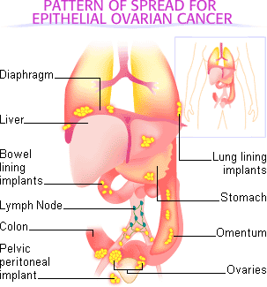

Slide 70
Investigations
Aim:
Confirm malignancy:Usually after laparotomy (Cytology) & CA 125
Extent of lesion:
CXR (PA)
Barium enema
Ultrasound
IVP
Cytologic examination of thoracocentesis
EUA( examination under anesthesia)

Slide 71
Investigations...
Detect primary sites
Stool occult test
Barium meal
Mammography
Gastroscopy
colonoscopy

Slide 72
Role of surgery in ovarian tumor(still last modality of investigation called explorative laparatomy)
Diagnosis
Staging
Treatment

Slide 73
FIGO staging: early stage
Staging is surgical
I. Growth limited to the ovaries
  Ia One ovary
  Ib Both ovaries
  Ic Surface tumor, rupture, ascites, +cytology
II. Growth involving one or both ovaries with pelvic extension
  IIa Extension and/or metastases in uterus and/or tubes
  IIb Extension to other pelvic structures
  IIc Surface tumor, rupture, ascites, +cytology

Slide 74
FIGO staging: advanced
III. Intra-abdominal spread
  IIIa Microscopic tumor on abdominal peritoneal surfaces
  IIIb <=2cm abdominal peritoneal implants
  IIIc >2cm abdominal peritoneal implants, retroperitoneal or inguinal nodes
  Superficial liver involvement is stage III
IV. Extra-abdominal spread
  pleural effusion (+cytology), liver parenchymal metastases

Slide 75
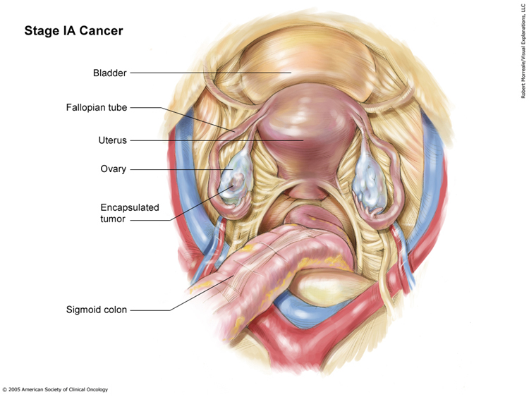
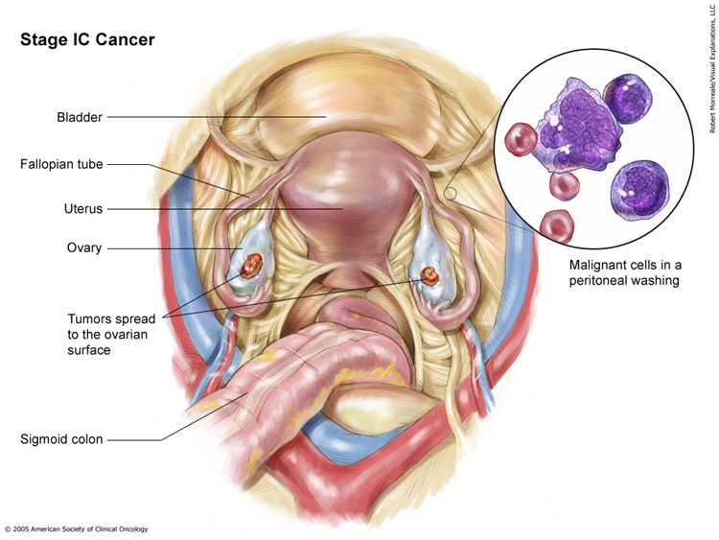

Ovarian Cancer Staging

Slide 76
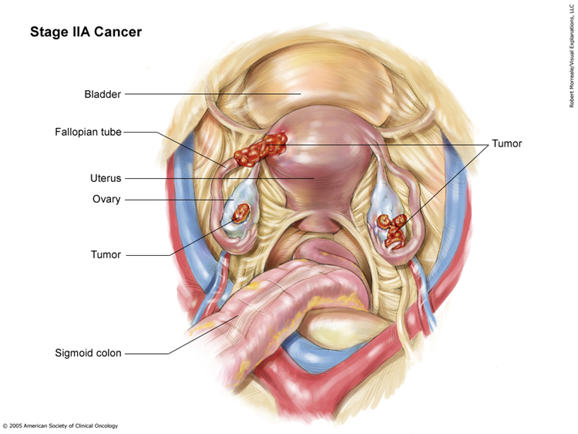
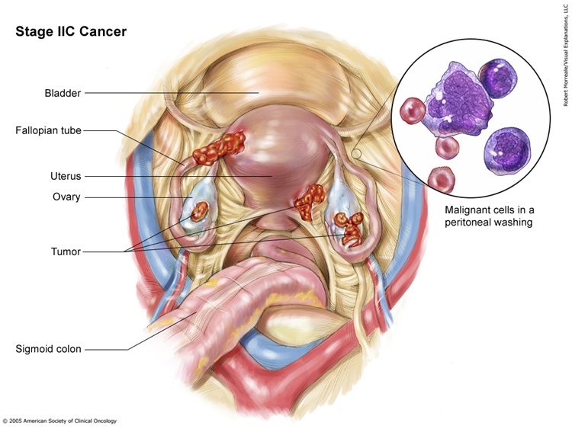
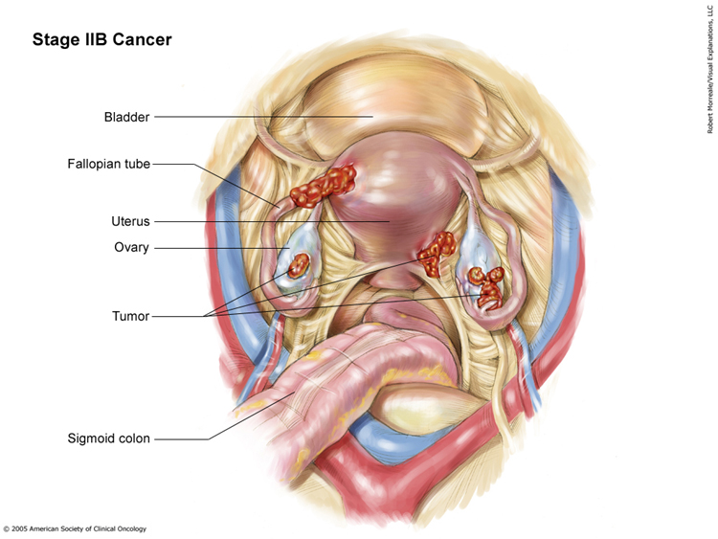
Ovarian Cancer Staging

Slide 77
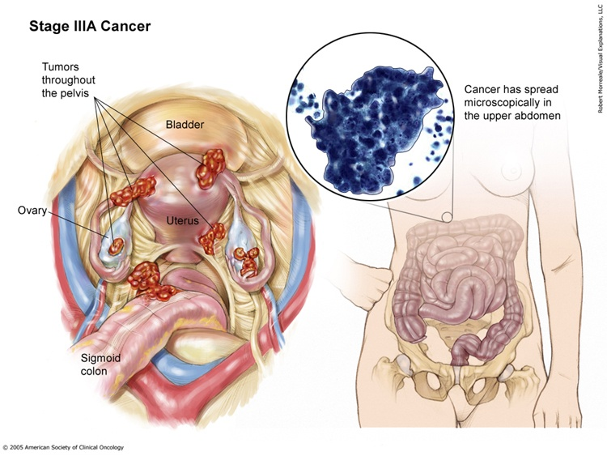
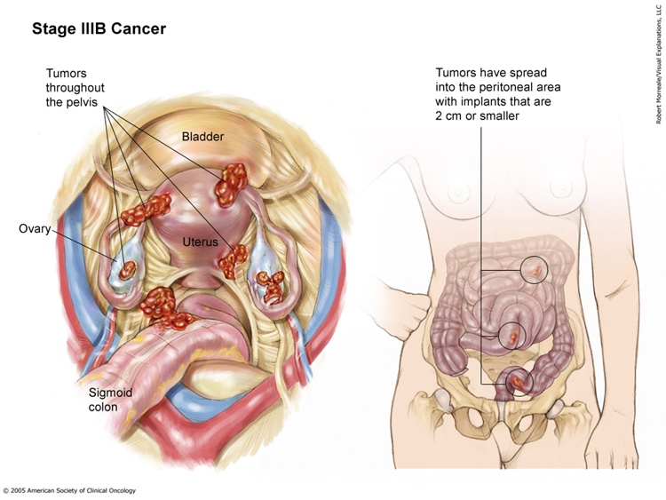
Ovarian Cancer Staging

Slide 78
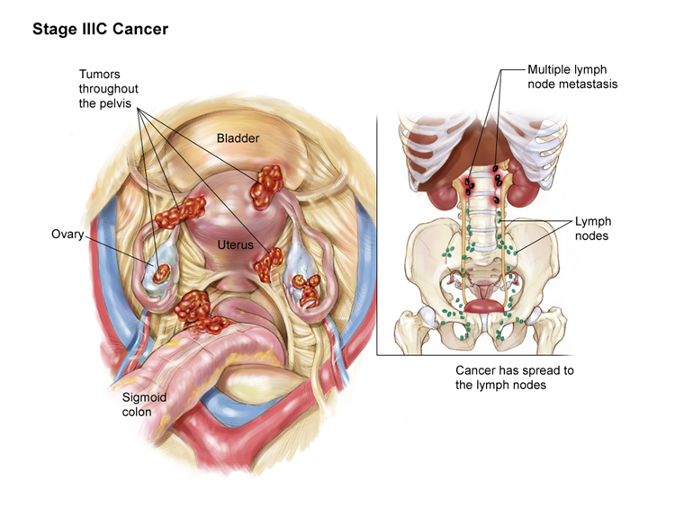
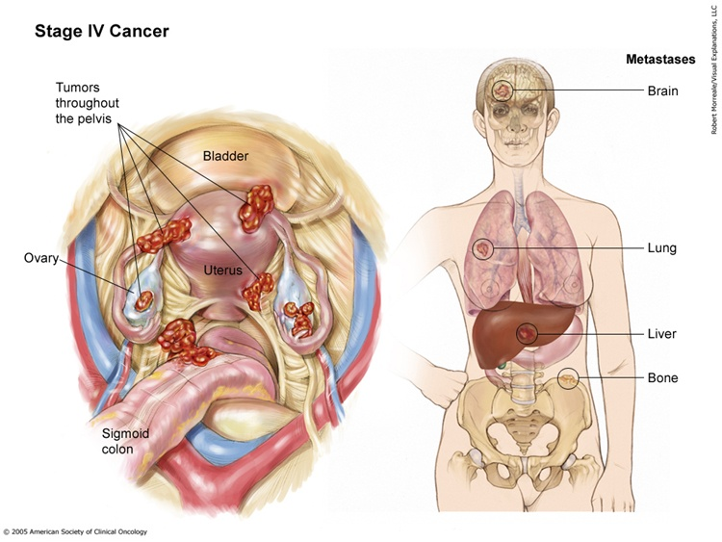
Ovarian Cancer Staging

Slide 79
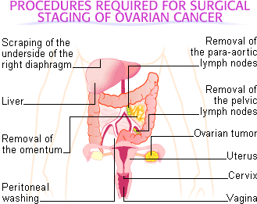
Treatment
Cytoreductive surgery (debulking)
  Optimal cytoreducion = <1cm residual disease
Chemotherapy

Slide 80
Surgical Management in Advanced OC
Value of debulking procedures:
  Removal of large ovarian tumors and omental cake and reduced tumor burden by 80–90%.
  Removal of large number of cells in the resting phase (G0) can propel the residual cells into the more proliferating pool
  → with higher chemosensitivity!
  Debulking reduces serum cytokine levels that act immuno-suppressive (e.g. interleukin-10, vascular endothelial growth factor – VEGF).
  Removal of tumor bulk may improve host immune competence .

Slide 81


Treatment of Epithelial Ovarian Cancer
Up-front Cytoreductive Surgery
IV Carboplatin and Paclitaxel
  First line
  Mechanism of action
    Carbo: binds and crosslinks DNA → prevents DNA synthesis
    Taxol: binds stable microtubules → inhibiting cell division
  Side effects
    Carbo
      thrombocytopenia, leukopenia, anemia,
      vomiting, hair loss
    Taxol
      neutropenia, leukopenia, anemia,
      hair loss, muscle pain, vomiting, diarrhea

Slide 82
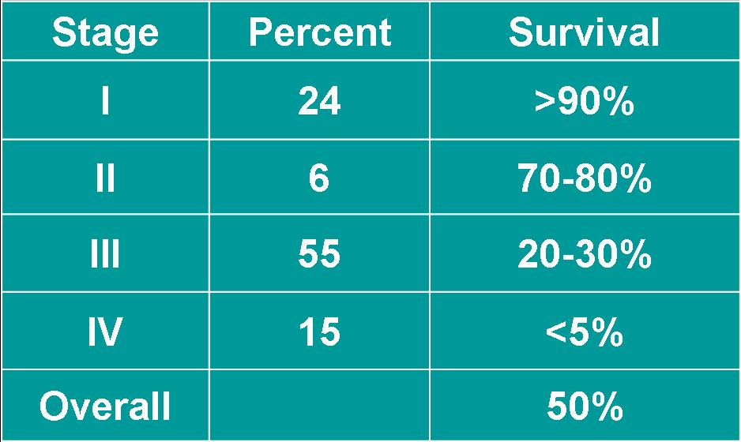
Ovarian Cancer Survival
Percent – percentage of patients who present at that stage
Survival – 5 year survival estimates

Slide 83
Second-look Laparotomy
Performed on a patient who has no clinical evidence of disease after a prescribed course of chemotherapy to determine the response to therapy.

Slide 84
Germ cell tumors of the ovary
Constitute 15-20% of ovarian tumors & 2nd commonest ovarian tumor
Varying degrees of malignant potential
Occur predominantly in children & young adults
In the first two decades of life, almost 70% of ovarian tumors are of germ cell origin,and one third of these are malignant

Slide 85
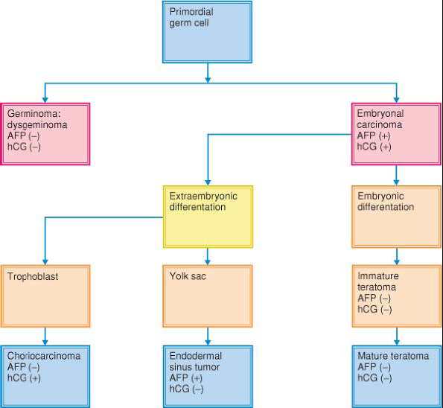

Slide 86
Dysgerminoma
Commonest (30-40%) malignant germ cell tumor
Arise from undifferentiated form of germ cells
Majority (75%) occur b/n 10 -30 years
20%to 30% of ovarian malignancies associated with pregnancy are dysgerminomas
PLAP and LDH produced by 95% of dysgerminomas
Bilateral in 10%(significant rate of bilaterality)
Treatment:
Unilateral oophrectomy, TAH + BSO
Radiotherapy: Loss of fertility is a problem
Chemotherapy: BEP, VBP, VAC

Slide 87
Endodermal sinus tumor(Yolk sack carcinoma)
Observed mostly between 15-20 years
2nd common (20%) malignant tumor of the ovary
Most unilateral(100%) & larger than 10 cm
a very rapidly growing tumor; almost half of patients have a duration of symptoms of 1 week or less
Characteristic histological feature is Schiller-Duval bodies(single papillae lined by tumor cells and containing a central vessel)
Treatment: unilateral oophrectomy
-TAH + BSO: doesn`t alter the outcome
-chemotherapy:VPB is a more effective regimen than VAC

Slide 88
Immature teratomas
Derive from three germ cell layers
Rare, less than 1 % of teratomas
Almost always unilateral
3rd most common germ cell ca
Content of the immature neural tissue determines the prognosis
Treatment:
Unilateral oophrectomy/ TAH & BSO
Chemotherapy: BEP(preferred)/ VAC

Slide 89
Sex Cord-Stromal Tumors of the Ovary
Incidence
  5–8% of all ovarian neoplasms, 2% of malignant tumors.
Pathogenesis
  Develop out of gonadal tissue or of undifferentiated mesenchyme.
  Tissue undergoes “female differentiation“ → granulosa-cell tumors, thecoma, fibroma.
  “Male differentiation“ → Sertoli-Leydig-cell tumor, gonado blastoma.

Slide 90
Sex Cord-Stromal Tumors of the Ovary
Granulosa-stromal cell tumor:
Diagnosis:
  Symptoms related to higher estrogenism are common with abdominal mass, endometrial hyperplasia, bleeding disorder, pain due to rupture not uncommon.
  Sonography, tumor markers.
  Laboratory: Inhibin, serum-estradiol (from granulosa cells)
Coincidence with endometrial cancer:
  Endometrial hyperplasia/adenocarcinomas with ovarian tumors raise differential diagnosis of ovarian metastases or primary granulosa-cell tumor leading to well-differentiated, receptor-positive endometrioid adenocarcinoma of the endometrium. So if u get endometrial adenocarcinoma ,suspect granulosa cell tumor

Slide 91
Treatment: conservative or TAH + BSO
BEP in selected patients with stage III/IV disease

Slide 92
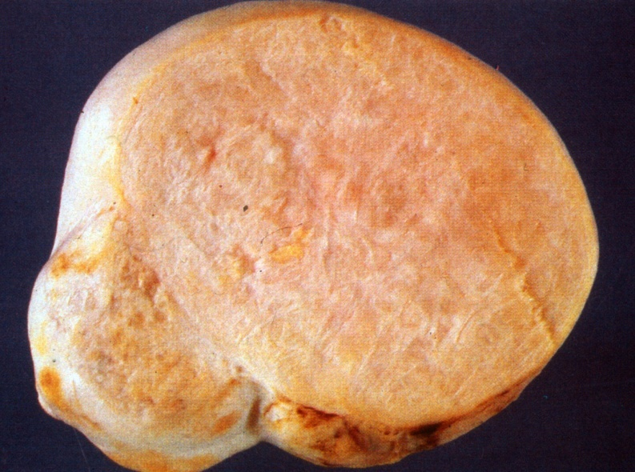
Sex Cord-Stromal Tumors of the Ovary
Thecoma:
Macroscopy:
  Benign, solid, fibromatous lesion, typical yellow coloration due to steroid hormones.
Pathogenesis:
  Adnexal mass, uterine bleeding due to
  hyperestrogenism and endometrial
  hyperplasia may be present.
Treatment:
  Unilateral oophorectomy plus fractional
  curettage. Women with completed family
  planning undergo TAH plus BSO.
Thecoma in a 24 year old woman
with infertility.

Slide 93
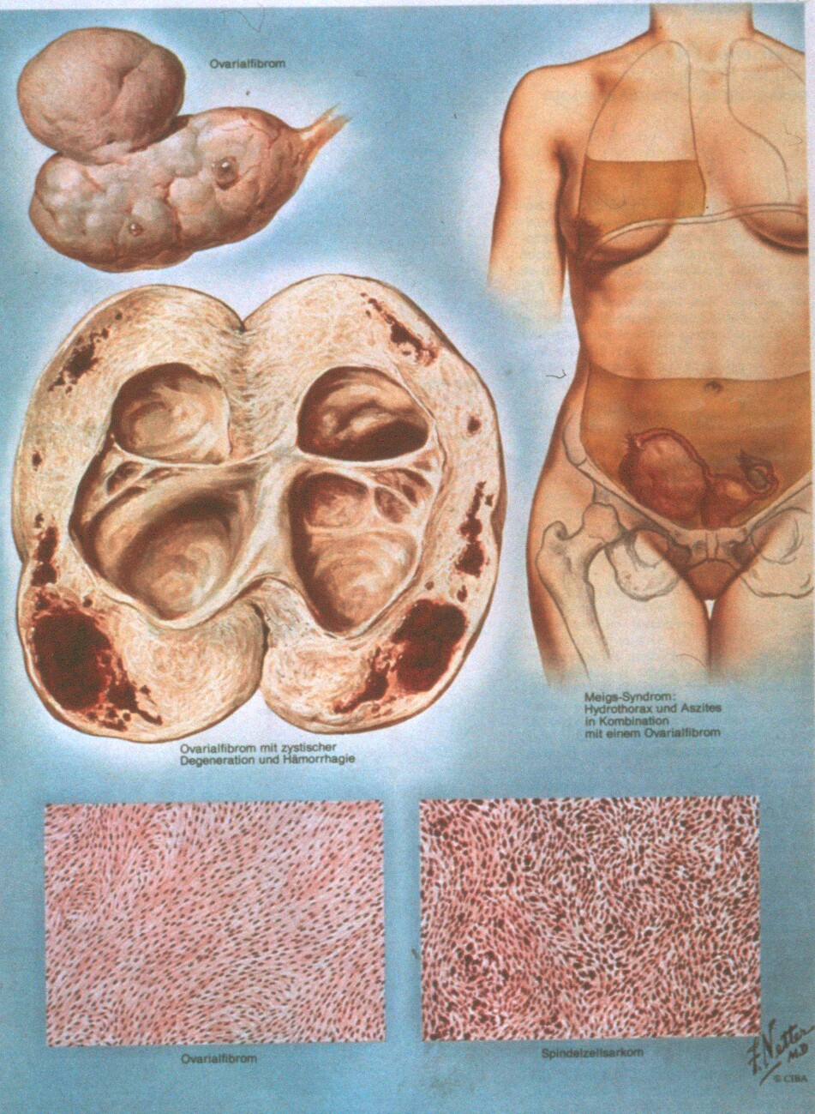
Sex Cord-Stromal Tumors of the Ovary
Fibroma – Meigs-Syndrome:
  Usually benign and unilateral tumors rarely associated with ovarian fibroma-ascites and pleural effusions (Meigs).
Pathogenesis:
  - vascular endothelial growth factor (VEGF) raises capillary permeability.
Treatment:
  Excision of the ovarian tumor.
(From Farbatlanten der
Medizin –The Ciba Collection
of Medical Illustrations, Frank
H. Netter Band 3: Genital-
organe, page 207. Georg
Thieme Verlag 1978)

Slide 94
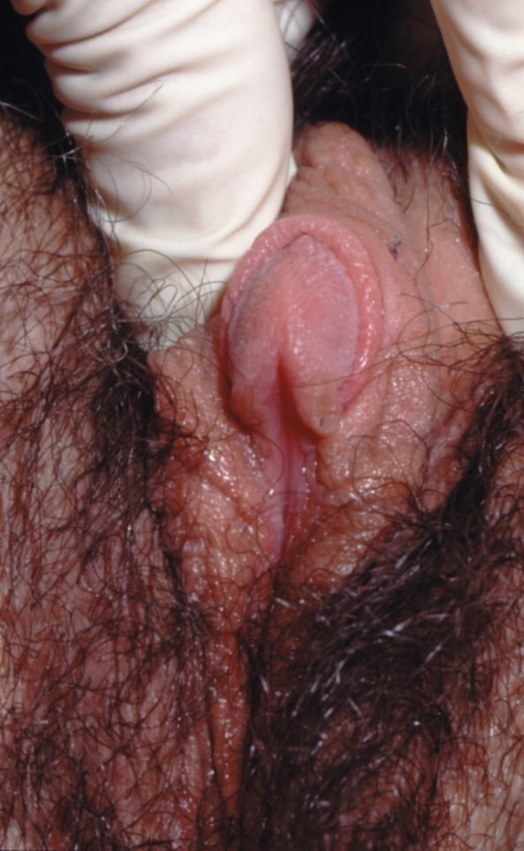
Sex Cord-Stromal Tumors of the Ovary
Sertoli-Leydig cell tumor:
Epidemiology
- Extremely rare, 0.2% of all malignant ovarian
tumors.
- 3rd and 4th decade
- 10% postmenopausal
- 30% are endocrinologically active
(produce testosterone, androstenodione)
      Clitoris hypertrophy in a 28 year old woman with Sertoli-Leydig cell tumor (Photo Dr. Keck, University Women‘s Hospital Freiburg)

Slide 95
Sex Cord-Stromal Tumors of the Ovary
Sertoli-Leydig cell tumor:
Histopathology
  Tumors are firm, 90% unilateral, lobulated, yellow-appearing external surface (steroids) .
  Well, moderately, and poorly differentiated tumors.
  Poorly differentiated tumors with areas of hemorrhage and necrosis.
Poorly differentiated SLCmor. Nests of Leydig cells and solid cords of Sertoli-cellecrosis and apoptotic bodies.

Slide 96
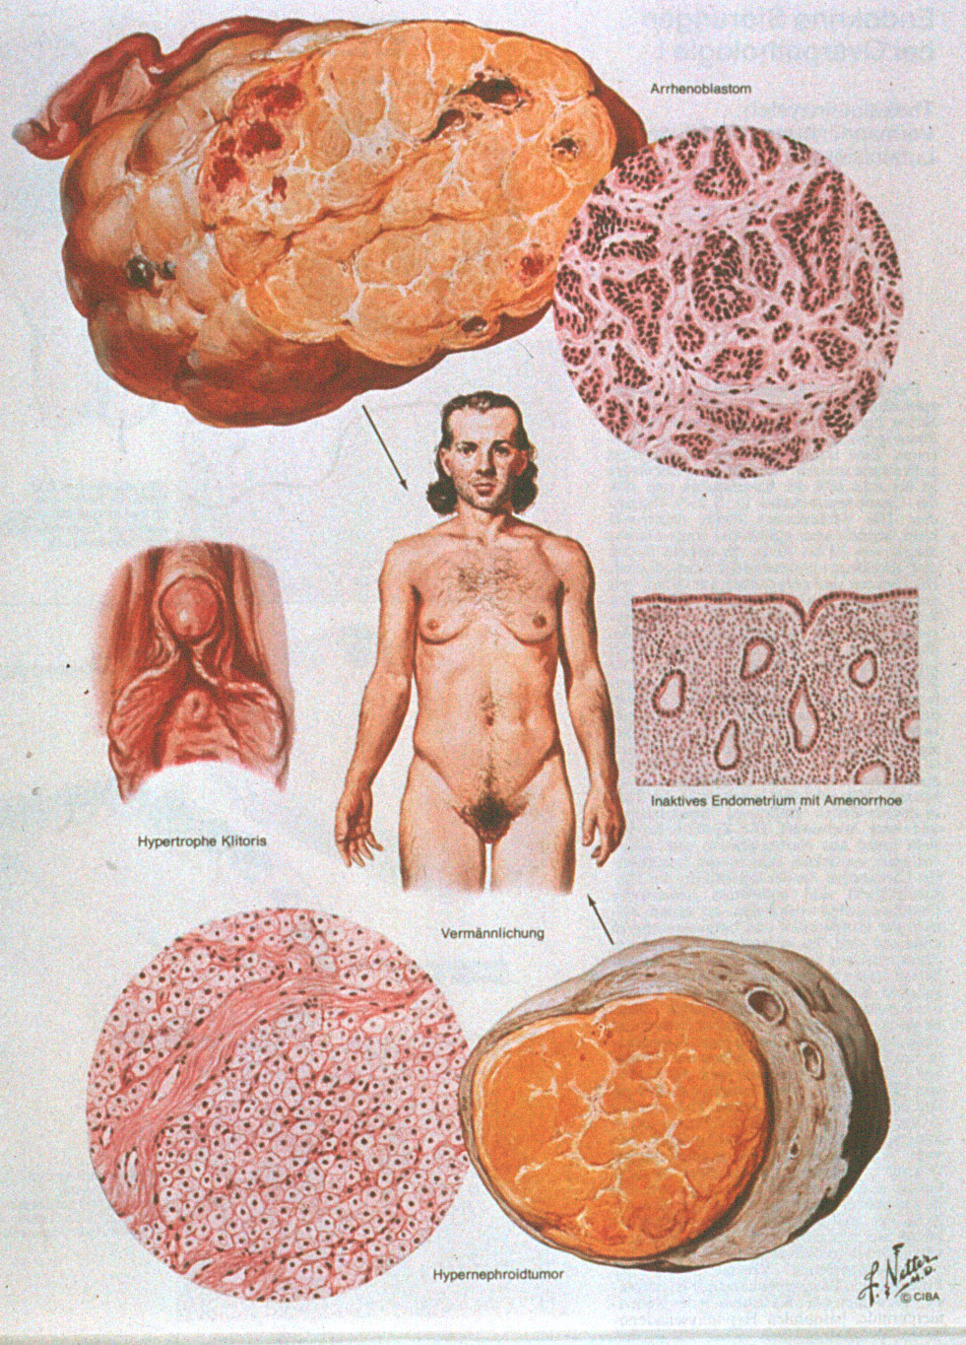
Sex Cord-Stromal Tumors of the Ovary
Sertoli-Leydig cell tumor:
Symptoms:
  Virilization in 50% of women plus oligomenorrhea, amenorrhea, breast atrophy, hirsutism, deepening of voice, baldness, acne, and clitoral hypertrophy, increasing abdominal girth and pain.
  DDX-POS,aromatase deficiency
Laboratory
  Testosterone, androstenedione, and the precursor 17-hydroxy progesterone in cases with virilization.

Slide 97
Sex Cord-Stromal Tumors of the Ovary
Sertoli-Leydig cell tumor:
Treatment:
  TAH and BSO after completed family planning. Unilateral oophorectomy is possible if preservation of fertility is desired

Slide 98
Metastatic tumors of the ovary
Common primary sites:
Genital: cervix, uterus
Extra-genital: GIT, breast, gall bladder
Krukenberg Tumor
30% to 40% of metastatic cancers
characteristic mucin-filled, signet ring cells
The primary tumor is most frequently located in the stomach and less commonly in the colon, breast, or biliary tract
usually bilateral

Slide 99
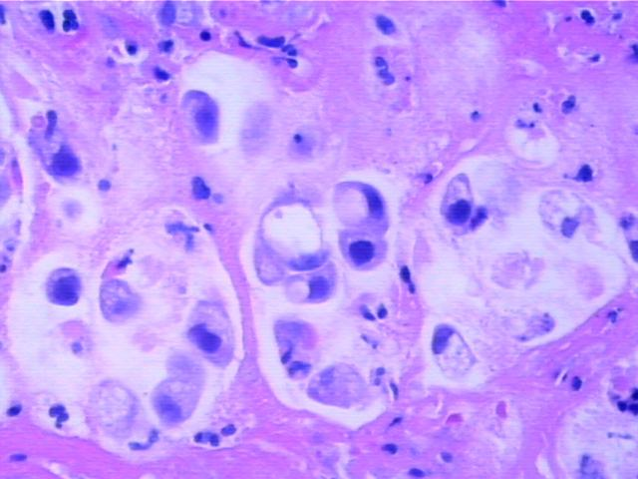

Slide 100
Thank U

