Slide 1
Benign and malignant conditions of the fallopian tube
Mihretu Molla (Bsc, Msc)

Slide 2
Introduction
The bulk tubal pathologies involve ectopic pregnancy or the sequelae of PID (Hydrosalpinx, Tubo-ovarian abscess (TOA)).
Fallopian tube neoplasms are rare

Slide 3
Benign Neoplasms
are rare.
the most common benign tumor of the fallopian tube is the mesothelioma
found in less than 1 percent of specimens .
Characterized by 1- to 2-cm, well-circumscribed solid nodules arise in the tubal wall .
Tubal leiomyomas are uncommon and derive from the smooth muscle of the muscularis, broad ligament, or from vessels in either location.
Additionally, hemangioma, lipoma, chondroma, adenofibroma, cystadenofibroma, angiomyolipoma, and neural tumors may rarely develop.

Slide 4
Malignant Lesions of the Fallopian Tube
rare gynecological malignancies
categorized as either primary or secondary.
On average, the 5-year survival rate is 51%; the rate for stage I disease is 65%, stage II disease is 50-60%, and stage III and stage IV disease is 10-20%.

Slide 5
Epidemiology
comprise 1% of all gynecologic cancers in USA.
These lesions are more common in whites.
Incidence increases with age but peaks at 60-66 years.

Slide 6
Etiology
The exact etiology is unknown.
associated with tuberculous salpingitis.
Similar to ovarian malignancy, a BRCA germ line mutation and TP53 mutation are associated with fallopian tube malignancy.

Slide 7
Pathophysiology
usually starts as a dysplasia or carcinoma in situ.
Typically, transition to adenocarcinoma is observed.

Slide 8
Clinical presentation
History
Patients may present with pelvic pain, a pelvic mass, postmenopausal bleeding, and serosanguineous vaginal discharge.
The classic description of hydrops tubae profluens, which is characterized by colicky lower abdominal pain relieved by a profuse, serous, watery, yellow, intermittent, vaginal discharge, usually is not found.

Slide 9
Clinical presentation…..
Physical finding
not specific; a pelvic mass usually is present, with or without ascites.
Diagnostic criteria include the following:
  Grossly, the main tumor should be in the fallopian tube.
  Histologically, the tubal mucosa should be involved, with a papillary pattern.
  The tubal wall, if involved, and a transition from benign to malignant tubal epithelium should be identified.
  The lesion is a more advanced stage of tubal tumor than the other tumors.

Slide 10
Diagnostic Considerations
Diagnosing at an early stage is difficult because of the lack of symptoms or the presence of nonspecific symptoms.
Papanicolaou smear test, showing malignant glandular cells
Endometrial biopsy
CT scan and MRI
Hysterosalpingography
Color Doppler
3-D ultrasonography

Slide 11
Differential Diagnoses
Benign Fallopian Tube Disease
Benign Lesions of the Ovaries
Benign Ovarian Disease
Breast Cancer
Broad Ligament Tumors
Fallopian Tube Disorders
Malignant Epithelial Ovarian Tumors
Ovarian Tumors of Low Malignant Potential

Slide 12
Staging (FIGO)
Although the fallopian tubes are derived from the same embryonic structure as the uterus, histologically and clinically, malignant lesions of the fallopian tubes behave like ovarian tumors.
Unlike ovarian tumors, 50% of fallopian tube tumors are stage I and II, whereas more than 50% of ovarian malignancies are usually in stage III and IV.
Fallopian tube carcinomas have a predilection for metastasis to retroperitoneal lymph nodes in contrast to intraperitoneal spread of ovarian carcinomas.

Slide 13
Staging….
Stage 0 - Carcinoma in situ (limited to tubal mucosa)
Stage I - Growth limited to the fallopian tubes
  Ia - Growth limited to 1 tube, with extension into the submucosa and/or muscularis but not penetrating the serosal surface; no ascites
  Ib - Growth limited to both tubes with extension into the submucosa and/or muscularis but not penetrating the serosal surface; no ascites
  Ic - Tumor stage 1a or 1b but with tumor extension through or onto the tubal serosa, or with ascites present containing malignant cells, or with positive peritoneal washings.

Slide 14
Staging……..
Stage II
Growth involving 1 or both fallopian tubes with pelvic extension
Stage IIa - Extension and/or metastasis to the uterus and/or ovaries
Stage IIb - Extension to other pelvic tissues
Stage IIc - Tumor stage IIa or IIb, with ascites present containing malignant cells, or with positive peritoneal washings

Slide 15
Staging……..
Stage III
Tumor involving 1 or both fallopian tubes, with peritoneal implants outside the pelvis and/or positive retroperitoneal or inguinal nodes; superficial liver metastasis equals stage III; tumor appears limited to true pelvis but has histologically proven malignant extension to the small bowel or omentum
Stage IIIa - Tumor grossly limited to the true pelvis, with negative nodes but with histologically confirmed microscopic seeding or abdominal peritoneal surfaces
Stage IIIb - Tumor involving 1 or both fallopian tubes, with histologically confirmed implants on abdominal peritoneal surfaces, none exceeding 2 cm in diameter; lymph node findings negative
Stage IIIc - Abdominal implants larger than 2 cm in diameter and/or positive retroperitoneal or inguinal nodes

Slide 16
Staging……..
Stage IV
Growth involving 1 or both fallopian tubes, with distant metastases; if pleural effusion is present, positive cytology results necessary to be stage IV; parenchymal liver metastases equal stage IV

Slide 17
Management
Similar with ovarian carcinoma
Surgical
  total abdominal hysterectomy with bilateral salpingo-oophorectomy
  omentectomy and peritoneal washing
  selective pelvic and para-aortic lymphadenectomy.
chemotherapy

Slide 18
Benign & malignant disorders of the ovary
Mihretu Molla (Bsc, Msc)

Slide 19
Objectives
Describe benign conditions of the ovary
Explain the clinical presentations of benign disorders and their management
Describe malignant conditions of the ovary
Explain the clinical presentations of malignant disorders and their management

Slide 20
Benign disorders of ovary
Introduction
Ovarian enlargement is one of the DDX for adnexal masses
Ovarian enlargement could be non-neoplastic or neoplastic.
Neoplastic enlargement could be benign or malignant
Benign disorders are caused by physiologic cysts or benign neoplasms
The management is dictated by their presentation. i.e (hemorrhage of a ruptured cyst or ovarian torsion)

Slide 21
Non-neoplastic ovarian enlargement
Caused by physiologic/functional cysts
Cystic ovaries are different from neoplasia by:-
  Temporarily related to hormonal disorders
  Common in Reproductive age
  Unilocular, unilateral, cystic and <=10cm
  Spontaneous regression
  Content is clear fluid
  Lining epithelium is corresponding functional epithelium

Slide 22
Causes of non-neoplastic enlargement
Follicular cysts
Corpus luteum cyst
Leutin cysts
PCOS
Endometrioma ( checolate cysts)
Infectious (TOA..)

Slide 23
Follicular cyst
Most common cystic structures found in healthy ovaries
Result from either nonrupture of the dominant mature follicle or failure of an immature follicle to undergo the normal process of atresia.
Are thin walled and unilocular,
Usually range up to 8 cm in diameter (average, 2 cm).
Lined with an inner layer of granulosa cells and an outer layer of theca interna cells.
Asymptomatic or vague pain
Spontaneous resolution (usually resolve in 4 to 8 weeks)
Laparatomy (if Hemorrhage,Torsion , Increase in size)

Slide 24
Corpus Luteum (Granulosa Lutein) Cysts
Thin-walled unilocular cysts, 3–11cm in size
Occur when the corpus luteum fails to involute and continues to enlarge after ovulation.
Occurs during over activity of corpus luteum Often during pregnancy
Uncommon in those taking COC
Local pain or tenderness
Amenorrhea or delayed menstruation
Usually regress after 1 or 2 months
Laparatomy in cases of acute abdomen (Torsion, rupture and bleeding )

Slide 25
Theca lutein cysts
Bilateral multi-septated cystic adnexal masses in a woman with GTD, Multiple gestation, Ovarian hyper stimulation, or Fetal hydrops.
Occurs as a result of
  Overstimulation from high hCG levels or
  Hypersensitivity to hCG (during normal pregnancy)
  Administration of gonadotropins or clomiphene
Most are asymptomatic, but maternal virilization, hyperemesis gravidarum, preeclampsia, or thyroid dysfunction may occur.
Gradually resolve weeks to months after the source of hCG is eliminated
Surgery for torsion and hemorrhage

Slide 26
Endometriomas
In women with endometriosis, ovarian endometrial cysts can develop and grow up to 6–8 cm.
These endometriomas are also referred to as "chocolate cysts" because they contain thick, brown blood debris inside.

Slide 27
Polycystic Ovarian Syndrome(PCOS)
Characterized by persistent anovulation resulting in enlarged polycystic ovaries, secondary amenorrhea/oligomenorrhea, and infertility.
Presumably related to hypothalamic pituitary dysfunction and insulin resistance.
Alterations in GnRH pulsatility lead to preferential production of LH compared with FSH.
Has a prevalence of 5–10%
≈50% of hirsute and 30–75% are obese
Diagnosed if at least 2 of the following conditions are present:
  oligomenorrhea or amenorrhea
  hyperandrogenism
  polycystic ovaries on ultrasound

Slide 28
PCOS…….
Hirsutism can be treated with any agent that lowers androgen levels, and with OCPs.
Infertility is often responsive to Clomiphene citrate (CC) or human menopausal gonadotropin (hMG).
Metformin improves fertility rates both when given alone and, even more so, when given in conjunction with clomiphene
Megestrol acetate 40–60 mg/d for 3–4 months for end hyperplasia and ca and follow up EMB
May have Long-term consequences like Diabetes mellitus Cardiovascular disease and Endometrial cancer.

Slide 29
Ovarian Neoplasms
The ovary is a complex structure with principal ovarian tissue components :
  Epithelial cells derived from coelomic epithelium
  Oocytes derived from primitive germ cells
  Mesenchymal elements from gonadal stroma

Slide 30
Classification of ovarian neoplasms
Based on clinical behaviors:
Benign
Borderline
Malignant
Based on morphologic characteristics:
Cystic
Mixed
Solid

Slide 31
Classification…
Based on histological features:
Epithelial tumor: benign, border line or malignant
Serous tumor
Mucinous tumor
Endometroid tumor
Mesonephroid (clear cell)
Brenner tumors
Mixed epithelial tumors
Undifferentiated carcinoma
Unclassified epithelial tumors

Slide 32
Classification (histological features )…
Germ cell tumors of the ovary
Dysgerminoma
Endodermal sinus tumor
Teratoma: mature, immature, monodermal
Embryonal carcinoma
Polyembroyoma
Choriocarcinoma
Mixed germ cell tumors

Slide 33
Classification(histological features) …
Sex-cord stromal tumors:
Granulosa cell tumors
Tumors of thecoma-fibroma group
Androblastoma: Sertoli cell tumors
Unclassified
Lipid cell tumor
Gonadoblastoma
Unclassified
Secondaries

Slide 34
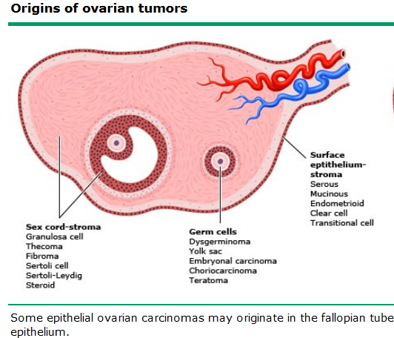

Slide 35
Benign ovarian neoplasms
75% of ovarian neoplasms are benign
Mucinous cystadenoma, serous cystadenoma & dermoid cyst account for 80% of primary ovarian neoplasia.
All above three are also called as ovarian cysts as opposed to cystic ovaries in functional ovarian enlargement.

Slide 36
Serous cystadenoma
Characterized by proliferation of ephithelium resembling that lining fallopian tube.
Common
Account for 40% of ovarian tumors
Bilateral in 10-15%
Chance of malignancy is 40%
Pathology
not as big as mucinous variant
More chance of proliferation of lining epithelium
Intracystic hemorrhage common
No abundant secretion

Slide 37
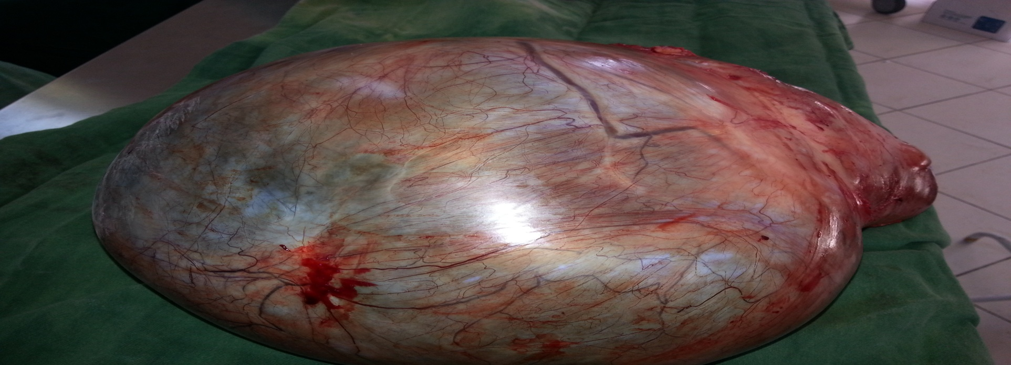
Serous cystadenoma…..
Naked eye appearance
  Smooth, shiny & grayish wall
  Papillary projections
  Multi-loculated on cut section
  Fluid content is clear & rich in proteins (albumin & globulin)

Slide 38
Serous cystadenoma…..
Microscopic features
  Lining is single layer of cuboidal epithelium
  Presence of ciliated, secretary & peg cells resembling fallopian tube lining
  Papillary structures has broad dense fibrous tissue

Slide 39
Mucinous cystadenoma
Originated from Mucinous metaplasia of epitheloid cells
20-25% of ovarian tumors
10-15% of all ephithelial ovarian neoplasm
Bilateral in 8-10%
Chance of malignancy is 5-10%
Largest tumor found in human body
The more massive the tumor, the greater the possibility it is mucinous.

Slide 40
Mucinous cystadenoma…..
Naked eye appearance
  Lobulated smooth wall with whitish or bluish white appearance
  Cut section shows a content of thick, viscid mucin which is a glycoprotein & multi loculated
  Colorless fluid.

Slide 41
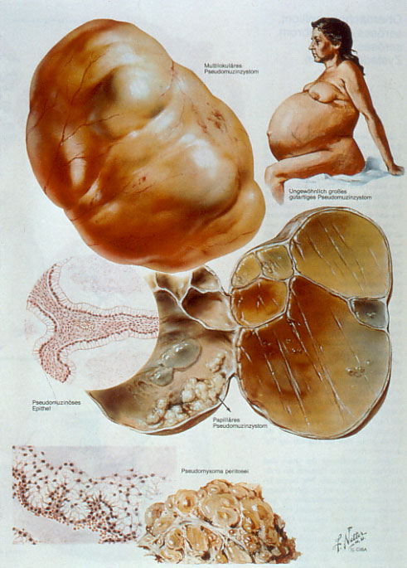
Mucinous cystadenoma….

Slide 42
Mucinous cystadenoma….
Microscopic features
  Lined by single layer of columnar epithelium
  Dark stained basal nucleus
  No cilia
  Cells are characteristic of endocervix

Slide 43
Mature Cystic Teratoma (Benign Cystic Teratoma, Dermoid Cyst)
Originated from Germ cells arrested after 1st meiotic division
Accounts for 10-25% of ovarian tumors
Bilateral in 15-20%
60% of all benign ovarian neoplasms
Accounts for 20-40 % of ovarian tumors in pregnancy
Torsion is most common complication (15-20%)
Chance of malignancy is1-2%

Slide 44
Dermoid cyst…..
Naked eye appearance
  Moderate size cyst
  Smooth & tense capsule
  Content is predominantly of sebaceous material
  Solid area of projection called as Rokitansky’s Protuberance

Slide 45
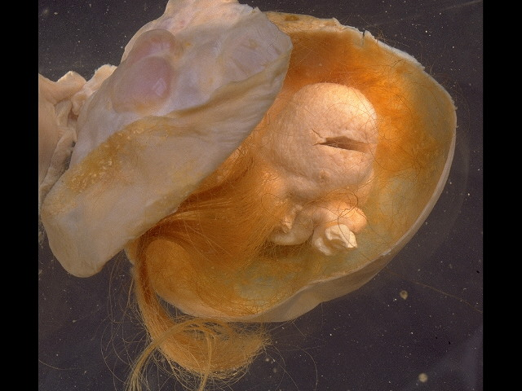
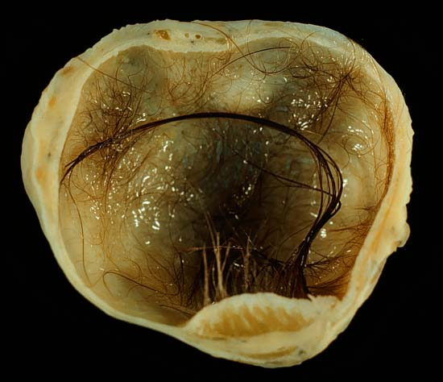
Mature Cystic Teratoma….

Slide 46
Dermoid cyst……
Microscopic features:
  Lined with stratified squamous epithelium
  Most common tissue is ectoderm
  Dermoid tumor is a misnomer as it encompasses all germ cell layers

Slide 47
Clinical features of benign tumors
Commonly seen in late child bearing age
Dermoid cyst & mucinous cystadenoma are common in reproductive age group
Dermoid cyst & serous cystadenoma are common during pregnancy
No association to parity
Most are asymptomatic
Heaviness in the lower abdomen
Gradually increasing mass in the lower abdomen, may also fill the lower abdomen
Dull aching lower abdominal pain
No effect on menses

Slide 48
Clinical features….
Signs
  General condition remain unaffected
  Cachexia in mucinous cystadenoma
  There may be pitting edema in lower extremities.
  Abdominal mass either central or in one side
  Cystic/ tense cystic feel or solid/firm
  Mass freely mobile from side to side
  Usually smooth surface
  Non-tender
  Dull at the center & resonant at the flanks
  Positive fluid thrill

Slide 49
Clinical features….
Meig’s Syndrome/ pseudomeig’s syndrome (ascites and pleural effusions)
There may be friction rub at the mass
Pelvic examination
  Mass felt separate from the uterus
  Groove between mass & uterus
  Movement of cervix fails to move the mass
  If mass felt above uterus, dermoid cyst

Slide 50
Investigations for benign ovarian tumors
Ultrasound with / without color Doppler studies:
  Size of the tumor, Nature of tumor
  Associated ascites
  Septation & thickness
  Blood flow
Straight x-ray
EUA (examination under anesthesia) for doubtful cases
Laparoscopy/laparatomy
Cytology

Slide 51
Differential diagnosis
Full bladder
Fibroid
Functional cyst
Encysted peritonitis
Pregnancy with or without fibroid
Ascites
Mesenteric cyst
Para-ovarian cyst

Slide 52
Management of benign ovarian tumors
Admit for operation
Complications may occur any time
Deliver tumor intact
Inspect other ovary & other structures
If contra-lateral ovary is normal, leave it

Slide 53
Complications
Torsion of the pedicle
Intracystic hemorrhage
Infection
Rupture
Pseudomyxoma peritonei
Malignancy

Slide 54
Borderline malignant epithelial tumors of the ovary
Low malignant potential
Constitutes 10-20% of all epithelial tumors
Characterized by:
Cellular pleomorphism
Stratification/ pseudo-stratification
No stromal invasion(absolute criterion for making the diagnosis)
Treatment:
Unilateral oophrectomy for young age or TAH + BSO if bilateral involvement.

Slide 55
Ovarian cancer
2nd most common gynecologic malignancy(developed)
3rd most common gynecologic malignancy (developing)
Most common cause of gynecologic cancer death.
5th leading cause of cancer death in the women
Average age @ dx in USA is =63years
Life time risk is 1.4%
Majority diagnosed @ advanced stage
EOC is most common histologic type (95%) and serous cystadenocarcinoma is the most common subtype(75%of epithelial)

Slide 56
Ovarian cancer…
Malignant epithelial tumours
    Serous adenocarcinoma
    Mucinous adenocarcinoma
    Endometrioid adenocarcinoma
    undifferentiated adenocarcinoma
Malignant germ cell tumours
    Dysgerminoma
    Endodermal sinus tumour (yolk sac tumour)
    Choriocarcinoma
    Solid teratoma
Malignant sex cord stromal tumours
    Granulosa cell tumour
    Sertoli-Leydig cell tumour

Slide 57
Etiology of epithelial ovarian cancer
Exact mechanism not known
Proposed hypothesis include
Incessant ovulation hypothesis
states that cancers arise as a result of repeated trauma to the epithelial cells during ovulation.
The pituitary gonadotrophin hypothesis
suggests that high levels of gonadotrophins acting via the stimulation of estrogens cause ovarian epithelial cells to become trapped in inclusion cysts and undergo malignant change.

Slide 58
Etiology…..
The androgenic/progesterone hypothesis
suggests that androgens, which are increased in obesity and the postmenopausal state, stimulate cancer formation, while progesterone is protective
The inflammation hypothesis
states that inflammation plays a role in cancer formation, which explains the risk factors of PID and the protective effect of BTL and hysterectomy.
The ovarian stromal hypothesis
states that, following ovulation, some theca and granulosa cells fail to apoptose, and persist while retaining their ability to produce steroids, thus stimulating cancer

Slide 59
Risk factors for ovarian cancer
Age
  Risk of EOC increases by 2%/yr for <50yrs old
  Increases 11%/yr for > 50years old women
Reproductive & hormonal factors
  Early menarch, late menopause
  Nulliparity
  Infertility
  Endometriosis
  PCOS
  Post menopausal hormonal therapy
  IUD

Slide 60
Risk factors…..
Genetic factors
  Family history of ovarian cancer
  BRCA 1 and BRCA 2 gene mutations
  Lynch syndrome
  Other genetic factors
    RAD51C
    RAD51D
    BRIP1
BRCA mutation & lynch syndrome account for 10-15% ovarian cancer.

Slide 61
Risk factors…..
Personal factors
Diet
Exercise
Obesity
Cigarette smoking
Environmental factors
Talc & asbestos

Slide 62
Protective factors
Oral contraceptives
Multiparty
Salpingo-oophorectomy
Tubal ligation
Hysterectomy
Breastfeeding

Slide 63
Pathologic types
Primary(80%)
Epithelial (80-90)
Non-epithelial
    Germ cell (10-20%)
    Sex-cord stromal (3-5%)
    Unclassified
Secondary(20%)
  Typical
  Atypical

Slide 64
Primary epithelial carcinoma
95% of all primary ovarian cancers is EOC
Constitute both solid & cystic, most cystic
Bilateral in 50%
Arise as De Novo as malignant or malignant transformation to benign tumors

Slide 65
Primary epithelial…
Cytological variants
Serous cystadenocarcinoma
Mucinous cystadenocarcinoma
Endometroid carcinoma
Transitional
Clear cell
Mixed
Undifferentiated and Unclassified
NB
Endometroid variant is associated with endometrial cancer in 20%

Slide 66
Serous cystadenocarcinoma
75% of epithelial ovarian cancers
Simulate fallopian tube, previously called papillary serous carcinoma
Grade of tumor should be identified (high vs low)
  grade 1 :well-differentiated
  grade 2:composed of a mixture of the two patterns
  grade 3:composed almost entirely of sheets of malignant cells
Laminated, calcified psammoma bodies are found in 80% of serous carcinomas(precipitation of calcium-phosphate apatite crystals)

Slide 67
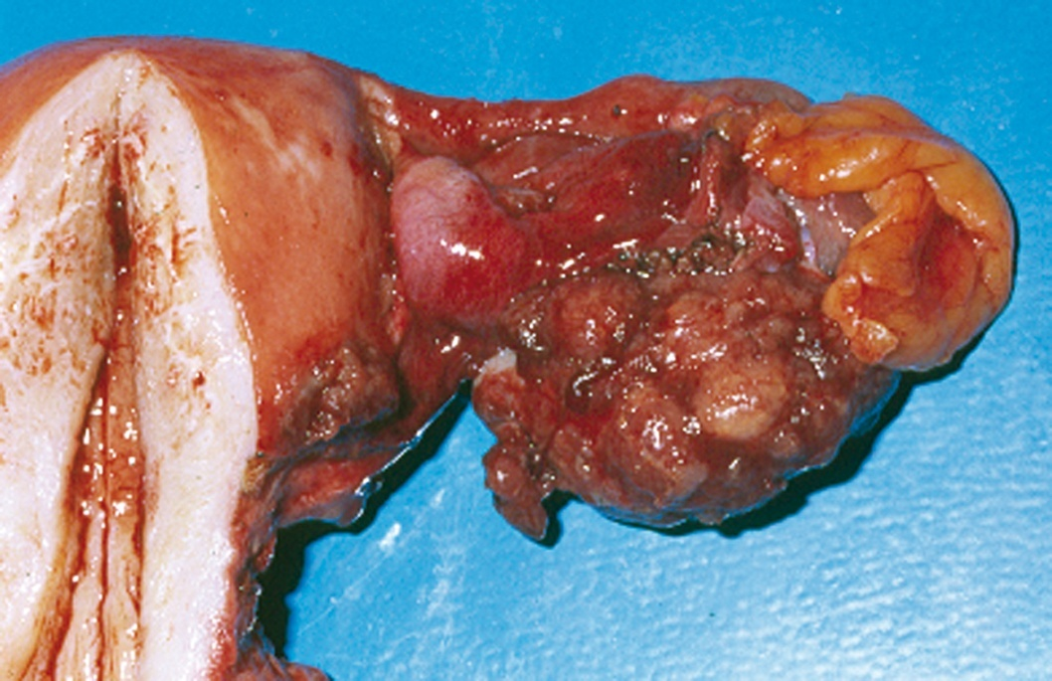
Serous cystadenocarcinoma….

Slide 68
Mucinous cystadenocarcinoma
10% of EOC
Bilateral in 8-10% of cases
Mucinous lesions are intraovarian in 95 -98% of cases
Characterized by Pseudomyxoma peritonei
  Used to describe either free mucin deposits or
  Mucin extravasating into tissues in the peritoneal cavity & implants of mucinous epithelium
Largest EOC (average diameter=18-20cm)
CA-125 not markedly elevated

Slide 69
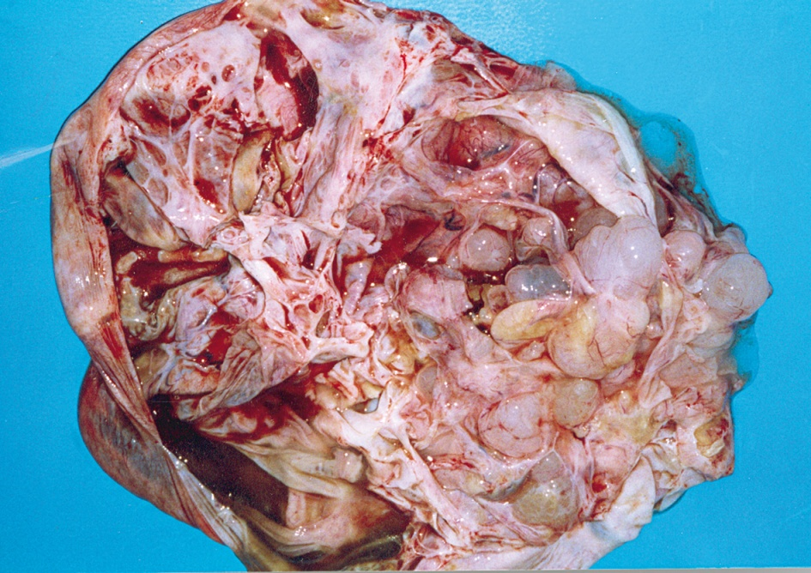
Mucinous cystadenocarcinoma……

Slide 70
Malignant Endometrioid Carcinomas
About 15 to 20% of epithelial EOC are endometrioid adenocarcinomas.
characterized by an adenomatous pattern with all the potential variations of epithelia found in the uterus.
Well differentiated carcinomas represent separate primary lesions rather than ovarian metastases from the uterus.
Multinodular disease in the ovary is a hallmark of metastasis from the endometrium.
Patients with bilateral ovarian involvement, vascular invasion, ovaries less than 5 cm in size, or deep myometrial invasion should be assessed for probable primary uterine tumor metastatic to the ovary.

Slide 71
Clinical Features
Ovarian cancer is called the “silent killer”
More than 80% of EOC are found in postmenopausal women
Peak incidence of invasive EOC is at 56 to 60 years of age
30% of ovarian neoplasms in postmenopausal women are malignant,
Only 7% of ovarian epithelial tumors in premenopausal patients are frankly malignant.

Slide 72
Clinical Features …..
Symptoms
Majority of women with EOC have vague and nonspecific symptoms
Pressure symptoms like frequency & constipation
  Abdominal distention
  Bloating
  Constipation
  Nausea
  Anorexia or
  Early satiety

Slide 73
Clinical Features …..
Signs
Pelvic mass on physical examination.
  Solid,
  Irregular,
  Fixed pelvic mass is highly suggestive of an ovarian malignancy
If an upper abdominal mass or ascites is present, the diagnosis of ovarian cancer is almost certain.
Postmenopausal palpable ovary syndrome

Slide 74
Diagnosis
Serum CA125 levels have been shown to be useful in distinguishing malignant from benign pelvic masses
Patients whose lesions are suggestive of malignancy (i.e., predominantly solid, relatively fixed, or irregularly shaped) should undergo laparotomy, as should postmenopausal patients with adnexal masses

Slide 75
Diagnosis……
Can be made based on:
  Clinical
  Ancillary aids
  Operative findings
  Histologic examination

Slide 76
Index of suspicion for cancer
  Size -
  Irregularity +
  Fixity +
  Bilaterality +
  Ascites +
  Nodules in POD ++
  Other tumor masses +++

Slide 77
Index of suspicion for cancer…..
Sonographic features
  Solid component that is not hyperechoic and is often nodular or papillary
  Septations, if present, that are thick (>2 to 3 mm)
  Color or power Doppler demonstration of flow in the solid component
  Presence of ascites
  Peritoneal masses, enlarged nodes, or matted bowel
Tumor markers
  Ca125 elevation
  Ca125 trend

Slide 78
Metastasis of OC
Most common sites of metastasis
  Peritoneum (85%)
  Omentum (70%)
  Contralateral ovary (70%)
  Liver (35%)
Patterns of spread
  Direct extension
  Transperitoneal
  Lymphatic
  Blood borne

Slide 79
Investigations
Confirm malignancy
Cytology & CA 125
Extent of lesion
  CXR (PA)
  Barium enema
  Ultrasound
  IVU
  Cytologic examination of thoracocentesis
  EUA

Slide 80
Investigations…..
Detect primary sites
  Stool occult test
  Barium meal
  Mammography
  Gastroscopy
  colonoscopy

Slide 81
Staging (FIGO)
Stage I. Growth limited to the ovaries
  Ia—one ovary involved
  Ib—both ovaries involved
  Ic—Ia or Ib and ovarian surface tumor, ruptured capsule, malignant ascites, or peritoneal cytology positive for malignant cells
Stage II. Extension of the neoplasm from the ovary to the pelvis
  IIa—extension to the uterus or fallopian tube
  IIb—extension to other pelvic tissues
  IIc—IIa or b and ovarian surface tumor, ruptured capsule, malignant ascites, or peritoneal cytology positive for malignant cells

Slide 82
Staging Cont..
Stage III. Disease extension to the abdominal cavity
  IIIa—abdominal peritoneal surfaces with microscopic metastases
  IIIb—tumor metastases < 2 cm in size
  IIIc—tumor metastases > 2 cm in size or metastatic disease in the pelvic, paraaortic, or inguinal lymph nodes
Stage IV. Distant metastatic disease
  Malignant pleural effusion
  Pulmonary parenchymal metastases
  Liver or splenic parenchymal metastases (not surface implants)
  Metastases to the supraclavicular lymph nodes or skin

Slide 83
Treatment
Surgery
  TAH + BSO
  debulking surgery
  interval cytoreductive surgery
  unilateral oopherectomy
Chemotherapy
Radiotherapy
Hormonal therapy
Inrtaperitoneal chemotherapy

Slide 84
Prognosis
Depends on pathologic, biologic and clinical factors
The 5-year survival rate is
  Stage I: 76-93%
  Stage II: 60-74%
  Stage IIIa: 41%
  Stage IIIb: 25%
  Stage IIIc: 23%
  Stage IV: 11%

Slide 85
Germ cell tumors of the ovary
Constitute 15-20% of ovarian tumors & 2nd commonest ovarian tumor
Varying degrees of malignant potential
Occur predominantly in children & young adults
In the first two decades of life, almost 70% of ovarian tumors are of germ cell origin, and one third of these are malignant

Slide 86
Special Features of Germ Cell Tumours
They differ from epithelial ovarian cancer by the following points:
Low age incidence
The commonest tumours of abnormal gonads and in sex chromatin negative in females.
Tend to grow rapidly resulting in pelvic pain and pressure symptoms occurring early.
Most tumours produce substances in the circulation that can be used as tumour markers;
  Dysgerminoma: alkaline phosphatase & lactic acid dehydrogenase.
  Endodermal sinus tumour : alpha feto proteins.
  Choriocarcinoma :HCG

Slide 87
Cont--
Rradiosensitive, chemotherapy in some of them gives excellent results in stage Ia.
Conservative surgery in the form of salpingoopherectomy is the first line of treatment.

Slide 88
Dysgerminoma
Commonest (30-40%) malignant germ cell tumor
Arise from undifferentiated form of germ cells
Majority (75%) occur b/n 10 -30 years
20%to 30% of ovarian malignancies associated with pregnancy are dysgerminomas.
Bilateral in 10%(significant rate of bilaterality)
Treatment
Unilateral oophrectomy, TAH + BSO
Radiotherapy: Loss of fertility is a problem
Chemotherapy

Slide 89
Endodermal sinus tumor(Yolk sack carcinoma)
Observed mostly between 15-20 years
2nd common (20%) malignant tumor of the ovary
Most unilateral(100%) & larger than 10 cm
a very rapidly growing tumor; almost half of patients have a duration of symptoms of 1 week or less
Characteristic histological feature is Schiller-Duval bodies(single papillae lined by tumor cells and containing a central vessel)
Treatment
unilateral oophorectomy
TAH + BSO: doesn`t alter the outcome
chemotherapy

Slide 90
Immature teratomas
Derive from three germ cell layers
Rare, less than 1 % of teratomas
Almost always unilateral
3rd most common germ cell ca
Content of the immature neural tissue determines the prognosis
Treatment
Unilateral oophrectomy/ TAH & BSO
Chemotherapy

Slide 91
Sex Cord-Stromal Tumors of the Ovary
Incidence
  5–8% of all ovarian neoplasms, 2% of malignant tumors.
Pathogenesis
  Develop out of gonadal tissue or of undifferentiated mesenchyme.
  Tissue undergoes “female differentiation“ → granulosa-cell tumors, thecoma, fibroma.
  Tissue undergoes “Male differentiation“ → Sertoli-Leydig-cell tumor, gynandro blastoma.

Slide 92
Granulosa Cell Tumours
Usually unilateral, solid, yellow or yellow-grey in colour.
Some are functioning secreting oestrogen, while most appear to secrete inhibit.
Associated with endometrial carcinoma in 5-10% of cases, and with endometrial hyperplasia in 25-50% of cases.
They may cause irregular bleeding in puberty or before puberty, menstrual irregularities or post menopausal bleeding.

Slide 93
Granulosa Cell Tumours….
Microscopically
The tumour is formed of granulosa cells arranged in different patterns.
Call-Exner bodies are pathognomonic, but are present in only 50% of cases. These are cystic spaces surrounded by granulosa cells arranged in a rosette-like shape.
Treatment
Unilateral salpingoophorectmy:
TAH& BSO:

Slide 94
Sertoli-Leydig cell tumor
Extremely rare, 0.2% of all malignant ovarian tumors
Tumors are firm, 90% unilateral, lobulated, yellow-appearing external surface (steroids) .
Well, moderately, and poorly differentiated tumors.
Poorly differentiated tumors with areas of hemorrhage and necrosis.

Slide 95
Sertoli-Leydig cell tumor......
Symptoms
  Virilization in 50% of women plus oligomenorrhea
  amenorrhea
  breast atrophy
  Hirsutism
  deepening of voice
  baldness
  acne, and clitoral hypertrophy
  increasing abdominal girth and pain.

Slide 96
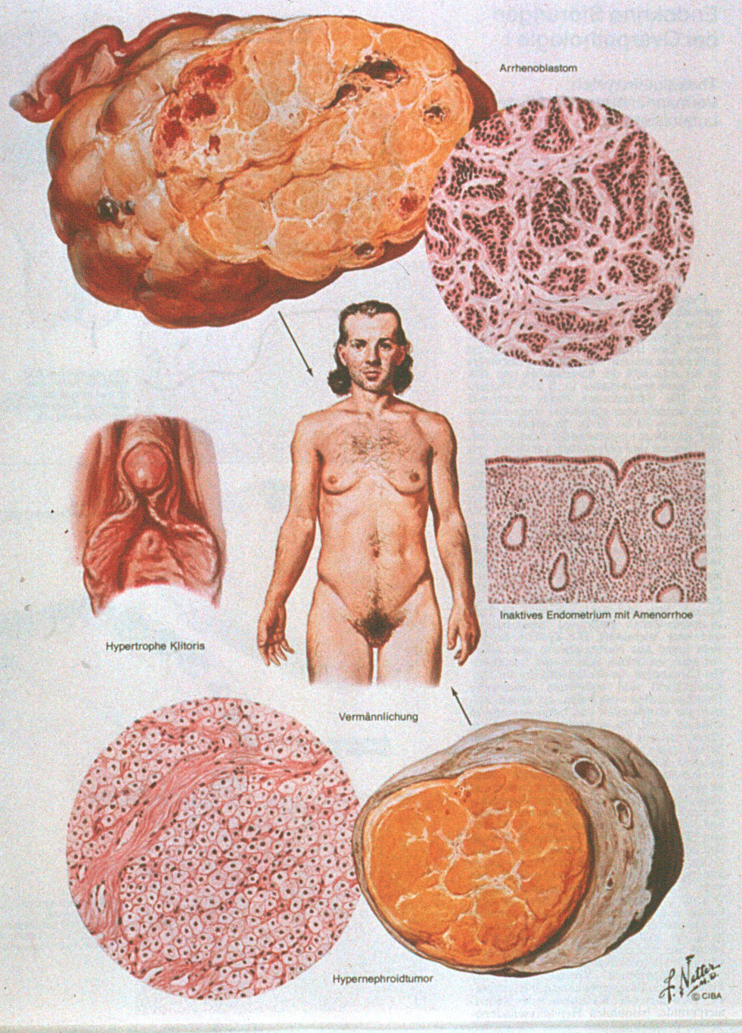
Sertoli-Leydig cell tumor......

Slide 97
Sertoli-Leydig cell tumor....
Laboratory
Testosterone, androstenedione, and the precursor 17-hydroxy progesterone in cases with virilization.
Treatment
TAH and BSO after completed family planning.
Unilateral oophorectomy is possible if preservation of fertility is desired

Slide 98
Metastatic Ovarian Cancer
Metastatic ovarian cancer forms about 5-6% of all ovarian tumours.
The primary may be:
Genital tumours
  From the endometrium, cervix, tube, and contra lateral ovary.
Extra-genital tumours
  From the stomach, colon, breast, biliary tract, and thyroid gland.

Slide 99
Metastatic Ovarian Cancer…
Krukenberg Tumour
It accounts of 30-40% of metastatic cancer to the ovary.
The primary is usually in the pylorus, less commonly in colon, breast or biliary tract.
They are bilateral solid ovarian tumour retaining the shape of the ovary.
The main interest is in its histogenesis, the most acceptable theory is that malignant cells reached both ovaries by retrograde lymphatic spread.
Prognosis
Bad, most patients die within one year because most of the lesions are not discovered until the primary disease is advanced.

Slide 100
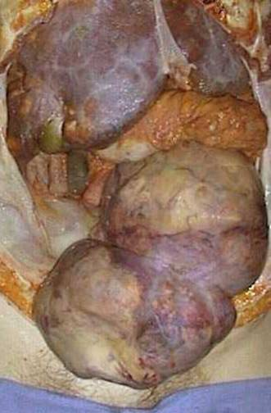
Krukenberg Tumor:

Slide 101


