Slide 1
Embryology & Malformations of The Female Genital Tract
Mihretu Molla (MSC )

Slide 2
Learning objectives
At the end of the session, students are expected to
Discuss embryologic origin of female genital organs
Identify and Classify congenital Anomalies of the female Genitalia

Slide 3
Embryology of the urogenital system
After fertilization in the fallopian tube, the mature ovum becomes a zygote—a diploid cell with 46 chromosomes—that then undergoes cleavage into blastomeres
The zygote undergoes slow cleavage for 3 days while still within the fallopian tube.
As the blastomeres continue to divide, a solid mulberry-like ball of cells, referred to as the morula, is produced.
The morula enters the uterine cavity about 3 days after fertilization.
The gradual accumulation of fluid between the cells of the morula results in the formation of the early blastocyst.

Slide 4
Embryology Contd.
At the blastocyst, the outer cells, called the trophectoderm, can be distinguished from the inner cell mass that forms the embryo
Outer cell mass give placenta & membranes, inner cell mass gives embryo
During the first 2 weeks after ovulation, successive phases of development are:
    Fertilization (at the day of ovulation)
    Formation of free blastocyst, and ( from fertilization to day 6-7)
    Implantation of the blastocyst (6 to 7days after fertilization)
The embryonic period commences at the beginning of the third week after ovulation and fertilization.
The end of the embryonic period and the beginning of the fetal period is arbitrarily designated to occur 8 weeks after fertilization

Slide 5
Embryology Contd.
Both the urinary and genital systems develop from the intermediate mesoderm.
During initial folding of the embryo in the horizontal plane, a longitudinal ridge of this intermediate mesoderm develops along each side of the primitive abdominal aorta and is called the urogenital ridge

Slide 6
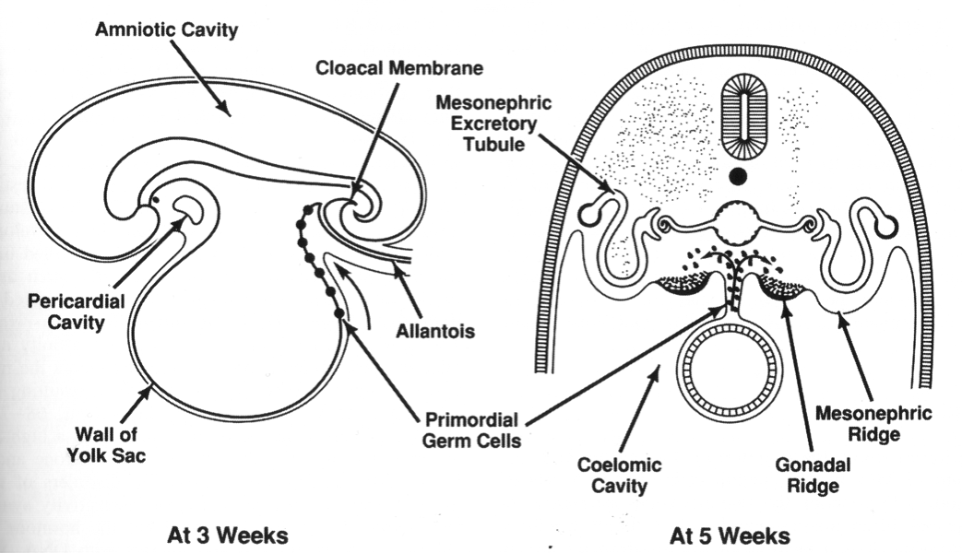

Slide 7
Embryology Contd.
The urogenital ridge then differentiates into the nephrogenic and genital ridges
The genital ridges develop into the primordial gonads.
The nephrogenic ridges instead give rise to the paired mesonephric ducts, also termed wolffian ducts.
Wolffian ducts connect the mesonephric kidneys to the cloaca, which is a common opening into which the embryonic urinary, genital, and alimentary tracts join
The paired paramesonephric, also known as müllerian ducts, develop from an invagination of the coelomic epithelium at about the sixth week, and grow on either side between the developing gonad and mesonephric duct

Slide 8
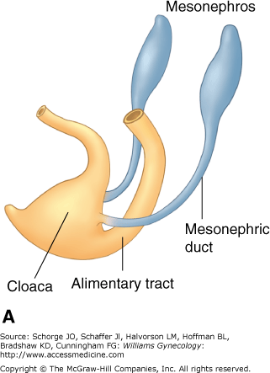
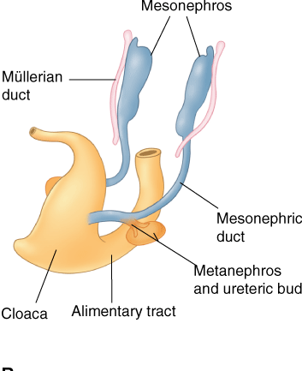
Embryology Contd.

Slide 9
Embryology Contd.
Evolution of the renal system passes sequentially through the pronephric, mesonephric & metanephric stages.
The ureteric bud arises from the mesonephric duct at approximately the fifth week of fetal life.
It lengthens to become the metanephric duct (ureter) and induces differentiation of the metanephros, which will eventually become the final functional kidney after degeneration of the mesonephric kidney at 10 weeks

Slide 10
Embryology Contd.
Although the gonads and reproductive tract complete their final maturation during puberty, critical developmental steps occur during the embryonic and fetal periods.
Histologically, the genital ridge begins as coelomic epithelium with underlying mesenchyme.
The major cellular components of the genital ridge include the primordial germ cells and somatic cells.
In both 46,XX and 46,XY embryos, the primordial germ cells are first identified as large polyhedral cells in the yolk sac.

Slide 11
Embryology Contd.
Primordial germ cells migrate from yolk sac by ameboid motion to the dorsal mesentery and then onto the undifferentiated genital ridge.
The embryonic reproductive tract is capable of developing along either male or female lines.
From this point onward, the presence or absence of gonadal determinant genes determines fetal gender development.
Sexual differentiation is dependent upon the genetic sex that is determined at fertilization of the X-bearing oocyte by either an X- or Y-chromosome-bearing sperm.
In the presence of the sex-determining region(SRY) of the Y chromosome, the gonads develop as testes.

Slide 12
Embryology Contd.
In males, cells in the medullary region of the primitive sex cord differentiate into Sertoli cells, and these cells organize to form the testicular cords.
Testicular cords are identifiable at 6 weeks and consist of these Sertoli cells and tightly packed germ cells.
Early in the second trimester, the cords develop a lumen and become seminiferous tubules.
Development of a testis-specific vasculature is crucial for normal testicular development

Slide 13
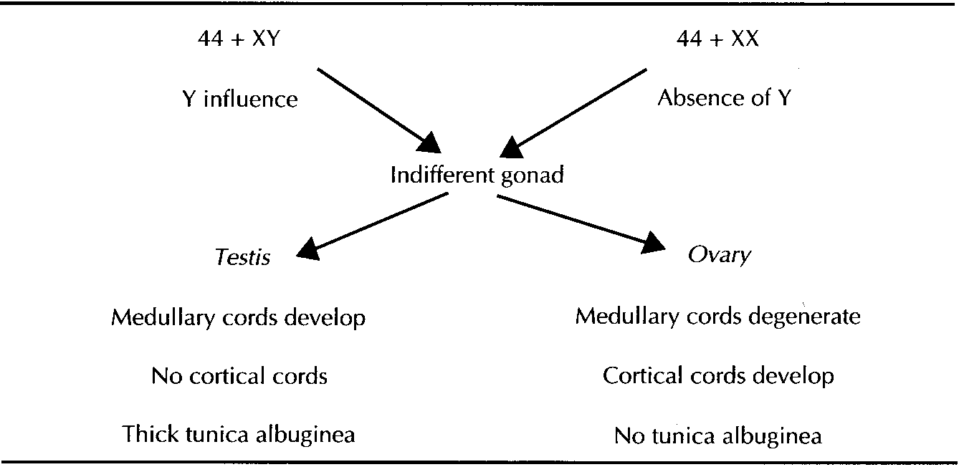
Embryology Contd.

Slide 14
Embryology Contd.
Molecular Regulation of Genital Duct Development
SRY is the master gene for testes development and appears to act directly on the gonadal ridge and indirectly on the mesonephric ducts.
Thus, it induces the testes to secrete a chemotactic factor that causes tubules from the mesonephric duct to penetrate the gonadal ridge and stimulate further testicular development.
Without penetration by these tubules, differentiation of the testes fails.
SRY also up regulates steroidogenesis factor 1 (SF1), which acts through another transcription factor, SOX9, to induce differentiation of Sertoli and Leydig cells.

Slide 15
Embryology Contd.
Sertoli cells then produce mullerian inhibiting substance (MIS, also called anti mullerian hormone, AMH) that causes regression of the paramesonephric (mullerian) ducts
Leydig cells produce testosterone, which enters cells of target tissues where it may remain or be converted to dihydrotestosterone by a 5α reductase enzyme.
Testosterone receptor complexes mediate virilization of the mesonephric ducts, whereas dihydrotestosterone receptor complexes modulate differentiation of the male external genitalia.

Slide 16
Embryology Contd.
Sexual differentation in females was once thought to be a default mechanism that occurred in the absence of a Y chromosome, but it now appears that there are specific genes that induce ovarian development.
For example, DAX1, a member of the nuclear hormone receptor family, is located on the short arm of the X chromosome and acts by down regulating SF1 activity, thereby preventing differentiation of Sertoli and Leydig cells.
In the absence of MIS production by Sertoli cells, the paramesonephric (mullerian) ducts are stimulated by estrogens to form the uterine tubes, uterus, cervix, and upper vagina.
Estrogens also act on the external genitalia at the indifferent stage to form the labia majora, labia minora, clitoris, and lower vagina

Slide 17
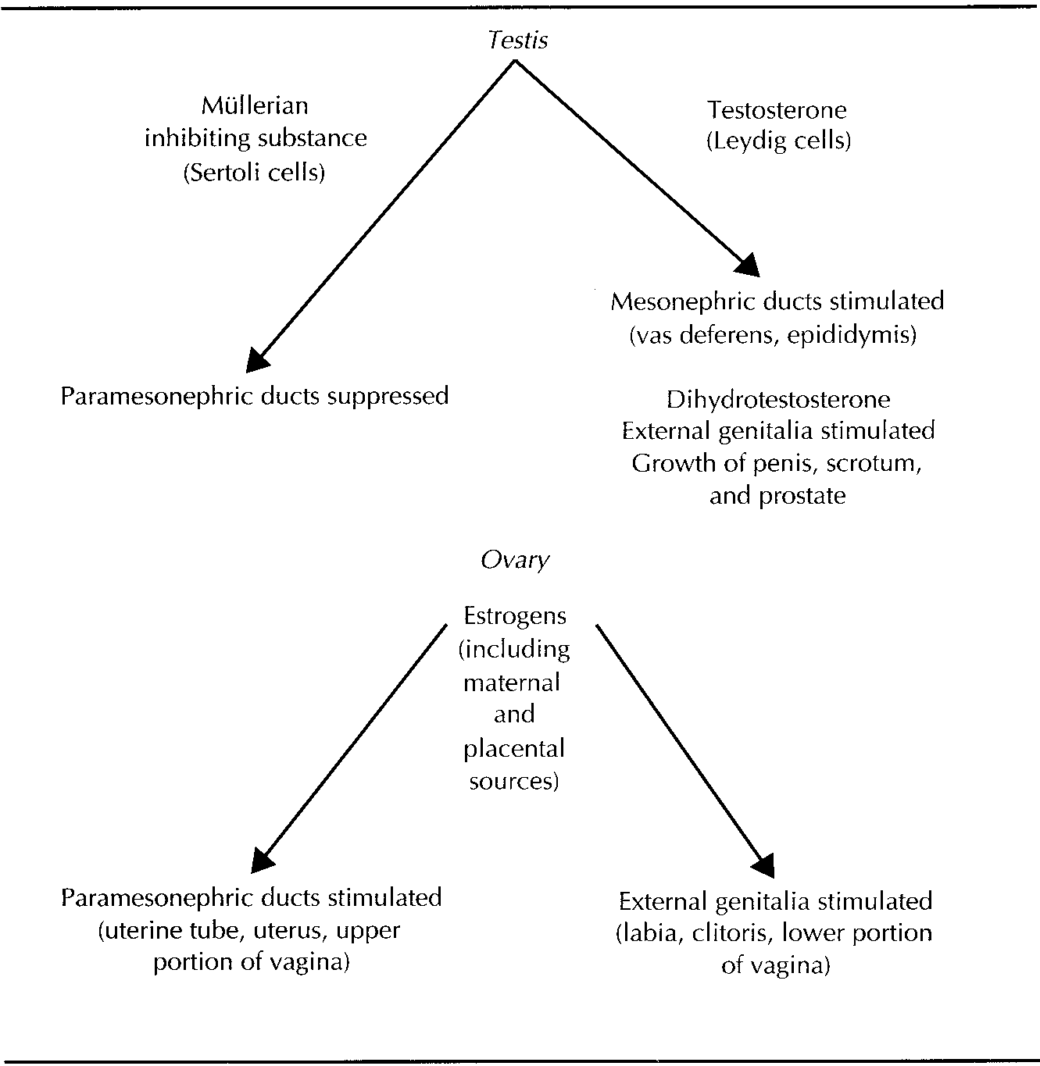
Embryology Contd.

Slide 18
Genital Ducts in the Female
The paired paramesonephric, (müllerian ducts) develop at about the sixth week.
The paramesonephric duct grow on either side between the developing gonad and mesonephric duct.
The caudal portions of the müllerian ducts approximate one another in the midline .
Around 12 wks, the caudal portion of the müllerian ducts fuse to form the uterovaginal canal.

Slide 19
Genital Ducts Contd.
The cranial point of fusion is site of future fundus of the uterus.
Subsequently, internal canalization of each duct produces two channels divided by a septum that is reabsorbed in a cephalad direction by 20 wks.
The cranial, unfused portions of the müllerian ducts develop into the fimbria & fallopian tubes.
The caudal, fused portions form the uterus, fornices & upper vagina.
Any failure to fuse the two müllerian ducts or failure to resorb the cavity between them results in separate uterine horns or some degree of persistent uterine septum.
Notes:
. Failure of this process is associated with persistence of the cell cord

Slide 20
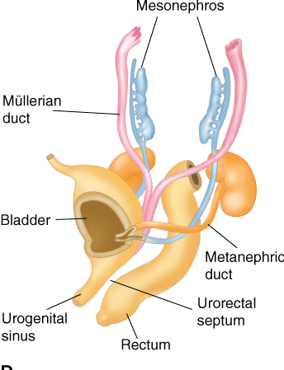
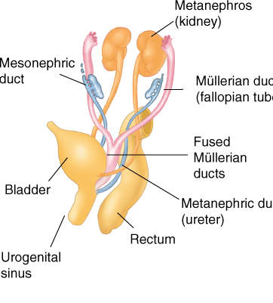
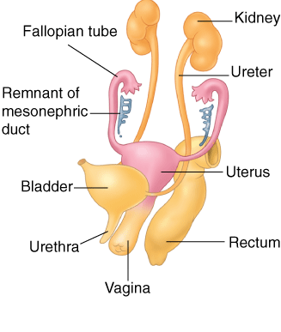

Slide 21
Genital Ducts Contd.
In females mesonephric duct reminants give , Gartner duct cysts and epoöphoron and paroöphoron found in the mesoovarium.
Gartner duct cysts are vestigial remnants of the wolffian ducts, and they are most commonly found on the cephalad, lateral wall of the vagina. The cysts are usually 1 to 5 cm. If small &asymptomatic may be followed conservatively. Symptomatic cysts may be treated by operative excision.
In males, a small vestige of the paramesonephros called the appendix testis.

Slide 22
Genital Ducts Contd.
Vagina
The cloaca is divided by formation of the urorectal septum by the seventh wk & is separated to create the rectum & urogenital sinus
The urogenital sinus is considered in three parts
The cephalad or vesicle portion, …. form the urinary bladder.
The middle part creates the female urethra; and
The caudal or phallic part give rise to the distal vagina and the greater vestibular (Bartholin), urethral, and paraurethral (Skene) glands

Slide 23
Genital Ducts Contd.
Shortly after the solid tip of the paramesonephric ducts reaches the urogenital sinus , two solid evaginations grow out from the caudal part of the sinus.
These evaginations, the sinovaginal bulbs, proliferate and form a solid vaginal plate.
Proliferation continues at the cranial end of the plate, increasing the distance between the uterus and the urogenital sinus.
By the fifth month, the vaginal outgrowth is entirely canalized.
The wing like expansions of the vagina around the end of the uterus, the vaginal fornices, are of paramesonephric origin.
Thus, the vagina has a dual origin, with the upper portion derived from the uterine canal and the lower portion derived from the urogenital sinus.
Vaginal agenesis or lesser abnormalities of this cell cord dissolution result in varying degrees of septum formation.
The vaginal lumen is separated from the urogenital sinus by the hymenal membrane.
The hymen usually ruptures before birth

Slide 24
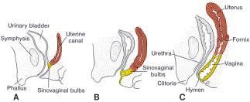

Slide 25
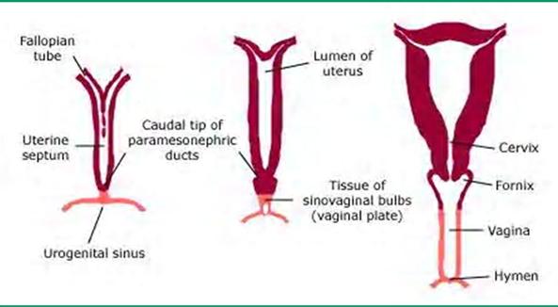

Slide 26
External Female Genitalia
In the third week of development, mesenchyme cells originating in the region of the primitive streak migrate around the cloacal membrane to form a pair of slightly elevated cloacal folds .
These folds unite to form the genital tubercle. Caudally the folds are subdivided into urethral folds anteriorly and anal folds posteriorly.
In the meantime, another pair of elevations, the genital swellings, becomes visible on each side of the urethral folds.
These swellings later form the scrotal swellings in the male and the labia majora in the female.
At the end of the sixth week, however, it is impossible to distinguish between the two sexes.

Slide 27
Development of External Genitalia
origin | Male | Female
Genital Tubercle | Glans and shaft of penis | Glans and shaft of clitoris
Urogenital Sinus | Penile urethra | Vestibule of vagina
Urethral fold | Penis | Labia Minora
Labioscrotal fold | Scrotum | Labia Major

Slide 28
Genital tract Anomalies
Anatomic disorders of the female reproductive system may result from genetic mutation, developmental arrest, or environmental insults .
Disorders range from congenital absence of the vagina & uterus, to defects in lateral or vertical fusion of the müllerian ducts.
A variety of anatomic defects may also be found in the urinary excretory system.
Because of the intertwined development of these two systems, organs from both are commonly involved in urogenital tract disorders.

Slide 29
Labial Fusion
Fusion of the labia majora is a commonly acquired defect of the labia.
It is typically found in young neonates or prepubertal girls when the labia and vagina are not adequately estrogenized.
This fusion can range from a thin filmy adhesion to a dense scar.

Slide 30
Hymeneal Defects
The hymen is the membranous vestige of the junction between the sinovaginal bulbs and the urogenital sinus.
It generally becomes perforate or patent during fetal life to establish a connection between the vaginal lumen and the perineum.
A variety of hymeneal abnormalities may exist such as microperforate, septate, cribriform, and imperforate hymen.
Imperforate hymen is due to complete failure of the inferior end of the vaginal plate to canalize.

Slide 31
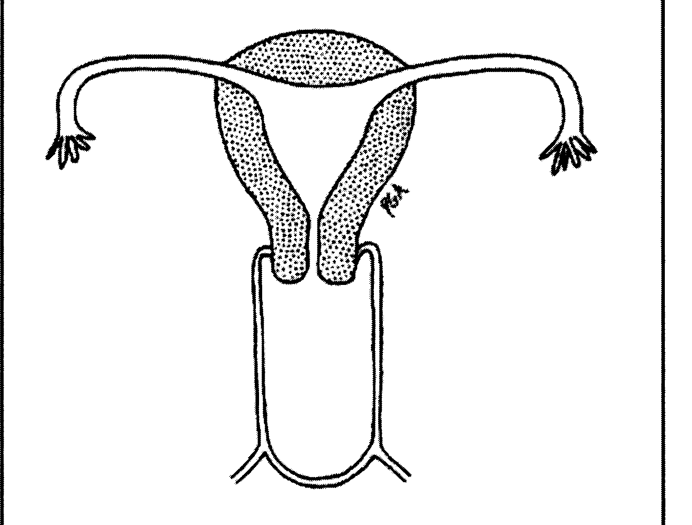
Imperforate Hymen: Diagnosis/ Treatment
Cyclic pelvic pain due to hematocolpos hematometria, or hematosalpinx
Bulging hymeneal membrane or a blind-ending pouch on exam.
Pelvic/Rectal exam, U/S, MRI
Rarely urologic anomalies.
Tx: Cruciate incision

Slide 33
Vaginal Abnormalities
In addition to vaginal agenesis, there are two types of congenital septa.
One is a longitudinal septum, which arises from a fusion or resorption defect.
The other, a transverse septum, results either from incomplete canalization or from vertical fusion failure between the down-growing müllerian duct system and the up-growing urogenital sinus
All of these defects may be isolated or associated with other müllerian anomalies

Slide 34
Transverse Vaginal Septum
The septum may be obstructive or non-obstructive.
Patients with obstructive transverse vaginal septum usually present during adolescence with cyclic lower abdominal pain, amenorrhea, and gradual development of a central pelvic mass.
Those with non obstructive transverse vaginal septum will typically complain of abnormal menstrual flow, pain with intercourse, difficulty in placing or removing tampons, or obstructed labor.

Slide 35
Transverse Vaginal Septum
Diagnosis and Treatment
Clinical presentation.
sonography or magnetic resonance Imaging(MRI)
Surgical repair is dependent upon septal thickness and skin grafts may occasionally be necessary to cover a defect left by excision of very thick septa.
Smaller septa may be approached by excision with an end-to-end anastomosis of the upper to the lower.

Slide 36
longitudinal vaginal septum
Seen with partial or complete duplication of the cervix and uterus.
Individuals complain of difficulty with intercourse or vaginal bleeding despite tampon placement.
A complete longitudinal vaginal septum usually does not cause dystocia.
An incomplete or partially obstructed longitudinal septum, however, may interfere with descent.
Ipsilateral renal agenesis is extremely common with this malformation
Surgical correction consists of wide excision of the obstructing septum.

Slide 37
MÜLLERIAN ABNORMALITIES
There are four principal deformities that arise from defective müllerian duct embryological steps:
  agenesis of both ducts, either focally or along the entire duct length or
  unilateral maturation of one müllerian duct with incomplete or absent development of the opposite side
  absent or faulty midline fusion of the ducts or
  defective canalization

Slide 38
MÜLLERIAN ABNORMALITIES…..
The true incidence of congenital müllerian anomalies, of which uterine malformations constitute the majority, is unknown.
Most cases are diagnosed during evaluation for obstetric or gynecologic problems, but in the absence of symptoms, most anomalies go undiagnosed
Recurrent pregnancy loss, preterm labor, abnormal fetal presentation, and prematurity constitute the major reproductive problems encountered with developmental or acquired uterine malformations.
Müllerian defects are also associated with renal anomalies in 30 to 50 percent of cases, ranging from renal agenesis and severe hypoplasia to ectopic or duplicate ureters

Slide 39
Classification of Müllerian Anomalies (American Fertility Society)
I. Segmental müllerian hypoplasia or agenesis
a. Vaginal
b. Cervical
c. Uterine
d. Tubal
e. Combined
II. Unicornuate uterus
a. Rudimentary horn with cavity, communicating to unicornuate uterus
b. Rudimentary horn with cavity, not communicating to unicornuate uterus
c. Rudimentary horn with no cavity
d. Unicornuate uterus without a rudimentary horn

Slide 40
Classification of Müllerian Anomalies…
III. Uterine didelphys ( no lateral fusion)
IV. Bicornuate uterus
a. Complete-divison to internal os
b. Partial bifurcation
V. Septate uterus
a. Complete septation- septate to internal os
b. Partial septation
VI. Arcuate uterus
VII. Diethylstilbestrol related

Slide 41
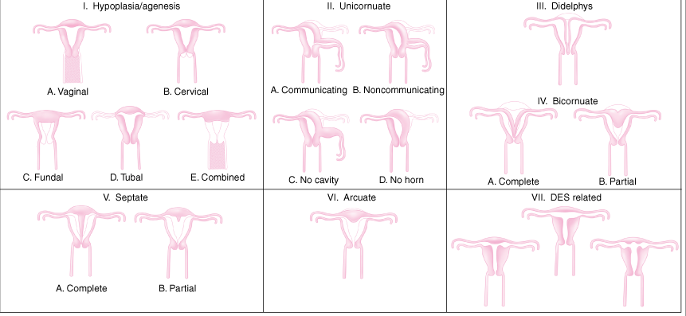

Slide 42
Diagnosis of malformations
For exact diagnosis of malformation, both internal & external architectures of the uterus must be viewed. Using
Passage of sound
Uterine curettage
C/S
Manual removal of placenta
Hysteroscopy
HSG
Laparoscopy
Ultrasonography(vaginal)
MRI
Evaluation of urinary tract
Evaluation of musculoskeletal system

Slide 43
Treatment
Mere presence of malformation per see is not an indication of surgery.
Options of surgery include
Excision of rudimentary horn
Unification operations
Success rate after abdominal metroplasty is 5-75%.
Unification operation indicated for unexplained infertility & recurrent pregnancy wastage.

Slide 44
Genital Ambiguity of the Newborn
Ambiguity of the neonatal genitalia is the result of either excessive androgen action in an embryo-fetus that was destined to be female, or inadequate androgen representation for one destined to be male.
Rarely, genital ambiguity indicates true hermaphroditism.
If the neonate is a phenotypic male with bilateral cryptorchidism, or if the genitalia are completely ambiguous, congenital adrenal hyperplasia is diagnosed and the neonate treated until appropriate tests confirm it or rule it out.
This is because, of all the causes of genital ambiguity, only congenital adrenal hyperplasia can be life threatening. If not treated immediately, adrenal failure provokes nausea, vomiting, diarrhea, dehydration, and shock

Slide 45
Ambiguity Contd.
Categories of genital ambiguity are
Female pseudohermaphroditism
Male pseudohermaphroditism
Dysgenetic gonads
True hermaphroditism

Slide 46
Category 1 Female Pseudohermaphroditism
In this condition
The karyotype is 46,XX.
Ovaries are present
Müllerian-inhibiting substance is not produced.
Androgen exposure of the embryo-fetus is excessive, but variable, for a fetus genetically predestined to be female.
Therefore, by genetic and gonadal gender, all subjects of this category are predestined to be female, and the basic abnormality is androgen excess.
Because müllerian-inhibiting substance is not produced, the uterus, fallopian tubes, and upper vagina develop in these subjects
If affected fetuses were exposed to a small amount of excess androgen reasonably late in fetal development, the only genital abnormality will be slight to modest clitoral hypertrophy, with an otherwise normal female phenotype. If exposure is early labial fusion occurs.

Slide 47
Category 2. Male Pseudohermaphroditism
These subjects are characterized by.
Production of müllerian-inhibiting substance.
Incomplete but variable androgenic representation for a fetus predestined to be male.
A 46,XY karyotype.
Androgen Insensitivity Syndrome formerly called testicular feminization, this is the most extreme form of the male pseudohermaphroditism.
These individuals have no tissue responsiveness to androgen.
Affected subjects have a female phenotype with a short, blind-ending vagina, no uterus or fallopian tubes, and no wolffian duct structures.
At the expected time of puberty, testosterone levels in affected women increase to values similar to normal men.
Nonetheless, virilization does not occur, and even pubic and axillary hair do not develop because of end-organ resistance.

Slide 48
Category 3: Dysgenetic Gonads
This category includes abnormalities of sexual differentiation that have in common several features.
Müllerian-inhibiting substance is not produced.
Fetal androgen exposure is variable.
The karyotype varies among subjects and is commonly abnormal.
Neither normal ovaries nor testes are present but rarely, both ovarian and testicular tissues are found.
The uterus, fallopian tubes, and upper vagina are present in all of the subjects in this category
In the majority, the gonads are dysgenetic.
With the most common form of gonadal dysgenesis, Turner syndrome (46X), the phenotype is female, but secondary gender characteristics do not develop at the time of expected puberty, and genital infantilism persists.

Slide 49
Category 4: True Hermaphroditism
In most subjects with true hermaphroditism, the guidelines for category 3 are met.
In addition, true hermaphrodites have both ovarian and testicular tissues, and in particular, germ cells (ova and sperm) of both sexes are found in the abnormal gonads.

Slide 50
Reading Assignment
Genetic and chromosomal abnormalities

Slide 51
Thank you

