Slide 1
Premalignant and Malignant
Conditions of the Cervix
Mihretu Molla (Bsc, Msc)

Slide 2
Learning Objectives
At the end of this session you are expected to
Briefly explain the anatomy of the cervix
Explain cervical intraepithelial neoplasia (CIN)
Describe the role of HPV in causation of Cervical Ca
Describe methods of cervical ca screening
Describe clinical presentation of cervical ca
Describe diagnostic and staging modalities of cervical ca
Describe management of cervical ca
Describe prevention mechanisms of cervical Ca

Slide 3
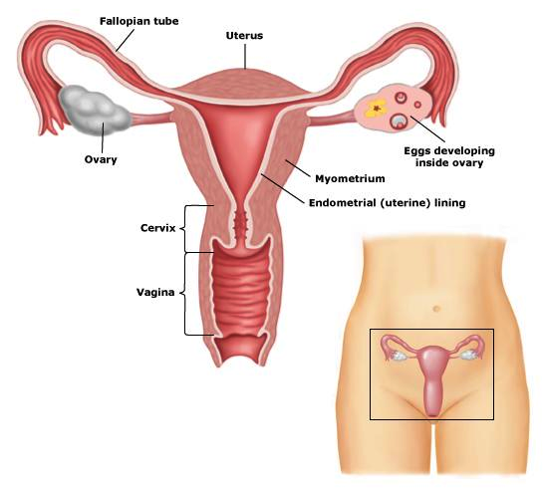
Anatomy of the Cervix

Slide 4
Anatomy…
  Size and Shape of the Cervix
  The cervix is the opening of the uterus.
  It is cylindrical in shape and is normally 3–4 cm long and 2.5–3.5 cm in diameter.
  The external os of the cervix opens into the vagina.
  The internal os is the point at which the cervix and uterus meet, above the vagina.

Slide 5
Anatomy…
  Parts of the Cervix
  Ectocervix
    Exterior to the external os and readily visible during speculum exam.
  Endocervix
    The portion above the external os and not easily seen.
  Endocervical canal
    traverses the endocervix, connects the uterine cavity with the vagina; extends from the internal to the external os.

Slide 6
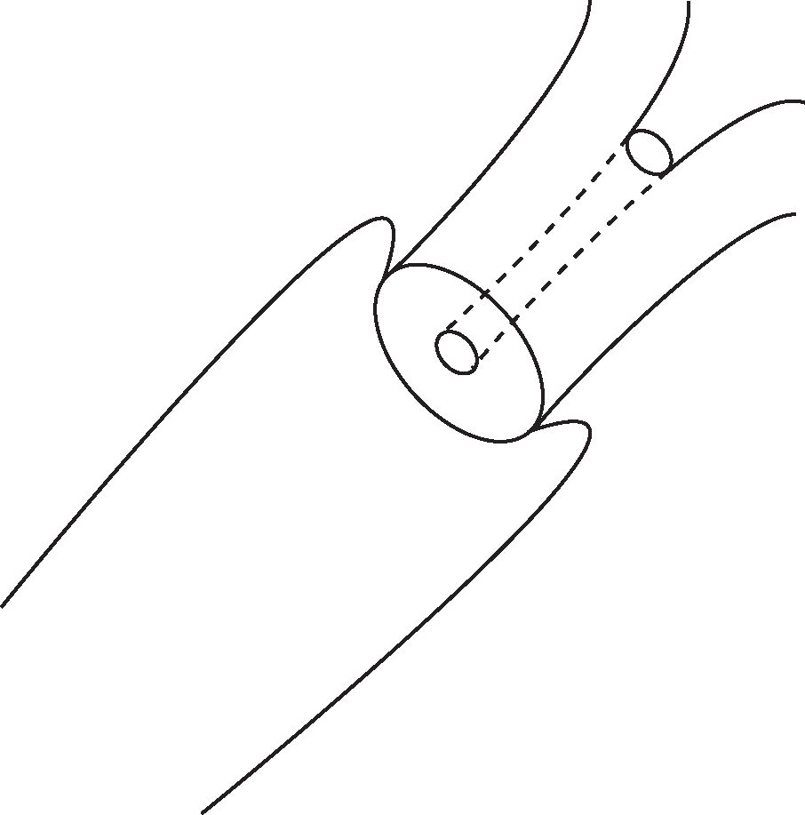
Anatomy………..
Internal os
External os
Endocervical canal
Ectocervix
Fornix
Vagina

Slide 7
Anatomy…..
Composition of the Cervix
Composed of dense fibromuscular connective tissue covered by two types of epithelium: i.e
  Stratified squamous epithelium (usually covering large areas of the ectocervix).
  Columnar epithelium (covers the endocervix and may also be visible on the ectocervix).
The two kinds of epithelium meet at the squamocolumnar junction (SCJ).

Slide 8
Anatomy……
Stratified Squamous Epithelium
The stratified squamous epithelium is located on the outside of the cervix or ectocervix.
Appears pink on visual examination
In adult women, there are two types:
  Original squamous epithelium, which is formed during embryonic life.
  Metaplastic squamous epithelium, which is newly formed.
Layers of squamous cells on the ectocervix are 15–20 cells deep.
In postmenopausal women, the multiple layers do not accumulate, and the squamous epithelium thins, becomes atrophic, looks pale, and is susceptible to trauma.

Slide 9
Anatomy…
Columnar epithelium
also called glandular epithelium and lines the endocervical canal.
It is a single layer of tall cells with dark-staining nuclei.
Columnar epithelium is much thinner than squamous epithelium.
It appears as a bumpy, reddish area.
Glandular cells within the columnar epithelium secrete cervical mucus.
A variable amount of the ectocervix can be covered by columnar epithelium, depending on the age and the hormonal and reproductive status of the woman.
This is called ectopy or ectropion and makes the cervix look red.

Slide 10
Anatomy ….
Squamocolumnar Junction (SCJ)
It is a place where the squamous and columnar epithelia meet.
It often appears as a sharp line of demarcation with a slight difference in height between the two kinds of epithelium.
The original SCJ,(laid down during embryonic life), is visible during childhood and perimenarche, after puberty, and in the early reproductive years on the outer cervix away from the os.

Slide 11
Anatomy ….
Squamous Metaplasia
Is a physiologic process where columnar cells on the side of the SCJ closest to the os are gradually replaced with squamous cells.
This process results from the exposure of the columnar cells to the acid environment of the vagina.

Slide 12
Anatomy ….
Transformation zone (TZ)
The area on the cervix between the original SCJ and the new SCJ.
Covered by metaplastic squamous epithelium
The TZ near the new SCJ is the most important area for observation, because this is the area where abnormal cells of the precursor lesions of cervical cancer are most likely to arise.

Slide 13
Anatomy….
Nabothian cysts or follicles
Are commonly observed in the TZ.
Retention cysts lined by columnar epithelium that result from the occlusion of the openings of the crypts by the squamous epithelium.
The buried columnar epithelium continues to secrete mucous that distends the follicle.
The surface has a milky-white hue.

Slide 14
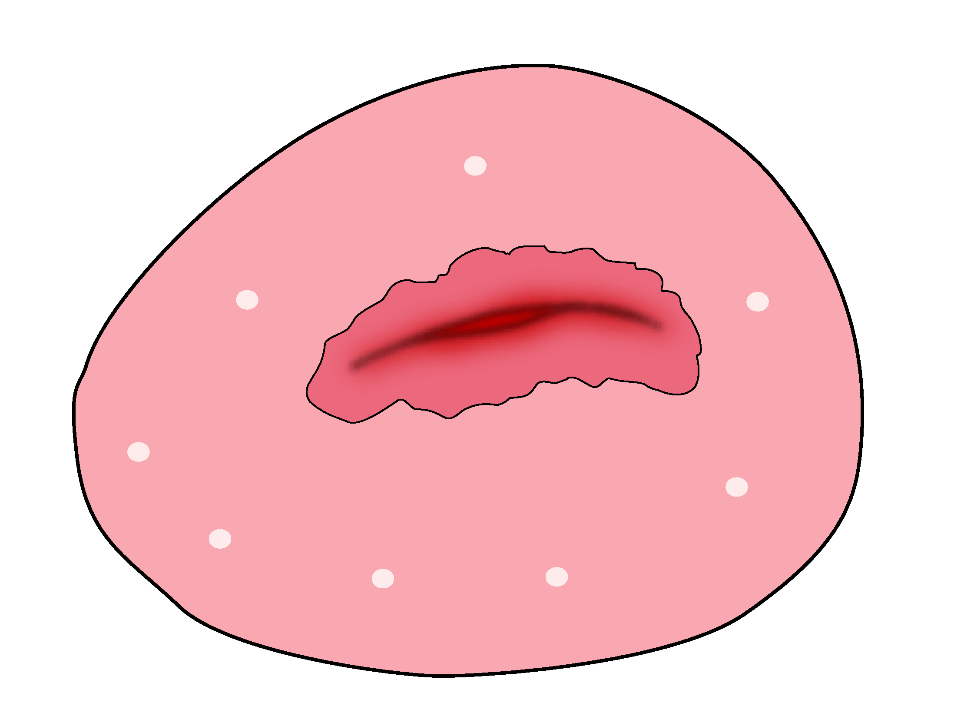
Anatomy…….
Transformation Zone
Nabothian Cyst
Squamo-Columnar Junction
{
Blood Vessels
Columnar Epithelium

Slide 15
Anatomy…
Effect of Estrogen
The location of the SCJ changes throughout a woman’s life in response to changes in estrogen levels.
As a result of increased estrogen levels (menarche, oral contraceptive use, pregnancy):
  Cervix swells and enlarges.
  Eversion of the endocervical epithelium out onto the ectocervix occurs, pushing the SCJ away from the os, making it easier to see.
As a woman ages, the SCJ retreats inward toward the internal os, making it more difficult to see.

Slide 16
Anatomy……
Blood supply
cervical and vaginal branches of the uterine vessels- 3 and 9 o‘clock positions.
Lymphatics drainage
common, internal and external iliac nodes, obturator and the parametrial nodes.
Nerve supply
hypogastric plexus
extensive sensory nerve endings, (endocervix and very few ectocervix)

Slide 17
Cervical Intraepithelial Neoplasia (CIN)
CIN means disordered growth and development of the epithelial lining of the cervix.
CIN is used to describe histologic findings of cervical biopsy.
Nearly all cervical neoplasia, both squamous and columnar, develops within the transformation zone, usually adjacent to the new SCJ.
Theoretically, cervical cells undergoing metaplasia are particularly vulnerable to the oncogenic effects of HPV and co-carcinogens.

Slide 18
CIN ….
Metaplasia is most active during adolescence and pregnancy
This may explain why initiation of sexual activity at early age and first pregnancy are known risk factors for cervical cancer.
CIN is most commonly detected in women in their 20s
The epidemiologic risk factors for CIN are similar to those for cervical cancer

Slide 19
CIN…..
Risk Factors for CIN or Cancer
Infection with a high-risk HPV type.
Family history of CIN or cancer (mother, sister).
Immunosuppression (disease, such as AIDS; medication to prevent rejection of transplant; chemotherapy; pregnancy).
Dietary deficiencies(vitamins such as A, C, E, beta carotene, and folic acid)
Age
Early coitarche
Diabetes mellitus.
Low socioeconomic status
Multiple sexual partners
Certain HLA tissue types.
Smoking.

Slide 20
CIN….
Classification
CIN 1
Mild atypical cellular changes in the lower third of the epithelium (formerly called mild dysplasia).
CIN 2
Moderate atypical cellular changes confined to the basal two-thirds of the epithelium (formerly called moderate dysplasia)
CIN 3
Severe atypical cellular changes encompassing greater than two-thirds of the epithelial thickness, and includes full-thickness lesions (formerly called severe dysplasia or carcinoma in situ).

Slide 21
CIN …..
Natural History of Cervical Intraepithelial Neoplasia Lesions
CIN grade | Regression (%) | Persistence (%) | Progression to CIS (%) | Progression to Invasion (%)
CIN 1 | 57 | 32 | 11 | 1
CIN 2 | 43 | 35 | 22 | 5
CIN 3 | 32 | < 5 6 | – | >12

Slide 22
CIN…..
Precursor Lesions (CIN) Precede Cancer by Many Years.
After the initial infection with HPV, a precursor lesion (CIN) may result (in <10% of cases), but the lesion rarely progresses to cervical cancer.
When it does, progression takes 10–15 years.
It is rare, but not impossible, for HPV infections to result in cervical cancer within 1–2 years.

Slide 23
Human papiloma virus
Human papillomavirus is a nonenveloped DNA virus with a protein capsid.
It infects epithelial cells exclusively and approximately 30 to 40 HPV types have an affinity for infecting the lower anogenital tract.

Slide 24
Risk Factors for HPV Infection
Number of sexual partners/frequency of sexual intercourse.
Sexual partner’s number of other sexual partners.
Infection with other sexually transmitted infections.
Over a lifetime, sexually active adults have a 70%–80% chance of being infected with a cancer-causing type of HPV.
High-risk types (for example, 16, 18, 31, 45, 56) account for 90% of SCC worldwide.
Type 18 associated with adenocarcinoma (cancer arising in the columnar epithelium).

Slide 25
Hpv….
Viral Life Cycle
The circular, double-stranded HPV genome consists of nine identified open reading frames.
The "early" (E) genes govern functions early in the viral life cycle such as DNA maintenance, replication, and transcription.
The "late" (L) genes encode capsid proteins needed late in the viral life cycle to complete assembly into new, infectious viral particles.
Completion of the viral life cycle takes place only within an intact squamous epithelium.
HPV is a nonlytic virus, and therefore infectiousness depends upon desquamation of infected cells

Slide 26
HPV Types and Related Cancer Risk
HPV type | Cancer risk
6, 11, 42–44 | Low to negligible risk
16, 18, 31, 33, 35, 39, 45, 51–53, 55, 56, 58, 59, 63, 66, 68 | High-risk—implicated in most cervical and other anogenital cancers

Slide 27
HPV ….
Transmission
Sexually transmitted
Vertical infection (Conjunctival, laryngeal, vulvar, or perianal warts present at birth or develop within 1 to 3 years).
Infection is not related to the presence of maternal genital warts or route of delivery .
Accordingly, cesarean delivery is recommended for HPV-related infection only in cases of large genital warts that would likely obstruct delivery or avulse with cervical dilation.

Slide 28
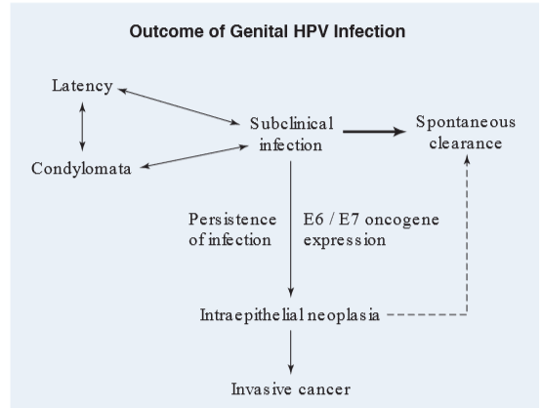
HPV….

Slide 29
How can HPV infection lead to cervical cancer?
There are several steps in the pathway from HPV infection to cervical cancer
  Initial infection – viral entry into target basal epithelial cells
  HPV integrates into the host genome
  HPV oncogenes (E6 & E7) are expressed
  Cytogenetic instability results
  Genetic changes allow uncontrolled cell growth (immortalization)
  Malignant transformation to cervical carcinoma occurs
Notes:
Progression from HPV infection to cervical cancer is a multi-step process.
Initial infection – viral entry into target basal epithelial cells.
The first step is the integration of the HPV genome into the host genome, which results in expression of HPV oncogenes E6 and E7.
E6 and E7 modulate the effect of the tumour suppressor proteins p53 and Rb, resulting in cytogenetic instability.
These genetic changes allow for uncontrolled cell growth (immortalization).
The final stage involves malignant transformation to invasive cervical carcinoma.

Slide 31
HPV ….
Diagnosis of Infection
Clinical lesions and results of cytology, histology, and colposcopy, all of which are subjective and often inaccurate.
Definitive diagnosis is made by direct detection of HPV DNA. Using
    In situ hybridization,
    Polymerase chain reaction (PCR)
    Hybrid capture (HC) technique

Slide 32
HPV…..
Treatment
The only indications to treat HPV infection are the presence of neoplasia or symptomatic warts.
Symptomatic wart is treated by excision or laser therapy

Slide 33
HPV …..
Prevention
Behavioral Interventions
Condoms use
Prophylactic Vaccines
  Recombinant quadrivalent vaccine against types 6, 11, 16, and 18 (Gardasil)
  Indicated for women aged 9 to 26 years
  Administered in three intramuscular doses over 6 months.
  Testing for HPV is not recommended prior to vaccination
  It elicits humoral antibodies that neutralize HPV before it can infect host cells
  Prevent establishment of persistent infection and therefore, the development of cervical neoplasia.

Slide 34
Screening of Cervical Cancer
Aims to detect disease before symptoms occur
Basis
Long preinvasive state(10-15yrs)
Effective screening methods
Effective treatment
Purpose
Identification of intraepithelial lesion (CIN)

Slide 35
Approaches of screening
Organized screening
Is designed to reach the highest possible number of women at greatest risk of cervical cancer with existing resources.
Opportunistic screening
- Is screening done on women who are visiting health services for other reasons

Slide 36
Screening ….
Methods of cervical cancer screening include:
Cervical Cytology
  Conventional PAP collection
  Liquid-based PAP collection
HPV DNA testing
Combined test
Visual method

Slide 37
1. Cervical Cytology
Conventional pap smear
Introduced in 1941 by Papanicolaou
Standard screening test for lower genital tract neoplasm
Historical success in developed countries in reduction of cervical cancer.
The Pap test's specificity is 98 % with sensitivity of 51%
In conventional pap sample is taken and quickly spread as evenly as possible over one half to two thirds of a glass slide.
Then fixation is done immediately by spray or immersion of slide with 95% alcohol

Slide 38
Cervical cytology …..
Liquid-Based Testing
Sampling and cell transfer to a liquid medium should be performed according to manufacturer specifications.
LBC is more sensitive and accurate for the detection of both squamous lesions and adenocarcinomas of the cervix

Slide 39
Cervical Cytology Contd.
Timing of sample
Avoid menstruation period
Abstain for 24 to 48 hours from
      Vaginal intercourse,
      Douching, and use of
      Vaginal tampons and
      Medicinal or contraceptive cream preparations
Location of sample
Sample transformation zone
Sampling Tools are
Airis Spatula, broom, and endocervical brush

Slide 40
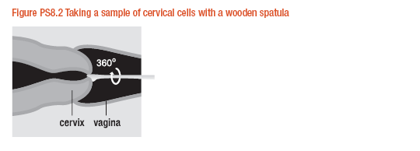
Cervical Cytology Contd.

Slide 41
American cancer society cervical cancer screening guide line
Initiation of screening | 3 years after onset of vaginal intercourse; no later than age 21
Screening intervals for women at average risk | Age <30: annual if conventional smear; every 2 years if LBC test Age >30: every 2 to 3 years after 3 consecutive negative tests
Screening intervals for women at higher risk | HIV + or other immunocompromised state: 2 tests during first year after immune disease diagnosis, then annually
Discontinuation of screening | Age 70: consider if 3 documented negative (and no abnormal) tests in prior 10 years
 | Continue if screening history uncertain, history of cervical cancer, DES, recent HPV +, HIV + status, other immunocompromised state
Screening after hysterectomy | Not indicated if removal confirmed for benign indication Subtotal hysterectomy: continue screening per guidelines
 | Continue screening if history of DES or cervical cancer
But WHO recommendation is : | once, 35-40 yrs

Slide 42
Cervical Cytology Contd.
Reporting of PAP smear results for both Conventional & liquid based is by the Bethesda System
In 1988, standardization of cervical cytology reporting took place with the development of the Bethesda System nomenclature.
Subsequently it was revised 2001.

Slide 43
The 2001 Bethesda System: Epithelial Cell Abnormalities
Squamous cell
Atypical squamous cells (ASC) of undetermined significance (ASC-US) cannot exclude HSIL (ASC-H)
Low-grade squamous intraepithelial lesion (LSIL)
High-grade squamous intraepithelial lesion (HSIL)
Squamous cell carcinoma
Glandular cell
Atypical glandular cells (AGC)
Endocervical, endometrial, or not otherwise specified
Atypical glandular cells, favor neoplastic
Endocervical or not otherwise specified
Endocervical adenocarcinoma in situ (AIS)
Adenocarcinoma

Slide 44
Cervical Cytology Contd.. . .
Limitations of cytology
Moderate to low sensitivity
High rate of false-negative test results ( may be due to poor sample collection , poor reading or poor interpretation of findings)
Women must be screened frequently
Requires complex infrastructure
Results are not immediately available
Requires multiple visits
Less accurate among postmenopausal women b/c of retraction of transformation Zone into endocervical canal

Slide 45
Cervical Cytology: Initial Management of Epithelial Cell Abnormalities
Epithelial Cell Abnormality | General Recommendation | Special Circumstances
ASC-US | Repeat cytology at 6 and 12 months Reflex HPV DNA testing if LBC is used and if +ve do Colposcopy | Refer to colposcopy for recurrent abnormal cytology, or initial positive HPV DNA test; adolescents managed with repeat annual cytology
LSIL | Colposcopy for non-adolescent women | Adolescents managed with repeat annual cytology; HPV DNA test at 12 months or repeat cytology at 6 and 12 months are also acceptable for postmenopausal women
ASC-H, HSIL, squamous cell carcinoma | Colposcopy
AGC, AIS, adenocarcinoma | Colposcopy, endocervical curettage; HPV DNA testing for AGC | Endometrial sampling indicated if age >35 years,or abnormal bleeding, or chronic anovulation, or atypical endometrial cells specified

Slide 46
Colposcopy
Colposcopy is an outpatient procedure that is simple, quick, and well-tolerated.
It allows examination of the lower genital tract and anus with a microscope.
Indicated for patients with abnormal Pap test results and visible epithelial abnormalities
Clinical objectives
Provide a magnified view of the lower genital tract
Identify SCJ cervix
Detect lesions suspicious for neoplasia
Direct biopsy of lesions

Slide 47
Colposcopy Contd.
Abnormal findings of colposcopy indicative of
dysplasia and carcinoma in situ (CIS) are those of:
    Leukoplakia or hyperkeratosis
    Acetowhite epithelium
    Mosaicism or punctation vessels
    Atypical vessels with bizarre capillaries with corkscrew, comma-shaped, or spaghetti-like configurations
Abnormal colposcopic finding are indication for
colposcopic directed biopsy.
Findings of biopsy may indicate CIN.

Slide 48
Management of CIN
Management of low grade lesions (CIN I)
CIN 1 can be observed indefinitely, especially in adolescents as it can regress, or
Treated if it persists for at least 2 years
Management of High Grade lesions
  CIN 2 adolescents manage same as CIN I
  CIN 2 in adult women and CIN 3 are treated by excision or ablation
Before using ablative treatment modalities, there must be no indication of invasive cancer or glandular lesion by cytologic or histologic colposcopic or evaluation.

Slide 49
Management of CIN Contd.
Ablative therapies are :
1. Cryosurgery
  Delivers refrigerant gas, usually nitrous oxide, through flexible tubing to a metal probe.
  Which freezes tissue on contact by crystallizing intracellular water.
2. Carbon Dioxide Laser
  Treatment with amplification by stimulated emission of
  radiation, or laser,
  Is delivered using colposcopic guidance with a
  micromanipulator.
  This modality vaporizes tissue to a depth of 5 to 7 mm

Slide 50
Management of CIN Contd.
Excisional Treatment Modalities
Lesions suspicious for invasive cancer and AIS of the cervix must undergo a diagnostic excisional procedure
Loop Electrosurgical Excision Procedure (LEEP)
uses a thin wire on an insulated handle through which an electrical current is passed.
This creates an instrument that simultaneously cuts and coagulates tissue under direct colposcopic visualization
2. Cold-Knife Conization
This surgical procedure removes the entire cervical transformation zone including the cervical lesion by scalpel
3. Hysterectomy

Slide 51
2. HPV DNA testing
Rational for using HPV testing in cervical screening
The strong causal associates of HPV& cervical ca &its precursors.
The high HPV –attributable fraction (90-99% of cervical ca).
The long time interval (15yrs)b/n infection and HSIL.
The minimal invasive nature of sampling procedure.
The availability of one standardized ,FDA approved test.
The high sensitivity of the available tests (for HSIL).

Slide 52
HPV DNA testing Contd.
Indication
For triaging women with ASC-US
Alternative 1st degree screening for cervical ca( HSIL)
Testing method: PCR
Sensitivity=50-95% (85%)
Specificity=50-95% (84%)

Slide 53
3. Combination Screening
Combination screening is Cytology + HPV testing in women > 35yrs
Alternative 1st degree screening approach
FDA approved, 2003
Interval of screening=3yrs

Slide 54
4. Visual Method
Screening of cervical cancer using visual methods are
Visual inspection with acetic acid (VIA)
Visual inspection with Lugol’s iodine(VILI)

Slide 55
Visual Inspection with Acetic Acid
Viewing the cervix with the naked eye to identify color changes on the cervix.
Acetic acid is a mucolytic agent.
It reversibly clumps nuclear chromatin causing lesions to assume various shades of white depending on the resultant degree of abnormal chromatin density.
Applying 3- to 5-percent acetic acid to mucosal epithelium results in the acetowhite change characteristic of neoplastic lesions as well as some non-neoplastic conditions

Slide 56
VIA Contd.

Slide 57
VIA Contd.

Slide 58
VIA test performance
 | Sensitivity | Specificity
Minimum | 65% | 64%
Maximum | 96% | 98%
Median | 84% | 82%
Mean | 81% | 83%

Slide 59
Visual inspection with Lugol’s iodine (VILI)
Lugol iodine solution stains mature squamous epithelial cells mahogany (red brown)in estrogenized women due to high cellular glycogen content.
Due to attenuated cellular differentiation, dysplastic cells have lower glycogen content and fail to fully stain, appearing various shades of yellow. This is called Schiller Test
Lugol solution should not be used in patients allergic to iodine, radiographic contrast, or shellfish.
Lugol solution is particularly useful when abnormal tissue cannot be found using acetic acid alone, and to better define the limits of the transformation zone.
VILI has Sensitivity =87.2 Specificity =84.7% both are above Visual Inspection with Acetic Acid

Slide 60
Strengths of Visual Method
Simple, easy-to-learn
Minimal infrastructure requirement
Low start-up and sustaining costs.
Many types of health care providers can perform the procedure.
Test results are available immediately.
Requires only one visit.
May be possible to integrate VIA screening into primary health care services.

Slide 61
Limitations of Visual method
Moderate specificity
No conclusive evidence regarding the health or cost implications of over-treatment.
There is a need for developing standard training methods and quality assurance measures.
Likely to be less accurate among post-menopausal women
Rater dependent.

Slide 62
Management of abnormal VIA /VILI
What to do if the VIA (VILI) test is positive?
Refer for confirmatory diagnosis or adjunctive test.
Offer to treat immediately.
      Cryotherapy

Slide 63
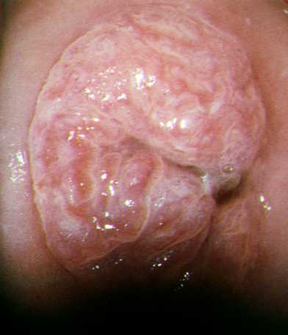
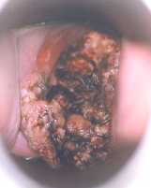
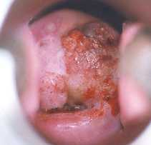
Cervical Cancer
Source: Photograph courtesy of Dr. Renzo Barrasso.

Slide 64
Cervical cancer
Cervical cancer is the most common gynecologic cancer in women
Worldwide, cervical cancer is common, and ranks second among all malignancies for women
Compared with other gynecologic malignancies, cervical cancer develops in a younger population of women
Most early cancers are asymptomatic
Advancing cervical cancer present with bleeding, watery discharge, and signs associated with venous, lymphatic, neural, or ureteral compression
The median age at diagnosis ranges from 40 to 59 years

Slide 65
Cervical cancer Contd.
Risks factors
Cervical cancer is a unique in that it is a confirmed sequela of a STI
Risk factors of cervical cancer are similar with risk factors for CIN
Tumorigenesis of cervical Ca
Squamous cell carcinoma of the cervix typically arises at the squamocolumnar junction from a pre-existing dysplastic lesion, which in most cases follows infection with HPV
Following tumorigenesis, the pattern of local growth is exophytic if a cancer arises from the ectocervix, or may be endophytic if it arises from the endocervical canal

Slide 66
Natural History of Cervical Cancer
HPV Infection
Characteristics:
HPV infection is extremely common among women of reproductive age.
HPV infection can remain stable, lead to CIN, or become undetectable.
Management:
While genital warts resulting from HPV infection may be treated, there is no treatment that eradicates HPV.
Primary prevention through use of condoms offers some protection.
Low-grade CIN
Characteristics:
Low-grade CIN usually is temporary and disappears over time. Some cases, however, progress to high-grade CIN.
It is not unusual for HPV to cause low-grade CIN within months or years of infection.
Management:
Low-grade CIN generally should be monitored rather than treated, since most lesions regress or do not progress.
High-grade CIN
Characteristics:
High-grade CIN, the precursor of cervical cancer, is significantly less common than low-grade CIN.
High-grade CIN can progress from low-grade CIN or, in some cases, directly from HPV infection.
Management:
High-grade CIN should be treated, because a significant proportion progresses to cancer.
Invasive Cancer
Characteristics:
Women with high-grade CIN are at risk of developing invasive cancer; this generally occurs slowly, over a period of several years.
Management:
Treatment of invasive cancer is hospital-based, expensive, and often not effective.
Screening strategies are intended to identify abnormalities in these ranges.

Slide 67
Cervical cancer Contd.
Spread patterns
Direct extension to adjacent tissues (the parametria, the vagina, the pelvic sidewall) is the most common
Lymphatic(parametrial, obturator, and iliac lymph nodes)
Hematogenous spread is less common

Slide 68
Cervical cancer Contd.
Histologic Types
Squamous Cell Carcinoma (85 %of all cervical cancers)
Adenocarcinoma (second most common)
Adenosquamous carcinoma
Neuroendocrine tumors of the cervix(Large cell neuroendocrine, Small cell carcinoma
Sarcomas of the cervix
Malignant lymphomas

Slide 69
Cervical cancer Contd.
Diagnosis
Symptoms
Vaginal bleeding that follows coitus or douching
Watery, blood-tinged vaginal discharge
Phsical Examination
Exophytic or endophytic growth
Polypoid mass, papillary tissue, or barrel-shaped cervix
Cervical ulceration or granular mass

Slide 70
Cervical cancer Contd.
Clinical Stages of Cervical Cancer (FIGO, Revised 1994)
Stage | Characteristics
0 | Carcinoma in situ, cervical intraepithelial lesion (CIN) 3
I | Carcinoma is strictly confined to cervix (extension to corpus should be disregarded)
IA | Invasion is limited to measured stromal invasion with a maximum depth of 5 mm and no wider than 7mm
IA1 | Measured invasion of stroma no greater than 3 mm in depth and no wider than 7 mm
IA2 | Measured invasion of stroma greater than 3 mm and no greater than 5 mm in depth and no wider than 7mm
IB | Clinical lesions confined to the cervix or preclinical lesions greater than IA
IB1 | Clinical lesions no greater than 4 cm in size
IB2 | Clinical lesions greater than 4 cm in size

Slide 71
Cervical cancer Contd.
II | Carcinoma extends beyond cervix but has not extended to pelvic wall; it involves vagina, but not as far as the lower third
IIA | No obvious parametrial involvement
IIB | Obvious parametrial involvement
III | Carcinoma has extended to the pelvic wall; on rectal examination there is no cancer-free space between tumor and pelvic wall; tumor involves lower third of vagina; all cases with hydronephrosis or nonfunctioning kidney should be included, unless they are known to be due to another cause
IIIA | No extension to pelvic wall, but involvement of lower third of vagina
IIIB | Extension to pelvic wall, or hydronephrosis or nonfunctioning kidney due to tumor
IV | Carcinoma has extended beyond true pelvis or has clinically involved mucosa of bladder or rectum
IVA | Spread of growth to adjacent pelvic organs

Slide 72
Cervical cancer Contd.
Prognostic Factors are
FIGO stage is the most significant prognostic factors
Nodal metastases

Slide 73
Cervical cancer Contd.
Treatment of cervical cancer
Early stage disease( stage I to IIA) surgery
Late stage disease ( stage IIB and beyond )radiation

Slide 74
Differential diagnosis
Cervical tuberculosis
Fibroid polyp
Syphilitic ulcer

Slide 75
Cause of death
Bleeding
Renal failure
Infection

Slide 76
Prevention
Invasive cancer of the cervix is considered a preventable disease because;
  it has a long preinvasive state,
  availability of screening programs and
  the presence of effective treatment of the preinvasive lesions
Approaches
  Primary prevention
  Secondary prevention

Slide 77
Primary prevention
  Prevent HPV infection by
    HPV vaccination( Cervarix, Gardasil)
    health information and warnings about tobacco use,
    Sexuality education tailored to age & culture,
    Condom promotion/provision for those engaged in sexual activity and
    Male circumcision.
  NB ;- Condom use doesn’t reduce HPV infection as effectively as reducing the risk of other STIs.

Slide 78
Secondary prevention
  Involves screening and treatment of precancerous lesions if they have developed
  Screening methods
    Cytology-based screening or Conventional (Pap) and liquid based cytology (LBC)
    Visual inspection with Acetic Acid (VIA)
    HPV testing for high risk HPV types

Slide 79
Thank you

