Slide 1
University of Gondar
College of Medicine and Health sciences
School of Midwifery
Department of Clinical Midwifery
Neonatology for 3rd year regular Bsc Midwifery students
By: Muhabaw Shumye (Bsc, Msc)
March/2020
Gondar, Ethiopia

Slide 2
Approach to respiratory distress in newborn
April/2019

Slide 3
Outline
Introduction
Causes of respiratory distress in Newborn
Assessment of a newborn with respiratory distress
Common causes of respiratory distress in new born
Respiratory distress syndrome
Congenital pneumonia
Meconium aspiration syndrome
Apnea in Newborn
Transient tachypnea
Persistent fetal Circulation
References

Slide 4
Definitions
Respiratory distress in the neonate most commonly presents as one or all of the following physical signs:
RR>60/min
Retractions /chest in drawing
Nasal Flaring
Grunting
Cyanosis

Slide 5
Causes
The incidence and severity of RDS are related inversely to the GA
The 1⁰ causes of RDS is inadequate pulmonary surfactant
When Surfactant is deficient, the surface tension is higher and alveoli are unable and collapse at end of expiration.
Common causes of RDS or HMD are classified into Pulmonary and extra pulmonary

Slide 6
Cont…
1-Pulmonary causes:- They are again subdivided into three:
A-Lung parenchymal disease:
Hyaline membrane disease
Meconeum aspiration syndrome
Congenital pneumonia
Pulmonary haemorrhage
B-Congenital Airway obstructions:
Nasal or nasopharyngeal: nasal edema
Oral cavity: macroglosia
Neck: congenital goitre
Larynx: laryngomalacia
Trachea: congenital tracheal stenosis
C-Intrathoracic malformations
Pulmonary hypoplesia or agenesis
Diaphragmatic hernia
Intrathoracic cysts

Slide 7
Cont…
2-Extrapulmonary causes of RDS: further divided into four:
A-Cardiac and circulatory causes
Congenital heart diseases
Congestive heart failure
Hypervolemia
B-Metabolic causes
Hypoglycemia
Hypocalcaemia
Hypothermia
C-Neurological causes
Neonatal meningitis
Extreme immaturity
Intracranial haemorrhage
D- Haematological causes
Anemia
Polycythemia
Notes:
2-Extrapulmonary causes of RDS: These are also further divided into four:
A-Cardiac and circulatory causes
Congenital heart diseases
Congestive heart failure
Hypervolemia
Cardiac arrhythmia
B-Metabolic causes
Hypoglycemia
Hypocalcaemia
Hypothermia
Metabolic acidosis
C-Neurological causes
Neonatal meningitis
Neonatal seizure
Hypoxic-ischemic encephalopathy
Extreme immaturity
Intracranial haemorrhage
D- Haematological causes
Anemia
Polycythemia

Slide 8
Assessment to respiratory distress
Proper history - antenatal , natal & postnatal
The history of pregnancy
Gestational age
Previous preterm babies
Antenatal prophylactic steroids
Maternal DM
History polyhydraminos , oligohydraminos
History of labor and delivery
Fetal monitoring during labor
Duration of labor, pre-term or prolonged rapture of membrane

Slide 9
Cont’d
Complications during delivery like p.previa, abruption
Meconium in amniotic fluid
Trauma sustained during birth process
The mode of delivery
The need of resuscitation in the immediate neonatal period
History of presentation
Time of onset of distress
Gradual improvement or deterioration
Feeding problems

Slide 10
Cont’d
1. For HMD
Gestational age
Previous preterm babies
Antenatal prophylactic steroids
APH
Maternal DM
2. For Congenital pneumonia
PROM, foul smelling discharge
Duration of labour
Maternal fever
Unclean vaginal examination
3. For Meconium Aspiration Syndrome
Meconium stained liquor
Suctions of Meconium
Gestational age

Slide 11
Cont’d
P/E
Look for Hypovolemia
Low BP , tachycardia, weak pulse, delayed capillary refill ( > 3sec)
Look for pallor, cyanosis
Signs of RD
AP diameter of chest
Air entry & added sounds
Cyanosis, murmurs
Organomegally
Abdominal distension ( scaphoid abdomen)
Meconium staining of umbilical stump and nail beds & skin.
Edema
Pallor
Neonatal reflexes
Notes:
1. A preterm baby weighing <1500 gms with retractions and grunt is likely to have HMD.
2. A term baby born through MSAF with an increase in the anteriorposterior diameter of the chest (full chest) is likely to be suffering from MAS.
3. A depressed baby with poor circulation is likely to have neonatal sepsis with or without congenital pneumonia
4. A near term baby with no risk factors and mild distress may have TTNB.
5. An asphyxiated baby may have PPHN.
6. A growth retarded baby with a plethoric look may have polycythaemia.
7. A baby presenting with tachypnea and a cardiac murmur may have a congenital heart disease.
8. Inability to pass an 5F catheter through the nostril of a term baby is suggestive of choanal atresia

Slide 12
Investigation
CBC
Septic screening
RBS and serum electrolytes
Gastric aspirate for shake test.
CXR

Slide 13
General management
1. ABC of life
2. O2 admin and saturation monitoring
3. Prevention of hypothermia:
HMD and PPHN are aggravated by hypothermia.
4. Fluid and electrolyte management:
Electrolyte balance, fluids, calcium and glucose homeostasis are all equally important.
5. Maintenance of adequate haemoglobin:
Any neonate with RD should have a packed cell volume (PCV) above 40% (but less than 75%).
6. broad spectrum antibiotics.
Notes:
Clearing of airway, ensuring adequate breathing and circulation are the first line of management.
2. Warm, humidified oxygen is given with a head box, preferably with a FiO2 meter and pulse oximeter monitoring to determine the amount of oxygen required.
3. Maintenance of correct temperature is essential. HMD and PPHN are aggravated by hypothermia.
4. Fluid and electrolyte management: Electrolyte balance, fluids, calcium and glucose homeostasis are all equally important.
5. Maintenance of adequate haemoglobin: Any neonate with respiratory distress should have a packed cell volume (PCV) above 40% (but less than 75%).
6. broad spectrum antibiotics.

Slide 14
HYALINE MEMBRANE DISEASE (HMD)
Incidence
RDS is an acute illness, usually of preterm infants, developing within 4–6hrs of birth.
Most common cause of RD in preterm infants
60 – 80% <28wk,
15 – 30% between 32 and 36 wk and
In about 5% of infants beyond 37 wk of gestation

Slide 15
Factors predisposing to RDS
Maternal factors
Diabetes
Hypertension
Multiple pregnancy
Malnutrition
Familial disposition
Perinatal factors
Premature delivery
Cesarean section
Male gender
Birth depression
Timing of cord clamping
Hypothermia
Hemolytic disease of the newborn

Slide 16
Factors protecting against RDS
Antenatal corticosteroid treatment
Intrauterine growth restriction
Prolonged rupture of the membranes
Maternal drugs and smoking
Female gender
Non-Caucasian ethnic group

Slide 17
Pathogenesis
Primary cause is inadequate pulmonary surfactant due to preterm birth (GA< 35wks)
a complex mixture of lipids and proteins(Surfactant) that lowers alveolar surface tension.
are synthesized and stored in type II alveolar cells
The major constituents of surfactant are
Dipalmitoyl phosphatidylcholine (lecithin),
Phosphatidylglycerol,
Apoproteins (surfactant proteins SP-A, -B, -C, -D), and
Cholesterol

Slide 18
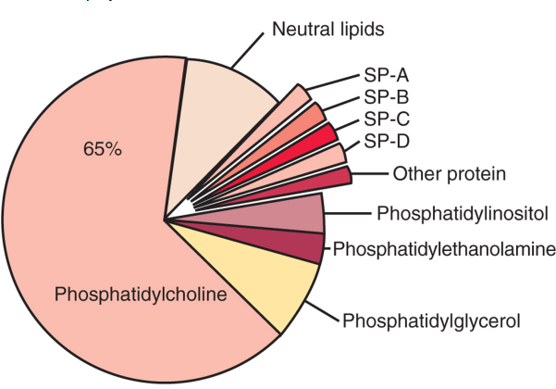
Composition of surfactant recovered by alveolar wash
Notes:
SP-B is required for normal pulmonary function . Infants with a mutation in the SFTPB gene resulting in deficient or abnormal SP-B expression have severe respiratory failure that is lethal in the perinatal period .
In this case, type II cells lack typical lamellar bodies, have abnormal accumulation of lipid vesicles, and cannot process SP-C precursor protein
SP-C promotes the formation of the phospholipid film lining the alveolus .
Humans with SP-C deficiency do not have respiratory distress at birth, but develop interstitial pulmonary fibrosis in early childhood.
SP-A and SP-D are small hydrophilic proteins that are members of the collectin protein family.
The primary role of these proteins is in host defense of the lung .
SP-A and SP-D facilitate the uptake and killing of bacterial and viral pathogens by immune cells, and appear to have a direct antimicrobial role

Slide 19
SP-B is required for normal pulmonary function . Infants with a mutation in the SFTPB gene resulting in deficient or abnormal SP-B expression have severe respiratory failure that is lethal in the perinatal period .
In this case, type II cells lack typical lamellar bodies, have abnormal accumulation of lipid vesicles, and cannot process SP-C precursor protein
SP-C promotes the formation of the phospholipid film lining the alveolus .
Humans with SP-C deficiency do not have respiratory distress at birth, but develop interstitial pulmonary fibrosis in early childhood.
SP-A and SP-D are small hydrophilic proteins that are members of the collectin protein family.
The primary role of these proteins is in host defense of the lung .
SP-A and SP-D facilitate the uptake and killing of bacterial and viral pathogens by immune cells, and appear to have a direct antimicrobial role

Slide 20
Cont’d
Low pulmonary surfactant :
alveolar collapse, especially at end expiration, reduced lung volume and decreased lung compliance.
Alveolar atelectasis ,edema, cellular injury
Inadequate gas exchange
Hypoxia ,acidosis
The combination of hypercapnia, hypoxia, and acidosis produces pulmonary arterial vasoconstriction

Slide 21
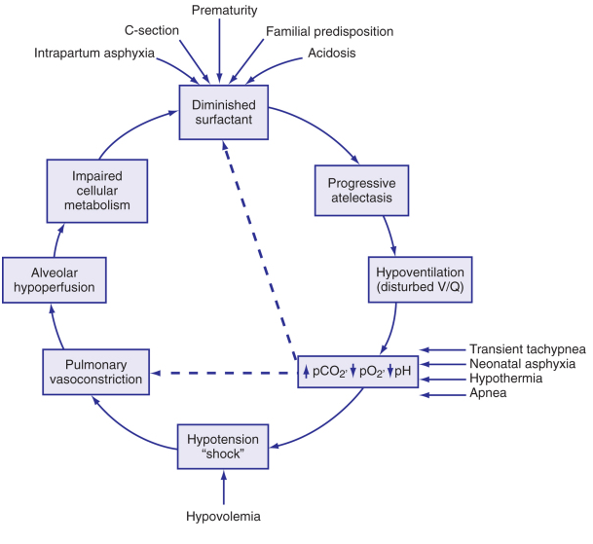
Contributing factors in the pathogenesis of hyaline membrane disease. The potential “vicious circle” perpetuated hypoxia and pulmonary insufficiency

Slide 22
Clinical manifestations
Onset of Sxs – with in 6 hrs of life
Tachypnea, Expiratory grunting , Retractions, Cyanosis
Symmetrically reduced air entry
Blood pressure may fall;
Apnea and irregular respirations
Respiratory failure
In most cases, the S/S reach a peak within 3 days
Death usually occurs between days 2-3 associated with alveolar air leaks, pulmonary hemorrhage, or IVH
With continued recovery the infant is usually asymptomatic and in room air by 7–10 days of age.
Notes:
Onset of Sxs – with in 6 hrs of life
Tachypnea
Expiratory grunting
Retractions
Cyanosis , often relatively unresponsive to oxygen administration
Symmetrically reduced air entry
blood pressure may fall; fatigue, cyanosis, and pallor increase, and grunting decreases or disappears as the condition worsens
In most cases, the symptoms and signs reach a peak within 3 days
Death usually occurs between days two and seven associated with alveolar air leaks (interstitial emphysema, pneumothorax), pulmonary hemorrhage, or IVH
With continued recovery the infant is usually asymptomatic and in room air by 7–10 days of age.

Slide 23
Investigations
CXR:
the best method of making a definitive diagnosis of RDS
Reduced lung volume
Reticulogranular pattern
Air-broncho gram extending beyond the heart border

Slide 24
Prenatal prediction: 1.Lecithin sphingomyeline ratio
Risk of HMD less if L/S > 2
Exceptions -Infant of diabetic mother
- Perinatal asphyxia
- Erythroblastosis fetalis

Slide 25
2.Lamellar body count
Lamellar bodies are packages of phospholipids produced by type II pneumocytes
Present in amniotic fluid
Numbers increase with gestational age
>50,000 bodies/ul predicts lung maturity

Slide 26
3.TDx-FLM II
The TDx-FLM II measures the surfactant-albumin ratio using fluorescent polarization technology.
It appears to predict clinically significant RDS when a cutoff of >45 mg/g is used for mature results.

Slide 27
Management
1. Keep in thermoneutral zone
2. Adequate oxygenation
3. Optimize fluid intake and calori
keep NPO
Put them on maintenance IV fluid for the first 24hrs
Breast milk or formula feeding with NG tube when respiratory distress stablize
4. Metabolic acidosis
-Sodium bicarbonate, 1–2 mEq/kg, may be administered over a 15–20 min period
5. Antibiotics
Antibiotic therapy is indicated empericaly until culture result obtained
Ampiciline plus Gentamicin
6. Endracheal exogenous surfactant
Notes:
1. Keep in thermoneutral zone
Avoid hypothermia
Maintain core T° between 36.5 and 37°C
2. Adequate oxygenation
Warm humidified oxygen
Sufficient to keep arterial levels between 50 and70mmhHg(85 -95%)
CPAP- to prevent alveolar collapse
- Improves ventilation- perfusion matching
Indications :
a. Inability to maintain Pao2 above 50mmHg
b. Prolonged apnoeic attack of prematurity
c. Prophylacticaly in extreme preterm babies
3. Optimize fluid intake and calori
keep NPO
Put them on maintenance IV fluid for the first 24hrs
Breast milk or formula feeding with NG tube when respiratory distress stablize
4. Metabolic acidosis
-Sodium bicarbonate, 1–2 mEq/kg, may be administered over a 15–20 min period
5. Antibiotics
Difficulty of distinguishing group B streptococcal or other bacterial infections
Antibiotic therapy is indicated empericaly until culture result obtained
Ampiciline plus Gentamicin
6. Endracheal exogenous surfactant

Slide 28
Prevention
Avoidance of unnecessary or poorly timed cesarean section
Appropriate management of high-risk pregnancy and labor
prediction and possible in utero acceleration of pulmonary immaturity
Betamethasone or Dexamethasone to women 48 hr before the delivery of fetuses between 28- 34 wk of gestation
Significantly reduces the incidence, mortality, and morbidity of RDS

Slide 29
Complications
Air leak syndromes
Persistent pulmonary hypertension
Brochopulmonary Dysplasia
Respiratory failure

Slide 30
CONGENTIAL PNEUMONEA
Epidemiology
Accounts for 5% of causes of RD in Newborn
Infection is acquired through:
Hematogenous spread(via placenta)
Ascending infection(amniotic fluid)
Most common predisposing factors are:
prematurity
PROM(>18hrs)
Prolonged duration of labour >24 hrs
Maternal fever(chorioamionities)
Faul smelling liquor
Unclean vaginal examination

Slide 31
Etiology
GBS, is the most common bacterial pathogen
Gram negative organisms – E.coli, klebsella pseudomonas
Staph- aureus
Listeria monocytogenes
Chlamydial infection

Slide 32
Clinical manifestation
Respiratory distress soon after birth, sick at birth
Recurrent apneoic attack
Temperature instability(fever ,hypothermia)
Progressive respiratory failure

Slide 33
Investigation
CXR:
bilateral homogeneous consolidation
Patchy infiltrates
Interstitial reticular opacities
segmental or lobar atelectasis
CBC,ANC
Gastric aspirate
Blood culture
CSF analysis
Notes:
CBC,ANC
Gastric aspirate for PMNL
Blood culture
CSF analysis

Slide 34
Management
1. Supportive care:
Oxygen administration
Prevent hypothermia and hypoglycemia
Avoid PO feeding in respiratory distress
V/S monitoring
2. Antibiotics:
Broad spectrem antibiotics until culture result
Ampicilline 100mg/kg/day÷2 doses(IV/IM)
Gentamicin 5- 7.5 mg/kg/day÷2 doses(IV/IM)
If no improvement with in 48hrs modify the antibiotics to Ceftriaxon plus Ampicilline
Ceftriaxon 50mg/kg/day÷2doses
Total duration 10 – 14 days.

Slide 35
Cont’d
Prognosis
The outcome of intrauterine pneumonia is variable
more critically ill infants are likely to die in utero or within the first 2 days of life
worse for premature than for term infants

Slide 36
MECONIUM APIRATION SYNDORME
Incidence :
MSAF is found in 10–15% of births
Meconium aspiration pneumonia develops in 5% of such infants
Predominantly seen in:
SGA
Postmature infants
Factors which compromise utero –placental circulation

Slide 37
Cont’d
Composition of meconium
Desquamated cells from the intestine and skin,
Gastrointestinal mucin
Lanugo hair
Fatty material from the vernix caseosa,
Amniotic fluid and,
Intestinal secretions
Meconium is sterile. However, when aspirated into the lung, it may stimulate the release of cytokines and other vasoactive substances

Slide 38
Pathophysiology:
Acute or chronic hypoxia ➔passage Meconium in utero
If gasping by the fetus /newly born infant ➔aspiration of Meconium stained amniotic fluid
Meconium aspirated ➔
air way obstruction,
interfere with oxygenation ,
chemical pneumonitis
➔Severe respiratory distress
Notes:
Acute or chronic hypoxia can result in passage Meconium in utero
In this setting, gasping by the fetus or newly born infant can cause aspiration of Meconium stained amniotic fluid
Meconium aspirated can lead to air way obstruction, interfere with oxygenation , chemical pneumonitis and, ultimately severe respiratory distress

Slide 39
Cont’d
Pulmonary disease
Airway obstruction
Chemical irritation
Infection
Surfactant inactivation and decreased synthesis

Slide 40
Clinical manifestation
Respiratory distress with in the first hr of birth
RD with tachypnea , retractions, grunting and cyanosis
Patients may have evidence of postmaturity
Hyper inflated chest
Meconium stained skin, nail beds & umbilical stump
Signs of Asphyxia- depressed Neonatal reflexes.
Usually improvement with in 72hrs

Slide 41
Diagnosis
Aspiration of meconium from the oropharynx
CXR
Hyper inflation
Bilateral fluffy shadows with patchy infiltrates and coarse streaking of both lung fields
Evidence of air leak( 10 – 30%)

Slide 42
Managment
Prevention of Meconium aspiration
Intrapartum suctioning of the oropharynx before delivery of the shoulders
2. Basic supportive care standared Mx of respiratory distress
O2 administration
Mechanical ventilation
Work up for sepsis
3. Antibiotics
Broad-spectrum antibiotics (ampicillin and gentamicin) while awaiting the results of blood cultures

Slide 43
Cont’d
Prevention
Risk of meconium aspiration may be decreased by:
Rapid identification of fetal distress
initiating prompt delivery in the presence of NRFH
Complications
Airleak (pneumothorax,pneumomediastinum)
Most common, 15-20%
Persistent pulmonary hypertension
Chronic lung disease, reactive airway disease

Slide 44
APNEA
Definition
Respiratory pause>20 seconds or any duration if accompanied by cyanosis and bradycardia (HR<100bpm)
Gestational age is the most important determinant of respiratory control, with the frequency of idiopathic apnea of prematurity being inversely related to gestational age.

Slide 45
Cont’d
classification
Central apnea occurs when inspiratory effort is absent
Obstructive apnea occurs when inspiratory efforts persist. Airway obstruction is present
Mixed apnea occurs when airway obstruction with inspiratory efforts precedes or follows central apnea

Slide 46
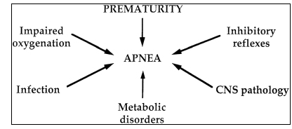
Specific contributory causes of apnea

Slide 47
pathogenesis
Developmental Immaturity of the brainstem respiratory centers
Chemoreceptor Response: an attenuated response to carbon dioxide and a paradoxical response to hypoxia that results in apnea rather than hyperventilation.
Reflexes
In coordination of the tongue and other upper airway muscles involved in maintaining airway patent
Pharyngeal instability, neck flexion, nasal occlusion

Slide 48
Clinical features
Occurs frequently in preterm infants; apnea immediately after birth signifies another illness
Onset :between 2nd–7th day of life, rare on the 1st day
The incidence of associated bradycardia increases with the length of the preceding apnea
Duration-usually cease by 37 weeks gestational age

Slide 49
Treatment
Cardio respiratory monitors for Infants at risk for apnea
Gentle tactile stimulation for mild and intermittent episodes.
Recurrent and prolonged apnea -require suctioning, repositioning, and bag and mask ventilation, oxygen administration
Recurrent apnea of prematurity-theophylline or caffeine.
Methylxanthines
increase central respiratory drive
Enhancing contractility of the diaphragm
Theophylline (PO) or Aminophylline (IV)
caffeine citrate

Slide 50
Transient tachypnea of the new born
The syndrome is secondary to slow absorption of fetal lung fluid resulting in decreased pulmonary compliance and tidal volume and increase dead space
The most common predisposing factor is C/S delivery b/c the thorax hasn’t been squeezed
CM
early onset on Tachypnea, granting, cyanosis
Patient usually recovers rapidly within 3 days
clear chest without rales or ronchi
hypoxia and acidosis is not common
The distinctive features of transient tachypnea from HMD
infant suddenly recover and absence of x-ray findings has been seen in transient tachypnea

Slide 51
Persistent pulmonary hypertention(PPHN) or persistent fetal circulation (PFC) of the new born
The problem might occur following new born problems/several event causing asphyxia, MAS, streptococcal sepsis, HMD hypoglycemia, polycytemia, pulmonary hypoplesia, diaphragmatic hernia
Pathogenesis
-it occurs as a result of right to left (R-L) shunting of blood away from the lungs and through the fetal ductus arteriosus and patent foramen ovale.

Slide 52
Cont…
C/M
-infants will be sick in delivery room or within 72 hrs of life
cyanosis, tachypnea,
granting, flaring, retractions,
tachycardia and shock
DX
CXR, ECG
Treatment
improving oxygenation
correct predisposing factors

Slide 53
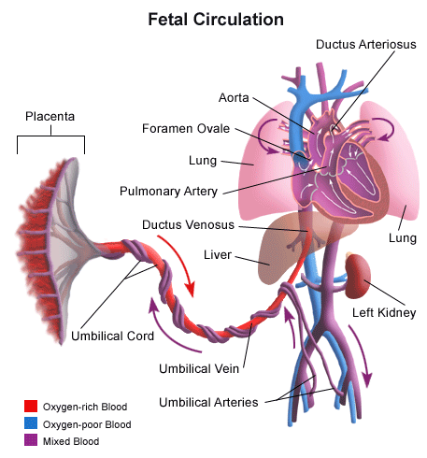
Fig –showing fetal circulation

Slide 54
References
1. Nelson Textbook of Pediatrics, 18th ed, respiratory tract disorders
2. Fanaroff and Martin's Neonatal-Perinatal Medicine, 8th ed, Respiratory Disorders in Preterm and Term Infants
3. Manual of neonatal care, 6th ed
4. Anne Greenough, Anthony D Milner, Neonatal respiratory disorders, 2nd ed
5. UpToDate , 17.3, 2009
6. Pediatrics in review , Newborn Respiratory Disorders, Jamie B. Warren and JoDee M. Anderson, Pediatr. Rev. 2010;31;487-496

Slide 55
Neonatal Sepsis
Objectives
Define neonatal sepsis
Identify causes of neonatal sepsis
Compare and contrast EONS and LONS
Manage neonatal sepsis

Slide 56
Neonatal Sepsis
Neonatal sepsis is a clinical syndrome characterized by systemic signs of infection, accompanied by bacteremia in the first month of life.
Frequent and important cause of mortality and morbidity
2% of fetus infected in utero
10% of infants – infection in the first month
Are unique
Infectious agents from mother
Neonates less capable of responding to infections (immunologic deficiency)
Coexisting conditions complicate the diagnosis and mgt.
Clinical manifestations vary
Source maternal infection often undiagnosed.

Slide 57
Cont…
Modes of transmission
Intrauterine
Ascending infection(amniotic fluid infection
Immunity
Diminished concentration of Ig
IgG activity transferred across placenta
Factors that increase risk of fetal/ neonatal infection
Gestational age <37weeks
Low birth weight
Rupture of membrane>18hr
Underlying illness
Decreased local or systemic immunity
Ventilation, catheters
High inoculums
Virulent organism

Slide 58
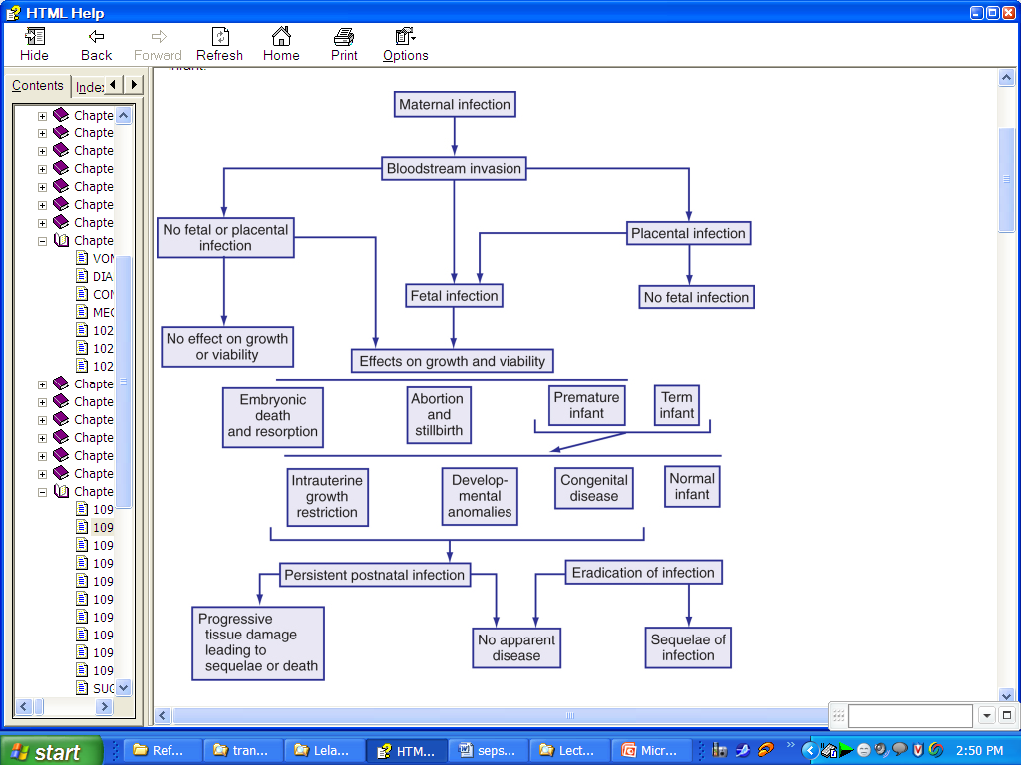

Slide 59
Epidemiology of early and late onset neonatal infections
Characteristic | Early | Late
Age | Birth to seven days usually <72hrs | 7 to30 days
Maternal obstetric complication | common | uncommon
Prematurity | Frequent | varies
Organism source | Maternal genital tract | Maternal genital tract or environment
Site | Normal nursery NICU community | NICU community
Manifestations | Multisystem | Multisystem or focal

Slide 60
Cont…
1-Early onset sepsis (disease)
Presents as a fulminant, multi systemic illness during the first 72 hours or 5-7 days of life.
Mostly caused by organisms prevalent in the genital tract or in labour room and maternity operation theatre.
Common pathogens
Group B streptococci
Escherichia coli
Staphylococci aurous
Klebsiella
Pseudomonas
Entrobacter species

Slide 61
Cont…
C/M – Majority manifest with respiratory distress due to an intrauterine pneumonia) fever, failure to feed etc…
Route of infection:
Ascending infection (PROM)
Passage of baby through infected birth canal
During resuscitation in labour room

Slide 62
Cont…
Risk factors of Early-onset of Neonatal sepsis
Birth Asphyxia
Unclean vaginal examination
Foul smelling liquor
Duration of labour > 24 hours
Birth weight <2500gm/or gestation <37 weeks
Premature rupture of membrane > 24 hours
Maternal pyrexia
When at least two or more of the above high-risk factors are present, the baby is considered to be infected and should be investigated properly for sepsis and treated with appropriate antibiotics

Slide 63
Cont…
2- Late-onset of neonatal sepsis
Is more commonly recognized after the first week of life or after 72 hours of life (Delayed by a minimum of 4 days)
Acquired as nosocommunal infection from the nursery or lying in ward
In most cases symptoms appear by the end of first week of life

Slide 64
Cont…
Common pathogens are:
Klebsiella pneumoniae
Entrobacteria
Eschercia coli 2/3rd cases are caused by gram
Pseudomonas negative bacilli
Salmonella
The rest are caused by gram- positive organism:
Staphylococci aurous
Staphylococci albus/epidermitis
Source of infection includes
Incubators
Resuscitation equipments
Feeding bottles
Catheter, face masks, infusion sets,

Slide 65
Clinical manifestations
Clinical manifestations are nonspecific
Temperature irregularity(low or high)
Change in behavior
Lethargy, irritability, depressed reflexes and tone
Skin change
Cyanosis, mottling, poor perfusion, pallor, jaundice
Feeding problem
intolerance., vomiting, abdominal distension, diarrhea
Respiratory
Tachypnea, grunting, flaring, retraction, apnea
Cardiac
Tachycardia, hypotension
Metabolic
Hypo or hyperglycemia, metabolic acidosis

Slide 66
Diagnosis
Cultures
Blood culture
Urine culture for late onset neonatal sepsis
CSF analysis
WBC count greater than or equal to 20cells/mm2
Protein greater 150 mg/dl
Glucose low glucose
Gram stain
Culture
WBC count
Neutropenia – ANC<1500
Neutrophylia –ANC >7500
Immature : total neutropil ratio > 0.2
Anemia, thrombocytopenia
Acute phase reactants
Micro ESR-Value more than 10mm/hr is suggestive of infection
C Reactive Protein
Glucose, elecrtolytes
Notes:
Cultures
Blood culture
Urine culture for late onset neonatal sepsis
CSF analysis
WBC count greater than or equal to 20cells/mm2
Protein greater 150 mg/dl
Glucose low glucose
Gram stain
Culture
WBC count
Neutropenia – ANC<1500
Neutrophylia –ANC >7500
Immature : total neutropil ratio > 0.2
Anemia, thrombocytopenia
Acute phase reactants
Micro ESR-Value more than 10mm/hr is suggestive of infection
C Reactive Protein
Glucose, elecrtolytes
Gastric aspirate for early onset neonatal sepsis
If >5 PMNs

Slide 67
Cont…
Management of Neonatal sepsis
First-line drugs:
Crystalline pencillin or Ampicilline + Gentamycine
Crystalline pencillin 50,000-100,000Iu- IV/Kg/day 2 doses for <1 weeks of age and 4 doses if >1 weeks of age
Gentamycine 5mg/kg/day (2 doses)
Ampicilline 100 mg/kg/day (2 dose for <1 wk age and 3 dose if >1 wk age)
If there is meningitis, double the dose of cry. Pencillin and Ampicilline

Slide 68
Cont…
Second – Line drugs
Hospital acquired infection or if the mother has gram negative infection, give the following
Cefotaxine or ceftriaxone + Amino glycoside
Supportive blood transfusion in DIC, sclerema and Hyperbilirubinaemia
Increase peripheral and pulmonary perfusion
Corrects coagulation abnormality
Removes toxins

Slide 69
Supportive care
Respiratory
Oxygen and ventilation as necessary
Cardiovascular
Support blood pressure with volume expanders and/or pressors
Hematologic
Treat DIC with FFP and/or cryo
CNS
Treat seizures with phenobarbital
Watch for signs of SIADH (decreased UOP, hyponatremia) and treat with fluid restriction
Metabolic
Treat hypoglycemia/hyperglycemia and metabolic acidosis

Slide 70
Complications
Endocarditis
Septic arthritis
Osteomyelitis
Septic embolization
Abscess formation

Slide 71
Prognosis
Mortality rate for neonatal sepsis is 10%
Case fatality rate for bacterial meningitis is 20-25%
Immediate complications of meningitis are ventriculitis, brain abscess and cerebritis
Late complications of meningitis are seizure disorder, hydrocephalus, developmental delay, focal motor deficit

Slide 72
Neonatal conjunctivitis
5-30% of pregnant women have chlamydial genital infection
C/F
70% have nasopharyngeal infection
Clinically conjunctivitis or pneumonia
C. Trachomatis is the most frequent identifiable infectious cause of neonatal conjunctivitis (Inclusion conjunctivitis)
30-50% born to mothers with active chlamydial infection develop conjunctivitis
Symptoms 5-14 days after delivery

Slide 73
Occurs in infants younger than 4 weeks
. Most common eye disease of newborns
. Variable etiologic agents
Risks of infection
Frequencies of maternal infections
Prophylactic measures
Circumstances during labor & delivery
Post delivery exposure

Slide 74
Epidemiology
Reflects sexually transmitted diseases
2% silver nitrate instilled (crede)
C/F
Non-specific to allow accurate dx
Redness, chemosis (swelling) of conjunctiva, edema of eye lids, & discharge (purulent) despite etiologic agent
Is potentially blinding
May have systemic manifestations

Slide 75
Silver nitrate drops - 6-12 hours after birth
Clearing by 24-48 hrs
N. Gonorrhea
2-5days
C.trachomatis 5-14 days
Gonnococal infections may be there at birth or delayed beyond 5 days of life –due to partial suppression by ocular prophylaxis
After infancy by inoculation from contaminated hands
Begins with mild inflammation & serosangenous discharge
Discharge becomes thick & purulent, within 24 hours.

Slide 76
Cont
Tense edema of eye lids with chemosis
Deeper layers of conjunctiva & cornea involved if Rx is delayed.
Complications
Corneal ulcerations & perforation
Iridocyclitis, anterior synechiae
Panophtbalmitis (rare)
C.trachomatis
Vary from mild inflammation to severe swelling of eyelids
With copious purulent discharge
Mainly tarsal conjunctiva, cornea-rare

Slide 77
Cont
Pseudomonas aerogenosa
Similar presentations
Rare, acquired in nursery
Potentially serious
5-18 days of life
Edema, erythema, purulent discharge, pannus formation
Endophthalmitis, sepsis, shock, death
Dx: - after 48 hours possibly infectious
G/s of discharge, culture
Giemsa staining (epithelial cells) for Chlamydia
Rx: cefriaxone 50mg/kg IM stat (don’t exceed 125mg)
Eye irrigation initially every 20-30min
Gradually – 2 hourly

Slide 78
Pustules/ Pyoderma:
Is superficial skin infection usually caused by Staphylococcus Aureus.
Develop after the first few days of life; they may be bullous, crusted, or pustular.
Although they can develop anywhere on the body, the blisters and pustules commonly occur on the diaper area, axillae, and periumbilical skin.
When the epidermis is shed in large sheets, staphylococcal scalded skin syndrome should be suspected.

Slide 79
The diagnosis is made by Gram stain and culture of the blister fluid
Blood cultures should be obtained before initiating systemic antibiotic therapy, even if the infants are usually otherwise well. Give cloxacillin 50 mg/kg every 12 hours (< 8 days) and every 8 hours (> 8 days). It is usually given intravenously.
- If no improvement/if there is a danger sign, consider treating for sepsis.

Slide 80
Cellulitis/Abscess:
If there is a fluctuant swelling, incise and drain the abscess.
If possible, take a specimen of pus using a sterile cotton swab
Give cloxacillin IV or IM according to the baby’s age and weight
If the cellulitis/abscess is improving after five days of treatment with the antibiotic, continue cloxacillin to complete 10 days of treatment

Slide 81
Candidiasis
Cutaneous lesions: Consist of erythematous papules and vesicopustules that become confluent, forming a moist, erosive, scaly dermatitis surrounded by satellite pustules.
Treatment: Topical antifungal agents from the imidazole group are the most effective.
Oral thrush: The lesions of thrush are detectable as creamy white patches of friable material on the buccal mucosa, gums, palate, and tongue .
Ap ply Nystatin oral solution 4 times daily after feeds, continuing for 2 days after lesions have healed.
Mother apply Nystatin cream on her breasts after breastfeeding

Slide 82
Umbilical infection (omphalitis)
Stickiness or pus discharge at the base of the cord or Inside the umbilicus
Caused by staphylococcus aureus and E.coli
Treatment cloxacillin with Gentamycin
Local care
Prevention with antiseptic application on the stamp

Slide 83
PERINATAL ASPHYXIA
Objectives of the session
At the end of this session the learner is expected to:
Define perinatal asphyxia
Explain the basic pathophysiology of asphyxia
Discuss Organ manifestations of asphyxia
Identify and treat perinatal asphyxia
Describe the prognosis of perinatal asphyxia

Slide 84
Perinatal asphyxia
It is simply defined as failure to initiate breathing during delivery.
It refers to impaired gas exchange leads to fetal hypoxemia and hypercarbia
Manifestations are low APGAR score less than 3 at 5th minute and abnormal muscle tone.

Slide 85
Cont…
An insult to the fetus or new born due to lack of oxygen ( hypoxia) and/ or lack of perfusion (Ischemia) to various organs.
Considered when 5th minute APGAR score is ≤3
Associated with tissue lactic acidosis (PH <7.20) and
Hypoxic – ischemic encephalopathy (depressed level of consciousness, altered tone, seizure)
Other multi-organ system signs

Slide 86
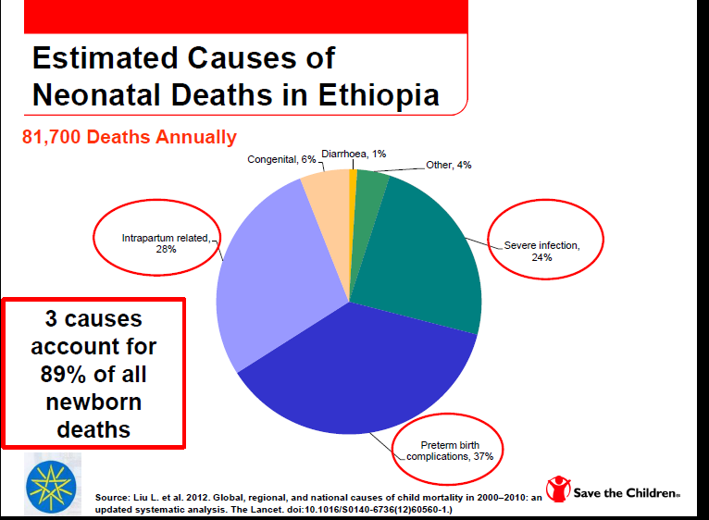
Epidemiology

Slide 87
Epidemiology
As displayed above it is the second commonest cause of neonatal mortality only preceded by prematurity, but commonest cause of disability in surviving newborns.

Slide 88
Causes of PNA
These are generally classified as:
Antepartal events
Maternal hypotension
Cardiopulmonary diseases
Placental abruption
Maternal hypertension
Preeclampsia/eclampsia
Maternal diabetes
Bleeding, shock
II. Intrapartum
Problems with umbilical circulation (Eg. Cord prolapse)
Meconium aspiration
Prolonged labor (maternal/ fetal causes)
III. Postpartal Asphyxia
Cardiovascular abnormalities
Pulmonary malformations
Neurologic abnormalities
Prematurity
Severe infections

Slide 89
Pathophysiology
Factors which result in low oxygen delivery to the newborn the initial response is increased respiratory rate followed by apnea.
If asphyxia is prolonged the following two scenario’s would happen:
1) Brief asphyxia:
Transient ꜛed followed by a decreased in HR, elevation of BP and essentially there will be redistribution of cardiac output.
It is followed by increased blood flow to brain, heart and adrenal glands which is referred to as DIVING REFLEX.

Slide 90
2.Prolonged asphyxia:
Hypotension and increased anaerobic metabolism in the brain.
Followed by anaerobic metabolism letter complicates energy failure, increased glucose metabolism and ATP depletion.
The final outcome is diffuse cortical and subcortical injury.

Slide 91
Biochemical alteration
Energy failure impairs ion pump function causing accumulation of
Intracellular Na, Cl, H2O, and Ca and
Extracellular K and neurotransmitters.
Impaired oxidative phosphorylation occur either primarily during the insult or 6- 24 hours after the initiating event.

Slide 92
Organ manifestations of PNA
CNS
Is affected in 28% and is the commonest cause of long term morbidity
It is encephalopathy caused by hypoxic- ischemic mechanism as underlying cause for the encephalopathy.
According to Saranat stages of HIE, Clinical spectrums includes mild, moderate or severe.

Slide 93
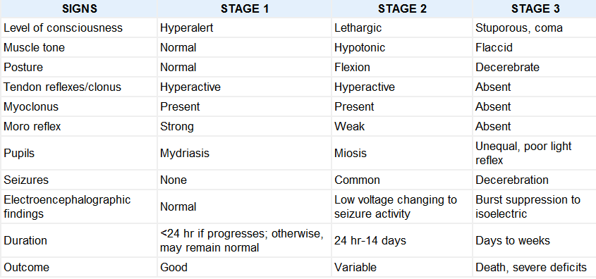
Hypoxic - ischemic encephalopathy in term infants

Slide 94
Cont…
Seizures :
it occurs in upto 50% of newborns with HIE, usually occurs within 24 hours after the insult. The causes of seizure includes hypoglycemia, hypocalcemia and increased ICP.
Kidney and Adrenal gland (50%):
Is the commonest organ affected by PNA
Oliguria less than 0.5ml/kg/hr shows advanced PNA
CVS effects (25%):
The acidosis causes myocardial depression with myocardial ischemia, poor contractility, tricuspid insufficiency, hypotension and even shock.
ALL ORGANS ARE affected !!

Slide 95
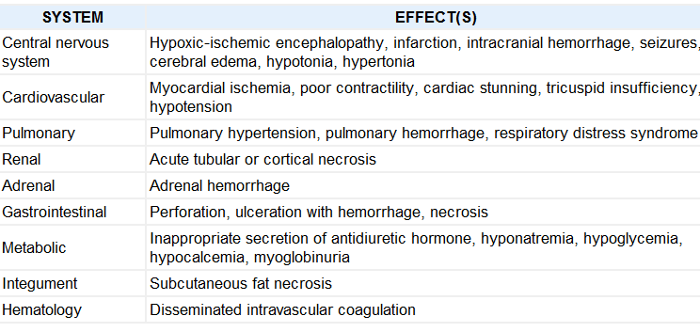
MULTIORGAN SYSTEMIC EFFECTS OF ASPHYXIA

Slide 96
Diagnosis
Perinatal assessment includes
awareness of preexisting maternal or fetal problems which may predispose to perinatal asphyxia.
Umbilical cord blood (PH< /= 7.20)
Clinical presentation
Laboratory evaluation (renal function, serum electrolytes, brain imaging, EEG).

Slide 97
Treatment
Perinatal management of high risk pregnancies
Delivery room management (effective neonatal resuscitation)
Postnatal management of neurologic effects of asphyxia
Keep NPO (because of risk of necrotizing enterocolitis, it can be for 48 hours).
Fluid management- two third of the maintainance fluid
Oxygenation - it should be maintained in the normal range
Cooling the neonate
It is neuroprotective
Total body/ head cooling within six hours
The target temperature 33-34 degree celius
Duration of treatment is for 72 hours with slow rewarming
NB don’t keep the neonate under radiant heater!
Correction of metabolic states
Identify the cause and treat seizure

Slide 98
Cardiac dysfunction:
Volume support is often ineffective in restoring normotension:
The inotrope dopamine (5 to 15 μg/kg per minute or 5 -15ml/kg/hr ) has been shown to be more effective in restoring blood pressure in asphyxiated infants
Renal dysfunction :
Fluid balance is very crucial
Stabilization of circulating volume
Consult for dialysis for overt renal failure

Slide 99
Prognosis of HIE
Stage I (mild HIE): 98- 100% of newborns will have a normal neurological outcome and < 1% mortality
Stage II (moderate HIE): 20-37% of them die or have abnormal neurodevelopmental outcome
Stage III (Severe HIE)
Death is more likely
Survivors would have one or more major neurodevelopmental

Slide 100
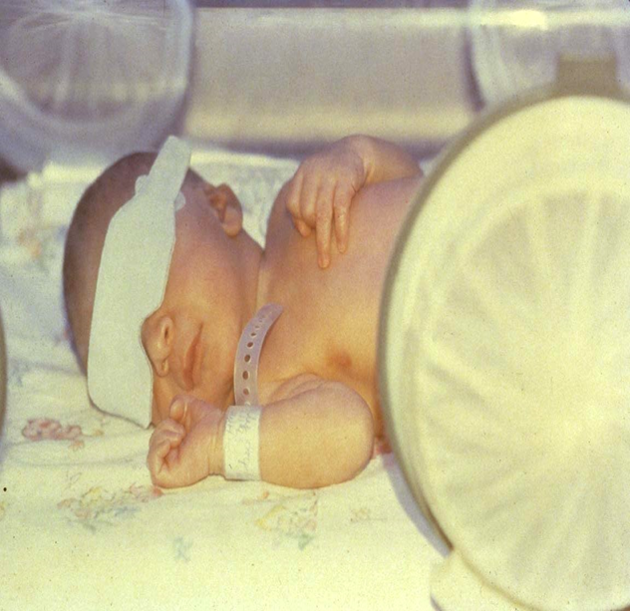
Jaundice and Hyperbilirubinemia in Neonates
Muhabaw Shumye(BSC,MSC)

Slide 101
Definitions
Jaundice is yellow discoloration of the sclera, skin, and mucous membranes due to bilirubin deposition.
Appears when total bilirubin (TB) is more than 7 mg /dl
Hyperbilirubinemia is an increase in the serum bilirubin manifested clinically by jaundice.
Bilirubin- is a degradation product of heme
Unconjugated (Indirect acting)
Conjugated (Direct acting)
Acute Bilirubin Encephalopathy: clinical nervous system manifestations caused by bilirubin toxicity
Kernicterus: chronic, permanent clinical sequelae of bilirubin toxicity

Slide 102
Introduction
Hyperbilirubinemia is a common problem in neonates, mostly benign.
Jaundice is seen in the first week of life in 60% of term and 80 % of preterm babies
Bilirubin has physiologic role in the body as anti oxidant but indirect or unconjugated bilirubin has neurotoxic effect when elevated.
Notes:
Hyperbilirubinemia is a common problem in neonates, mostly benign.
Jaundice is seen in the first week of life in 60% of term and 80 % of preterm babies
Bilirubin has physiologic role in the body as anti oxidant but indirect or unconjugated bilirubin has neurotoxic effect when elevated.
Even though its not neurotoxic, the direct is a sign of serious systemic or hepatic disorder.

Slide 103
Bilirubin metabolism
The heme ring from heme-containing proteins is oxidized in reticuloendothelial cells to biliverdin by the microsomal enzyme heme oxygenase.
This reaction releases CO) (excreted from the lung) and iron (reutilized).
Biliverdin is then reduced to bilirubin by the enzyme biliverdin reductase:
Catabolism of 1 mol of hemoglobin produces 1 mol each of CO and bilirubin.
Notes:
The heme ring from heme-containing proteins is oxidized in reticuloendothelial cells to biliverdin by the microsomal enzyme heme oxygenase. This reaction releases carbon monoxide (CO) (excreted from the lung) and iron (reutilized). Biliverdin is then reduced to bilirubin by the enzyme biliverdin reductase. Catabolism of 1 mol of hemoglobin produces 1 mol each of CO and bilirubin. Increased bilirubin production, as measured by CO excretion rates, accounts for the higher bilirubin levels seen in Asian, Native American, and Greek infants.
1. Transport. Bilirubin is nonpolar, insoluble in water, and is transported to liver cells bound to serum albumin. Bilirubin bound to albumin does not usually enter the central nervous system (CNS) and is thought to be nontoxic. Displacement of bilirubin from albumin by drugs, such as the sulfonamides, or by free fatty acids (FFAs) at high molar ratios of FFA: albumin, may increase bilirubin toxicity (see Table 18.1).
2. Uptake. Nonpolar, fat-soluble bilirubin (dissociated from albumin) crosses the hepatocyte plasma membrane and is bound mainly to cytoplasmic ligandin (Y protein) for transport to the smooth endoplasmic reticulum. Phenobarbital increases the concentration of ligandin.
3. Conjugation. Unconjugated (indirect) bilirubin (UCB) is converted to water-soluble conjugated (direct) bilirubin (CB) in the smooth endoplasmic reticulum by uridine diphosphate glucuronyl-transferase (UDPG-T). This enzyme is inducible by phenobarbital and catalyzes the formation of bilirubin monoglucuronide. The monoglucuronide may be further conjugated to bilirubin diglucuronide. Both mono- and diglucuronide forms of CB are able to be excreted into the bile canaliculi against a concentration gradient.

Slide 104
Bilirubin metabolism…
Transport.
Bilirubin is transported to liver cells bound to serum albumin.
Bilirubin bound to albumin does not usually enter the CNS and is thought to be nontoxic.
Displacement of bilirubin from albumin may increase bilirubin toxicity
2. Uptake:
Nonpolar, fat-soluble bilirubin (dissociated from albumin) crosses the hepatocyte plasma membrane and is bound mainly to cytoplasmic ligandin (Y protein) for transport to the smooth endoplasmic reticulum.
Phenobarbital increases the concentration of ligandin.
Notes:
Transport.
Bilirubin is nonpolar, insoluble in water, and is transported to liver cells bound to serum albumin.
Bilirubin bound to albumin does not usually enter the CNS and is thought to be nontoxic.
Displacement of bilirubin from albumin by drugs, such as the sulfonamides, or by free fatty acids (FFAs) at high molar ratios of FFA: albumin, may increase bilirubin toxicity
2. Uptake. Nonpolar, fat-soluble bilirubin (dissociated from albumin) crosses the hepatocyte plasma membrane and is bound mainly to cytoplasmic ligandin (Y protein) for transport to the smooth endoplasmic reticulum. Phenobarbital increases the concentration of ligandin.
3. Conjugation. Unconjugated (indirect) bilirubin (UCB) is converted to water-soluble conjugated (direct) bilirubin (CB) in the smooth endoplasmic reticulum by uridine diphosphate glucuronyl-transferase (UDPG-T). This enzyme is inducible by phenobarbital and catalyzes the formation of bilirubin monoglucuronide. The monoglucuronide may be further conjugated to bilirubin diglucuronide. Both mono- and diglucuronide forms of CB are able to be excreted into the bile canaliculi against a concentration gradient.

Slide 105
Bilirubin metabolism…
3. Conjugation.
Unconjugated bilirubin (UCB)➔Conjugated Bilirubin (CB) in the smooth endoplasmic reticulum by uridine diphosphate glucuronyl-transferase (UDPG-T).
This enzyme is inducible by phenobarbital and catalyzes the formation of: Bilirubin monoglucuronide.
The monoglucuronide may be further conjugated to bilirubin diglucuronide.
Both mono- and diglucuronide forms of CB are able to be excreted into the bile canaliculi against a concentration gradient.

Slide 106
Bilirubin Synthesis
The daily production of bilirubin is:
6-8 mg/kg 24 h in healthy term infants
3-4 mg/kg 24h in healthy adults
Bilirubin is derived from
The protoporphyrin in Hb (70-80%) (from senescent erythrocytes,immature erytrocyte precursor)
Degradation of 1gm HG= 34mg bilirubin
Other Fe containing heme proteins (20-25%) (cytochorome, catalase, peroxidase)

Slide 107
Bilirubin Transport in Plasma
Unconjugated (indirect bil) in plasma is tightly bound to albumin (1 gr albumin can bind 8.3 mg bilirubin)
Erythrocytes and plasma lipoproteins are the other carrier for bilirubin

Slide 108
BLOOD
CELLS
Stercobilin
excreted in feces
Urobilin
excreted in urine
Hemoglobin
Globin
Urobilinogen
formed by bacteria
Heme
KIDNEY
O₂
reabsorbed
into blood
Heme oxygenase
INTESTINE
CO
Biliverdin IXα
Bglucoronidase
via bile duct to intestines
NADPH
Biliverdin
reductase
Bilirubin diglucuronide
(water-soluble)
NADP⁺
2 UDP-glucuronic acid
Indirect (unconj.)
Bilirubin
(water-insoluble)
Bilirubin
(water-insoluble)
LIVER
via blood to the liver
Catabolism of hemoglobin

Slide 109
Physiologic Jaundice (Icterus Neonatorum)
Jaundice that appears by the 2nd or 3rd day of life
Total bilirubin <12mg/dl in term and < 10-14mg/dl in preterm
Rate of rise of bilirubin is <5mg/dl/24hrs
Direct bilirubin <2mg/dl

Slide 110
Cause of physiologic jaundice
Increased bilirubin production
Increased fetal RBC value
Shorter life span of RBC(70-90days)
Increased enterohepatic circulation
Increased beta glucoronidase activity
Decreased hepatic uptake, conjugation and excretion
Y protein (ligandin) is diminished
UDP-Glucuronyl transferase enzyme activity is decreased

Slide 111
Pathologic hyperbilirubinemia
Considered pathologic if the
Time of appearance is with in first 24-36 hrs of life
The rate of rise of bilirubin is > 5mg/dl/24hr
Serum bilirubin is greater than 12mg/dl in term and greater than 10-14mg/dl in preterm babies
If jaundice persists after 10-14days of life
If direct bilirubin is >2mg/dl

Slide 112
Etiology
Increases the load of bilirubin to be metabolized by the liver
Hemolytic anemias, polycythemia, bruising or internal hemorrhage, shortened red blood cell life as a result of immaturity or transfusion of cells, increased enterohepatic circulation, infection
Damages or reduces the activity of the transferase enzyme or other related enzymes (genetic deficiency, hypoxia, infection, thyroid deficiency)
Competes for or blocks the transferase enzyme ,drugs and other substances requiring glucuronic acid conjugation
Absence or decreased amounts of the enzyme or to reduction of bilirubin uptake by liver cells (genetic defect, and prematurity).

Slide 113
Causes of pathologic indirect hyperbilirubinemia
I. Increased bilirubine production
Hemolytic anemia
Hematoma
Polycythemia
Gut obstructions, pylor stenosis, ileus
Infections

Slide 114
Causes cont……
II. Hereditary disorders of bilirubin metabolism
Crigler-Najjar syndrome
Gilbert’s syndrome
III. Acquired unconjugated hyperbilirubinemia
Breast feeding
Hypothyroidism
Lucey-Driscoll syndrome

Slide 115
Comparison b/n physiological from Pathological Jaundice
No | Features | Physiologic Jaundice | Pathological Jaundice
1 | Clinical onset of jaundice (after birth) | >24 hrs | <24 hrs
2 | Jaundice still clinically visible (day after birth) | Term < 8 days Preterm < 14 days | Term ≥8 days Preterm > 14 days
3 | Peak TSB | Term < 12 mg/dl Preterm < 15 mg/dl | Term > 12 mg/dl Preterm > 15 mg/dl
4 | Rise in TSB | < 5mg/dl/24 hrs | > 5mg/dl/24 hrs
5 | Conjugated serum bilirubin level | <2mg/dl | >2mg/dl or 15 % of TB

Slide 116
Hemolytic Anemia in the Newborn
Fetal-maternal blood group incompatibilities
Rh isoimmune hemolysis – 90% D antigen
ABO isoimmune hemolysis
Minor blood group incompatibilities -kell, duffy
Red blood cell abnormalities
Membrane defects (Hereditary spherocytosis, elliptocytosis, pyropoikilocytosis)
Enzyme defects (G6PD, pyruvate kinase)
Hemoglobinopathies (α-thalasemia)

Slide 117
Rh- isoimmune hemolysis
90% are due to D antigen the rest C or E
The most common cause of severe early jaundice
Maternal immunization develops when RBCs leak from fetal to maternal circulation
Fetal erythrocytes carrying different antigens are recognised as foreign by the maternal immune system
Antibodies are formed against fetal RBC and cross the placenta to the fetal circulation and bind to fetal erythrocytes

Slide 118
Not common in the first born
Severity of illness varies from mild degree of hemolysis to severe hemolysis
Hyperbilirubinemia appears with in 24 hrs of life
May develop severe form of hemolytic disease hydrops fetalis with sever anemia
Kernicterus if not treated timely
Prevention is giving anti D for the mother

Slide 119
ABO incompatibility
Most common cause of hemolytic disease of the newborn
Approximately 15% of live births are at risk, but manifestations of disease develop in only 0.3-2.2
milder disease than Rh incompatibility
Usually, the mother is type O and the infant is type A or B.
Although ABO incompatibility occurs in 20-25% of pregnancies, hemolytic disease develops in only 10%

Slide 120
Doesn’t require previous exposure it is natural antibody
Milder disease than RH isoimmunization
Mostly milder jaundice is the manifestation, pallor is uncommon
Hydrops fetalis is rare
Kernicterus is also rare

Slide 121
Breast milk jaundice
Occurs in 2% of breast feed infants
After 7th day of life
A level of 10-30 may be reached on 2-3rd wk of life
Etiology not clear but attributed to the presence of glucuronidase in some breast milk
Decreases with discontinuation of breast milk for 24hrs

Slide 122
Breast feeding jaundice
Occurs in the 1st week of life
Occurs in infants with decreased breast milk intake with dehydration and reduced calorie intake

Slide 123
Crigler Najjar Syndrome Type I
Autosomal recessive disorder
Complete absence of UDP GT enzyme
Onset of jaundice with in th1st 3 days of life
The major complication is kernicterus during the newborn period
Therapy:
Phenobarbital has no effect
Require repeated exchange transfusion
Phototherapy is required life long
Cure is liver transplantation

Slide 124
Crigler Najjar Syndrome Type II
Autosomal recessive
Unconjugated hyperbilirubinemia
Serum bil. concentrations often exceed 20 mg/dl in the newborn , but they ranged from 6-20 mg/dl in older children and in adults
Reduced activity of UDP-GT
Liver shows small, residual enzymatic activity
Therapy: Phenobarbital is effective in reducing serum bil at a dose of 5mg/kg/24hrs

Slide 125
Gilbert’s Syndrome
Autosomal dominant
Mild, chronic unconj. hyperbilirubinemia
Hepatic GT activity is diminished (25-30%)
The serum bil. varies between 1-6 mg/dl
Stress, illness, fasting exacerbate the jaundice
Fasting causes 3-4 fold increase in the serum bil. level from baseline
Bil. levels decreased in response to phenobarbital

Slide 126
Risk factors for unconjugated hyperbilirbinemia
Jaundice visible on the first day of life
A sibling with neonatal jaundice/anemia
Unrecognized hemolysis(RH/ABO etc )
Nonoptimal feeding(breast/formula)
Defficiency of UDP-glucuronyle transferase def.(Crigler-Najar, Gillbert disease.
Infection(viral,bacterial), Infant of diabetic mother, Immaturity
Cephalhematoma/bruising, central Hct>65%
East Asian, Mediterranian,Native American

Slide 127
C/M
Jaundice may be present at birth or may appear at any time during the neonatal period, depending on etiology.
Jaundice usually becomes apparent in a cephalocaudal progression
Dermal pressure reveals the anatomic progression of jaundice (face, ≈5 mg/dL; mid-abdomen, ≈15 mg/dL; soles, ≈20 mg/dL)
Symptoms of the underlying cause will be there
May present with CNS complication of hyperbilirubinemia -Kernicterus

Slide 129
Kernicterus/bilirubin encephalopathy
Due to deposition of unconjugated bilirubin in the basal ganglia and brain stem nucleoli
Is due to passage of the blood brain barrier by UB
Factors that increase risk of kernicterus
Hypoalbuminemia
Acidosis
Sepsis
Prematurity
Hypoxia
hypothermia

Slide 130
Bilirubin encephalopathy
Transient = early bilirubin induced neurologic dysfunction is transient & reversible
Increasing lethargy is seen with rising UCB
Reversible with exchange transfusion
If not treated on time can lead to kernicterus
2. Bilirubin encephalopathy/ kernicterus
(clinical worsening encephalopathy) over 24hrs
- Phase I. poor sucking, lethargy, depressed sensorum
- Phase II. Fever, Hypertonia, seizure
- Phase III. High – pitched cry
Hearing & visual abnormalities
Poor feeding, athetotic

Slide 131
Cont..
The exact level of UCB kernicterus develops is not clear but common if exceeding 25 -30mg/dl
Most of the infants with overt neurologic symptoms will die(70%)
Among the survivors 85% of the will have severe neurologic squeal

Slide 132
Causes of Conjugated Hyperbilirubinemia
Extrahepatic biliary cholestasis
Biliary atresia
Choledochalcyst
Perforation of bile duct
Cholelithiasis
Intrahepatic biliary cholestasis
Paucity of bile duct
Inspissated bile syndrome
III. Hepatocellular cholestasis
Metabolic disorders
Infection – TORCH, sepsis, viral hepatitis
Toxic hepatits – drugs

Slide 133
Investigations
Total serum bilirubin and direct bilirubin
Complete blood count
Blood group of mother and baby
Direct coombs test of baby
Peripheral morphology
Reticulocyte count
Work up for TORCH – direct hyperbil.
Septic workup
Ultrasound

Slide 134
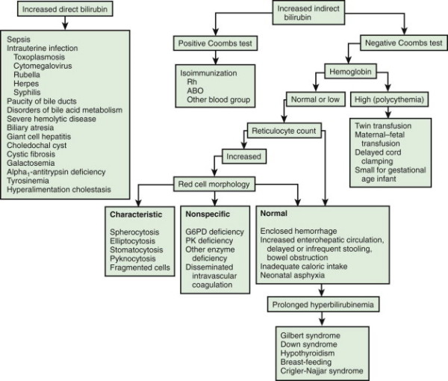

Slide 135
Management of UCH
Regardless of the cause the first goal of therapy is to prevent the UCB from reaching neurotoxic level
To prevent severe anemia & hypoxia
Modes of treatment phototherapy, exchange transfusion and pharmacotherapy

Slide 136
a) Phototherapy
Is used when in phototherapy range of UCB
17-22mg/dl(280-365mmol)for term infants who become jaundiced after 48hrs
8-10mg/dl(140-165mmol)for preterm infants >1500gm
5-8mg/dl(80-140mmol)for preterm infants <1500gm
Is not a replacement for exchange transfusion
Bilirubin absorbs light in blue range(420-470nm) wave length
Also green and white light can be effective
Its effect is seen with in the first 6-12hrs of use

Slide 137
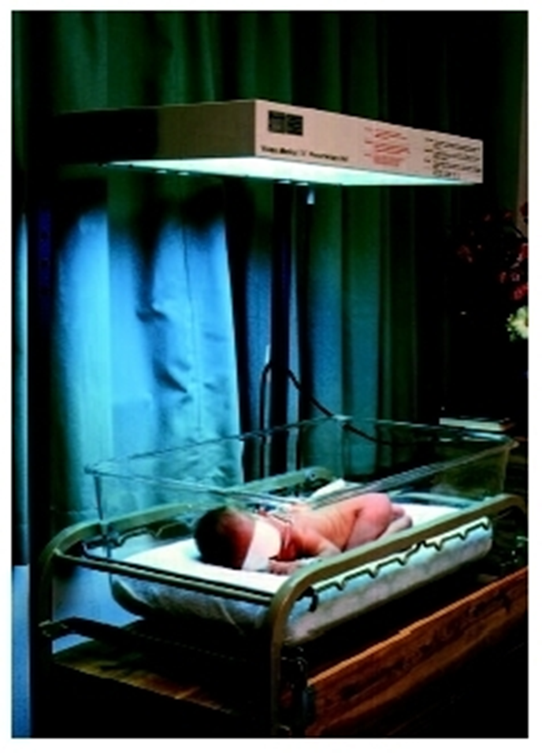

Slide 138
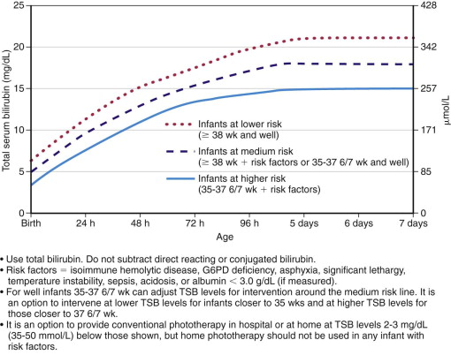

Slide 139
Phototherapy cont….
MOA
=>photoisomerization converting the toxic native unconjugated 4Z,15Z-bilirubin into an unconjugated configurational isomer, 4Z,15E-bilirubin, which can then be excreted in bile without conjugation, is reversible
=>structural isomerization converts bilirubin to lamirubin which can be excred without conjugation, not reversible
=>photooxidation converts bilirubin in to small polar products which can be excreted via urine

Slide 140
Phototherapy decreases the need for exchange transfusion
Its effect depends on:
1. Light energy emitted in the effective range of wavelength
2. The distance b/n the light and the neonate
3. the amount of skin exposed
4. rate of hemolysis
5. metabolism & excretion of bilirubin

Slide 141
Phototherapy D/C when
1. Bilirubin level is lower enough to eliminate the risk of kernicterus
The serum bilirubin level at which phototherapy is discontinued varies.
Declining serum bilirubin levels below 13mg/dl (215mmol) are generally accepted as necessary for stopping phototherapy.
2. the risk factor for the newborn is resolved
3. the neonate is older enough to handle the bilirubin load
- Contraindications
Direct hyperbil.
Notes:
Porphyria
Direct hyperbil.

Slide 142
Side effects of phototherapy
Insensible water loss
Watery and frequent stool
Retinal damage
Erythema and increased blood flow
Bronze baby syndrome (with increased CB)
Low calcium level (in preterm)
Interferes with maternal infant bonding

Slide 143
b)Exchange Transfusion
Indication
If phototherapy fails to lower UCB
If risk of kernicterus exceeds risk of procedure
If newborn has sign of kernicterus
When UCB is reached to level of exchange transfusion
When rising Bilirubin is faster
(0.5mg/dl/hrs) cord blood bilirubin >5mg/dl & Hb ≤ 10gm/dl with the condition:
- previous kernicterus or severe
erythroblastosis in sibling
- reticulocyte count > 15%

Slide 144
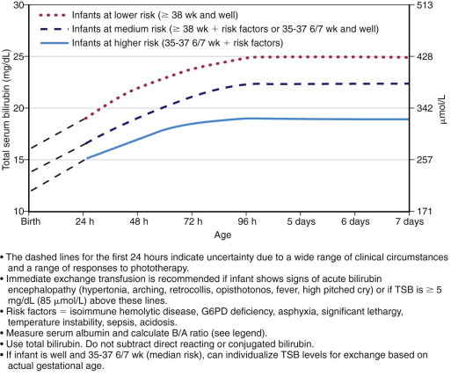

Slide 145
Double Volume Exchange transfusion
The amount of blood volume to be exchanged is equivalent to 2x the blood volume of the baby (85ml/kg )
Use fresh blood less than 24 hours
Do procedure after umbilical catheterization using aseptic technique
Heparinize the catheter
The amount of blood to be removed at a time is 5ml to 20 ml
O negative blood is the most preferred type of blood for exchange transfus

Slide 146
Type of blood to be transfused
Rh hemolytic disease
give blood group compatible to the baby and RH of the mother.
ABO hemolytic disease
give blood group of the mother and Rh compatible to the newborn
O negative blood is the most preferred type of blood for exchange transfusion.

Slide 147
Monitoring
Strictly monitor the vital signs during the procedure.
Determine post transfusion HCT 4-6 hours after the procedure.
Determine bilirubin 4 hourly after the procedure.
Monitor RBS every 30-60 minutes during the procedure and 2-4 hourly for the first 24 hours after procedure.
Calcium gluconate slowly via a peripheral vein under strict cardiac monitoring after every 100ml of blood is exchanged.
Cloxacillin 50mg/Kg bid for 2- 3 days and gentamicin 5mg/kg BID for 2-3 days.
Keep baby NPO for 4 hours before and after procedure.
Notes:
Strictly monitor the vital signs during the procedure.
Determine post transfusion HCT 4-6 hours after the procedure.
Determine bilirubin 4 hourly after the procedure.
Monitor RBS every 30-60 minutes during the procedure and 2-4 hourly for the first 24 hours after procedure.
Calcium gluconate slowly via a peripheral vein under strict cardiac monitoring after every 100ml of blood is exchanged.
Cloxacillin 50mg/Kg bid for 2- 3 days and gentamicin 5mg/kg BID for 2-3 days.
Keep baby NPO for 4 hours before and after procedure.

Slide 148
Cont…
Double volume exchange transfusion
- Replaces 85% of circulating newborn RBC
- Reduces bilirubin level by half of the previous pre exchange value
- Besides removing bilirubin corrects anemia
Baby needs to continue phototherapy after exchange transfusion

Slide 149
Complications
Thrombocytopenia
Portal vein thrombosis/perforation
Necrotizing Enterocolitis
Cardiac arrythmias, volume overload
Hypocalcemia, Hypomagnesemia, Hypoglycemia, and Hyperkalemia
Acidosis
Respiratory & metabolic accidosis
HIV, Hepatitis B & C infection
Graft vs host disease
Death

Slide 150
C. Pharmacologic therapy
To reduce unconjugated hyperbilirubinemia which is less practical in our setup
Phenobarbital therapy
Metaloporphyrins

Slide 151
Hemorrhagic Disorders
Pathophysiology
Neonatal hemorrhagic disorders are bleeding disorders that are manifested within 5 days of life and related to vitamin k deficiency.
In neonatal hemorrhagic disorders vit k stores are absent in new born, thereby impeding the action of vit k dependent coagulating factors II,VII,X.
C/M
Usually present during 2nd or 3rd day of life
Oozing from umbilicus or circumcision site
Bloody tarry stools
Hematuria, ecchymosed/petechiae, epistaxis, are also indicate hemorrhagic disorders

Slide 152
Cont…
Dx
-confirmed by lab findings of abnormal clotting times when normal platelet and fibrinogen levels are found
Mx or Nursing care
Mx of hemorrhagic disorder in new born is aimed at prevention
vit k administration with in the first 24 hrs
When hemorrhagic disease occurred, avoid taking temperatures rectally, giving injections or drawing blood. Handle gently, monitor vital sign, monitor signs for bleeding.

Slide 153
Congenital cardiac defects.
Def’n:- CHD is a structural malformation of the heart or great vessels, present at birth
Incidence- 0.008-0.01%
The CHD is generally classified in to two:
Acyanotic heart disease
Cyanotic heart disease
1. Acyanotic heart disease
It is a heart or a circulatory anomaly that involves either a stricture to the flow of b/d or a shunt that moves blood from (oxygenated to deoxygenated or from left to right shunts.)
No mixing of unoxygenated blood in the systemic circulation. (no cyanosis in this defect observed )
These disorders cause the heart to function as an ineffective pump.

Slide 154
Cont…
Examples are:-
ventricular septal defects (VSD)
Atrial –septal defects left to right shunts
Patent ductus arteriosus
Coarctation of the aorta obstruction of
Pulmonary stenosis blood flow
Aortic stenosis
N:B ventricular septal defect ( VSD ) is the commonest of all CHD tetralogy of fallout is the most common cyanotic CHD.

Slide 155
Cont…
2. Cyanotic Heart Disease
Cyanotic heart disease occurs when blood is shunted from the Venus to the arterial system.
(Deoxygenated to oxygenated, right to left shunt.) there is mixing of unoxygenated blood in the systemic circulation.( cyanosis is in this defect)
1. Rt to Lt shunts.
2. Tetralogy of fallot
The most common type of cyanotic heart disease has "4" defects.
a. Ventricular septal defect
b. Pulmonic artery stenosis
C. Rt. ventricular hypertrophy
d. over riding or dextro position of aorta

Slide 156
Cont…
Etiology CHD
Exact cause is unknown, but the possible causes are:-
Maternal infection during pregnancy e.g. rubella (German measles)
drug & radiation (teratogenic effect)
maternal nutritional deficiencies
Heredity e.g. chromosomal disorder (down syndrome).
Maternal alcoholism.
Transposition of great arteries:- The aorta has its origin in the Rt ventricle & pulmonary artery the Lt ventricle so the fun is vice versa.

Slide 157
Cont…
Pathophysiology of CHD
Anatomically the following principal defects may be found.
A) Abnormal communication in the heart or b/n big vessels
-atria septal defect
-ventricular septal defect
-patent ductus arteriosus
In these cases due to the highest pressure in the left heart there is a shunt from left to right heart with an increased blood load in lesser circulation.
In this group of diseases there is no cyanosis.

Slide 158
Cont…
B) Congenital obstruction of the b/d flow
-pulmonary stenosis
- Aortic stenosis (coarctation of aorta)
C) Combination of abnormal communication and stenosis, Pallot’s disease is an example.
C/F
Besides the above mentioned symptoms failure of normal growth
Repeated attacks of respiratory tract infection
A loud murmur is usually present
Feeding difficulty ( become dyspnic or sweating excessively during sucking
Exercise intolerance

Slide 159
Cont…
The sign / symptom of CHD includes:-
Abnormal murmur
Varying degree of cyanosis & dyspnea
fatigue with exertion
Growth failure late sign or slow wt gain
Clubbing of the finger
The infant is weak & irritable
The presence of cyanosis w/h does not respond to oxygen therapy
CHF
Unable to feed

Slide 160
Cont…
Dx of CHD.
- cardiac catheterization
Chest x- ray - determine - shape/size of the stenosis
ECG - Indicates Rt.& Lt. Ventricular hypertrophy
-Auscultation murmurs

Slide 161
Cont…
MX
Any child with CHD should be referred to hospital whenever possible. In all cases where you have to start treatment:
Check the wt of the child, record the pulse and respiration carefully at 2 hrs interval and indicate the exact time of any drugs given.
Respiratory tract infections are readily treated with penicillin in normal doses.
give chloroquine in case of fever after taking blood
Treat anemia if present
arrange a well- timed comprehensive vaccination program
Give prophylaxis against sub acute bacterial endocarditis.

Slide 162
Cont…
surgery -(correction of stenosis)
Surgical closure (ASD,VSD)
Management of or N/care of CHF if occurs
Immunization of Rubella
Small & frequent feeding
Prevention of infection e.g ARI.
Prepared the child for diagnostic & Rx procedures.

Slide 163
Ventricular septal defect
The ventricle is divided into two chambers by a septum, which grows upwards along the anterior and posterior margin in the 2nd month of intrauterine life
A bout 90% of cases of VSD is due to the failure of closure of the inter ventricular foramen and is associated with abnormality in the division of truncus arteriosus into aorta and pulmonary artery
Because of the higher pressure in the left ventricle, the blood is shunted from left to right ventricle
As the systolic blood is not contaminated by venous blood there is no cyanosis

Slide 164
Cont…
In severe cases the pulmonary blood flow is ↑ed 3 to 5 times the systemic flow, the work of both ventricles is ↑ed, specially of the left ventricles
Hyperkinetic pulmonary hypertension due to huge blood flow relative to the capacity of pulmonary vascular bed
Abnormal opening b/n the Rt & Lt ventricle

Slide 165
Cont…
C/M – Majority of cases with small shunts are asymptomatic
In moderate left to right shunt
Mild exercise intolerance
Repeated respiratory infection
In severe left to right shunt (large defect)
Congestive heart failure
Slow weight gain, feeding difficulties, pale, tachypnea, excessive sweating,
Pan systolic murmur with maximum intensity in the left 3rd and 4th interspaces
A thrill accompanies the murmur in 90% of cases
Audible 3rd heart sounds

Slide 166
Cont…
Dx- X-ray – Shows enlargement of left ventricle with prominent pulmonary artery
Enlargement of left atrium
ECG-Shows incomplete right bundle branch pattern in large defects
Left ventricular hypertrophy
Biventricular hypertrophy in severe cases
Dx –murmur on auscultation, chest x-ray, ECG, ultra sound
Complications-endocarditis, CHF

Slide 167
Cont…
Treatment
medical treatment of CHF
surgical closure of the defect
Small defects may close spontaneously
Repair of other defects under direct vision (suture for bigger defects)
Pulmonary banding as a palliative measure
Pre and postoperative nursing care

Slide 168
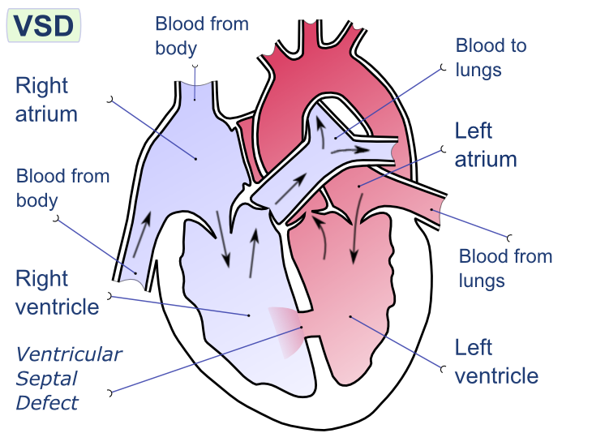
Fig – showing heart ventricular septal defect

Slide 169
Atrial septal defect
At the end of the 1st month of fetal life, the posterior superior portion of the common atrium a septum divide into left and right (Septum primum)
A defect in the lower portion of septum primum is ostium primum
An opening which also appears in the upper portion of ostium primum is ostium secondum
Ostium secondum is later embraced by a membrane arising from the right side called septum secondum, but still leaving a small aperture called Foramen ovale

Slide 170
Cont…
Atrial septal defect is a common form of congenital heart disease comprising nearly 10% of all such cases
Secondum types of defect comprises 90% of all such cases
Ostium primum constitute 10%
In ASD, the shunt is usually from left to right due to more pressure in the left atrium even though it is only 3-5mm of Hg.
In large ASD, the pressure in both atria may be equal and flow will depend up on the relative resistance offered by pulmonary and systemic circulation

Slide 171
Cont…
The resistance offered by the pulmonary circulation is less than that of the left ventricle and as such the shunt is from left to right.
Reverse of shunt occurs if there is:
Pulmonary hypertension due to ↑ed pulmonary arteriolar resistance
Obstruction to right ventricular flow as in pulmonary stenosis
Right atrium and right ventricle are hypertrophied and pulmonary artery gets dilated

Slide 172
Cont…
CM
Generally asmptomatic
There may be no symptom during child hood; however, the following are present
Dyspnea on exertion
Palpitation and weakness
In infants
Feeding difficulties
Growth retardation
Recurrent respiratory infection
Skeletal abnormalities, ejection systolic and mid diastolic murmur
Wide split 2nd heart sound, which is characteristically fixed in respiration
-slow wt gain, tiredness, dyspnea, frequent respiratory infection, CHF

Slide 173
Cont…
Dx –murmur, chest x-ray, ECG
Shows cardiomegally (enlarged right ventricle and right atrium)
Enlarged pulmonary artery
ECG- Show right axis deviation
Incomplete right bundle branch is seen in 90% of cases
Mg’t – Surgical treatment
Repair of the defect by direct vision and by cardio pulmonary bypass is necessary in most of the cases
Preoperative and postoperative nursing care
Complications
endocarditis, cardiac failure, pulmonary hypertension, coronary artery diseases

Slide 174
Coarctation of aorta
narrowing or constriction of aortic lumen. Aortic stenosis:-stenosis of aortic value
Altered physiology - (Blood can't pass freely from Lt. Ventricle to systemic circulation because of aorta obstructed and affected blood flow)
The following congenital anomalies may be associated with coarctation of aorta
Aortic stenosis
Patent ductus arteriosus
Bicuspid aortic valve defect
The patent ductus arteriosus is the most commonly associated anomaly chiefly of the pre-ductal type
Due to resistance to the flow of blood, the left ventricle hypertrophies in all cases

Slide 175
Cont…
The blood bypasses the constricted segment via collateral circulation, chiefly form:
Branches of subclavian artery
The superior intercostals
The internal mammary with its intercostals
Superior epigastric and musculo-phrenic branches
The thoracic and sub scapular branches of the axillary artery may also enlarge as collateral channels
These in turn unit with the intercostals branches of descending aorta and inferior epigastric branches of the femoral to form alternate channels

Slide 176
Cont…
C/m
usually asymptomatic childhood-growth and development are normal
may demonstrate –fatigue, headache, nose bleeding, leg cramps
absence or reduced femoral pulsation
Sever anomalies causes –growth failure, tachypnea, dyspnea, edema and CHF
There may be Left ventricular failure
Small femoral pulse
Visible or palpable pulsation of collateral vessels is best appreciated Posteriorly in relation to intercostals arteries

Slide 177
Cont…
Dx- X-ray finding may show
Left ventricular enlargement
Prominence of ascending aorta
Elongated aortic knuckle resulting from dilatation of Left sub-clavian artery
Post – Stenotic dilatation of short segment of descending aorta
Aortogram will reveal the site of coarctotion and collaterals

Slide 178
Cont…
Mg’t – In case of CHF- immediate and energetic Rx is indicated
Surgical Rx consists of resection of coarcted segment with end to end anastomosis with or without a graft as early as possible
Infants –care for CHF, and surgical correction if present at 6th year age of life with heart failure
Asymptomatic older infants-surgical resection (present b/n 3 to 6 years)
-Surgery –resection of coarcted segment –end to end anastomosis or graft
Complications of coarctation of aorta includes:
Congestive Heart Failure
Bacterial Endocarditis
Rupture of the Aorta
Cerebral haemorrhage

Slide 179
Patent ductus arteriosus
normally closes few days after birth if this remains open blood shunted from aorta to the pulmonary artery.
R.A →R.V → Pulmonary Artery→Ductus Arteriosus → Descending Aorta → systemic circulation
Immediately after birth, due to expansion of lungs and establishment of pulmonary circulation very little blood goes through the Ductus
Anatomically the Ductus closes by the 3rd month
The patent Ductus is usually 1cm long and 1mm to 7.5 mm in width

Slide 180
Cont…
A higher pressure in the aorta shunts blood from that vessel into the pulmonary artery which continues throughout the cardiac cycle
The pulmonary artery dilates and pulsation may be exaggerated
Degree of shunt is directly proportional to the calibre of duct and inversely proportional to the length
Increased pulmonary resistance because of persistence of foetal state and arteriolar hypertrophy causes reversed shunt – pulmonary artery to Aorta

Slide 181
Cont…
C/M
-Small ductus arteriousus –usually asymptomatic
-Large patent ductus arteriousus develop symptoms –slow wt gain, feeding difficulties, frequent respiratory infections and CHF
Repeated chest infections common complaints
Dyspnea on exertion
Tiredness
Collapsing pulse due to Left to Right shunt
Continuous or machinery murmur, which is best heard in 1st and 2nd interspaces
- In infants may be heard only during systole

Slide 182
Cont…
Dx-Chest X-ray findings shows
Dilatation of pulmonary artery
Pulmonary plethora
Left a trial and Left ventricular enlargement
Enlarged and pulsatile aorta
murmur, ECG
Electrocardiogram (ECG)
Normal in mild cases
Left ventricular hypertrophy
Deep Q wave and inverted T-wave (Indicates diastolic over load)
Cardiac catheterization
Reveals a rise of 0₂ saturation about 5% in pulmonary artery over that of right ventricle

Slide 183
Cont…
Mg’t – Surgical ligation and exclusion of the duct as early as possible, usually results in a complete cure
Restores the cardiac size to normal and abolishes the risk of complications
surgical division of patent ductus arteriosus
indomethacin treatment choice which may trigger natural closure of ductus
Complications
-CHF, infective endocarditis

Slide 184
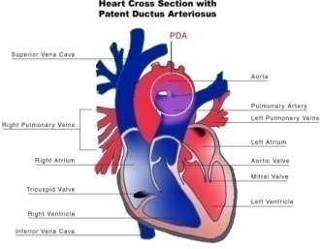
Fig – showing patent ductus arteriosus

Slide 185
Pulmonic stenosis
narrowing of the opening through which blood is ejected from right ventricles to pulmonary artery.
Restrict blood flow from the heart to the lung or thus causes ↑ ed pressure in Rt. ventricle forcing unoxygenated blood to the Lt. ventricles.
CM
-decreases exercise tolerance
-Severe obstruction may have –dyspnea, generalized cyanosis
-may complain pericardial pain, dysarrythemia and death

Slide 186
Cont…
Dx- murmur, chest x-ray, ECG
Complication
-bacterial endocarditis
- Sudden death at any age
Treatment
-Surgery –widening of narrow tissue

Slide 187
Gastrointestinal malformations
1. Exomphalos and gastroschisis
2. Oesophageal atresia
3. Rectal atresia and imperforated anus
4. cleft lip and palate

Slide 188
Exomphalous and gastroschisis
- It occurs when of abdominal content hernate through umbilical ring at the point where the umbilical cord connects the abdomen.
The sac is covered is with peritoneal membrane instead of skin
This sack may be large & contains much of the intestine plus the liver
Dx; based on inspection of abdomen.
Rx: cover the defect with sterile saline dressing helps prevent to air born bacterial infection .
Surgery - Replacement of viscera in to the abdominal & closure of abdominal wall

Slide 189
Oesophageal Atresia (EA) and Tracheo-esophageas Fistula (TEF)
Atresia- is absence of a normal body opening or the abnormal closure of a body passage
EA is the most frequent congenital anomaly of the esophagus, affecting about 1 in 4,000 neonates
Of these more than 90% have an associated TEF
Cause
-mostly unknown
- Failure of embryonic development
In the most common form of EA, the upper oesophagusend in a blind pouch and TEF is connected to the distal esophagus
There are five most commonly encountered forms of EA and TEF

Slide 190
Cont…
Atresia of upper esophageal end with fistula of lower end to trachea (87-90%)
Both esophageal ends are atresia with no fistula (8%)
H-Type TEF- Recurrent pneumonia
Upper end fistula with treachea and lower end blind loop (massive aspiration with 1st feeding) – (<1%)
Both ends form TEF (<1% )
C/M – Atresia of esophagus should be suspected if:-
There is maternal polyhydraminoas
A catheter or NGT can’t pass into stomach
Infant has excessive oro-pharyngeal secretions (Frothing and bubbling at the mouth and nose)
Chocking, coughing or cyanosis occurs during feeding

Slide 191
Cont…
DX- By clinical manifestation
Resistance to nasol (NGT) catheter 10-11cm passage
Recoiled NGT after X-ray
Contrast studies, Fluroscopy, bronchoscopy
Mg’t- Preoperatively
Maintaining a patent airway and preventing aspiration of secretion
Basic supportive care, keep NPO, open IV line, elevate head and chest 30⁰
Frequent oro-pharyngeal suctioning (Every 10-15 minutes)
Surgical correction (ligation) of the TEF and primary end to end anastomosis of the esophagus are performed when feasible

Slide 192
Cont…
Post operatively
Initially small quantities of normal saline feeds through gastrostomy or by indwelling polythene tube
If tolerated well, replaced by milk feeds in gradually increasing quantities
It is possible to start oral-feeds in 7-10 days time
Observe any s/s that indicates complication
Prognosis:-is guarded (prematurity and associated anomalies) but survival is possible.

Slide 193
Rectal atresia /imperforated anus
Imperforate anus:- is a congenital malformation in which the rectal pouch ends blindly at a distance above the anus and there is no anal orifice
There may be a fistula b/n the rectum and the vagina in females or b/n the rectum and the urinary tract in males
Incidence varies from 1 in 3,000 to 1 in 5,000 live births
Imperforate anus can be classified into four:-

Slide 194
Cont…
Type –I- Although there is patency, a stricture of anus is present
Type –II- The anus is separated from rectum by an intact thin bulging membrane
Type –III- The rectum ends blindly or by fistulous tract, at a varying distance above the perineum
Type –IV- The top of the anal canal is separated from the rectum by a gap of varying distance.
-25.6% to 80% of imperforate anus is associated with fistula
-39% to 59 % of imperforate anus is also associated with other congenital malformation
E.g.-Down syndrome

Slide 195
Cont…
C/M – No meconeum passage (> 24 hours)
Abdominal distension
Rectal thermometer resistance
Anal dimple only
No flatus
DX- Based C/M and PE
X-ray
Mg’t – Surgical correction colostomy
Toilet training to a void faecal impaction

Slide 196
Cleft palate and lip
Cleft palate and lips are congenital deformities due to the failure of various parts of the upper lip and palate to fuse in the normal manner –most common facial deformations
Both cleft palate and cleft lip may be present together
Cleft – lip- It may be unilateral or bilateral
May be extended up into the nostrils
Etiology – Not entirely clear (unknown) but it appears to be influenced by genetic and other environmental factors
This defect results from failure of the maxillary and premaxillary process to fuse during the 5th to 8th week of intrauterine life
Dx- Physical examination

Slide 197
Cleft palate
It is treated similarly with cleft lip by pairing the edges and suturing other cutting on either side
The child born with a cleft palate, but with an intact lip does not have the external disfigurement that may be so distressing to the new mother
But it is more serious
Although a cleft lip and palate frequently appear together, either defect may appear alone
In embryonic development the palate closes at a later time than does the lip, and the failure to close is for somewhat different reasons

Slide 198
Cont…
At about 8wks of the embryo, there is still no roof to the mouth
The tissues that form the palate are two shelves running from the front to the back of the mouth, and projecting vertically downward on either side of the tongue
The shelves move from a vertical position to a horizontal position, and their free-edges meeting and fusing in midline
Normally the palate is intact by the tenth week of fetal life

Slide 199
Cont…
Etiology – Exactly what happens to prevent the closure of the palate is not known with certainty
Relatives/heredity Plays a role
Environmental factor
A cleft palate may involve the soft palate alone, or it may extend into the nose and into the hard palate
It may be bilateral or unilateral, an isolated defect, or in conjunction with the cleft lip

Slide 200
Cont…
Mg’t – The goal is to give the child a union of the cleft parts that would allow intelligible and pleasant speech and to avoid injury to the maxillary growth
The child should be admitted several days before the operation, and observed for signs of cold- if present the operation should be delayed and throat swab should be taken
The child should be trained in spoon feeding, putting the food well to the back of the tongue
Surgery is the best mg’t for cleft lip, usually performed by plastic surgeon
Cleft lip is operated on about the age of three month

Slide 201
Cont…
Surgery- Timing of surgery for cleft palate is individualized according to the size, the placement and degree of deformity
Optimal time b/n 6 months and 5 years
Mg’t of cleft lip and palate needs members of the professional teams which include:
Paediatrician - Speech therapist
Plastic surgeon - Social worker
Orthodontist - Public and clinical nurse
Counselling – Explanation and counselling concerning the child’s diet
Counsel on speech training and immunization including general supervision
Answer questions and misconceptions
Counsel on dental caries of the deciduous teeth

Slide 202
Cont…
Summary of cleft lip and palate
Cleft lip – is a congenital anomaly involving one or more clefts in the upper lip ranging from a slight dimple to a large cleft involving nasal structures
Cleft palate – is a congenital anomaly consisting of a cleft ranging from soft palate involvement a lone to a defec including the hard palate and portion of the maxilla in severe cases
Etiology and Incidence
Causes include genetic, heredity, environmental and teratogenic factor
Cleft lip occurs in approximately 1 in every 1,000 births, most commonly in boys.
Cleft palate occurs in 1 in every 2,500 births; incidence in girls is double than in boys

Slide 203
Cont…
Pathophysiology
The defect occur during embryonic development
Cleft lip results from failure of fusion of lateral and medial tissues forming the upper lip
Cleft palate resulted from failure of fusion of tissues forming the palate
These defects may occur separately or in combination to produce complete unilateral or bilateral cleft form the lip through the soft palate
Depending on the defect’s severity and the child’s general health, surgical correction of cleft lip and palate are done
Early correction of cleft palate enables development of more normal speech pattern
Delayed closure or large defects may require the use of orthodontic devices

Slide 204
Cont…
Care
Little preoperative preparation for the infant who has surgery during the 1st few days of life
Elbow restraints has to be worn several days following surgery
The nurse should learn how to feed the infant with an Asepto syringe or teach the mother
For the first few hours, the infant must never be left alone b/c he/she can quickly and easily aspirate the mucus
The suture line is left uncovered after surgery and must kept clean and dry to prevent infection with subsequent scaring
Crying must be prevented by good nursing care and let the mother to spend much of her time

Slide 205
Cont…
Do not allow visitors with cold to come and see the child
The stitches may be removed on the 3rd to 5th days
Soft food is given by spoon well back on the tongue and followed by sterile water
Techniques of feeding
Parents should be told that this baby can be fed and treated as any other person
The baby is able to suck after the lip repair and should progress normally until ready for palate surgery
Have sterile Aseptic syringe with tip protected by a piece of sterile rubber tubing

Slide 206
Cont…
Place the syringe and warmed formula on the bedside stand within easy reach
Hold the infant in your arms in upright position
Pour the formula into the syringe and place the rubber-covered tips in the child’s mouth away from the suture line
The formula usually drips quickly enough without squeezing the bulb
Regulate the drops to the infant’s breathing and swallowing
Allowed 30 minutes for feeding
The infant should be watched carefully after feeding

Slide 207
Abnormalities relating to respirations.
Diaphragmatic hernia
Laryngeal stridor
Diaphragmatic hernia
Def’n-is abnormality consists of a defect in the diaphragm that allows herniation of abdominal contents in to the thoracic cavity.
May occur as a result of a congenital or traumatic defect in the diaphragm
Acquired/traumatic herniation is not common in children, but the congenital one is common

Slide 208
Cont…
Cause – The cause of CDH is largely unknown
Exposure to drugs
Disrupted developing thoracic mesenchyme
CDH can occur as part of a multiple malformation syndrome in up to 40% of infants (cardiovascular, genitourinary, and gastrointestinal malformations)
Karyotype abnormalities have been reported in 4% of infants with CDH, and may be found in a variety of chromosomal anomalies including trisomy 13, trisomy 18, and tetrasomy 12p mosaicism

Slide 209
Cont…
C/M – Majority of infants with CDH experiences severe respiratory distress within the 1st hours of life – within 24 hours
Dyspnea
Cyanosis
Vomiting
Intestinal sounds (peristaltic sounds especially on the left side) of the chest on auscultation with evidence of Mediastinal shift
Incarceration of the intestine will proceed to ischemia with sepsis and cardio respiratory collapse
N.B – Unrecognized CDH has been the cause of sudden death in infants and toddlers

Slide 210
Cont…
Dx -Ultra Sonography is a common diagnostic procedure during prenatal period (as early as the second trimester)
x-ray will confirm diagnosis
Mg’t Infants has to be nursed in the sitting position/posture/
Provide small frequent feeds
Intubation and gavage feeding may be given
Emergency surgery may have to be done if condition allows
Recognition of the role pulmonary hypertension in addition to pulmonary hypoplesia and the adverse effects of operative repairs on pulmonary function prompted critical re-evaluation of that strategy.

Slide 211
Cont…
The availability of extracorporeal membrane oxygenation (ECMO) and utility of preoperative stabilization have been the major stimuli to aggressive therapy.
mechanical ventilation
continuous suctioning should be commenced
surgery
Nitric oxide
-use of drugs for
ECMO- Is a form of cardiopulmonary bypass that augments systemic perfusion and provides gas exchange

Slide 212
Laryngeal stridor
is a noise made by the baby
usually on inspiration and exacerbated by crying
most common cause larygomalacia, in which due to laxity of the laryngeal cartilage
S/S
although the sound is distressing baby is not at all upset
Mx
-reassure the parent
-if stridor accompanied by dspynea or feeding problem further investigation can be done such as laryngoscopy

Slide 213
Thank you

