Slide 1
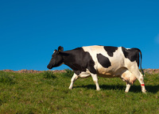
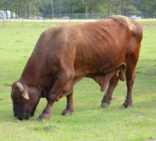
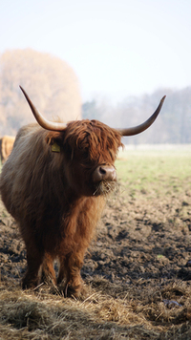
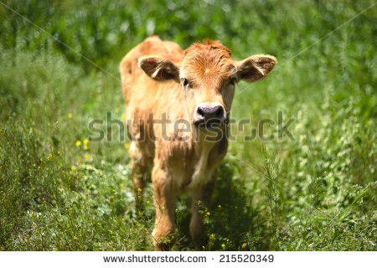
Ch-2-BEEF
Topics to be discussed
Different classes of Beef animal
Grading
Cuts of beef and their cooking

Slide 2
Different classes of beef animal
Mostly the beef animal is called and identified in the name such as Cattle or Bovine
There are many people worldwide who think they know what cattle look like but cannot properly tell the difference between a cow, bull, steer or heifer.

Slide 3
Contd….
Cow: a mature female bovine that has given birth to at least one or two calves.
Bull: a mature, intact (testicles present and not removed) male bovine used for breeding purposes.
Cattle: general plural term for more than one bovine
Calf (plural: Calves): an immature bovine (male and female) that is reliant on milk from its dam or from a bottle in order to survive and grow. A calf is known as such from birth to around 10 months of age.

Slide 4
Contd…..
Ox (plural: Oxen): a bovine that is trained for draft work (pulling carts, wagons, plows, etc.)This is a term that primarily refers to a male bovine that has been castrated after maturity. However, an ox can also be female bovine (cow or heifer) or even a bull that has been trained for the same purpose.
Steer: a male bovine (or bull) that has been castrated before reaching sexual maturity and is primarily used for beef.
Stag: a male bovine (or bull) that has been castrated after or upon reaching sexual maturity and is primarily used for beef.

Slide 5
Contd…..
Heifer: a female bovine (often immature, but beyond the "calf" stage) less than 1 to 2 years of age that has never calved. Such females, if they've never calved beyond two years of age may also be called heiferettes.
Bred Heifer: a female bovine that is pregnant with her first calf.
First-calf Heifer or First-calver: a female bovine that has given birth to her first calf, and is often around 24 to 36 months of age, depending on the breed and when she was first bred.

Slide 6
Contd…..
Bull calf: an immature intact male bovine (since all males are born with testes) that is reliant on milk from his dam or a bottle for growth and survival.
Steer calf: an immature male bovine that has been castrated a few days to a couple months after birth, and is reliant on milk from his dam or a bottle for growth and survival.
Heifer calf: an immature female bovine that is reliant on milk from her dam or a bottle for growth and survival.

Slide 7
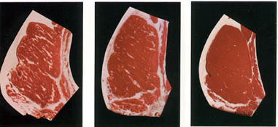
GRADING
Voluntary service paid by meat processors; cost is passed on to consumers in price
Provides information relating to taste/palatability of meat

Slide 8
GRADING
A. Factors Affecting Meat Grades
  1. Marbling
  2. Age of Animal
  3. Texture
  4. Appearance
  5. Conformation- amount of bone/lean
  6. Cutability- amount of fat/lean

Slide 9

USDA GRADES
Prime
  Well marbled
  Firm texture
  Bright color
  Limited supply
  Sold to better restaurants

Slide 10

USDA GRADES
Choice
  Slightly less marbling than Prime
  Most in demand by consumers

Slide 11

USDA GRADES
Select
  Less fat/older animal
  Less juicy
  Less flavorful
  For thrifty shoppers

Slide 12

USDA GRADES
Standard/Commercial
  Not found in commercial outlets
  Used in processed meats

Slide 13
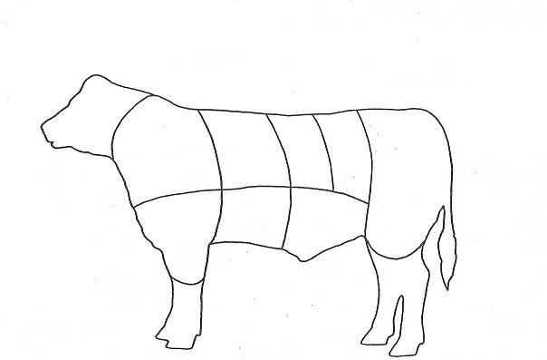
Dissection-Cuts of Beef
Wholesale Beef Cuts: Blue=Locomotion Muscles
Green=Suspension Muscles
RIB
SHORT
LOIN
SIRLOIN
CHUCK
ROUND
FORESHANK & BRISKET
SHORT
PLATE
FLANK

Slide 14
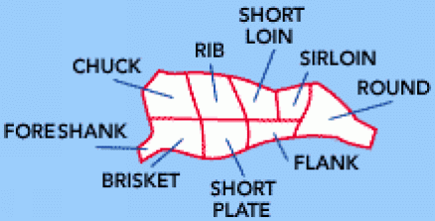
TYPES OF CUTS
Wholesale Cuts- large subdivisions sent to grocery stores for further cutting

Slide 15
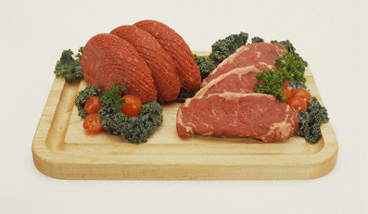
TYPES OF CUTS
Retail Cuts- individual cuts of meat sold to consumers

Slide 16
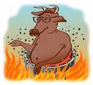
COOKING METHODS
A. Moist Heat Methods (locomotion muscles/tough cuts)
  1. Braising
  2. Cooking in a Liquid (simmering/stewing)
  Wholesale Cuts- (chuck, foreshank and brisket, short plate, flank, round)

Slide 17
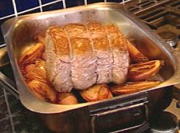
COOKING METHODS
B. Dry Heat Methods- Suspension Muscles/Tender Cuts
  Roasting
  Broiling
  Pan-broiling
  Pan-frying
  Stir-frying
  Wholesale Cuts- (Rib, Short Loin, Sirloin)

Slide 18
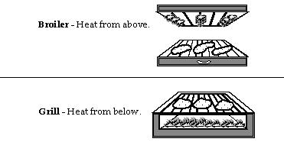
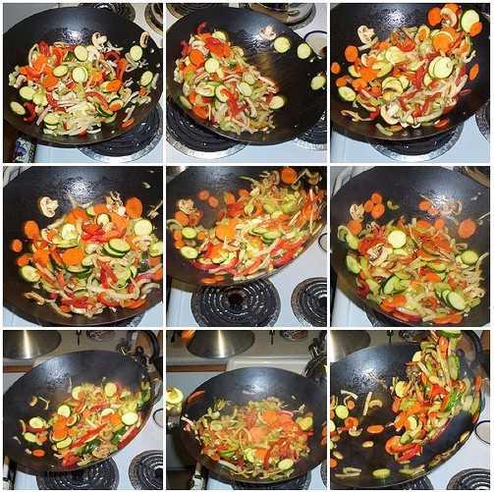
Images-Broiling & Stir frying

Slide 19

HEALTHY COOKING TIPS
Choose cuts from the round and loin sections
Limit portion sizes to two 3-ounce servings per day
Trim all visible fat before cooking
Broil or grill meats
Use non-stick pans when frying and browning
Skim fat from surface of chilled meat soups and stocks

Slide 20


Thank you….!!!!
For your attention
Chapter-2 is completed
Are you happy?
Get ready for the first Quiz

