Slide 1
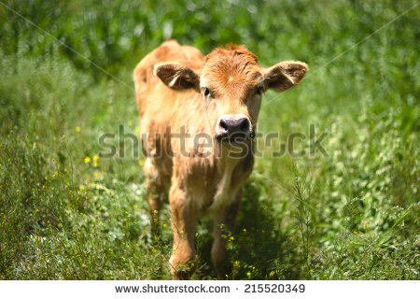
Ch-3- VEAL
Introduction-What is veal?
Veal comes from young calves aged 6-7 months. When the calf reaches the age of one year they are called a cow/bovine animal. The veal is then called beef.

Slide 2
Characteristics
Veal has light colour, a fine texture, a smooth taste and is tenderer.
Young veal is generally excluded from market; that from an animal about 2 months old is considered best.
The meat is much paler than beef, and shows no mottling of the lean with fat. It should be pinkish and fine-grained.

Slide 3
Types of Veal
Bob Veal: About 15% of veal calves are marketed up to 3 weeks of age or at a weight of 150 pounds. These are called Bob Calves.
Special-Fed Veal: Special, milk-fed and formula fed veal calves usually are fed nutritionally balanced milk or soy based diets. These specially controlled diets contain iron and 40 other essential nutrients, including amino acids, carbohydrates, fats, minerals and vitamins. The majority of veal calves are "special-fed."

Slide 4
Grading
Veal and calf carcasses are graded on a composite evaluation of two general grade factors: conformation (proportion of lean, fat, and bone in carcass); and quality of the lean.
There are 5 grades for veal: prime, choice, good, standard, utility.

Slide 5
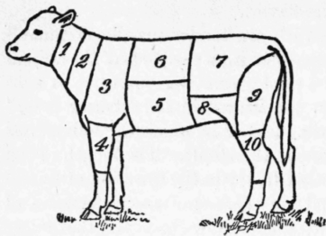
Dissection/Cuts of veal
1. Neck.
2. Chuck.
3. Shoulder.
4. Fore shank.
5. Breast.
6. Ribs.
7. Loin.
8. Flank.
9. Leg.
10. Hind shank.

Slide 6
Cooking Methods
Dry Heat Methods- Tender Cuts
  Roasting
  Broiling
  Pan-broiling
  Pan-frying
  Stir-frying
  (Tender cuts including leg, cutlets, veal patties, and rib or loin chops)

Slide 7
Contd….
Moist Heat Methods -Less Tender cuts
  1. Braising
  2. Cooking in a Liquid (simmering/stewing)
(Less tender cuts, such as cross cut shanks, stew meat, round steak and breast of veal)

Slide 8
Cooking Tips/Temperature
Cook all organ or variety meats (such as heart, kidney, liver, and tongue) to 160 °F.
Cook all raw veal steaks, chops, and roasts to a minimum internal temperature of 145 °F.
For safety and quality, allow meat to rest for at least 3 minutes before carving or consuming.

Slide 9
Thank you…!!!
For your kind listening
Chapter-3 is completed
Bye take care

