Slide 1
Ch-4-PORK
4.1 Introduction:
Pork is the meat from the domestic pig (Sus scrofa) or Swine
It is one of the most commonly consumed meats worldwide.
Pork is eaten in various forms, including cooked (as roast pork), cured or smoked (ham, including the Italian Prosciutto) or a combination of these methods (gammon, bacon or Pancetta).
It is also a common ingredient of sausages.

Slide 2
4.2 Grading of Pork
USDA grades for pork reflect only two levels: "Acceptable" grade and "Utility" grade.
Pork sold as Acceptable quality pork is the only fresh pork sold in supermarkets. It should have a high proportion of lean meat to fat and bone.
Pork graded as Utility is mainly used in processed products and is not available in supermarkets for consumers to purchase.

Slide 3
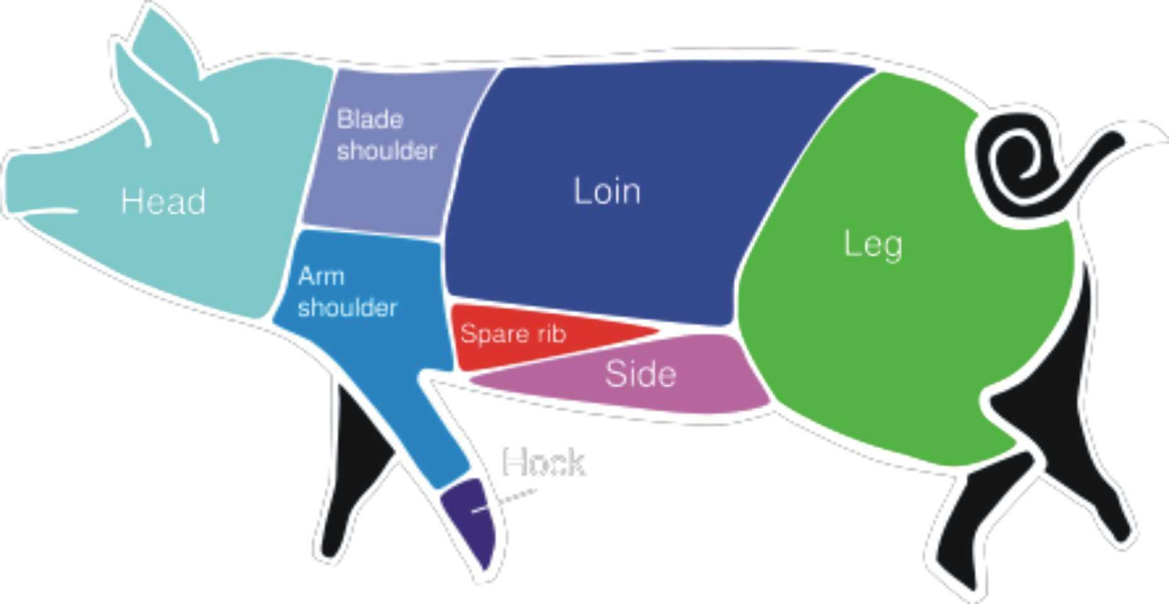
4.3 Dissection/Cuts of Pork:

Slide 4
4.4 Cooking Pork:
Cook all raw pork steaks, chops, and roasts to a minimum internal temperature of 145 °F as measured with a food thermometer before removing meat from the heat source. For safety and quality, allow meat to rest for at least three minutes before carving or consuming.
The common methods that are used in cooking pork are:
Braising
Broiling
Grilling
Roasting
Sauté
Stewing
Smoking and Curing

Slide 5
4.5 Pork Terminologies
Hog: A castrated male pig.
Boar: An uncastrated male pig over six months old.
Sow: A female pig that has had its first litter.
Gilt: A female pig which has not yet produced a litter.
Gestation Period: Length of pregnancy. In pigs it is of three months, three weeks and three days.

Slide 6
Contd…..
Piglet: A young pig.
Ham: A cut of pork from the hind leg that has been cured and smoked.
Bacon: A cut of pork from the hog’s sides and belly that has been cured and/or smoked.
Weaner: A piglet separated from its mother and eating only solid food.

Slide 7
Thank you…..!!!!
For your co-operation and listening
Ch-4 is completed
Are you happy?

