Slide 1
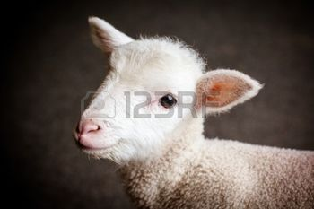
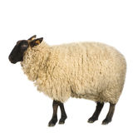
Ch-5-Lamb and Mutton
5.1 Introduction:
The terms lamb, hogget or mutton is names for the meat of a domestic sheep.
The meat of a sheep a year old or younger is generally known as lamb, whereas the meat of an older sheep is either hogget or mutton depending on its age and characteristics.
All of these are known generically as sheep meats. A sheep less than one year old is known for its tender meat.

Slide 2
Types of Lamb
Baby lamb is customarily slaughtered between 6 and 8 weeks old.
Spring lamb is usually 3 to 5 months old;
Regular lamb is slaughtered less than 1 year of age.
Lamb between 12 and 24 months is called yearling; when over 2 years, it's referred to as mutton and has a much stronger flavor and less tender flesh.

Slide 3
Lamb Grading
Lamb graded for quality based on traits such as tenderness, juiciness and flavor. USDA-graded lamb sold at the retail level is
Prime
Choice
Good.
Lower grades (Utility and Cull) are mainly ground or used in processed meat products.

Slide 4
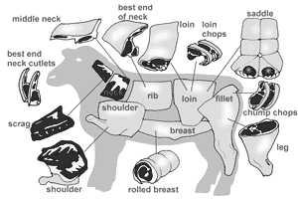
Cuts of lamb and cooking methods
Scrag- Stewing
Neck- Stewing
Shoulder-Pan frying, grilling and braising
Fore shank- Roasting, stewing and braising
Breast- Roasting
Rib- Roasting frying and grilling
Loin- Roasting frying and grilling
Leg- Roasting frying and grilling
Hind shank- Roasting, stewing and braising

Slide 5
10q
For your effective listening
Ch-5 is completed
Are you ready for 2nd Quiz?

