Slide 1
CHAPTER- THREE
Consumer Markets and Consumers Buying Behaviors

Slide 2
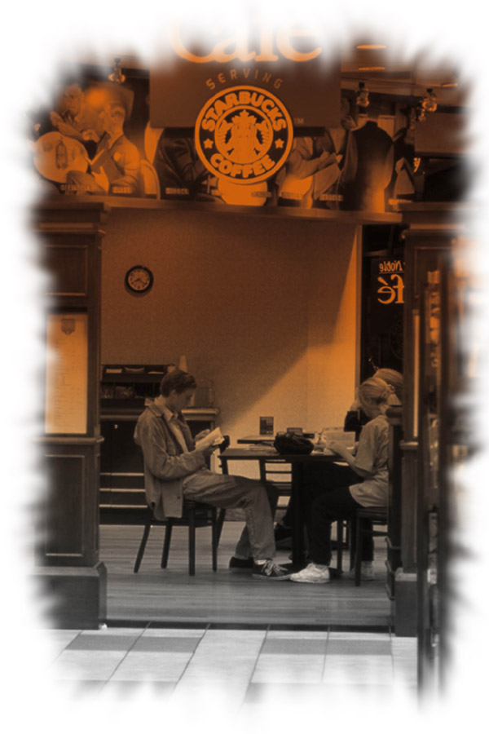
Consumer Buyer Behavior
“The most important ingredient in the success of an organization is a satisfied customer”

Slide 3

The most important thing is to forecast where Customers are moving, and to be in front of them.

Slide 4

Understanding consumers
Behavior and “knowing
Customers” is never simple.
Customers may say one thing and do another.
They may not be in touch with their deeper Motivations.

Slide 5
Model of Buying Behavior
Marketing
stimuli
Product
Price
Place
Promotion
Other
stimuli
Economic
Technological
Political
Cultural
Buyer’s
characteristics
Cultural
Social
Personal
Psychological
Buyer’s decision
process
Problem recognition
Information search
Evaluation
Decision
Postpurchase
behavior
Buyer’s decisions
Product choice
Brand choice
Dealer choice
Purchase timing
Purchase amount

Slide 6
Cultural Factors
Culture
Subculture
Social Class
Buyer

Slide 7
Culture
Exert the broadest and deepest influence on consumers behavior.
Culture is the most basic determinant of a person’s want and behavior.
It comprises the basic values, perceptions, wants, and behaviors that a person learns consistently in a society.

Slide 8
Culture is an integral part of the hospitality and travel business.
It determines what we eat, how we travel, where we travel, and where we stay.
Culture is dynamic, adapting to environment.

Slide 9
Sub-culture
each culture consists of smaller subcultures that provide more specific identification and socialization for its members.
It includes nationalities, religions, racial groups, and geographical regions.
Many subcultures make up important market segments, and marketers often design products and marketing programs tailored to their needs.

Slide 10
Social class
Social classes are relatively permanent and ordered divisions in a society whose members share similar values, interests, and behaviors.

Slide 11
Social Factors
Reference
Groups
Family
Roles &
Statuses

Slide 12
Social Factors
Consumer behavior is also influenced by social factors including the consumers’ groups, family, social roles, and status.
Groups- an individual’s attitudes and behavior are influenced by many small groups.
Those to which the person belongs that have a direct influence are called membership group.

Slide 13
They include primary groups, such as family, friends, coworkers and so on.
Reference group- has face to face interaction
Aspirational groups- those which do not belong but would like to.

Slide 14
Family- has a strong influence on buyer behavior.
Role and status – an individual’s position in each group can be defined in terms of role and status.

Slide 15
Personal factors
Personal Influences
Age and Family Life
Cycle Stage
Lifestyle
Occupation &
Economic Circumstances
Personality &
Self-Concept

Slide 16
Age and life cycle stage - the type of goods and services people buy change during their lifetime.
Preference for leisure activities, travel destinations, food and entertainment are often age related.

Slide 17
Occupation – a person’s occupation affects the goods and services bought.
Economic situations – a person’s economic situation greatly affects product choice and decision to purchase a particular product.

Slide 18
Life style- is a person’s pattern of living as expressed in his or her activities, interests, and opinions.

Slide 19
Psychological Factors
Motivation
Perception
Beliefs &
Attitudes
Learning

Slide 20

Influencing Buyer Behavior
Psychological Factors
  Motivation (Freud; Dichter; Maslow; Herzberg; Petty and Cacioppo’s ELM)
    Motive: a need that is sufficiently pressing to drive a person to act.
    a need becomes a motive when it is aroused to a sufficient level of intensity

Slide 21
Maslow’s Hierarchy of Needs
Self-
actualization
(self-development
and realization)
5
Esteem needs
(self-esteem, recognition)
4
Social needs
(sense of belonging, love)
3
Safety needs
(security, protection)
2
Physiological needs
(food, water, shelter)
1

Slide 22
Perception
A motivated person is ready to act.
How that person acts is influenced by his or her perception.
Why do people have different perception of the same situation? This is because of three perceptual processes; Selective attention, Selective distortion and Selective retention.

Slide 23
Learning
Change in individual’s behavior arising from experience.
Most human behavior is learned.

Slide 24
Beliefs and Attitudes
A belief is a descriptive thought that a person holds about something.
An attitude describes a persons relatively consistent evaluations, feelings, and tendencies toward an object or an idea.

Slide 25
Consumer Buying
Process
Problem
recognition
Information
search
Evaluation of
alternatives
Purchase
decision
Postpurchase
behavior

Slide 26
Influencing Buyer Behavior

Slide 27

Decision Making Sets
Total
Set
Aware-
ness
Set

Slide 28
Postpurchase Behavior
Postpurchase Behavior (cognitive dissonance?? What increases it? What does it lead to?)
  Postpurchase Satisfaction
  (expectations versus
  performance)
    Disappointed
    Satisfied
    Delighted

Slide 29

Any Question?

Slide 30


