Slide 1
CHAPTER FOUR
MARKET SEGMENTATION, TARGETING, AND POSITIONING

Slide 2
Market
Original Meaning- a physical place where buyers and sellers gathered to exchange goods and services.
Economists- all buyers and sellers who transact for a good or service.
Marketer-set of all actual and potential buyers of a product.

Slide 3
Market Segments and Market Segmentation
Market segment: a group of customers who share a similar set of wants.
Market segmentation: the act of dividing a market into distinct groups of customers who might require separate products and/or marketing mixes.

Slide 4
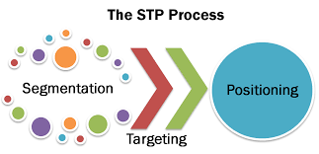

Slide 5
Steps in Market Segmentation, Targeting,and Positioning
Market
Positioning
Market
Segmentation
Market
Targeting
5. Identify
possible
positioning
concepts for
each target
segment
6. Select,
develop, and
communicate
the chosen
positioning
concept
1. Identify
segmentation
variables and
segment the
market
2. Develop
profiles of
resulting
segments
3. Evaluate
attractiveness
of each
segment
4. Select the
target
segment(s)

Slide 6
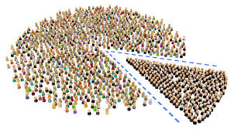
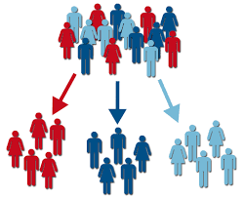
Segmentation

Slide 7
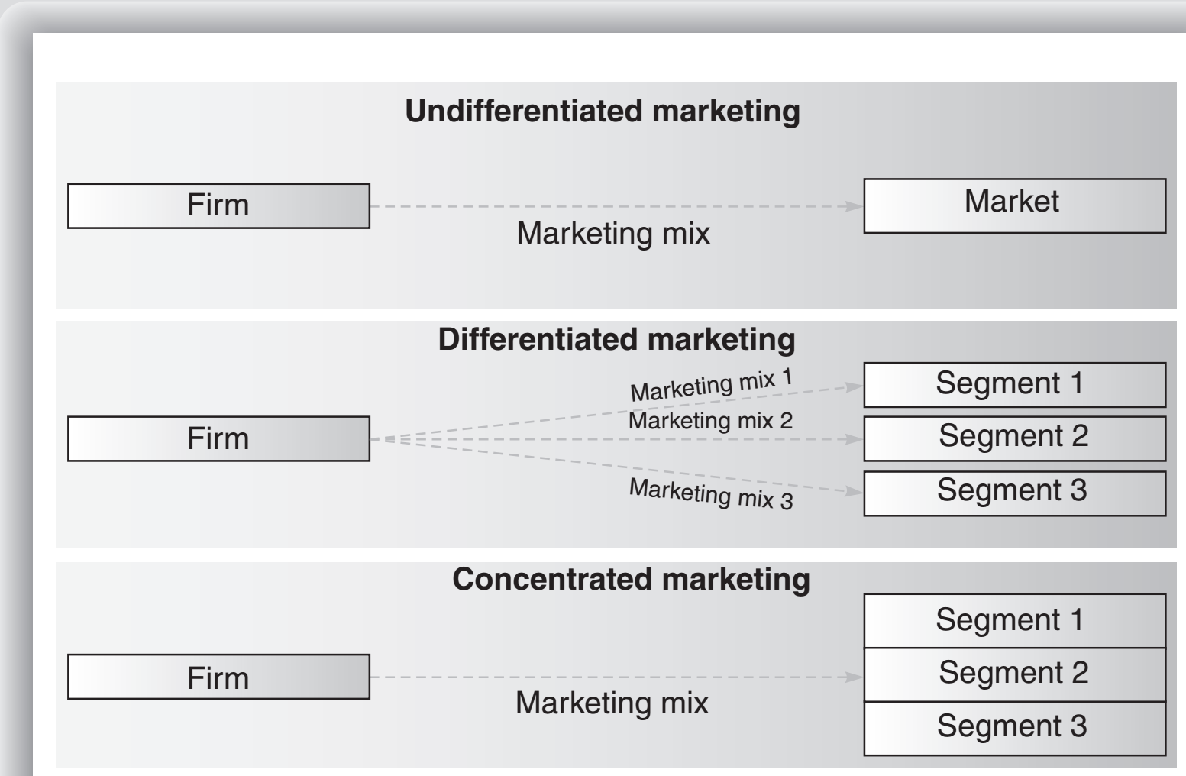
THE NATURE AND PURPOSE OF SEGMENTATION

Slide 8
Effective Segmentation
Measurable
Substantial
Size, purchasing power, profiles of segments can be measured.
Accessible
Segments must be large or profitable enough to serve.
Differential
Segments can be effectively reached and served.
Actionable
Segments must respond differently to different marketing mix elements & actions.
Must be able to attract and serve the segments.

Slide 9

Bases for Segmenting Consumer Markets
Geographic
Demographic
Region, City or Metro
Size, Density, Climate
Age, Gender, Family size and life cycle, Race, Occupation, or Income ...
Psychographic
Lifestyle or Personality
Behavioral
Occasions, Benefits, Uses, or Attitudes

Slide 10

Geographic
involves dividing markets into different geographical units such as
countries,
regions,
counties and cities.
Demographic
age,
sex,
income,
education,
occupation,
religion,
race, nationality, family size and stage reached in the family life cycle.

Slide 11
Behavioral
Occasions- regular, special occasion
Benefits- quality, economy, speed.
User status- non-user, potential user, first-time-user, regular user.
Usage rate- light user, medium user, heavy user.
Buyer-readiness- informed, non-informed, knowledgeable,
Loyalty status- Hard-core loyals, Split loyals, Shifting loyals, Switchers
Attitude- enthusiastic, positive, indifferent, negative, hostile.

Slide 12
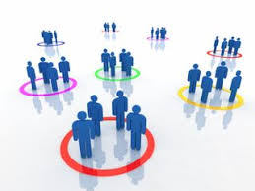
Psychographic
dividing buyers in to different groups based on
social class,
lifestyle (activities, interests, opinions), and
personality characteristics/core values/.

Slide 13
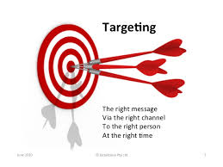
MARKET TARGETING
Evaluate the attractiveness of each segment and select the target segment
Three factors need to be considered:
The size and growth potential of each segment
Their structural attractiveness
The organization’s objectives and resources.

Slide 14
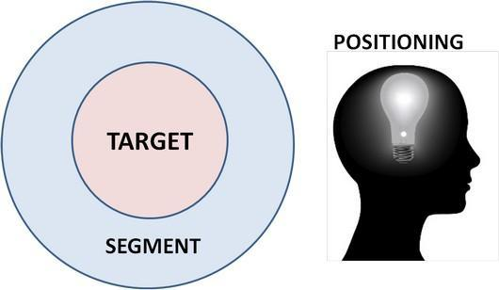

Slide 15
POSITIONING: THE BATTLE FOR THE MIND
Positioning is therefore the process of designing an image and value so that customers within the target segment understand what the company or brand stands for in relation to its competitors.
positioning has direct and immediate implications for the whole of the marketing mix.

Slide 16
USP ( Unique Selling Proposition)
It means the one aspect of your product that makes you
different from all other products.
USP can be something real, which one product
has over all others, such as the strong taste of Minto mints.
.
Steps in positioning
Identifying the organization or brand’s possible competitive advantages
Deciding on those that are to be emphasized
Implementing the positioning concept.

Slide 17

Selecting the Right Competitive Advantages
Three Errors
1. Confused positioning,
2. Over-positioning,
3. Under-positioning
Important
Distinctive
Superior
Communicable
Preemptive
Affordable
Profitable

Slide 18
Positioning Strategies
Types of positioning
1. specific product attributes
2. against an existing competitor
The Best Position
The Against Position
The Niche Position
The New Category

Slide 19

Any Question?

Slide 20
Thank You Very Much
For your cooperation
Your patience
Your stamina

