Slide 1
INTRODUCTION TO FINGERPRINTING
TWO TYPES OF FINGERPRINTS ARE KNOWN SO FAR !

Slide 2
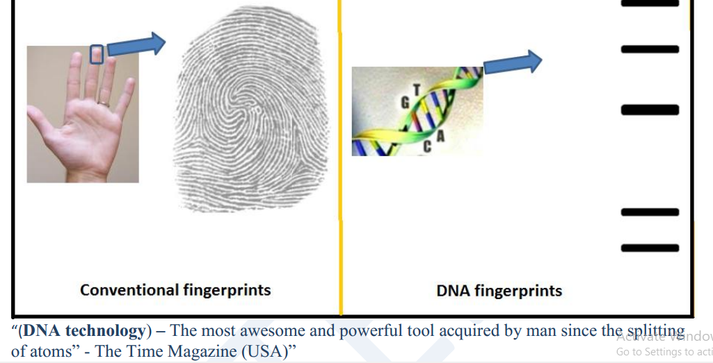

Slide 3
Continued
Conventional fingerprint of an individual comes from finger tip and unique for an individual.
This is used for identification of a person in forensic lab, police station etc.
However, the major drawback of the conventional fingerprints is that it can be changed by surgery.
There is another type of fingerprint unique to an individual called DNA fingerprint.
This remains same in all body parts, tissues and cells as well as cannot be altered by any known methods.
Thus, DNA fingerprint method is becoming primary method for identifying an individual.

Slide 4
We have already studied about DNA structure and recombinant DNA technology etc.
The DNA of every human being on the planet is 99.9% same.
However, 0.1% of DNA is unique to the individual that makes all the difference. These differences are a consequence of mutations during evolution.
As single change in nucleotide may make a few more cleavage site of a given nucleotide or might abolish some existing cleavage site
Thus, if DNA of any individual is digested with a restriction enzyme, fragments pattern (sizes) will be produced and will be difference in cleavage site position. This is the basics of DNA fingerprinting.
DNA Fingerprinting is used by scientists to distinguish between individuals of the same species using only samples of their DNA.
The process of DNA fingerprinting was invented by Sir Alec Jeffrey at the University of Leicester in 1985.

Slide 5
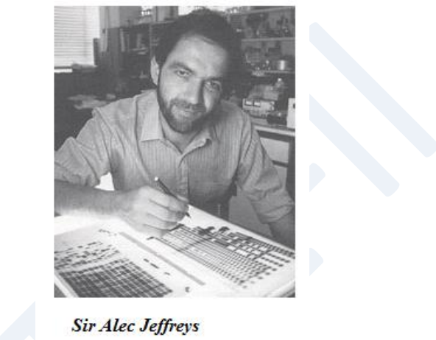
Continued

Slide 6
DNA profiling
DNA profiling is a technique by which individuals can be identified and compared via their respective DNA profiles
Within the non-coding regions of an individual’s genome, there exists satellite DNA – long stretches of DNA made up of repeating elements called short tandem repeats (STRs)
As individuals will likely have different numbers of repeats at a given satellite DNA locus, they will generate unique DNA profiles

Slide 7
The DNA profiling of each individual is unique because of the diverse in polymorphic regions present in genome of every individual.
These polymorphic regions used for identification are the non-coding regions of the genome.
The polymorphic regions of the DNA do not code for
proteins and which make-up 95% of our genetic DNA.
Hence these regions are therefore called the ―junk DNA.
Although these ―junk DNA regions do not code for proteins, they are involved in regulating gene expression, they help in reading of other genes that code for protein and are a large portion of the chromosome structure.
The junk DNA regions are made-up of length polymorphisms, which show variations in the physical length of the DNA molecule.

Slide 8
Continued
In DNA profile, the length of the polymorphisms in the non-coding areas is measured as it varies with each individual.
These polymorphisms are identical repeat sequences that are present in non-coding DNA region.
At specific loci on the chromosome the number of tandem repeats varies between individuals.
There will be a certain number of repeats for any specific loci on the chromosome.
Depending on the size of the repeat, the repeat regions are classified into two groups.
Short tandem repeats (STRs) contain 2-5 base pair repeats and variable number of tandem repeats (VNTRs) have repeats of 9-80 base pairs.

Slide 9
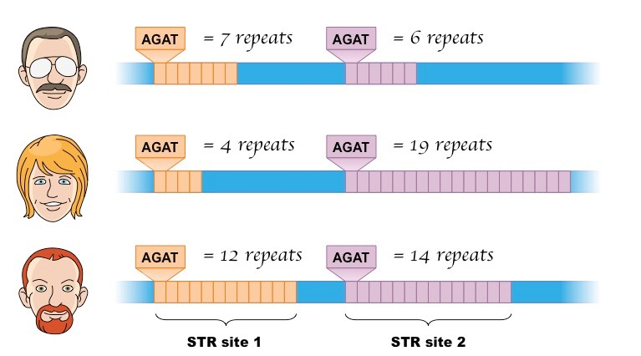
Comparative STR Lengths at Two Specific Loci

Slide 10
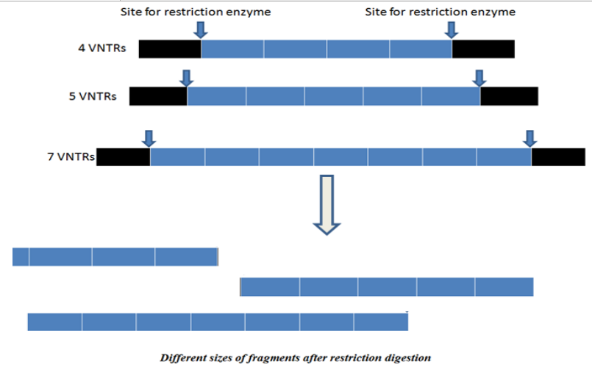

Slide 11
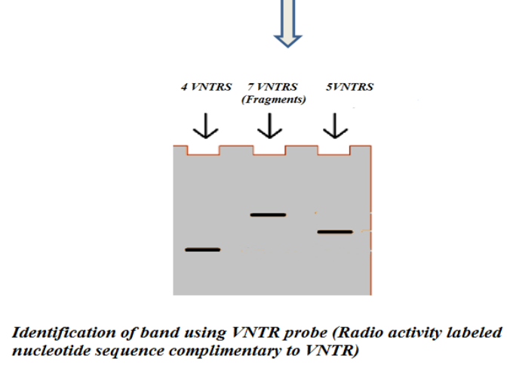
Different sizes of fragments after restriction digestion

Slide 12
Continued
We inherit a copy of chromosome, one from father and one from mother for each of the 23 pairs of chromosomes, which indicate that we carry two copies of each VNTR locus, just like we have two copies of genes donated by our parents.
At a particular VNTR site if you have the same number of sequence repeats, you are called homozygous at that site; if you have a different number of repeats, you are said to be heterozygous.
VNTR sequences from different loci can be combined to create DNA fingerprint. Resulting patter of each individual is theoretically unique.

Slide 13
Forensic techniques
The diagnosis of DNA is a laboratory process which requires a number of sequential steps. There are many forensic techniques used by various laboratories in analyzing DNA.
However, the two most popular techniques used are Restriction fragment length polymorphism (RFLP), and polymerase chain reaction (PCR) using short tandem repeats (STRs).
DNA extraction and purification is the first step involved in both the techniques.
Techniques for DNA isolation depend on the type of sample used for isolation.
Generally, the sample may be treated with detergent that degrades protein and not affecting the DNA.
To break the proteins and other cellular material, enzymes can be used. DNA can be separated using organic solvents form organic and non-organic material.
By using the above methods the DNA is separated from the sample.

Slide 14
The two types of DNA fingerprinting tests: RFLP and PCR/STR
Restriction fragment length polymorphism (RFLP) and polymerase chain reaction (PCR) amplification of short tandem repeats (STRs) are two main DNA tests widely used for DNA fingerprinting. Other diagnostic methods exist, but they lack accuracy and precision.
Restriction fragment length polymorphism (RFLP):
The RFLP is considered to be more accurate than the PCR, mainly because the size of the sample used more, use of a fresh DNA sample, and no amplification contamination.
The RFLP, however, requires longer time period to complete the analysis and is costly.
The first step in this process is to isolate the DNA from the sample material to be tested. As mentioned, the sample size for RFLP test must be large enough to get the proper result.

Slide 15
Once the required size of the sample is available, the DNA is isolated from the sample and is subjected to restriction digestion using restriction enzymes.
The digested DNA sample is then separated by agarose gel electrophoresis, in which the DNA is separated based on the size.
The next step is transfer of separated DNA from gel slab onto the nitrocellulose membrane to hybridize with a labeled probe that is specific for one VNTR region (radio activity labeled complimentary sequence for VNTR region nucleotide sequence).
This technique of transferring and hybridizing DNA onto nitrocellulose membrane is known as southern blotting, a most widely used DNA detection technique by molecular biologists.
After the hybridization with the radioactive probes, the X- ray film is developed from the southern blotting and only the areas where the radioactive probe binds will show up on the film. Now these bands when compared with the other known samples, will give the final result of the DNA fingerprinting.

Slide 16
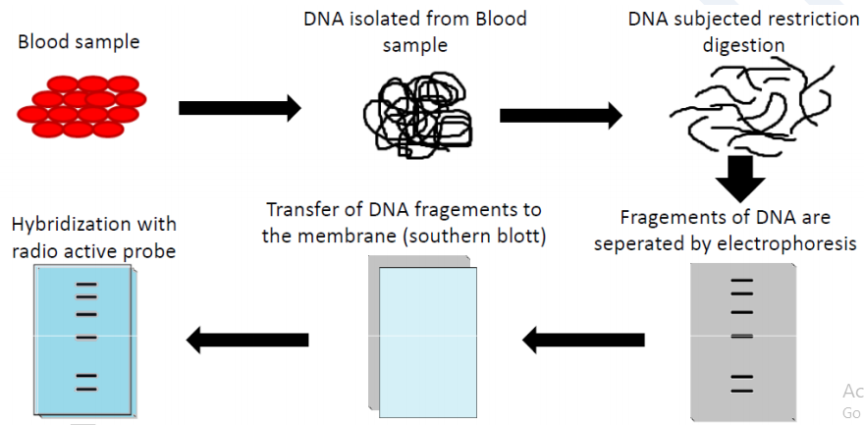
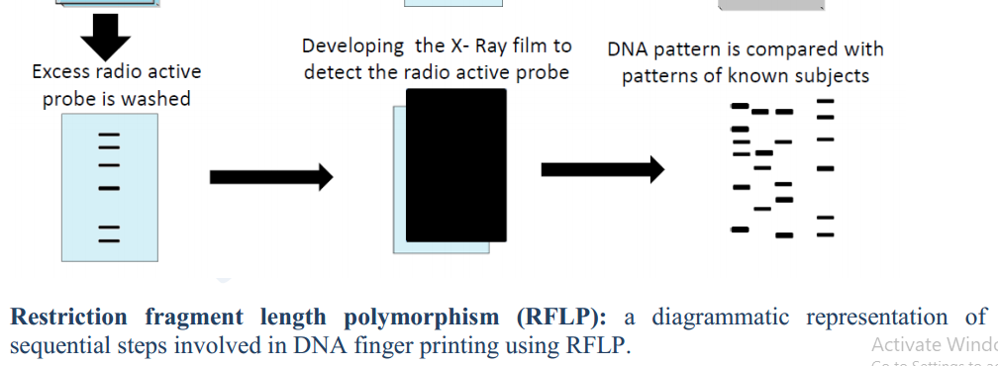

Slide 17
Polymerase chain reaction (PCR) amplification of short tandem repeats (STRs)
Kary Mullis in the year 1991 developed a technique to amplify a DNA.
PCR generates the repeated copies of a specific area of the DNA fragment.
These areas are the alleles and are specific sequences of base pairs. They are the target regions with variable length.
On either side of the target regions there are ―flanker sequences which are non-variable regions.
On chromosomes ―flanker occurs at same location for all individuals. Thousands of copies of a particular variable region are amplified by PCR which forms the basis of this detection.
STR with a known repeat sequence is amplified and separated using gel-electrophoresis. The distance migrated by the STR is examined.
For the amplification of STRs using PCR, a short synthetic DNA, called primers are specially designed to attach to a highly conserved common non-variable region of DNA that flanks the variable region of the DNA.
By comparing the STR sequence size amplified by PCR with the other known samples, will give the final result of the DNA fingerprinting.

Slide 18
Applications of DNA Fingerprinting
1. In Forensics Science:
DNA Fingerprinting and Forensics: Forensic science can be defined as the intersection of law and science.
The DNA profile of each individual is highly specific. The chances of two people having the exact DNA profile are 30,000 million to 1 (except for identical twins).
Biological materials used for DNA profiling are: Blood, Hair, Saliva, Semen, Body tissue cells etc.
DNA isolated from the evidence sample can be compared through VNTR (Variable number of tandem repeats) prototype. It is useful in solving crimes like murder and rape.
For example; the sex scandal of President Clinton with Monica Lewinsky.

Slide 19
2. Paternity and Maternity Determination:
A Person accedes to his or her VNTRs from his or her parents. Parent-child VNTR prototype analysis has been used to solve disputed cases.
This information can also be used in inheritance cases, immigration cases.
For Example: In 2002 Elizabeth Hurley used DNA profiling to prove that Steve Bing was the father of her child Damien.
3. Personal Identification:
The concept of using DNA fingerprints as a sort of genetic bar code to pinpoint individuals has already been discussed above.
4. Diagnosis of Inherited Disorders:
It is also useful in diagnosing inherited disorders in both prenatal and newborn babies.
These disorders may include cystic fibrosis, hemophilia, Huntington's disease, familial Alzheimer's, sickle cell anemia, thalassemia, and many others.

Slide 20
5. Development of Cures for Inherited Disorders
By studying the DNA fingerprints of relatives who have a history of some particular disorder, DNA prototypes associated with the disease can be ascertained. The Hong Kong Baptist University was able to use DNA fingerprinting to identify the Chinese medicine—Lingzhi in 2000.
6. Detection of AIDS: By comparing the band of HIV "RNA" (converted to DNA using RTPCR) with the bands form by the man’s blood, person suffering with AIDS can be identified.
7. Breeding Program: Breeders conventionally use the phenotype to evaluate the genotype of a plant or an animal. For example, homozygous dominant genotype AABB is always desirable. As
it is difficult to make out homozygous or heterozygous dominance from appearance, the DNA fingerprinting allows a fastidious and precise determination of genotype. Offspring from the discerning mating of superior animals are expected to inherit desirable characters like strong cardiopulmonary capacity and speed. It is basically useful in breeding race horses and hunting dogs.

Slide 21
Summary
DNA fingerprinting used to characterize biological samples and analyses genotypic traits
You're 99.9% identical.
But of course, you are unique--in a genome of three billion letters (human genome project), even a 0.1 % difference translates into three million differences.
These differences (or polymorphisms) reside in several places in the genome, often in microsatellites.
Microsatellites: are a tract of repetitive DNA in which certain DNA motifs are repeated, typically 5-50 times.
Examples of such polymorphisms include VNTRs, STRs, RFLPs and SNPs.
Focuses on the region of human DNA that is unique.

Slide 22
Uses of DNA fingerprinting
Paternity testing
Identification of criminals (e.g. murderers, rapists, letter bombers) In legal proceedings to identify suspects and clear others.
Immigration disputes (family relationships)
Identification of deceased individuals with mutilated or decomposed bodies (e.g., the military, 9/11 victims)
Identifying the sperm donor.

Slide 23
The working principle of DNA fingerprinting
DNA obtained from hair, semen, blood, sweat, saliva, bone or any other tissue (often found at a crime scene)
Can be done by southern blotting with an appropriate probe or by a PCR method using appropriate primers
Can use single probes/primers or multiple probes/primers
DNA can be resolved on a gel or by a capillary electrophoresis system

Slide 24
Sequences examined in DNA fingerprinting
VNTRs-variable number tandem repeats; composed of 8-80 bp repeat units (e.g., [GCGCAATG]n) which are tandemly repeated so that the overall length is 1-30 kb.
STRs-short tandem repeats; composed of 2-7 bp repeat units (e.g., [AC]n) which are tandemly repeated so that the overall length is less than 1 kb
RFLPs-restriction fragment length polymorphisms
Amplify using PCR cut PCR product with restriction enzyme R then size fractionation using Agarose gel electrophoresis
SNPs-single nucleotide polymorphisms
Y chromosome DNA- passed from father to son.

Slide 25
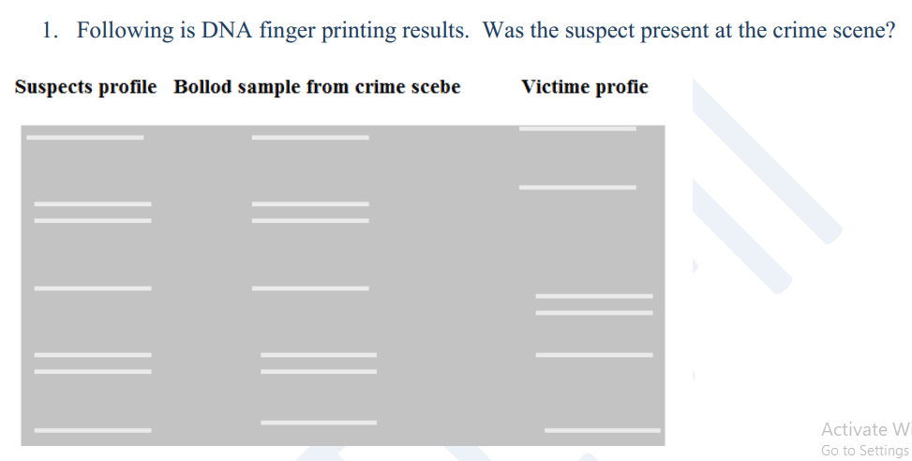
Home take assignment

Slide 26
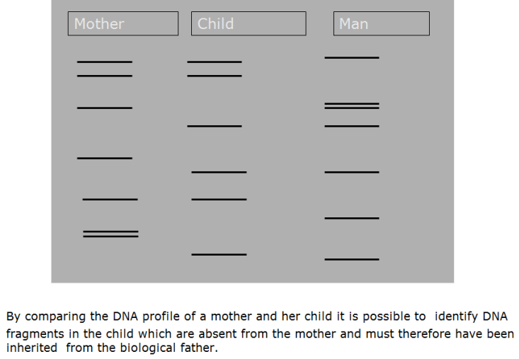
2. Solve the following paternity dispute
Is this man the father of the child?

Slide 27
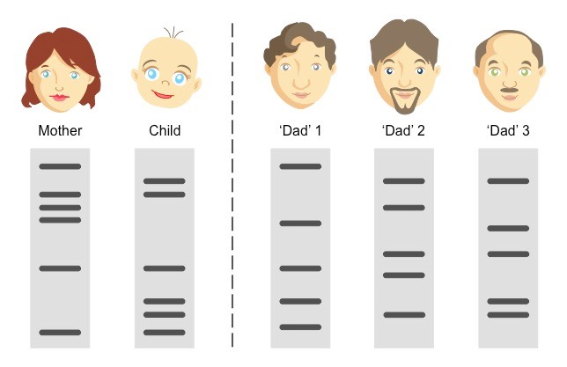
3. Compare the profiles of three men with that of a mother and child to determine the biological father
Compare the profiles of three men with that of a mother and child to determine the biological father (click picture to solve)

Slide 28
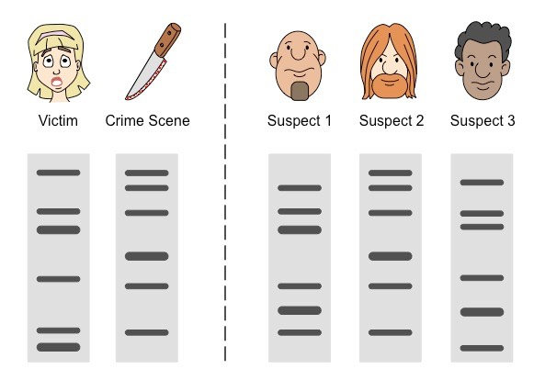
4. Compare the DNA collected from the crime scene to determine which of the three suspects was present

