Slide 1
Variable Number Tandem Repeat Profiling
Variable number tandem repeats also called minisatellites were first identified as a class of tandem repeats in the 1980s.
The repeat unit length can range from six to hundreds of base pairs (bp).
The numbers of tandem repeat units in some VNTR loci are highly variable, leading to variable lengths of DNA fragments.
A genotype is defined by a particular number of tandem repeat units at a given locus.

Slide 2
VNTR Loci for Forensic Testing
The VNTR loci chosen for forensic use are on different chromosomes, or sometimes very distant on the same chromosome, so they are separately inherited.
The loci selected should be compatible with the restriction endonuclease cleavage sites.
Many VNTR loci used for forensic applications are highly polymorphic.
Hundreds of different genotypes per locus can be observed among the population.
The discriminating power of VNTR loci used for forensic testing can be measured by population match probability(Pm).
The lower the Pm, the less likely a match will occur between two randomly chosen individuals.

Slide 3
Restriction Fragment Length Polymorphism (RFLP)
RFLP—the first method used in forensic DNA testing (Figure 1) employs restriction endonucleases that recognize and cleave specific sites along the DNA sequence.
Cleavage of a DNA sample with a particular restriction enzyme results in a reproducible set of restriction fragments of various lengths.
Appropriate restriction endonucleases should be selected so that the genomic DNA is cleaved at sites that flank the VNTR core repeat region.
The resulting fragments are then separated according to their sizes by gel electrophoresis through a standard agarose gel.

Slide 4
The DNA is then processed using the Southern transfer and hybridization technique.
The DNA is denatured and transferred from the gel to a supporting matrix such as a nylon or nitrocellulose membrane.
The DNA immobilized on the membrane is then hybridized with a labeled probe.
Only bands complementary to the probe are recognized by detection systems such as autoradiography.
Using the RFLP technique, the length variations among restriction sites can be detected.
Most forensic applications focus on the length variations of VNTR regions located between two restriction sites.

Slide 5
In summary, the RFLP method includes genomic DNA preparation, restriction endonuclease digestion of the genomic DNA into fragments, agarose gel electrophoretic separation of the DNA fragments according to size, transfer of DNA fragments, hybridization with locus-specific probes using Southern transfer and a hybridization method, and detection of locus-specific bands by autoradiography or chemiluminescence.

Slide 6
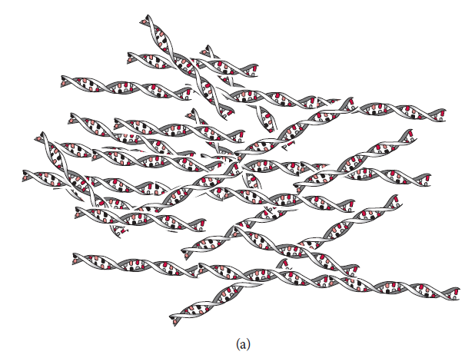
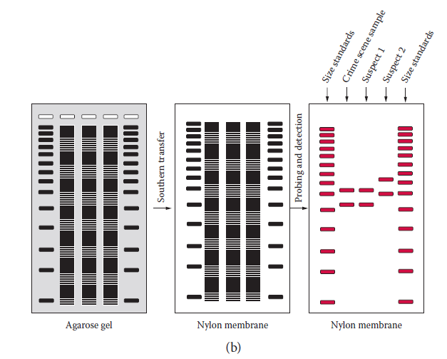
Figure 1 RFLP. (a) Restriction fragments with various lengths of genomic DNA.
(b) Restriction fragments are separated by gel elelctrophoresis.
DNA is transferred to a solid phase and probed.
The signal is detected and the DNA fragment of interest can be observed. Band patterns of heterozygous loci of an individual are shown.

Slide 7
DNA samples to be compared are run in parallel lanes on the same gel.
The band locations are compared from lane to lane to identify similar patterns.
If the VNTR fragments are at corresponding positions, they are declared a match.
If not, the result is a non-match and the two DNA samples can be deemed to have come from different origins.
The following possible conclusions can be made:
    Exclusion (profiles are different)
    Inclusion (profiles match)

Slide 8
Factors Affecting RFLP Results
Sample conditions, genetic mutations, and artifacts (things) appearing during testing can affect VNTR profiling results and consequently impact data interpretation.
DNA Degradation
RFLP analysis requires intact (unbroken) genomic DNA.
DNA degradation results in damage such as creating nicks and breaks in the strand.
The more severe the degradation, the smaller the average size of the DNA, When the average size becomes too small, the allele may not be detected.
Many VNTR tandem arrays can span several Kb in length.
In theory, large sized alleles are more likely to be affected by degradation than smaller sized alleles at a different locus.
The smaller alleles may be not affected at all.

Slide 9
A two-banded heterozygous profile might be observed as a one-banded homozygous profile if the larger band is missed due to degradation.
This artifact could lead to a false determination of exclusion.
However, DNA degradation can be detected prior to conducting RFLP by the use of agarose gel electrophoresis also known as a yield gel.
Restriction Digestion-Related Artifacts
Partial Restriction Digestion
Deviation of the specificity of a cleavage site of a restriction enzyme
Point Mutations

Slide 10
Electrophoresis and Blotting Artifacts
Bands running off bottom of gel
The commonly used VNTR loci generate bands from hundreds of bp to 20 kb in length.
The small sized bands have higher electrophoretic mobility and may run off the front edge of a gel during electrophoresis and fail to be detected.
This phenomenon may also lead to a false interpretation.

Slide 11
Separation Resolution Limits and Band Shifting
Agarose gel electrophoresis cannot resolve restriction fragments that differ by one or a few repeat units, especially for high molecular weight fragments.
These bands may not be separated and will appear as a single band.
This may lead to a false interpretation as a homozygous profile.
Additionally, minor variations in the electrophoretic mobility of DNA fragments, known as band shifting, can cause two samples from the same individual to appear different.

Slide 12
Amplified Fragment Length Polymorphism (AFLP)
Some VNTR loci have relatively short alleles (fewer than 1 kb).
These loci are applicable for PCR amplification.
This technique is called ampliﬁed fragment length polymorphism (AFLP).
One locus, D1S80, was used by forensic DNA laboratories for AFLP analysis.
Fragments in the range of 14 to 42 repeat units (16 bp per repeat) were ampliﬁed using the AFLP method (Figure 2).
The ampliﬁed DNA fragments were commonly separated according to size using polyacrylamide gel electrophoresis and detected using a silver stain.

Slide 13
D1S80 loci are detected as discrete alleles and thus can be compared directly to an allelic ladder (a collection of common alleles used as a standard) on the same gel.
This technique represented an improvement over the RFLP system.
RFLP allele sizing cannot be performed with precision and the resolution limits of agarose gel electrophoresis are much lower compared to the polyacrylamide gels.
The AFLP technique requires less DNA than the RFLP method and performs better for degraded samples.
The AFLP method at the D1S80 locus can be analyzed in a multiplex fashion with an amelogenin locus.
The amelogenin gene is used for forensic gender typing applications.

Slide 14
Typing the amelogenin gene enables the determination of sex of the contributor of a biological sample.
Due to the wide variation in allele sizes at the D1S80 locus, preferential amplification may be observed.
Under certain conditions, the larger alleles may not be consistently amplified as the small alleles, which may cause lower intensity of the larger allele.
Additionally, only one locus was analyzed in this system and the D1S80 locus contains two alleles that are common in some populations.
Thus, the discriminating power is reduced compared to RFLP.
D1S80 was gradually replaced by multiplex STR systems in the late 1990s.

Slide 15
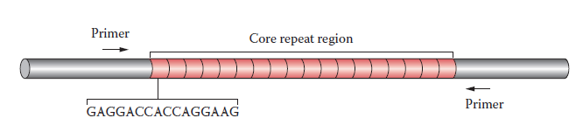
Figure 2. VNTR locus D1S80 (chromosome 1p). Each repeat unit is 16 base pairs long. PCR primers are indicated to amplify the core repeat region.

Slide 16
Autosomal Short Tandem Repeat (STR) Profiling
An STR is a region of human DNA containing an array of tandem repeats ranges from only a few to about a hundred repeated units.
A repeat unit can be 2 to 6 base pairs (bp) long.
STRs are also called microsatellites or simple sequence repeats.
The number of repeat units of STR loci can vary greatly among the population.
The most commonly used STR loci are—shorter in length than the smallest VNTRs (up to 1000 bp).

Slide 17
STR loci have many advantages due to the small size of the alleles:
  STR loci are applicable for PCR amplification.
  STR profiling performs better than VNTR profiling for degraded DNA samples.
  Preferential amplification is reduced at STR loci compared to VNTR loci using AFLP.
  Better electrophoretic resolution of DNA fragments is achieved than VNTR profiling.
  STR loci are applicable for multiplexing amplification.
  STR profiling, As with VNTR profiling, is capable of handling interpretation of mixed DNA profiles from multiple contributors.
Thus STR loci are better candidates for forensic DNA testing than VNTR loci.

Slide 18
Characteristics of STR Loci
More than 10⁵ STRs exist in the human genome.
Many STRs have been characterized and used in various types of studies such as genetic mapping and linkage analysis.
Some STRs have been characterized specifically for forensic DNA profiling.
Core Repeat and Flanking Regions
Each STR locus contains a core repeat region in which the number of tandem repeat units varies among individuals (Figure 3).

Slide 19
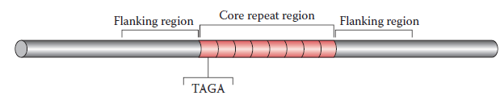
Figure 3. Core repeat and flanking regions of CSF1PO STR locus.
It consists of eight repeating units of tetrameric nucleotides (TAGA), thus, designated as allele 8.
The number of tandem repeat units determines genotypes for human identification.
The flanking regions surrounding the core repeats are also needed for STR analysis.
PCR primers complementary to these flanking regions are used to allow the core repeat regions to be amplified.

Slide 20
Repeat Unit Length
Repeat unit length is the number of nucleotides in a single unit of tandem repeat.
Dimeric, trimeric, tetrameric, pentameric, and hexameric repeat units appear in the human genome.
For example, the human genome has at least 10⁴ tetrameric repeats representing approximately 9% of total STRs.
The tetrameric repeats are the most commonly used STR loci for forensic DNA profiling.
Only a few thousand pentameric repeats and a few hundred hexameric repeats exist in the human genome.
The pentameric and hexameric repeats are very polymorphic.

Slide 21
Only a few pentameric and hexameric repeats are used for forensic applications because they are less abundant in the human genome.
Dimeric and trimeric repeats are very abundant but they are not usually used for forensic applications.

Slide 22
Core Repeat Sequences
STR loci compatible for forensic use can be divided into several classes based on their repeat sequences.
Simple repeats consist of tandem repeats with identical repeat unit sequences.
Allele designation is based on the number of repeat units in the core repeat region.
For example, a D5S818 allele consisting of ten repeating units of the tetrameric nucleotide AGAT is designated as allele 10.
Compound repeats consist of more than one type of simple repeat.
Complex repeats contain several clusters of different tandem repeats with intervening sequences.

Slide 23
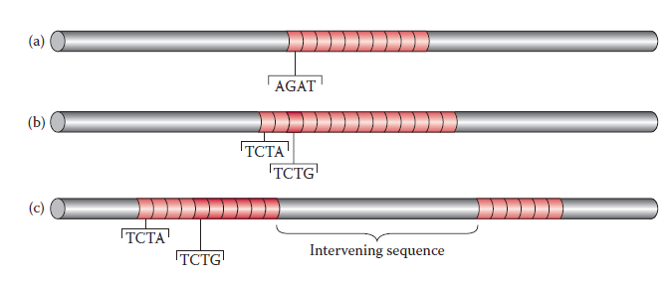
Figure 4 Examples of core repeat sequences.
Simple repeat in which D5S818 [AGAT]10 is designated as allele 10 consisting of ten repeating units of the tetrameric nucleotides, AGAT.
Compound repeats. Allele 14 of D8S1179 consists two types of repeating units, [TCTA]2, [TCTG]1, and [TCTA]11.
Complex repeats in which allele 24 of D21S11 contains several clusters of different tandem repeats, [TCTA]4, [TCTG]6, [TCTA]6 with intervening sequences (43 base pairs).

Slide 24
The designation of complex repeats is based on the sizes of the alleles.
However, size is also dependent upon the primers used for PCR amplification.
Figure 4 shows representative examples of core repeat sequences.
Non-consensus alleles with incomplete repeat units also appear in the population.
These non-consensus alleles, also known as micro variants, differ from common alleles by one or more nucleotides.
They are designated by the number of consensus repeats, followed by a decimal point and the number of nucleotides of the partial repeat, e.g., the TH01 allele 9.3 is 1 nucleotide shorter than allele 10.
Another type of non-consensus allele can result from a limitation of STR analysis.

Slide 25
These alleles have the same number of tandem repeats as commonly encountered alleles but contain different sequences.
These microvariants cannot be distinguished by STR profiling because their length is identical to the lengths of common alleles.

Slide 26
STR Loci Commonly Used for Forensic DNA Profiling
A number of STR loci have been characterized for forensic DNA profiling (1).
The discriminating power of an STR locus used for forensic testing can be measured by a parameter known as population match probability (Pm).
The lower the Pm, the less likely a match will occur between two randomly chosen individuals.
To achieve low Pm in forensic STR profiling, a number of unique characteristics of STR loci are desired.
First, the STR loci should be highly variable among the population.
Second, if more than one locus is selected, the loci should not be linked.

Slide 27
Table 1 Common STR Loci
Locus | Repeat Motif | Repeat Category | Chrs Location | Physical Position | Structural Gene
ACTBP2 / SE33 | AAAG | Complex | 6q14 | Chr 6 89.043 Mb | β-actin related pseudogene
CSF1PO | TAGA | Simple | 5q33.1 | Chr 5 149.436 Mb | c-fms protooncogene, intron 6
D2S1338 | [TGCC] [TTCC] | Compound | 2q35 | Chr 2 218.705 Mb | Anonymous
D3S1358 | [TCTG] [TCTA] | Compound | 3p21.31 | Chr 3 45.557 Mb | Anonymous
D5S818 | AGAT | Simple | 5q23.2 | Chr 5 123.139 Mb | Anonymous
D7S820 | GATA | Simple | 7q21.11 | Chr 7 83.433 Mb | Anonymous
D8S1179 | [TCTA] [TCTG] | Compound | 8q24.13 | Chr 8 125.976 Mb | Anonymous
D13S317 | TATC | Simple | 13q31.1 | Chr13 81.620 Mb | Anonymous
D16S539 | GATA | Simple | 16q24.1 | Chr 16 84.944 Mb | Anonymous

Slide 28
Locus | Repeat Motif | Repeat Category | Chrs Location | Physical Position | Structural Gene
D18S51 | AGAA | Simple | 18q21.33 | Chr 18 59.100 Mb | Anonymous
D19S433 | AAGG | Simple | 19q12 | Chr 19 35.109 Mb | Anonymous
D21S11 | [TCTA] [TCTG] | Complex | 21q21.1 | Chr 21 19.476 Mb | Anonymous
FGA | CTTT | Simple | 4q31.3 | Chr 4 155.866 Mb | α-fibrinogen, intron 3
Penta D | AAAGA | Simple | 21q22.3 | Chr 21 43.880 Mb | Anonymous
Penta E | AAAGA | Simple | 15q26.2 | Chr 15 95.175 Mb | Anonymous
TH01 | TCAT | Simple | 11p15.5 | Chr 2 2.149 Mb | Tyrosine hydroxylase, intron 1
TPOX | GAAT | Simple | 2p25.3 | Chr 2 1.472 Mb | Thyroid peroxidase, intron 10
VWA | [TCTG] [TCTA] | Compound | 12p13.31 | Chr 12 5.963 Mb | Von Willebrand factor, intron 40
Chromosomal location is based on the cytogenetic map and physical position is based on the DNA sequence (Mb = megabase). Chr = chromosome.
Sources: Adapted from Butler, J. M. 2006. J Forensic Sci 51 (2):253; Jobling, M. A., and P. Gill. 2004. Nat Rev Genet 5 (10):739.

Slide 29
The STR loci employed usually are located at different chromosomes.
Loci located at the same chromosome can also be used, but should be separated enough to ensure they are not linked (Figure 5 and Figure 6).
STR loci with fewer amplification artifacts such as stutter products, are desired.
STR loci with short allele lengths are preferred for multiplexing STR analysis and the testing of degraded DNA samples.
The application of STR for genetic studies was documented in the early 1990s.

Slide 30
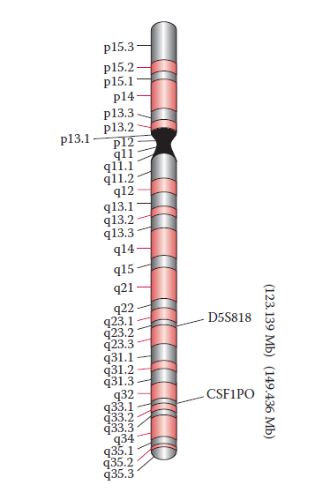
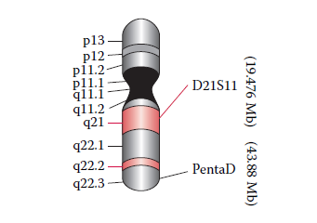
Figure 5 Cytogenetic map showing locations of STR markers on chromosome 5. CSF1PO and D5S818 are separated by 26 Mb (megabases).
Figure 6 Cytogenetic map showing locations of STR markers on chromosome 21. D21S11 and PentaD are separated by 24 Mb (megabases).

Slide 31
STR Genotyping and Analysis
STR loci are amplified using fluorescent dye-labeled primers.
The amplified products are separated and detected via electrophoresis.
The genotyping process requires two steps:
The DNA fragments are sized by comparison to an internal size standard
The size of an STR fragment is determined by an internal size standard that is mixed in with DNA samples.
The standard is labeled with a different colored dye so that it can be spectrally distinguished from DNA fragments of an unknown size.
The sample is then separated by electrophoresis.

Slide 32
The genotype is determined by using an allelic ladder.
Allelic ladders are important for accurate genotype profiling.
An allelic ladder is a collection of synthetic fragments corresponding to common alleles observed in the human population for a given set of STR loci .
The ladders are compared to data obtained to determine sample genotype.
Thus, each allele in a ladder must be resolved properly in order to determine correct STR alleles for an unknown sample.

Slide 33
The sizes of the questioned sample are correlated to sizes for each allele in an allelic ladder to determine the genotype of an unknown sample.
The comparison of the unknown and the known allows determination of the allele designation (genotype) of the unknown sample .
If a rare allele fails to match alleles within an allelic ladder, it is considered an off-ladder allele.
If an off-ladder allele is present, the sample should be reanalyzed so that it can be confirmed.
The electrophoretic mobility of the rare allele is reproducible.

Slide 34
Factors Affecting Genotyping Results
A number of genetic, amplification, and electrophoresis-related factors may affect the accuracy of genotypic profiles.
Mutations
STR loci with low mutation frequencies are desired, in particular, for human identification after mass disasters and also in missing person and paternity cases.

Slide 35
1.1 Mutations at STR Core Repeat Regions
Mutations, usually resulting in a gain or loss of a single repeat unit, are observed at some STR loci.
If a mutation occurs in the germ line cells, the mutant allele will be transmitted to and be present in all cell types of the progeny.
This type of inheritable mutation in germ cell lineage is called a germ line mutation.
The frequency of germ line mutation can be measured by mutation rate, expressed as the number of mutations per generation (germ line transmission).
However, the mutation rate may vary among different STR loci.

Slide 36
In contrast, somatic mutations involve mutation only of somatic cells.
The germ cells are not affected and thus a mutant allele will not be transmitted to progeny.
A somatic mutation occurring at an STR core repeat region can be detected.
The ratio of the signal intensities of these alleles varies, depending on the number of mutant cells in the tissue.
Somatic mutations usually are tissue type-specific.
STR profiles from different tissue types from the same individual can be compared.

Slide 37
1.2 Chromosomal and Gene Duplications
Duplication of a single chromosome or part of a chromosome results in three copies of a particular chromosome.
This condition, called trisomy, is rare and often associated with genetic diseases such as Down’s syndrome (chromosome 21 duplication).
Duplications have also been observed in chromosomes 13 & 18.
Other abnormalies include duplication of a single gene or a group of genes instead of an entire chromosome.
A duplication bearing a mutation within the STR core repeat region can affect the number of tandem repeat units.

Slide 38
1.3 Point Mutations
Point mutations involve change of a base pair through substitution, insertion, or deletion.
Insertion or deletion mutations affect the lengths of the STR core repeat region and the amplified flanking region and thus affect the profile.
A base pair substitution mutation (except those residing within the primer binding region) will not affect the length of DNA and thus not affect the STR profile.
However, mutations occurring at the primer binding sequence of the flanking region of an STR locus may affect genotype results.
If the mutation at the primer binding region abolishes the ability of the primer to anneal, complete failure of the amplification of the allele will result.

Slide 39
This phenomenon is known as a null allele or silent allele.
Alternative primers can be used to compensate for this mutation.
Additionally, a primer that matches the known mutation sequence can be used.
If the mutation does not completely prevent the primer from binding and simply alters the efficiency of the amplification, the resulting signal intensity of the allele will only be decreased.
This problem may be solved by modifying the amplification conditions.

Slide 40
2 Amplification Artifacts
2.1 Non-template Adenylation
During PCR amplification, DNA polymerase often adds an extra nucleotide, usually an adenosine, to the 3′-end of a PCR product.
Such a phenomenon is referred to as a non-template addition resulting in an amplicon that is one base pair longer than the parental allele (designated the +A peak).
Commercial multiplex STR kits utilize amplification conditions that favor the adenylation of amplified products.
Thus, most amplicons in a sample contain an additional adenosine on the 3′ end (+A peak).
Partial non-template addition can occur when too much DNA template is utilized in a PCR reaction; often a mixture of –A and +A peaks can be observed.

Slide 41
2.2 Heterozygote Imbalance
This imbalance occurs when one of the alleles has greater amplitude than the other allele within the same locus in which the two alleles of a heterozygote are compared.
It is believed that heterozygote imbalance may arise if
  the DNA extracted contains unequal copies of DNA template of the two alleles for the heterozygote or
  the two alleles of a heterozygote may be unequally amplified, a condition known as preferential amplification in which a smaller sized allele is amplified more efficiently than larger ones.

Slide 42
2.3 Allelic Dropout
Allelic dropout occurs when an allele, usually one of the heterozygote alleles, fails to be detected.
To date, our understanding of what causes the dropout is very limited.
Some believe allelic dropout is the result of an extreme situation of preferential amplification or heterozygote imbalance.

Slide 43
Genotyping of Challenging Forensic Sample
1 Degraded DNA
Environmental exposure of biological evidence can lead to DNA degradation (breaking of DNA molecules into smaller fragments).
The more severe the degradation, the fewer intact DNA templates are available in a sample.
The lack of an intact DNA template will result in failure of PCR amplification
An average STR amplicon is 100 to 400 bp in length.
It seems that smaller alleles are more likely to be amplified when a sample has some degradation.

Slide 44
In degraded samples, the larger alleles are usually the ones that fail to be amplified.
Redesigned PCR primers have been developed recently for a mini STR multiplex kit.
These primers are located more proximally to the STR core repeat region to yield reduced size amplicons.
The mini STR kit perform better with degraded samples than existing commercial STR kits.
2 Low Copy Number DNA Testing
Low copy number (LCN) DNA analysis involves the testing of very small amounts of DNA (less than 100 pg) in a sample.
Such low levels are often encountered in samples such as fingerprints and from tools and weapons handled by perpetrators.

Slide 45
STR analysis of extremely low levels of human DNA can be achieved by increasing the number of PCR cycles (for example, from 28 to 34 cycles) to improve the yield of amplicons, thus increasing the sensitivity of the analysis.
However, this approach also increases the appearance of artifacts that can make interpretation difficult.
For instance, allele dropout, and heterozygote imbalance are frequently observed in such cases.
Additionally, allele drop-in can arise from contamination.
The allele drop-in phenomenon is usually not reproducible.
Thus, with LCN testing, genotypes can be determined if the alleles can be identified in two independent amplification reactions.

Slide 46
3 Mixtures
Samples of DNA from two or more contributors are commonly encountered in forensic cases such as sexual assaults in which the evidence recovered from a victim is mixed with a suspect’s biological fluids.
The interpretation of DNA profiles of mixed stains is known as mixture interpretation.
The procedures for analyzing mixed stains using STR typing results are described below.
Determine the presence of a mixture: First, determine whether the source of the DNA in the sample came from one or more individuals by examination of alleles at multiple loci.

Slide 47
The characteristics listed below usually indicate a mixture, but caution should be taken not to confuse various artifacts such as non-template adenylation with true alleles.
    Severe heterozygote imbalance
    Presence of three or more alleles per locus at multiple loci
Determine genotypes of all the alleles and identify the number of contributors: Note that the maximum number of alleles at any given locus is four for a two-person mixture.
In case of homozygous or allele overlap, the number of alleles observed can be less than four.

Slide 48
Estimate the ratios of the contributions: Determine the relative ratios of the contributions to the mixture made by each individual by comparing the amplitudes.
Amelogenin, a gender type marker, is useful in determining the genders of contributors.
Consider all possible genotype combinations: This may be done by pair-wise comparisons to determine the allele combinations that belong to the minor contributor and those that belong to the major contributor.
Compare reference samples: The final step is to compare the genotype profiles with the genotypes of reference samples from a suspect and/or victim.
If the DNA profile of the suspect’s reference sample matches a major or minor component of the mixture, the suspect cannot be excluded as a contributor.

Slide 49
Interpretation of STR Profiling Results
Conclusions are typically categorized as inclusion (match), exclusion, or inconclusive result.
Inclusion (match):Peaks of compared STR loci show identical genotypes.
The strength of the conclusion can be evaluated via statistical analysis and is usually cited in the case report.
Exclusion :The genotypes of two or more samples differ and the profile of the sample is determined to be an exclusion, meaning that the profiles originated from different sources.
Inconclusive result :The data does not support a conclusion of inclusion or exclusion.
In other words, insufficient information is available to reach a conclusion.

Slide 50
Single Nucleotide Polymorphism Profiling
Basic Characteristic of SNPs
Forensic Applications of SNP Profiling
  HLA-DQA1 LOCUS
  Existing and Potential Applications
    Application of SNPs for Forensic Identification
    Potential Application of SNP for Phenotyping
    Techniques

Slide 51
Basic Characteristics of SNPs
Sequence polymorphisms are sequence variations in the human genome.
One type is called a single-nucleotide polymorphism (SNP) and constitutes single base pair change originating from spontaneous mutation.
SNPs can result from base substitutions, insertions, or deletions at a single site.
They account for most human DNA polymorphisms.
An estimated 10 million SNPs exist in the human genome and approximately 1.4 million SNPs have been identified.
Most appear in noncoding regions of the genome, although some are found in coding regions as well .

Slide 52
Most SNPs are biallelic, although very rare triallelic and tetraallelic SNPs also occur.
As noted earlier, an SNP originates from a spontaneous mutation in the genome.
If it is a germ-line mutation, it can be inherited by offspring and spread in the population.
As a result, both the parent and mutant alleles are produced (biallelic SNP).
Subsequently, if a third mutation occurs at the same nucleotide site, a rare triallelic SNP is produced.

Slide 53
SNP loci have the advantages in that:
they are abundant within the human genome and can be used as markers for forensic applications;
SNP amplicon sizes (usually 50 to 100 base pairs in length) are smaller than STR amplicons and thus can be useful when dealing with degraded DNA samples in which many STR loci are not successfully amplified by PCR;
SNPs have low mutation rates and are thus useful for paternity testing; and
many SNP analysis methods including multiplex systems are available.

Slide 54
The technique also has some disadvantages in that
SNP loci are not as polymorphic for forensic identity testing as STR loci.
It is estimated that 50 to 60 SNP loci are required to achieve a similar level of the population match probability (Pm; the lower the Pm, the less likely a match will occur between two randomly chosen individuals) using 13 STR loci in CODIS;
it is difficult to resolve mixed DNA profiles because most SNPs are biallelic; and
most DNA databases contain STR profiles instead of SNP profiles.

Slide 55
2. Forensic Applications of SNP Profiling
1 HLA-DQA1 LOCUS
The first use of SNP-based profiling for forensic application involved sequence polymorphisms at the HLA-DQA1 locus .
The HLA-DQA1 gene is a highly polymorphic member of the human leukocyte antigen (HLA) family involved in the immune response.
The HLA-DQA1 locus is located within human HLA gene clusters on chromosome 6.
The region tested for forensic use is located at the second exon of the gene.

Slide 56
Existing and Potential Applications
2. Application of SNPs for Forensic Identification
Autosomal SNP panels can be used for many types of forensic testing including analysis of degraded DNA samples.
The SNP panels for mtDNA profiling are under development and may serve as alternative methods to direct sequencing which is time consuming and laborious.
SNP loci on the Y chromosome are also potentially useful markers for paternity testing because of low mutation rates.
SNP loci such as ancestry informative markers (AIM) can be used to determine ethnic origins of questioned samples to generate leads (clues) for investigations.

Slide 57
2.2 Potential Application of SNP for Phenotyping
One potential DNA analysis application is determining phenotypic information, also known as phenotyping.
The relevant SNP loci usually are nonsynonymous SNPs (nsSNPs); they reside in the exon and change the encoded amino acid and lead to an altered phenotype.
Phenotyping of a questioned sample can reveal physical characteristics such as hair and eye colors to provide leads for investigations.
A number of SNPs residing within the melanocortin 1 receptor gene (MC1R) are associated with red hair, fair skin, and freckles, while SNPs residing within the P gene that play a role in pigmentation are associated with eye color variations.

Slide 58
Phenotyping can also be employed in the area of forensic pathology.
Cardiac arrhythmia long QT syndrome (LQTS) can cause sudden death.
A number of LQTS-associated SNPs, for example, SNPs in KCNH2 and SCN5A genes, have been shown to correlate to such deaths.
Thus, these SNPs are potentially useful for investigating the causes of death.
Finally, phenotyping also has applications in forensic toxicology.
A number of SNPs in the genes such as CYP2D6 that are responsible for metabolizing drugs can serve as potential markers for autopsy investigations of drug overdose cases.
Notes:
arrhythmia /ə′rɪmɪə/ (also arhythmia) • n. Medicine a condition in which the heart beats with an irregular or abnormal rhythm. - ORIGIN C19: from Gk arruthmia ‘lack of rhythm’, from a- ‘without’ + rhuthmos (see rhythm).

Slide 59
2.3 Techniques
Over the years, various SNP analysis techniques have been developed and can be divided into four groups based on mechanisms used: allele-specific hybridization, primer extension, oligonucleotide ligation, and invasive cleavage.
In allele-specific hybridization, allele discrimination is based on an optimal condition allowing only the perfectly matched probe–target hybridization to form.
Primer extension methods are based on the ability of DNA polymerase to incorporate specific dNTPs (deoxynucleotides) complementary to the sequence of the template DNA.
Allele-specific oligonucleotide ligation is based on the condition that only the allelic probe perfectly matched to the target will be ligated.

Slide 60
In the invasive cleavage method, allelic discrimination is based on DNA sequence-specific cleavage by endonucleases.
A number of detection methods can be utilized in SNP analysis such as the measurements of fluorescence, luminescence, and molecular mass.
Most assays are carried out in solution or on a solid matrix support such as glass slide, chip, or bead.

Slide 61
Y chromosome Profiling and Gender Typing
Human Y chromosome Genome
  Pseudo-Autosomal Region
  Male-Specific Y Region
  Polymorphic Sequences
Profiling Systems
  Y-STR
  Core Y-STR Loci
  Multiplex Y-STR
Gender Typing
  Amelogenin Locus
  AMELY Null Mutations

Slide 62
Y Chromosome Profiling and Gender Typing
The Y chromosome is inherited from the father, unique to males and passed on to all male offspring.
The chromosome encodes dozens of genes required for male-specific functions, including sex determination and spermatogenesis.
Y chromosome loci are very important for forensic DNA profiling.
For instance, the Y chromosome STR (Y-STR) used in forensic DNA testing is male-specific (for humans and certain higher primates) and is thus useful in investigations of sexual assault cases involving male suspects.

Slide 63
The evidence gathered in such cases usually consists of mixtures of high levels of female DNA and low levels of male DNA.
The Y chromosome-specific loci can be examined without interference from large amounts of female DNA; differential extraction of sperm and nonsperm cells may not be needed.
Furthermore, the Y-STR system is useful for determining numbers of male criminals in sexual assault cases involving more than one male.
The Y-STR loci used for forensic applications are located in the non-recombining section of the Y chromosome so that paternal lineages can be established.
The technique can be used for paternity testing and identification of missing persons.

Slide 64
The major disadvantage of Y chromosome loci is that their discriminating power is low compared to the discriminating power of autosomal loci.
Because the Y chromosome loci test cannot distinguish individuals with the same paternal lineage.
Also, Y chromosome loci are linked.

Slide 65
Human Y Chromosome Genome
The human Y chromosome genome contains approximately 60 million bp and the chromosome can be divided into two regions: the pseudo-autosomal region (PAR) and the male-specific Y (MSY) region.
Pseudo-Autosomal Region
Approximately 5% of the Y chromosome sequence is located at the telomeres of the chromosome.
In particular, PAR1 is located on the tip of the short arm and PAR2 is located at the tip of the long arm (Figure 1).
This region undergoes recombination with homologous regions on the X chromosome during meiosis in males.

Slide 66
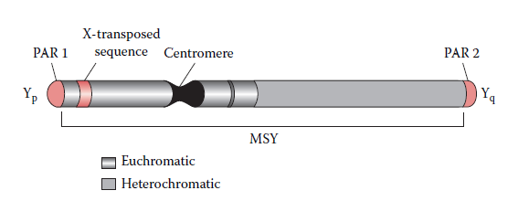
Figure 1. Human Y-STR chromosome structure. PAR = pseudo-autosomal region. MSY = male-specific Y region. Yp = short arm of Y chromosome. Yq = long arm of Y chromosome.

Slide 67
Male-Specific Y Region
The remainder of the Y chromosome is known as the MSY region.
It was previously called the non-recombining Y (NRY) region (Figure 1 above) or it does not participate in homologous recombination.
However, certain sections involve intra chromosomal gene conversion.
About 40 megabases (Mb) within the MSY region are heterochromatic (highly repetitive sequences) including the centromeric region and the bulk of the distal long arm.

Slide 68
The euchromatic region is about 23 Mb and most of it has been sequenced.
Certain sections of the euchromatic region share some homology with the X chromosome.
For instance, X-transposed sequences of the Y chromosome are 99% identical to sequences within Xq21 (a band in the long arm of the X chromosome).
Additionally, dozens of genes located in the euchromatic region share 60% to 96% homology with their X chromosome counterparts.
These X-homologous regions should be avoided when selecting Y chromosome-specific markers for forensic DNA profiling.

Slide 69
3 Polymorphic Sequences
The Y chromosome contains an abundance of repetitive elements, namely STRs, Alu, and LINE elements.
Many of these are highly polymorphic.
To date Y-STRs are usually used for Y chromosome DNA testing.
Single nucleotide polymorphisms (SNPs) at the Y chromosome are also useful for forensic applications.

Slide 70
Profiling Systems
Y-STR
More than 400 STR loci have been identified in the Y chromosome genome.
The precise locations of these loci have been sequentially mapped using human genome sequencing data.
The distribution of Y-STR loci at the Y chromosome has also been analyzed.
Most Y-STR loci, approximately 60% of the 400 identified, are located at the long arm of the chromosome; about 22% are located at the short arm and a few are found in the centromeric region.
Y-STRs in the telomeric region have yet to be identified.
Only about 5% of Y-STRs are located within 5′ untranslated or intron regions of protein coding genes.

Slide 71
The repeat unit length of identified Y-STRs have been analyzed.
Among the 400 Y-STRs, 6% are dimeric repeats, 39% are trimeric, 45% are tetrameric, 9% are pentameric, and 1% are hexameric.
Fewer than half the STRs have been characterized. Some loci are polymorphic and are useful for forensic applications and developing new Y-STR multiplex systems.
The STR loci at the Y chromosome are usually referred to as haplotypes.
A haplotype is a collection of alleles that are usually linked (inherited together) since homologous recombination does not occur on the majority of the Y chromosome.

Slide 72
2. Core Y-STR Loci
In 1997, the European minimal haplotype (EMH) locus set was recommended by the International Y-STR User Group for forensic applications.
This haplotype set includes a core set of nine Y-STR loci: DYS19, DYS385 a and b, DYS389I, DYS389II, DYS390, DYS391, DYS392, and DYS393.
In 2003, the U.S. haplotype loci were recommended by the Scientific Working Group on DNA Analysis Methods (SWGDAM) for forensic DNA analysis.
The U.S. haplotype loci includes the EMH loci set plus two additional loci, DYS438 and DYS439.

Slide 73
DYS385 and DYS389 are multi-local Y-STR loci (MLL).
The MLL designation refers to a presence of a particular STR at more than one site on the Y chromosome DNA due to duplication.
To date, about 50 such MLL Y-STRs have been identified. Further MLL subdivisions are designated bi-local, trilocal, etc. DYS385 and DYS389 are bi-local.
The DYS385 locus has two inverted duplicated clusters and is separated by a 4 × 104 bp interstitial region (Figure 19.5).
It can be amplified by a single set of primers. One allele is observed if the duplicates are the same length.
If the duplicated clusters have different lengths, they can generate two different alleles when amplified.
The smaller sized allele is designated “a” and the larger sized allele is designated “b.”

Slide 74
The DYS389 locus has two duplicated clusters with the same orientation.
In a single set of PCR primers, there are two binding sites for the same forward primer at each 5′ flanking sequence of the core repeat region of DYS389.
These binding sites between DYS389I and DYS389II are about 120 bp apart.
Therefore, two amplicons are produced.
DYS389I is designed for the smaller allele and DYS389II is designated for the larger allele.
The average mutation rate for the core Y-STR loci is approximately 10^{–3} per generation—similar to the mutation rate of autosomal STR loci. Mutations can exert major impacts on the interpretation of paternity test results.

Slide 75
3 Multiplex Y-STR
The application Y-STR for forensic casework was initiated in Europe.
In the U.S., the laboratory of the Office of Chief Medical Examiner in New York City was the first to perform Y-STR testing of four loci (DYS19, DYS390, DYS389I and II) for casework.
The use of Y-STR loci has been facilitated by various commercially available PCR amplification kits in multiplex systems.
ReliaGene Technologies developed the first commercial multiplex Y-STR system, the Y-PLEXTM6.
The kit includes DYS19, DYS385a and b, DYS389II, DYS390, DYS391, and DYS393.

Slide 76
Additional commercially available kits with more Y-STR loci are now available and have been validated for forensic use.
To improve discriminating power, multiplex systems including new Y-STR loci are desired.
Many new Y-STR loci are being characterized for developing new multiplex systems.

Slide 77
Gender Typing
Gender typing of a biological sample is useful in forensic investigation, for example, for victim identification in disaster cases and suspect identification in sexual assaults.
One commonly used gender typing marker is the amelogenin (AMEL) locus.
1 Amelogenin Locus
This region encodes extracellular matrix proteins involved in tooth enamel formation.
Mutations in the AMEL gene can lead to an enamel defect known as amelogenesis imperfecta.

Slide 78
The AMEL locus has two homologous genes: AMELX (Xp22.1–Xp22.3) is located on the human X chromosome and AMELY (Yp11.2) is located on the human Y chromosome.
Although the genes constitute a homologous pair, they differ in size and sequence.
Gender typing can be performed using various primers designed specifically for the sequences of the homologous region on these genes, followed by amplification. Different sizes of amplicons are obtained.
The most commonly used gender typing method at the AMEL locus is the detection of a 6-bp deletion at intron 1 of AMELX.
This deletion is not present in AMELY.

Slide 79
Primer sets were developed to amplify both alleles in a single PCR by Forensic Science Service in the United Kingdom in 1993.
The amplicons generated from AMELY and AMELX are separated by electrophoresis.
The observation of the AMELX fragment alone indicates a female, whereas the observation of both AMELX and AMELY indicates a male.
Nevertheless, primate and some rudiment DNA can be amplified as well but the amplicon sizes vary.
The AMEL locus has been co-amplified with other markers to provide a combined gender and identity test.
Such combined tests have been used in D1S80 AFLP and various STR multiplex analyses.

Slide 80
2 AMELY Null Mutations
Several cases of AMELY null mutations have been reported.
Only the AMELX fragment was detected in these AMELY null males.
Many of them are phenotypically normal but present the AMEL gender types of females.
Various interstitial deletions at the Y chromosome short arm have been identified as the cause of some AMELY null gender typing.
The frequency of AMELY null males is rare, but is higher in Sri Lanka and India.

Slide 81
Mitochondrial DNA Profiling
Forensic mitochondrial DNA (mtDNA) analysis is a useful tool for human identification.
Because mtDNA is maternally inherited, it is especially useful for identifying victims.
Additionally, the mtDNA genome produces much higher numbers of copies per cell than the nuclear genome.
Thus, mtDNA testing is frequently used when nuclear DNA in samples is insufficient.
For example, hair shafts, bones, and decomposed samples may be tested with mtDNA analysis.

Slide 82
Human Mitochondrial Genome
Mitochondria are subcellular organelles that serve as the energy-generating components of cells (Figure 1).
Each cell contains hundreds of mitochondria that have their own extrachromosomal genomes separate from the nuclear genome.
Although each human mitochondrion contains several copies of the mtDNA genome, the exact copy number varies for each cell.
However, it is estimated that hundreds of copies of mtDNA genome exist in most cell types.
Recombination has not been observed in mtDNA.
Thus, the mtDNA type, also referred to as the mitotype, is considered a haplotype treated as a single locus.
The mitochondrial genome has a higher mutation rate (up to 10 times higher) than its nuclear counterpart.

Slide 83
1 Genetic Contents of Mitochondrial Organelle Genomes
Organelle genomes are usually much smaller than their nuclear counterparts.
The much smaller mitochondrial genome has been sequenced and is known as the Cambridge reference sequence.
It was established in the early 1980s, later modified, and is now known as the revised Cambridge reference sequence (rCRS) that is presently used as the standard for sequence comparisons.
The human mitochondrial genome is a circular DNA molecule consisting of 16,569 bp containing 37 genes (Figure 1.).
Thirteen of these genes code for proteins involved in the respiratory complex, a main energy-generating component in mitochondria.

Slide 84
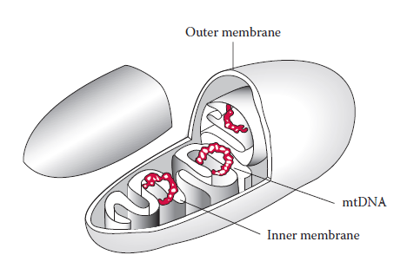
Figure 1 Mitochondrion. mtDNA = mitochondrial DNA.

Slide 85
The other 24 specify noncoding RNA molecules required for expression of the mitochondrial genome.
The genes in the human mitochondrial genome are much more closely packed than in the nuclear genome and contain no introns.
A control region, also known as a displacement loop (D loop), contains the origin of replication for one of the mtDNA strands but does not code for any gene products (Figure 2).
An asymmetric distribution of nucleotides gives rise to light (L) and heavy (H) strands when mtDNA molecules are separated in alkaline CsCl gradients.
The H strand that contains a greater number of guanine nucleotides has a higher molecular weight in comparison to the L strand.

Slide 86
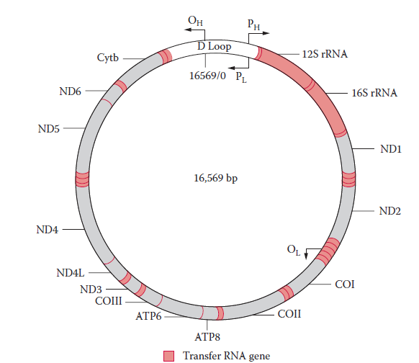
Figure 2. Human circular mitochondrial genome.
The transcription direction for the H (heavy) and L (light) strands are indicated by arrows (PH, PL).
The origins of replication are labeled OH for heavy strand and OL for light strand, respectively.
The mitochondrial DNA genome encodes genes. ND = NADH coenzyme Q oxidoreductase complex. CO = cytochrome c oxidase complex. Cytb = cytochrome b. ATP = ATP synthase. rRNA, ribosomal RNA.
Transfer RNA genes are shown as indicated.

Slide 87
2 Maternal Inheritance of mtDNA
Maternal inheritance is typically observed for the mtDNA genome.
mtDNA is inherited differently from nuclear genes; it does not obey the rules of Mendelian inheritance and is thus called non Mendelian inheritance.
The mitochondria of the spermatozoa are located at the mid pieces of spermatozoa.
At conception, only the head portion of a spermatozoon (containing a nucleus but no mitochondria) enters the egg.
The fertilized egg contains the maternal mitochondria which is transmitted to progeny.
The mtDNA sequence is identical for relatives within the same maternal lineage (Figure 3).
This characteristic of maternal inheritance is useful for identifying samples by comparing them with samples from maternal relatives.

Slide 88
mtDNA Polymorphic Regions
Hypervariable Regions
Heteroplasmy
Hypervariable Regions
The most polymorphic region of mtDNA is located within the D loop (Figure 4).
The three hypervariable regions in the D-loop region are designated HV1 (16024–16365; 342 bp), HV2 (73–340; 268 bp), and HV3 (438–574; 137 bp).
The most common polymorphic regions of the human mtDNA genome analyzed for forensic purposes are the two hypervariable regions within the D loop known as hypervariable region I (HV1) and hypervariable region II (HV2).

Slide 89
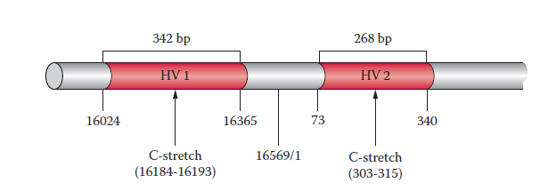
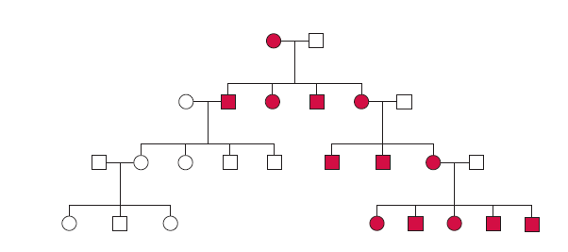
Figure 4 Hypervariable regions of the D loop in mtDNA (with nucleotide positions).
Figure 3 Pedigree of a human family showing inheritance of mtDNA Females and males are denoted by circles and squares, respectively.
Red symbols indicate individuals who inherited the same mtDNA.

Slide 90
Heteroplasmy
Heteroplasmy occurs when an individual carries more than one mtDNA haplotype. Occurs due to non disjunction during meiosis.
Heteroplasmy may be observed with one type of tissue and be absent in other tissue types; for example, it is commonly observed in hair samples.
Several instances of heteroplasmy may be observed in different tissue types.
An individual may exhibit one mitotype in one tissue and a different mitotype in another.
Thus, it is necessary to obtain and process additional samples to confirm the heteroplasmy when it is observed in a questioned sample but not in a known sample or vice versa.
The two types of Heteroplasmy are sequence and length heteroplasmies.

Slide 91
Sequence Heteroplasmy
Sequence heteroplasmy is defined as the presence of two nucleotides at a single position shown as overlapping peaks in a sequence electropherogram (Figure 5).
Heteroplasmy usually occurs at one position, but on rare occasions can be observed at more than one position.
Heteroplasmy may complicate the interpretation of mtDNA results, but its presence can also improve the strength of a match

Slide 92
Length Heteroplasmy
Both HV1 and HV2 of the human mtDNA D-loop region contain homopolymeric cytosine sequences known as C stretches.
The HVI region contains a C stretch between positions 16184 and 16193, interrupted by a thymine at position 16189.
If a base transition from T to C occurs at position 16189 (a variant present in approximately 20% of the population), it results in an uninterrupted C stretch.
A similar C stretch resides between positions 303 and 315 of the HV2 region.
Length heteroplasmies are often observed at the uninterrupted C stretches, which create serious problems with sequence analysis downstream from the homopolymeric regions (Figure 6).
It is not clear whether the length heteroplasmy is due to replication slippage at the C stretches or results from a mixture of length variants in the cells.
If length heteroplasmy occurs, alternative sequencing primers can be used to obtain the downstream sequences of the C stretches.

Slide 93
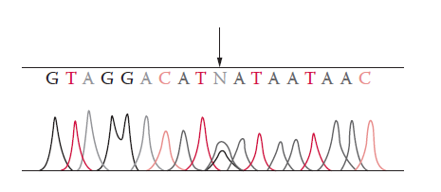
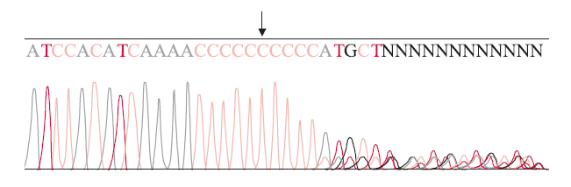
Figure .5 Electropherogram showing mtDNA sequence heteroplasmy at position 234 R (A/G) as indicated by arrow. N = unresolved sequence.
Figure .6 Electropherogram showing mtDNA length heteroplamy at C stretch of HV1 region where position 16189 is a C as indicated by arrow. N = unresolved sequence.

Slide 94
Forensic mtDNA Testing
1 General Considerations
mtDNA analysis is often used on samples derived from skeletal or decomposed remains.
The surface of the sample should be cleaned to remove any adhering debris or contaminants.
Bones and teeth are pulverized to facilitate extraction of the mtDNA.
Duplicate extractions (e.g., two sections of a single hair) are recommended if sufficient sample material is available.
mtDNA is extracted using a similar method to nuclear DNA (nuclear DNA is coextracted with mtDNA).
The amount of mtDNA can therefore be estimated from the quantity of nuclear DNA obtained.

Slide 95
For mtDNA sequencing, analysis of both strands of the mtDNA in a given region must be performed to ensure accuracy.
Due to the high sensitivity of mtDNA analysis, it is essential to minimize risks of contamination during the procedure.
Contamination must be strictly monitored using proper controls such as reagent blanks and negative controls (samples containing all reagents except DNA template).
Finally, a positive control must also be used to monitor the success of the analysis.
It should be introduced at the amplification step and remain through the sequencing process.
A positive control consists of a DNA template of known sequence such as DNA purified from an HL60 cell line.

Slide 96
mtDNA Sequencing
To sequence a specific region of mtDNA, a combination of PCR amplification and DNA sequencing techniques is employed that reduce the time and labor needed to obtain DNA sequences from genomic DNA templates.
mtDNA sequencing usually consists of
    PCR amplification,
    DNA sequencing reactions,
    separation using electrophoresis, and
    data collection and sequence analysis .

Slide 97
PCR Amplification
The extracted DNA samples must be amplified to yield sufficient quantities of template for sequencing reactions.
PCR amplification of all or a part of the D loop region can be carried out with various primer sets.
If a sample contains high quality and high copy number mtDNA, the HV1, and HV2 regions can be amplified as two amplicons, each of about 350 to 400 bp in length.
If a sample is degraded or contains low copy number mtDNA, the hypervariable regions can be amplified as smaller PCR products. PCR amplification of mtDNA is usually done in 34 to 38 cycles.
Protocols for highly degraded DNA specimens sometimes require 42 cycles.

Slide 98
The use of higher PCR cycle numbers can improve the yield of the amplicon.
Following mtDNA amplification, a purification step is necessary to remove excess primers and deoxynucleotide triphosphates (dNTPs).
This step can be performed by using filtration devices such as a MicroconR to remove small molecules from the sample or by using nuclease digestion with shrimp alkaline phosphatase or exonuclease I to degrade remaining primers and dNTPs.
The concentration of the PCR product is important for an optimal sequencing reaction in the next phase of mtDNA sequencing.
The quality and quantity of the mtDNA amplicon must be evaluated to confirm the presence or absence of PCR products and their concentrations.
This can be done using an agarose yield gel to visualize the PCR products of the sample or via capillary electrophoresis, a more informative method, for quantifying PCR products.

Slide 99
DNA Sequencing Reactions
The best known DNA sequencing techniques are the chain termination method and the chemical degradation method developed, respectively, by Sanger and Gilbert.
Over the years, the chain termination method became more common because it was applicable for automation and did not require the toxic chemicals necessary for the chemical degradation method.

Slide 100
Electrophoresis and Sequence Analysis
The cycle sequencing products can be separated using electrophoresis in a 4% polyacrylamide denatured gel or a POP-6 polymer (Applied Biosystems) as the matrix for capillary electrophoresis.
Following data collection, sequence data analysis can be performed with the Sequencher™software (Gene Codes Corporation, Ann Arbor, MI, USA).

Slide 101
Interpretation of mtDNA Profiling Results
Interpretation guidelines are used when the evaluation of sequencing results from evidence and reference samples are necessary.
General guidelines were set forth by the Scientific Working Group on DNA Analysis Methods (SWGDAM) and the DNA Commission of the International Society of Forensic Genetics (ISFG).
The limitations of mtDNA technology should be taken into account as should the higher mutation rates found with the mtDNA genome than found with the nuclear genome.
Mutations seem to be more common in certain tissues.
For that reason the sources of the tissues investigated should be taken into consideration as well.
In reporting mtDNA profiling results, the most common categories of conclusions are: cannot exclude, exclusion, and inconclusive result.

Slide 102
Exclusion — If the sequences are different, then the samples can be excluded as originating from the same source.
Additionally, the SWGDAM’s guidelines define that this conclusion can be made if there are two or more nucleotide differences between the questioned and known samples.
Cannot exclude — If the sequences are the same, the reference sample and evidence cannot be excluded as potentially arising from the same source.
When a mtDNA proﬁle cannot be excluded, it is desirable to evaluate the weight of the evidence.
In cases where the same heteroplasmy is observed in both questioned and known samples, its presence increases the strength of the evidence.

Slide 103
However, if heteroplasmy is observed in a questioned sample but not in a known sample or vice versa, a common maternal lineage still cannot be excluded.
Inconclusive result — If the questioned and known samples differ by a single nucleotide, and no evidence of heteroplasmy is present, the interpretation may be that the results are inconclusive.

