Slide 1
Chapter 9: LABORATORY DIAGNOSIS OF INFECTIOUS DISEASES
Course code: Biot. 3113
Course name: Medical Biotechnology
Department of Biotechnology
University of Gondar

Slide 2
Infectious disease is:
    A group of common diseases
    Caused by different pathogens
    To possessing infectivity
    To form epidemic
    Infectious disease is a threat to the health of people
    The pathogens causing infectious diseases are:
      Virus, Chlamydia, rickettsia, mycoplasma, spirochete, bacteria, fungus, protozoa and helminthes

Slide 3
Infection and Immunity
Definition of infection
  Complex process of interaction between pathogen and human body
  Infection is composed of three factors: pathogen, host and environment
  There are commensalisms and opportunistic infection
Manifestations of infectious process (Infection spectrum)
  Clearance of pathogen
    Covert infection (Subclinical infection)
    Overt infection (Clinical infection or apparent infection)
    Carrier state

Slide 4
The five periods of disease (sometimes referred to as stages or phases) include:
  the incubation,
  prodromal,
  illness,
  decline, and
  convalescence periods.
The incubation period occurs in an acute disease after the initial entry of the pathogen into the host (patient).

Slide 5
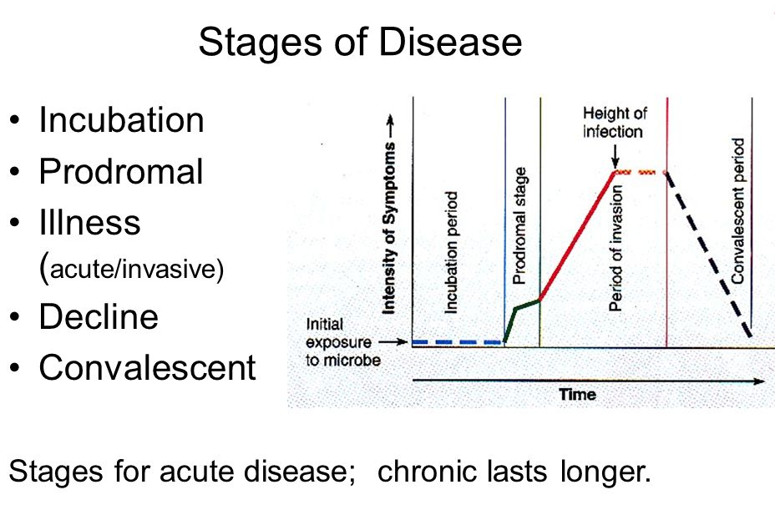

Slide 6
Features of infectious disease
Clinical features
Regularity in the development of course
  Incubation period : diagnosis, quarantine period
  Prodromal period
  Period of apparent manifestation
  Convalescent period
  Relapse
  Recrudescence

Slide 7
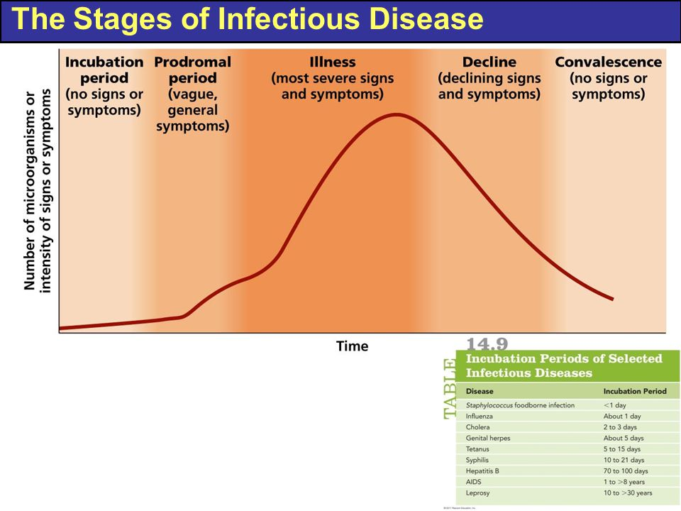

Slide 8
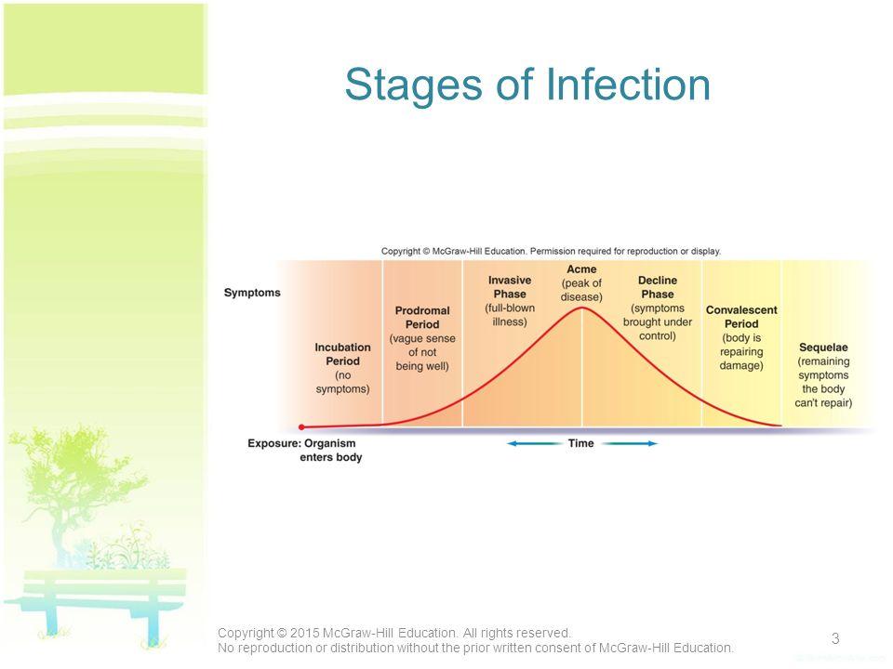

Slide 9
Chronic carrier:
  For longer period
Latent infection
  A latent infection is an infection that is hidden, inactive, or dormant.
  As opposed to active infections, where a virus or bacterium is actively replicating and potentially causing symptoms, latent infections are essentially static.

Slide 10
Infection and Immunity
The action of pathogen in infectious process
  The pathogenicity of pathogen is related to: (is the ability to produce disease in a host organism).
    Invasiveness: disease or condition that has a tendency to spread.
    Virulent: extremely severe or harmful in its effects.
    Number of pathogen
    Mutation (variability)

Slide 11
Infection and Immunity
The action of immune reaction of host in infectious process
Non specific immunity
  Barrier action (natural barrier)
    External barrier:
      skin , mucosa
    Secretion of skin and mucosa
    Accessory organ

Slide 12
  Internal barrier: placenta, blood-brain barrier
  Phagocytosis
  Humoral action:
    Complement, Lysozyme, Fibronection, Cytokines.
    The complement system is a part of the immune system that enhances (complements) the ability of antibodies and phagocytic cells to clear microbes and damaged cells from an organism, promotes inflammation, and attacks the pathogen's cell membrane.
Specific immunity
  Humoral immunity
    Immunoglobulin: IgG, IgM, IgE, IgA, IgD
  Cell mediated immunity

Slide 13
Epidemic process and epidemic factors of infectious disease
the process of the rise and the spreading of the infectious diseases among the people.
Source of infection (basic conditions)
Patients (acute, chronic),
Covert infection ,
Carrier ,
Infected animal

Slide 14
Epidemic process and epidemic factors of infectious disease
Route of transmission
Contact transmission ( direct and indirect),
Air-borne,
Food water fly borne,
Insects borne,
Blood borne,
Soil borne.
Susceptibility of population
Factors of influencing epidemic process
nature factors, social factors

Slide 15
Features of infectious disease
Basic features
  Pathogen
    kinds of pathogen
  Infectivity
  Epidemiological features
    Quality : exotic, local, endemicity
Quantity :
  sporadic occurrence,
  epidemic,
  pandemic,
  outbreak,
  endemicity,
  seasonal

Slide 16
Features of infectious disease
Post infection immunity
  Viral infection: life-long immunity
  Bacteria infection: shorter immunity
  Helminthes infection: no protective immunity
  Protozoa infection: shorter immunity

Slide 17
Fever:
  Elevated core temperature, often, but not necessarily, part of the systemic acute phase response to pathogens or other perceived threats.
  Fever enhances hosts immunity, increasing WBC count, decreases iron for bacterial growth, stimulates cytokines.
  Its duration and degree depend on the severity of the threat and the body's ability to respond.
Body Temperature
  Body temperature is the amount of heat produced - heat lost.
  Internal core temperature is a more reliable indicator than surface temperature, which can change according to the environment or physical activity.
  'Core' areas include tympanic membrane, rectum, bladder, esophagus, or pulmonary artery, the most representative.
  Recall: C = 5/9 (F-32) F = 9/5 (C+32)

Slide 18
Applications of Molecular Based Testing in Clinical Microbiology
Rapid or high-throughput identification of microorganisms
Detection and analysis of resistance genes
Genotyping
Classification
  Discovery of new microorganisms

Slide 19
Laboratory Investigation of Microbial infections
Examining specimens to detect isolate and identify pathogens:
  1- Microscopy
  2- Culture techniques
  3- Biochemical reactions
  4- Serological identification:
  5- Molecular biology techniques
  6- Bacteriophage typing

Slide 20
1- Microscopy
Microorganisms can be examined microscopically for:
a- Bacterial motility:
Hanging drop method:
  A drop of bacterial suspension is placed between a cover slip and glass slid
b- Morphology and staining reactions of bacteria:
Simple stain: methylene blue stain

Slide 21
1- Microscopy
Gram stain: differentiation between Gm+ve and Gm–ve bacteria
. Primary stain (Crystal violet)
. Mordant (Grams Iodine mixture)
. Decolorization (ethyl alcohol)
. Secondary stain ( Saffranin)
Ziehl-Neelsen stain: staining acid fast bacilli
. Apply strong carbol fuchsin with heat
. Decolorization (H2SO4 20% and ethyl alcohol
. Counter stain (methylen blue)

Slide 22
2- Culture Techniques
* Culture media are used for:
- Isolation and identification of pathogenic organisms
- Antimicrobial sensitivity tests
* Types of culture media:
a- Liquid media:
- Nutrient broth: meat extract and peptone
- Peptone water for preparation sugar media
- Growth of bacteria detected by turbidity
b- Solid media:
- Colonial appearance
- Hemolytic activity
- Pigment production

Slide 23
Types of solid media
1- Simple media:
    Nutrient agar
2- Enriched media: media of high nutritive value
  Blood agar
  Chocolate agar
  Loffler’s serum

Slide 24
Types of solid media
3- Selective media: allow needed bacteria to grow
. Lowenstein–Jensen medium
. MacConkeys agar
. Mannitol Salt Agar
4- Indicator media: to different. between lact. and non lact. ferment
. MacConkeys medium
. Eosine Methlyne blue Agar
5- Anaerobic media: for anaerobic cultivation
. Deep agar, Robertson’s Cooked Meat Medium

Slide 25
Colonial appearance on culture media
* Colony morphology:
. Shape . Size . Edge of colony . Color
* Growth pattern in broth:
. Uniform turbidity
. Sediment or surface pellicle
* Pigment production:
. Endopigment production (Staph. aureus)
. Exopigment production (Ps. aeruginosa)

Slide 26
Serological identification
A- Direct serological tests:
- Identification of unknown organism
- Detection of microbial antigens by using specific known antibodies
- Serogrouping and serotyping of isolated organism
B- Indirect serological tests:
- Detection of specific and non specific antibodies
(IgM & IgG) by using antigens or organisms

Slide 27
DIAGNOSTIC TECHNOLOGIES
Immunoserology
  Hemagglutination
  EIA
  Latex agglutination
  Complement fixation
  Immunoflorecent

Slide 28
RAPID DIAGNOSTIC TESTS
High sensitivity and specificity
High negative and positive predictive values
High accuracy compared to gold standard
Simple to perform
Rapid turn around time
Cost effective

Slide 29
LIMITATIONS OF CONVENTIONAL CLINICAL MICROBIOLOGY
Culture
  Labor intensive
  Need for special media
  Prolonged period of time to culture
  Some organisms are uncultivable on artificial media
  Potential health hazards
Antigen Detection
  Negative tests require confirmation
  Effected by poor specimen collection
  Low microbe burden
Serology
  Unhelpful during early stage of infection
  Not quite useful in immunocompromised patients

Slide 30
Molecular Biology Techniques
A- Genetic probes (DNA or RNA probes):
  Detection of a segment of DNA sequence (gene) in unknown organism using a labeled probe
Probe: consists of specific short sequence of labeled single-stranded DNA or RNA that form strong covalently bonded hybrid with specific complementary strand of nucleic acid of organism in question

Slide 31
Molecular Biology Techniques
B- Polymerase chain reaction (PCR):
  Amplification of a short sequence of target DNA or RNA.
  Then it is detected by a labeled probe
C- Plasmid profile analysis:
  Isolation of plasmids from bacteria and determination of their size and number compared with standard strains by agarose gel electrophoresis

Slide 32
MOLECULAR DIAGNOSTICS
Most widely used is PCR
  High sensitivity
  High specificity
  Diversity
Nucleic acid probes
  Do not amplify DNA

Slide 33
Specific PCR: uses primers to known DNA targets. Use when conventional diagnostics are inadequate, time consuming, difficult and hazardous.
Broad range PCR: uses complementary primers to conserved regions shared by a given taxonomic group.
  Used in cases of B. henselae and Mycobacterium spp.
Multiplex PCR
  Uses single clinical specimen to investigate several potential pathogens simultaneously
    Encephalitis/meningitis panel: HSV,VZV, CMV HHV-6, EBV, Enteroviruses
Real-time PCR
  Utilizes a fluorescent labeled probe
  Requires small volumes thus takes 30-60 minutes to complete

Slide 34
PCR Detection of Microorganisms: Quality Control
PCR and other amplification methods are extremely sensitive and very specific.
For accurate test interpretation, use of proper controls.
  Positive control: positive template
  Negative control: negative template
  Amplification control: omnipresent template unrelated to target
  Reagent blank: no template present

Slide 35
  Positive control: receives a treatment with a known response, so that this positive response can be compared to the unknown response of the treatment.
  Negative control: is a group in which no response is expected.
    It is the opposite of the positive control, in which a known response is expected.
  Amplification control: omnipresent template unrelated to target.
    DNA sequence present in the same tube as the sample, which is coamplified simultaneously with the target.
  Reagent blank: no template present

Slide 36
Internal controls are used as indicator of perfect nucleic acid extraction, quality of samples, quality of PCR.
Internal controls can be either:
  homologous extrinsic,
  heterologous extrinsic, or
  heterologous intrinsic.
A homologous extrinsic control is a wild-type-derived control with a non target-derived sequence insert.

Slide 37
A heterologous extrinsic control is a non-target-derived control added to each sample prior to nucleic acid extraction.
It requires a duplex amplification of target DNA or RNA and control DNA or RNA in a single reaction.
A heterologous intrinsic control confirms the presence of human nucleic acid and thus cellular material in the sample.

Slide 38
PCR Quality Control: Internal Controls
Homologous extrinsic
  Controls for amplification
Heterologous extrinsic
  Controls for extraction and amplification
Heterologous intrinsic
  Human gene control
Target sequence

Slide 39
Quality Control: False Positives
Contamination: check reagent blank
Dead or dying organisms: retest 3–6 weeks after antimicrobial therapy
Detection of less than clinically significant levels

Slide 40
Real time PCR for Diagnosis of Infectious Disease
Detect PCR product during synthesis
Requires fluorescence-based detection and specialized detection instrumentation
Advantages
  Less time for results
  Improved analytical sensitivity
  Broad applicability (target characterization, load determination etc)

Slide 41
OTHER USES OF MOLECULAR DIAGNOSTICS
Viral load monitoring
Viral genotyping
Bacterial resistance detection
Bacterial genotyping

Slide 42
LIMITATION OF PCR TECHNOLOGIES
Specimen should be frozen until amplification
No antimicrobial sensitivity is available
Needs the clinician to name the suspect
Cost
False positives caused by amplification of contaminants
Only sample from normally sterile sites should be considered for broad-range PCR
Specimen is required to be refrigerated or stored in alcohol before processing

