Slide 1
Chapter 10: Overview of Nucleic Acid-Based Diagnostic Techniques
Course code: Biot. 3113
Course name: Medical Biotechnology
Department of Biotechnology
University of Gondar

Slide 2
Introduction
Attributes of molecular assays
Advantages
High sensitivity
Earlier detection of infections
Quantification
Species differentiation
Strain identification to distinguish new and recrudescent infections
Potential for high throughput
Disadvantages
Can be time consuming
Expensive
Extensive training required
Mixed infections require more elaborate assay designs
Requires cross contamination provisions
Standardization is complicated
Notes:
We’re all guilty of this. We’ve all written the two column advantages/disadvantages of NAATs. Good for simplicity for slide decks and proposals. But this approach is woefully lacking details useless to anyone contemplating use of a molecular technology for dx.

Slide 3
Drivers of Molecular Diagnostics Innovation
Malaria surveillance programs
Epidemiology research
Blood bank screening
Travel medicine
Hunt for sub-patent asymptomatics
Vaccine and drug studies
Passive case detection
Genotyping for origin and resistance
Competition for intellectual property – financial gains
Notes:
Tie in to use-scenarios and LOD timeline
Sauerwein RW, Roestenberg M, Moorthy VS: Experimental human challenge infections can accelerate clinical malaria vaccine development. Nat Rev Immunol 2011, 11:57–64.
16. Moorthy VS, Diggs C, Ferro S, Good MF, Herrera S, Hill AV, Imoukhuede EB,
Kumar S, Loucq C, Marsh K, Ockenhouse CF, Richie TL, Sauerwein RW:Report of a consultation on the optimization of clinical challenge trials for evaluation of candidate blood stage malaria vaccines, 18–19 March 2009, Bethesda, MD, USA. Vaccine 2009, 27:5719–5725.
Hermsen CC, De Vlas SJ, Van Gemert GJA, Telgt DS, Verhage DF, Sauerwein RW: Testing vaccines in human experimental malaria; statistical analysis of parasitemia measured by a quantitative real-time polymerase chain reaction. Am J Trop Med Hyg 2004, 71:196–201.
19. Bejon P, Andrews L, Andersen RF, Dunachie S, Webster D, Walther M, Gilbert SC, Peto T, Hill AV: Calculation of liver-to-blood inocula, parasite growth rates, and preerythrocytic vaccine efficacy, from serial quantitative polymerase chain reaction studies of volunteers challenged with malaria sporozoites. J Infect Dis 2005, 191:619–626.

Slide 4
1. Operational Characteristics
Types of PCR
Single-step
Nested
Multiplexed
Quantitative
Design variables
Extraction
Choice of target
Infrastructure capacity

Slide 5
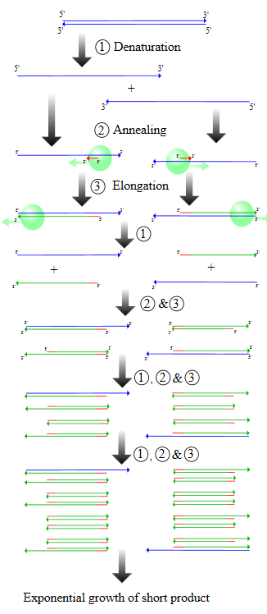
Single-Step PCR
Fewer steps and time compared to nested
Less risk of contamination
Electrophoresis gel readout
Range of limit of detection from 0.002-30 p/µl
Trade-off – less sensitive than nested
Notes:
The PCR process can be divided into three stages:
Exponential amplification: At every cycle, the amount of product is doubled (assuming 100% reaction efficiency). The reaction is very sensitive: only minute quantities of DNA need to be present.^{[14]}
Leveling off stage: The reaction slows as the DNA polymerase loses activity and as consumption of reagents such as dNTPs and primers causes them to become limiting.
Plateau: No more product accumulates due to exhaustion of reagents and enzyme
Procedure[edit]
Figure 2: Schematic drawing of the PCR cycle. (1) Denaturing at 94–96 °C. (2) Annealing at ~65 °C (3) Elongation at 72 °C. Four cycles are shown here. The blue lines represent the DNA template to which primers (red arrows) anneal that are extended by the DNA polymerase (light green circles), to give shorter DNA products (green lines), which themselves are used as templates as PCR progresses.
Typically, PCR consists of a series of 20-40 repeated temperature changes, called cycles, with each cycle commonly consisting of 2-3 discrete temperature steps, usually three (Fig. 2). The cycling is often preceded by a single temperature step (called hold) at a high temperature (>90°C), and followed by one hold at the end for final product extension or brief storage. The temperatures used and the length of time they are applied in each cycle depend on a variety of parameters. These include the enzyme used for DNA synthesis, the concentration of divalent ions and dNTPs in the reaction, and the melting temperature (Tm) of the primers.^{[10]}
Initialization step: This step consists of heating the reaction to a temperature of 94–96 °C (or 98 °C if extremely thermostable polymerases are used), which is held for 1–9 minutes. It is only required for DNA polymerases that require heat activation by hot-start PCR.^{[11]}
Denaturation step: This step is the first regular cycling event and consists of heating the reaction to 94–98 °C for 20–30 seconds. It causes DNA melting of the DNA template by disrupting the hydrogen bonds between complementary bases, yielding single-stranded DNA molecules.
Annealing step: The reaction temperature is lowered to 50–65 °C for 20–40 seconds allowing annealing of the primers to the single-stranded DNA template. Typically the annealing temperature is about 3-5 degrees Celsius below the Tm of the primers used. Stable DNA-DNA hydrogen bonds are only formed when the primer sequence very closely matches the template sequence. The polymerase binds to the primer-template hybrid and begins DNA formation.
Extension/elongation step: The temperature at this step depends on the DNA polymerase used; Taq polymerase has its optimum activity temperature at 75–80 °C,^{[12][13]} and commonly a temperature of 72 °C is used with this enzyme. At this step the DNA polymerase synthesizes a new DNA strand complementary to the DNA template strand by adding dNTPs that are complementary to the template in 5' to 3' direction, condensing the 5'-phosphate group of the dNTPs with the 3'-hydroxyl group at the end of the nascent (extending) DNA strand. The extension time depends both on the DNA polymerase used and on the length of the DNA fragment to be amplified. As a rule-of-thumb, at its optimum temperature, the DNA polymerase will polymerize a thousand bases per minute. Under optimum conditions, i.e., if there are no limitations due to limiting substrates or reagents, at each extension step, the amount of DNA target is doubled, leading to exponential (geometric) amplification of the specific DNA fragment.
Final elongation: This single step is occasionally performed at a temperature of 70–74 °C for 5–15 minutes after the last PCR cycle to ensure that any remaining single-stranded DNA is fully extended.
Final hold: This step at 4–15 °C for an indefinite time may be employed for short-term storage of the reaction.

Slide 6
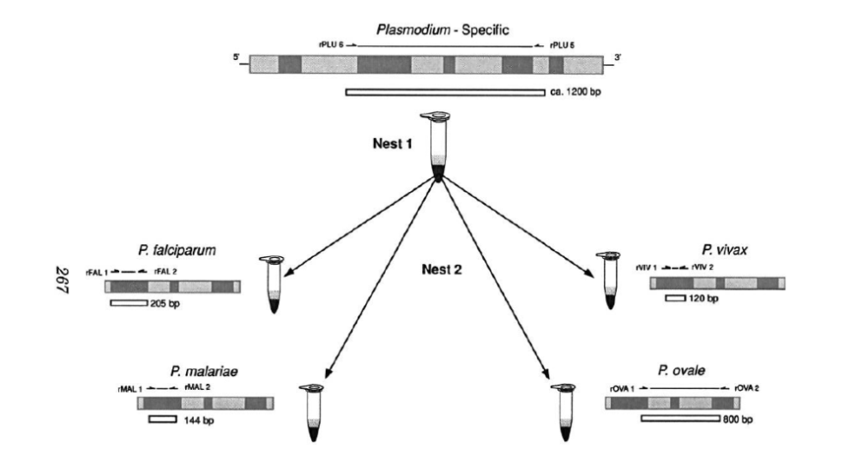
Nested PCR
Increased specificity – two sets of primers
Two reactions with sample transfer between them
First assay to detect presence of fewer than 10 parasites from the 4 human malaria species
Time and cost
Opening tubes risks contamination
Notes:
Nested PCR: increases the specificity of DNA amplification, by reducing background due to non-specific amplification of DNA. Two sets of primers are used in two successive PCRs. In the first reaction, one pair of primers is used to generate DNA products, which besides the intended target, may still consist of non-specifically amplified DNA fragments. The product(s) are then used in a second PCR with a set of primers whose binding sites are completely or partially different from and located 3' of each of the primers used in the first reaction. Nested PCR is often more successful in specifically amplifying long DNA fragments than conventional PCR, but it requires more detailed knowledge of the target sequences.

Slide 7
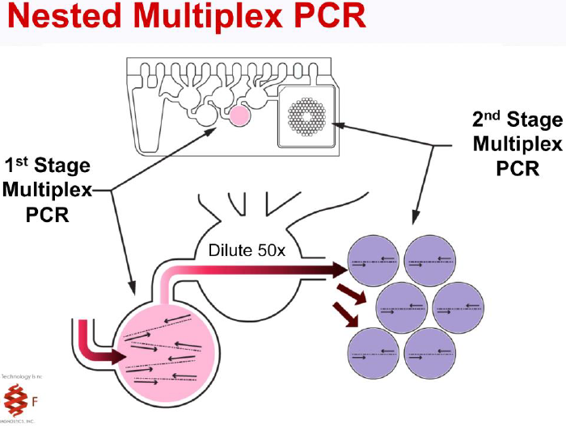
Multiplexed PCR
Simultaneous, multiplex PCR to detect malarial species present
Cost and time savings
Primer competition – decreased sensitivity compared to monoplex; 0.2- 5 p/µL
Overcome decrease in sensitivity with novel targets and probes
Notes:
Demas 2011
And image Biofire
8. Veron VS, Simon S, Carme B: Multiplex real-time PCR detection of P.
falciparum, P. vivax and P. malariae in human blood samples. Exp Parasitol
2009, 121:346–351.
Multiplex-PCR: consists of multiple primer sets within a single PCR mixture to produce amplicons of varying sizes that are specific to different DNA sequences. By targeting multiple genes at once, additional information may be gained from a single test-run that otherwise would require several times the reagents and more time to perform. Annealing temperatures for each of the primer sets must be optimized to work correctly within a single reaction, and amplicon sizes. That is, their base pair length should be different enough to form distinct bands when visualized by gel electrophoresis.

Slide 8
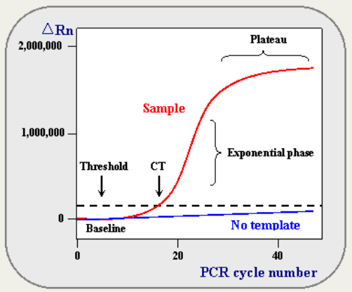
Quantitative PCR (qPCR)
Visualization
Precision
Simultaneous detection
Quantification of target DNA
Increased capital and reaction costs
Notes:
quantitative PCR (qPCR): used to measure the quantity of a target sequence (commonly in real-time). It quantitatively measures starting amounts of DNA, cDNA, or RNA. quantitative PCR is commonly used to determine whether a DNA sequence is present in a sample and the number of its copies in the sample. Quantitative PCR has a very high degree of precision. Quantitative PCR methods use fluorescent dyes, such as Sybr Green, EvaGreen or fluorophore-containing DNA probes, such as TaqMan, to measure the amount of amplified product in real time. It is also sometimes abbreviated to RT-PCR (real-time PCR) but this abbreviation should be used only for reverse transcription PCR. qPCR is the appropriate contractions for quantitative PCR (real-time PCR).
rapid amplification
simultaneous detection
quantification of target DNA through the use of specific fluorophore-labeled probes (Elsayed et al., 2006)
Perandin F, Manca N, Calderaro A, Piccolo G, Galati L, Ricci L, Medici MC,
Arcangeletti MC, Snounou G, Dettori G, Chezzi C: Development of a real-time
PCR assay for detection of Plasmodium falciparum, Plasmodium vivax, and
Plasmodium ovale for routine clinical diagnosis. J Clin Microbiol 2004,
42:1214–1219.
Hermsen CC, Telgt DS, Linders EH, van de Locht LA, Eling WM, Mensink EJ,
Sauerwein RW: Detection of Plasmodium falciparum malaria parasites
in vivo by real-time quantitative PCR. Mol Biochem Parasitol 2001,
118:247–251.
10. Lee MA, Tan CH, Aw LT, Tang CS, Singh M, Lee SH, Chia HP, Yap EP: Real-time
fluorescence-based PCR for detection of malaria parasites. J Clin Microbiol
2002, 40:4343–4345.
11. Rougemont M, Van Saanen M, Sahli R, Hinrikson HP, Bille J, Jaton K:
Detection of four Plasmodium species in blood from humans by 18 S
rRNA gene subunit-based and species-specific real-time PCR assays.
J Clin Microbiol 2004, 42:5636–5643.

Slide 9
Standardization?
PCR machine used can influence the results
PCR assay parameters:
Specific polymerase
Specific temperatures/time/cycles – important to note that a 1°C change in temperature can have a huge impact on the results – yet calibrated thermocouples can only hold +/1 0.5°C
Hot start
2 temperatures vs 3 temperatures
Intercolating dyes vs fluorescent probes
Batch-to-batch variations in enzymes, mastermix; cold chain requirements, etc.

Slide 10
Standardization?
Other thermocycler machine design considerations
Peltier vs exotherm, thin resistive film vs continuous flow heat
Bonnet heating vs oil
Ramp time between cycles
Machine maintenance/calibration: Who?/How often?
Choice of target gene and primers
Standardization should start at the point of sampling
MIQE standard for qPCR reporting
Standard DNA for comparison of techniques – WHO NAT STD DNA
Repeatable results require standardized tactics supported by standardized tools and process

Slide 11
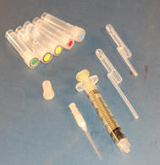
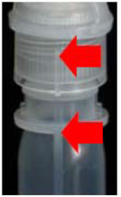
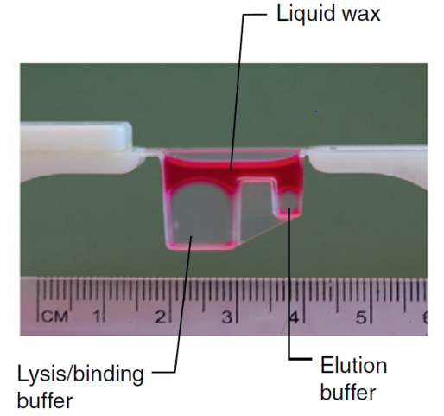
Extraction
Highest efficiency from chaotropic and silica binding
BUT, high cost, steps, time, centrifuge requirements
Boil and spin – possible if inhibitors are not a problem (e.g., isothermal methods)
Chelex-100
Immiscible fluids
Many syringe-based alternatives
Notes:
Niemz paper – 2011 graphics
Magnetic beads
Paper flow extraction
Immiscible phase
Sur,K. et al. (2010) Immisciblephasenucleicacidpurification eliminatesPCRinhibitorswithasinglepassofparamagnetic particlesthroughahydrophobicliquid. J. Mol.Diagn. 12, 620–628

Slide 12
Targets and Primers
> 65 Primer sets; > 5 targets
18S target is the most common
Moderate copy number
Well conserved
BUT, it is not the perfect target
Sequence variation – Po and Pm – poor annealing/false negatives
Actually 4 small subunits rRNA genes expressed during Plasmodium lifecycle
Alternatives:
Cytochrome b gene
Mitochondrial genes
Var
Stevor
Notes:
Murphy 2013
Erdman 2008 – 74/75
Ockenhouse 2013

Slide 13
Detection of Total Nucleic Acid (DNA and RNA)
Reverse transcriptase
Amplification of total nucleic acid (18S rRNA genes) significantly increases the analytical sensitivity of the assay... roughly a log improvement
Detection of total nucleic acid (cyt b) via simultaneous qPCR and reverse transcriptase qPCR resulted in a 3-log reduction in the LOD as compared to DNA only
Cost: Add $1.00 for reverse transcriptase step
Trade-off – RNA is inherently more friable, and, therefore, (despite nice results in Jones 2012 with filter spots) more difficult and potentially more expensive to transport samples
Notes:
Synchronized sequestration (Plasmodium falciparum only): An ideal diagnostic test requires only a single sample. However, analysis of a single time-point sample may only reflect a fraction of the whole parasite population when the P. falciparum parasite is undergoing sequestration on regular 48 hour cycles.3,4 These large fluctuations have been documented for asymptomatic children in endemic areas and in adults5 during the wet and dry seasons.5 Increased synchrony has been observed with single clone infections (conversation with Anna Farnert, May 16, 2013). It has been suggested that the cycles observed correspond with an “internal clock” that results in a synchronized explosion of schizontes around noon that somehow gives the parasite a fitness advantage.6 Sequestration occurs during the late stages of the cycle when parasitized red blood cells cyto-adhere to deep tissue capillaries in adipose tissue, brain, spleen, lungs, and liver. Sequestration can yield a false single time-point negative diagnosis due to lack of detectable parasites in the peripheral blood.‡ Nonetheless, single time-point peripheral sampling is the norm; thus, “visible” parasitemia, the gold standard for malaria diagnosis, has inherent sensitivity limitations and is a poor predictor of the total parasitic load. Synchrony may also affect the presence of other analytes such as DNA (discussed elsewhere in this report); short-term cyclic patterns ranging from a high of more than1,000 parasites per μl visible parasitemia to a low below the detection range of PCR have been documented (conversation with Anna Farnert, May 16, 2013).

Slide 14
Portability
Palm PCRt
Tetracore
T-CORt 8
POCKIT
BioFire
Open PCR
1 lb
requirements gel
Trends toward level 1 facility:
Battery power
Reduced mass
Ease of use
Reduced cost
Trade-off: reduced performance
16 samples; USB; $599
2 color
real time
10 lbs barcode reader
Isothermal, end point
Notes:
Tetracore: 8 independent real-time PCR wells, reads up to five dyes per well, has an integrated barcode reader, and weighs under 10 lbs.
Mine this for details:
Almassian 2013
Tetracore’s T-CORt 8: real-time PCR wells, reads up to five dyes per well, has an
integrated barcode reader, and weighs under 10 lbs. An internal
battery allows continuous operation of all eight wells for four
complete PCR runs. does not require software installation; it has out of the box support for either an
on-board 10.400 touch screen or a web browser on any computer
or mobile device. The T-CORt 8 is also cloud ready, enabling
the user to review the data on the device remotely. The
GeneReach POCKIT is an isothermal PCR instrument that uses
convection for thermal cycling. It has eight insulated isothermal
(iiPCR) wells, reads two dyes per well, and has an
integrated 3.500 touch screen. However the GeneReach POCKIT
can only perform end point detection and it does not have an
integrated battery.
Ahram Biosystems has a Palm PCRt portable,
battery powered, twelve well instrument that weighs under
a pound. However the Palm PCRt does not have integrated
optical detection, and thus requires the user to perform endpoint
detection such as gel electrophoresis.
The Razors EX from BioFire Diagnostics has a single sample pouch with twelve
chambers. The pouches are designed for either testing one
sample against 11 targets, or for testing two samples against
3 targets. It is a two color real-time PCR instrument that weighs
less than twelve pounds. It is battery operated and uses either
an on-board push button interface, barcode reader, or a laptop
with software installed.
An interesting thermocycler developed
by an open source project is OpenPCR; however it does not have on-board optical detection. OpenPCR provides access to the schematics, mechanical models, and software necessary to build and run the device. It retails for $599, runs sixteen samples, and is operated using a USB connection to a computer.

Slide 15
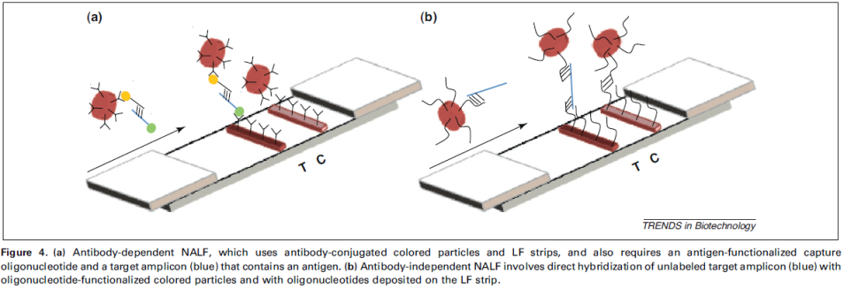
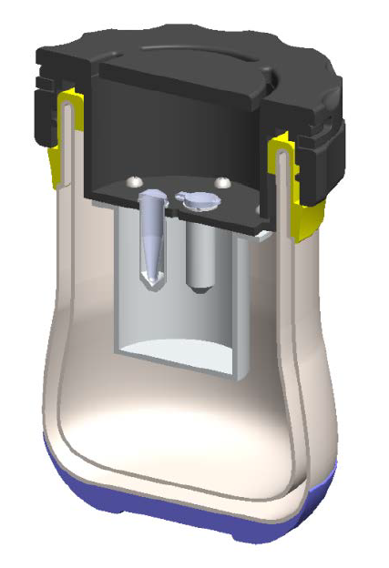
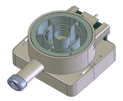
Nucleic Acid Amplification at Level Zero?
NALFIA or molecular RDTs: using hybridization of labeled amplicon
Exothermic heat
Magnetically-driven sample in/results out disposable lab
Notes:
Hybridization of labeled ampolicon -
Photo from MENS, incl
Graphics from Niemz 2011
Disposable laboratory

