Slide 1
Chapter 11 Topic: Stem cell therapy
Course code: Biot. 3113
Course name: Medical Biotechnology
Department of Biotechnology
University of Gondar

Slide 2
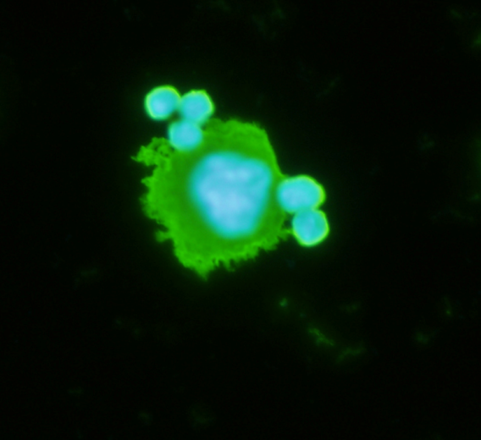
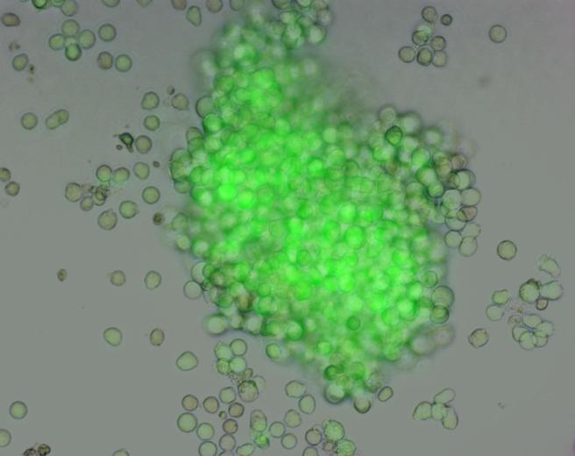
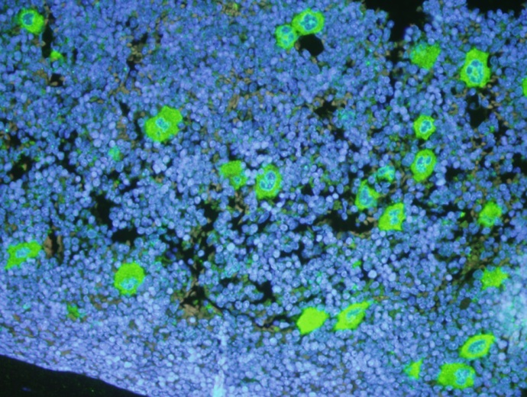
Stem cells and their clinical application: now and in future
What are stem cells?
Stem cells in the clinic
Unproven stem cell treatments
Legal, ethical and social considerations
Notes:
This slide introduces the topics in the presentation.

Slide 3
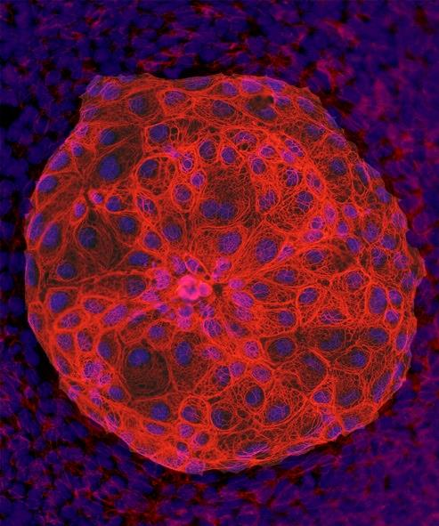
What is a stem cell?
A stem cell is a primitive cell capable of:
self-renewal
conversion to more differentiated cells
proliferation
leading to regeneration of tissues
Pluripotent stem cells
Notes:
Basics of what makes a stem cell a stem cell.

Slide 4
Stem cells are the progenitors of many different cell types, depending upon which type of stem cell is used: e.g.,
bone marrow stem cells,
neural stem cells,
embryonic stem cells
Stem cell therapy-the goal is to repair damaged tissue:
e.g. Parkinson’s disease, spinal cord injury

Slide 5
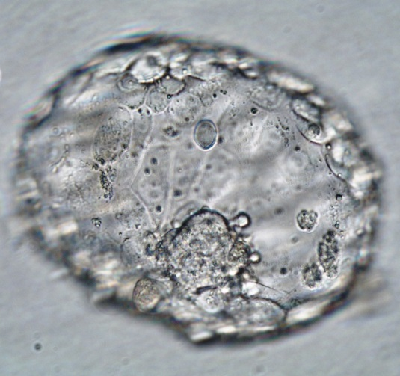
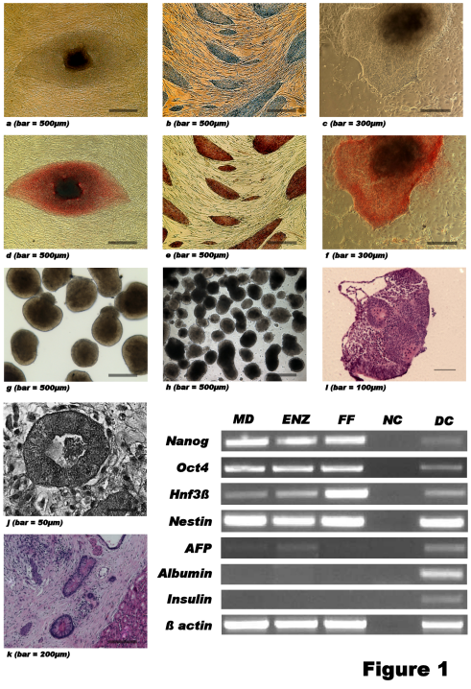
Embryonic stem cells (ESCs)
derived from human embryos by
harvesting inner cell mass of donated excess IVF embryos
Embryos created by IVF from sperm and egg cells donated for the purpose of providing embryos for research materials
or somatic cell nuclear transfer (SCNT)
or parthenogenetic activation
Notes:
Human embryonic stem cells were first reported in 1998.
The images on this slide are:
1 - blastocyst showing inner cell mass (National Stem Cell Foundation of Australia).
2 - colony of human embryonic stem cells (Diabetes Transplant Unit, Prince of Wales Hospital).
3 - multiple colonies of human embryonic stem cells growing on fibroblasts (Diabetes Transplant Unit, Prince of Wales Hospital).
Use photo of blastocyst to identify inner cell mass and state that this is isolated and cultured to form ESC.
Other points you may wish to raise are:
At the completion of their infertility treatment, IVF couples must decide what happens to any embryos they may still have frozen. Not all couples will have excess embryos. Their options are to discard the embryo (disposed of in biological waste), donate the embryo to research, or donate their embryo/s to another couple.
Human ESC are immortal in the right conditions and can differentiate into all three germ layers and theoretically all cell types
Transplantation of undifferentiated ESC carries a high risk of teratoma formation. However transplantation of differentiated cells reduces this risk considerably
It has been legal to use human embryos in research in Australia since 2002 when specific legislation was passed - Research Involving Human Embryos Act 2002. Any researcher wanting to use embryos in their research must obtain a licence from the government specifically for their project.

Slide 6
Human embryonic stem cells (hESCs) can self-renew indefinitely to produce more stem cells
Create cell lines
can be grown indefinitely in the laboratory in an undifferentiated state
retain ability to specialise into all the different tissue types – referred to as pluripotent

Slide 7
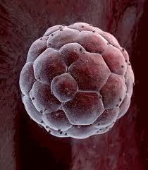
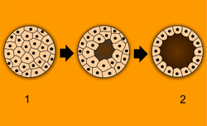
Fertilization of egg by sperm results in a zygote
Zygote divides rapidly to form a compact ball of cells called a morula
Morula develops into embyro consisting of a small hollow cluster of cells called a blastocyst.
A morula is an embryo at an early stage of embryonic development.

Slide 8
Two layers to the blastocyst
Outer layer forms the placenta
Inner cell mass is the source of human embryonic stem cells (hESCs)
hESCs have the ability to undergo differentiation
Maturation process in which cells develop specialized functions
Eventually can differentiate to form all of the more than 200 cell types in the human body
hESCs - human embryonic stem cells

Slide 9
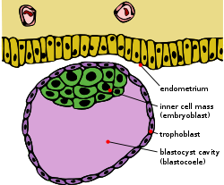
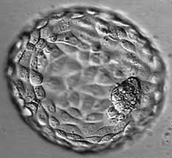
The blastocyst is a structure formed in the early embryogenesis, after the formation of the morula.

Slide 10
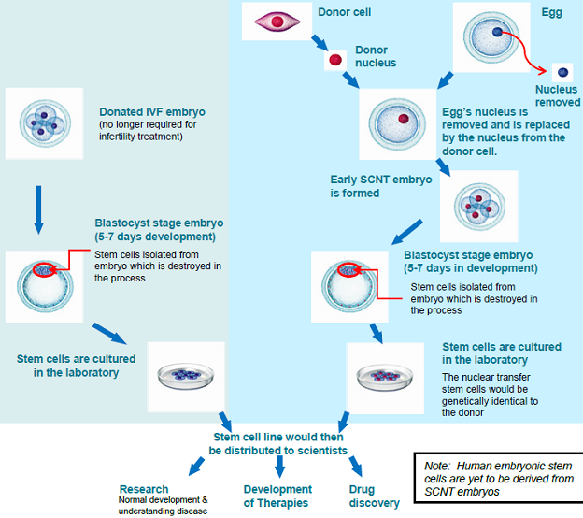
Derivation of human embryonic stem cells
1. From donated IVF embryos
2. Somatic cell nuclear transfer (SCNT)
Donor cell
Egg
Donor nucleus
Nucleus removed
Donated IVF embryo (no longer required for treatment)
Egg’s nucleus replaced by the nucleus from the donor cell
Early SCNT embryo is formed
Blastocyst stage embryo (5-7 days development) Stem cells isolated from embryo which is destroyed in the process
Blastocyst stage embryo (5-7 days development)
Stem cells isolated from embryo which is destroyed in the process
Stem cells are cultured in the laboratory
Nuclear transfer stem cells are genetically identical to the donor
Stem cells are cultured in the laboratory
Stem cell line distributed to scientists
SCNT is also known as therapeutic cloning.
Research
Developing therapies
Drug discovery
Normal development and understanding disease
Notes:
This slide shows schematically how human ESC are created from excess IVF and SCNT embryos.
At this point mention that stem cells can also be derived from parthenogenetic activated eggs.
When introducing SCNT state that human embryonic stem cells were first created with this technique only recently, in 2013. (Tachibana N, et al. Cell 2013; 153: 1228-1238.)
It has been legal to use excess, donated human embryos for research in Australia since 2002 provided researchers receive ethics approval and obtain a licence from the NHMRC. SCNT has been legal in research in Australia (except Western Australia where the State legislation differs from the federal legislation) since 2006 when a modification was made to the original legislation. Researchers involved in SCNT experiments must also apply for a licence from the NHMRC and seek ethics approval.
Reproductive cloning remains banned.

Slide 11
Can adult stem cells do everything embryonic stem cells can do?
Cells of matured adult tissue can also be cultured and differentiated to produce other cell types
Small in number and not yet discovered in all adult tissues
Can differentiate into another different specialized cell type, but may not be as good as hESCs

Slide 12
Stem cells
Totipotent Stem Cells
These are the most versatile of the stem cell types.
When a sperm cell and an egg cell unite, they form a one-celled fertilized egg.
This cell is totipotent, meaning it has the potential to give rise to any and all human cells, such as brain, liver, blood or heart cells.
It can even give rise to an entire functional organism.
The first few cell divisions in embryonic development produce more totipotent cells.

Slide 13
Pluripotent Stem Cells (Embryonic Stem Cells)
These cells are like totipotent stem cells in that they can give rise to all tissue types.
Unlike totipotent stem cells, however, they cannot give rise to an entire organism.
On the fourth day of development, the embryo forms into two layers:
an outer layer which will become the placenta, and
an inner mass which will form the tissues of the developing human body.
These inner cells, though they can form nearly any human tissue, cannot do so without the outer layer; so are not totipotent, but pluripotent.
As these pluripotent stem cells continue to divide, they begin to specialize further.

Slide 14
Multipotent Stem Cells
These are less plastic and more differentiated stem cells.
They give rise to a limited range of cells within a tissue type.
The offspring of the pluripotent cells become the progenitors of such cell lines as blood cells, skin cells and nerve cells.
At this stage, they are multipotent.
They can become one of several types of cells within a given organ.
For example, multipotent blood stem cells can develop into:
red blood cells,
white blood cells or
platelets

Slide 15
Adult Stem Cells
An adult stem cell is a multipotent stem cell in adult humans that is used to replace cells that have died or lost function.
It is an undifferentiated cell present in differentiated tissue.
It renews itself and can specialize to yield all cell types present in the tissue from which it originated.

Slide 16
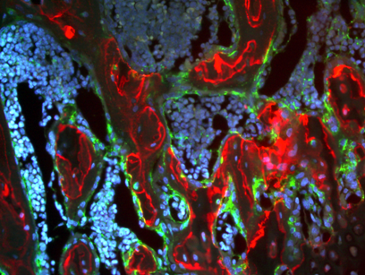
Tissue-specific stem cells
often called “adult” or somatic stem cells but also includes stem cells isolated from fetal tissues and umbilical cord blood
involved in tissue homeostasis and repair
generally multipotent
difficult to isolate and grow in large numbers in the laboratory
Bone marrow
HSCs CD34+
MSCs CD34-
Notes:
Note the use of ‘tissue’ rather than ‘adult’ stem cells. Tissue is a more accurate description as the category also includes fetal and cord blood stem cells.
Points you may wish to raise if presenting these slides are:
tissue stem cells are multipotent, they only give rise to a limited number of different tissues
under the right conditions tissue stem cells can be grown in the laboratory
now thought to be present in most tissues.
This slide is a good opportunity to introduce haematopoietic stem cells (HSCs) and their long use and history in medicine.
This is also a good opportunity to introduce mesenchymal stem cells (MSCs) which are currently being investigated in many clinical trials for several indications. Mesenchymal stem cells:
Promote angiogenesis
Anti-inflammatory properties
Non-immunologically reactive
May act to stimulate new endogenous cell formation rather than differentiating into desired cells
Usually prepared from bone marrow but also increasingly from adipose tissue
For more information on MSCs, see http://www.nature.com/nrm/posters/mscs/mscsposter.pdf

Slide 17
Induced Pluripotent Stem Cells (IPsCs)
IPSCs are differentiated cells that have been reprogrammed back to pluripotent stem cells.
The introduction of 4 genes:
OCT3/4, SOX2, c-MYC, and KLF4 by a retrovirus into cells
reprograms the cells into an earlier stage of differentiation similar to embryonic stem cells.
These genes encode transcription factors involved in cell development.

Slide 18
IPSCs
IPSCs can be used for patient specific therapies without the risk of cell rejection.
Cells could be taken from a patient,
reprogrammed into an IPC, and
then differentiated into a cell that could combat disease in the patient.
There would be no need for embryonic stem cells.

Slide 19
IPSCs
Scientists still do not fully understand how to control induced pluripotent stem cells.
They do not understand the degree of pluripotency in these cells.
Producing them is inefficient: 1 in 1000 cells exposed to a reprogramming approach becomes an IPSC.
The cells require constant feeding in cell culture.
The cells have low viability after they have been frozen for storage.
The cells are prone to forming tumors.
Occasionally, IPSCs spontaneously revert to differentiated cells.

Slide 20
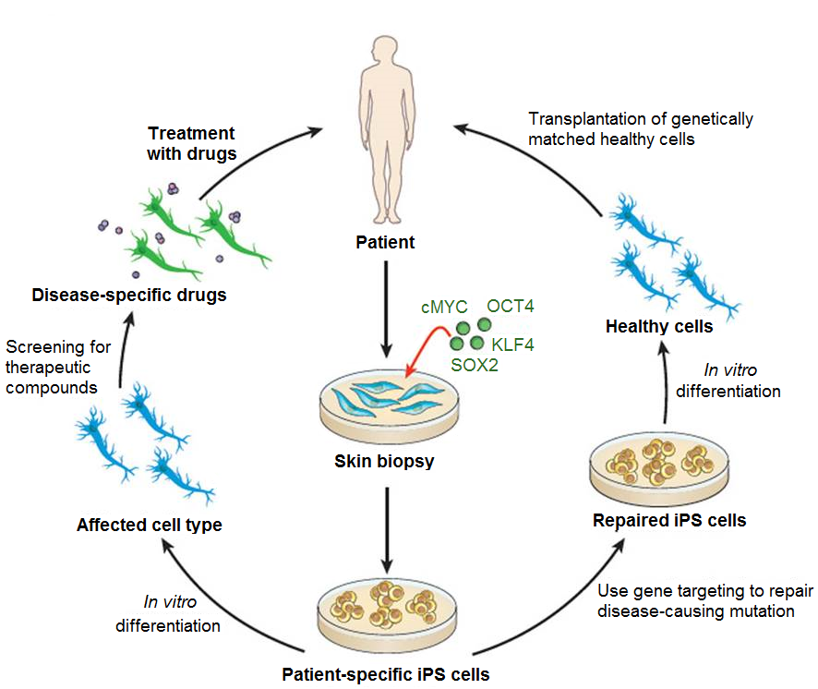
Induced pluripotent stem cells (iPSC)
Can create stem cells directly from a patient
Can be maintained indefinitely in the laboratory
Pluripotent with similar properties to ESCs
Image source: Robinton DA, Daley DQ. Nature 2012; 481, 295–305.
Notes:
Image source: Robinton DA, Daley DQ. The promise of induced pluripotent stem cells in research and therapy. Nature 2012; 481, 295–305. http://www.nature.com/nature/journal/v481/n7381/full/nature10761.html
Consider discussing that:
Induced pluripotent stem cells are a new discovery - human (Takahashi K et al. Cell 2007; 131: 861–872) and mouse (Takahashi K, Yamanaka S. Cell 2006; 126: 663-676).
Initial techniques employed viral induction but techniques have evolved to replace with non-viral means.
Properties not exactly the same as human ESCs and do not obviate the need for ESCs in research.
iPSC valuable to study ‘disease in a dish’ where stem cells are made directly from a patient with a particular condition and for drug screening and discovery – around the world many disease specific iPSC lines have now been made.
iPSC are a source of patient-specific stem cells for transplant, with first human transplant carried out in 2014, with cells differentiated from iPSC (www.ipscell.com/2014/09/stem-cell-landmark-patient-receives-first-ever-ips-cell-based-transplant/). There is a risk of tumour formation, as with human ESC, because of pluripotency.

Slide 21
Different attributes
 | Pluripotent stem cells ESCs iPSCs |  | Tissue stem cells (multipotent)
Source | Embryo | Somatic cell | Adult, juvenile and fetal organs
Rate of proliferation | High | High | Usually low
Availability | High | High | Low
Spontaneous differentiation | Yes | Yes | No
Capacity to produce diverse cell types | High | High | Low
Notes:
Pluripotent stem cells, both hESC and iPSC, when undifferentiated, will form teratomas when transplanted (Takahashi K et al. Cell 2007; 131: 861–872).

Slide 22
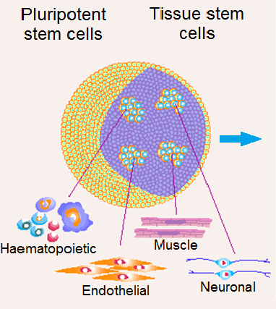
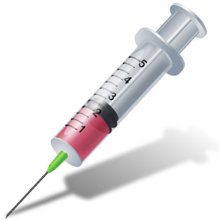


What makes stem cells so valuable?
Biology
Applications
Pluripotent stem cells
Tissue stem cells
Cell therapy
Transplantation of specific cells and precursors
Research
Genetic, molecular and biologic control of tissue growth and development; in vitro and in vivo system for understanding function of genes and proteins
New drugs
Early efficacy and toxicity screening system for drug and chemical development
No one stem cell type fits all applications
Research must continue using all types of stem cells
Image modified from Keller & Snodgrass, Nat Med 1999; 5(2): 151-152.
Notes:
22
Image source: Keller G, Snodgrass HR. Human embryonic stem cells: the future is now. Nat Med 1999; 5(2): 151-152.
While the focus is on the much hoped for revolution in cellular replacement therapies, much of the value especially in the immediate future is in research and in knowledge gained from their use in the laboratory and as an adjunct in the development of new drugs (screening and toxicology).
Pluripotent stem cells and their derivatives provide an unlimited source of normal and disease cell lines for screening.

Slide 23
Potential Applications of Stem Cells
Using stem cells to make white blood cells is becoming an effective way to treat leukemia
Stem cells from umbilical cord blood used to treat sickle cell anemia and other blood deficiencies
Stem cells from adipose have been used to form bone tissue in the human skull
Repair of heart cells
Adult stem cells isolated from brain and used to make neurons in culture

Slide 24
Stem Cell Therapies
Potential and promise are two words frequently used to describe stem cell therapies.
The most promising application to date has been for leukemia.
Patients receive chemotherapy or radiation to destroy cancerous white blood cells.
Patients receive WBC stem cells which proliferate to normal cells.

Slide 25
Stem Cell Therapy
Researchers have injected stem cells from different sources into damaged heart tissue of mice (heart tissue does not repair itself well).
The stem cells developed into cardiac muscle and improved heart function by 35%.
This work shows promise for human heart attack victims.
Researchers have demonstrated that embryonic stem cells can be differentiated to form neurons in mice to show improvement in spinal cord injuries.
The FDA has approved the first clinical trial for the use of embryonic stem cells to treat humans with spinal cord injuries.

Slide 26
Stem cell trials for cardiac disease: 1
Congestive cardiac failure and refractory angina
large number of trials over last 15 years using autologous or allogeneic bone marrow derived cells (MSCs and HSCs)
demonstrated to be safe but minor or no clinical benefit
likely to be delivering paracrine effects on endogenous cardiac progenitor cells
allogeneic trials being undertaken in Australia by Mesoblast
cardiac progenitors derived from hESC implanted for 1st time in October 2014 (France)
Notes:
Cochrane review of stem cells for heart disease. Analysing the literature, the Cochrane reviewers found “some evidence that stem cell treatment may be of benefit.” But, they noted, “the quality of the evidence is relatively low because there were few deaths and hospital readmissions in the studies, and individual study results varied. Further research involving a large number of participants is required to confirm these results.”
(http://www.cochrane.org/CD007888/VASC_stem-cell-treatment-for-chronic-ischaemic-heart-disease-and-congestive-heart-failure)
Recent study published in BMJ (2014 Apr 28; 348: g2688. doi: 10.1136/bmj.g2688) found that many of the most promising results in the field are illusory and that the potential benefits of stem cells to treat heart disease are probably far more modest than we have been led to believe.

Slide 27
Stem cell trials for cardiac disease: 2
Acute myocardial infarction
number of trials underway involving bone marrow and adipose derived stem cells
one randomised double blind trial showed ongoing benefit up to 18 months
better mean reduction in infarct size
better improvement in LV perfusion
no major adverse events
larger, randomised trial now underway in Europe
Notes:
One randomised double blind trial showed ongoing benefit up to 18 months — see: Gao LR et al. BMC Medicine 2015; 13: 162.)
Larger, randomised trial now underway in Europe — see: www.bbc.com/news/health-26273707 referring to clinical trials NCT01569178 and NCT01693042.

Slide 28
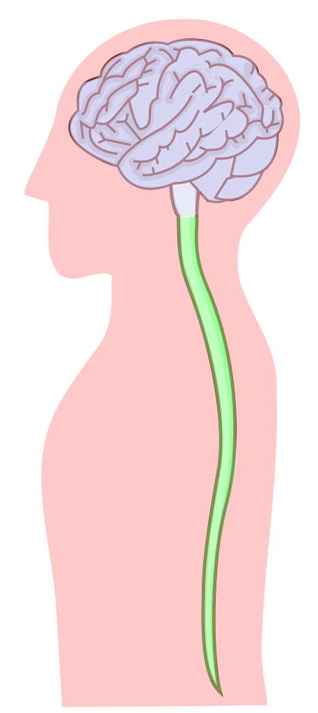
Stem cell trials for spinal cord injury: 1
Acute thoracic spinal cord injury
Geron trial (US) involving oligodendrocyte progenitor cells from human ESC
Phase I commenced October 2010 (FDA approved first in human) but discontinued in 2011: 5 people treated within 7-14 days of injury
Delivered directly into lesion
No serious adverse events
Geron’s stem cell assets taken over by Axterias Biotherapeutics in 2013 and plan to continue with clinical trial
Notes:
This trial took many years and dollars to get approval as first in human using hESCs.
Five patients with neurologically complete, thoracic spinal cord injury as classified by the American Spinal Association Impairment Scale, were administered a relatively low dose of two million AST-OPC1 cells at the spinal cord injury site 7-14 days post-injury. The subjects received low levels immunosuppression for the next 60 days. The patients have been followed to date for 2-3 years through numerous clinical visits, MRIs, and neurological assessments.
Asterias press release on this matter can be found at: “www.fiercebiotech.com/press-releases/biotime-subsidiary-asterias-biotherapeutics-raises-130-million-equity-finan”

Slide 29
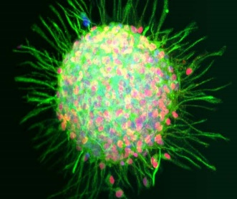
Stem cell trials for spinal cord injury: 2
Chronic thoracic spinal cord injury
Numerous trials using MSCs and olfactory ensheathing cells from nose
Limited benefit, with one report of tumour formation from olfactory cells
StemCells Inc are conducting Phase I/II trial in Switzerland
fetal-derived neural stem cells
12 patients (both complete & incomplete) enrolled
monitoring for safety and have demonstrated improvements in neurological function below injury site
Results were expected to be announced in mid-2015 (?)
1st patient enrolled in phase II trial to study cervical SCI
HuCNS-SC
StemCells Inc
Notes:
Limited benefit, with one report of tumour formation from olfactory cells (Dlouhy BJ et al. J Neurosurg Spine 2014; 21: 618-622).
First patient enrolled in phase II trial to study cervical SCI (www.stemcellsinc.com/About-Us/CEO-Corner).

Slide 30
Stem cell trials for blindness: 1
Corneal disease
Numerous trials using autologous limbal stem cells to replace damaged or diseased cornea
majority of patients treated in large Italian trial had permanent corneal restoration
Trial undertaken at UNSW, Sydney Eye Hospital and Save Sight Foundation biopsy expanded in vivo on therapeutic grade contact lens autologous limbal cells or conjunctival epithelial cells then transferred to eye via contact lens
16 people treated, with 10 achieving a clinically stable corneal epithelium at a median of 2.5 year follow up.
Half of these had some improvement in visual acuity
Notes:
Limited benefit, with one report of tumour formation from olfactory cells (Dlouhy BJ et al. J Neurosurg Spine 2014; 21: 618-622).
First patient enrolled in phase II trial to study cervical SCI (www.stemcellsinc.com/About-Us/CEO-Corner).

Slide 31
Stem cell trials for blindness: 2
Macular degeneration
Several trials underway or about to begin; one completed
US company Advanced Cell Technology (now trading as Ocata Therapeutics) started two clinical trials in 2011
Dry age related macular degeneration
Stargardt’s macular degeneration
Phase I/II trials use retinal pigment epithelial (RPE) cells derived from human ESC
Stem Cells Inc has completed phase 1 study in Stargardt’s macular degeneration using allogeneic human neural stem cells
London Project to Cure Blindness with Pfizer planning trial using sheets of RPE for acute macular degeneration
RPE derived from iPSC transplanted in Japan, October 2014
Notes:
The trials by Advanced Cell Technology (now trading as Ocata Therapeutics) were the second and third trials to begin worldwide to use cells made from hESC.
More information about StemCells Inc trials is available at www.stemcellsinc.com/Clinical-Programs/AMD.

Slide 32
Stem cell trials for cerebral palsy
Substantial speculation about use of umbilical cord blood
Phase II clinical trial at Duke University
re-infuse autologous cord blood in children <6yrs and seeking to treat 120 children
assumes infused cells will home to areas of ischaemic damage
results yet to be published but has attracted a lot of attention based on anecdotal reports
Korean study
96 treated (31 with erythropoietin & donor cord blood)
Improvement in motor skills and cognitive function
Notes:
Korean study (Min K et al. Stem Cells 2013; 31: 581-591)
Monash University (MIMR-PHI) together with Cell Care Australia (private cord blood bank) are planning a similar autologous cord blood transfusion study in children with cerebral palsy.

Slide 33
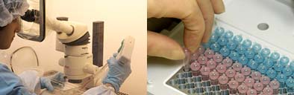
Stem cell trials for stroke
Although improvement demonstrated in animal models, not yet shown in patients
UK based company ReNeuron have commenced a trial
Phase I study – 12 patients using genetically engineered fetal neural stem cells
involves intracerebral injection into patients with significant disability 6 to 24 months after stroke
proposed action though known anti-inflammatory, trophic and pro-angiogenic properties
Interim data (9 patients) no adverse events

Slide 34
Unproven stem cell treatments
Little medical or scientific justification for this approach
Cavalier demonstration of safety
Often invasive and may involve not only autologous but also allogeneic and even animal cells
Charging usually $10,000 to $40,000 per treatment, sometimes even more
Heavily promoted on the internet
Concern that risks to health are not being considered in decision
Notes:
While not restricted to stem cells, medical tourism is a growing concern.
Issue with stem cell tourism is the prematurity of the technology been offered as ‘treatment’ now with no or little justification/safe or follow-up
Desperate patients are paying large sums of money for such therapies
Companies offering treatments usually do not have animal data or clinical trial data to back up their claims.
Clinics often claim that their treatments are completely risk free.
Several adverse events have been reported in the literature either as a direct result of the stem cell therapy or from the procedure:
An Israeli boy with ataxia telangiectasia who had been to Russia three times for intracranial and intrathecal injections of fetal neural stem cells was subsequently diagnosed with a multifocal brain tumour. Tests found that the tumours were of non-host origin and had been derived from at least two of the donor fetuses. (Amariglio N et al. PLoS Med 2009; 6: e1000029)
A clinic in Germany was shut down following the death of an 18 month old child who suffered internal bleeding as a result of injections into the brain with stem cells (www.telegraph.co.uk/news/worldnews/europe/germany/8500233/Europes-largest-stem-cell-clinic-shut-down-after-death-of-baby.html).
Stem Cells Australia, the National Stem Cell Foundation of Australia and the NSW Stem Cell Network offer individualised responses to patient queries. See their websites, which are listed on the final slide.
NHMRC have published ‘A Quick Guide for Medical Practitioners’ and a ‘Frequently Asked Questions’ for patients – available via https://www.nhmrc.gov.au/guidelines-publications/rm001

Slide 35
Regulatory frameworks elsewhere
Allow procurement of hESC from spare embryos:
19 countries
Allow creation of human embryos for research purposes:
Australia, Belgium, Israel, Japan, Singapore, South Korea, Sweden, UK, USA (6 States and privately)
Prohibit procurement of hESC from spare embryos but allow import of hESC lines:
Germany, France
Prohibit procurement of hESC:
Austria, Italy, Norway, Poland, US State of Nebraska
Prohibit human cloning: 51 countries
Notes:
For more information on the different policy approaches adopted around the globe visit http://www.stemgen.org

Slide 36
Regulatory framework in the clinic
Stem cell research has ethical issues and these are governed by guidelines released by NHMRC, with approval from an institutional ethics committee required
Clinical translation and manufacturing are covered by specific legislation, although there is an exemption for autologous cell applications.
This is under review.
Notes:
Ensuring appropriate consent is obtained from the donors is essential no matter what type of stem cell research will be conducted.

Slide 37
Challenges for stem cell therapy
Controlling differentiation –When stem cells are injected scientists cannot control the spread of cells to other places in the body nor can they control the differentiation of stem cells into tissues other than those that were intended.
Injected human embryonic stem cells tend for form tumors.
Chromosomal abnormalities – Abnormality in chromosome number( trisomy) occurs frequently when stem cells differentiate
The most promising therapy appears to be differentiating the stem cells in vitro and them injecting them.

Slide 38
Regenerative Medicine
Regenerative Medicine – growing cells and tissues that can be used to replace or repair defective tissues and organs.
1. Cell and Tissue Transplant
Fetal tissue grafts
Organ transplantation
Cellular therapeutics
Fetal tissue graft/implant is a therapy where tissue from fetus is implanted to a patient for treatment of disease.
Fetal tissue is unique since it is fast growing and has a lower possibility of rejection from the host's cells.
Use for treating Parkinson’s disease, Alzheimer’s disease

Slide 39
Tissue Engineering
May provide tissues and organs that can be used to replace damaged or diseased tissues
1990s Dr. Charles Vacanti revealed a mouse with an engineered ear growing on its back
Seeded with cells from a cow
Just the outer ear without the inner ear structures that actually detect sound
Human bladders, rudimentary kidney

