Slide 1
Chapter 12 Topic: Gene therapy
Course code: Biot. 3113
Course name: Medical Biotechnology
Department of Biotechnology
University of Gondar

Slide 2
Objectives: Gene Therapy
Germline vs. somatic gene therapy
Gene therapy vectors (advantages and disadvantages):
Retrovirus
Adenovirus
Adeno-associated virus (AAV)
Non-viral vectors
in vivo vs ex vivo gene therapy
Current status of human gene therapy experimentation

Slide 3
Early Human Gene Therapy Experiments
Marty Cline human experiments-- 1980
NeoR/TIL marking studies-- 1989
ADA/peripheral blood T cells-- 1990
LDL receptor/ex vivo hepatocytes-- 1992
HLA-B7 Melanoma-- 1992
ADA/bone marrow, cystic fibrosis, multiple cancer protocols, HIV
October 1999-- 1st reported death due to gene therapy
November 1999-- Failure of scientists to report gene therapy trial deaths to FDA/RAC
April 2000-- 1st definite success of human gene therapy (SCID-X1) Cavazzana-Calvo, et al. Science 288:669.
Factor IX gene therapy (hemophilia B) ? promising
In vivo AAV: Kay et al. Nat. Gen. 24:257, 2000.
Ex vivo fibroblast: Roth et al. NEJM 344:1735, 2001.

Slide 4
There are two different types of gene therapy depending on which types of cells are treated:
Somatic gene therapy: transfer of a section of DNA to any cell of the body that doesn't produce sperm or eggs.
E.g.: cells of the bone marrow
Germline gene therapy: transfer of a section of DNA to cells that produce eggs or sperm.
Germline therapy insertion of the gene into the reproductive tissue in such a way that the disorder in his or her offspring would also be corrected.
But germline therapy have ethical issues!!!!

Slide 5
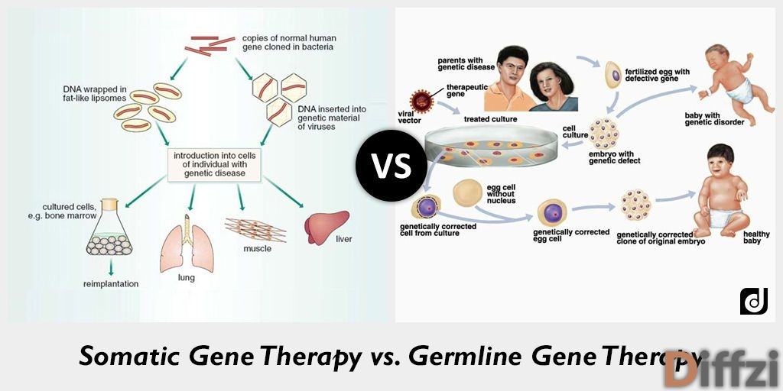

Slide 6
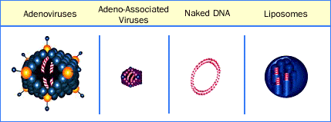
Gene Transfer Methods
Retroviral vectors
Lentiviruses
Adenovirus
Adeno-associated virus (AAV)
Other viral vectors
Vaccinia – Hepatitis virus
Herpes virus – Polio virus
Papilloma virus – Sindbis and other RNA viruses
Non viral methods
Ligand-DNA conjugates – Adenovirus- ligand-DNA
Lipofection – Direct DNA injection
CaPO4 precipitation – Ribozymes
chimeric oligo/gene correction

Slide 7
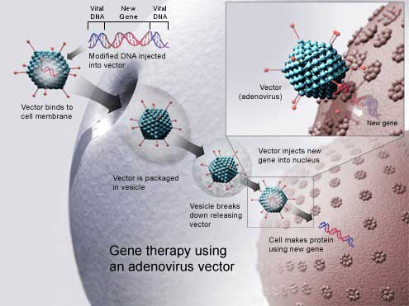
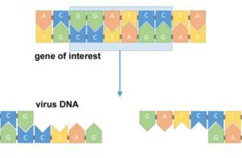
First identify the gene missing from a sick patient.
Then head to the lab and create a modified virus that includes that missing gene.
how a virus is used to deliver a gene into a patient that is missing that gene.

Slide 8
Gene Therapy Vectors
Vector | Advantages | Disadvantages
Retrovirus | High efficiency transduction of appropriate target cells. Long-term expression- integration into chromosomal DNA). | Potential for insertional mutagenesis. Requires dividing cells. Limited size of DNA insert.
Adenovirus | High transduction efficiency. Broad range of target cells. Does not require cell division. Low risk of insertional mutagenesis. | Transient expression. Immunogenicity. Direct cytopathic effects of virus.
Adeno-associated virus (AAV) | Does not require cell division. ? Site specific integration. | Potential for insertional mutagenesis if integration not site-specific. Limited size of DNA insert.
Non-viral vectors | No infectious risk. Completely synthetic. No limitation on insert size. | Low efficiency. Limited target cell range. Transient expression.

Slide 9
Adeno-associated virus
AAV is a small virus that infects humans and some monkeys.
AAV has become the preferred virus for the following reasons:
only causes a mild immune response
infects both dividing and non-dividing cells
persists in cells without directly inserting into the host genome (remains in an extra-chromosomal state.)
the carrying capacity of this viral vector is limited.
This means it is not possible to insert large genes into an AAV.
The size limit for AAV is debatable, but is generally listed between 4.5 to 4.9 kb.
Scientists are currently trying to overcome this limitation.

Slide 10
In addition to being safe and cost-effective, the most important properties of an efficacious gene transfer system will be;
1) target cell selective.
2) transcriptionally competent for the desired length of time.
3) available in a highly concentrated active form.
4) immunologically neutral.

Slide 11
Problems
Delivery of DNA
Achieving high level expression
Maintaining stable expression
Tissue-specific expression
in vivo regulation

Slide 12
Gene Therapy: adding a normal gene to correct a specific gene disorder
Two types of gene therapy:
Ex vivo gene therapy
Cells are removed from the patient, treated with techniques similar to transformation, and then reintroduced to the person
time consuming and expensive
In vivo gene therapy
Introducing genes directly into tissues and organs in the body
Challenge is delivering genes only to intended tissues and not tissues throughout the body.
quick and inexpensive,
targeting certain cells is difficult
e.g., bone marrow stem cells

Slide 13
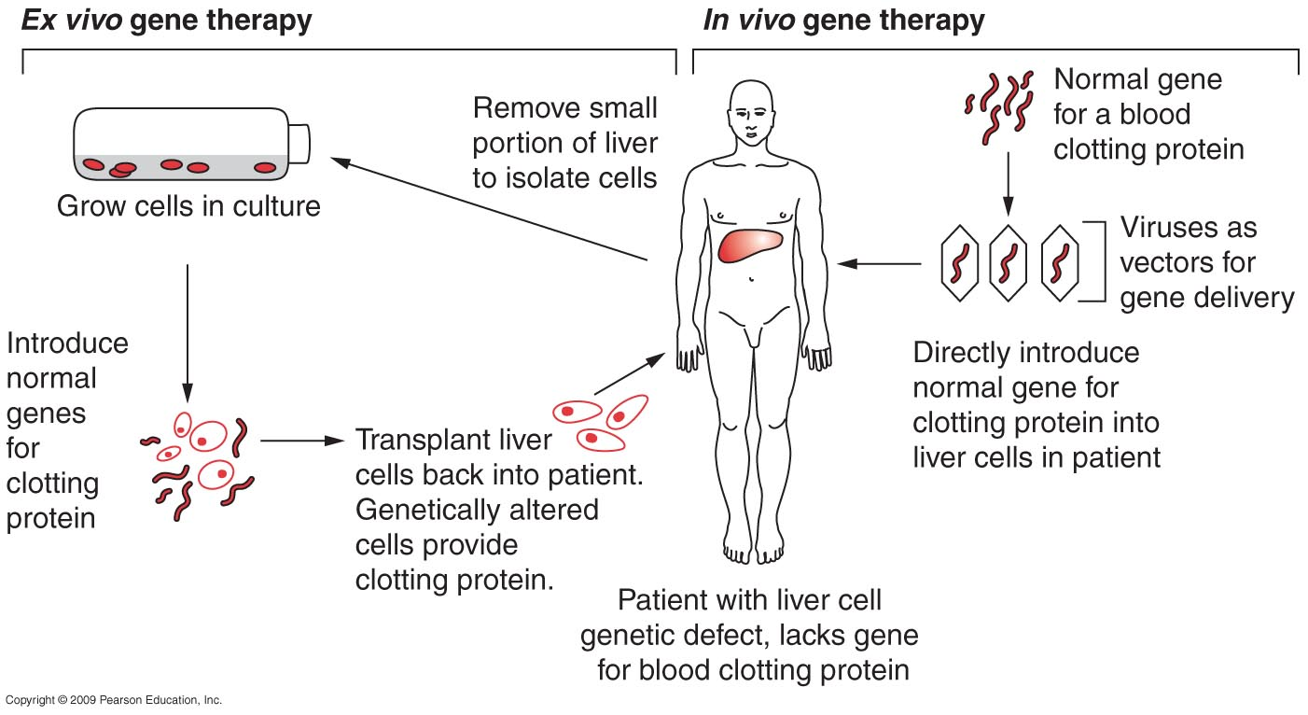
Gene Therapy

Slide 14
Gene Therapy
Vectors for Gene Delivery
Rely on viruses as vectors
Use viral genome to carry a therapeutic gene or genes and use virus itself to infect human cells, introducing the gene
Adenovirus (common cold)
Influenza virus (flu)
Herpes virus (cold sores, some cause STD)
Must make sure the virus has been genetically engineered so that it can neither produce disease nor spread throughout the body

Slide 15
Gene Therapy
Viral Infection of Human Cells
Bind to and enter cells; release genetic material (usually DNA) into nucleus or cytoplasm
Human cell now acts as a host to reproduce the viral genome and to produce viral RNA and proteins
Make Good Vectors
Efficient at infecting many types of human cells
Retroviruses (HIV) permanently insert their DNA into host cell genome
Some viruses infect only certain types of cells – good for targeted gene therapy

Slide 16
Other Gene Delivery Options
Naked DNA – DNA by itself that is injected directly into body tissues
Liposomes – small, hollow particles made of lipid molecules
Packaged with gene and injected or sprayed into tissues
New Approaches to Gene Therapy
Antisense RNA
Ribozymes
RNA interference (RNAi)
Spliceosome-mediated RNA trans-splicing
Triplex helix oligonucleotide therapy

Slide 17
Inhibition of translation of specific RNA by antisense nucleic acid molecules
Promoter antisense cDNA poly A addition signal
mRNA
-antisense
RNA complex
antisense oligonucleotide

Slide 18
Ribozymes: A. Hammerhead B. Hairpin

Slide 19
RNA interference (RNAi)
Double-stranded RNA molecules are delivered into cells where the enzyme Dicer chops them into 21-nt-long pieces called small interfering RNAs (siRNAs)
siRNAs join with an enzyme complex called the RNA-induced silencing complex (RISC)
RISC shuttles the siRNAs to their target mRNA where they bind
siRNA-bound mRNAs are degraded so they cannot be translated into a protein

Slide 20
RNA interference (RNAi)
dsRNA
sense
antisense
Binding of dsRNA-specific nuclease
Nuclease-ssRNA complex
Hybridizes to mRNA
cleavage
mRNA is cleaved!
A cellular nuclease binds to the dsRNA cleaving it into ssRNAs of 21-23 nucleotides each.
The nuclease-RNA oligonucleotide complex binds and cleaves specific mRNA.

Slide 21
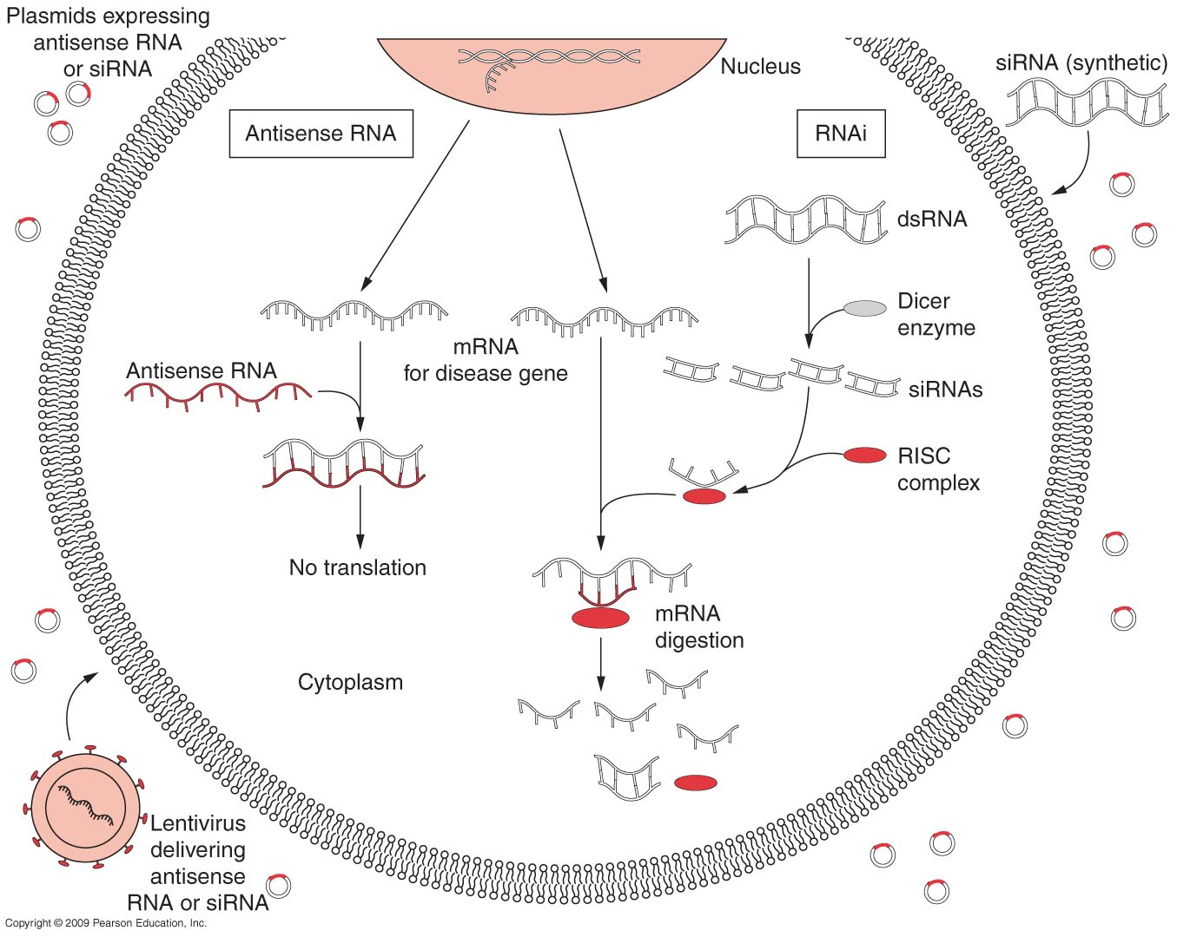
Gene Therapy

Slide 22
First human gene therapy – SCID patient in 1990
SCID is severe combined immunodeficiency
Defect in gene called adenosine deaminase (ADA)
Produces an enzyme involved in the metabolism of nucleotide dATP
Accumulation of dATP is toxic to T cells
Without T cells, B cells cannot recognize antigen and make antibodies
Ex vivo gene therapy successful

Slide 23
Cystic Fibrosis
two defective copies of a gene encoding a protein called cystic fibrosis transmembrane conductance regulator (CFTR)
Normal protein serves as a pump to remove chloride ions from cell
Produced by many cells in the body – skin, pancreas, liver, digestive tract, male reproductive tract, and respiratory tract
Extremely thick sticky mucus in airways; infertility; extremely salty sweat

Slide 24
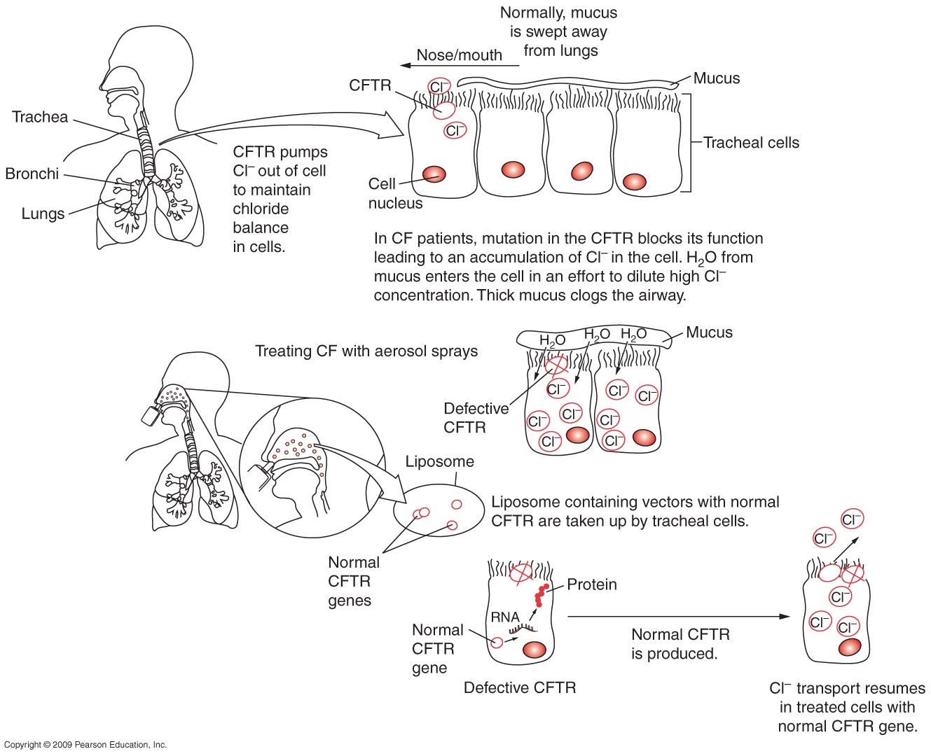

Slide 25
Challenges Facing Gene Therapy
Potential risks of viruses as vectors
Death of Jesse Gelsinger in 1999 due to complications related to adenovirus vector
Death of 2 children in France in 2002
Temporary cessation of a large number of gene therapy trials and FDA stopped most retroviral studies
Greater patient monitoring

Slide 26
Challenges Facing Gene Therapy
Can gene expression be controlled?
Can we safely and efficiently target only the cells that require the gene?
How can gene therapy be targeted to specific regions of the genome?
How long will therapy last?
Will immune system reject?
How many cells need to be corrected?

Slide 27
ADA Deficiency
Rare Immunodeficiency (fatal in childhood)
Advantages as model for gene therapy:
Regulated expression not necessary
Low level expression sufficient
Site of synthesis not critical
Potential for in vivo selection
Bone marrow suitable target
Problems:
Difficulty achieving high level, stable expression
Other effective therapy:
PEG-ADA therapy, allogeneic/haploidentical Bone Marrow Therapy
First human experiments performed 1991 (2 patients)
?successful; simultaneous PEG-ADA therapy

Slide 28
Glycogen storage disease type 1 (GSD-1)
Cause:
Autosomal recessive deficiency of G6Pase and glucose-6-phosphatase (G6Pase) system transporter (G6PT) cause
GSD-1a and GSD-1b, respectively.
Features:
growth retardation, hypoglycemia, hepatomegaly, kidney enlargement, hyperlipidemia, hyperuricemia, and lactic acidemia.
GSD-1b also have chronic neutropenia, functional deficiencies of neutrophils and monocytes, recurrent bacterial infections, ulcerations of the oral and intestinal mucosa

Slide 29
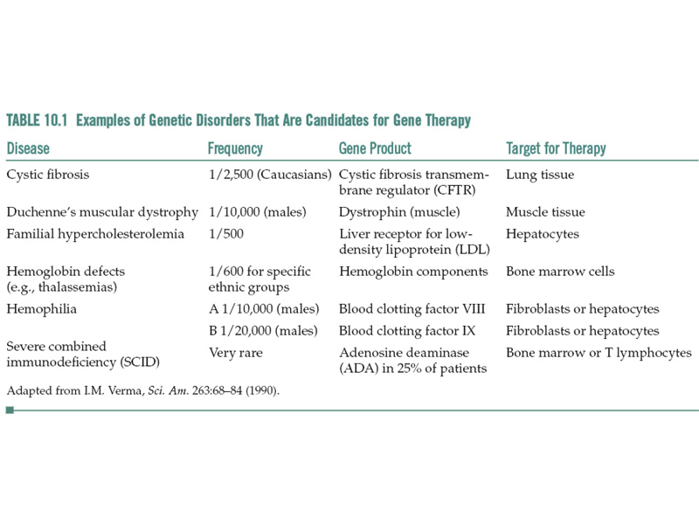
Consider somatic vs germline gene therapy; the later is currently banned.
Note that gene therapy is limited to somatic cells and disorders that are caused by a single gene.

Slide 30
Disease Target cells Transfected gene(s)
Hemophilia A Liver, muscle, Factor VIII
Hemophilia B bone marrow cells, fibroblasts Factor IX
Familial Liver LDL receptor
hypercholesterolaemia
Severe combined Bone marrow cells, T cells Adenosine deaminase
immunodeficiency
Hemoglobinopathy Red blood precursor cells alpha-globin, beta-globin
Cystic fibrosis lung airway cells CFTR
Gaucher disease Bone marrow cells Glucocerebrosidase
macrophages
Cancer Tumor cells p53, Rb, interleukins
growth-inhibitory genes,
apoptosis genes`

Slide 31
ex vivo gene therapy approach for hemophilia A (factor VIII):
Factor VIII production is not regulated in response to bleeding
Only need to raise levels a little bit, not to 100%, as low levels of the Factor VIII can be beneficial to the patient
Broad therapeutic index of factor VIII minimizes risk of overdose
Delivery of factor VIII into the bloodstream does not require cell-specific expression

