Slide 1
Chapter 1 Topic: Clinical Trials
Course code: Biot. 3113
Course name: Medical Biotechnology
Department of Biotechnology
University of Gondar

Slide 2
Introduction
Molecular techniques in prenatal diagnosis
Molecular diagnosis and cancer therapy
Markers for cancers
Cancer therapy:
DNA synthesis and repair
Anti-gene therapy:
RNAi approaches: ribozyme technology, antisense techn.
Immunology and immunotherapy for cancer:
Tumor immunotherapy and tumor suppressors,
Drug resistance,
Hematopoietic gene transfer,
Translational research,
Gene delivery systems (viral and non-viral),
Apoptosis: mechanisms and therapies,
Vaccine development for cancer.

Slide 3
Report writing is creating an account or statement that describes in detail an event, situation or occurrence, usually as the result of observation or inquiry.
Report Writing Format
Title Section – This includes the name of the author(s) and the date of report preparation.
Summary – There needs to be a summary of the major points, conclusions, and recommendations. ...
Introduction – The first page of the report needs to have an introduction. ...
Body – This is the main section of the report.

Slide 4
How do we write a report?
Step 1: Decide on the 'Terms of reference' ...
Step 2: Decide on the procedure. ...
Step 3: Find the information. ...
Step 4: Decide on the structure. ...
Step 5: Draft the first part of your report. ...
Step 6: Analyse your findings and draw conclusions. ...
Step 7: Make recommendations. ...
Step 8: Draft the executive summary and table of contents.

Slide 5
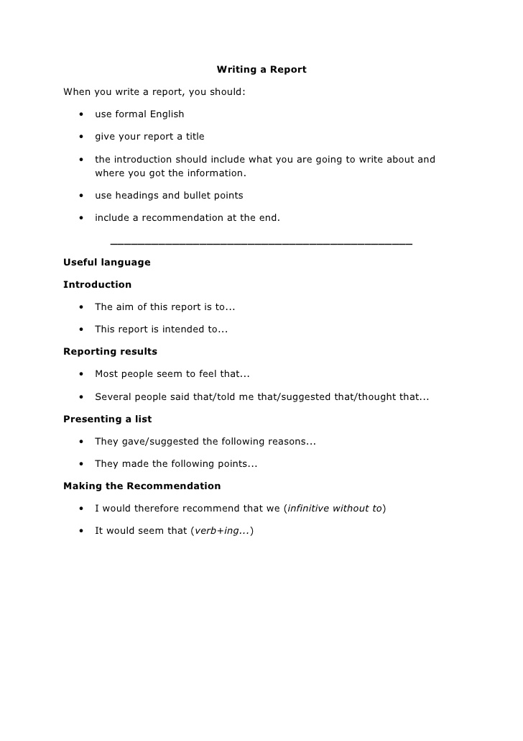

Slide 6
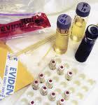

Why study toxicology???
Benefit –risk ratio can be calculated
Prediction of therapeutic index
Therapeutic index= Maximum tolerated dose
Minimum curative dose
Smaller ratio, better safety of the drug

Slide 7
Why do we require non clinical studies IN ANIMALS before ADMINISTERED to man??
Pharmacological effects are same in man as in animals
Toxic effect in species will predict adverse effects in man
Giving high doses in animals improves predictability to man
Risk assessment can be made by comparison of toxic doses in test species with predicted therapeutic dose in man

Slide 8
PHASES OF DRUG DEVELOPMENT
(ANIMAL MAN)
MOLECULE
PHASE II
PHASE III
PHASE IV
PRECLINICAL
PHASE I
PHASE II
PHASE III
PHASE IV
PHASE I
None
Healthy subjects
Safety and tolerability
Patients
Small scale
efficacy studies
Patients
Large scale
multicentre
studies
Patients
Large scale
post-marketing
studies
Clinical
Genetic toxicity
(in vivo)
Repeat dose toxicity testing +
Bioanalysis /
Toxicokinetics
Drug Metabolism
Reproductive Toxicity Testing
(teratogenicity)
Chronic (long term) toxicity testing
+
Bioanalysis / Toxicokinetics
Reproductive Toxicity Testing (fertility and pre/post natal)
Carcinogenicity studies
Drug Metabolism
As required
Genetic toxicity
(in vitro)
Single / repeat dose
toxicity studies
+
Bioanalysis / Toxicokinetics
Safety Pharmacology
Drug Metabolism
Non-clinical
Lead candidate Identified
Entry to man
(IND / CTA)
Patient studies
Product Approval (NDA/MAA)

Slide 9
General PRINCIPLES in toxicity studies
Studies should comply with GLP
Performed by trained and qualified staff
Use of standardized and calibrated equipment
SOP’s followed in laboratory tasks
All documents should be preserved for minimum 5 years after marketing of the drug

Slide 10

TOXICOKINETIC STUDIES
Generation of Pharmacokinetic data to access systemic exposure achieved in animals
Relation to dose level and the time course of toxicity study
To support choice of species & Treatment regimen
Design on clinical studies accordingly

Slide 11
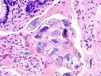
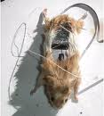
Relevant Test Models
Pharmacodynamic responses
Pharmacokinetic profile
Species, sex, age of experimental animals
Susceptibility, sensitivity and reproducibility of test system
In vitro: Isolated organs, tissues cell-cultures
Mechanism of effect in vivo

Slide 12
What is a clinical trial?
Clinical trials are research studies involving people
Used to find better ways to prevent, detect, and treat disease
The final step in a long process that includes preliminary laboratory research and animal testing
Types of Clinical Trials
Prevention Trials – explore ways to prevent cancer in people who have never had it, or to prevent cancer from recurring in previously treated patients
Screening Trials – test ways to find cancer as early as possible
Diagnostic trials – examine new tests or procedures to identify a suspected cancer
Treatment Trials – test new treatments
Quality of Life Trials – consider ways to improve comfort and quality of life for cancer patients

Slide 13
Phases of Clinical Trials
 | Purpose | Number of people who take part
Phase I | To find a safe dose To decide how the new treatment should be given To observe how the treatment affects the human body | 15-30 people
Phase II | To determine if the new treatment has an effect on a particular cancer To see how the treatment affects the human body | Fewer than 100 people
Phase III | To compare the new treatment with the current standard treatment | From 100 to thousands of people
Phase IV | To further assess the long-term safety and effectiveness of the new treatment | Several hundred to several thousand people

Slide 14
Who can join a clinical trial?
Every clinical trial has a protocol (like a recipe for conducting the trial) which clearly states who can or cannot join the trial
Eligibility criteria are the characteristics of the potential subject that determine whether he or she can be included in a clinical trial
Eligibility Criteria
The eligibility criteria can be general (age, sex, cancer type) or more specific (cancer stage, tumor characteristics)
Having these criteria ensure that each trial is:
Safe – the new treatment may not be appropriate for patients with certain medical conditions
Accurate and meaningful – patients may not be able to join a clinical trial if they have already been treated
Doctors need to be able to determine if the patient’s response is due to the treatment being studied and not an earlier treatment

Slide 15
Bias:
Bias is a personal belief that prevents impartial consideration of a question
Scientific conclusions must be based upon fact rather than assumption or bias
Limiting Bias in Clinical Trials
Two methods to limit bias in a clinical trial:
Randomization – participants are arbitrarily placed in either an investigational group (receiving new treatment) or a control group (receiving the standard treatment)

Slide 16
Limiting Bias in Clinical Trials
Blinding
Single blind trials - participants do not know whether they are in the investigational or control group
Double-blind trials - neither the patient nor the physician knows whether the participant is in the investigational or control group
Measuring Outcomes
An endpoint is a measurable outcome that indicates a treatment’s effectiveness.
Typical endpoints for a cancer treatment trial:
Tumor response rate – the proportion of trial participants whose tumor was reduced in size
Disease-free survival – the amount of time a participant survives without cancer occurring or recurring
Overall Survival – the amount of time a participant lives, typically measured from the beginning of the clinical trial until the time of death

Slide 17
Patient Protection
Federal rules help ensure that clinical trials are run in an ethical manner
Protocols must be reviewed by two separate panels – a scientific review panel, and an institutional review board (IRB)
Ongoing monitoring by:
IRB
Data and Safety Monitoring Boards (DSMBs) for phase III trials
Research team

Slide 18
Informed Consent
Informed consent is the process through which people learn the purpose, risks and benefits of a clinical trial before they decide to join
Members of the research team, including doctors and nurses, explain the trial and discuss participant’s rights.
Participants may:
Choose to participate or not
Leave the study at any time
Learn about all treatment options
Learn all the details about the treatment offered including risks and benefits
Discuss the trial with the principal investigator and members of the research team
Hear and read the information in a language they can understand

Slide 19
Ending Trials Early
If participants experience severe side effects, or if there is clear evidence that risks outweigh benefits, the IRB and DSMB will recommend the trial be halted
Trial can be stopped if there is clear evidence the new treatment is effective to make it widely available
Participating in a clinical trial
Possible drawbacks
New treatments under study are not always better than, or even as good as, standard care
If patients receive standard care instead of the new treatment being tested, it may not be as effective as the new approach.
Health insurance and managed care providers do not always cover all patient care costs in a study.

Slide 20
Participating in a clinical trial
Possible benefits
Clinical trials offer high-quality cancer care.
If someone is in a randomized study and does not receive the new treatment being tested, they will receive the best known standard care.
This may be as good as, or better than the new approach.
If a new treatment is effective, the participant may be among the first to benefit
The chance to help others and improve cancer treatment

