Slide 1
PELVIC ORGAN PROLAPSE(POP)

Slide 2
Objectives
Define POP
Describe clinical presentation
Explain factors involved in the pathogenesis
Current management principles

Slide 3
INTRODUCTION
POP is the downward displacement of the
structures that are normally located adjacent to the vaginal vault.
Protrusion of the pelvic organs into or out the vaginal canal
Defects in the pelvic supporting structures result in a variety of clinically evident pelvic relaxation abnormalities

Slide 4
It's estimated that half of women who have children will experience some form of prolapse in later life, but because many women don't seek help , the actual number of women affected by prolapse is unknown.
POP occurs when the pelvic floor muscles become weak or damaged and can no longer support the pelvic organs.

Slide 5
Predisposing factors
Most are parous, older women
Heredity
Estrogen defiecacy
History of increased intra-abdominal pressure
Postmenopausal
History of trauma to pelvic supporting structures
Surgical proceduers

Slide 6
Elements comprising the Pelvis
Bones
  Ilium, ischium and pubis fusion
Ligaments
Muscles
Endopelvic fascia

Slide 7
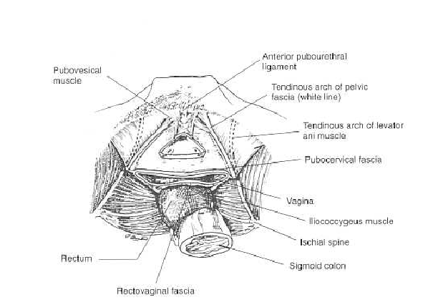
Fascial and Muscular layers of the Pelvic Floor

Slide 8
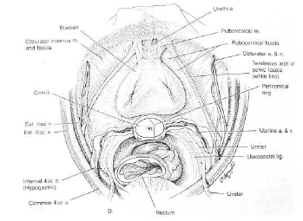
Attachments of cardinal/uterosacral ligaments

Slide 9
Pelvic Relaxation
Cystocele
Rectocele
Enterocele
Uterine and vaginal prolapse
  Result of weakness or defect in supporting tissues-
  endopelvic fascia and neuromuscular damage

Slide 10
Clinical feature
Symptom:
Pelvic pressure
Sexual dysfunction
Feeling of something coming down
Back ache or dragging sensation
Urinary symptoms like difficulty in passing urine, frequency, etc
Bowel symptoms like constipation
Excessive white or blood stained discharge

Slide 11
P/E
Straining & different positions
Prolapsed uterus with cervix as leading point
Prolapse of one organ is associated with other prolapses

Slide 12
Hormonal and neurologic evaluation
  Level of estrogenization
  Sensory and sacral reflex activity
Quantitative site-specific assessment of pelvic floor components
  in lithotomy position, patient sitting
  at rest and with valsalva
  ability to contract levator and anal sphincter muscles

Slide 13
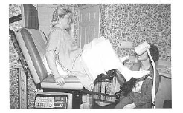
Patient position for evaluating pelvic floor defects

Slide 14
Investigations
Hct/ Hgb, blood group & Rh status
U/A, culture & sensitivity
RBS/FBS
RFT
Ultrasound
Urodynamic studies
CXR, etc

Slide 15
Complications
1.Vaginal mucosa: decubitus ulcer
2.Cervix: hypertrophied & elongated
3.Urinary symptom:
-Bladder: cystitis, incomplete evacuation
-Ureters: hydroureter, pyelonephritis
4. bleeding
5. Peritonitis
5. Carcinoma: rarely develops on decubitus ulcer

Slide 16
DDX
Cystocele versus Gartner’s cyst(wolffian remnant)
Congenital elongation of the cervix
Chronic uterine inversion
Fibroid or polyp
Tumors

Slide 17
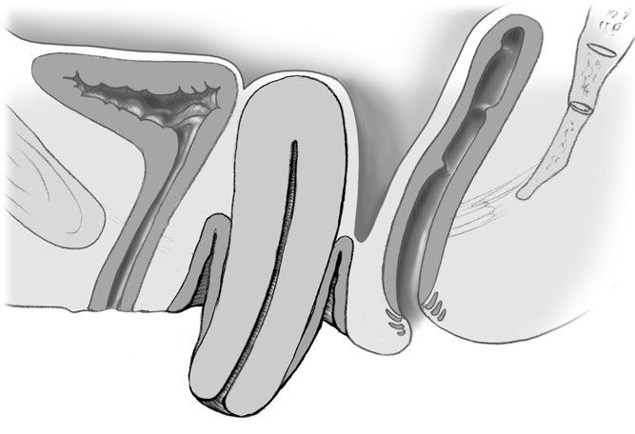
UVP

Slide 18
compartments
Anterior
Cystocele
Uretherocele
Midle
Enterocele
Uterine prolapse
Vault prolapse
Posterior
Rectocele

Slide 19
Uterine prolapse
Weakness of endopelvic fascia and detachment of cardinal and uterosacral ligaments
Complains of severe pelvic or abdominal pressure, bulge or mass, and low back pain
Surgical management includes hysterectomy and vaginal cuff or apex suspension

Slide 20
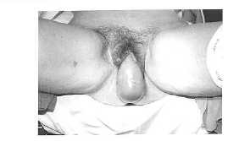
Complete Uterovaginal procidentia

Slide 21
Grading/staging/degrees of UVP
Three systems
Degree system: three degrees
1st degree: external cervical os below the ischial spines but within the vagina
2nd degree: external os protrudes out of the interoitus but fundus inside the vagina
3rd degree: uterine body outside of the interoitus. It is also called as PROCEDENTIA

Slide 22
Baden-Walker half way system:
Grade 0: normal position
Grade 1: Halfway between ischial spine to hymen
Grade 2: In to hymen
Grade 3: halfway past hymen to maximal descent
Grade 4: Maximal descent past hymen

Slide 23
Pelvic organ prolapse quantification system (POP-Q)
Four stages
Stage 0: no prolapse
Stage 1: maximal descent is 1cm above hymenal ring
Stage 2: up to 1cm beyond the hymenal ring
Stage 3: up to 2cm from total vaginal length from hymenal ring
Stage 4: beyond the hymenal ring to the extent of total vaginal length

Slide 24
Principles of reconstructive pelvic surgery
Site-specific repair
Rebuild weakened endopelvic fascia, repair fascial tears, and reattach prolapsed tissues to stronger sites
Goal is a vagina of normal depth, width and axis: function follows form
Denervation or muscle trauma cannot be corrected surgically

Slide 25
Conservative treatments
Pessary: can be fitted in most women regardless of the stage or site of predominant prolapse
Obstetric care to protect pelvic floor
  Decreased pushing times
  Avoid forceps, major lacerations
  Permit passive descent
General lifestyle changes
  Smoking cessation and cough cessation
  Routine use of Kegel pelvic floor exercises
  Regular physical activity
  Proper nutrition
  Weight loss
  Avoid constipation and repetitive heavy lifting
  Hormone replacement therapy

