Slide 1
Environmental Biological Analysis
EnvH-4125

Slide 2
Chapter 1: Introduction
Fresh air and good quality potable water have become commodities. Why?
Nature has its own way of indicating the health of the environment. How?
Globally, 1.1 billion people rely on unsafe drinking water sources from lakes, rivers and open wells
2.4 billion people lack adequate sanitation worldwide
  Ethiopia is the least
    lack of food hygiene and personal hygiene

Slide 3
Contd.
As a result, over 75 % of the health problems in Ethiopia are due to communicable diseases attributed to:-
  unsafe and inadequate water supply
  unhygienic waste management, particularly human excreta
    which one of the following are contributing more for communicable diseases?
      Water, Soil or Air
        In terms of global burden of disease, diarrhea ranks second after respiratory infections.
        There are two types of standards to identify the environmental health
          Primary standard
          secondary standard

Slide 4
  Introduction to Laboratory Safety
Preparing for laboratory work
check emergency protocols
comply with the procedures
During laboratory work
restrict only to authorized persons
keep work place clean
you are allowed to work with materials you know about
Consult material safety data sheets
Prepare and maintain a chemical inventory for the lab
Wash your hands thoroughly before leaving the laboratory.
Perform procedures that liberate infectious bioaerosols in a biological safety cabinet.

Slide 5
Contd.
Cleaning up before leaving
Turn off gas, water, electricity, vacuum and compression lines and heating apparatus
Return unused materials, equipment and apparatus to their proper storage locations
Label, package and dispose of all waste material properly
  how?
    Decontaminate any equipment or work areas that may have been in contact with hazardous materials

Slide 6








Understanding hazard warning information
Compressed Gasses- Class A
Flammable and Combustible Material- Class B
Oxidizing Material- Class C
Poisonous and Infectious Material- Class D
  Division 1: Materials Causing Immediate and Serious Toxic Effects
    Poisonous and Infectious Material - Class D
      Division 2: Materials Causing Other Toxic Effects
      Poisonous and Infectious Material- Class D
        Division 3: Biohazardous Infectious Materials
        Corrosive Material- Class E
        Dangerously Reactive Material- Class F

Slide 7
Lab reporting
Scope and Applications
  About the methods
  Does it keep viable o/ms
  Ways of application, what made it d/t from the other, how does it apply,
    Is based on sound underlying scientific principles
    Is applicable for routine analysis of samples
    Can detect analytes in the concentration range of interest
    Has sufficient specificity and sensitivity for intended use
    Can meet specific method performance criteria
    Has adequate QA/QC
    Can be performed with readily-available equipment
    Can be conducted for a reasonable cost

Slide 8
Contd.
        Addresses the level of expertise required (e.g., are there technique-sensitive areas? Is specialized training required?)
        Contains necessary aspects of quality assurance (e.g., calibrated equipment, media quality, incubation conditions)
        Addresses biosafety concerns (e.g., are there specific biosafety practices necessary to handle the test pathogens?)
        Does it directly identify the m/os
        In what kind of sample does it apply
Summary of Method
  The summary of overall process by which the method help you reach at your results
  Definitions
    Key words which are the core part of the experiments

Slide 9
Contd.
Interference and contamination
  Colloidal or suspended particulates,
  Lateral diffusion of colors( eg. Blue colors on E. coli colony identification)
  Species other than the target o/ms
  Contamination from the sample( E. g reagent chlorine), the materials
  Safety
    Remind the safety precautions and the ways you sterilize the equipments and media
    Equipment and supplies
      All the equipments needed and used in the procedures

Slide 10
Contd.
Reagents and Standards
  The agar used in preparation of culture media must be of microbiological grade.
  Whenever possible, use commercial culture media as a means of quality control.
  All has to be in accordance with the standards
Sample Collection, Preservation, and Storage
  Container type, aseptic techniques used, sample point identification, sampling procedures, number of samples, sample transportation, sample storage, etc

Slide 11
Contd.
Calibration and Standardization
  Incubators, thermometers autoclaves, balances and other equipments has to be calibrated and standardized
Quality Control
  Filter control, dilution water control, Agar, broth control
Procedures of the experiment
Data analysis and calculations
  M/o/100ml= No. of Colonies/Volume of sample filtered(mL) x 100
Method Performance
  The outcomes

Slide 12
Contd.
Pollution Prevention
Waste Management
References
Tables and Figures

Slide 13
Chapter 2: Instruments and equipment used in the biological analysis
Laboratory glassware
Introduction
Laboratory glassware refers to a variety of equipment, traditionally made of glass, used for scientific experiments and other work in science, especially in chemistry and biology laboratories

Slide 14
Introduction…
Some of the equipment is now made of plastic for cost, ruggedness, and convenience reasons, but glass is still used for some applications because it is relatively inert, transparent, more heat-resistant than some plastics up to a point, and relatively easy to customize. Borosilicate glasses are often used because they are less subject to thermal stress and are common for reagent bottles.

Slide 15
Introduction…
For some applications quartz glass is used for its ability to withstand high temperatures or its transparency in certain parts of the electromagnetic spectrum. In other applications, especially some storage bottles, darkened brown or amber (actinic) glass is used to keep out much of the UV and IR radiation so that the effect of light on the contents is minimized. Special-purpose materials are also used; for example, hydrofluoric acid is stored and used in polyethylene containers because it reacts with glass. For pressurized reaction, heavy-wall glass is used for pressure reactor.

Slide 16
Applications
There are many different kinds of laboratory glassware items, the majority are covered in separate articles of their own; see the list further below. Such glassware is used for a wide variety of functions which include volumetric measuring, holding or storing chemicals or samples, mixing or preparing solutions or other mixtures, containing lab processes like chemical reactions, heating, cooling, distillation, separations including chromatography, synthesis, growing biological organisms, spectrophotometry, and containing a full or partial vacuum, and pressure, like pressure reactor.

Slide 17
Application…
When in use, laboratory glassware is often held in place with clamps made for that purpose, which are likewise attached and held in place by stands or racks. This article covers aspects of laboratory glassware which may be common to several kinds of glassware and may briefly describe a few glassware items not covered in other articles.

Slide 18
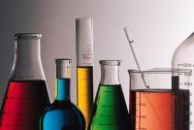
laboratory glassware

Slide 19
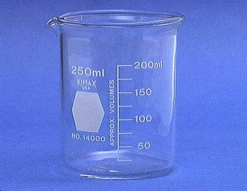
Beaker
Beakers hold solids or liquids that will not release gases when reacted or are unlikely to splatter if stirred or heated.

Slide 20
Beaker…
Used for transferring liquid to another container or to transfer a small amount of reagent for use in procedures.
Volume is not accurate, just an estimate.
NEVER PLACE A REAGENT IN ANOTHER CONTAINER WITHOUT LABELING THE CONTAINER FIRST

Slide 21
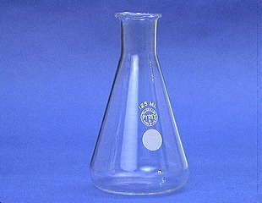
Erlenmeyer Flask
Erlenmeyer flasks hold solids or liquids that may release gases during a reaction or that are likely to splatter if stirred or heated

Slide 22
Erlenmeyer Flask…
Features a conical base, a cylindrical neck and a flat bottom.
They are marked on the side (graduated) to indicate the approximate volume of their contents.
This is NOT used for ACCURATE measurement

Slide 23
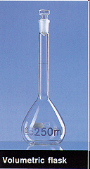
Volumetric Flask

Slide 24
Volumeric…
A volumetric flask is used to measure very precisely one specific volume of liquid (100 ml, 250 ml, etc., depending on which flask you use).
This flask is used to prepare a solution of known concentration.
To make up a solution, first dissolve the solid material completely, in less fluid than required to fill the flask to the mark.
After the solid is completely dissolved, very carefully fill the flask to the mL mark.
The top is then sealed and the flask is inverted several times to mix.

Slide 25
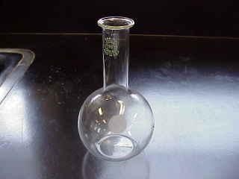
Florence Flask
it is used for the mixing of chemicals. Narrow neck prevents splash exposure.

Slide 26
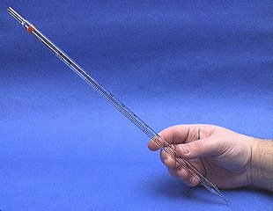
Mohr Pipet
A Mohr pipet measures and delivers exact volumes of liquids.

Slide 27
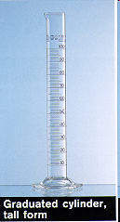
Graduated Cylinder
For rapid measurement of liquid volume.
They are generally more accurate and precise for this purpose than flasks.
This is a semi-accurate liquid measuring vessels.

Slide 28
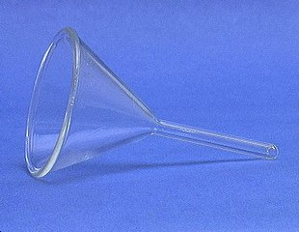
Funnel
A funnel is used to aid in the transfer of liquid from one vessel to another.

Slide 29
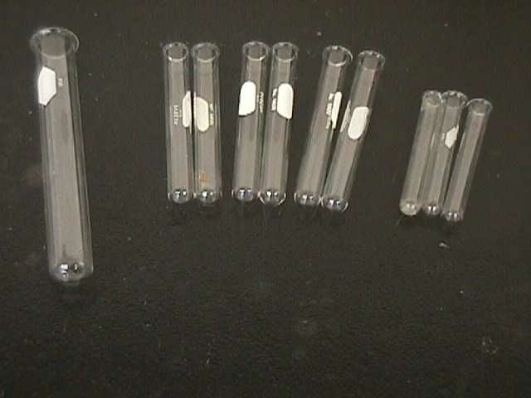
Test Tubes

Slide 30
Lab equipment
Introduction
Lab equipments are all the apparatus used in the lab for the proper functioning of lab activities
Functioning Equipment is Vital for:
  Producing reliable test results
  Minimizing instrument breakdown
  Lowering repair costs
  Preventing delays in reporting test results
  Maintaining productivity

Slide 31
A Good Equipment Program Achieves
Maintaining a high level of performance
Lengthening instrument life
Reducing interruption of services due to breakdowns and failures
Improving customer satisfaction
Improving the technologist’s confidence and knowledge

Slide 32
Basic Laboratory Equipment
Microscope
Autoclave
Balance/scale
Centrifuge
Micropipette
Spectrophotometer
Refrigerator
Freezer

Slide 33
Types…
Hot air oven
Incubator
pH Meter
Water bath
Washer
Shaker / rotator
glassware

Slide 34
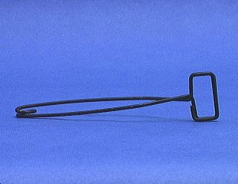
Test Tube Holder
A test tube holder is useful for holding a test tube which is too hot to handle.

Slide 35
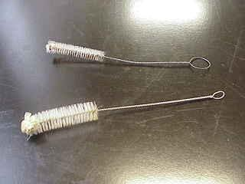
Test Tube Brushes
Test tube brushes are used to clean test tubes and graduated cylinders

Slide 36
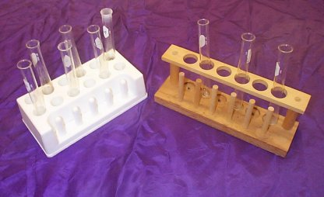
Test Tube Racks
Test tube racks are for holding and organizing test tubes on the laboratory counter. Plastic racks may melt in contact with very hot test tubes.

Slide 37
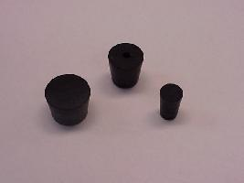
Rubber Stoppers
Rubber stoppers are used to close containers to avoid spillage or contamination.
Containers should never be heated when there is a stopper in place

Slide 38
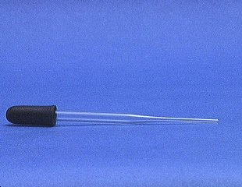
Medicine Dropper
A medicine dropper is used to transfer a small volume of liquid (less than one mL).
On top of each medicine dropper is a “rubber bulb”

Slide 39
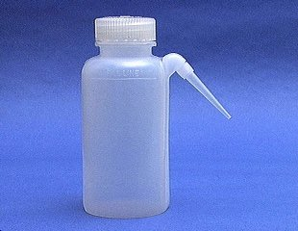
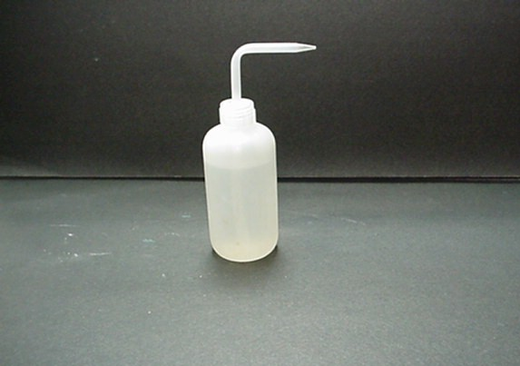
Wash Bottle
A wash bottle has a spout that delivers a wash solution to a specific area. Distilled water is the only liquid that should be used in a wash bottle.

Slide 40
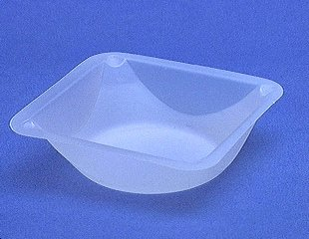
Weighing Boat
Weighing boats are used to weigh solids that will be transferred to another vessel.

Slide 41
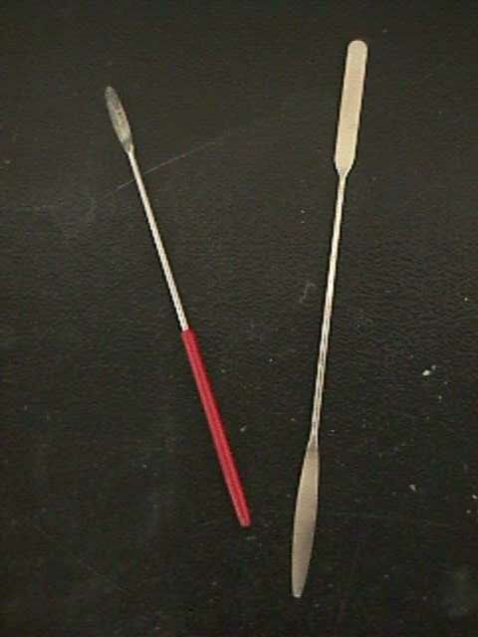
Spatulas
Spatulas are used to dispense solid chemicals from their containers.
Chemicals should never be transferred with your bare hands.

Slide 42
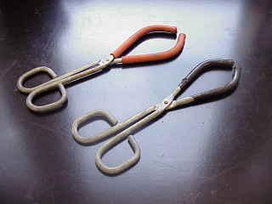
Beaker Tongs
Beaker tongs are used to move beakers containing hot liquids

Slide 43
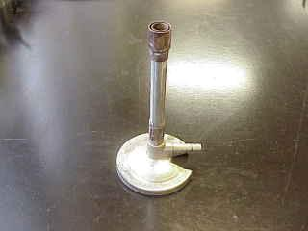
Bunsen Burner
Bunsen burners are used for the heating of nonvolatile liquids and solids.
To heat substances (with a flame)

Slide 44
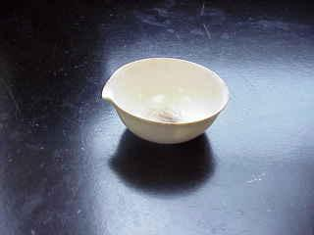
Evaporating Dish
The evaporating dish is used for the heating of stable solid compounds and elements.

Slide 45
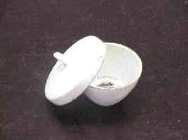
Crucible
Crucibles are used for heating certain solids, particularly metals, to very high temperatures.

Slide 46
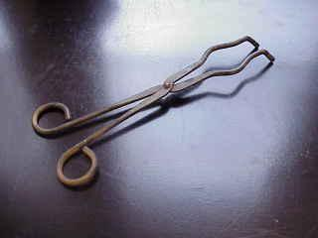
Crucible Tongs
For handling hot crucibles; also used to pick up other hot objects. NOT to be used for picking up beakers!

Slide 47
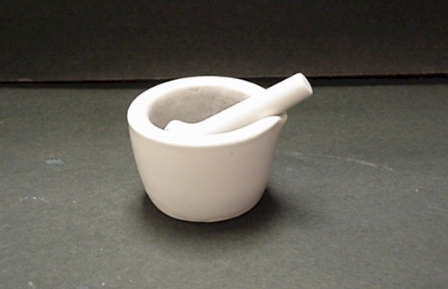
Mortar and Pestle

Slide 48
Chapter 3
Sampling methods, transportation and storage for various biological parameters

Slide 49
FIELD EQUIPMENT CHECKLIST (EXAMPLE)
Documentation | Quality control samples
Monitoring plan including site plan | Field blanks
Appropriate area maps | Transport/equipment blanks
Field notebook/record sheets | Sample storage and transport
Chain of Custody | Eskies and ice
Pens and textas | Packing material
Sampling equipment | Ice packs/blocks
Sampling rod | Packing tape
Depth sampler | Address Labels
Field meters | Courier information
Disposable gloves | Safety equipment
Sample containers (including containers for duplicates and blanks) | First-aid kit

Slide 50
Contd.
Labels for samples | Sunscreen/sunglasses
Decontamination | Drinking water
Clean work area, eg plastic groundsheet | Mobile phone/communication equipment
Buckets | PPE— wide brimmed hat wet weather gear waders/rubber boots disposable overalls
Demineralised/deionised water | Antiseptic hand wash
Detergent solution | Lifejackets/EPIRB
Ethanol (in wash bottle) | Other
Sponges, scrubbing brush | Tools—spanner/shifter, etc
Gas burner/sodium hypochlorite (for microbiological) | Digital camera and batteries/ charger
Field filtration | GPS and batteries
Filtration pump | Keys for gates
Filtration apparatus, syringe etc | Other equipment for site specific or remote area requirements
Filters

Slide 51
Sampling
Water sample
Surface samples—grab sampling
  When the water body is shallow and well mixed
  taken from approximately 20 cm depth
  care taken to ensure no floating films or organic material are collected
  Stirring up and collection of bottom sediments will also compromise sample integrity
  Try and collect the sample a reasonable distance from the edge
    To control loss of preservatives

Slide 52
Contd.
When sampling water from lakes or streams
  put the container upside down up to the required depth
  invert and open with the neck facing the water current
  Keep your hands, sampler and other equipments downstream to minimize contamination
  If it is still water, move the container forward to let uncontaminated water in.

Slide 53
Contd.
Where it is impractical or unsafe to sample by hand,
  Use sampling rods made of polycarbonate or stainless steel poles with a large clamp or cage on one end
    Containers are placed in the cage to reduce contamination
    container should be gently but quickly lowered into the water
  use a bucket and a rope in situations where access to the water is limited
    a sub-sample is immediately taken from the bucket

Slide 54
Composite samples
a sample consisting of two or more sub-samples mixed together in known proportions
collected manually (by combining grab samples), or by an automatic sampler
are not appropriate for analytes that degrade during sampling or transport
  dissolved oxygen, chlorine
  microbiological sampling

Slide 55
Contd.
There are two basic types of composite samples in water sampling:
time-weighted samples
  sub-samples of equal volume taken at constant intervals during the sampling period
Flow-weighted samples.
  sub-samples are proportional to the effluent flow or volume during the sampling period
  taking samples at constant intervals but with varying sample volumes that are proportional to the flow at the sampling time

Slide 56
Contd.
For both types of composites, the volume of the sub-samples should be able to be accurately measured to ±5%,
  the smallest sub-sample should be at least 50 mL in volume.
When undertaking composite samples it is important that holding times and preservation requirements are adhered to.
The holding time should be measured from the collection of the first sub-sample.
The composite sample needs to be appropriately preserved between additions of the sub-samples

Slide 57
Microbiological samples
Obtaining representative microbiological samples can take considerable care and timing
Microbiological samples can often require large sample volumes and are easily contaminated
They also have short holding times (preferably less than six hours).
Needs timely communication with the laboratory expert
Prior to and between collection of samples, hands should be washed
  Wearing latex gloves will help avoid contamination of samples during collection
  Gloves should be changed between samples.
For samples of chlorinated or chloraminated water, the container should contain sufficient sodium thiosulphate to neutralise the disinfectant

Slide 58
The hierarchy with regard to sampling equipment for microbiological analytes is/are:
Minimize usage of sampling equipment where possible, thus avoiding risk of contamination.
Use disposable pre-sterilised equipment
Use metal sampling equipment by flaming with a gas burner.
  All sections of the sampling equipment should be flamed.
For plastic and glass or when unsafe to use a flame, a solution of 10% sodium hypochlorite should be used.
  Flood the surface with the solution and wait approximately two minutes.
  For pump lines and hoses, trap bleach solution within the hose or equipment. Wait for a minimum of 15 minutes.
In an emergency, scalding with boiling water for 10 minutes may disinfect a suitable glass or plastic container and equipment.

Slide 59
Sampling for biological analytes
Plankton to macro-invertebrates, fish and other vertebrate aquatic animals
Sample size depends on
  the concentration of plankton in the water being sampled,
  the type of determination to be made (eg phytoplankton count, algal identification or chlorophyll concentration) and
  the analysis method.
When collecting samples for live analysis leave an air gap in the container
Protect from extra Temp, direct sunlight
Examine as soon as possible (48hrs)
  The most suitable preservative for phytoplankton is Lugol’s solution

Slide 60
Labeling and identification
Samples need to be labeled so they can be readily identified at all times.
  Use insoluble/non contaminating ink
  Biro/pencil should be used in place of Xylene
Additional information should be recorded
Labels may also contain:
  date of sampling
  time of sampling
  location and name of sampling site (include GPS coordinates if available)
  job or project number
  name of sampler
  container pre-treatment and preservations added
  Other observations that may affect the method or results of the analysis.
Hazardous or potentially hazardous samples (such as solvents) should be clearly marked as such

Slide 61
Chain of custody
a record used to trace possession and handling of a sample from the time of collection through analysis, reporting and disposal
The basic point is the control of
  Custody
  appropriate transfer and handling

Slide 62
Transport and storage
to ensure that samples are not significantly altered in condition and are in a state fit for analysis at the laboratory
The key aspects of effective transport and storage are to:
  ensure samples are appropriately packed to avoid breakage and cross-contamination
  reduce sample degradation through appropriate preservation
  ensure time between sampling and analyzing does not exceed holding time
  Sample containers should be sealed, carefully packed with an appropriate packing material, chilled or frozen

Slide 63
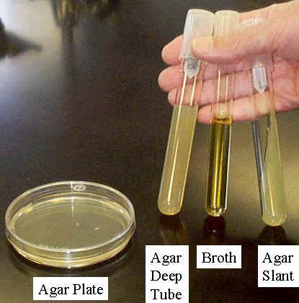
Methods of biological examination

Slide 64
Culture media
Any liquid or solid preparation made specifically for the growth, storage, or transport of microorganisms or other types of cells.
The growth medium should contain all the correct nutrients and energy source and should be maintained at proper pH, salinity, oxygen tension and be free of antibacterial substances.

Slide 65
Preparation and storage
Care must be taken to adjust the pH of the medium before autoclaving.
Various pH indicators that are in use include phenol red, neutral red, bromothymol blue, bromocresol purple etc.
Dehydrated media are commercially available and must be reconstituted as per manufacturers’ recommendation.
Most culture media are sterililized by autoclaving. Certain media that contain heat labile components like glucose, antibiotics, urea, serum, blood are not autoclaved.
  These components are filtered and may be added separately after the medium is autoclaved.
  Once prepared, media may be held at 4-5ºC in the refrigerator for 1-2 weeks.

Slide 66
Contd.
media can be either liquid or solid
  solid media agar- It melts at 100 ⁰C but does not solidify until below 40 ⁰C.
Most bacteria can be cultured artificially if the culture medium contains:
  The required nutrients
  The proper osmotic pressure, and
  The proper pH.

Slide 67
Classification
Based on their state
Therefore, the media used for growing should contain water, and sources of phosphorus, nitrogen, carbon, minerals and essential vitamins.
Based on their complexity
  simple media
  complex media
Based on their requirements
fastidious vs. non fastidious
Based on their oxygen requirement
  Aerobic vs. anaerobic

Slide 68
Anaerobic media
Anaerobic bacteria need special media for growth because they need low oxygen content, reduced oxidation –reduction potential and extra nutrients.
Media for anaerobes may have to be supplemented with nutrients like hemin and vitamin K.
Such media may also have to be reduced by physical or chemical means.
  Addition of 1% glucose, 0.1% thioglycollate, 0.1% ascorbic acid, 0.05% cysteine or red hot iron filings can render a medium reduced.

Slide 69
Classification based on functional use or application:
Based on their content
Basal media are basically simple media that supports most non-fastidious bacteria. Peptone water, nutrient broth and nutrient agar considered basal medium
Enriched media are used to grow nutritionally exacting (fastidious) bacteria. Blood agar, chocolate agar, Loeffler’s serum slope
  Blood agar is preparing by adding 5-10% (by volume) to a basal medium such as nutrient agar or other blood agar bases.

Slide 70
Contd.
    Chocolate agar is also known as heated blood agar or lysed blood agar. The procedure is similar to that of blood agar preparation except that the blood is added while the molten blood agar base is still hot.
    Selective and enrichment media are the type of Culture Media that are designed to inhibit unwanted commensal or contaminating bacteria and help to recover pathogen from a mixture of bacteria.
      Selective media are solid based Both have the same function
      Enrichment media are liquid based
    Various approaches to make a medium selective include addition of:-
      antibiotics, dyes, chemicals, alteration of pH or a combination of these
        Eg. McConkey’s Agar used for Enterobacteriaceae containing bile salt

Slide 71
Contd.
    Differential/Indicator media:
    Certain media are designed in such a way that different bacteria can be recognized on the basis of their colony color.
      Various approaches include incorporation of dyes, metabolic substrates etc, so that those bacteria that utilize them appear as differently colored colonies.
      for bacteria utilizing specific carbohydrate by producing gas that shows color difference upon pH change.
  This change in pH is detected by using a pH indicator incorporated in the medium and the bacterium that can ferment the sugar appears in a different color. Eg. peptone and neutral red
    Eg. MacConkey’s Agar contains bile salts (selective agent), lactose (sugar), peptone and neutral red (pH indicator), agar and water
    STORAGE MEDIA. Media used for storing the bacteria for a long period of time. Examples: Egg saline medium, chalk cooked meat broth.

Slide 72
Transport media:
Clinical specimens must be transported to the laboratory immediately after collection to prevent overgrowth of contaminating organisms or commensals.
  Such media prevent drying (desiccation) of specimen, maintain the pathogen to commensal ratio and inhibit overgrowth of unwanted bacteria.
    eg. Addition of charcoal serves to neutralize inhibitory factors

Slide 73
Basic Constituents of Media
Inorganic salts
Carbohydrates
Amino Acids
Vitamins
Fatty acids and lipids
Proteins and peptides
Serum
Trace Elements

Slide 74
Chapter 5
Indicator microorganisms
Indicator microorganisms and their identification
What Is an Indicator Microorganism?
A nonpathogenic microorganism whose presence suggests the presence of enteric pathogens

Slide 75
Indicator microorganisms
Indicator microorganisms are considered normal flora (always present) in the digestive system of all warm-blooded animals, including humans.
The detection of indicator microorganisms suggests that enteric pathogenic microorganisms may also be present due to the fecal contamination.

Slide 76
Process indicator - A group of organisms that demonstrates the efficacy of a process, such as total heterotrophic bacteria or total coliforms for chlorine disinfection.
Faecal indicator - A group of organisms that indicates the presence of faecal contamination, such as the bacterial groups thermotolerant coliforms or E. coli. Hence, they only infer that pathogens may be present.
Index and model organisms- A group/or species indicative of pathogen presence and behaviour respectively, such as E. coli as an index for Salmonella and F-RNA coliphages as models of human enteric viruses.

Slide 77
Types of indicator microorganisms
Total coliforms
  First group of indicators developed
  Problematic because of the ability of some species to replicate in the environment
Fecal coliforms
  Subgroup of Total coliforms
  Restricted to fecal origins
Fecal Streptococci
  Primarily an indication of animal fecal pollution
  FC/FS ratio

Slide 78
Criteria for an Ideal Indicator Organism
Should be useful for all types of water (drinking water, wastewater, recreational water, sea water)
Should be present whenever enteric pathogens are present, and absent when pathogens are absent
Should survive longer in the environment than the toughest enteric pathogen
Should not grow in water originally
Detection protocols should be easy and inexpensive
Density of indicator microorganisms should correlate with the degree of fecal pollution
Should be a member of the normal intestinal microflora of warm-blooded animals

Slide 79
FEACAL POLLUTION
Exposure to feacally contaminated water does not always translate into infection. (dose)
diarrhea are of critical importance as they could lead to death within 48 hours after the initial symptoms.
Examples of fecal waterborne diseases are
  gastroenteritis,
  typhoid and paratyphoid fevers,
  salmonellosis,
  cholera,
  meningitis,
  hepatitis,
  encephalitis,
  amoebic
  meningoencephalitis,
  cryptosporidiosis,
  giardiasis,

Slide 80
Indicator microorganisms
A good indicator microorganism has qualities which make it …
  Easy to test for in the lab.
  Present in greater numbers than the pathogens they indicate.
  Safer to work with in the lab than pathogens since the indicators cause no or only mild illnesses.
Indicators must not only be easy to work with in the lab, they must also predict the presence of pathogens.
Coliform bacteria are good indicators because they only reproduce in the intestines of animals, so they will not be present in water unless the water has been contaminated with sewage.
Coliform bacteria are also able to survive outside animals' intestines, so they will be present in water for several days after the water has been contaminated.

Slide 81
Indicator of fecal microorganisms
Total Coliforms
Fecal Coliforms
E. coli
Fecal Streptococci
Enterococci

Slide 82
Escherichia coli(E.coli)
E. coli normally colonizes an infant's gastrointestinal tract within 40 hours of birth, arriving with food or water or with the individuals handling the child.
In the bowel, it adheres to the mucus of the large intestine. It is the primary facultative anaerobe of the human gastrointestinal tract.
As long as these bacteria do not acquire genetic elements encoding for virulence factors, they remain benign commensals.

Slide 83
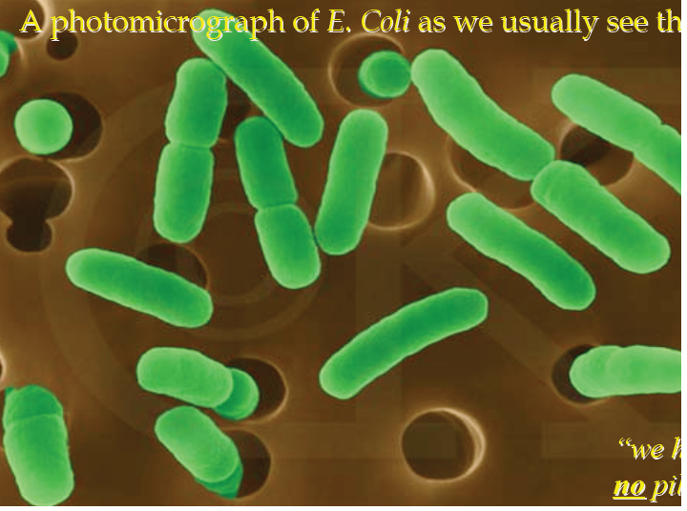

Slide 84
Definitions of (Total) Coliforms
Multiple-Tube Fermentation
  All aerobic and facultative anaerobic, Gram-negative, non-spore-forming, rod shaped bacteria that ferment lactose with gas and acid formation within 48 hr. at 35°C.
Membrane Filtration
  All aerobic and many facultative anaerobic, Gram-negative, non-spore-forming, rod-shaped bacteria that develop a red colony with a metallic sheen within 24 hr. at 35°C on an Endo-type medium containing lactose.

Slide 85
Total coliforms
Most commonly used indicator for drinking water, wastewater treatment, shellfish harvesting water, and recreational water
Aerobic or facultative anaerobic
Gram negative
non-spore-forming
rod-shaped
gas production during lactose fermentation within 48 hours at 35°C
Examples: Escherichia, Citrobacter, Klebsiella and Enterobacter
High numbers (2 x 10⁹ per capita per day) in human AND animal feces
< 1 coliform per 100 mL drinking water ensures the prevention of bacterial waterborne disease outbreaks

Slide 86
Drawbacks
Coliforms may grow in aquatic environments, particularly if organic matter levels and temperatures are elevated
Coliforms may form biofilms in drinking water distribution systems – this is a problem because, for example, E. coli is 2400 times more resistant to chlorine in a biofilm than when plankton
Coliforms may recover from disinfectant injury
Growth of heterotrophic bacteria on media selective for coliforms can mask coliform population in water (occurs when heterotrophic counts exceed 500/mL)
More vulnerable to disinfection and environmental trauma than enteric viruses or parasites
Do not necessarily indicate fecal contamination

Slide 87
Feacal coliforms
Subgroup of total coliforms
Able to ferment lactose and produce both acid and gas at 44.5°C in 24 hours
Include Escherichia and Klebsiella, which are exclusively feacal in origin.
Drawbacks
  same drawbacks as for total coliforms
  indicates fecal contamination for sure, but can’t distinguish between animal and human feaces
  can survive and grow for extended periods of time in tropical waters
    may be natural inhabitants of these waters!

Slide 88
Feacal Streptococci
  do not multiply in water
  are more resistant to stress/disinfection
  last longer in the environment
  used as indicators of enteric viruses, and gastroenteritis for swimmers
  Members of the lactic acid bacteria
  Gram positive, non-motile, non-spore-forming, aerotolerant anaerobic bacteria that ferment sugars to lactic acid
  FC/FS ratio - ratio of fecal coliform counts to fecal strep counts
  FC/FS >4 : fecal contamination of human origin
  FC/FS < 0.7: fecal contamination of animal origin
  This relationship is only valid for recent fecal contamination (within the last 24 hours)

Slide 89
Anaerobic bacteria
Clostridium perfringens
  Gram positive, anaerobic spore-forming rod-shaped bacterium
  Spores are heat resistant (can survive 75°C for 15 min), resist disinfection, can remain viable in the environment for a long time
  May be used as indicator of resistant pathogens (viruses, parasites), past fecal contamination, or tracing fecal contamination in a marine environment
  Drawbacks
  A common soil bacterium; may not necessarily indicate fecal contamination
  Pathogenic (causes gas gangrene if it infects wounds, produces enterotoxin in small intestine causing gastroenteritis)
  Anaerobic culture is difficult

Slide 90
Bacteriophage
Coliphage
  bacteriophage that infect coliforms, particularly E. coli
  similar to enteric viruses in size, morphology, and performance in environment
  found in higher numbers than enteric viruses in wastewater and other waters
  rapid and easy detection methods available
  survive for 7 days in shellfish without increasing in numbers
  routinely used as indicator microorganisms to determine the effectiveness of wastewater treatment processes
  resistant to disinfection

Slide 91
Chapter 6
Biodiversity in relation to macroinvertebrate

Slide 92
Biodiversity
Genetic diversity
Species diversity
Ecosystem diversity

Slide 93
Definitions
Abundance-the total number of organisms in an area. Does not matter what species they are.
Species richness-the number of different species in an area. Does not matter how abundant they are.
Diversity-incorporates BOTH the number of species in an area the evenness of their abundance.

Slide 94
Diversity Indices:
A diversity index is a mathematical measure of species diversity in a given community.
Based on the species richness (the number of species present) and species abundance (the number of individuals per species).
The more species you have, the more diverse the area, right?
However, there are two types of indices, dominance indices and information statistic indices.

Slide 95
Species diversity
Measured by diversity indexes
  Shannon index (H) - information index
H= Value of Shannon index
n_{i}= # of individuals (biomass) in the i^{th} species
N= total # of individuals
ln=natural logarithm
S= number of species in community

Slide 96
 | Number of individuals
Flower species | Field A | Field B
Daisy | 300 | 10
Dandelion | 330 | 50
Buttercup | 370 | 940
Abundance | 1000 | 1000
Species | 4 | 4

Slide 97
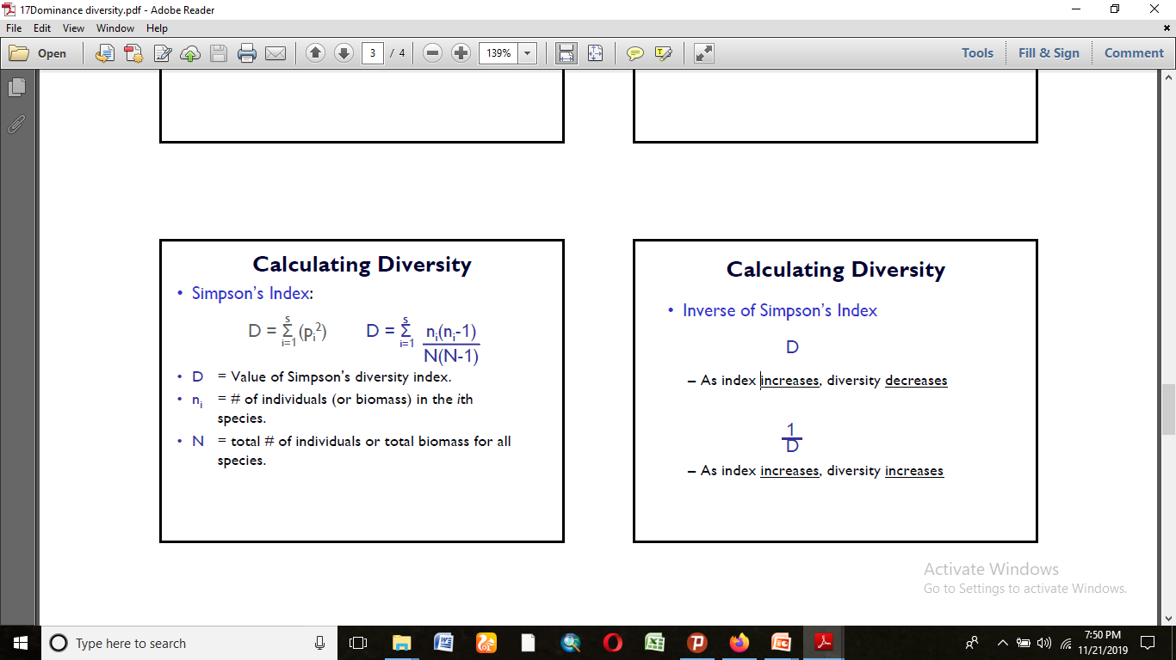

= D
Where P_{i}= #n_{i}/N

Slide 98
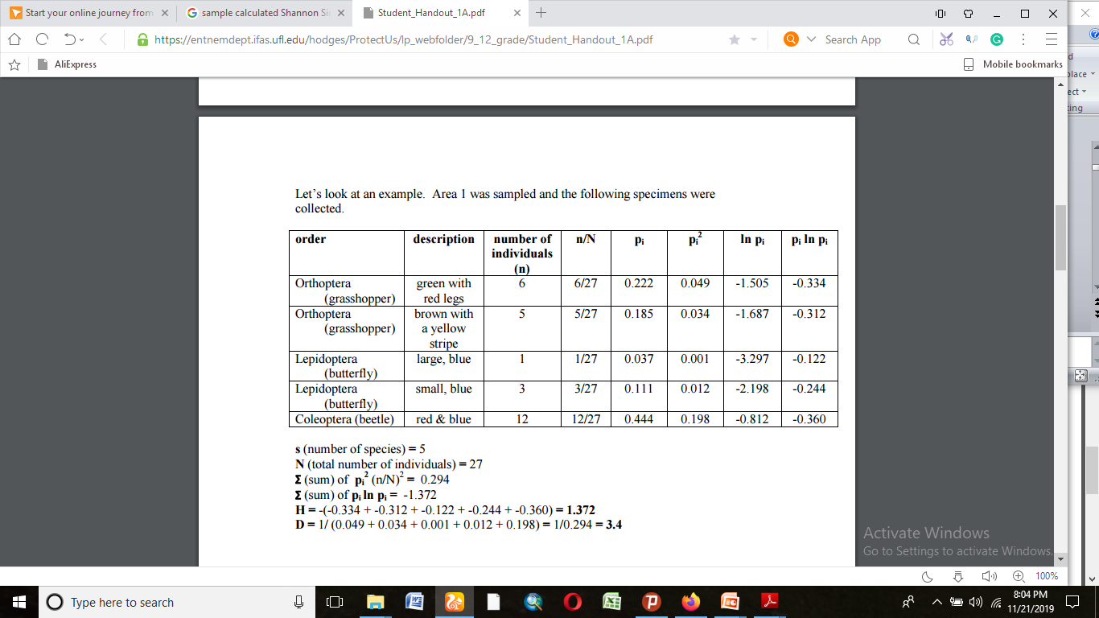
Species diversity
Measured by diversity indexes
  shannon index (H) - information index
H= Value of Shannon index
n_{i}= # of individuals (biomass) in the i^{th} species
N= total # of individuals
ln=natural logarithm
S= number of species in community

Slide 99
The value of D tell us, the bigger the value the more the diversity

Slide 100
Low diversity
relatively few successful species in the habitat
the environment is quite stressful with relatively few ecological niches and only a few organisms are really well adapted to that environment
food webs which are relatively simple
change in the environment would probably have quite serious effects

Slide 101
High species diversity suggests
a greater number of successful species and a more stable ecosystem
more ecological niches are available and the environment is less likely to be hostile
complex food webs
environmental change is less likely to be damaging to the ecosystem as a whole

Slide 102
Community Similarity
Calculating community similarities (what the communities have in common in terms of species) helps us determine if we are comparing apples to apples and oranges to oranges.
There are many indices that do this, we will use Sorenson’s coefficient.
Sorenson’s coefficient gives a value between 0 and 1, the closer the value is to 1, the more the communities have in common. a. Complete community overlap is equal to 1; complete community dissimilarity is equal to 0.
The equation is:

Slide 103
Community similarity (cont’d)
Sorensen’s similarity index = 2N
n1+ n2
 | Number of individuals
Flower species | Field A | Field B
Daisy | 300 | 10
Dandelion | 330 | 50
Buttercup | 370 | 940
Total | 1000 | 1000

Slide 104
Contd.
Ex.2: There are 20 species found in community 1 and 25 in community 2. Between them, they have 5 species in common. The calculation would be:
Sorensen’s similarity index = 2N
n1+ n2
= 2*5 = 0.222
20+ 25
NB: According to Sorenson’s coefficient, these communities do not have much overlap or similarity.

Slide 105
Macro invertebrates
Biological Monitoring
The quality of a aquatic health can be determined in several ways:
Physical monitoring gives information about a stream’s watershed and can help to identify possible sources of water quality problems.
Chemical analysis provides information about selected parameters at one moment in time.
In order to get an indication of stream conditions over a longer period of time, we need to look at the biological community that the stream supports.
A more complete assessment of water quality can be accomplished by evaluating the physical, chemical and biological aspects of a stream.

Slide 106
Advantages of Macro invertebrates as Biological Indicators
Non-Mobile
Species with Different Tolerances
Continuous Monitoring
Easy to Collect
Inexpensive Equipment
Easy to Identify
No Chemicals Needed

Slide 107
Macro invertebrates fall into three categories of pollution tolerance:
Pollution Sensitive
Somewhat Pollution Tolerant
Pollution Tolerant

Slide 108
Sampling equipments
Qualitative and quantitative sampling equipments
Facilitated Nets of different types
Hand lens
Safety equipments
Brush
Containers with 5% formalin
Identification key
Transportation
Information about the water body

Slide 109
Qualitative sampling
Hand net
shovel
Dredge
Drift

Slide 110
Quantitative sampling
Benthose sampler
Cable operated
    - Ekman grab
Peterson grab
Van Veen grab
Pole operated
  -Ekman grab

Slide 111
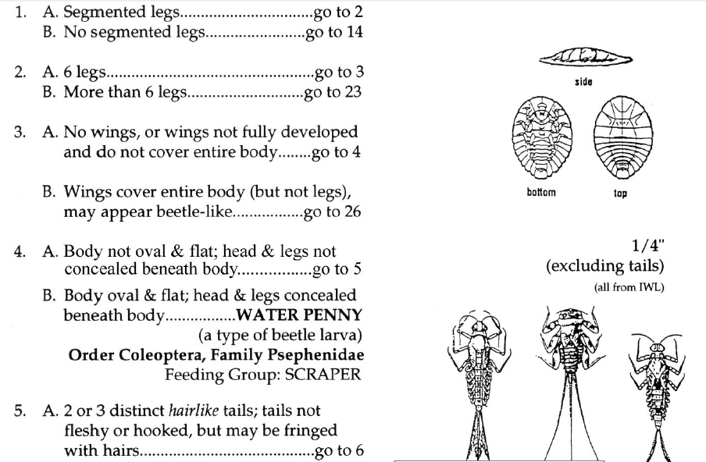
IDENTIFICATION KEY

Slide 112
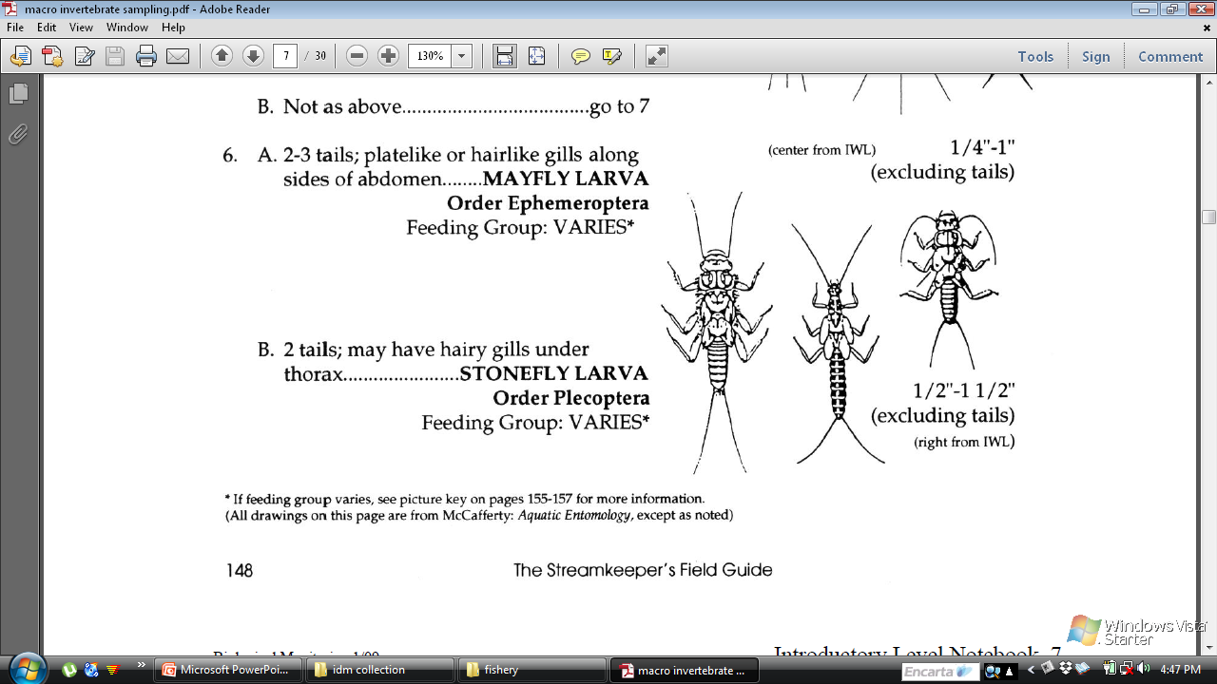

Slide 113


Slide 114
Sampling
How often, where, How?
How often? – 2-4 times/year
How? Require 2 person, net, and safety eqts
Where?
  riffle ? (3 X 3 ft surface vs 3X6ft down)
    Make sure there is no gap b/n the net and substrate
    Take 3 samples from d/t direction of the riffle
    Always sample upstream

Slide 115
Contd.
Root Mats: detach the plant and let the macro invertebrates fell on the net/seive
Snags
  Have to be in the water for some times
  Quickly remove the snags not to lose the insects
  Require 3-5 snags for one net set
  The horizontal net width is 6X12 inches
  Require two people

Slide 116
Non flowing
Non-flow areas of the stream are not in the main channel and do not have a flow.
They may be pooled areas in pockets behind logs or in pockets on the downstream end of a riffle, or in a bend in the stream.
Use D frame nets for rivers with non flowing area
One person is enough

Slide 117
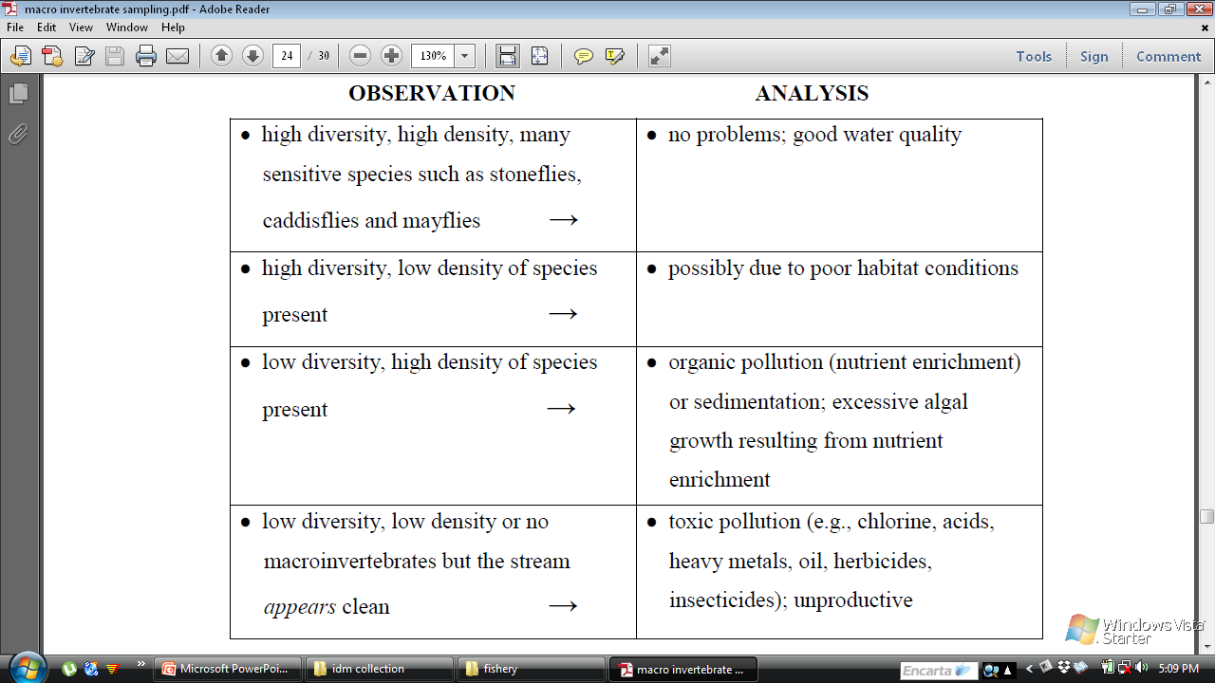

Slide 118
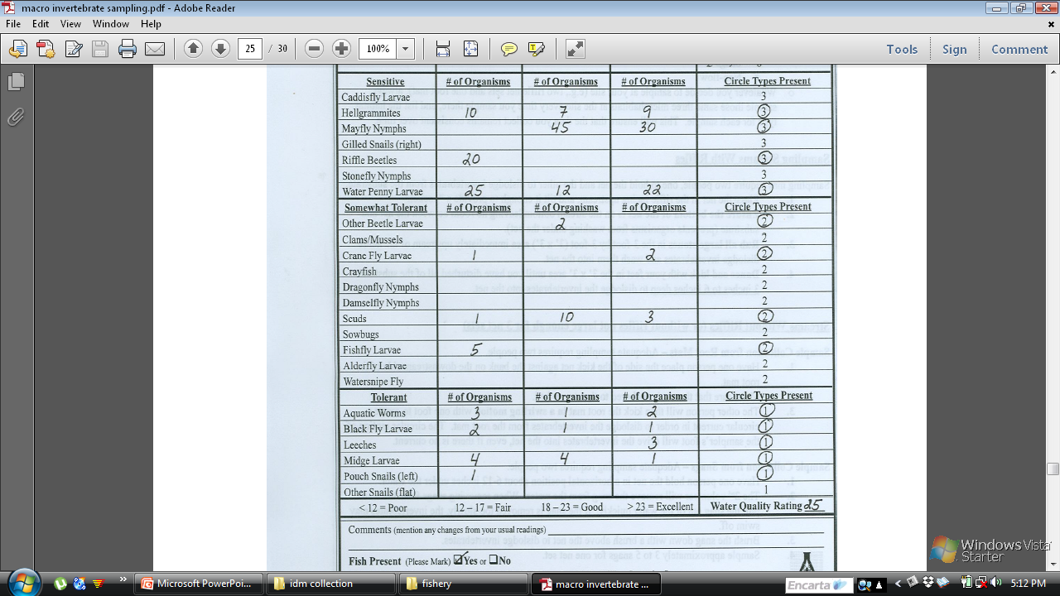

Slide 119
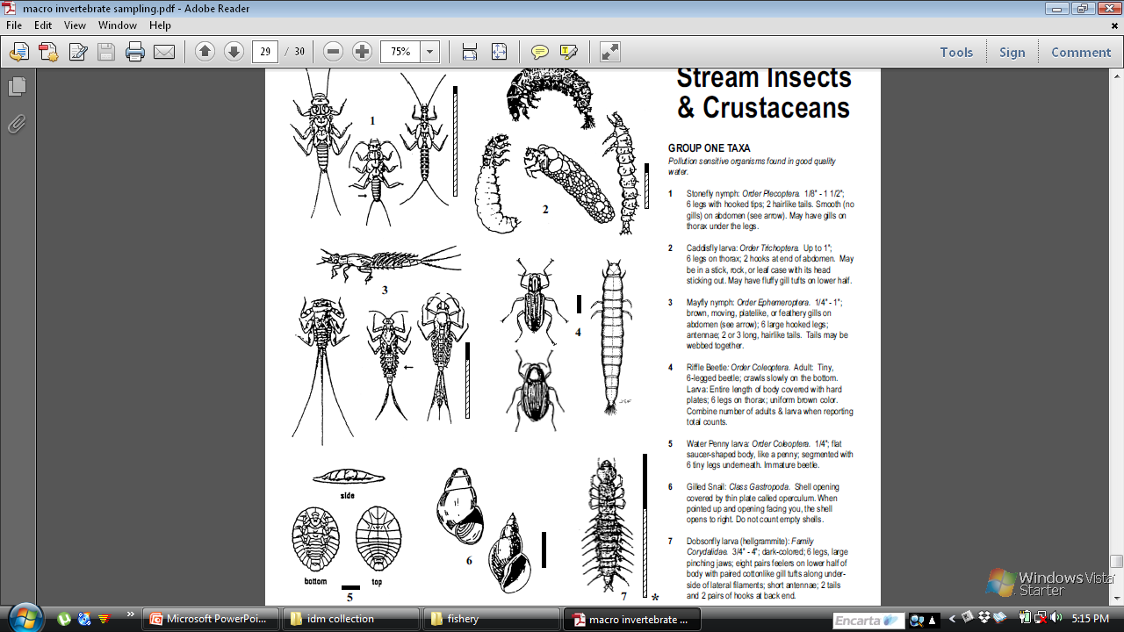

Slide 120
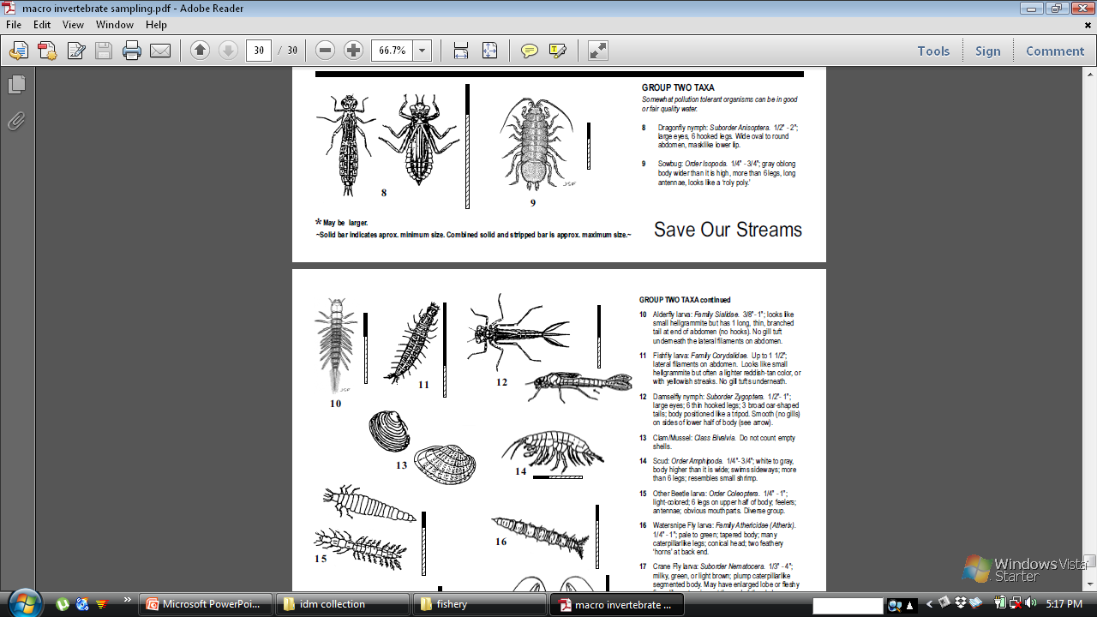
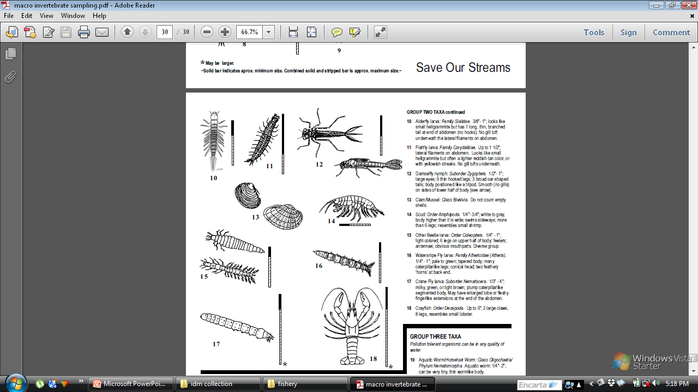

Slide 121
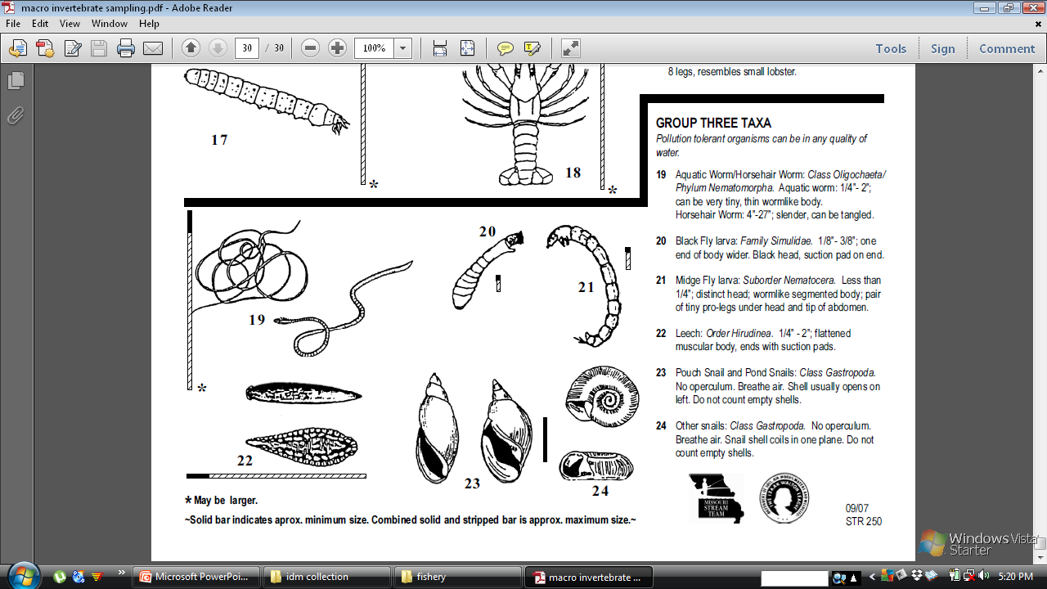

Slide 122
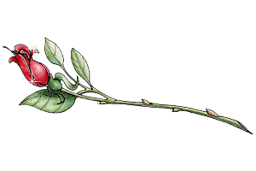
The End of the course!

