Slide 1
Lecture 2.
Preparation of Standard solutions and expression of results
By: Dinaol

Slide 2
In this Lecture
Definitions of some terms
Definitions of standard solutions
Why we need to prepare standard solutions
Methods of Preparing standard solutions (Some calculations)
How to express the results of our test

Slide 3
Definitions of related terms
Solutions
  Homogeneous mixtures that are mixed so thoroughly that neither component can be observed independently of the other.
  Homogeneous mixture composed of two or more substances. In such a mixture, a solute is dissolved in another substance, known as a solvent.
Solvent
  The major component of solutions.
  The substance which dissolves another to form a solution
Solute
  The minor component of a solutions
  The substance which dissolves in a solution

Slide 4
Definitions of related terms …
Saturation
  Saturation is the point at which a solution of a substance can dissolve no more of that substance and additional amounts of it will appear as a precipitate.
Supersaturation
  It refers to a solution that contains more of the dissolved material than could be dissolved by the solvent under normal circumstances.

Slide 5
Definitions of related terms …
Stock solutions
  A stock solution is a concentrated solution that will be diluted to some lower concentration for actual use.
  Stock solutions are used to save preparation time, conserve materials, reduce storage space, and improve the accuracy with which working lower concentration solutions are prepared.

Slide 6
Definition of Standard Solutions
What is Standard Solutions?
  A standard solution is any chemical solution which has a precisely known concentration. Similarly, a solution of known concentration has been standardized.
  To prepare a standard solution, a known mass of solute is dissolved and the solution is diluted to a precise volume.
  Standard solution concentration is usually expressed in terms of molarity (M) or moles per liter (mol/L).

Slide 7
Why we need to prepare Standard Solutions?
You use a standard solution to determine the concentration of the analyte during laboratory tests.

Slide 8
What must be considered during preparation of standard solution?
  The nature of solute
    Must be pure (analytical grade)
      Example, Oxalic acid , K2Cr2O7
  The quality we need/expect at the end
  Not all substances are suitable solutes for standard solutions.
  The reagent must be stable, pure, and preferably of high molecular weight.

Slide 9
Solutions recipes: Where do they come from?
Original Scientific Literature
Lab manuals (instructional)
Lab Manuals (professional)
Handbooks
Manufacturers and suppliers

Slide 10
Concentration Versus Amount
CONCENTRATION -- amount / volume
Fraction where:
  Numerator, the amount of solute
  Denominator, usually volume of entire solution
    solvent + solute(s)

Slide 11
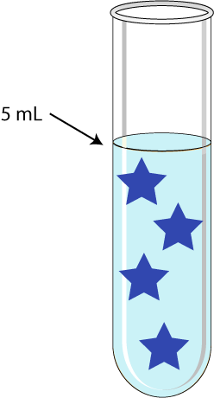
Each star represents 1 mg of NaCl.
What is the total amount of
NaCl in the tube? _____
What is the concentration of NaCl in the tube (in mg/mL)? _____

Slide 12
Each star represents 1 mg of NaCl.
What is the total amount
of NaCl in the tube?
4 mg
What is the concentration
of NaCl in the tube (in mg/mL)?
4 mg = ?_
5 mL 1 mL
? = 0.8 mg,so the
concentration is 0.8 mg/mL
Figure 1.

Slide 13
Ways To Express Concentration Of Solute
Source of confusion: more than one way to express concentration of solute in a solution

Slide 14
Concentration Expressions (Most Common)
WEIGHT PER VOLUME
MOLARITY
PERCENTS (Three kinds)
    a. Weight per Volume % (w/v %)
    b. Volume per Volume % (v/v %)
  c. Weight per Weight % (w/w %)

Slide 15
Percents
X % is a fraction
numerator is X
denominator is 100
Three variations on this theme.

Slide 16
Weight/volume %
TYPE I:
Grams of solute
100 mL total solution
Most common in biology but seldom used in chemistry manuals
  Technically, the units should be the same in the numerator and denominator

Slide 17
Example
    20 g of NaCl in
    100 mL of total solution
    = 20% (w/v) solution.

Slide 18
Example:
By Proportions
How would you prepare 500 mL of a 5 % (w/v) solution of NaCl?

Slide 19
Answer, By
Proportions
By definition: 5 % = 5 g
100 mL
5 g = ?
100 mL 500 mL
? = 25 g = amount of solute
BTV 500 mL

Slide 20
By Equation
How would you prepare 500 mL of a 5 % (w/v) solution of NaCl?
Total volume required is 500 mL.
5% = 0.05
(0.05) (500 mL) = 25
25 is the amount of solute required in grams.
Weigh out 25 g of NaCl. Dissolve it in less than 500 mL of water.
In a graduated cylinder or volumetric flask, bring the solution to 500 mL.

Slide 21
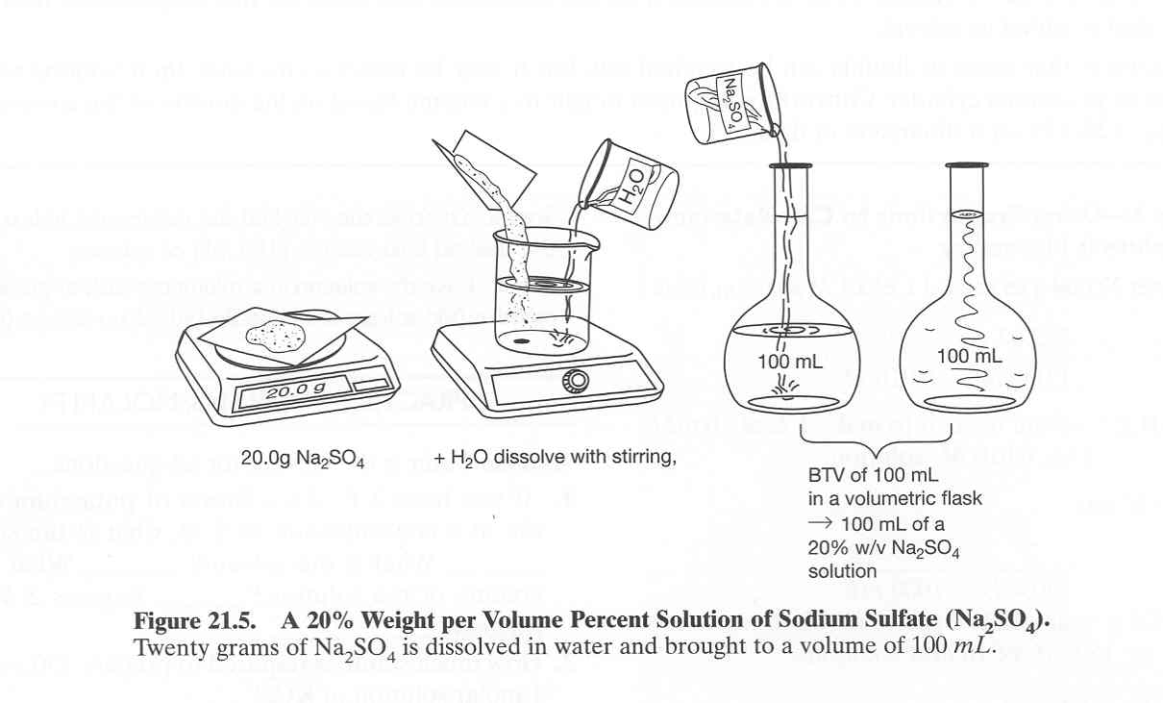

Slide 22
Concentration Expressions (Most Common)
PARTS (Common in environmental sciences, for example)
Amounts of solutes expressed as "parts"
a. Parts per Million (ppm)
b. Parts per Billion (ppb)
c. Might see parts per Thousand (ppt)

Slide 23
Parts
Parts may have any units but must be the same for all components of the mixture.

Slide 24
Example:
A solution is 3:2:1 ethylene:chloroform:isoamyl alcohol
Might combine:
3 liters ethylene
2 liters chloroform
1 liter isoamyl alcohol

Slide 25
Two Other Forms Of %
v/v mL solute
100 mL solution
w/w g solute
100 g solution

Slide 26
Weight/weight
How would you make 500 g of a 5% solution of NaCl by weight (w/w)?

Slide 27
Answer
Percent strength is 5% w/w, total weight desired is 500g.
5% = 5g/100g
5g X 500 g = 25 g = NaCl needed
100 g
500 g – 25 g = 475 g = amount of solvent needed
Dissolve 25 g of NaCl in 475 g of water.

Slide 28
Weight / Volume
Means a fraction with:
    weight of solute in numerator
total volume in denominator

Slide 29
Example:
2 mg/mL proteinase K
  Means 2 mg of proteinase K in each mL of solution.
Example: How much proteinase K is required to make 50 mL of solution at a concentration of 2 mg/mL?

Slide 30
Can Solve as A
Proportion Problem
2 mg proteinase K = X
1 mL solution 50 mL solution
X = 100 mg
= amount proteinase K needed.

Slide 31
Volume / Volume
Means a fraction with:
    volume of solute in numerator
total volume in denominator
Usually the “solute” here is a liquid as well
Remember that volume in the denominator is the total volume of the solution

Slide 32
Example
You are to make 50 mL of a 8% v/v solution of diluted dish soap.
How many mLs of concentrated dish soap must be added to how many mLs of water?

Slide 33
Weight / Weight
Means a fraction with:
    mass of solute in numerator
total mass in denominator
Most times the “solute” here is a solid and sometimes the “solution” is also a solid
Remember that mass in the denominator is the total mass of the solution

Slide 34
Examples
You are to prepare 4 kg of specific soil sample which is to be 8% w/w sand and 5% w/w clay in which the remainder is top soil.
How many grams of each sand and clay need to be added to the soil to make the solution?

Slide 35
Ppm And Ppb
ppm: The number of parts of solute per 1 million parts of total solution.
ppb: The number of parts of solute per billion parts of solution.

Slide 36
Ppm Example:
5 ppm chlorine = 5 g of chlorine in 1 million g of solution,
or 5 mg chlorine in 1 million mg of solution,
or 5 pounds of chlorine in 1 million pounds of solution

Slide 37
Conversions
To convert ppm or ppb to simple weight per volume expressions:
5 ppm chlorine

Slide 38
Conversions
To convert ppm or ppb to simple weight per volume expressions:
5 ppm chlorine = 5 g chlorine = 5 g chlorine 10⁶ g water 10⁶ mL water
= 5 mg/1 L water
= 5 X 10⁻⁶ g chlorine/ 1 mL water
= 5 micrograms/mL

Slide 39
PPM To
Micrograms/ml
For any solute:
1 ppm in water = 1 microgram
mL

Slide 40
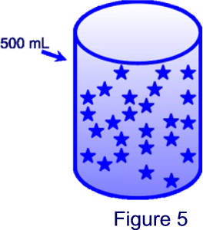
Each star represents 1 mg of dioxin.
What is the concentration of dioxin in the beaker expressed as ppm (parts per million)? ____________
What is the total amount of
dioxin in beaker?
___________

Slide 41
Each star represents 1 mg of dioxin.
What is the total amount of dioxin in tube? 25 mg
What is the concentration of dioxin in tube expressed as ppm? ____________
1 ppm in water = 1 μg
mL
25 mg/500 mL
= 0.05 mg/mL= 50 μg/mL
so the concentration is 50 ppm

Slide 42
Still More Concentration Expressions
TYPES NOT COMMON IN BIOLOGY MANUALS:
MOLALITY
NORMALITY
    We remember that for NaOH and HCl, molarity = normality, however, this is not true for all solutes

Slide 43
More with Molarity
Molarity is: number of moles of a solute that are dissolved per liter of total solution.
By definition: A 1 M solution contains 1 mole of solute per liter total volume.

Slide 44
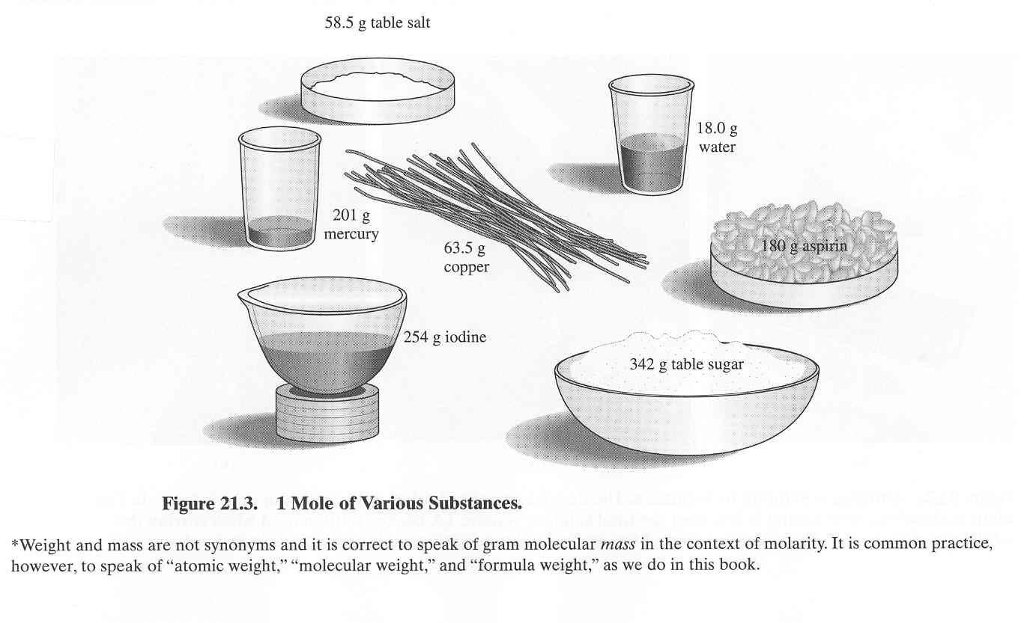
Mole
How much is a mole?

Slide 45
Examples:
Water, Sulfuric Acid and Glucose
For a particular compound, add the atomic weights of the atoms that compose the compound.
What is the formula weight for water H₂O?
What is the formula weight for sulfuric acid H₂SO₄?
What is the formula weight for glucose C₆H₁₂O₆?

Slide 46
Example:
Sulfuric Acid
For a particular compound, add the atomic weights of the atoms that compose the compound.
H₂SO₄:
2 hydrogen atoms 2 X 1.00 g = 2.00 g
1 sulfur atom 1 X 32.06 g = 32.06 g
4 oxygen atoms 4 X 16.00 g = 64.00 g
98.06 g/mole
Glucose = 180 g/mole

Slide 47
Example
Continued
A 1M solution of sulfuric acid contains 98.06 g of sulfuric acid in 1 liter of total solution.
Observe that "mole" is an expression of amount
“Molarity" is an expression of concentration.

Slide 48
Definitions
"Millimolar", mM, millimole/L.
  A millimole is 1/1000 of a mole.
"Micromolar", µM, µmole/L.
  A µmole is 1/1,000,000 of a mole.

Slide 49
Formula
HOW MUCH SOLUTE IS NEEDED FOR A SOLUTION OF A PARTICULAR MOLARITY AND VOLUME?
FW X molarity x volume = g solute needed

Slide 50
Example
How much solute is required to make 300 mL of 0.8 M CaCl₂?

Slide 51
Answer
Substituting into the formula:
(111.0 g) (0.8 mole) (0.3 L) = 26.64 g
mole L

Slide 52
Example
What is the concentration (M) of a salt solution that has 28 g of NaCl in 185 mL of water?
What is the w/v% of this solution?

Slide 53
To Make Solution
Of Given Molarity And Volume:
Find the FW of the solute, usually from label.
Determine the molarity desired.
Determine the volume desired.
Determine how much solute is necessary by using the formula.

Slide 54
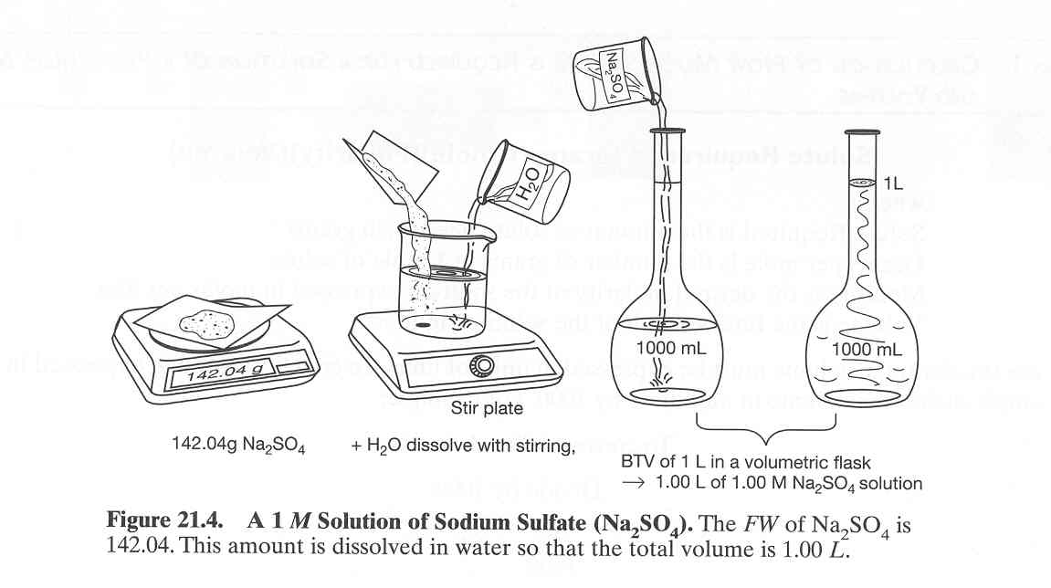

Slide 55
Procedure Cont.
Weigh out the amount of solute.
Dissolve the solute in less than the desired final volume of solvent.
Place the solution in a volumetric flask or graduated cylinder. Add solvent until exactly the required volume is reached, “Bring To Volume”, “BTV”.

Slide 56
From Basic Laboratory Methods for Biotechnology: Textbook and Laboratory Reference, Seidman and Moore, 2000

Slide 57
Preparing
Dilute Solutions
From Concentrated Ones
Concentrated solution = stock solution
Use this equation to decide how much stock solution you will need: C₁V₁=C₂V₂
      C₁ = concentration of stock solution
      C₂ = concentration you want your dilute solution to be
      V₁ = how much stock solution you will need
      V₂ = how much of the dilute solution you want to make

Slide 58
Example
How would you prepare 1000 mL of a 1 M solution of Tris buffer from a 3 M stock of Tris buffer?
  The concentrated solution is 3 M, and is C₁.
  The volume of stock needed is unknown, ?, and is V₁.

Slide 59
Example Cont…
  The final concentration required is
  1 M, and is C₂.
  The final volume required is 1000 mL and is V₂.

Slide 60
Substituting Into
The Equation:
C₁ V₁ = C₂ V₂
3 M (?) 1 M (1000 mL)
? = 333.33 mL
So, take 333.33 mL of the concentrated stock solution and BTV 1 L.

Slide 61
“X” Solutions
The concentration of a stock solution is sometimes written with an “X”.
The “X” is how many more times the stock is than normal.
You generally want to dilute such a stock to 1X, unless told otherwise.

Slide 62
Example
A can of frozen orange juice is labeled 4X. How would you dilute it to make 1L of drinkable drinkable juice?
Using the C₁V₁=C₂V₂ equation:
C₁ V₁ = C₂ V₂
4X (?) = 1X (1L)
? = 0.25 L
Use 0.25 L of orange juice, BTV 1L.

Slide 63
Biological Buffers
Laboratory buffers
solutions to help maintain a biological system at proper pH
pKa of a buffer
the pH at which the buffer experiences little change in pH with addition of acids or bases = the pH at which the buffer is most useful

Slide 64
Temperature
Some buffers change pH as their temperature and/or concentration changes
Tris buffer, widely used in molecular biology, is very sensitive to temperature

Slide 65
Dilution
Some buffers are sensitive to dilution
Phosphate buffer is sensitive to dilution

