Slide 1
Lecture 3. Instruments and equipment used in the biological analysis of Environment
By: Dinaol

Slide 2
In This Lecture:
Laboratory glassware and reagents
Instruments in environmental quality control laboratory
Operation of equipment (some)

Slide 3
3.1. Laboratory Glassware
Laboratory glassware refers to a variety of equipment used in scientific work, and traditionally made of glass.
Glass can be blown, bent, cut, molded, and formed into many sizes and shapes, and is therefore common in chemistry, biology, and analytical laboratories.
Many laboratories have training programs to demonstrate how glassware is used and to alert first–time users to the safety hazards involved with using glassware.

Slide 4
Laboratory Glassware selection
Laboratory glassware and plastic wares are widely used in medical laboratories.
Glasswares are usually manufactured from boro- silicate glass.
Boro - silicate glass is a material with the following defined characteristics:
Resistant to the action of chemical
Made to withstand mechanical breakage,
Made to withstand sudden change of temperature.
Glassware produced from the soda lime type of glass does not fit the above requirements and is easily broken by mechanical stress produced by a sudden change of temperature.

Slide 5
Laboratory glassware selection
Laboratory glassware is typically selected by a person in charge of a particular laboratory analysis to match the needs of a given task.
The task may require a piece of glassware made with a specific type of glass.
The task may be readily performed using low cost, mass-produced glassware, or it may require a specialized piece created by a glass blower.
The task may require controlling the flow of fluid. The task may have distinctive quality assurance requirements.

Slide 6
Types of Glass
Laboratory glassware may be made from several types of glass, each with different capabilities and used for different purposes.
Borosilicate glass is transparent and can withstand thermal stress.
Quartz glass can withstand very high temperatures and is transparent in certain parts of the electromagnetic spectrum.
Darkened brown glass can block ultraviolet and infrared radiation.

Slide 7
Types of Glass …
Heavy-wall glass can withstand pressurized applications.
Coated glassware is specially treated to reduce the occurrence of breakage or failure.
Siliconized glassware is specially treated to prevent organic samples from sticking to the glass

Slide 8
Precautions:
All glasswares must be handled carefully.
Breakage can sometimes be dangerous and may result in the loss of valuable and irreplaceable materials.
Flasks and beakers should be placed on a gauze mat when they are heated over a Bunsen flame.
Test tubes exposed to a naked flame should be made of heat resistant glasses.
If liquids are to be heated in a bath or boiling water, the glass contents should be heat resistant.

Slide 9
Precautions …
When diluting concentrated acids, specific walled glassware should be used since the heat evolved by the procedure often cracks glasswares. Examples:- hydrochloric and sulfuric acid.
Heat expansion is liable to crack bottles if their caps are screwed on tightly so if heat is to be applied, flasks should not be tightly clamped.
Containers and their corresponding ground glass stoppers should be numbered in order to ensure direct matching when stoppers are replaced.
Because of the danger of chemical and bacteriological contamination, pipettes should never be left lying on the bench.

Slide 10
Volumetric Wares:
Volumetric wares are apparatus used for the measurement of liquid volume.
They can be made from either glass or plastic wares such as pipettes, volumetric flasks, cylinders and burettes.

Slide 11
PIPETTES:
There are several types each having its own advantages and limitations. Pipettes are designated as class “A” or “B” according to their accuracy.
Class “B” pipettes are less accurate but quite satisfactory for most general laboratory purposes.

Slide 12
Volumetric pipettes:
Volumetric pipettes are calibrated to deliver a constant volume of liquid.
The most commonly used sizes are 1, 5, and 10ml capacities.
The Volume (capacity) and calibration temperature of the pipettes are clearly written on the bulb. They should be used when a high degree of accuracy is desired.
The pipette is first rinsed several times with a little of the solution to be used, then filled to just above the mark.
Then the liquid is allowed to fall to the mark and the tip is carefully wiped with filter paper. The contents are allowed to drain in to the appropriate vessel.
A certain amount of liquid will remain at the tip and this must not be blown out.

Slide 13
Graduated or Measuring pipettes:
Graduated pipettes consist of a glass tube of uniform bore with marks evenly spaced along the length.
The interval between the calibration marks depends up on the size of the pipette.
Two types calibration for delivery are available. These are:
One is calibrated between two marks on the stem (Mohr).
The other has graduation marks down to the tip (serological pipette)
These pipettes are intended for the delivery of predetermined volumes.
Measuring pipettes are common only in 0.1, 0.2, 0.5, 1.0 5.0, and 10.0 ml sizes. The liquid is delivered by allowing it to fall from one calibration mark to another.

Slide 14
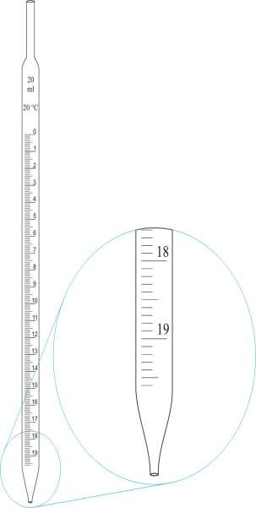
Graduated pipette (blow-out)
(Serological pipette)
Volumetric pipette
Graduated or Measuring Pipette
(Mohr’s Pipette)

Slide 15
Micropipettes:
Micropipettes are frequently used in medical chemistry, Virology, immunology and environmental laboratories.
This is because in these laboratories often only small quantities of materials are available for measurement.
They are found in different capacities such as 5, 10, 25, 50, 100 and 1000 microliter.
There are also other kinds of pipettes that are used in medical laboratories. Examples include: Toma pipette, ESR pipette, Pasteur pipette, Automatic pipettes and others.

Slide 16
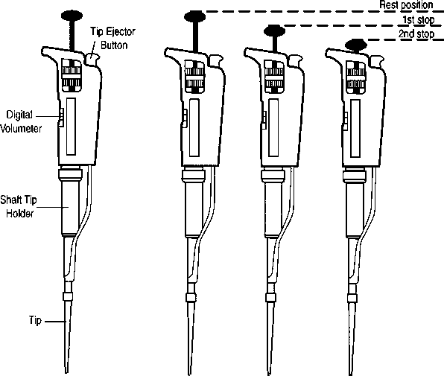
Micropipette

Slide 17
BURETTES:
Burettes are used for measuring variable quantities of liquid that are used in volumetric titrations.
They are made in capacities from 1-100 milliliters.
They are long graduated tubes of uniform bore and are closed at the lower end by means of a glass stopper, which should be lightly greased for smooth rotation.
FLASKS:
There are four types of flasks having 25 to 6,000 milliliter (ml) capacities.
A. Conical (Erlenmeyer) flasks:
Conical (Erlenmeyer) flasks are useful for titrations.
For boiling solutions when it is necessary to keep evaporation to a minimum.
Some have a side arm suitable for attachment to a vacuum pump.

Slide 18
B. Flat bottomed round flasks:
Flat-bottomed round flasks are convenient containers to heat liquids.
A gauze mat should be interposed between the flask and flame.
These flasks are widely used in the preparation of bacteriological culture media.
C. Round bottomed flasks:
Round bottomed flasks can with stand higher temperatures than the flat- bottomed type
They may be heated in a necked flame, or in an electro-thermal mantle.
They can be used for boiling of different kinds of solutions and to make titration.

Slide 19
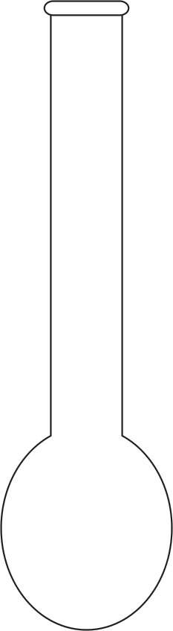
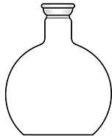
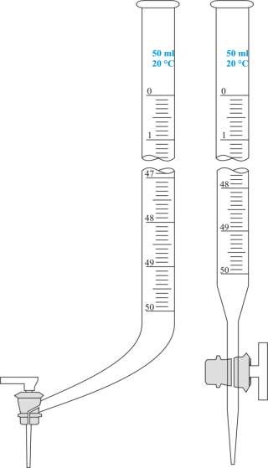
Flat Bottomed Round Flask
Round Bottomed Flask
Burette

Slide 20
D. Volumetric flasks:
Volumetric flasks are flat - bottomed, pear-shaped vessels with long narrow necks, and are fitted with ground glass stoppers.
A horizontal line etched round the neck denotes the stated volume of water at given temperature, for example at 20ºC.
They are used to prepare various kinds of solutions.

Slide 21
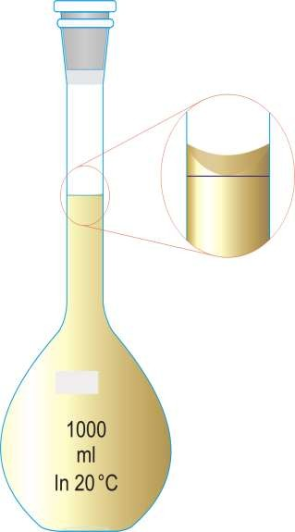
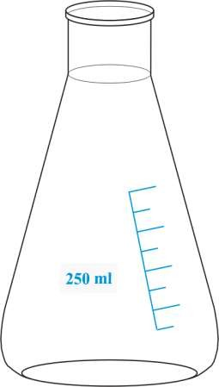
Volumetric Flask
Conical (Erlenmeyer) flasks

Slide 22
BEAKERS:
Beakers have capacities from 5 to 5,000 ml.
They are usually made up of heat resistant glass and are available in different shapes.
Beakers are often supplied for heating or boiling of solutions.
CYLINDERS:
Cylinders are supplied in 10 to 2,000 ml capacities.
Some are made of heat resistant glass or plastic and some are fitted with ground- glass stoppers.
Measurement of liquids can be made quickly with these vessels, but a high degree of accuracy is impossible because of the wide bore of the cylinders.

Slide 23
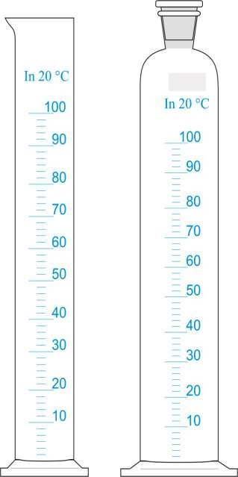
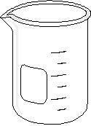
Cylinders
Beaker

Slide 24
Other Glass Wares:
TEST TUBES:
Test tubes are made of hardened glass or plastic materials that can withstand actions of chemicals, thermal shock and centrifugal strains.
They are used to hold samples and solutions, during biological laboratory procedures.
These include simple round hollow tubes, conical centrifuge tubes, vacutainer tubes and nunck tubes.
Test tubes can be with or without rims (lips). Test tubes without rim are satisfactory because there is less chance of chipping and eventual breakage.
REAGENT BOTTLES:
Reagent bottles are used to store different types of laboratory reagents.
They are made from glass or plastics. Depending on their use, they are available in various sizes.

Slide 25
PETRIDISHES:
Petridishes are flat glass or plastic containers, which have a number of uses in the biological laboratory.
They are used predominantly for the cultivation of organisms on solid media.
They are made with diameters of 5 to 14cm.
To isolate, identify and study the characteristics of microorganisms it is essential to grow them on artificial media,
And in routine bacteriology the most important requirement of a culture medium is its ability to allow detectable growth from a minute inoculum within the shortest period of incubation.

Slide 26
FUNNELS:
There are two types of funnels that are widely used in a biological laboratory. These are filter funnel and separating funnel.
Filter Funnels:
Filter funnels are used for pouring liquids into narrow mouthed containers, and for supporting filter papers during filtration. They can be made from glass or plastic materials.
Separating funnels:
Separating funnels are used for separating immiscible liquids of different densities. Example, ether and water.
PESTLE AND MORTAR:
Pestle and mortar are used for grinding solids, for example, calculi and large crystals of chemicals.
Those of unglazed portion have porous surfaces, and those of heavy glass are made with roughened surfaces.
After each use always clean the pestle and mortar thoroughly.
– This is because chemicals may be driven into the unglazed surfaces during grinding, resulting in contamination when the apparatus is next used.

Slide 27
LABORATORY CUVETTES (ABSORPTION CELLS):
Cuvettes can be glass cuvettes or plastic cuvettes.
Glass cuvettes resist many laboratory reagents like organic solvents, whereas plastic cuvettes are affected by many reagents and become cloudy, hence affecting the absorbance of the reacting mixture and so lack accuracy & precision.
Therefore plastic cuvettes whenever used should be cleaned immediately. If the cuvettes turn to cloudy it should not be used for any analytical procedures.
Any scratch or white spot on glass cuvettes cannot be washed out with any solvent and therefore, disturbs absorbance of a given solution. Therefore, such cuvettes should be discarded.

Slide 28
Glass cuvettes are the choice for photometry. Absorption cells must be absolutely clean.
Optical surfaces should not be touched, as grease smudges are difficult to remove.
As soon as possible after each use, absorption cells should be rinsed and soaked in distilled water.
When cleaning cells, a mild detergent should be used.
Stubborn contaminants can be removed by soaking the cells in diluted sulfuric acid. Absorption cells should never be allowed to soak in hot concentrated acids, alkalis, or other agents that may etch the optical surfaces.
When drying cuvettes, high temperatures, and unclean air should be avoided. A low to medium temperature often not to exceed 100ºC or vacuum or a combination of the two can be used to rapidly dry cuvettes.

Slide 29
Cleaning of Glasswares:
It is clear that volumetric glasswares and glass apparatus must be absolutely clean, otherwise volumes measured will be inaccurate and chemical reactions are affected adversely.
One gross method generally used to test for cleanness is to fill the vessel with distilled water and then empty it and examine the walls to see whether they are covered by a continuous thin film of water.
Imperfect wetting or the presence of discrete droplets of water indicates that vessel is not sufficiently clean.
A wide variety of methods have been suggested for the cleaning of most glassware.
Chromic-sulfuric acid mixture is the cleaning agent in common usage.

Slide 30
Fats and grease are the most frequent causes of severe contamination present and,
It is advisable to dissolve these contaminants by a liquid solvent followed by water washing.
The most widely used oxidant is a solution of sodium dichromate in concentrated sulfuric acid.
Because of its oxidizing power, the solution, particularly when hot, removes grease and fats quickly and completely.
Cleaning solution, as a mixture, is not a general solvent for cleaning all apparatus but only for cleaning boro-silicate glasswares, including volumetric wares.
Glassware is generally in contact with the mixture for 1 to 24 hours, depending up on the amount of grease or liquid present.

Slide 31
After removal of the acid and draining, the glass ware should be washed out at least four times with tap water and then rinsed three times with distilled water
New glass wares should also be washed and socked in 1% HCL since they are slightly alkaline while they are manufactured.
CLEANING OF PIPETTES:
Pipettes should be placed in a vertical position with the tips up in a jar of cleaning solution in order to avoid the breakage of their tips.
A pad of glass wool is placed at the bottom of the jar to prevent breakage.
After soaking for several hours, the tips are drained and rinsed with tap water until all traces of cleaning solution are removed.
The pipettes are then soaked in distilled water for at least an hour.

Slide 32
Filing with water, allowing the pipette to empty, and observing whether drops formed on the side within the graduated portion make a gross test for cleanness.
Formation of drops indicates greasy surfaces, after the final distilled water rinse the pipettes are dried in an oven at not more than 110ºC.
Most laboratories that use large numbers of pipettes daily use a convenient automatic pipette washer.
These devices are made of metal or polyethylene and can be connected directly to hot and cold water supplies.
Polyethylene baskets and jars may be used for soaking and rinsing pipettes in chromic acid cleaning solution.

Slide 33
Cleaning of flasks, beakers, cylinders and other glass wares:
Pour warm cleaning solution into each vessel and stopper or cover carefully.
Each vessel should be manipulated so that all portions of the wall are repeatedly brought into contact with the solution.
This procedure should be followed for at least five minutes.
The cleaning solution can be poured from one vessel to another and then returned to its original container.
The vessels should then be rinsed repeatedly with tap water four times and finally rinsed three times with distilled water.

Slide 34
Plastic Wares:
Plastic wares are usually manufactured from polymers of polyethylene, polypropylene and TEFLON.
These plastics are chemically inert and unaffected by acid /alkali.
Plastic wares are durable and suitable to store alkaline solutions.
However, surface bound may be leached to the solution, absorb dyes and proteins.

Slide 35
Cleaning of plastic wares
After each use Laboratory plastic wares should be immediately soaked in water or if contaminated, soaked overnight in a suitable disinfectant such as 0.5% w/v sodium hypochlorite or bleach.
Most plastic ware is best clean in a warm detergent solution, followed by at least two rinses in clean water, and ideally a final rinse in distilled water.
The articles should then be left to drain and dry naturally or dried in a hot air oven, set at a temperature the plastic can withstand. A brush or harsh abrasive cleaner should not be used on plastic ware. Stains or precipitates best removed using dilute nitric acid or 3% v/v acid alcohol

