Slide 1
Lecture 4.
Sampling methods, transportation and storage for various environmental parameters.
By: Dinaol

Slide 2
In this Lecture:
Food Sampling and analysis

Slide 3
4.1.Food Sampling and analysis

Slide 4
Key Words…..
Population
the total quantity from which a sample is obtained .
Sample
a portion, that is representative of the whole

Slide 5
Lot
A definite quantity of some commodity manufactured or produced under conditions, which are presumed uniform.
Sampling
Procedure used to draw or constitute a sample.

Slide 6
Quality of Analysis Results
Quality of laboratory analysis results Relays on:
Representatives of sample /collection, techniques/
Sample handling /as per the product nature/
Sample transportation
Lab Sample preparation
Methods
Facility /equipment, reagent/

Slide 7
Is there any risks associated with sampling?

Slide 8
Risks Associated with Sampling
There are two types of risks associated with sampling:
  The consumer risk /probability of accepting a poor quality population/
  FBO risk /the probability of rejecting an acceptable product/.

Slide 9
Basics for sample collection
Aim of sampling /proximate, Microbial, contaminants/
Target population / homo or heterogeneity of population/

Slide 10
Sample Collection
What is Homogeneous Versus Heterogeneous Populations?

Slide 11
What are sampling techniques?

Slide 12
Sampling Techniques/Methods
Basic sampling techniques:
Probability sampling,
Non-probability sampling,

Slide 13
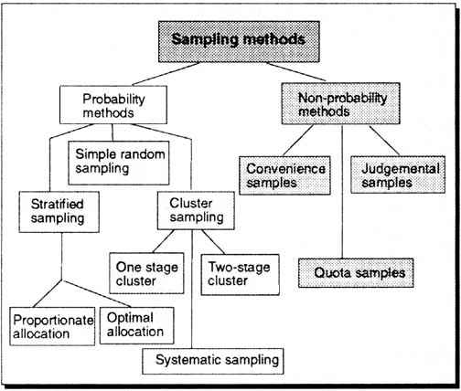
Types of sampling

Slide 14
Probability Sampling
Probability sampling is used when a representative sample is desired, and uses principles of statistical sampling and probability i.e. elimination of human bias.
It is a random selection approach that tends to give each unit an equal chance of being selected.

Slide 15
Simple random sampling
Number each frame unit from 1 to N.
Use a random number table or a random number generator to select n distinct numbers between 1 and N, inclusively.
Easier to perform for small populations
unpractical for large populations

Slide 16
Systematic sampling
Convenient and relatively easy to administer
Population elements are an ordered sequence (at least, conceptually).
The first sample element is selected randomly from the first k population elements.
Thereafter, sample elements are selected at a constant interval, k, from the ordered sequence frame.
N
k
=
n
Where
n = sample size
N = population size
K= size of selection interval

Slide 17
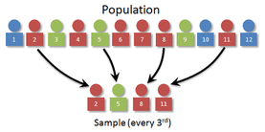

Slide 18
Stratified sampling
involves dividing the population into overlapping subgroups so that each subgroup is as homogenous as possible.
Random samples are then taken from each subgroup.
The procedure provides a representative sample because no part of the population is excluded and it is less expensive than simple random sampling.

Slide 19
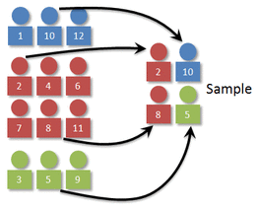
Stratified sampling

Slide 20
Cluster sampling
Similar to stratified sampling but the groups are selected for their geographical location
dividing the population into clusters or subgroups so that cluster’s characteristics are as identical as possible.
Any heterogeneity occurs within each cluster.
The clusters are sampled randomly and may be either totally inspected or sub sampled for analysis.

Slide 21
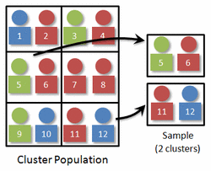

Slide 22
Composite sampling
is used to obtain samples from bagged products such as flour, seeds, and larger items in bulk.
Two or more samples are combined to obtain one sample for analysis that reduces differences between samples.

Slide 23
2. Non-probability Sampling????

Slide 24
Non-probability sampling
Non-probability sampling is used when it is not possible to collect a representative sample, or a representative sample is not desired.
The sample collector uses judgement rather than statistical considerations in the selection of the sample.
The unusual or unexpected characteristics in a population could be selected to be identified.

Slide 25
Purposive/ Judgment/ Sampling
Sampling with “a purpose” in mind
Assessor recruits target population in need.
Example: when adulteration is an issue
Able to quickly reach targeted sample when sampling for representativeness is not a major concern
Usually excludes unique or special cases
Often used in rapid assessments

Slide 26
Quota sampling
Non-probability equivalent of stratified sampling
Assessor identifies stratums and their proportions
Convenience or purposive sampling used to recruit samples
Select the first sample which aimed to fit the need regardless of what group they represent
Key is to select sample which match target population.

Slide 27
Convenience Sampling
Draw sample from population that are available and easy to reach
This involves selecting the nearest and most convenient people to participate in the research.
Used for pilot testing such as a random survey
Low cost and quick results
May match and compare convenience samples to reduce bias.

Slide 28
Sampling equipment status

Slide 29
  Sampling equipment status
The devices or equipment's used to collect samples should be sterilized before collecting samples
The sampling device should be clean, leak-proof.
The devices should have cover/cap
The cold food samples should be collected in cold sampling devices

Slide 30
Sampling amount and status

Slide 31
  Sampling amount
Food sampling technique has it own procedure. The major ones are the following.
When taking the sample of packed food, the label should not be damaged.
If the amount of the packed food to be sampled is large, the sample should be taken from different places and should be mixed and collected in the sampling devices prepared for this purpose.

Slide 32
Sampling amount …
4. The amount of food sample depends on the amount of the source food.
5. If the amount of the food (source food) is less than 5 kg or 5L the whole food can be taken as sample.
6. If the amount of the food is more than 5 kg or 5 Liter the sample to be taken is as follows..

Slide 33
Table : Minimum Number of Primary Samples to be taken from a Lot
Weight/volume of lot (in kg or l) | Minimum Number of Primary Samples to be taken from a Lot (kg or l)
<50 | 3
50-500 | 5
500- 1000 | 10
1000 - 3000 | 20
Number of cans, cartons, containers in the lot | Minimum Number of Primary Samples to be taken from a Lot (cans or cartons etc)
1-25 | 1
26-100 | 5
> 100 | 10

Slide 34
Sampling Procedure and Minimum Amount to be Sampled from lots of d/t crops
Crop Type | Sampling Procedure | Example | Minimum Quantity
Root, tuber and bulb vegetables | Take samples from all areas of the crop. Remove as much adhering soil as possible from samples but do not wash. | Beet ,onions, potatoes, sweet potatoes, turnips | 5 kg
Leafy, stem, Fruits and legume vegetables | Remove as much soil as possible from crops such as celery, but do not wash. | lettuce, spinach, Cucumber, Peppers,tomatoes,Beans, peas (with pods) | 5 kg
Cereal Grains | Cut not less than ten small areas (approximately 0.1 m2) chosen randomly from all areas of the crop. Remove grain from the straw. | Maize, wheat | 2 kg

Slide 35
Sending the Sample for Analysis

Slide 36
Sending the Sample for Analysis
As much as possible do not remove pre-packed retail samples from their packaging.
Seal the entire pack in a plastic bag after purchase, and put the sample code on the outside of the bag.
Dispatch samples to the laboratory as soon as possible after collection together with type of analysis in need.

