Slide 1
Water quality parameters and pollutants those are important in environmental quality control
Learning objectives:
At the end of this chapter students will be able to:
Describe common parameters in water and wastewater
Describe environmental significances of pollutants
Compare and contrast level of pollutants in water with
regard to national standard parameters.

Slide 2

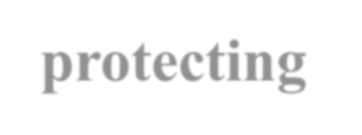
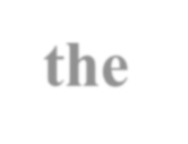
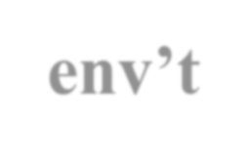
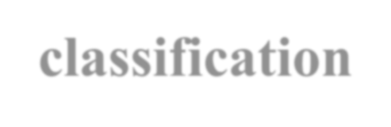
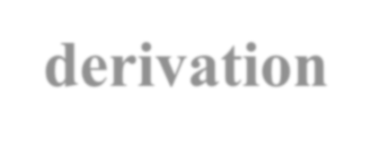
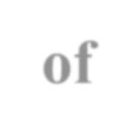



Introduction
The world is not short of water, the world is short of water mgt
Ambient env’tal quality standards are set with a goal of safeguarding public health and protecting the env’t.
The gov’t of Ethiopia set standards which will ensure that the environmental quality is not degraded while also ensuring a healthy env’t.
Standards from first principles requires classification and prioritisation of pollutants, derivation of pollutant exposure processes and determine their ecological effects.

Slide 3
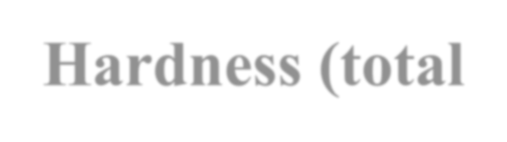


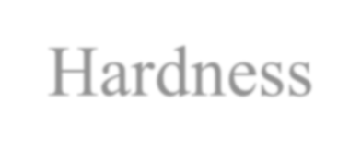
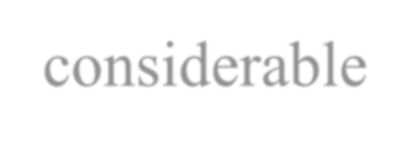
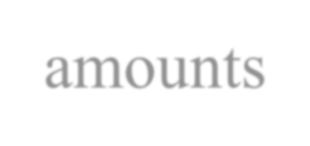

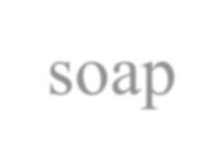

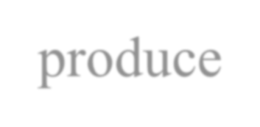
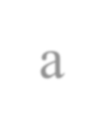
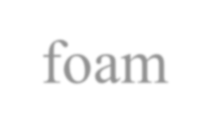
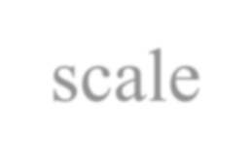
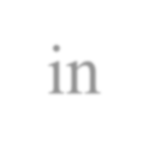
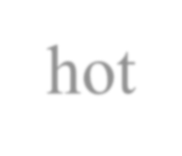

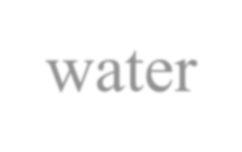
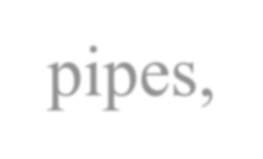
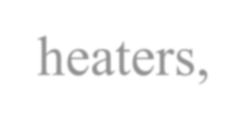
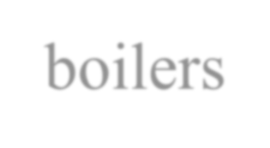
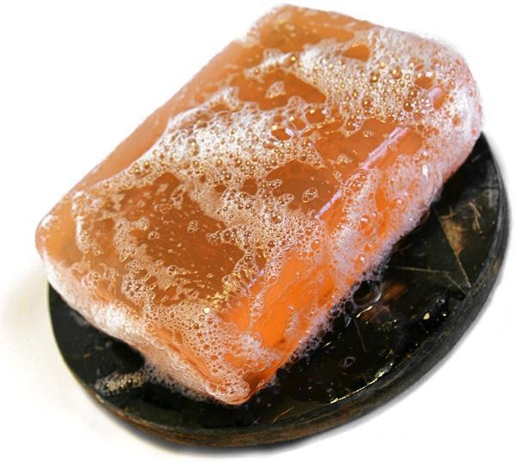
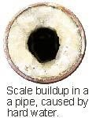
Common Water Quality parameters :
Hardness (total)
Hardness is defined as the con. of multivalent metallic cations in solution.
Hard water are generally considered to be:
waters that requires considerable amounts of soap to produce a foam and;
produce scale in hot-water pipes, heaters, boilers

Slide 4

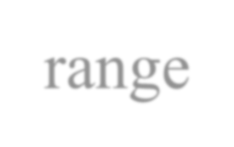
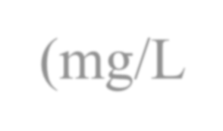
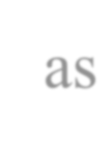
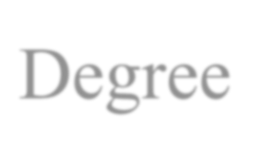
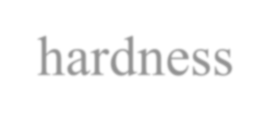
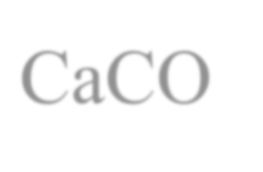


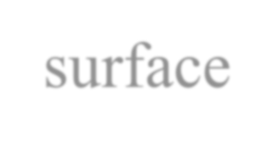
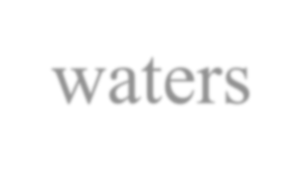
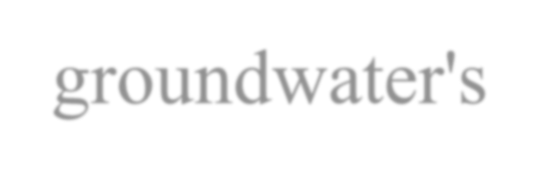
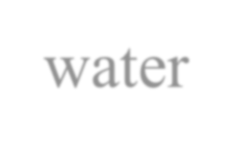

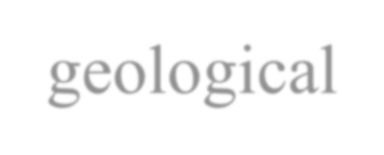
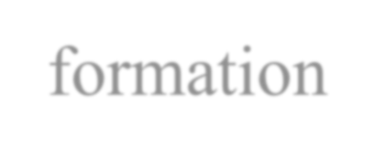
Classification of hard water
Hardness range (mg/L as CaCO₃) | Degree of hardness
0-75 | Soft
75-150 | Moderately soft
150-300 | Hard
Above 300 | Very hard
The hardness of waters varies from place to place
In general, surface waters are softer than groundwater's
The hardness of water reflects the nature of geological formation with which it has been in contact

Slide 5
Causes and sources of hardness:
Hardness is caused by the presence of multivalent metallic
cations in water
The principal hardness causing cations are: divalent Ca²⁺, Mg²⁺, Sr²⁺ , Fe²⁺ and Mn²⁺ ; anions are HCO ⁻, SO ²⁻, Cl⁻, NO ^{-`} and SiO ⁻
3 4 3 3
Anions and monovalent cations such as Na⁺ and K⁺ do not contribute to hardness.

Slide 6
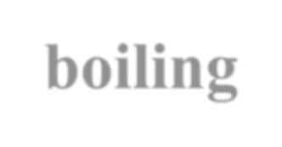
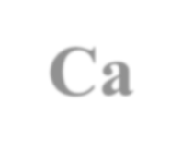
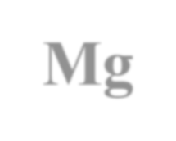
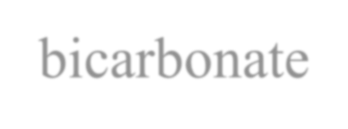
Types of hardness
Bicarbonate hardness was formerly called temporary hardness.
It can be removed by boiling and is caused by dissolved
Ca and Mg bicarbonate
Removal process of Ca and Mg bicarbonate is as follows: Ca(HCO₃)₂ + heat CaCO₃(ppt) + CO₂ + H₂O Mg(HCO₃)₂ + heat MgCO₃(ppt) + CO₂ + H₂O
Carbonate hardness is especially important since it leads to scaling

Slide 7
Permanent Hardness
Non carbonate hardness was formerly called permanent hardness.
  it cannot be removed by boiling
Non-carbonate hardness cations are associated with Ca and Mg salts of:
sulphate (SO₄²⁻) Chloride (Cl⁻) and
Nitrate (NO₃ ) ions
-

Slide 8

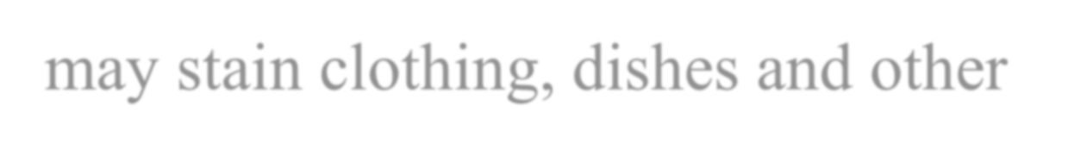
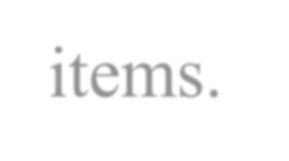
Environmental Significance
Soap consumption by hard-water causes economic loss to water consumers
Precipitated foam by hard water adheres to surfaces of tubes, sinks etc and may stain clothing, dishes and other items.
Carbonate hardness precipitate leads to scaling in boiler, which causes considerable economic loss.
Determination of hardness serves as a basis for routine control of softening process.

Slide 9
Removal of Hardness
Ground waters, where the hardness level is more than 1000 mg/L, softening is needed
The two basic methods of softening public water supplies are:
  chemical precipitation and
  ion exchange
Others (electrodialysis,
distillation, freezing, and
reverse osmosis)
These processes are complex and expensive

Slide 10
Lime-soda ash softening
Chemical precipitation is one of the more common methods used to soften water
The chemicals normally used are lime (calcium hydroxide, Ca(OH)₂) and soda ash (sodium carbonate, Na₂CO₃).
Lime is used to remove the chemicals that cause the
bicarbonate hardness.
Soda ash is used to remove the chemicals that cause the
non-carbonate hardness.

Slide 11
What are the chemical reactions that happen with lime addition?
Ca(HCO₃)₂ + Ca(OH)₂ -> 2CaCO₃ + 2H₂O
Mg(HCO₃)₂ + Ca(OH)₂ -> CaCO₃ + MgCO₃ + 2H₂O MgCO₃ + Ca(OH)₂ -> CaCO₃ + Mg(OH)₂
What are the chemical reactions with soda ash?
MgSO₄ + Ca(OH)₂ | -> | Mg(OH)₂ + CaSO₄
CaSO₄ + Na₂CO₃ | -> | CaCO₃ + Na₂SO₄

Slide 12
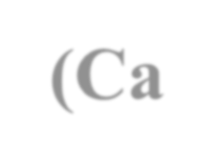




Zeolite softening
The ion-exchange method of water softening has been used extensively in smaller water systems and individual homes
It is based on the ability to exchange one ion from the water being treated for another ion that is in the resin
Zeolite resin exchanges Na⁺ for ions causing hardness in the water (Ca²⁺, Mg²⁺).

Slide 13
Removal of carbonate hardness:
Ca(HCO₃)₂ + Na₂X ------> CaX + 2NaHCO₃ Mg(HCO₃)₂ + Na₂X ------> MgX + 2NaHCO₃
Removal of non-carbonate hardness:
CaSO₄ + Na₂X ----- > CaX + Na₂SO₄ CaCl₂ + Na₂X ------> CaX + NaCl₂ MgSO₄ + Na₂X ------> MgX + Na₂SO₄ MgCl₂ + Na₂X ------> MgX + 2NaC1
NB: Hardness is expressed in terms of milligrams of CaCO₃ per liter (mg/l) or ppm.
Common methods of hardness analysis is EDTA (ethylene diamine tetra acetic acid.

Slide 14
Public Health Significance of Hard Water
Hard water can be good for health:
  Calcium is needed for healthy bones and teeth
  Magnesium is needed for effective metabolism.
Some studies have also shown that people living in hard water areas are less likely to suffer from heart disease.

Slide 15
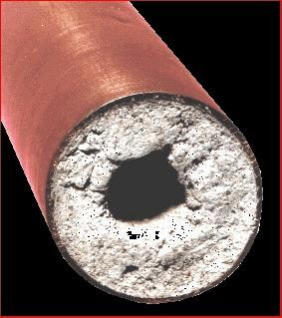
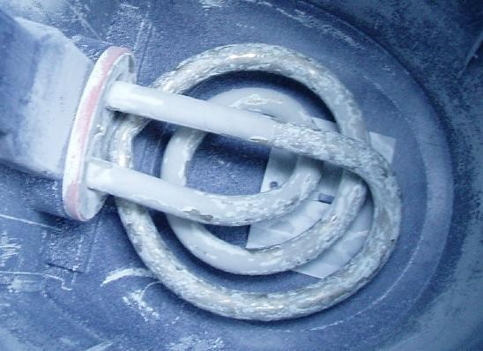
Disadvantages of Hard Water-(Again)
Soap is less effective in hard water because the calcium ions react with the stearate ions in soap to form a precipitate, calcium stearate (“soap scum”).
When temporarily hard water is heated, calcium carbonate (“scale”) is formed. This solid can reduce the efficiency of tea kettles and block hot water pipes.

Slide 16
Methods of Determination
Hardness of Water by EDTA Titration
The ions involved in water hardness, i.e. Ca²⁺⁽aq) and Mg²⁺(aq), can be determined by titration with a chelating agent, ethylenediaminetetraacetic acid (EDTA), usually in the form of disodium salt (H₂Y²⁻).
Eriochrome Black-T is commonly used as indicator.
At pH 10, Ca²⁺⁽aq) ion first complexes with the indicator as CaIn⁺(aq) which is wine red.
As the stronger ligand EDTA is added, the CaIn⁺(aq) complex is replaced by the CaY²⁻(aq) complex which is blue.
The end point of titration is indicated by a sharp colour change from wine red to blue.

Slide 17
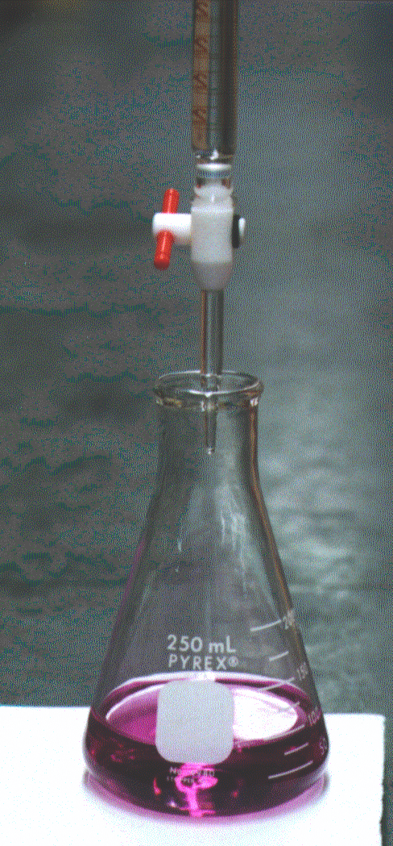
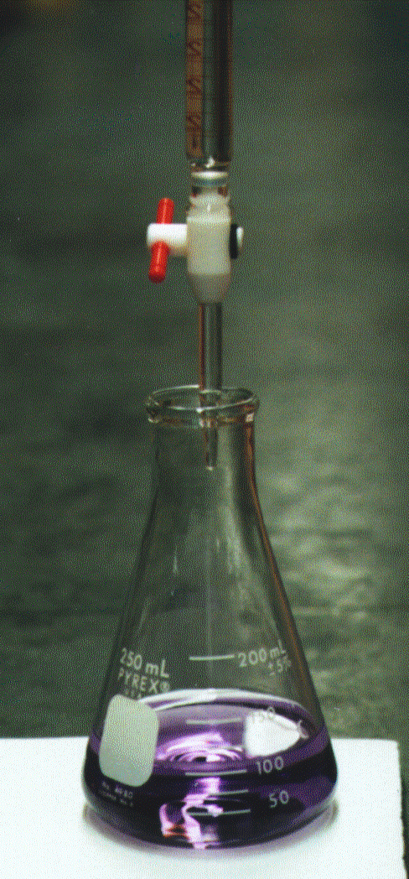
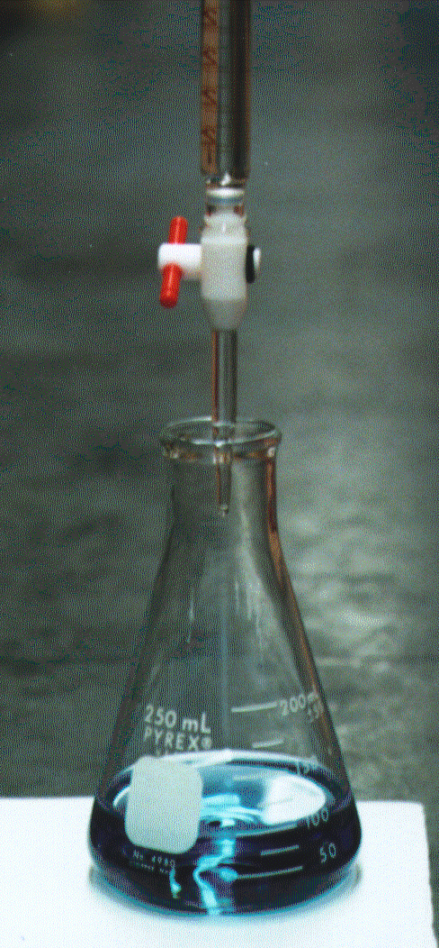

Methods of Determination (Cont’d)
Titrate water with EDTA until colour changes from red
to blue
Total hardness (as CaCO₃ mg/L) =
Where
A= ml EDTA titrant
N= Normality of EDTA titrant

Slide 18
Drinking water (as mg/l CaCO₃)
WHO (1971): 100 (highest desirable)-500(maximum permissible)
WHO (1984): Max. 500 mg/l (aesthetic quality)-No health related guideline value set by WHO.
WHO (1993)-No standards. High hardness causes scale deposition and scum formation.

Slide 19
Oxygen: A Soluble Gas
H₂O
O₂
H O
2
H₂O
O₂
O
O
2
2
O₂ H₂O
H₂O
H₂O
O₂
O₂
H O
H O
H₂O
2
2

Slide 20
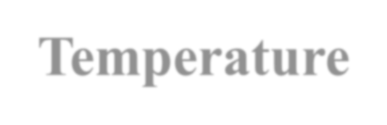
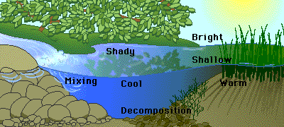

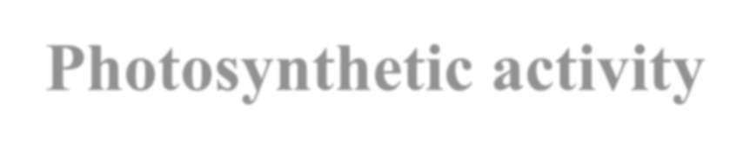



Dissolved oxygen (DO)
One of the most important water quality parameters is the amount of dissolved oxygen (DO) present.
DO is the amount of oxygen in the dissolved state in the water/wastewater.
DO determination helps to find the efficiency of biological treatment and good quality of fresh water.
Factors that effect DO levels:
  Temperature
  Photosynthetic activity
  Decomposition activity
  Mixing and turbulence
  Salinity

Slide 21


mg/L
mg/L mg/L
mg/L mg/L

Slide 22
Dissolved oxygen (DO) (Cont’d)
DO in polluted water is highly dependent on the amount and types of pollutants and the presence of bacteria
Most often, oxygen consuming pollutants are organic compounds (protein, sugar, and fatty acids) & in some cases inorganic contaminants in reduced forms
There are two methods for DO analysis:
  The classical Winkler method (iodometric method)
  The polargraphic membrane electrode method.

Slide 23
Dissolved oxygen (DO) (Cont’d)
The membrane electrode procedure is an electrochemical method based on the rate of diffusion of molecular oxygen across a membrane
The iodometric method is a titrimetric procedure based on the oxidizing property of DO
Iodometric test is the most precise and reliable method for DO analysis

Slide 24

Dissolved oxygen (DO) (Cont’d)
It is essential to ensure that at least 4 mg/l of DO is present in treated wastewater upon discharge into receiving waters. If DO is less, the aquatic animals like fish etc. are likely to be killed near the vicinity of disposal.
•

Slide 25
Environmental Significance
To evaluate the pollution strength of domestic and industrial effluents
For corrosion control
DO measures are vital for maintaining aerobic conditions in natural waters that receive polluted matter
For maintenance of desire aquatic life
As DO levels falls; undesirable odours, tastes and colours reduce the acceptability of water

Slide 26
















Biochemical Oxygen Demand (BOD)
BOD is defined as the amount of oxygen required by bacteria in decomposing organic material in a sample under aerobic condition at 20⁰C over a period of 5 days.
C₆H₁₂O₆ + 6O₂ microbes 6CO₂ + 6H₂O + new microbes
This converts the major elements present in plant matter (C, H, N, S) into CO₂, H₂O, NO ⁻ and SO ^{2-,} respectively
3 4
If no oxygen is present in the water, organic material will still be broken down.
Instead of the material being oxidized, it is reduced
The process is once again microbiological and is known as
anaerobic decay

Slide 27
Biochemical Oxygen Demand (BOD) (Cont’d)
The final products are CH₄, NH₃, and H₂S
Iron in the form of Fe²⁺ can deplete oxygen by oxidation to Fe³⁺
Because of low solubility of O₂ in water, strong wastes are always diluted
A mixed group of microorganisms should be present in the sample if not; sample has to be seeded artificially

Slide 28

Biological Oxygen Demand (BOD)
Measured by determining the mass of oxygen consumed per litre of wastewater (mg/L or parts per million, ppm).
Measure dissolved
oxygen in
wastewater
Micro-organisms in wastewater
consumes organics
(5 days)
Measure how
much dissolved oxygen left
Wastewater
Sample
Biodegradable Organics + microbes
Wastewater
Sample
Microbes eat
less
organics
Wastewater Sample
Microbes eat organics and use oxygen
BOD₅ = DO consumed = DO initial – DO after 5 days

Slide 29
Chemical Oxygen Demand (COD)
COD can be defined as amount of oxygen required to chemically oxidize organic matter using a strong oxidizing agent like potassium dichromate (K₂Cr₂O₇) under acidic condition (silver nitrate used as a catalyst).
O.M + Potassium dichromate (K₂Cr₂O₇) + H⁺ (electron acceptor, Cr⁶⁺ )
high temperature (~ 150 ºC )
- 3+ 6+
CO₂ + H₂O + NO₃ + Cr + Cr
Add oxidizing reagent (dichromate in acid solution) – to convert organics
Organics consumes oxygen
in reagent (2.5 hours)
Determine how much
oxidizing reagent left
Wastewater Sample
Organics react with O₂ in reagent
Wastewater Sample
No more organics Some reagent left
Wastewater Sample
Organics
COD = oxygen in consumed reagent = oxygen in initial reagent – oxygen in reagent left

Slide 30
Usually COD > BOD. This is because:
  Many organic which are difficult to oxidize biologically can be oxidized chemically
  Certain organic substances may be toxic to the microorganisms used in the BOD test, and
  High COD values may occur because of the presence of inorganic substances with which the dichromate can react.
Major advantage of COD analysis is relatively faster as compared to BOD analysis (~2.5 hours)
Therefore, wastewater personnel often use COD analysis to obtain information quickly for plant operation.

Slide 31
Acidity
All waters having pH lower than approximately 8.3 should contain acidity
Acidity is the capacity of water to neutralize a base (OH⁻)
Sources of acidity in natural water include:
  CO₂ (air, bacterial degradation)
  H₂PO⁻₄
  H₂S
  protein, fatty acids, and
  salt of trivalent metals such as hydrated Fe³⁺ and Al³⁺ (e.g. Al(H₂O)³⁺ ⬄Al(H O) OH²⁺ + H⁺).
6 2 5

Slide 32
Acidity (Cont’d)
In polluted water, acidity may be caused by :
  free mineral acid (H₂SO₄, HCl)
  from metallurgical industry, acid mine drainage, acid rain and organic acid waste

Slide 33

pH (Potentia Hydrogenii)
Defn: pH is the negative logarithm of hydrogen ion concentration; more precisely hydrogen ion-activity
pH = -log[H⁺]
Typical pH ranges for environmental waters

Slide 34
pH (Potentia Hydrogenii) (Cont’d)
The biological effect of a change in pH can most easily be seen by the sensitivity of freshwater species to acid.
Populations of Salmon start to decrease below pH 6.5, perch below pH 6.0 and eels below pH 5.5
Chemical effects are also observed; a decrease in pH increases the solubility of metals
The use of Pb piping for domestic water supplies becomes of greater concern as the water becomes more acidic
The weathering of minerals, such as limestone or dolomite by water becomes more rapid with a decrease in pH.

Slide 35
Residual chlorine and chloride in drinking water
Chlorine is primarily added to the water (i.e., chlorination) for destroying the harmful microorganisms in water and wastewater.
Disinfection using gaseous chlorine (Cl₂) is the most widely used in domestic water supply and sewage treatment plants.
When chlorine is added to water, it rapidly hydrolyzes to form hypochlorous acid (HOCl) and hydrochloric acid (HCl).
Hypochlorous acid is a weak acid that can be further dissociated into hypochlorite (OCl⁻).

Slide 36
Residual chlorine and chloride in drinking water (Cont’d)
The reactions are:
Cl₂ + H₂O ⬄ HOCl + H⁺ + Cl⁻ HOCl ⬄ H⁺ + OCl⁻
The two species formed by Cl₂ HOCl and OCl⁻.
in water are primarily
HOCl and OCl⁻ species are termed as free chlorine residuals that have the disinfection capacity in killing bacteria and pathogens
Unlike HOCl and OCl⁻, chloride (Cl⁻) is not effective in disinfection at all

Slide 37
Residual chlorine and chloride in drinking water (Cont’d)
At pH levels below 5 almost all the hypochlorous acid is undissociated whilst at pH levels above 9 dissociation is almost complete
Quantities of HOCl and OCl⁻ depend on pH of the solution
  HOCl 96% at pH=6
  HOCl 75% at pH=7
  HOCl 3% at pH= 9
NB: The killing efficiencies of HOCl is about 40 to 80 times more than OCl⁻.

Slide 38
Residual chlorine and chloride in drinking water (Cont’d)
In the presence of NH₃, the ff rxns will occur to form mono-, di-, and tri-chloroamines:
NH⁺₄ + HOCl
NH₂Cl + HOCl
NHCl₂ + HOCl
NH₂Cl + H₂O + H⁺ NHCl₂ + H₂O NCl₃ + H₂O
The chloroamines are called combined chlorine residuals
They are less effective in disinfection but can last longer
There are 3 titrimetric methods along with several other instrumental methods for the measurement of residual chlorines

Slide 39
The quality of the water to be chlorinated
Since chlorine is a very active element, it will combine with many substances, organic or inorganic, that may be present in the water, and will then lose its effectiveness.
The water to be chlorinated must therefore be as free as possible of suspended or dissolved substances.
For effective and reliable disinfection, at least 20 minutes (normally 30 minutes) of contact time must be allowed.
At higher temperatures, the disinfecting power of chlorine is higher, especially when the chlorine is used in the form of a compound.

Slide 40
What is residual chlorine?
Residual chlorine is the amount of chlorine left over in the water in the form of Cl₂, hypochlorous acid (HOCl) or hypochlorite ion (OCl ⁻), after the water is completely disinfected and the chlorine demand of the water is satisfied.
It may also be found chemically combined with ammonia, when it is termed as combined available chlorine residual (residual chloramines).
sufficient dose of chlorine is added to a water supply system in order to obtain a minimum residual chlorine of 0.2 to 0.5 ppm at any time and at any point throughout the system.
Therefore WHO, CDC, and other organisations recommend
0.2 to 0.5 mg/l free chlorine.

Slide 41
Residual chlorine and chloride in drinking water (Cont’d)
These three titrimetric methods are:
Iodometric titration,
Iodometric back titration and
DPD-FAS titration
The iodometric method is applicable to the measurement of total chlorine residuals in natural and treated waters at concentrations greater than 0.1 mg/L
The iodometric back titration method is applicable to all types of waters but is primarily used for wastewater

Slide 42
Residual chlorine and chloride in drinking water (Cont’d)
Both back titration method and DPD-FAS method are suited to differentiating free chlorines and combined chlorines
Iodometric titration free chlorine (OCl⁻ and HOCl) and chloramines stoichiometrically liberate iodine (I₂) from potassium iodide (KI) at pH 4 or lower
The I₂ is titrated with a standard reducing agent sodium thiosulfate (Na₂S₂O₃) using a starch indicator
The end point is the disappearance of the blue color.
Cl₂ + 2KI
I₂ + starch
I₂ + 2Na₂S₂O₃
I₂ + 2KCl----Eq. (1)
blue color ----eq. (2)
2NaI + Na₂S₄O₆----eq. (3)

Slide 43
Residual chlorine and chloride in drinking water (Cont’d)
Iodometric back titration; in this method, the liberated I₂ (Eq.
  is immediately reacted with an excess amount of Na₂S₂O₃ (Eq.2).
The remaining Na₂S₂O₃ is back titrated with I₂ as the titrant (Eq. 3) instead of using Na₂S₂O₃
I₂ + 2Na₂S₂O₃ (excess) 2NaI + Na₂S₄O₆
Potassium bi-iodate, KH(IO₃)₂ used as titrant
Back titration method is used to measure separately free chlorine residuals and combined chlorine residuals by conducting a two-stage titration
Phenylarsine oxide (PAO) is used for this purpose
At pH above 7, PAO reacts with free chlorine residuals, whereas at pH below 4, only react with chloramines

Slide 44

Residual chlorine and chloride in drinking water (Cont’d)
DPD-FAS titration method
The N, N-diethyl-p-phenylenediamine (DPD) used to determine free chlorine residuals at pH 6.2 to 6.5 with ferrous ammonium sulfate (FAS) [Fe(NH₄)₂(SO₄)₂]
If a small amount of iodide is further added to the sample, NH₂Cl reacts to produce iodine, which in turn oxidizes more DPD to form additional red color. Titrate with FAS

Slide 45
Types of chlorine
Chlorine is available in various forms, including calcium hypochlorite (Ca(ClO)₂), sodium hypochlorite (NaClO₂) and as pure chlorine gas in cylinders.
Calcium hypochlorite (chlorinated lime, tropical bleach, bleaching powder) is a powder containing between 30 and 70% available chlorine
Sodium hypochlorite (including household bleaches) is a solution (1 to 18%)

Slide 46
Chloride
The measurement of Cl⁻ is necessary to determine the suitability of water for domestic, industrial or agricultural uses
High chloride concentration may be a result of:
seawater intrusion due to excessive pumping of groundwater
evaporation of irrigated water leaving salts behind in the soil and
discharge of human excreta into municipal wastewater

Slide 47
Iron and manganese
Iron and manganese are usually considered together because they usually occur together in groundwater, and their chemical behavior is similar.
Iron and manganese, when present in excess of the optimum level of concentration, impart a brown-to- reddish color to the water, and they stain clothes washed in such water.
They also affect the taste of water, and their removal to an acceptable level (MAC: iron as Fe 1.0 mg/l, and manganese as Mn 0.5 mg/l) is essential in water treatment.

Slide 48
Lead
Lead (Pb) is one of the toxic elements that may be present in a water supply, but which is not normally found in natural waters.
However, lead dissolves in water that is acidic, and will contaminate water that is conveyed through lead pipes, collected over lead-painted surfaces or stored in lead-coated containers, etc.
Lead can also reach water through industrial wastes.
Lead poisoning is cumulative; that is, it increases with every addition of lead in the human system, which cannot get rid of it; and it causes various forms of paralysis.
The maximum allowable concentration that can be permitted in water without ill effects is established to be less than 0.1 mg/l.

Slide 49
Alkalinity
Measure of the capacity of a water to neutralize acids or capacity to accept protons
Alkalinity in water or wastewater results from the
presence of the hydroxides [OH⁻], carbonates [CO ²⁻],
3
and bicarbonates [HCO₃ ] of elements such as calcium,
-
magnesium, sodium, potassium, and ammonia.
Of these, calcium and magnesium bicarbonates are most common.
Lime in water softening and coagulants for turbidity removal react with alkalinity, thus to ensure optimum dosages of chemical treatment, alkalinity is monitored.

Slide 50
Total alkalinity is usually expressed in terms of equivalent calcium carbonate in mg/l or meq/l.
Carbonate hardness is that part of the total hardness that is chemically equivalent to the bicarbonate and carbonate alkalinities.
Noncarbonate hardness (NCH) is equal to the total hardness (TH) minus the carbonate hardness (CH).
If the total hardness (TH) is greater than the alkalinity (Alk) when measured as meq/l or mg/l as CaCO₃, then
CH = Alk
NCH = TH – CH

Slide 51
If total hardness is less than alkalinity then CH = TH
NCH = 0
For pH ranges of natural water, alkalinity is usually in
the form of bicarbonate ion, HCO₃ .
-

Slide 52









Carbon Forms and pH of Water Bodies
Carbonic acid (H₂CO₃), Bicarbonate (HCO₃⁻ ), and Carbonate (CO₃²⁻)
1
Fraction of each carbonate species
H₂CO₃
HCO₃⁻
0.8
_{CO} 2-
3
0.6
0.4
0.2
0
4
5
6
7
8
9
10
11

Slide 53
Measurement of alkalinity
M-Alkalinity (boiler water)
  Also known as total alkalinity
  Measures carbonate, bicarbonate and hydroxide
  Measurement using methyl orange indicator (end point is about pH = 4.4)
  Unit ppm CaCO₃
p-Alkalinity
  Measures carbonate and hydroxide
  Measurement using phenolphthalein indicator (end point is about pH = 8.2)
  Unit ppm CaCO₃

Slide 54


Slide 55
Total Solids
Total solids, as the term implies, includes all of the solid constituents of water and wastewater.
It is the total of the organic and inorganic solids or the total of the suspended, colloids and dissolved solids.
In an average domestic wastewater, total solids are about half organic and half inorganic, and about two- thirds in solution (dissolved) and one-third in suspension.
The organic solids, which are subject to decay, constitute the main problem in wastewater treatment.

Slide 56

Suspended Solids
Suspended solids are those which are visible and in suspension in the water.
They are the solids which can be
by
removed from the wastewater
physical or mechanical means, such as sedimentation or filtration.
Suspended solids includes sand, grit, clay, fecal solids, paper, pieces of wood, particles of food and garbage, and similar materials.
  Suspended solids are ~ 70% organic solids and 30% inorganic solids, the latter being principally sand and grit.

Slide 57

Dissolved Solids (DS)
DS are truly in solution and pass through a filter
Homogenous & of a single phase
Of the total “dissolved solids”, about 90% are in true solution and about 10% colloidal.
Dissolved solids, as a whole, are about 40% organic and 60% inorganic.

Slide 58

Colloidal Solids
Colloidal solids are solids that
are not truly dissolved and yet do not settle readily.
They are uniformly dispersed in solution but form a solid phase that is distinct from the water
phase.
Colloidal solids are about 65% organic, 35% inorganic, subject
to rapid decay, and are an important factor in the treatment
and disposal of wastewater.
Milk is an emulsified colloid of liquid butterfat globules dispersed within a water-based solution.

Slide 59


Turbidity
It is a measurement of the clarity of water.
It is a test used to indicate the quality of water discharge and natural waters with respect to colloidal and residual suspended matter.
It is an important measurement for drinking water because microorganisms usually attach themselves to suspended particles.
Turbidity in natural waters reduces light transmittance and affects the species that may live in the water.

Slide 60


Material that causes water to be turbid include:
  clay
  silt
  finely divided organic and inorganic matter
  soluble colored organic compounds
  plankton
  microscopic organisms
Turbidity (NTU)

Slide 61
Turbidity in Drinking Water
Groundwater has very low turbidity (natural filtration)
Most streams & rivers have high turbidities (soil erosion during and just after rain storms)
The treatment of turbid stream water for drinking supplies can be an expensive process. Turbidity↑, amount of chemical needed↑.
Suspended particles provide hiding places for harmful microorganisms and shield them from the disinfection process in a water treatment plant.

Slide 62

Turbidity Unit (TU)
Nephelometers used to measure the turbidity of water and wastewater.
It measures the amount of scattered light electronically.
Expressed in terms of Nephelometric Turbidity Unit (NTU).
Example:
 < 1 NTU
 <5 NTU
 5 NTU
 25 NTU
 > 100 NTU
treated drinking water unnoticeable noticeable
clear lake
muddy water

Slide 63


Color
Caused by dissolved/suspended colloidal particles, primarily from decaying leaves/ microscopic plants.
The age of wastewater is usually determined qualitatively by its colour.
Fresh wastewater are usually light brownish-gray. As the water gets older and more anaerobic conditions develop, the colour will change sequentially from gray to dark gray and ultimately to black.
Black wastewater - septic.

Slide 64
Temperature
The temperature of wastewater is commonly higher than that of the local water supply, because of the addition of warm water from households and industrial activities.
The temperature of water is a very important parameter because of its effect on biochemical reactions and reaction rates, aquatic life, and the suitability of the water for beneficial uses.
Most aquatic species can adapt to a moderate change from their optimum temperature. A change of about 5º can significantly alter the balance and health of an aquatic environment.
Increase in temperature will cause more damage than a decrease; therefore, river must be protected from warm water discharges from power plants.

Slide 65



Generally, the rate of biochemical reactions that increases with an increase
in temperature, combined with the decrease in the quantity of oxygen present in surface waters, can often cause serious depletions in dissolved oxygen concentrations in the summer months.
Temperature (°C
increase in biochemical reactions rate at high temperature
oxygen is less soluble at
high temperature

Slide 66
Optimum Temperatures for Biological Activity
Optimum temperatures are in the range from 25 to 35℃.
Aerobic digestion stops at 50℃.
At 15℃, methane-producing bacteria become quite inactive.
At 2℃, even the chemoheterotrophic bacteria becomes dormant.

Slide 67


Can also be used to check:
  salinity
  ionic strength
Typical conductivity levels are:
Sea water | 50,000 μS/cm
Potable water | 1000 μS/cm
Distilled water | 50 μS/cm
Deionised water | 1 μS/cm
Ultrapure water | 0.06 μS/cm

Slide 68


Summary: Chemical Characteristics

Slide 69

Drinking water Specification
Definitions
Maximum permissible level
A requirement disqualify the
level whose non-fulfillment would water for drinking and
domestic use
because of its probable hazard to health
Palatable water
Water that is safe to drink, pleasant to the taste and useable for domestic purpose

Slide 70
Physical Characteristics of Drinking water
Characteristic | Maximum permissible level
Odour | Unobjectionable
Turbidity, NTU | 5
Taste | Unobjectionable

Slide 71
Chemical Requirements
Characteristics that affect palatability of water
Substance or characteristic | Maximum permissible level
Total hardness (as CaCO₃) mg/l | 300
Total dissolved solids mg/l, max | 1000
Total iron (as Fe) mg/l, max | 0.3
Manganese (as Mn)mg/l, max | 0.5
Ammonia (NH₃⁺NH₄⁺) mg/l, max | 1.5
Residual, free chlorine mg/l, max | 0.5
Magnesium (as Mg)mg/l, Max | 50
Calcium (as Ca), mg/l, max | 75
Chloride (as Cl), mg/l, Max | 250
Total alkalinity (as CaCO3)mg/l, max | 200
pH value, in units | 6.5 to 8.5
Nitrate (as NO₃), mg/l max | 50
Lead (as Pb)mg/l, max | 0.01
Flouride (as F⁻) mg/l, max | 1.5
Chromium (as Cr) mg/l, max | 0.05

