Slide 1
Preservation, Transportation and storage of Water samples
1

Slide 2
Preservation, Transportation and storage of Water samples (Cont’d)
INTRODUCTION
In general, the shorter the time that elapses between collection of a sample and its analysis, the more reliable will be the analytical results.
Sample preservation is difficult because almost all preservatives interfere with some of the analyses.
At best, preservation methods only serve to retard the chemical and biological changes that inevitably continue after sample collection.
2

Slide 3
Preservation, Transportation and storage of Water samples (Cont’d)
The main factors affecting sample stability are:
The nature of the sample
The sample container, and
The addition of preserving reagents to the sample
Strict rules for the preservation of water samples do not exist.
3

Slide 4
Preservation of Water Samples
Suggested chemical preservatives and,
recommended maximum storage times for samples for various analyses are summarized in Table below:
4

Slide 5
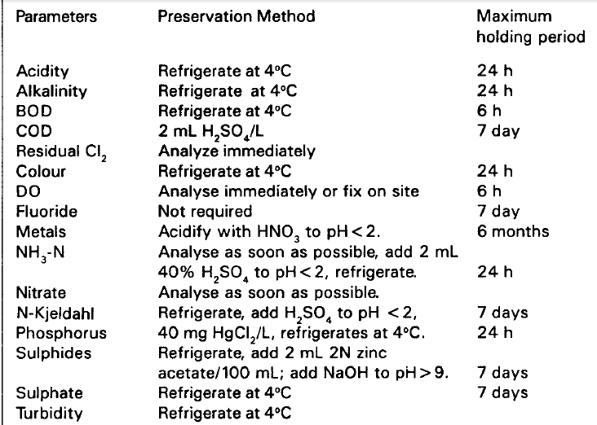
Preservation of Water Samples (Cont’d)
Container
PE (Polyethylene)
PE
Glass
PE
PE
PE
Glass
PE PE
PE
PE Glass
PE
PE
PE
5

Slide 6
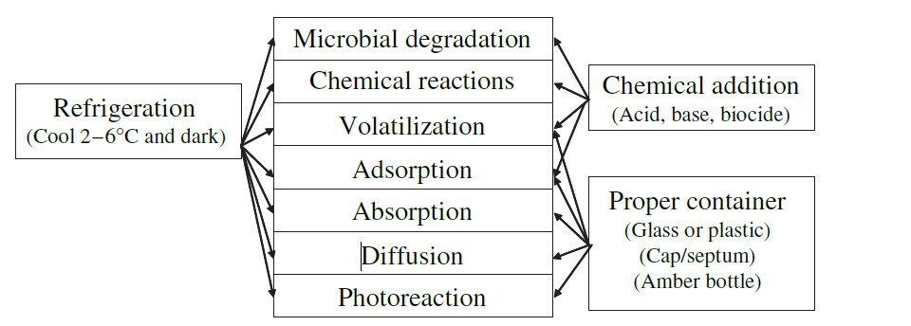
Preservation of Water Samples (Cont’d)
Fig. Methods of sample preservation to minimize potential changes of analytes during sample transportation and
storage
127

Slide 7
TRANSPORTATION OF SAMPLE
Following parameters are recommended
measurement at the sampling site or in the
for
field
immediately after a water sample has been taken:
Temperature; pH; EC
DO by DO probe. If DO probe is not available, take 300 mL sample in a BOD bottle and fix the DO by adding 1 mL MnSO₄
Turbidity; Transparency (for lakes and reservoirs).
Residual chlorine (particularly for chlorinated drinking water)
7

Slide 8
TRANSPORTATION OF SAMPLE (Cont’d)
If it is possible, alkalinity should also be measured at the time of sample collection.
Samples should be placed in a cooler with ice box immediately after collection, at 4⁰C.
Be careful, when freezing samples, to leave at least 10% of the bottle volume as head space to accommodate expansion of the sample
Unfrozen samples should contain little or no head space.
8

Slide 9
TRANSPORTATION OF SAMPLE (Cont’d)
It is advisable to filter samples as soon as possible to reduce algal and bacterial activity
The following fig. shows a suitable sample transport box.
If the sample can be transported to the laboratory within 24 hours, it should not be frozen or preserved but kept cold and in the dark.
It is recommended that no acids be added to unfiltered samples as the acidity may cause leaching of the sediments and/or degradation of biological constituents.
9

Slide 10
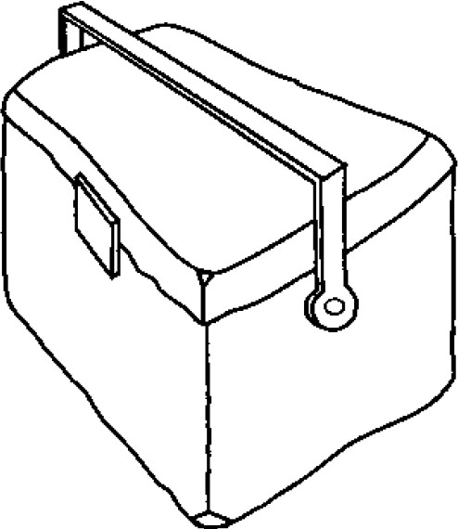
TRANSPORTATION OF SAMPLE (Cont’d)
Fig. Ice Box/sample transport box
10

Slide 11
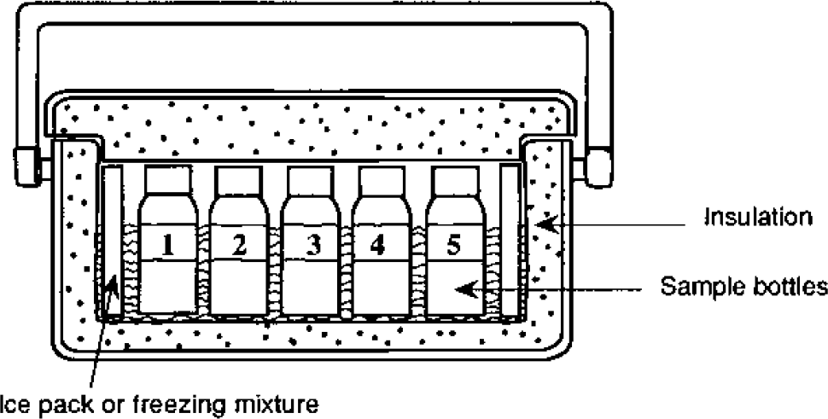
TRANSPORTATION OF SAMPLE (Cont’d)
11

