Slide 1
Sanitary Construction (5 ECTS)
for
Environmental Health Second Year Regular students
Lecture 1. Carpentry Work
By: Dinaol

Slide 2
In this Lecture:
Introduction About the course
Carpentry work
Carpentry materials, tools and machines

Slide 3
Introduction about subject
Why Sanitary Construction?
Environment includes the home/place we live in, the air we breath, the water we drink, the food we eat, etc.
Imagine what will happen if these places are not safe?
Adequate sanitation, together with good hygiene and safe water, are fundamental to good health and to social and economic development.
So, Sanitary construction is one of the subjects which focuses on the materials which the houses constructed from, the water lines, masonry tools, and the building preliminaries in the way safe for human being

Slide 4
Chapter One: Carpentry Work
In this Chapter;
  Wood as construction materials
  Wood working Hand Tools
  Wood working Safety rules
  Wood working joints
  Material used with wood

Slide 5
Chapter One: Carpentry Work
Why Carpentry?
  Starting from ancient civilization carpentry is widely used in all construction; there is no construction that does not utilize carpentry technology.
  There is definite evidence that wood, wherever it was available, became the favorite material for building shelters.
Why construction utilizes wood?
  easily available; simple to work; less cost of construction; too simple to get the required shape; easily and quickly joined with fasteners and adhesives; etc.

Slide 6
Chapter One: Carpentry Work
Why Carpentry?
  Carpentry started a long time ago
  During the construction of a house, the carpenters are recognized as the key craftsmen.
  There is an old saying that carpenters drive the first location stakes and finally hand the front-door keys over to the owners.
  During the construction period, carpenters generally guide all the work.

Slide 7
Chapter One: Carpentry Work
Why Carpentry?
  As far as most ordinary types of houses are concerned, carpentry work is all-important. Carpenters construct the framework, which constitutes the "backbone" of a house and other furniture and materials.
  The final appearance of a house and furniture depends almost entirely up on the skill and judgment of the carpenter.

Slide 8
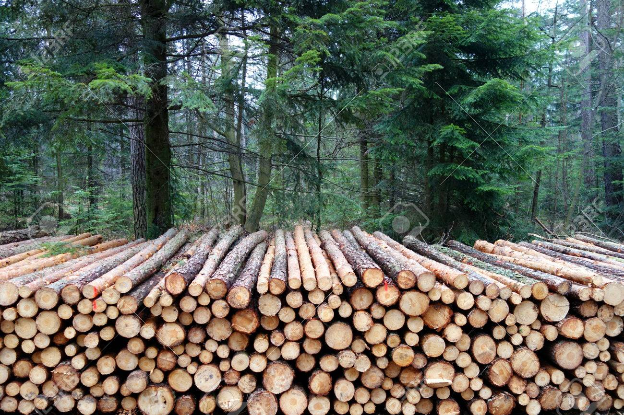
Chapter One: Carpentry Work
Production of wood for construction
  Wood for construction is mostly produced
  from tree trunks, or logs and sometimes from
  branches and roots by direct cutting or industrial
  processes.
  This tree trunk is of two types in its species.
    1. The broad leafed species of wood (tree)
    2. The coniferrous species of wood (tree)
  Their difference is the structure of the internal fibers called the grain of the wood and their physical appearance:

Slide 9
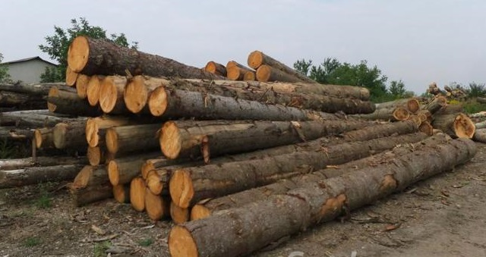
Production of wood for construction…
1. Broad leaved species of wood
  Identified by its network on the leaves which is seasonally dropped, and the internal grain structure seen on the lumber, which is a network of bow-shaped fibers.
  The type of wood produced from this species is called hard wood, due to its grain structure.
  It is good type of wood for construction due to its strength, attractive nature, grain structure and colour.

Slide 10
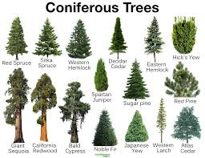
Production of wood for construction…
2. The coniferous species of tree
  is identified by its needleshaped ever-green leaves and internal parallel-running zigzag-shaped grain structure seen on the lumber.
  The type of wood produced from this species is called soft wood and is less valuable than that of hard wood.
  It is mostly used for packages, internal
  wall partitions, and so on due to its
  non-attractive grain structure and colour
  and less strength.

Slide 11
Production of wood for construction…
Main Section of a Tree-Trunk
When wood for construction is produced from a tree trunk we see three sections, due to the position of the cutting blade (saw) passing through the trunk.
  Cross-section:- is seen when the cutting plane (blade)passes across the grain and circular rings are seen on the surface.
  Radial section:- this is when the cutting blade passesalong the grain through the central pith, and parallel running fibers are seen on the face.
  Tangential section:- When the cutting blade passes along the grain at some distance from the central pith and a bow shaped grain structure is formed on the face.

Slide 12
Production of wood for construction…
The cross-section of a tree trunk shows us the three structural portions of a tree:
  The outer covering portion called the bark
  The central loosely joined tissues to thin straight line called the pith
  The main valuable medium portion from the bark to the pith called the wood, divided into two: the dead cell called heat wood next to the pith, and; the life cell portion, called the sapwood next to the bark. It is this part from which wood for construction is produced and is the hard and stronger portion of a tree trunk.

Slide 13
Production of wood for construction…
The main forms of wood product
Wood for construction is commonly produced in two forms:
  In solid form:-
    This is produced by directly cutting logs into timber, lumber, boards, etc. by hand saw or high scale cutting machine (e.g. lumbers, solid boards and stocks.) This form of wood product is very useful for construction, specially where there is a need of load carriage.
  Fabricated and laminated form
    wooden sheets and boards, as ply wood fiberboard, chip wood etc.

Slide 14
The main forms of wood product
Fabricated and laminated form
  Ply wood
    is made from a number of slices of wood encased in veneer, overlapping one another crosswise or at right angle to each other in their grain (fiber) direction in order to increase strength.
    The grain of the consecutive layer of veneer overlaps should be three or more odd numbered layers, to ensure the same face on both surfaces.
  Chip wood:
    is an artificial board (sheets of wood) made from ground chips of tree trunk, branches and roots which is mixed with synthetic resin (glue), then pressed at high pressure and temperature.
    It is specially produced from low-grade wood and branches and roots. Its disadvantage is it does not resist any moisture and water

Slide 15
The main forms of wood product…
  Fiber board
    is another form of wood made from wood fibers felted (sliced) from wood or other vegetables, mixed with resins and pressed, as that of chip wood.
    N.B.
    Chip wood and fiber boards are mostly used for ceilings, internal covering and where there is no exposure to moisture.

Slide 16
Production of wood for construction…
Effect of moisture on wood
  Wood is more greatly affected by moisture than other construction material.
  Every wood has its own natural moisture content.
  This moisture is called normal wood moisture content. It is about 30% of the maximum moisture that a green wood can have.
  This normal moisture content is called saturation. If the moisture in wood goes beyond its normal point the wood will swell and tends to decay, which results in loss of strength, colour, and durability.
  If the moisture goes down (below its normal point) it results in wood defects such as creaks, twists, warping, etc.

Slide 17
Production of wood for construction…
But drying of wood has its own advantages. Therefore, to prevent these defects (creaks, twists, warping, etc.) wood should be dried in controlled method, which is called seasoning.
Among Advantages of drying of wood by seasoning
  Minimizes decaying
  Decreases weight and stiffness
  Reduces defects as checking, creaks, warping and twists
  Facilitates taking up of gluing materials sanding and finishing materials
  Increases fastener-holding strength.

Slide 18
Carpentry Materials, Tools and Machines
A. Carpentry materials
These are many materials that are used to perform some carpentry activities.
  a) Wood Abrasives and sand papers
  Since sandpaper is no longer made with sand, industry has adopted and uses the term "coated abrasive." This is a more descriptive term that can be generally used for various kinds of abrasive materials that are applied to paper or cloth, and then made into sheets, discs, drums, belts, and other forms.
  There are four principal kinds of abrasive materials used for woodwork:
    1. Flint ---- like sand paper
    2. Garnet –group of silicate minerals
    3. Aluminum oxide
    4. Silicon carbide --- sandpaper and glass paper

Slide 19
Carpentry Materials, Tools and Machines…
A. Carpentry materials…
b. Wood adhesives
  The most common wood adhesive is called glue. Glue is an adhesive substance that binds or fastens together any absorbent substances as paper, wood etc., by forming a binding force between the joined materials.
  There are two types of glue:
    i) Natural glue:
      This is produced from direct extraction of animal protein, animal hides, skin, bones etc; and plant protein as oil resides and oil seeds etc.
    ii) Synthetic glue:
      This is produced from the result of a reaction of condensation and polymerization of adhered substances. It is good glue for all woodwork joining and has enough resin.

Slide 20
Carpentry Materials, Tools and Machines…
A. Carpentry materials…
  c) Wood fasteners and wares
    Human beings have been used glue as wood fasteners since early times.
    Good glue makes joints and parts even stronger than the wood.
    When we apply glue, it spreads over the surface and goes into the pores of the wood.
    Fasteners and woodwork include: Nails, screws, staples, bolts, glue, spines, and many special items.

Slide 21
Carpentry Materials, Tools and Machines…
A. Carpentry materials…
d) Finishing materials
  Finishing materials and equipment used for finishing
  include brushes, wax, sand paper, linseed oil, alcohol, turpentine, steel wool, pumice, rotten stone, rubbing oil, thinner, varnish, shellac, lacquer and paint.

Slide 22
Carpentry Materials, Tools and Machines…
B.Carpentry tools and machines
  1) Measuring tools-
    Measuring tools are used for measuring before any activities are performed to have accurate performance. Some of the measuring tools are listed as follows.

Slide 23
B. Carpentry tools and machines …
1. Measuring tools
Rules:
  are tools commonly used for measuring distances.
  There are different types of rules:
    Pocket rules:
      Pocket rules are made of either wood or metal and are used for any kind of measuring on projects made on a bench or as part of house. These rules are often referred to as folding or zigzag rules. The flexible push-pull 6 or 8 feet tape is also classified as a pocket rule.
    Steel tape:
      A steel tape is required for house-construction layout where measurements longer than 6 or 8 feet must be made. The 50 feet tape is long enough for most carpentry needs. A cloth tape is not considered satisfactory for accurate measuring since it varies in length according to the amount of stretching done by the user.

Slide 24
B. Carpentry tools and machines …
1. Measuring tools …
B. Squares :
are measuring tools used for measuring angles and checking squaraness and flatness of a surfaces as well as for measuring distances of a work place.
The common types of squares are:-
  Framing square:
    also called carpenter square. It is a large hard steel square used for base angle laying out for carpentry as well as masonry. It measures only right angles for testing squareness of internal and external angles.
  Try square:
    built up of two parts; thin hard steel called the blade and thin hard metal called the handle. It measures right angles as well as 450 angles. It is a very important commonly used type of square and has divisions units to measure distance.
  Marking gauge:
    made from wood or metal and has a beam and head that can be adjusted to various length. It is for making lines parallel to the given edge or end.

Slide 25
B. Carpentry tools and machines …
1. Measuring tools …
  Combination square: -
    it has a moveable head which is used for measuring 450 on one side and 900 on the other side in addition to checking horizontal and vertical level with horizontal blead.
  T-bevel
    is similar to try square except having a movable blead and adjustable handle, which enables to lay out different angle measure and chamfer and bevel checking.

Slide 26
B. Carpentry tools and machines …
2. Layout tools
2) Layout tools
Layout tools are tools used for making or pointing the measurements on the working surface:
  Pencil:
    is one of marking (laying out) tools which marks the measured units with its lead colour. The common wood pencil is called carpenter pencil.
  Divider:
    resembles a compass, but both legs are sharp tipped metal instead of fixed pencil on one leg of a compass. It is used to transfer measurements from measuring tools to a work piece and to scribe circles, arcs etc. on a work piece by scratching lines.
  Trimmed point:
    is used for scribing large circle and arcs that are too large to be marked by divider. It has one horizontal beam on which two pointed legs, one of them is moveable, attached on it.
  Marking knifes:
    puts mark of measured units by its sharp edge. It just looks like a knife.

Slide 27
B. Carpentry tools and machines …
3) Cutting tools
  Cutting tools are varied in character and purpose.
  They include saws and chisels.
  The term cutting, as used here, refers not only to making two or more pieces from one piece, by means of a saw, but also to dapping hinges (cutting in a flat recess exactly to receive one leaf of a hinge) and shaping various parts of a project by means of a chisel or gouge.
  Saws:
    are cutting tools that cut wood by its sharp tip of teeth.
    There are different types of saws. The commonest ones are as follows:

Slide 28
B. Carpentry tools and machines …
3. Cutting tools …
Crosscut saws:
  The carpenter should have two crosscut saws: one 8-point saw for cutting rough or green lumber and one 10-or 11-point saw for finish work. Each should be 26 inches in length.
12 inch backsaw:
  The 12-inch backsaw is very useful for fine cabinetwork. It has very small teeth designed for fine cutting. The manufacturer establishes the number of teeth per inch.
Keyhole saw:
  Usually purchased with detachable blades, of three different lengths, which can easily be removed and replaced on the handle, the keyhole saw is useful for cutting inside circles or small curved corners or angles.
Miter box saw:
  A miter box, actually a metal frame carefully designed to hold vertical posts in which the saw slides, permits fine duplicate precision cutting for any angle desired on material up to the width capacity of the box.
Hacksaw:
  A hack saw is a "must' for the mechanic who does a great variety of work. This tool is used for cutting metal, such as bolts and nails, and is constructed so that the blade can be replaced as it becomes worn.

Slide 29
B. Carpentry tools and machines …
3. Cutting tools…

Slide 30
Check Lecture 2 for the next content

