Slide 1
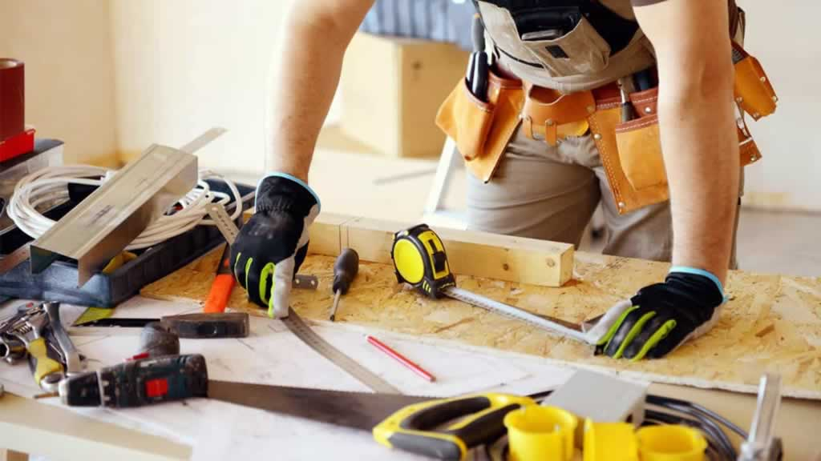
Lecture 2.
B. Carpentry Tools and Machines …
By: Dinaol

Slide 2
3. Smoothing tools
What is smoothing Tools?
  are tools to smooth surfaces of the wood to produce leveled, plane and accurate angle surfaces.

Slide 3
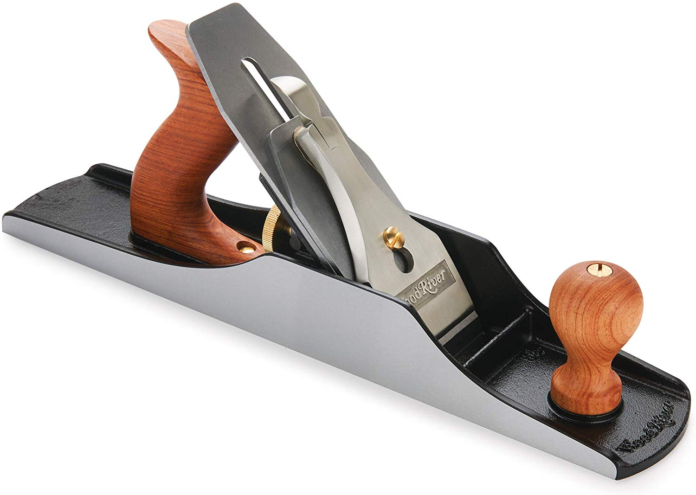
3. Smoothing tools …
There are different types of smoothing tools. The main ones are:
1. Jack plane:
  The jackplane is all-purpose plane, although it is generally used to remove the surface of a rough piece of lumber, after which the smoothing plane is used to give a very smooth surface.

Slide 4
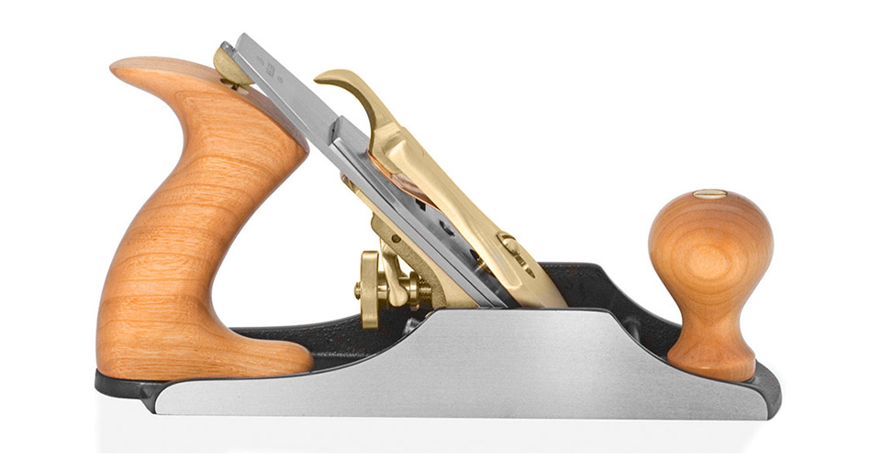
3. Smoothing tools …
2.Smoothing plane:
  Used for the final smoothing of wood prior to sanding.
  If this tool is kept in sharp condition, much time and effort are saved in sanding.

Slide 5
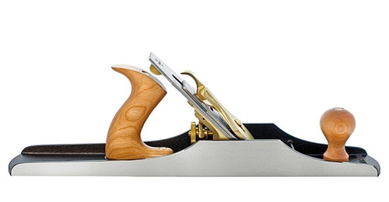
3. Smoothing tools …
3. Fore plane:
  The fore plane, which is 18 inches in length, serves admirably as a jointer on short stock.
  It should not be used for hanging doors, except small cabinet doors.

Slide 6
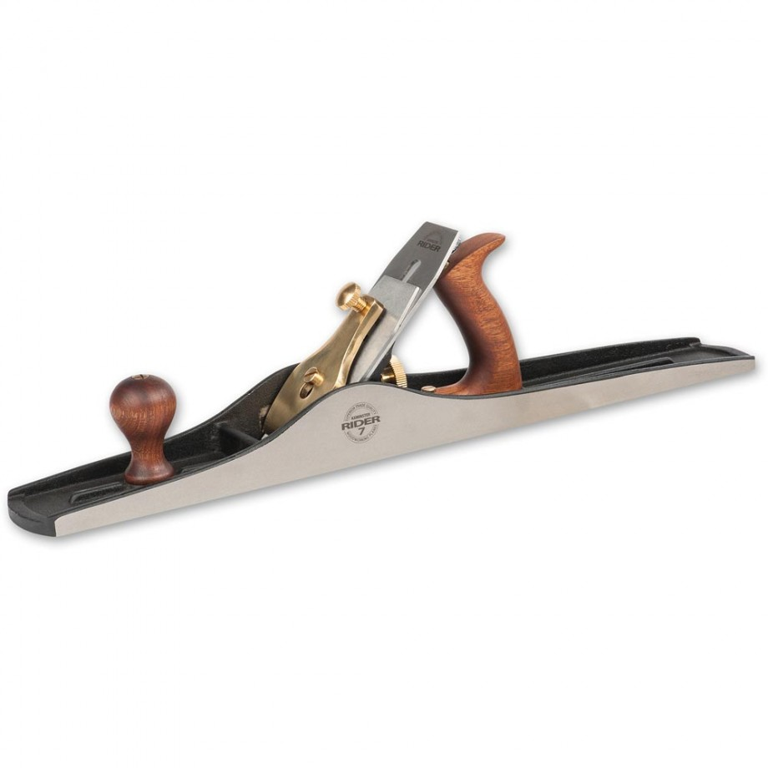
3. Smoothing tools …
4. Jointer plane:
  A jointer is made either 22 or 24 inches in length.
  Designed for making the edges of boards straight prior to gluing them together.
  The tool is also a necessity for full size door hanging.

Slide 7
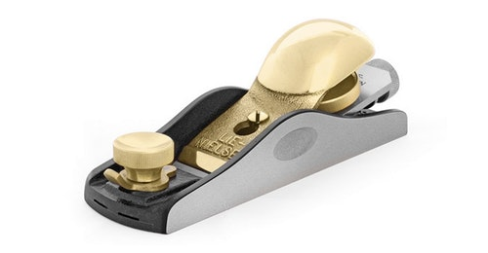
3. Smoothing tools …
5. Block plane:
  Small plane designed to cut end grain of wood.
  It is useful for general purpose.

Slide 8
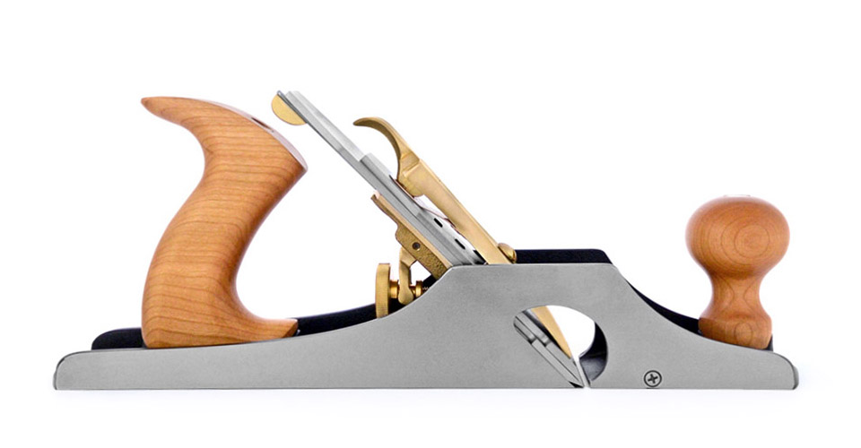
3. Smoothing tools …
6. Rabbet plane:
  Used for cutting rabbets grooves and slots along the grain of the wood.
  It is made from two chisel like blade adjusted at different depth.

Slide 9
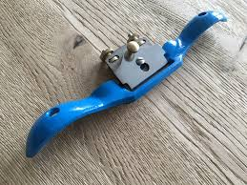
3. Smoothing tools …
7. Spoke shave:
  Designed for smoothing curved edges and flat surfaces of wood.

Slide 10
3. Smoothing tools …
Important parts of a hand plane
  The Plane Iron: -
      Also called the blade. It is the main functional part in cutting the wood with its sharp edge. Since it is the important cutting part, it should be kept sharp, grinding with a grinder or with metal files.
      During grinding (sharpening) the plane iron, the following should be taken in to consideration.
        The beveled of sharp edge should approximately be from 2-2 ½ times blade thickness
        The angle of the bevel should also be from 250 – 350
        The sharp edge should be right angled with the side edge of the blade
        The sharp edge should be soaked in water to prevent the bald tip from turning blue due to extreme heat; it is the sign of loss in strength.
        After grinding it should be wetted on a grindstone to remove sharp corners

Slide 11
Important parts of a hand plane …
2. Plane iron cap:
  Bender metal fixed to the blade in assembling to reinforce it and to break the chips or shaves coming through the throat.
3. The lever cap:
  The outer covering metal which keeps the overall assembly stationed or fixed by pressing the piece fastened on it, called the cam.
4. The depth adjusting screw:
  Used to adjust the depth of the blade by pushing forward or pulling back the blade through the throat.
5. The lateral adjusting lever:
  Long thin flat metal fixed on the frog used to adjust the blade tip side-wise parallel to the bottom sole of the blade through the throat.

Slide 12
Important parts of a hand plane …
6. The throat:
  The gap through which the blade tip comes out to plane the wood surface
7. Wood chisels and gauges:
  a. Chisels:
    are cutting tools used to cut outside and inside curves of small radius, holes, slots and grooves and to remove wastes and shavings from slots and grooves.
    It is also used to cut joints, to make models and decorations on wood surfaces.
  b. Gauges:
    are chisel like cutting tools with curved sharp cutting edge.
    They are used for cutting round holes, grooves, decorations, and used on wood machine for rounding wood.

Slide 13
4) Boring and Drilling tools
Boring and drilling tools are tools that are used to make a hole in materials.
Boring tools are classified according to the nature of the work that is done with them. Typical boring tools that are used to make holes are
  augur bits,
  drill bits,
  expansive bits,
  counter sinks, and
  star drills.

Slide 14
4) Boring and Drilling tools …
Augur bits:
  For boring holes in wood, augur bits are available that vary in size from 3/16 to 1 1/8 inches (by sixteenths) and from 1 1/8 to 2 inches (by eighths).
Wood drill:
  As its name implies, the wood drill is only used to drill wood materials.
  The skilled carpenter will usually have several of the smaller sizes, such as 1/8-inch, ¼-inch, etc.

Slide 15
4) Boring and Drilling tools …
Twist drill:
  The twist drill is designed for drilling in metal only.
  It can be used in shallow-hole drilling, and in electric, hand, and breast drills. Obviously, if the twist drill is, say, ¾ inch in size, it must be used with a power drill in order to bore a hole in metal.
Expansive bit:
  This bit is particularly useful in fitting cylinder locks or for boring holes to receive metal pipes, etc.
  It can be purchased with two detachable expansive bits, each of a different size, permitting the cutting of holes up to 3 inches in diameter.

Slide 16
4) Boring and Drilling tools …
Star drill:
  The star drill is a very useful tool for making holes in masonry to receive a bolt sleeve or a metal sleeve.
  Star drills come in several different sizes, which are designated by the diameter measurements as ¼ inch, 3/8 inch, etc.

Slide 17
5) Sharpening Tools
Sharpening tools are divide into several groups. These are
Saw set:
    A saw set is needed to set the teeth of a handsaw to provide cutting clearance so that the saw can slide freely; rough lumber requires a saw with considerable set;
    finish saws have a little set. The amount of set in a saw, provided that the saw is properly filed, determines whether the resulting cuts are smooth or rough.

Slide 18
5) Sharpening Tools …
Saw files:
  Saw files are procurable in sizes designated as extra-slim taper, slim taper, and regular taper.
  They are made in various lengths. A saw file must be purchased on the basis of the type of saw to be filed.
  There are so many variations that no description is possible here but a good hardware man will know what size to recommend for a specific type of saw.
Bit files:
  For augur bits, a special file is obtainable with "safe edges" (no teeth) to permit filing the cutting edges of the bit without injuring the other metal parts.

Slide 19
5) Sharpening Tools …
Slip stone:
  A slip stone is required for sharpening gouges and carving tools. Various shapes, sizes and fineness of grit are available.
  This tool is not a necessity unless one has a set of carving tools or a gouge or two in his tool kit.

Slide 20
6) Finishing Tools
After a piece of finish stock has been planed to remove imperfections, it is often necessary to do more 'finishing’ to prepare the stock for the stain, varnish, lacquer, or other materials used to preserve the surface of the wood and give it an attractive appearance.

Slide 21
6) Finishing Tools …
Cabinet scraper
  Fitted with a removable beveled-edge scraper blade which, when properly sharpened by turning the sharp corner of the beveled edge with a burnisher, will smooth ridges or torn grain left by the smoothing plane.
Hand scraper
  The hand scraper is a piece of steel 2 or 3 inches in width and 4 to 6 inches in length.
  The sharp corners of this tool are sharpened by the use of a burnisher and will actually remove a very fine shaving.
  It is especially adaptable in close quarters, where it would not be possible to use the cabinet scraper.

Slide 22
7) Hammers
Two shapes of nail hammerheads are in common use:
  1. The curved claw hammer
  2. The ripping (straight) claw hammer.
The curved claw is the most common and more suitable for pulling nails.
The ripping claw can be driven between fastened pieces and works somewhat like a chisel in prying them apart.

Slide 23
7) Hammers …
Claw hammer (nail claw) is used to drive and pull out nails.
The size of the claw hammer is determined by the weight of the head.

Slide 24
8) Screwdriver and chisels
The screwdriver is used to drive in and withdraw screws.
A screwdriver with a square head is used together with brace. The screwdriver tip must be correctly shaped.
It is the screw head that determines the shape of the screwdriver tip. Chisels are essential cutting tools that are used in woodwork.
They are used in joint construction, and in fitting, shaping and in cutting curves. There are two types of chisels:
  1. Tang chisel
  2. Socket chisel

Slide 25
8) Screwdriver and chisels …
The names indicates how the handle is fastened into the blade.
Both types have a beveled cutting edge. The width of the blade determines the size of the wood chisel.
According to their use, chisels are divided into the following classes:
  Firmer:
    Has a strong blade and may be used for heavy and light work.

Slide 26
9) Screwdriver and chisels …
2. Paring chisel:
  Has a slender blade, mainly used for hand chiseling.
3. Framing chisels:
  Has a very heavy and strong blade and is used in rough carpentry work and shipbuilding.
4. Butt chisel:
  Differs from others only in that it has a shorter blade and can be used in more inaccessible place. It is commonly use for cutting hinges.
5. Mortise chisel:
  As its name implies, it is used for cutting mortise.
6. Gauge chisel:
  Is used for grooving, shaping edges and model making.

Slide 27
C. Basic Woodwork Techniques
A. Cutting
  In cutting wood, the purpose of the cut, whether sawing, planning, boring, sapping, routing or sanding is to separate stock along its length, width or thickness. Every wood cutting tool is a wedge or a series of wedge with a single or double bevel.
  The teeth of all saws (hand or machine saws) can be classified as:
    1. Ripsaw
    2. Cross-cut saw
    3. Combination saw

Slide 28
C. Basic Woodwork Techniques …
The shearing is accompanied by the cutting edge of the blade or teeth being wedged into the stock in the sliding motion and usually to a regulated depth.
Complicated joints and work on the table saw may require a series of cuts.
The cuts must be carefully planned. Some cuts that can easily be made at first may be difficult or impossible to make at the end of the sequence.

Slide 29
C. Basic Woodwork Techniques …
B. Boring
  Boring means cutting larger holes with brace and auger bits.
  One must bore the holes in exactly the right place and in the correct direction.
  During Boring, when the holes goes right through the stock, take care to prevent pieces from splitting off when the bit comes through.

Slide 30
C. Basic Woodwork Techniques …
C. Forming
  Wood is formed into shape through the following techniques:
    1. Bending
    2. Compressing
    3. Laminating

Slide 31
C. Basic Woodwork Techniques …
D. Jointing
  Wood joints, as commonly used in wood working, means the at which two separate piece of wood are connected, united or combined together for the purpose of changing direction.
  There are many kinds of joints used in building construction, furniture construction, pattern-making, cabinetmaking and boat-building. Most of them can be classified into a few basic groups.

Slide 32
D. Jointing …
In choosing wood joints for furniture construction, you need to give consideration to their strength, appearance and difficulty of construction.
Your choice will also be based on the kind of wood you are using and the direction of the grain in the parts.
Taking the appearance into consideration does not necessarily mean that the joint should be seen.
Joints which can be seen but which have correct proportions and which fit may add to the character and attraction of the design.

Slide 33
D. Jointing …
The type of joint (or joints) selected is dependent on a number of factors:
The purpose of the job
The material to be used (i.e., its working qualities and strength) Soft woods may require a different type of joint than hard woods.
How the job is to be used. Is the job part of a whole that will be come a fixed part, such as a framed opening in a wall, or will it be moved occasionally, such as a piece of furniture?
Method of fastening the joint, which may require nails, screws, glue, dowels, or metal fasteners, or possibly a combination of several of these.

Slide 34
D. Jointing …
There are different kinds of joints. These are:
Butt joint
    It is the simplest of all joints.
    In house framing, it is a good "load carrying" joint and a very easily made joint.
    The end of a board or framing member is cut off perfectly square and then butted against a piece of lumber having similar dimensions.
    The butt joint is an excellent joint for rough carpentry jobs, where strength is most important and appearance is not a prime requisite.

Slide 35
Butt Joint

Slide 36
D. Jointing …
2. Scabbed joint
  Sometimes it is necessary to join two short pieces of lumber to make longer pieces.
  The scab ties the two pieces together.
  It is definitely a rough-carpentry joint and only used where appearance doesn't count or where the joint may eventually be completely hidden.
  The piece of lumber or scab is usually face-nailed to the lumber to be joined.
  It is common that box nails of suitable length are used.

Slide 38
D. Jointing …
3. Cleated joint
  The cleated joint has some of the characteristics of the scabbed joint.
  It is, however, a carpentry semi finish method and used to fasten two (or more) boards together to make a wider board.
  It is often used in making rough doors for frame buildings and face cleats are fastened on with screws or nails.

Slide 40
D. Jointing …
4. Half-Jap joint
  A half-lap joint is useful in constructing a workbench.
  It is used primarily to provide rigidity and strength when two pieces are to be joined, usually at a 900 angle.
  The joint is formed when the two half laps are fitted together and held by means of nails (in very rough carpentry) or, preferably, by countersunk wood screws, at least two to each corner joint.
  To increase strength of the joint, use glue and clamps.

Slide 42
D. Jointing …
5. Miter joint:
  This is a finish joint and is not used where strength is the main factor.
  It is most often used to make the 90-degree angle formed by the top and side casing of a window or doorframe and to construct picture frame.
  If the pieces to be mitered are molded, the 450 angle of the cut must be very carefully laid out.

Slide 44
D. Jointing …
6. Dowel joint
  Doweling stock is made from birch or maple.
  The dowel joint is used for fine cabinetwork, such as a cabinet door, to ensure strength and holding power where the rails and stiles are joined.
  Preparing a dowel joint is a good test of craftsmanship.
  The hoses made to receive the dowels must be carefully bored at right angle to the joint edge.
  Hot glue is preferable on the dowel joint. Cold air will make hot glue set very quickly.
  Cold glue, however, is very satisfactory in regard to strength.

Slide 46
D. Jointing …
7. Dado and Rabbet joints
  A dado joint and a rabbet joint are very similar in shape and purpose and are usually made with the same tools.
  The rabbet joint is used at the corners of a window or doorframe or in making a set of shelves.
  The dado joint, which is a groove made at right angle to the grain of a board, is used to hold a shelf in exact position to the vertical supporting member.
  Dado and rabbet joints are commonly used on many cabinet and other finish carpentry jobs.

Slide 48
D. Jointing …
8. Tongue and groove joint
  A tongue and groove joint is usually a machine-made joint and is used primarily in flooring, wall sheathing, finished the face of a wall with knotty-pine boards, and doing any similar work in which a number of boards must be joined to make a smooth, flat surface.
  A groove is made in the edge of one board to receive a tongue made in the edge of another board.

Slide 50
D. Jointing …
9. Coped joint
  A coped joint is used when fitting one
  piece of molding at right angles to
  a second piece.
  This joint is most often used when
  fitting molding on the walls of a room
  or on the surface of a piece of paneling.

Slide 51
D. Jointing …
10. Scribed joint
  A scribed joint is required when a piece of
finish stock is to be fitted at right angles
against a slightly uneven surface, such as
a plastered wall.

Slide 52
C. Basic Woodwork Techniques …
E. Finishing
  Finishing in construction is coating or covering of the external surface with protective and decorative film forming materials.
  Wood in its nature is a porous, absorbent material. Uncoated wooden materials tend to absorb moisture, fumes, oils etc., which causes it to swell, shrink, check, warp and discolor. It is also subjected to fungi and insect attacks, which result in wood defects.
  Coating or covering the external surface with coating or film forming materials such as paints, varnishes, enamels can slowdown or stop these external effects.
  This process is known as finishing of wood, as it is the final or last process in construction.

Slide 53
E. Finishing …
Purposes of finishing
  To protect wooden materials against environmental effects such as:
    Moisture, Heat, Fumes, Frost, Light, etc.
  For decorating the external surfaces to:
    Give attractive color
    Clarify the attractive nature and grain texture
    Produce smooth, level and shiny surface
  Ease the problems of cleaning and reduce dust collection of surfaces.
  Make odorless and non-attractive to insects and other organisms.

Slide 54
E. Finishing …
Types of finish
  Depending on the nature of the materials used, there are two types of wood finish. There are opaque and transparent wood finishes.
  1. Opaque wood finish:
    Type of finish that hides or completely covers the natural color, grain texture and nature of the wood.
    The material used in this case is colored liquids such as paints, stains etc.
    It is used mostly for:
      Slightly water exposed furniture
      Low grade (non attractive nature) of wood
      Outdoor furniture and materials
      Special purpose furniture for hospital, baby, kitchen, furniture, etc.

Slide 55
E. Finishing …
2) Transparent Finish
  For high quality (grade) Type of finish in which all the natural color grain texture and attractive nature of the wood is clearly seen through the film-forming protective layer.
  The materials used for coating in this case are colorless after drying, such as varnishes, wax, enamels, etc. It is applicable:
    Wooden furniture
    On the opaque finish to give hard surface
    Where there is no need for covering the nature of the wood.

Slide 56
E. Finishing …
Finishing materials include:
  Paint: produces colored protective layer
  Varnishes, lacquers, shellacs are colorless, organic solvent-finishing materials
    Which produce transparent protective layer on the wood.
    It is a film-forming substance that clearly magnifies the natural texture, attractive nature and color of the wood.

Slide 57
End of carpentry work.
Next Lecture is Plumbing (Lecture 3.)

