Slide 1
Health communication
By: Dereje Geleta ( BSc,MPH)

Slide 2
Learning Objective
Upon successful the completion of this Module, the student will able to:
Describe communication
List the components of communication
List Appeals of communication
List barriers to effective communication

Slide 3
INTRODUCTION
Communication is the process by which two or more people exchange ideas, facts, feelings or impressions in ways that each gains a common or mutual understanding of the meaning and the use of the message.
Evert M. Rogers (1993), defined “communication as the process by which an idea is transferred from a source to a receiver with intent to change his/her behavior.

Slide 4
Relevance to Health
To mobilize the community,
To implement HE & HP programs
To coordinate with different agencies.
The ultimate goal of all Health communication is to create behavioral change.

Slide 5
Key characteristics of Health Communication
Audience-centered
Research-based
Multidisciplinary
Strategic
Cost-effective
Aimed at behavioral or social change (BCC/SBCC)

Slide 6
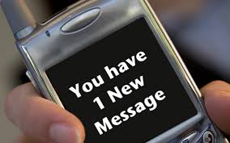
Components of communication
Sender/source
Message
Channel
Receiver
Feedback

Slide 7
source
The sender is the originator of the messages.
The source can be from an individual or groups, an institution or organization.

Slide 8
Receiver/Audience
Is the person or the group for whom the communication is intended or the person who receive the message.

Slide 9
Message
Message is a piece of information, ideas, facts, opinion, feeling, attitude or a course of action that passed from the sender to the receiver.
It is the subject matter of communication.
Something that is considered important for the audience to know or do

Slide 10
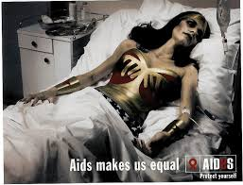

Types of appeals in health communications
A. Fear arousal appeal
The message is conveyed to frighten people into action by emphasizing the serious outcome from not taking action.
Symbols such as
dying persons,
coffins, grave stones,
skulls may be used.
It is good for a person
with little or no school.

Slide 11
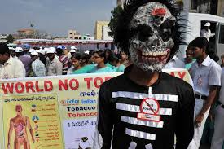
Cont …
Evidence suggests that mild fear can arouse interest, create concern & lead to change.
However too much fear
can lead to people denying
& rejecting the message.
Too much fear is not
appropriate for two reasons;
1st : It can lead to denying &
rejecting the message and results
in laughter & failure to take action .
2nd : It also involves ethical issues.

Slide 12
B. Humour
The message is conveyed in a funny way such as cartoon.
Humour very good way of attracting interest & attention.
It can also serve as useful role to lighten the tension when dealing is serious subjects.

Slide 13
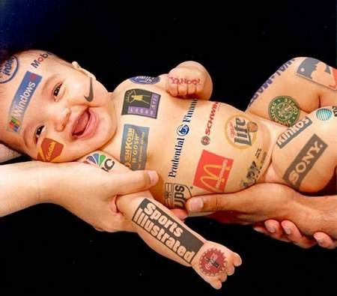
Cont …
Enjoyment & entertainment can result in highly effective remembering and learning.
However, humor does
not always lead to changes
in beliefs & attitudes.
Humor also very subjective
What one person finds funny
another person may not.

Slide 14
C. Logical/Factual
The message is conveyed to convince people by giving facts, figures and information
It carries weight with a person of high educational level.
Information on its own is usually not enough to change behaviors

Slide 15
D. Emotional Appeal
The message is conveying to convince people by arousing emotions, images & feelings rather than giving facts & figures
e.g. by showing smiling babies, wealthy families with latrine, etc., and associating with FP education.
A Person with less education will often be more convinced by simple emotional appeals from people they trust.

Slide 16
E. One sided message
Only presents the advantages of taking action & does not mention any possible disadvantages.
E.g. educating the mothers only about benefits of oral contraceptive pill.
F. Two sided message
Presents both the advantages & disadvantages (pros’ & cons’) of taking action.

Slide 17
G. Positive Appeal
Communications that ask people to do something,
e.g. breast feed your child, use a latrine.
H. Negative Appeal
Communications that ask people not to do something,
e.g. do not bottle feed your child, do not defecate in the bush.

Slide 18
Channel
A channel is the physical bridge or the media by which the message travels from a source to a receiver.
The commonest types of channel are audio, visual, or combined audio-visual & printed materials
The channel is essential. The medium – be it TV, newspaper, or a meeting – dictates who receives the message.

Slide 19
Feedback
Feedback Is the mechanism of assessing what has happened on the receivers after the communication has occurred.
A communication is said to have feedback when the receiver of the message gives his/her responses to the sender of the message.

Slide 20
Models of communication
1.One way model
Sender → message → Channel → Receiver.
Linear type of communication.
No feedback.
No opportunity to clear up misunderstanding
Meaning is controlled by a receiver
      what message
      how much communicated

Slide 21
Cont …
No input from the receiver
Motivation of the sender may be personal gain or public good
Quick if the message is simple and needs quicker communication
  e.g. date & time of meeting
  may be less effective

Slide 22
2. TWo-way communication
Feedback
Channel
Receiver
Sender
Message

Slide 23
Cont. …
Advantages
Suitable for more complex messages
Feedback is added
Allows the sender to find out how much the message is received - can be monitored
Sender can affect the quality and quantity of the feedback through the type of question chosen and the way it is asked.
Notes:
Why Two way communication suitable for complex messages than one way communication?

Slide 24
Methods of communication
There are two main groups of methods;
Face-to-face (‘interpersonal’)
Mass media.

Slide 25
Interpersonal Methods
Forms of communication involving direct interaction between the source & receiver.
In most instances the decisive criterion for personal communication is.
  Communication at the same time &
  Communication at the same place.

Slide 26
Cont …
1. Dynamic or bi-directional
2. Feed back
3. Multisensory (channel)
4. Useful in all stages of adoption of innovation
5. useful when the topic is taboo or sensitive.
6. Can fit to local needs
7. Can be highly selective

Slide 27
Limitations
Easily distorted – as we mostly rely on word-of-mouth.
Often needs multi-lingual
Needs personal status/ credibility
Needs professional knowledge & preparation

Slide 28
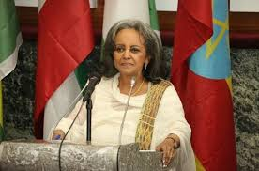
Mass communication
Is a means of transmitting messages, on an electronic or print media, for a large segment of a population.

Slide 29
Advantages
1. They can reach many people quickly.
2. They are accurate and believable
e.g. article on a newspaper, or “voice” of highly respected person.
3. They can provide continuing reminders and reinforcement.
4. Useful to communicate new ideas to early adopters (opinion leaders).

Slide 30
Limitations
1. One sided/poorly organized
2. Does not differentiate the target
3. Only provides non-specific information

Slide 31
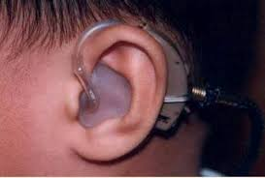
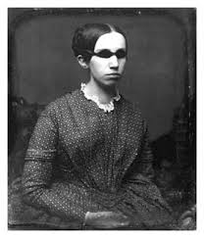
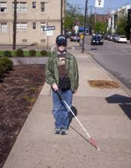
Barriers to effective communications
1. Physical
Difficulties in hearing, seeing
In appropriate physical facilities

Slide 32
Cont …
2. Intellectual
The natural ability, home background, schooling affects the perception of the receiver for what he sees & hears.
The ability of the facilitator/ education/ instructor.

Slide 33
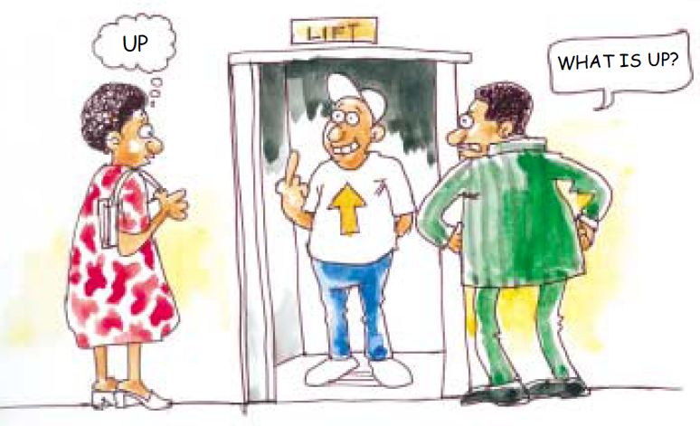
Cont. …
3. Emotional
Readiness, willingness or
eagerness of the receiver
Emotional status
of the educator

Slide 34
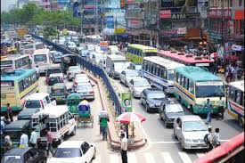
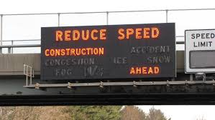
Cont.…
4. Environmental
Noise, invisibility,
congestion

Slide 35
Cont …
5. Cultural
Customs, beliefs, religion, attitudes, economic and social class differences, language variation.
6. Status of the source
7. Inconsistencies between verbal & non- verbal communication

Slide 36
The End
THANK YOU !!

