Slide 1
Resource management

Slide 2
Session objectives
At the end of this session you will be able to:
Define HRM
Describe functions of HRM
Describe functions of drug management

Slide 3
Brainstorming
What is human resource management?
Why HRM is important?

Slide 4
Human Resource Management
“Human resource management is the integrated use of system, policies and management practices to support the organization to meet its desired goal through recruitment, maintaining and development of employees.”
Management Sciences for Health
Involves having the right number of the right people in the right place at the right time

Slide 5
Cont …
Human Resource Management is planning, organizing, directing and controlling, development, compensation, integration, maintenance and separation of human resources to the end that individual, organizational, and social objectives are accomplished.
It is a function of management, concerned with hiring, motivating and maintaining people in an organization
HRM is concerned with the people dimension in management.

Slide 6
Cont …
A major HRM challenge for managers is ensuring that their company has a high-quality workforce
Getting and keeping competent and talented employees is critical to the success of
every organization
If an organization doesn’t take its HRM responsibilities seriously, performance may suffer

Slide 7
Cont …
Human capital is essential to any organization’s long-term performance success
Organizations perform better when they treat their employees better
Human resource management (HRM) views people as organizational assets and internal customers

Slide 8
Cont …
Ethiopia has major HRH management challenges including shortage, urban/rural and regional disparities, poor motivation, retention and performance.
HRM is sub optimal as modern concepts and practices are lacking and HR functions are generally limited to traditional personnel administration tasks

Slide 9
Cont …
Due to limited efforts to modernize HR functions, there is limited investment into HRM capacity development as evidenced by
  Limited technical skills and experience of existing HR staff in HRM and leadership,
  Inadequate HR structure and staffing at all levels,
  Limited capacity and practices in strategic and operational HR planning and budgeting

Slide 10
Cont …
The health workforce density in Ethiopia has increased from 0.84 to 1.3 per 1000 population between 2008 and 2013, indicative of an improvement in supply and availability of health workers.
However, the doctor, public health officer, nurse and midwife to population ratio is 0.7 per 1000 population, far behind the minimum threshold of 2.3 doctor, nurse and midwife to 1000 population ratio required to ensure high coverage with essential health interventions

Slide 11
Cont …
Human resources department is the organizational component responsible for staffing and labor relation activities, programs and policies
All managers have some degree of responsibility for staffing activities like:
  Selection
  Performance appraisal

Slide 12
Cont …
  Promotion
  Training and development
  Discipline and corrective counseling
  Compensation of their employees

Slide 13
Functions of HRM
HR planning
It is the process by which managers ensure that they have the right number and kinds of capable people in the right places and at the right times
Through HR planning, organizations avoid sudden people shortages and surpluses

Slide 14
Cont …
HR planning entails assessing current human resources and meeting future HR needs
An important part of a current assessment is job analysis
Job analysis is an assessment that defines a job and the behaviors necessary to perform it

Slide 15
Cont …
It has two components:
  Job description is a written statement describing a job content, environment, and conditions of employment
  Job specification states the minimum qualifications that a person must possess to successfully perform a given job

Slide 16
Job Analysis
Process of Obtaining all information pertinent Job Facts
Job Description
A proper definition & design
of work. A statement containing:
Job Title
Location
Job Summary
Duties & Responsibilities
Materials, Tools & Equipment used
Forms & reports handled
Supervision given / received
Working conditions
Hazards & Safety precautions
Job Specification
A statement of human qualifications necessary to do the job containing:
Education & Qualifications
Experience & Training
Knowledge & Skills
Communication skills
Physical requirements - Height, Weight, Age
Personality requirements -
Appearance, Judgement, Initiative, Emotional stability

Slide 17
Cont …
The content and format of job descriptions & specifications vary among organizations
The general practice is to include:
Job title – standard title of the person. E.g. Head Nurse, Senior Nurse, Midwife Nurse, etc…
Job code e.g. PS/ADM1 (professional science /administration 1)

Slide 18
Cont …
Job summary – a statement of the core duties and responsibilities of the employee
General duties and responsibilities (5-9)
Supervision given or received
Special working conditions (including equipment or systems used)

Slide 19
Cont …
Qualifications- a statement of qualifications should include the minimum education, training, experience, and demonstrated skills required.
Review and appraisal

Slide 20
Cont …
Job descriptions for each job should be updated whenever job content, performance requirements, or qualifications change
This basic document is used for other HRM functions (recruitment, selection, training, performance appraisal, career counseling, and compensation) and a fundamental document in legal disputes

Slide 21
Cont …
2. Recruitment & decruitment
Recruitment is, locating, identifying, and attracting capable applicants
It involves searching for and attracting prospective employees, either from outside or within
If recruitment is effective, the organization will have applicants for the vacancies

Slide 22
Cont …
Recruitment sources include newspaper, internet, employee referrals, training institutions
Decruitment is when an organization reduces its workforce if HR planning shows a surplus of employees
Decruitment options include firing, layoffs, transfers, attrition, early retirements etc…

Slide 23
Cont …
3. Selection
It is a process of screening job applicants to determine who is best qualified for the job
The essence of selection procedure is to determine, whether a given applicant is suitable for the job in terms of training, experience and aptitude.

Slide 24
Cont …
It should be done carefully since hiring errors can have significant implications
Selection involves predicting which applicants will be successful if hired
Rejectiob/acceptance errors may occur
Selection tools include: application formats, interviews, written tests, performance-simulation tests, background investigations, physical examinations

Slide 25
Cont …
4. Induction & orientation
Induction activities are typically carried out by the human resources department and include:
  Enrolling new employees in benefit plans,
  Issuing identification card/badge and
  Creating a database for the individual
  Orientation: A set of activities designed to familiarize new employees with their jobs, coworkers, and key aspects of the organization.

Slide 26
Cont …
Work unit orientation familiarizes the employee with the goals of the work unit, clarifies how his or her job contributes to the unit’s goals, and includes an introduction to his/her coworkers
Organization orientation informs the new employee about the organization’s goals, history, philosophy, procedures and rules

Slide 27
Cont …
The orientation program includes:
  Informing employees about the mission, vision and values of the organization
  Information about the physical facility and organizational structure
  Introducing with colleagues

Slide 28
Cont …
  Universal precautions, fire & safety programs
  Employee health service and other HRD services
  Explanation of organizational policies and benefits
  Orientation on department specific work methods

Slide 29
Cont …
Importance of orientation
Builds employees’ sense of identification
Helps them gain acceptance by fellow workers
Gives them a clear understanding of what they need to know
Familiarize new employees with the entire organization as well as their own work area and department

Slide 30
Cont …
A Role play
Assume you are chief executive officer (CEO) of a NAGH and a new employee (ophthalmologist) has arrived the hospital. Show how you will orient him.

Slide 31
Cont …
5. Training
Intentional efforts to improve current and future performance by helping employees acquire the skills, knowledge, and attitudes required of a competitive workforce.

Slide 32
Cont …
Its objective is to improve employee performance in a specific job
In many org’s employee interpersonal (soft skill) trainings such as communication, conflict resolution, team building, customer service etc. are necessary

Slide 33
Cont …
Traditional training methods include: on-the-job, job rotation, mentoring/coaching, manuals, lectures etc
Technology-based training methods: DVD, audiotapes, Videoconferencing, teleconferencing, satellite TV

Slide 34
Cont …
6. Performance Appraisal
A performance appraisal is a formal system of review and evaluation of individual or team performance.
The performance appraisal is a periodic event to reflect and evaluate past performance with the intent to identify strengths and weaknesses of an employee’s performance and to identify developmental goals.

Slide 35
Cont …
Importance of PA
  To determine if individual work results are consistent with expectations
  To identify high, marginal and unsatisfactory performers
  On the basis of their performance, interventions like training, in-service education, jobs redesign etc or counseling, discipline or separation may be provided.

Slide 36
Cont …
  To provide information on compensation determination
  To provide information for employee assistance and counseling. E.g. substance use
  To provide feedback to both employee and supervisor

Slide 37
Cont …
7. Compensation and Benefits
It is about rewarding the top performers with a bonus or promoting them to another position
Most of effective workers expect to receive appropriate compensation from their employer
Developing an effective and appropriate compensation system is an important part of the HRM process

Slide 38
Cont …
Managers must develop a compensation system that reflects the changing nature of
work and the workplace in order to keep people motivated
Compensations can be wage and salary add-ons, incentive payments, promotions, surfing lessons, tickets

Slide 39
Drug management

Slide 40
Brainstorming
What is drug?
What is essential drug?
Why do we concerned about drug management?

Slide 41
Drug management
Drug can be defined as:
A chemical substance that affects the processes of the body or mind;
Any chemical compound used on or administered to humans or animals as an aid in the diagnosis, treatment or prevention of disease, or other abnormal condition, for the relief of pain or suffering, or to control or improve any physiologic or pathologic state;

Slide 42
Cont …
A substance used recreationally for its effects on the central nervous system.
WHO defines essential drugs as:
  Drugs that are indispensable and necessary to satisfy the health care needs of the majority of the population

Slide 43
Cont …
These drugs should therefore be available and accessible at all times, in the appropriate dosage forms and at prices affordable to all
Most leading causes of morbidity and mortality can be treated, prevented or at least alleviated with cost-effective essential drugs
Drugs are of particular importance because they can save lives and improve health

Slide 44
Cont …
They promote trust and participation in health services
Drugs are powerful so must be used with skill, knowledge, and accuracy, otherwise they are dangerous.

Slide 45
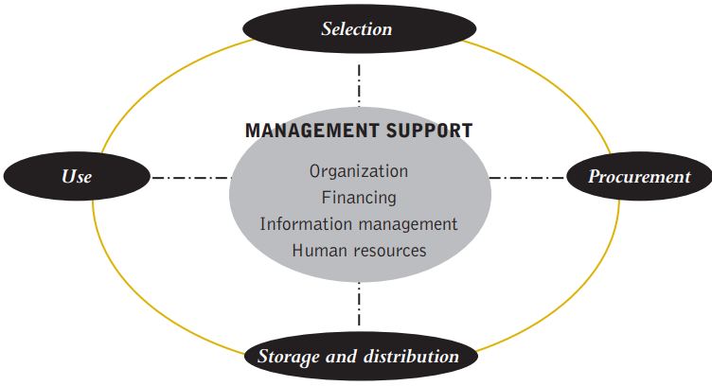
Cont …
Drug management cycle (four basic functions)

Slide 46
Cont …
Selection
Involves reviewing the prevalent health problems, identifying treatments of choice, choosing individual drugs and dosage forms, and deciding which drugs will be available at each level of health care
Proper selection will lead to better supply, more rational use, and lower costs

Slide 47
Cont …
The process of selecting essential drugs begins with defining a list of common diseases for each level of health care
Essential drugs should be selected on the basis of:
  Relevance to the pattern of prevalent diseases
  Proven efficacy and safety

Slide 48
Cont …
  Adequate scientific data and evidence of performance in a variety of settings
  Adequate quality
  Favorable cost-benefit ratio
  Desirable pharmacokinetic properties and possibilities for local manufacture
  Availability as single compounds

Slide 49
Cont …
B. Procurement
It is about:
  quantifying drug requirements
  selecting procurement methods
  managing tenders
  establishing contract terms
  assuring drug quality
  ensuring adherence to contract terms

Slide 50
Cont …
An effective procurement process ensures:
  the availability of the right drugs in the right quantities & reasonable prices
  standards of quality

Slide 51
Cont …
Steps of procurement:
  Reviewing drug selections,
  Determine quantities needed,
  Reconcile needs and find,
  Choose procurement method,

Slide 52
Cont …
  Locate and select suppliers,
  Specify contract terms,
  Monitor order status,
  Receive and check drugs, &
  Make payment

Slide 53

Cont …
C. Distribution
This includes stock control, store management, and delivery to drug depots and health facilities

Slide 54
Cont …
Effective drug distribution relies on good system design and good management
A well-designed and well-managed distribution system should:
  Maintain a constant supply of drugs;
  Keep drugs in good condition throughout the distribution process;
  Reduce theft and fraud;
  Provide information for forecasting drug needs

Slide 55
Cont …
  Minimize drug losses due to spoilage and expiry;
  Maintain accurate inventory records;
  Rationalize drug storage points;
  Use available transportation resources as efficiently as possible;

Slide 56
Cont …
Rational prescribing: Prescriptions should be written after a diagnosis or a health problem has been identified
The prescription must then contain all the necessary information clearly written
E.g. Paracetamol 500 mg ii tabs tid ??
Amoxicillin .5 gm i cap tid x 7 days??

Slide 57
Cont …
Content of the prescription: Name of the patient and age (especially if a child), date, generic name and dosage form, dose etc..
Appropriate abbreviation use: E.g. od = once a day, prn = when necessary, qid (qds) = four times daily, Rx = treatment, sc = subcutaneous stat = at once, supp = suppository, tbsp = tablespoonful (=10 ml) tid/tds = thrice daily tsp = teaspoonful (= 5 ml)

Slide 58
Cont …
Packaging of drugs for patients:
  All drugs should be put in suitable and appropriately labelled containers to ensure correct use and maintain potency and quality during the period of use

Slide 59
Cont …
D. Use
It includes rational use of drugs and provision of necessary information to the patients
Rational use of drugs requires that patients receive medications appropriate to their clinical needs, in doses that meet their individual requirements, for an adequate period of time, and at the lowest cost to them and their community

Slide 60
Cont …
Prescriptions should promote the rational use of drugs.
Rational use of drugs requires:
  Appropriate dose,
  Appropriate dosage form,
  Appropriate route of administration,
  Appropriate frequency of administration,
  Appropriate duration of treatment,
  Appropriate information to the patient,
  Adequate follow up

Slide 61
Cont …
Irrational drug use occurs with poly-pharmacy, with the use of wrong ineffective drugs, or with under use or incorrect use of effective drugs
Prescriber's knowledge and experience, dispensing process, the patient or community, and the health system are factors that influence rational drug use

Slide 62
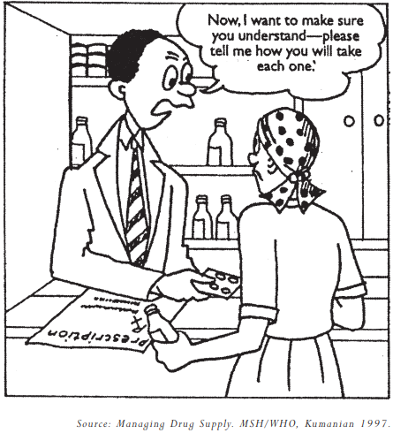
Cont …
Information to the patient

Slide 63
Cont …
The health worker should be able to give the patient additional information to re-enforce the right instructions on the label
This should be in a language that is familiar to the patient
  How often to take the drug,
  When to take the drug (e.g. before or after the meals)

Slide 64
Cont …
  How to take the drug (e.g. with water, chewing or swallowing),
  How to store the drug (e.g. avoid heat, light and dampness),
  Do not share drugs with other persons,
  Keep drugs out of the reach of children

Slide 65
Summary
HRM
Drug mgt

Slide 66
Reading assignment
Financial management in health care organizations
Health management information system

Slide 67
References
SB Robbins, M Coulter. Management 11th edition. 2012
HSM lecture note
WHO African Region. Management of drugs at health center level. 2004

Slide 68
Thank you!!

