Slide 1
Patient care & hospital procedure
Prepared by Beza Tesfaye

Slide 2
Patient care and hospital procedure
Course description
  This topic gives awareness to recognize patients right and acknowledge the teamwork.
  To introduce technical experience in managing patients and
  Enabling to give basic nursing care ;-
      During radiographic procedures,
      Emergency handling of patient.

Slide 3
Introduction
WHAT IS HEALTH?
is a state of complete physical, mental and social well-being and not merely the absence of a disease. (WHO)
is the fundamental right of every human being regardless of politics, race, sex, religion, . . .
A patient :-is a person whose activity and feeling is restricted to a certain degree depending on their illness .

Slide 4
Con’t . . .
Radiology:- is a branch of medical science which deals with the diagnosis of a disease by the use of x-radiation.
Interventional Radiology :- which somehow deals with the treatment of some diseases.
Radiography :-is a technique used to produce an image of the internal structure of the body by using x-radiation.

Slide 5
UNIT ONE
1. The Radiologic Technologist and Professionalism
The RT and the hospital
The RT and the Radiology Department
General preliminaries to Radiographic Exam
Responsibility of the R.T

Slide 6
1.1 The RT and the hospital
    Any hospital has two team of workers
I. Medical Team
  deals with diagnosis and treatment of a disease.
E.g. Physician(Dr), Nurse , RT, Lab. technologist……
II. Administrative Team
  administrative work of the hospital; these are: the administrator of the h/l, maintenance engineer, lifts operator, accountant, cleaner etc…
  Note :-
No one is entirely independent of each other.
They all serve the patient (common goal).
So, the patient is the most important person in the h/l.

Slide 7
1.2 The RT and the Radiology Department
The most important department in the h/l, b/c it carries out many diagnostic services.
They should work well with other depts. (Team Work)
The radiology dept has its own gradation of authority:-
      a) senior medical person (consultant radiologist )
      b) superintendent technologist
      c) radiographers.

Slide 8
1.3 General preliminaries to Radiographic Exam
Patients must be greeted by full name and correct prefixes E.g. Mr. Mrs, Miss, Ato, w/o, W/t, . . .
Smiling is also necessary to establish easy relationship.
The x-ray room must be tidy.
Explanation must be given to the patient about the procedure.

Slide 9
Con’t . . .
The examination must be clearly known and obtain pertinent pt. history from the request form.
Determine pregnancy status.
Assist the unable pt. to get on the x-ray table.
Check if special preparation is needed and give proper instruction.

Slide 10
Con’t . . .
Preliminaries to the child patient
All children are fearful of many things, so don’t handle children roughly.
        Don’t expose to sudden loud noise,
        Don’t leave children alone.
To make the x-ray room less strange:-
        Put favorite toys and decorate the wall
        Explain to the child any things he/she knows.
Children should wait little time in the x-ray dept.
Children should be undressed by their parents.

Slide 11
Radiographic consideration in child patient
The easiest and least uncomfortable view must be done 1st .
Exposure factor and equipment must be prepared 1st
Use fast screen cassette.
Sedate if necessary (in the OPD or Ward)

Slide 12
Con’t . . .
Preliminaries to the Elderly patients (Geriatrics)
They need special care and support and they should be called by their correct name and be respected.
Care must be taken during handling them, because old patients have delicate skin so pressure sore must be considered.

Slide 13
Con’t . . .
Appointment must not be during busy period.
Appointment and preparation must be in written form.
Special privacy must be given to old patients.
Instruction should be given with rehearsal.

Slide 14
Radiographic consideration to the Elderly patient
Take least uncomfortable view 1st .
E.g For weak pts. take “AP” views with the patient sitting
      on the wheelchair or stretcher.
Steps must be kept near the table
To lift the pts. from the stretcher to the table use canvas.
Use fast screen cassettes.

Slide 15
MANAGING PATIENTS
Conducts of pts. & how to manage them
a) The over talkative pt. – talks too much
    Remedy – answer his/her questions carefully.
b) The frightened pt. – reassure and calm him/her.
    Remedy – discuses with him/her with interesting conversations and cheerfully.
c) The worried pt. – he/she is quiet and thoughtful.
    Remedy – treat him/her like a frightened pt.
d) The extrovert pt. – Interested in worldly affairs, social, political,.

Slide 16
e) The introvert pt : concerned with him/her self
    He/she doesn’t like joke, chatting
    Remedy: Be serious and never criticize or oppose such a pt.
f) The quiet pt : polite and soft spoken
    Remedy: Approach him/her quietly and courteously
g) The moody pt : changes his/her behavior from time to time.
    Remedy: If he/she is happy encourage him/her
    If he/she is not happy, make yourself happy
h) The impatient type : has no consideration for others (selfish)
    Remedy: Treat him/her quickly with respect and courtesy

Slide 17
i) Suspicious pt : doubtful, asks many questions.
    Remedy : Answer all his/her questions in ethical and courteously manner.
j) Hypochondriac pt : he/she believes he/she has a pain and discomfort.
Remedy: Don’t be sympathetic and Make him/her forget his/her pain and discomfort

Slide 18
1.4. RESPONSIBILITY OF THE R.T.
1.4.1 Clinical
1.4.2 Ethical
1.4.3 Legal

Slide 19
1.4.1 CLINICAL RESPONSIBILITY OF THE R.T.
Knowledge of pathology and disease processes- not to worsen disease conditions
Knowledge of first aid and what to do in an emergency case.
Knowledge of pt’s psychological state for proper handling.
The RT should have personal qualities e.g sympathetic, understanding , cheerful and self-control.
The RT must look efficient in his/her work and no mistake should be done.

Slide 20
Cont…
Female dress and adornment have the greater range:-
    Long nails and jewelries should be avoided, as it may scratch Pt.
Just look suitably dressed.
Looking both efficient and attractive has therapeutic effect on the patient.

Slide 21
Cont…
Restrict spoken exchange between each other to technicalities relating to the examination.
Irrelevant conversation should be avoided.

Slide 22
1.4.2. ETHICAL RESPONSIBILITY
The technologist is governed by a code of Ethics and principles of professional conducts such as:-
Don’t reveal pt. confidential for any one not professionally involved.
E.g. name of the pt., examination performed, results .
Any question about treatment or diagnosis must be referred to the concerned radiologist or physician,

Slide 23
Cont…
If you observe illegal or unethical practice by coworkers, report it to the proper person.
The technologist must not be wasteful of materials and medication or take them for personal use; keep them in a safe place.
Responsibility of keeping abreast of the changes and growth of knowledge in his/her profession.
To be a member of local and professional organizations (to contribute his part).

Slide 24
1.4.3. LEGAL RESPONSIBILITY (MEDICO LEGAL ASPECTS)
It is considered under three aspects:-
I. Breach of professional confidence: all patients are protected by
the “Pt’s bill of right”.
Don’t disclose any information concerning the patient or colleagues to unauthorized person.
Discussion concerning pt. information must be limited with in the radiologist, physician, nurse and colleagues.
Don’t discuss with the patient himself about his condition; questions must be referred to the concerned radiologist or physician

Slide 25
ii. Negligence
It is a failure in care .
E.g - Failure to read request
- Failure in protecting the patient from unnecessary radiation

Slide 26
iii. Procedures in the event of an accident
Accident can happen during work;
- the procedures to be followed during accident are:-
  A. Care for the victim and see for medical advice
  B. Reporting the accident
C. Recording the accident

Slide 27
SUMMARY
Radiologic technologists are the medical personnel who perform diagnostic imaging examinations.
The relation b/n radiological technologist and hospital can be seen with respect to medical and administrative team.
General preliminary to radiographic procedure
Describe the responsibilities of technologies

Slide 28
Thanks

Slide 29
CHAPTER TWO
INFECTION CONTROL

Slide 30
Outline
Nosocomial Infection
Microorganisms
The body’s defense against disease
Techniques of infection control
Disinfection
Surgical Aseptic Techniques for RTs/Radiographers
Method of sterilization

Slide 31
Introduction
Infection control in health care institutions is essential.
All health workers are responsible for complying with infection-control precautions.
All pts. Coming to the diagnostic imaging dept. must be regarded as potential carriers of diseases.
Every piece of equipment must be thoroughly cleaned after each use.

Slide 32
1.1 Nosocomial Infection
- Is infection acquired in the health care institution.
because:-
a) there are different types of patients .
b) growth of hospital bacteria that have learned to resist antimicrobial drugs.

Slide 33
Site of nosocomial infection
1.urinary tract - most frequent
- associated with the use of catheters
2. Wound infections- second most frequent cause
- following surgical procedures
3. Respiratory tract - third most frequent cause.

Slide 34
1.2 MICRO ORGANISMS (MO)
basically four major groups of MOs:
    1.Bacteria
    2. Fungi
    3.Viruses
    4.Protozoa

Slide 35
1.BACTERIA
are minute, one-celled organisms without a typical nucleus.
- they contain both DNA and RNA.
-they are both harmful and useful
e.g.-. E.coli natural (normal flora-useful in digestion and absorption of food in the GIT)
- some common diseases produced by bacteria are: diphtheria, tuberculosis, boils, abscesses, wound infections, salmonella.
- Bacteria’s are classified according to their shape and to divisional grouping as:

Slide 36
according to their shape
      a) Spherical (cocci)
      b) Oblong (bacilli)
      c) Spiral (spirilla)

Slide 37
according to divisional grouping
    a) Diplococcic (group of to two)
    b) Streptococci (chains)
    c) Staphylococci (grape like bunches)

Slide 38
2. FUNGI
Fungi exist in two forms:-
      Yeast : are one-celled
      Mold : have many cells
Some fungi have the characteristics of both yeasts and molds.
Reproduce by budding or spore formation
Require moisture and darkness to grow
Many pathogenic fungi infect the skin and scalp of humans.
E.g. common diseases caused by fungi are those caused by Candida albicans (yeast like): thrush (in the mouth), “Black hairy tongue” infections, and vulvo-vaginitis.

Slide 39
3.VIRUSES
Viruses are minute MO that can not be visualized under an ordinary microscope.
Their genetic material is composed of either DNA or RNA but never both.
E.g. some viral diseases that affect humans are: influenza, measles, mumps; hepatitis A, B; herpes zoster; herpes simplex; AIDS and common cold.

Slide 40
4. PROTOZOA
are more complex one-celled MOs
They are often parasitic
move from place to place by pseudopod formation by the action of flagella, or by cilia,
Many protozoa are able to form themselves in cysts ,to prolong their existence.
Many of the diseases in human caused by the protozoa affect the GI, GUT and the circulatory system.
E.g. some of the common protozoal diseases are amebiasis, gardiasis, malaria, toxoplasmosis, …

Slide 41
1.3 THE BODY’S DEFENCE AGAINST DISEASE
both specific and non-specific defense system
i. non-specific - is not selective when dealing with microbes.
Non-specific defense system
- skin, hair, ciliated mucous membrane
urine
Lysosomes

Slide 42
Cont…
ii. specific method (antibody )
When MO by pass the non-specific method they produce antigen
our body then forms, specific antibody to act against antigen by macrophages and neutrophils
Anti body form to react against an invading antigen to produce an immunity

Slide 43
ACTIVE IMMUNITY: -Naturally acquired (inherited) or acquired as a result of having the disease or by vaccination (injection) of weakened or attenuated MO.
PASSIVE IMMUNITY: -acquired by injection of antibody or transplacental transfer (from mother to fetus).

Slide 44
PROCESS OF INFECTION
Infection invades the body in a progressive manner:
1. first stage (incubation period)
- interval b/n exposure to an infection and appearance of first symptoms
-It is not possible to detect a particular disease during the incubation period.
2. second phase (prodromal phase.)
- early signs and symptoms of the disease are demonstrated.

Slide 45
Cont…
      3. Third phase (active or full stage )
      - all of the characteristic signs and symptoms of the disease are at their peak.
      4. fourth phase (convalescence)
      - symptoms begin to diminish and eventually disappear
      5. phase of remission
      - incase of chronic infections,
      - lessening the severity

Slide 46
ELEMENTS NEEDED TO PRODUCE INFECTION
Infection can not begin unless three elements are present:-
      A source
      Host
      Means of transmission
Source :- is a person with or incubating a disease
Host : - is any susceptible person
e.g. fatigued or poorly nourished, diabetic pts., cancer pt.
Means of transmission :- can be by direct and indirect contact, by droplet, vehicle, vector or air born.

Slide 47
Cont…
Means of transmission
a) Direct contact -when infected blood or fluid is touched with hands, or by kissing or sexual intercourse.
b) Indirect contact - is transfer of pathogenic MO by touching contaminated objects
- dressings, instruments, clothing, dishes. .
c) Droplet contact - involves infectious secretions of the nose, mouth (during coughing) etc.
d) Vehicles - may also transport infection;
- these include: food, water, drugs, blood.

Slide 48
Cont…
e) Air born - residue from evaporated droplets suspended in air for a long period of time
f) Vectors - are insects or animal carriers of disease --- transmit by stinging or biting

Slide 49
1.4 TECHNIQUES OF INFECTION CONTROL
It is the RT’s duty to practice strict medical asepsis at all times.
Medical aseptic technique - destroying MO
-by using soap, water, friction and chemical disinfectants

Slide 50
1.4.1 DRESS IN THE WORK PLACE
The RT shouldn’t wear Jewelries on hands
remove long nails and nail polishes
Wrist watch is the only acceptable one.
The RT must always wear uniform
Short sleeves are better
Chlorine bleach is recommended for clothes that have become heavily contaminated.

Slide 51
1.4.2 HAIR
Hair follicles and filaments harbour MO, and are sources of staphylococcus contamination
So, hair must be worn short and washed frequently

Slide 52
1.4.3 HAND WASHING
Microbes are most commonly spread from one person to another by hands.
Correct hand washing procedure
- before and after handling supplies for pt. care - before and after each pt. contact
All blood and body fluid must be disposed of correctly, then hands must be washed
Any exposed breaks in your skin must be covered by a water proof protective covering

Slide 53
THE ACCEPTED MEDICALLY ASEPTIC HAND-WASHING TECHNIQUE IS AS FOLLOWS:-
1.Approach the sink, but don’t touch the sink with your uniform
2. Turn on the tap by using paper towel; then discard the towel
3. Regulate the flow of water so that it does not splash from the Sink
4. During the entire procedure, keep your hands and forearms lower than your elbow
5 Wet the hands and soap them well. When using bar soap, rinse the bar before using it.
6. With a firm circular rubbing motion wash the palms, back of the hands, each finger, between the fingers and finally the knuckles.
7. Rinse the hands well under running water

Slide 54
Cont…
8. Wet the wrists and forearms to the elbow. Apply soap and rub with the same circular motion
9. Rinse
10. Clean finger nails once each day
11. Repeat the washing procedure as described above
12. Rinse fingers
13. Rinse soap well and replace it in the dish
14. Turn off the water by using paper towel
15. Dry arms and hands by using towel
16. Use lotion on hands and forearms to prevent cracking of the Skin (to prevent infection)

Slide 55


Slide 56
1.4.4. GLOVES
Disposable, single-use gloves are to be worn any time that the RT fells that he might touch a patient’s blood or body fluids
Gloves should be removed by use of the following technique to prevent contamination of the RT’s hands or clothing:-
1. With the gloved Rt. Hand, hold the upper, outside portion of the left glove and pull it off, turning it in side out.
2. Hold the removed glove with the Rt. Hand
3. With index and middle finger of the bare hand reach inside the top of the soiled glove and pull if off, turning it inside out
4. Dispose of the soiled glove in to a contaminated waste receptacle
5. Wash your hands.

Slide 58
1.4.5. EYE PROTECTION
The eyes may be a port of entry for pathogenic MO.
wear goggles or eye glasses, if the RT is in a situation where there may be a spattering of blood or body fluid.
Hands must be kept away from eyes during the course of work.

Slide 59
1.4.6 DISINFECTION
Is the removal of pathogenic MO by mechanical and chemical processes.
Articles or surfaces
Usually in reference to body surfaces , the term antiseptic is used ,
If a Pt. with contagious disease comes to radiology dept. give him tissue to cough and sneeze in to it and discard them safely.

Slide 60
Con…..
After the Pt. left the dept. the radiographic table and other equipment must be disinfected.
The technologist should put on a gown and mask, if necessary.
The RT should then scrub his/her hands.

Slide 61
1.4.7. SURGICAL ASEPTIC TECHNEQUE (STERILIZATION)
Is the complete removal of all MOs and their spores from the surface of any object
begins with cleaning the object in a medically aseptic way.
an invasive procedure requires the use of surgical aseptic technique.
- E.g. parenteral medications, catheterization
utilizing either heat or chemical action to accomplish the total removal of MOs & spores.

Slide 62
METHODS OF STERILIZATION
The method used to attain sterilization depends on the nature of item to be sterilized.
The methods currently used for sterilization include:
1. Steam under pressure
2. Gas
3.Chemicals
4. Dry heat
5. Ionizing radiation

Slide 63
1. STEAM UNDER PRESSURE
- used to sterilize items that can withstand high temperature and moisture.
It is fast, convenient, and economical.
Pressure is attained in a chamber called an autoclave

Slide 64
Con……
Some bacterial spores continue to live for longer than 3hrs. in temp. as high as 115°C , but none can live if the temperature is raised to 125°C for longer than 15 min. ;so ,the temperature with in the autoclave must reach this range for this period of time.

Slide 65
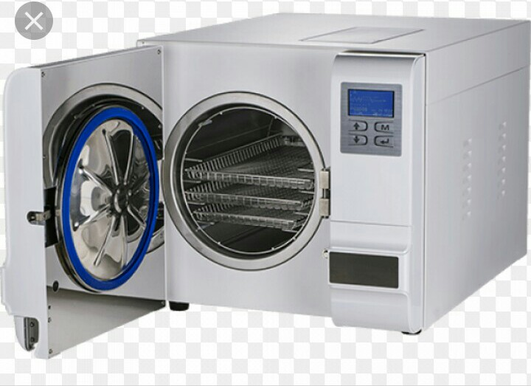

Slide 66
2. GAS
items that cannot withstand moisture and high temperature.
Used A mixture of ethylene oxide and CO2 .
Gas sterilizers are heated from 49°C-60°C with a humidity of 49%-80%.

Slide 67
3. CHEMICALS
items that cannot withstand heat and when gas sterilization is not available
2% activated , buffered alkaline glutaradehyde, which will kill spores on items immersed in solution for at least 10hrs.

Slide 68
4. DRY HEAT (rarely used)
Used to sterilize anhydrous oil, petroleum products and bulk powders.
It may also be used to sterilize some delicate cutting instruments that may be corroded or discolored by other methods of sterilization.
It is rarely used in hospital.

Slide 69
5. IONIZING RADIATION
used in commercial sterilization ; not used in institutions,
Cobalt 60 is the most common source of radiation sterilization.
Ionic energy is converted to thermal energy during this process to kill MOs.

Slide 70
1.4.8 . ISOLATION TECHNIQU
is separate the Pt. who has contagious illness from other persons in the hospital.
The RT must always adhere to four basic principles :-
1.Hands are washed
2. All items used for patient care are sterilized, disinfected, or disposed.
3. Items removed from isolation rooms are bagged and labeled as “contaminated”.
4. All hypodermic needles must be placed in a labeled, puncture-resistant receptacle.

Slide 71
1.4.9 TAKING RADIOGRAPHS IN THE OPERATING ROOM (OR)
The RT/Radiographer must clean his portable radiographic machine and cassettes
Care must be taken to prevent contamination of the surgical field
Cassette must always be placed in a sterile plastic bag.

Slide 72
THANKS

Slide 73
Chapter 3
Basic patient care in Diagnostic
Imaging

Slide 74
Care of valuables
A pt may required to remove all or some items of clothing before exams.
Pts properties like: purses, jewelries and other valuables should be treated with special care.
An envelope should be offered to the pt.
The envelope may be kept in the Pt's purse or pocket, or in a secure place in the radiography dept.

Slide 75
Question
What is the leading cause of injuries to health- care personnel in the hospital?

Slide 76
Body mechanics
Is systematic exercise designed to hold something in balanced and steady position.
If the RT employs the rule of correct body mechanics, they will be less fatigued and will avoid injury to him self and his pts.
The center of gravity is the point at which the mass of any body is centered.
When a person is standing, his center of gravity is at the center of the pelvis.
Safe body mechanics requires a posture aligned with all parts in balance.
This permits the musculo-skeletal system to work efficiently with a minimum amount of strain on joints, tendons, ligaments and muscles.

Slide 77
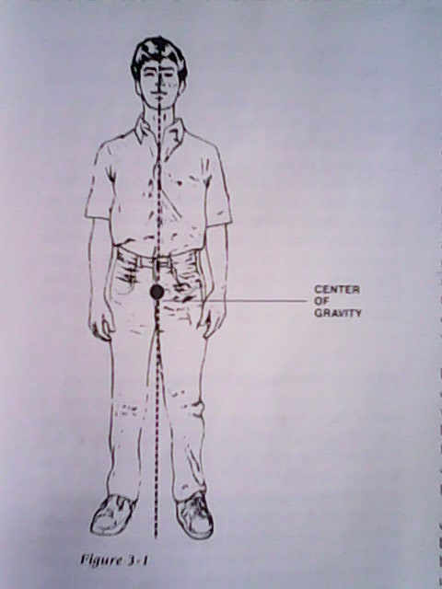

Slide 78
Rules for correct upright posture
The rule which govern correct upright posture are :-
The chest should be held up and slightly forward with the waist extended , it increases lung efficiency.
The head should be held erect with the chin held in (spine is in alignment and no curve in the neck).
Stand with the feet parallel and at right angle to the lower leg.
Keep the knees slightly bent . They act as a “shock absorber” for the body.
Keep the buttocks in and the abdomen up .

Slide 79
Con’t . . .
The RT should always protect him/herself by keeping the body’s line of balance close to the center of gravity.
      When picking up an object from the floor, bend the knees and lower your body.
      Don’t bend from the waist.
      Always pull the weight. of an object; don’t push it.
      When a pt. must be lifted, balance the weight over the feet.
      Hold the object close to your body, bend your knees, and set your spine to support the load.
              Use your arms and leg muscles to lift.
              The spine must always be protected.
      Instead of twisting your body to move with a load, change foot positions.

Slide 80
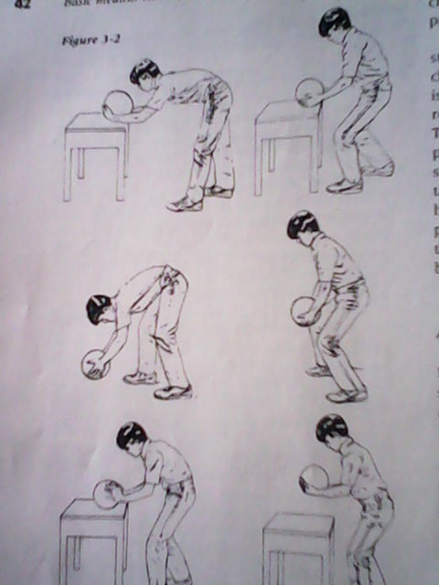
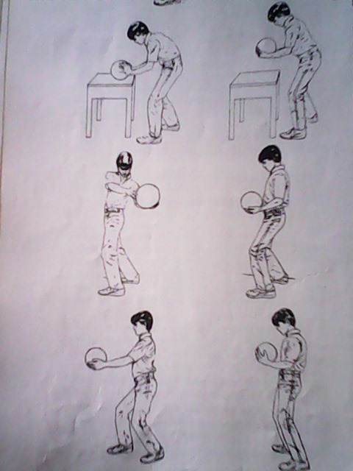

Slide 81
vidio

Slide 82
Moving and Transferring Patients
I. Transferring a pt from a wheelchair to radiographic table
The pt in a wheel chair will require assistance.
The chair should be brought close to the x-ray table and parallel to it.
The pt facing towards the end of the x-ray table at which it is designed to put his feet when he lies down.
In controlling the wheel chair itself there are two points to watch:-
        That it does not slide away from the pt as he/she rises
        That he doesn’t tip the whole thing forward by standing on the foot-rest.

Slide 83
Follow the following steps when lifting a pt from a wheel chair
Two people are required to assist the pt.
    Place the wheel chair near the table.
    Apply the break.
    Explain the procedure to the pt.
    Move the pt to sit at the edge of the chair.
    Stand either side of the pt. facing the back of the chair.
    Place shoulder nearest the pt under the Pt's axila.
    Place the other arm under the Pt's thighs.
    Clasp the wrist of the other lifter.
    Pt’s arms are hang over the lifters back.
    Support pt’s back with free hands.
    Lifters bend knee and keeping their backs straight, lift the pt.
    Lift pt’s leg on the x-ray table.

Slide 84
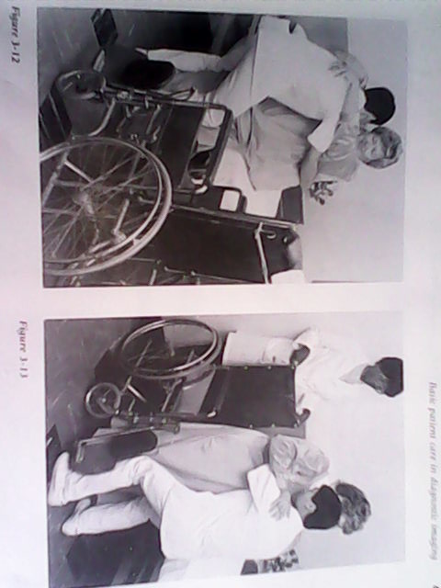

Slide 86
Con't . . .
Transferring a pt from a stretcher to radiographic table or the reverse
There are two methods to accomplish this:
      Using a sheet for transfer and;
      Three-carrier lift method
1. Using a sheet for transfer
Obtain a bed sheet.
There should be one person on each side of the bed or table
Turn the pt onto his side.
Place the sheet on the stretcher or table.
Tell the pt to turn back over the sheet to supine position.

Slide 87
    Three or four people require to transfer the pt.
    Two ppl stand at each side of the table and stretcher.
    Slide the pt from one surface to another

Slide 88
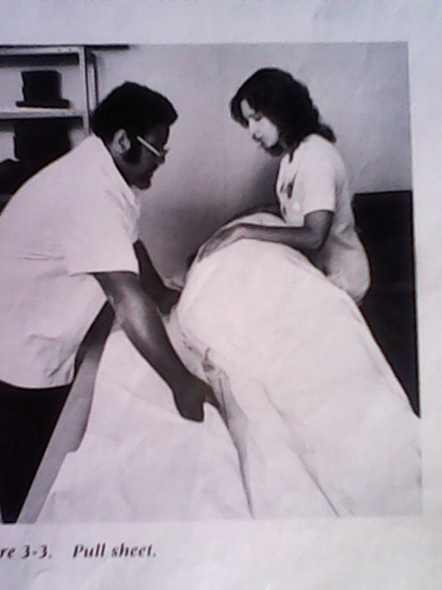
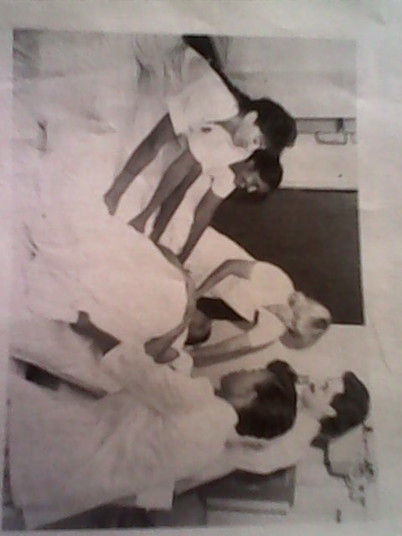
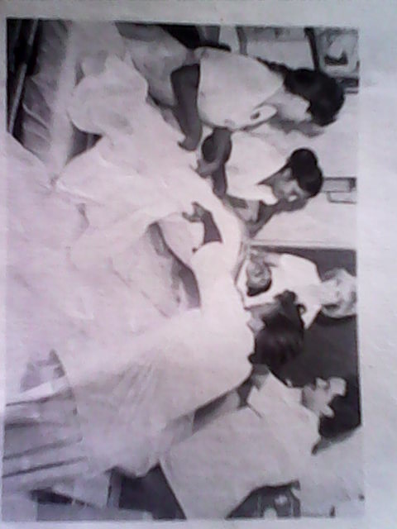

Slide 89
Con't . . .
2. Three-Carrier Lift Method
Explain the procedure to the pt.
Have the stretcher at right angle to the end of the radiographic table.
Lock the wheels.
Slide the pt to the edge of the stretcher.
One person place his arms under the Pt's head and neck.
The other, places his arms under the buttocks.
The 3rd person places his arms under the legs and ankles.
Bend the knees, back straight then lift the pt.
Walk together to the table.
Gently place the pt on the table or stretcher.

Slide 90
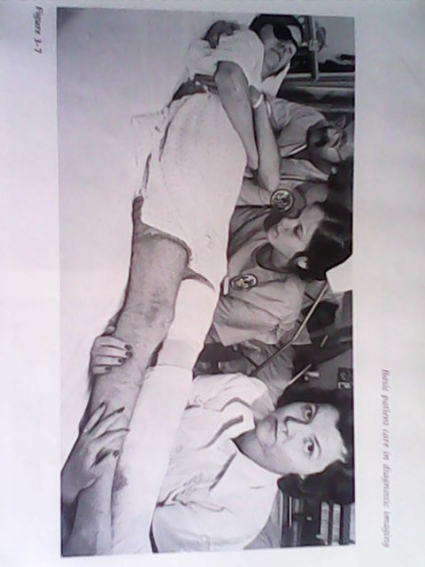

Slide 91
Positioning the Pt for diagnostic imaging examinations
If a pt is to stay for a long period of time on the radiographic table he/she must be in a normal alignment and comfort to maintain normal physiologic functioning.
Some of the protective, diagnostic and treatment positions are:-

Slide 92
Con…..
1. Supine position
– pt lies flat on his back. Head and neck should be
supported.
2. protective side-laying position
– Pt lie on either side with a pillow support under the head and neck.
– This position prevents lateral flexion of the neck, inward rotation of the arm and femur.

Slide 93
      3. protective prone position - Pt lie facing down.
    4. Fowler’s position
    - Pt semi sits with his head raising from 45 – 60 angle
5. Semi - Fowler’s position
- Pt’s head is raised from 15-30 angle.
- This position is used for a pt with respiratory distress.
6. Sim's position
- Pt lies on either his left or right side.
      - The bottom arm is flexed forward and the top
      arm is extended and placed behind the body.
- This position is useful for imaging of the lower bowel
E.g. During Barium Enema
.

Slide 94
7. Trendlenburg position (shock position)
- The table is inclined with the Pt's head lower than the rest of the body to facilitate venous return to the brain

Slide 95
Patients with Intravenous Infusion
if the clothing must be changed follow the following steps.
    The clothing should be slipped off the unaffected side first.
    Next, carefully slide the sleeve of the unaffected side over the IV tubing catheter.
    Then over the container of fluid.
when replacing the Pt's gown the steps are :-
    First place the sleeve on the affected side over the container of fluid, then over the tubing and onto the arm with venous catheter in place.
    Rehang the bottle of fluid.
Always keep the bottle of fluid above the infusion site to prevent blood from flowing into the tubing.

Slide 96
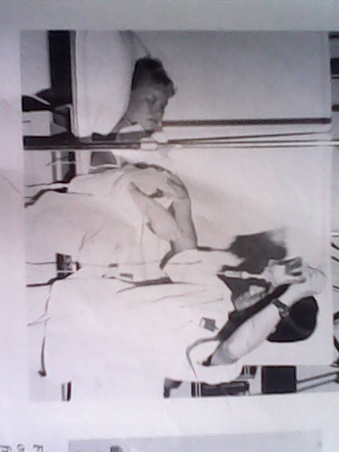

Slide 97
Prevention of Decubitus Ulcers
Decubitus ulcer is a bed sore that is open; often infected on bony prominences.
The areas most susceptible to decubitus ulcer are: the scapula, the sacrum, the trochanters, the knees, and the heels of the feet.
The RT must change the position of pt who is lying for a long period of time on the radiographic table. This is done every 30min-2hrs.
Pressure should be kept off hips, knees, and heels by placing a pillow under the pt.

Slide 98
CASTS
Pt often comes to radiology dept with a plaster cast.
A fresh cast contains water and can be compressed.
Compression may produce pressure on the pts. skin, this may produce Decubitus ulcer.
A cast that is tight may cause circulatory impairment or compression of a nerve.
To prevent the above hazards the RT should move a cast with care:-
        Avoid grasping a cast with your fingers, because this may produce indentation.
        Support the cast at the joints when moving.
        Move the casted extremity as a whole unit.

Slide 99
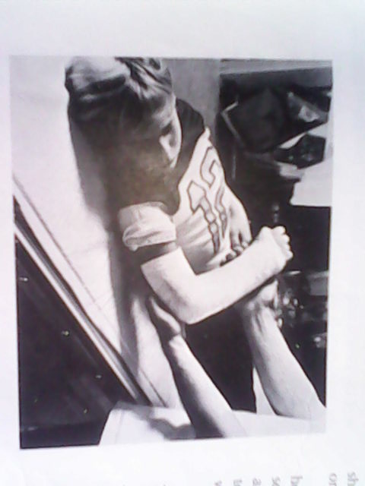

Slide 100
THANKS

Slide 101
CHAPTER FOUR
VITAL SIGNS AND OXYGEN ADMINISTRATION

Slide 102
Introduction
Taking pt’s vital sign (cardinal sign) is important part of
physical assessment.
Vital sign includes :- temp, pulse, respiration and blood pressure.
Changes in vital signs from the normal value can be an indication of a problem.
The RT must use accepted normal values for a patient in his Pt’s age group as baseline information.
N.B The human brain cannot function for longer than 4-5min.
without an adequate o2 supply.

Slide 103
At what time should the RT take vital sign?

Slide 104
MEASURING VITAL SIGN
The RT. Should take vital sign: -
    1. During invasive diagnostic procedures,
    2. Before and after the pt. receives medication,
    3. Any time the Pt’s general condition suddenly changes.

Slide 105
1. TEMPERATURE
Is the physiologic balance b/n heat produced in the body and heat lost to the environment
It must remain stable for body’s cellular and enzymatic activity to remain efficient.
When the body’s metabolism is increased, more heat is produced.
What is the normal value of body temperature?

Slide 106
Con’t . . .
37⁰c or 98.6⁰F
environmental temp., time of day, age, wt., physical exercise, disease and injury.
3 months - 3 yrs = 37.2⁰c - 37.7⁰c,
5yrs -13yrs is = 36.7⁰c - 37⁰c.
A variation of 1⁰c above or below average is not abnormal

Slide 107
What Is fever?

Slide 108
Fever
body temperature is elevated above normal limits.
indicates a disturbance in the heat-regulating center of the body.
Persistent fever can cause irreparable damage to the (CNS).

Slide 109
Con’t . . .
Symptoms of fever are:
      a. Increased pulse and respiration rate
      b. General discomfort
      c. Flushed(redness) dry skin that feels hot to the touch
      d. Chills (occasionally)
      e. Loss of appetite.

Slide 110
MEASUREMENT OF TEMPERATURE
1. Oral temperature - is taken by mouth, under the tongue;
- average temperature reading here is 37⁰c.
2. Axillary temperature - here is 36.4⁰c-36.7⁰c.
3. Rectal temperature - is taken at the anal opening to the rectum;
- average temperature here is 37.5⁰c

Slide 111
Con…..
The reading will vary depending on where it is measured.
Because of this, the measurement must be specified when the reading is reported:
      A Rectal temp. of 99.6ºF is written as 99.6 R;
      An Oral temp. of 98.6⁰F is written as 98.6 O;
      An Axillary temp. of 97.6⁰F is written as 97.6 Ax

Slide 112
THE CLINICAL THERMOMETER
Is a tube-shaped glass that contains mercury in a bulb at one end.
The END with the BULB is placed in to the mouth, rectum or armpit.
When the mercury is exposed to heat, it rises in the tube.
Numbers inscribed on the tube indicate the amount of heat in the body at that location.
A thermometer must be resterilized for each Pt.

Slide 113
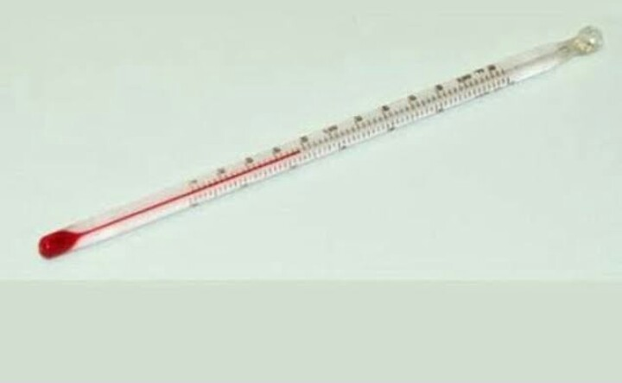
THERMOMETER

Slide 114
1. TAKING AN ORAL TEMPERATURE
The mouth is most accessible and often the most convenient site for measuring body temp.
You must not use oral thermometer for a Pt. who is unable to hold the thermometer with his lip.

Slide 115
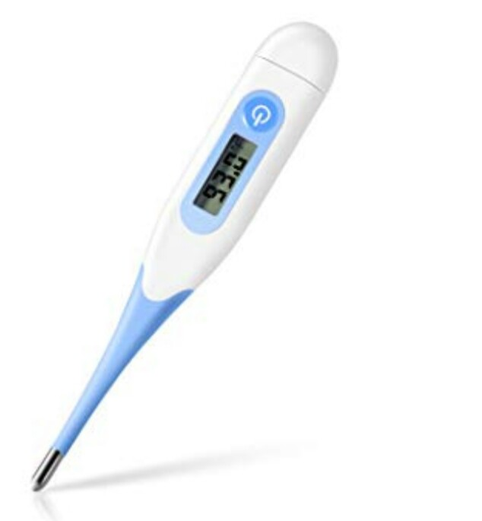

Slide 116
Con’t . . .
Procedure when using oral thermometer:-
      Obtain an oral thermometer that has an elongated tip.
      Shake the thermometer down to a mercury reading of 35⁰c.
      Wash your hands.
      Place the thermometer under Pt’s tongue,
      The Pt. must close his lips over the tip of the thermometer,
      Leave it in place for 3-5 minutes.
      Finally, remove it, whip it with a tissue, and read it.
When reading a thermometer, hold it at eye level by the blunt end
Observe where on the marked scale the mercury stops; this is the temperature to be recorded.

Slide 117
2. TAKING AN AXILLARY TEMPERATURE
This is the least accurate but the safest method of measuring body temperature because it is non invasive procedure.
To take an axillary temperature an oral thermometer with a rounded tip will be used.

Slide 118
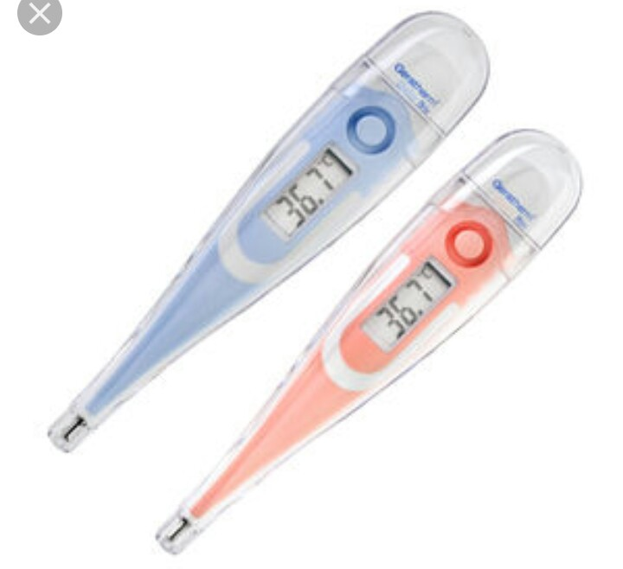

Slide 119
Procedure:-
  Wash your hand and shake the thermometer down,
  Dry the Pt’s armpit with a paper towel or a dry wash cloth.
  Lift the Pt’s arm and place the thermometer to the center of the armpit,
  Place the arm down tightly over the thermometer,
  Leave the thermometer in place for 5-10 min.
  Finally, remove it, wipe it, read it and put it in its proper place.
A child’s arm must be gently held in place until the thermometer has registered.

Slide 120
3. TAKING A RECTAL TEMPERATURE
This site is the most reliable measurement of body temp.
Don’t use rectal thermometer if the Pt. is a restless or if the Pt. has rectal pathology such as tumors or hemorrhoids.
Don’t use an oral thermometer to take a rectal temperature .

Slide 121
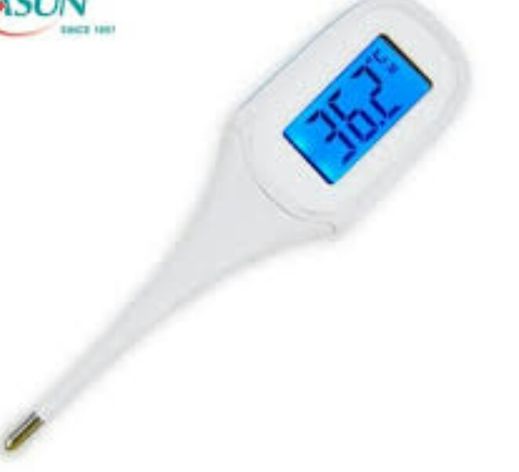

Slide 122
procedure:-
    Wash your hands and don(wear) clean gloves
    Have the Pt. turn on his side to assume the Sims's position
    Lubricate the tip of the thermometer with a lubricating jelly.
    Gently insert the tip of the thermometer in to rectum about 4cm
    Hold it in place for 2-3 min.
      Remove the thermometer and return the Pt. to a comfortable position
      Wipe the thermometer with a tissue, read it and place with the soiled rectal thermometers.
      Finally remove your gloves and wash your hands

Slide 123
2. PULSE
As the heart beats, blood is pumped in a pulsating fashion in to the arteries.
where arteries are superficial, the pulse can be felt .
The average pulse rate in an adult is between 60-90 beats/min in a resting state.
infant -120 beats /min.
A child 4-10yrs - 90-100 beats/min

Slide 124
Con’t . . .
Areas of the body where pulse can be detected easily are:-
  1. Apical pulse - over the apex of the heart
  (heard with a stethoscope.)
  2. Radial pulse - over the radial artery at the wrist, at the base of
  the thumb.
  3. Carotid pulse - over the carotid artery, at the front of the neck.
  4. Femoral pulse - over the femoral artery, in the groin.
  5. Popliteal pulse - at the posterior surface of the knee joint.
  6. Temporal pulse - over the temporal artery in front of the ear.
  7. Dorsalis pedis - at the top of the feet
  8. Posterior tibial - on the inner side of ankles
  9. Brachial pulse - above the elbow at the antecubital fossa.

Slide 125
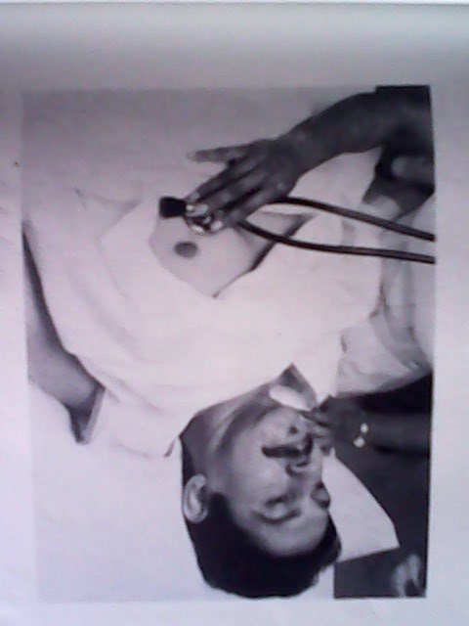
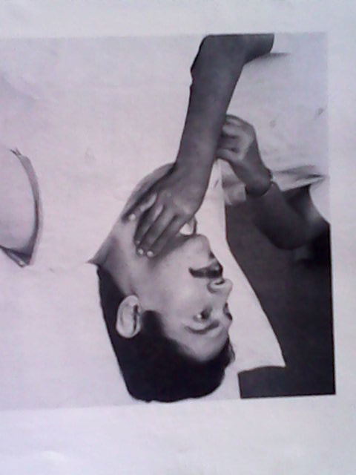
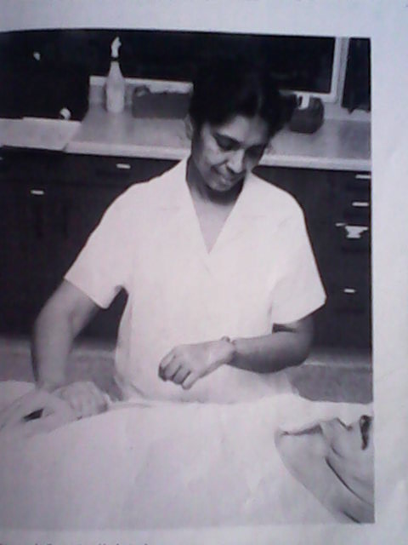
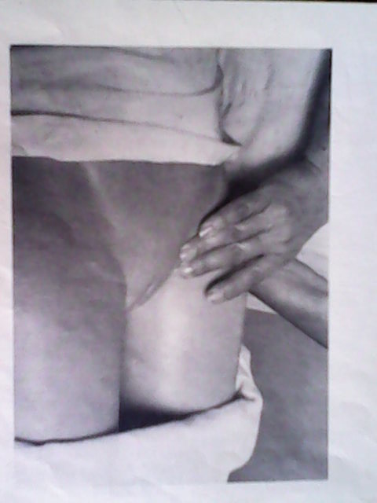

Slide 126
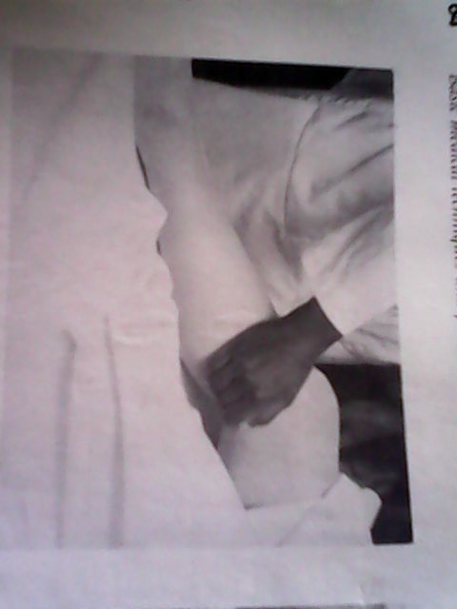
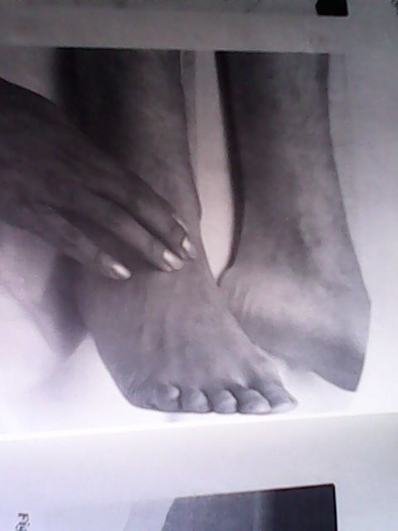
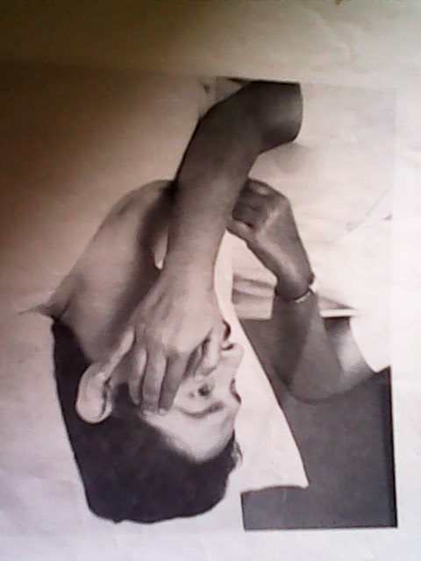
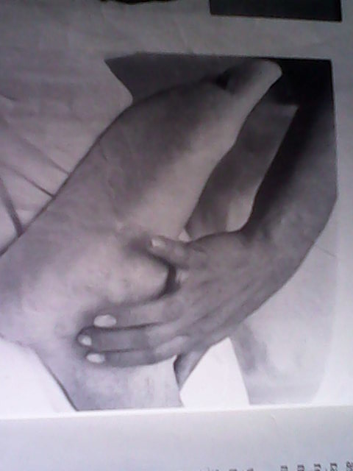

Slide 127
Reading assignment
Pulse rate is rapid if the blood pressure is low and slower if the blood pressure is high. Why?

Slide 128
Con't …
ASSESSMENT OF THE PULSE
The pulse rate is a rapid and relatively efficient means of assessing cardiovascular function.
Tachycardia - abnormally rapid heart rate (over 100 beats/min.),
Bradycardia - abnormally slow heart rate (below 60 beats/min).

Slide 129
Con't …
Radial pulse is the most accessible and convenient site in adult Pt.
Pulse must be counted for one full minute .
If there is any irregularity of radial pulse or if it is inaccessible, the apical pulse must be taken.
For infants and children, the apical pulse is the most accurate .
When pulse rate is being assessed, the strength and regularity of the beat and number of beats per min. must be reported.
The normal rhythm of the pulse beat is regular, with equal time intervals between beats.
The pulse should not be obliterated by the pressure of the fingers.

Slide 130
Con't …
If the beat is irregular, unusually rapid or slow, or weak it must be reported to the physician.
To assess pulse, one needs a watch with a second hand and a pad and Pencil to record the findings.
For monitoring apical pulse, a stethoscope is necessary.
To assess radial, femoral, carotid, popliteal, pedal and temporal pulses, wash your hands and lightly place your index and middle finger flat over the artery.
Don’t press too hard, or your finger will compress the artery and the beat won’t be felt.

Slide 131
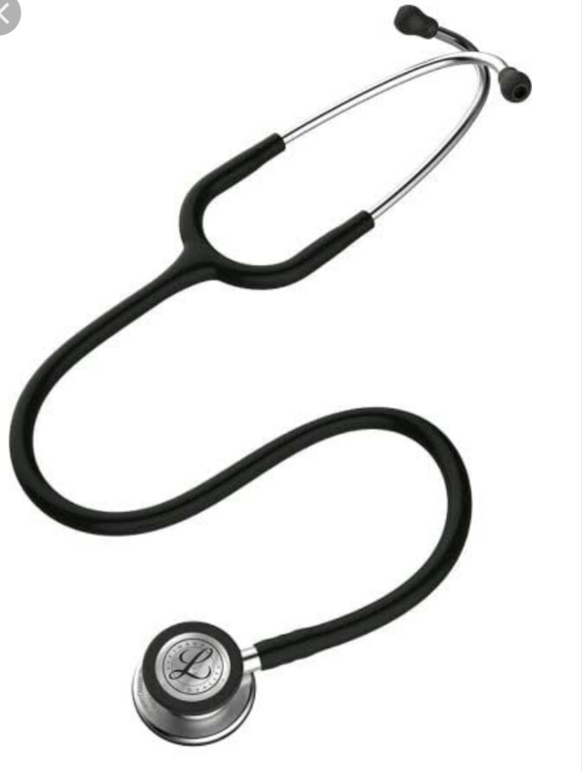

Slide 132
Con't …
Don’t use the thumb when counting the pulse rate.
To assess the apical pulse place the bladder of the stethoscope at the 5th intercostal space 5cm from the left sternal margin (nipple of the breast).
If the beat cannot be heard, move the stethoscope slightly in every direction until you can hear it.
Count the beats for 1min.
Assess the beats for regular rate and rhythm.
Finally remove the stethoscope, wipe the earpieces and bladder with alcohol then wash your hands and record the pulse rate.

Slide 133
3. RESPIRATION
It is an act of breathing.
It is the exchange of oxygen and C⁰2 between the external environment and the blood.
The average rate of respiration (one inspiration and one expiration) for adult man/women is = 10-20 breaths/min.
For an infant (birth-1yr.) = 30-60 breath/min

Slide 134
Respirations <10 breaths/min. for an adult may result in :-
- cyanosis (bluish discoloration of the skin),
- apprehension (suspicion or fear)
- restlessness and
- change in level of consciousness
because of inadequate supply of ⁰2.
Normal respirations are quiet, effortless and uniform.
Medication, illness, exercise or age .
Dyspnea - difficulty in breathing.

Slide 135
ASSESSMENT OF RESPIRATION
The rate, depth, quality, and pattern should be observed.
The chest wall should be observed for symmetrical movement.
Sign of respiratory distress - Abdominal, intercostal or neck muscle involvement in breathing.
Other signs of respiratory distress in adult are:-
- need a sitting position to breath easily or
- to lean forward or
- to place the arm on the knee. . .

Slide 136
Infants with respiratory distress will have:-
- retractions of the intercostal spaces of the ribs,
- sternal retraction,
- nasal flaring and cyanosis.
During respiratory assessment the RT should observe for cyanosis of the skin, mouth, gums, nail beds and earlobes since these are indicators of respiratory distress.

Slide 137
Con't …
Noisy respiration should also be noted. (wheezes)
Abnormal respiratory patterns are described as:-
- rapid, shallow, labored, regular or irregular.
During assessment of respiration the Pt. must be in a quiet state and unaware that his respiration is being assessed.
The most convenient time to count respiration is immediately following the pulse count.
The respirations are counted by observing the rise and fall of the pt’s chest for one full min.

Slide 138
Use the abbreviation P for pulse and R for respiration
Ex. P 80= pulse rate of 80 beats/min.
R 20= 20 resp. /min.
Abnormality should be recorded as for e.g.:
-P96, weak and irregular;
-R26, labor and noisy

Slide 139
4.BLOOD PRESSURE
Is the force exerted by the blood on the walls of the vessels as it is pumped by the heart.
The instrument used to measure BP is called SPHYGMOMANOMETER.
Two numbers, read in mm Hg are recorded when reporting BP:
systolic pressure and diastolic pressure.

Slide 140
The systolic reading is the highest point reached during contraction of the Lt. ventricle
Diastolic pressure is the lowest point to which the pressure drops during relaxation of the ventricles.
age, sex, physical development and health status.
The normal systolic pressure in men/women ranges from 110 mm Hg-140mmHg
The normal diastolic ranges from 60mmHg-80mmHg

Slide 141
Con't …
Physiologic factors that may increase Bp are:
      Increased cardiac output,
      Increased peripheral vascular resistance,
      Increased blood volume,
      Increased blood viscosity, and
      Decreased arterial elasticity.
NB – BP decrease as the above elements vice versa.
Hypertensive if his systolic BP is consistently greater than 140 mm Hg and diastolic BP is consistently > 90 mm Hg
Hypotensive if his systolic BP is < 90 MM Hg.

Slide 142
EQUIPMENT NEEDED TO MEASURE BP.
There are two types of sphygmomanometers:-
      1. Mercury manometer
      2. Aneroid manometer

Slide 143
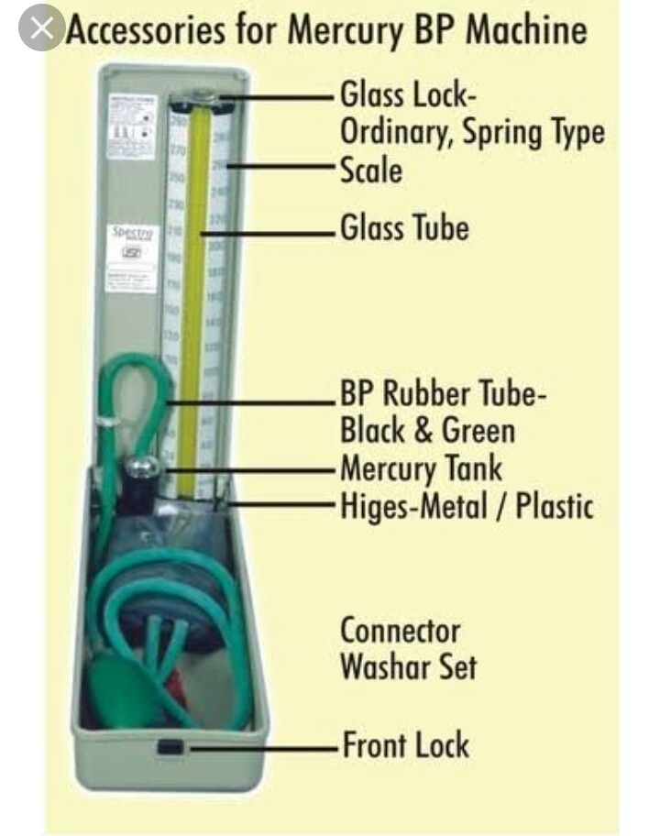

Slide 144
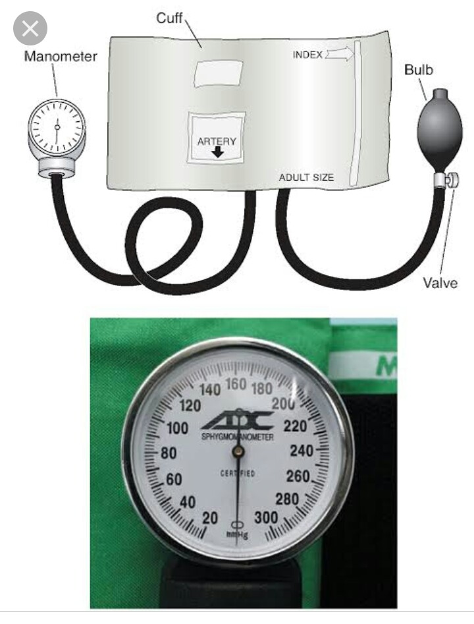

Slide 145
The mercury manometer is the most accurate of the two but less convenient to use.
The aneroid manometer needle should point to zero before the bladder of the cuff is inflated.
A stethoscope is needed with the sphygmomanometer

Slide 146
MEASURING BP
The Pt. Should be sitting in a chair with his arm supported or in a supine position.
The room should be as quiet as possible to facilitate hearing the pulsations.
Place the deflated cuff evenly around the pt’s upper arm above the elbow and place the bell or bladder of the stethoscope over the brachial artery
place the earpieces of the stethoscope in your ears,
Tighten the thumbscrew of the pressure bulb, and
Pump the bulb until it reaches 180 mmHg or until you are no longer able to hear the pulse beat.
Open the valve slowly and allow the mercury or pointer to fall,
Listen carefully for the pulse beat to begin, and

Slide 147
Con't …
Take the reading at the level of mercury or pointer where it is first heard.
The first reading will be the systolic reading.
Continue to listen until the pulsation becomes soft or quiet. This is the diastolic reading.
BP is recorded as: For e.g. If the systolic reading is 120 and the diastolic reading is 80, it is written 120/80 and is read “one twenty over eighty”.

Slide 148
OXYGEN THERAPY
Adequate ⁰2 supply is essential to life. So, the supply from the external environment must be constant.
When pulmonary function is disturbed, the level of ⁰2 in arterial blood becomes inadequate to meet the patient’s physiologic needs.
Hypoxemia - abnormal low level of oxygen in the blood .
Hypercapnea – a greater than normal level of CO₂ in the blood

Slide 149
HAZARDS OF ^{O}2 ADMINISTRATION
^{O}2 supports combustion; therefore, care must be taken to prevent sparks or flames where ^{O}2 is being administered.
Smoking is prohibited in rooms where ^{O}2 is in use.
Varying degrees of ^{O}2 toxicity may result from inhalation of 100% ^{O}2 for longer than a few hrs.
^{O}2 should always be administered at the lowest possible dose that achieves desirable results.
Special care must be taken when ^{O}2 is administered to pts with chronic respiratory disease.

Slide 150
DELIVERY SYSTEM
1. Low-flow system - which utilizes ^{O}2 mixed with room air
2. High-flow system - to supply high concentration of ^{O}2, up to 100% ^{O}2 by using face masks (ICU).

Slide 151
1.LOW-FLOW SYSTEM
Nasal cannula -1-6 LPM is prescribed for adult, 1/4-1/2 LPM for children.
Nasal catheter: A French-tipped catheter is inserted in to one nostril until it reaches the oropharynx.
It is used to deliver a moderate to high concentration of ^{O}2 (1-6 LPM).
low flow masks : Is used to deliver ^{O}2 for short period of time.
- It should be run at no less than 5 LPM to flush out CO₂ from the mask.

Slide 152
2. HIG H -FLOW SYSTEM
Face masks are usually used to administer high-flow concentration of oxygen.
The high flow mask include
    Non rebreathing mask - which, if correctly used, may supply
    100% ^{O}2.
    Partial rebreathing mask – which may deliver 60 to 90% ^{O}2.
    Aerosol mask – which provides 60 to 80% ^{O}2
    Venturi mask – which limits ^{O}2 to 24 to 50%
    oxygen tent – when there is a need for humidity and higher
    concentration of ^{O}2

Slide 153
The end ! ! !

Slide 154
CHAPTER FIVE
FIRST AID AND EMERGENCIES IN DIAGNOSTIC IMAGING

Slide 155
Objectives
List what are emergency cases in diagnosing imaging
Define what is shock
Describe types of shock
Describe types &defintion of DM
Describe basic life suppor process
Explain what are RT action during emergency

Slide 156
SHOCK
SHOCK: Is a condition in which there is a sudden fall in Blood flow
to viral organs and inadequate supply of ^{O}2 to the brain.
CLASSIFICATION /TYPES/ OF SHOCK
Hypovolemic stock – Is caused by an abnormally low volume of
circulating blood in the body due to hemorrhage or fluid loss.
Septic shock – Is caused by severe systemic infections and bacteremia.
(bacterial endotoxins)
Cardiogenic shock – caused by a failure of the heart to pump an
adequate amount of blood to the vital organs.
Neurogenic shock – occurs when concussion, spinal cord injury, psychic
trauma, or spinal anesthesia.
Anaphylactic shock – is the result of an exaggerated hypersensitivity
Reaction (allergic reaction) to an antigen that was
Previously encountered by the body’s immune system.

Slide 157
Con’t . . .
The common causes of anaphylaxis are: drugs, iodinated contrast agents, anesthetics, foods, insect venoms…
GENERAL (COMMON) SIGNS AND SYMPTOMS OF SHOCK.
Decreased Temp. - Cyanosis
Weak, thread pulse - Hypotension
Rapid heart beat - Skin pallor
Rapid shallow resp. - Restlessness
Falling BP
Increased Thirst - Confusion
Anxiety – Oliguria (decreased urine output)
Sweating
Cold clammy moist skin
Semi consciousness

Slide 158
SINGS AND SYMPTOMS OF ANAPHYLACTIC SHOCK:
Itching Nausea
Sneezing and coughing vomiting
The RT action during shock
Stop the radiologic procedure immediately,
Place the Pt. in a flat supine position/place the Pt. in semi-fowler’s position for cardiogenic shock.
Notify the physician and call for assistance,
If there is bleeding don glove and apply tourniquet,
Observe for respiratory distress
Check vital sign
Assist in administering ^{O}2, intravenous infusion, and medications
Don’t give to the Pt. anything to eat or drink
Be prepared to begin cardiopulmonary resuscitation during cardiogenic shock.

Slide 159
Con’t . . .
To prevent /encounter anaphylactic shock:
Keep emergency cart readily available and correctly prepared whenever iodinated contrast media (Cm) is being administered.
Before administering C.M. ask the Pt. for allergic foods, medicine, asthma, high fever, allergic skin reaction, if CM examination is done previously and reaction happened or not; if the answer is yes discuss the condition with the radiologist.
DIABETIC EMERGENCIES
Diabetes Mellitus (DM) is a chronic disease involving a disorder of CHO, protein, and fat metabolism.
The cause of DM is disturbance in the production, action or utilization of insulin.
Medical treatment of DM consists of: diet therapy, insulin injection or use of oral hypoglycemic drugs.

Slide 160
DM IS CLASSIFIED IN TO TWO TYPES:
Type I- Insulin-Dependent form
      Produce no insulin, majority of the Pts. Are young teenagers.
Type II- Noninsulin-Dependent form
      Produce less insulin than is necessary, majority of the Pts. are over weighted and middle-aged.
Note - A normal adult blood glucose level ranges from 80-115 mg/dl.
There are three complications of DM:-
    Hypoglycemia=Excess amount of insulin or inadequate diet
    Diabetic ketoacidosis= Insufficient insulin, fatty acid metabolism
    Hyperosmolar coma (Hyperglycemic, non-ketotic coma
(HHNK)= Resistance to insulin, blood glucose level > 600ml/dI

Slide 161
Con’t . . .
1. Signs and symptoms of Hypoglycemia are:
  Shaking - Cold clammy skin
  Nervousness - Blurred vision
  Dizziness and hunger - Tremor
  Slurred speech
  Diminishing level of consciousness.
The RT action during Hypoglycemia:
  Administer some type of sugar immediately;
  Call for help;
  Monitor vital sign;
  Prepare to assist with administration of ^{O}2, IV fluid, and medication.

Slide 162
Con’t . . .
2. Signs and symptoms of Diabetic ketoacidosis:,
  General weakness - Deep and rapid respiration
  Hypotension - Tachycardia
  Warm dry skin - Weak pulse
  Dry mucous membrane – Drowsiness
  Extreme thirst - Flushed face
The RT action during DKA:
  Give fluid by mouth;
  Call for help;
  Prepare to assist with administration of ^{O}2, IV fluid and medicine.

Slide 163
Con’t . . .
3. Sings and symptoms of hyperosmolar coma:
  Extreme dehydration – Extreme thirst
  Dry skin – Difficult, slurred speech
  Sunken eye – Confusion
  Increased body temp – Convulsion
  Polyuria – Coma
  Muscle twitching
The RT action during Hyperosmolar coma:
  Call for help,
  Notify, monitor vital sign,
  Prepare to administer ^{O}2, IV- fluid and medication.

Slide 164
THE THREE COMPONENTS OF BASIC LIFE SUPPORT PROCESS:
RESPIRATORY, CARDIAC FAILURE AND AIRWAY OBSTRUCTION
Respiratory failure/dysfunction: may result from airway obstruction caused by pt. position, tongue, foreign object, vomitus, disease, drug overdose, injury, or coma.
Symptoms of partially obstructed airway are:
    Noisy breathing;
    Wheezing;
    Use of muscles of the neck, abdomen or chest for breathing
    Anxiety
    Cyanosis.

Slide 165
The RT action:
    Call for help,
    Assist the Pt. to sitting or semi-follower’s position, and
    Prepare for ^{O}2 administration

Slide 166
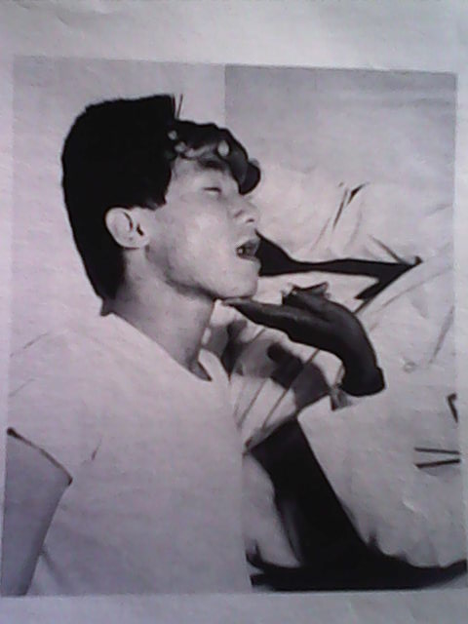
Con’t . . .
If the Pt. lapse in to complete respiratory failure, the first consideration is an airway:
Check the larynx and trachea to make certain that the Pt’s tongue, epiglottis, or a foreign body is not blocking his airway,
Next, tilt the head back by placing one hand on the Pt’s forehead; lift the chin forward with the other hand.

Slide 167
Con’t . . .
If the Pt. doesn’t resume breathing, begin mouth-to- mouth breathing (pulmonary resuscitation).
Procedures to be followed for pulmonary resuscitations are:-
  If the Pt. is adult, squeeze the nostrils together and cover his/her mouth tightly with yours, being careful not to allow air to escape.
  Inflate the Pt’s lung by giving two full breaths in succession in to his mouth.
  Allow the Pt. time to exhale these breaths as you inhale b/n each.
  Check for the rise of the pt’s chest; if you are not successful continue pulmonary resuscitation at the rate of 12 breathes per minute.

Slide 168
CARDIAC RESUSCITATION/COMPRESSION
Check for carotid pulse; if it is absent start cardiac compression immediately,
Procedure to be followed for cardiac resuscitation are :-
    Pt. must lie supine on firm flat surface
    Place yourself at the side of the Pt.
    Feel for the lower half of the sternum for adult pt.
    Place the heel of one hand on this part of the sternum
    Place second hand on top of the first hand
    Keep your elbow straight and give 15 compressions
    Lower ½ of sternum is depressed 2 inches down word with
        even rhythm.
    Then inflate the pt’s lung two more times-continue
    This rhythm must be maintained until help arrives.

Slide 169
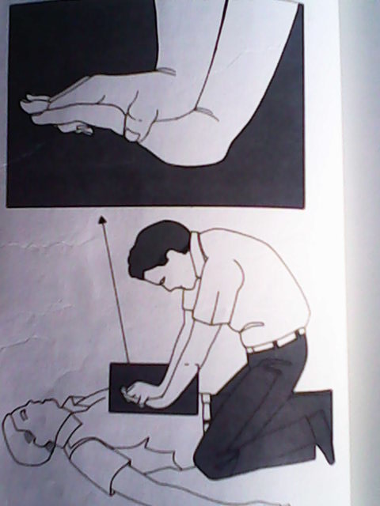
Con’t . . .
Note:-
For children, only one hand compression is used
For infant only two or three fingers are used for compression
For a pt. with communicable disease use manual resuscitation bag if it is available.

Slide 170
Cerebral vascular accident (CVA)/stroke:
Caused by – rupture of cerebral arteries into the brain or
subarachnoid space;
Signs are – dizziness, difficult speech (dysphasia), ataxia.
Fainting:
Caused by – insufficiency in the supply of blood to the brain
Signs are – pallor, dizziness, cold clammy skin;
Action to be taken – use Trendlenburg position
Convulsion seizure:
Epilepsy is the commonest cause;
Action – protect the pt. from injuring himself.

Slide 171
The End !!!

Slide 172
CHAPTER SIX
CARE OF PATIENTS WITH SPECIAL PROBLEMS

Slide 173
THE PATIENT WITH A HEAD INJURY
Head injury: refers to any injury of the skull, the brain or both, which requires medical attention.
There are two basic types of head injury:
      Open head injury and
      Closed head injury
With an open injury to the skull or meninges, the brain is vulnerable to damage and infection.
If the injury is closed (also called a blunt injury), the brain tissue may swell; the swelling is limited by the confines of the skull, and the resulting pressure may cause brain damage.

Slide 174
Con’t . . .
Any injury to the brain may cause permanent damage.
Fractures at the base of the skull (basal skull fracture) often have accompanying fractures of the facial bones;
This type of injury may result in a tear in the dura matter and a leakage of CSF may result.
The RT must consider all pts. With head injury to have accompanying cervical spinal injuries.
Precautions to alleviate potential extension of these injuries must be taken as a matter of routine

Slide 175
SIGNS AND SYMPTOMS OF HEAD INJURY
Closed injury:- varying level of consciousness ranging
from drowsiness, confusion,
irritability, and coma ;
  Loss of reflexes
  Change in vital signs
  Headache, visual disturbance, dizziness
  Gait abnormalities
  Unequal pupil dilatation
  Seizures, vomiting, and hemiparesis

Slide 176
Open injury:
Abrasions, contusions, or lacerations apparent on the skull
A break or penetration in the skull or menengis seen by inspection or on radiographs.
Basal fracture may result in leakage of CSF from the nose or ears…
Varying levels of consciousness
Sub conjunctivial hemorrhage
Hearing loss
Periorbital ecchymosis (raccoon’s eyes)
Facial nerve palsy

Slide 177
RT action:-
Keep the head and neck immobilized
Do not remove sandbags, collars, or dressings; make all radiographs with these things in place
Wear sterile gloves if in contact with open wounds
Check the pt’s vital signs frequently while working with him.
Apply a sterile pressure dressing if bleeding is profuse, and call for assistance.
Observe for signs and symptoms of hypoxia, change in level of consciousness, and respiratory arrest;
If any change occurs, notify the nurse or the physician.
Be prepared to assist with administration of ^{O}2 and other emergency treatment, if the pt’s condition requires it.

Slide 178
THE PATIENT WITH A SPINAL CORD INJURY
The spinal cord is encased in the vertebral canal, which extends down the length of the vertebral column.
The spinal column is protected by the fluid in the canal and by the vertebrae.
Injury to or severing of the spinal cord causes message transmission to cease.
The result is a cessation of motor function and partial or complete cessation of physical function from the level of damage to the cord to all parts below that level.
Most spinal cord injuries occur in the cervical or lumbar areas because these are the most mobile parts of the spinal column.
Injuries to the spinal cord usually cause permanent damage.

Slide 179
SIGNS AND SYMPTOMS:
Complete transection of spinal cord:
    Flaccid paralysis of the skeletal muscles below the level of the injury.
    Loss of all sensation below the level of injury.
    Unstable, lowered BP.
    Loss of ability to perspire below level of injury
    Bowel and bladder incontinence
    Possible priapism in male
Partial Transection of spinal cord:
    Asymmetrical, flaccid paralysis below level of injury.
    Asymmetrical loss of reflexes.
    Some sensory retention: feeling of pain, temp., pressure, and touch.
    More stable BP
    Ability to perspire intact unilaterally

Slide 180
RT action:
Monitor vital signs , with special attention to respiration
Maintain an open airway, call for help if respiration become noisy or labored
Don’t allow or request pt. to move for radiographs until diagnosis is confirmed and physician supervises moves.
Don’t move head or neck
Don’t remove sand bags, collars, anti shock garments, or other supports unless the physician advises.
Observe for signs and symptoms of shock, and prepare to help with emergency CPR.

Slide 181
THE PATIENT WITH A FRACTURED EXTREMITY
Fracture (#): is a disturbance in the continuity of a bone.
Fractures can be classified simply as open or closed.
In open fracture there is a visible wound that extends between the fracture and the skin surface.
In closed fracture there is swelling around the injured area, pain, and deformity of the limb. All or some of these symptoms may be absent and a closed fracture still be present.
During traumatic injury, pelvic fracture should be suspected always.
When there is fracture, slightest movement may initiate hemorrhage or irreparable damage to a vital organ.

Slide 182
SIGNS AND SYMPTOMS
Pain and swelling
Functional loss
Deformity of the limb
Grating sound or feel of grating (crepitus) if moved
Discoloration of surrounding tissue caused by hemorrhage within tissue (in closed #).
Over bleeding (open #).
Possible signs and symptoms of shock.

Slide 183
RT action:
Don’t move affected limb or body part unless the physician recommends
If Pt. is to be moved, inform him and enlist his support.
Do not remove splints or any type of supports
If moving a splinted limb, support the joint above and below the #, and at the joints.
The limb must be moved with support and as a single unit
If it is an open #, wear sterile gloves if in contact with wound, and use strict infection-control measures.
Observe the pt. for signs symptoms of shock, and prepare to act if that emergency occurs.

Slide 184
The end ! ! !

Slide 185
CHAPTER SEVEN
CATHETERIZATION OF THE URINARY BLADDER

Slide 186
Introduction
Catheterization of the urinary bladder refers to the insertion of a plastic, silicon, or rubber tube trough the urethral meatus in to the bladder
In the radiology dept. catheter is inserted to instill contrast media in to the urinary bladder for diagnosis. (other than for drainage of urine)
The urinary bladder is easily infected, so any object or solution that is inserted in to it must be sterile.
It is less stressful for patients if male nurses or technologists catheterize male pts., and female nurses or technologists catheterize female pt.

Slide 187
EQUIPMENT NEEDED TO PERFORM CATHETERIZATION:-
  A retention catheter (# 14 or 16 for an adult female; # 16 -#20 for an adult male)
  Antiseptic solution (savalon)
  cotton balls for cleansing
  water-soluble lubricant
  Sterile gloves
  Sterile drapes (sheet)
  Sterile forceps

Slide 188
An extra means of casting light on the perineal area is needed.
A straight catheter is a single-lumen tube;
Retention catheters have a double lumen with an inflatable balloon at one end. One lumen allows for continuous urinary drainage, or contrast administration and the other is a passageway for instilling sterile water in to the balloon through a valve.
The balloon holds the catheter in place after it is inserted in to the bladder.

Slide 189
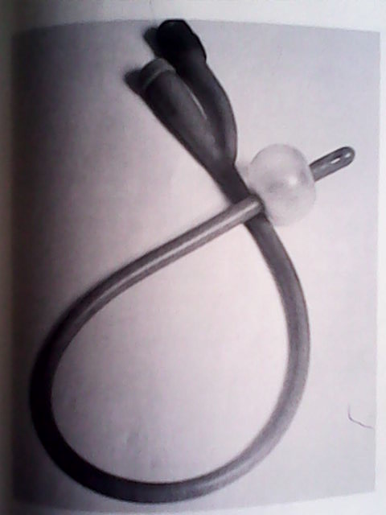
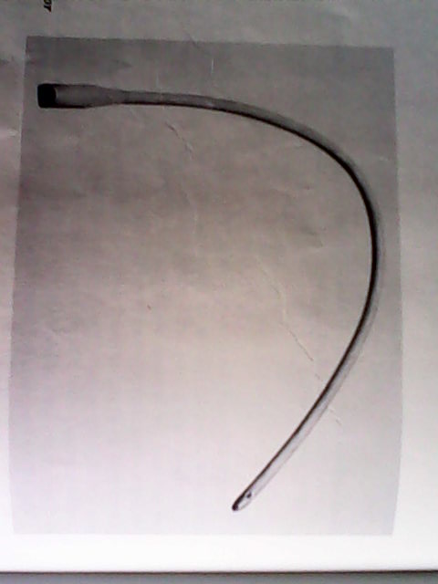

Slide 190
FEMALE CATHETERIZATION
Determine the type of catheters to be inserted
Then assemble the equipment necessary,
Wash hands
Explain and reassure the Pt. so that, there will be little if any, pain; explanation and reassurance are vital to the success of the procedure.
Provide privacy for her by using a screen or by closing the door to the procedure room.

Slide 191
STEPS FOR CATHETERIZATION:-
Position the Pt. on her back; have her flex her knees and relax her thighs
Drape the Pt. with a sheet so that only the perineum is exposed
Adjust the light so that it shines directly on the perineal area.
Open the sterile pack, which may be conveniently placed between the pt’s legs if she is cooperative and will not contaminate the sterile filed.
Put on the sterile gloves
lubricate the catheter tip
Pour antiseptic solution over all except two of the cotton balls to wipe away excess antiseptic.
Syringe containing sterile water is attached to the valve to
inflate the balloon.

Slide 192
Con’t . . .
9. With the non dominant hand, separate the labia minora
until the urethral meatus is visible.
10. Pick up forceps with one cotton ball saturated with
antiseptic solution.
11. Cleanse the distal side of the meatus with a single downward
stroke, then the proximal side with another cotton ball
and discard it.
13. Keep the non dominant hand in place, and with the dominant
hand, pickup the lubricated catheter and insert it in to the urethra.
14. Instill 5-10 ml sterile water in to the balloon.
15. Gently tug on the catheter, if there is resistance, the balloon is
properly inflated.
16. Remove soiled equipment and your gloves then wash your hands

Slide 193
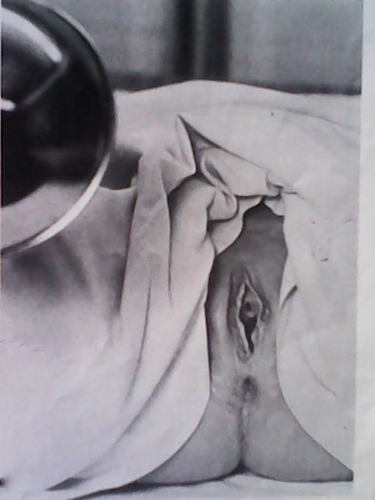
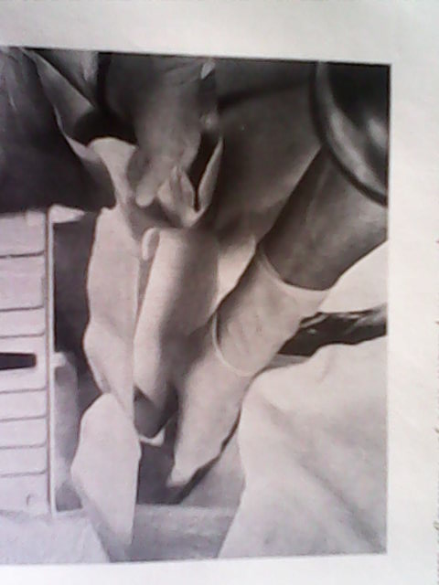
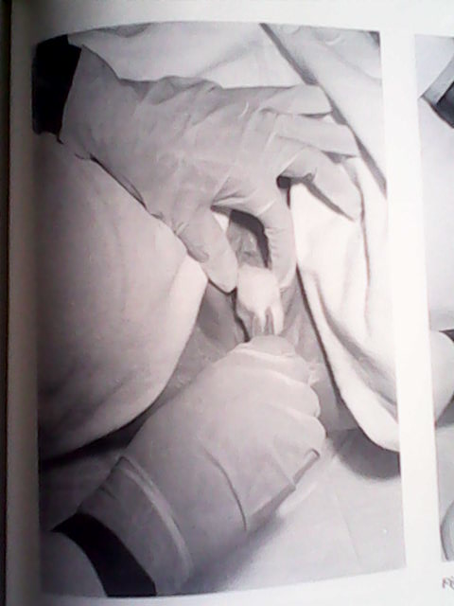

Slide 194
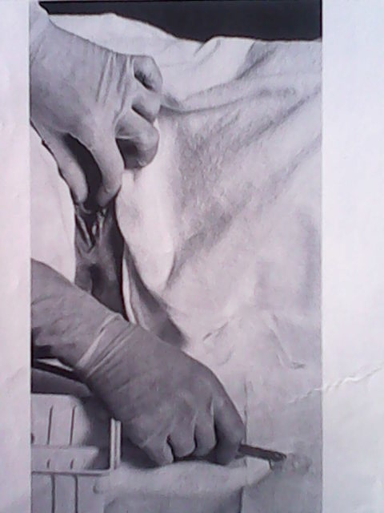
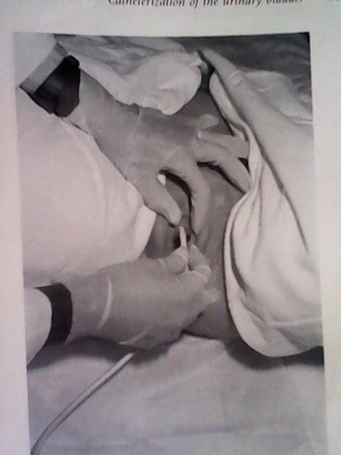
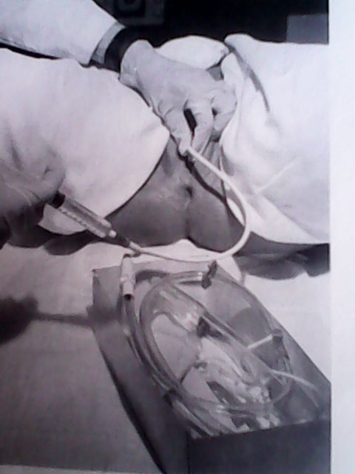

Slide 195
MALE CATHETERIZATION
The equipment needed for catheterizing males is the same as for catheterizing females, but larger catheter (# 16 - #20) is required.
The pt. is placed in a supine position with his legs slightly abducted.

Slide 196
STEPS :-
Wash hands and don gloves
Pick up the catheter and lubricate it heavily from the tip down about 12-17 cm to facilitate passage of the catheter for males than for females
Grasp the penis firmly at the shaft with the non dominant hand; slightly spread the urinary meatus between the thumb and forefinger.
Pick up forceps and with it a cotton ball saturated with antiseptic solution, cleans from the urethral meatus to the glans using circular motion.

Slide 197
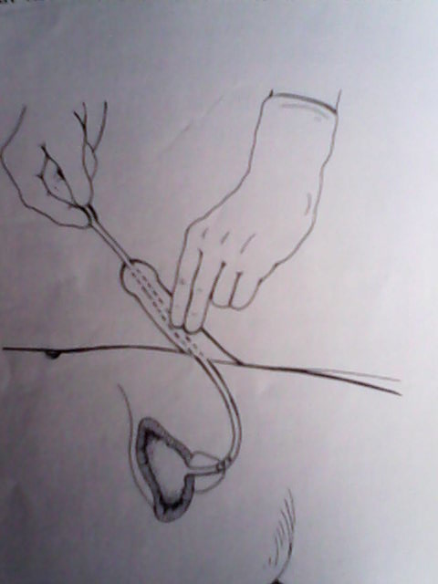
Con’t . . .
5. Repeat step 4 two more times
6. Pick up the lubricated catheter with the dominant hand and
using gentle, constant pressure, insert the catheter.
7. When the urine begins to flow, the catheter is in the bladder.
8. Follow steps 13-15 for female catheterization.

Slide 198
REMOVING A RETENTION CATHETER
Equipment's needed are: 10ml syringe, several thickness of paper toweling, non permeable disposable bag, and clean, disposable gloves.

Slide 199
STEPS:-
Uncover the Pt., remove the tape(plaster) that holds the catheter in place
Pull the sterile water from the retention balloon.
Wrap the paper toweling around the catheter and gently withdraw it from the bladder
Place the solid equipment in to the container for contaminated waste, remove your gloves and wash hands.
Whenever moving a pt. with a retention catheter in diagnostic imaging dept., care must be taken not the catheter be dislodged.

Slide 200
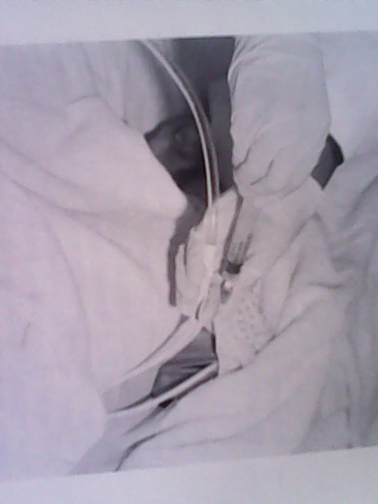
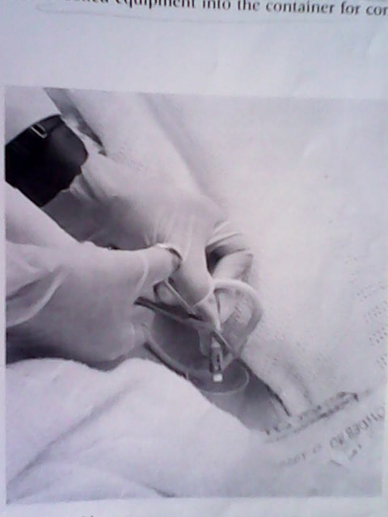

Slide 201
The end !!!

Slide 202
CHAPTER EIGHT
DRUGS USED IN RADIOLOGY DEPT

Slide 203
INTRODUCTION
Drug: Is any chemical compound that may be used or administered to humans as an aid in the diagnosis, treatment, or prevention of disease. . .
Drugs are classified as: Anti-infective, antialergic, drugs that act on the autonomic nervous system, CNS, GIT, CVS, to treat endocrine disorders. . .
ROUTE OF DRUG ADMINISTRATION
The way a drug enters the body affects the speed and intensity of its absorption and action.
The two types are:-
I. oral route
II. Parenteral route

Slide 204
I. ORAL ROUTE
  The oral route is the safest and most desirable route of drug administration when it can be used.
  It is used when the drug is not destroyed by gastric secretion and slower absorption and longer duration of drug activity is desired.
  Oral medications are available in liquid, tablet or capsule form.

Slide 205
II. PARENTERAL ROUTE
  There are several methods of parenteral (other than digestive tract) drug administration.
  Parenteral drug routes are used when rapid action is desired.
  The different parenteral procedures are :-
    Subcutaneous: injected in to the subcutaneous or loose connective layers under the skin.
    Intramuscular (IM): Through the skin and subcutaneous tissue in to the muscle.
    Intradermal: between the layers of the skin
    Intravenous (IV): in to the vein

Slide 206
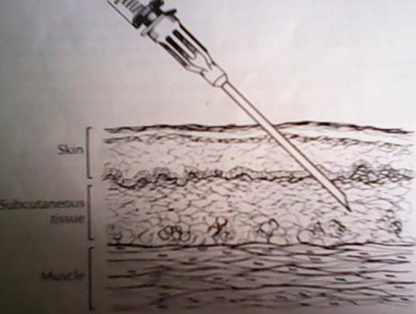
PROCEDURES FOR DRUG ADMINISTRATION
I. SUBCUTANEOUS ADMINISTRATION:
  Subcutaneous medications are given at 45⁰ angle by injection in to the tissue beneath the skin.
Equipment needed:-
  Syringe of correct size
  (~2ml amount)
  ½ inch long hypodermic
  needle
  3 alcohol wipes
  The correct medication

Slide 207
Note - Subcutaneous injections are given in the upper arm, abdomen
and anterior thighs.

Slide 208
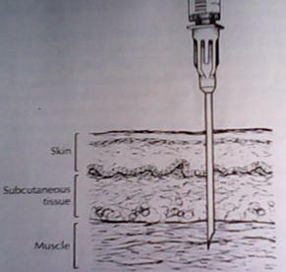
Con’t . . .
II. INTRAMUSCULAR ADMINISTRATION (IM).
  IM injections are used when prompt absorption of a drug is desired. (Large amount of drug may be administered, 1-3ml).
  The length of the needle required for IM injection is determined by the pt’s weight. (1.5 in. for adult)
Equipment needed:-
    A 3-5ml syringe
    1½ inch length needle
    Three alcohol wipe
    Correct medication
Note - The usual sites for IM injection are the upper-outer quadrant
of the gluteus maximums muscle or gluteus medius muscle;
deltoid muscle.

Slide 209
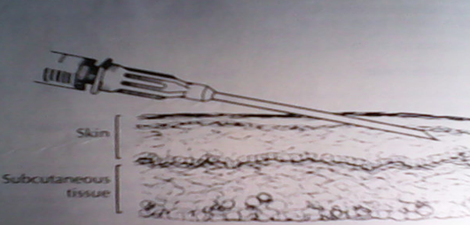
Con’t . . .
III. INTRADERMAL (INTRACUTANEOUS) ADMINISTRATION:
  Usually used for purposes of testing for sensitivity to a drug or antigen.
  They are usually given in to the dermis of the inner aspect of the forearms.
  A very short needle, abut ½ inch in length, is used.
  Explanation must be given to the pt. before injection because there is a burning pain for a brief time at the site.

Slide 210
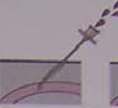
Con’t . . .
IV. INTRAVENOUS ADMINISTRATION (IV)
  This method is selected when the effect of a drug is desired immediately.
  Most drugs given in diagnostic imaging are given by this route.
  It is the most hazardous routes of drug administration
  Vital sign should always be checked during IV drug admin.
  Use surgical asepsis always during IV drug administration.
  Some IV drugs are given through a pre-existing IV infusion line.
  Mostly the antecubital vein is used for IV drug administration
Equipment needed for IV drug administration are :-
  A large syringe
  A 25- gauge needle ;1 inch in length
  4 or 5 antiseptic alcohol wipes
  The correct drug
  Sterile gloves

Slide 211
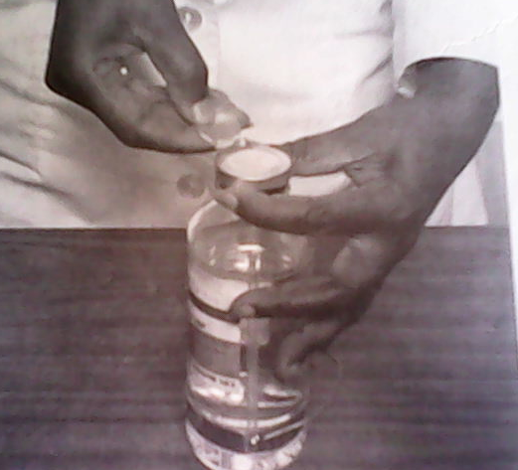
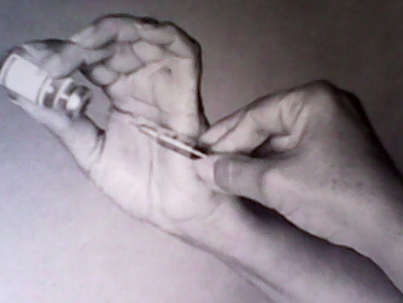
Injectable medications are packaged in Ampule and Vials form.
A Vial
  Is a glass container with a rubber stopper circled by a metal band;
  A needle is inserted through the rubber Stopper into the solution;
  The solution runs in to the syringe more quickly if air is injected in to the vial before the solution is drawn up.

Slide 212
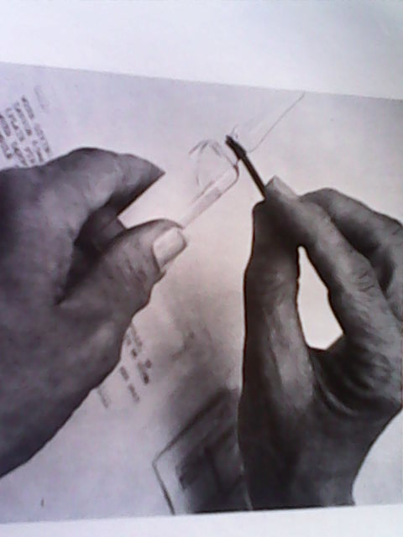
Con’t . . .
An Ampule
  Is always a single-dose container and is made entirely of glass.
  The indented area at the neck is opened by filing the neck with a small metal file.
  Never attempt to snap the top off an ampule with out protecting your hands with a sterile gauze pad.
  If all of the medication is not used, the remainder must be discarded.

Slide 213
PRECAUTIONS IN DRUG ADMINISTRATION
All drugs are potentially dangerous
The RT must know adverse reactions and contraindications for administration of a particular drug.
The RT must adhere to the “FIVE RIGHTS” of drug administration:-
      The right patient
      the right drug
      The right amount
      The right route
      The right time.

Slide 214
Con’t . . .
Other precautions that must be taken during drug administration Are:
  The pt. must be observed for adverse reaction for 30 min. after administration
  History of adverse reaction /allergic reaction to drugs must be taken before administration.
  Expiry date of a drug must be checked and if the medication is beyond the prescription date discard it.
  Two medications must not be mixed together unless this is authorized by the physician or radiologist.

Slide 215
DRUGS USED IN RADIOLOGY DEPARTMENT
Drugs used in radiology dept. will be seen to fall in to three main groups:
    Drugs to be used in preparation of the Pt.
    Contrast agents
    Drugs to be used in resuscitation

Slide 216
    1. Drugs to be used in preparation of the Pt.
Many radiological examinations require preparation of the abdomen, because feces and gases produce confusing shadow with abdominal organs.
The drugs used in evacuation of feces and gases are termed as laxatives, aperients, purgative, and cathartic (all have the same meaning):
The commonest name for drug in preparation of abdomen is laxative; it is an agent that causes evacuation of the bowels by increasing bulk, stimulating peristaltic action.
Example of laxative: castor oil
It encourage peristalsis and the breakdown and dispersal of fecal masses.
The usual dose of castor oil is 30ml (1 vial) sometimes 2 vials are needed.

Slide 217
    2. Contrast agents /medias
Contrast agents: are drugs that are administered to a pt. for
radiographic examination to enhance the contrast of
a particular structure.
There are two types of radiographic contrast agents:
      Negative contrast agent and
      Positive contrast agent
.

Slide 218
1. Negative contrast agent:
  Is radiolucent, has low-atomic number, and allows x-rays to pass through it.
  Structure that is filled with a negative C.M appear dark (black) on a radiograph and appear brighter or seen as light on fluorescent or television screen.
  Examples of Negative contrast agent are: Gases, such as º2, CO₂, Nitrous oxide and room air.
  A negative CM may be used alone such as in arthrogram or in combination with a positive CM in examination of GIT, such as barium enema to produce a double-contrast effect

Slide 219
Con’t . . .
2. Positive contrast agents:
  Are radiographic substances of high atomic number which absorb x-rays highly.
  Organs filled with a positive CM appear white (light) on a radiograph and appear dark (black) on florescent or television screen.
  The two types of positive CM used in radiography are: Barium sulfate (BaSO₄) and iodinated compounds.

Slide 220
Ba SO₄:
  Is the most frequently chosen CM for radiologic examination of the GIT.
  BaSO₄ is a white, crystalline powder that is mixed with water to make a suspension.
  It may be administered by mouth for examination of the upper GIT, by rectum for examination of the lower bowel or through tube to visualize the jejunum and ileum.

Slide 221
Con’t . . .
Contraindication of BaSO₄
Because BaSO₄ is insoluble and cannot be absorbed by the body, it must not be administered intravascularly or intrathecally.
It is also contraindicated in case of suspected perforation of the
GIT, as it may leak in to the peritoneal cavity and causes peritonitis.
It is also contraindicated in case of recent or impending abdominal surgery.

Slide 222
II. Iodinated compounds:
  Iodinated CMs are available as oil based and water soluble agents.
  Oil-based iodinated CM is limited in use and primarily used in
  lymphangiography.
  Water-soluble iodinated CMs are routinely used for examination of
  GUS (Genito Urinary System), biliary system, CV, GIT (when BaSO₄
  is contraindicated).
  They are available in liquid form.

Slide 223
Con’t . . .
Water-soluble CM are divided in to ionic and non-ionic:
  Ionic CM: The compound dissociates or separates in H₂O in to two charged particles, cation and anion; so that adverse reaction is high.
  Non-ionic CM is more soluble in H₂O and doesn’t dissociate in to changed particles; so that adverse reaction is almost none in non-ionic CM.
Contraindication: Allergic history to iodine.
Iodinated CMs are administered intravenously and orally for GIT exam.

Slide 224
3. Drugs used in Resuscitation
It has been indicated that reactions to contrast agents are possible, particularly when they are injected in to the blood stream.
To meet emergencies, the radiology dept. must have an emergency supply of various resuscitation drugs and instruments.
The drugs must always be ready on a prepared trolley during IV examinations.
Example of drugs used in resuscitation:
  Drugs which reduce allergic reactions in the body.
E.g corticosteroids - such as hydrocortisone 100mg), and
Anti-histamines - such as Phenergan and sparine
(promethazine hydrochloride).
  Adrenaline: to raise blood pressure and increase cardiac output.

Slide 225
The end !!!

