Slide 1
CHAPTER SEVEN
PROCESSING EQUIPMENT

Slide 2
Materials for processing equipment
The following factors are relevant
    The material should have no effect on the photographic properties of the solution concerned
    The material should be capable of resisting the most corrosive fluid with which it is likely to be in contact
    The period of the time during which a material is likely to be exposed to chemical action and the probable dilution of the solution concerned
    The cost of the material
    The mechanical adaptability of the material for constructional purpose

Slide 3
Processor for manual operation
General construction
  The processor consists of a large master tank which includes certain smaller tanks and divisions
      A lidded tank for the developer
      A tank or compartment, usually having a separately tapped cold water supply, which provides a means to rinse films b/n developing and fixing solutions
      A lidded tank for the fixer
      A large compartment, which its own cold water inlet- valve, in which developed and fixed films are washed

Slide 4
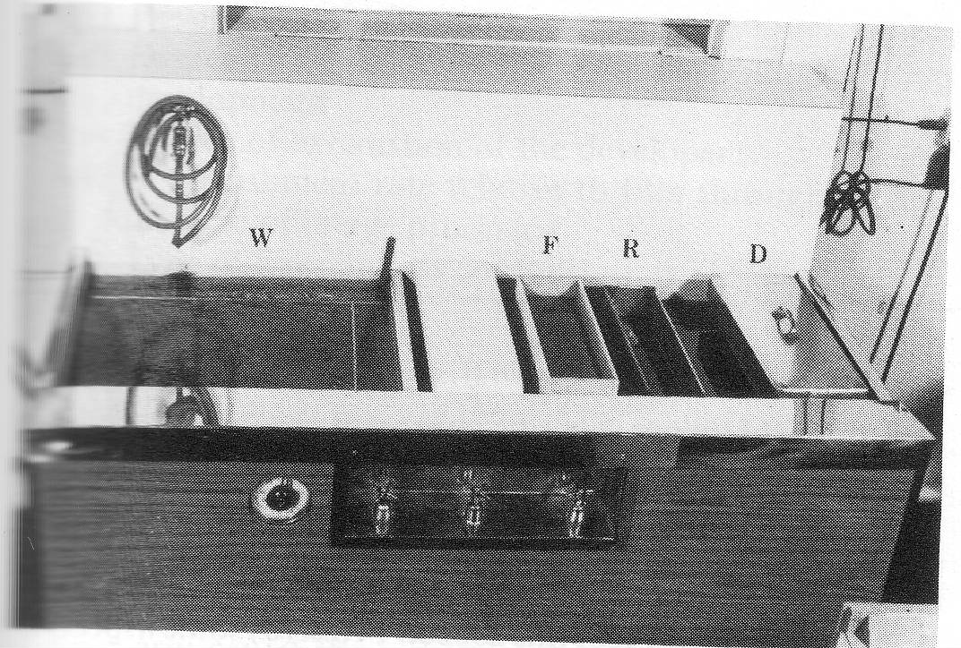
Typical manual processing unit

Slide 5
Controls
  A thermometer regulator, operating in conjugation with a thermostat and an immersion heated in water jacket has the following functions:
      To raise the temperature of the water jacket to pre-selected degree
      To maintain this temperature whilst the unit is operational

Slide 6
  The next three controls are
      Inlet valves for the rinse
      Water jacket
      wash
  There is an ON/OFF switch for the electrical supply

Slide 7
Materials
  Typically a manual processor is constructed on a strong steel, or chemically resistant iron, framework
  The internal and external faces of the master tank are made panels of polyvinyl chloride(P.V.C)

Slide 8
  The space b/n the inner and outer walls is usually filled with a substance such as expanded polystyrene
  The edges and corners of the master tank are capped with stainless steel
  The individual capacities of solution tanks in a processor vary from model to model

Slide 9
Temperature control
  In manually operated processors, the developer is the only significant solution of which the working temperature must be closely controlled
  This control is given by maintaining the temperature of the water jacket at an appropriate level
  A thermometer regulator allows the heating system of the processor’s water jacket to be in continuous operation

Slide 10
Processing Hangers
  Films are suspended for processing in metal frames known as hangers
  These are designed
      To support the film and allow it to be manipulated without handing of the emulsion
      To permit a number of film to be processed simultaneously and to keep them separate from each other during the procedure

Slide 11
  There are two general varieties of hangers
      Channel hangers
      Tension hangers
  Hanger bars and clips
      Hanger bars virtually essential accessories to the use of the channel type of hanger, since they are designed mainly to support the film during drying
      The position of the clips along the bar is adjustable so that each is appropriate for any size of radiograph
  Dental hangers: a special type of hanger is used for the processing of dental radiographs

Slide 12
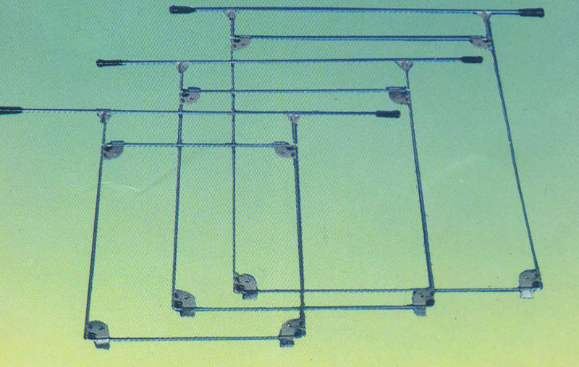
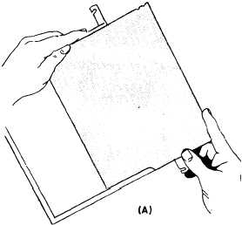

Slide 13
Processing procedures
  To process a radiograph by means of manually operated equipment requires much more time than would be taken any automatic processors
  The following is a description of the procedures to be followed
      1. The film is unloaded from its cassette

Slide 14
      2. The film is identified by means of a suitable maker, if this has not already been done before the entry of the cassette to the darkroom
      3. The film is placed in a processing hanger of an appropriate size
      4. The lid is removed from the developing tank and the loaded hanger is suspended in the solution
      5. The time is then noted from a darkroom clock---------4 minutes

Slide 15
      6. If possible, some agitation of the solution should be made by slightly raising and lowering each hanger in turn
      7. The lid of the developing tank should now be replaced
    8. When the appropriate development time has elapsed, the hanger is removed from the solution and transferred to the rinse tank ----5-10 sec

Slide 16
    9. After rinsing, hanger and film are put in the fixer for an interval of which the duration is much less critical than in case of the developer but should be at least twice the clearing time
    10 For the last ‘wet’ stage of processing, the operator transfers the radiographs in its hanger to the washing section of the processor ----15-20 minutes
    11. Finally the film is dried

Slide 17
Automatic processing
History of processing
  Manual processing -1 hours dry - to – dry
      Stir solution
      Check temperature
      Load film on hanger
      Set timer-time/temperature relationship
      Develop- agitate film
      Rinse – use acid –stop bath
      Fix -2- 3 times clearing time
      Wash - 5- 30 minutes – use wetting agent
      Dry – 20- 30 min in dust – free environment

Slide 18
  Automatic processing
  To develop, fix, wash, & dry radiographs rapidly, with highly reproducible results
    The first automatic film processor was introduced in 1942 and required 40 minutes for completion
    1942- pako – 120 films per hour
    In 1956 the first roller transport unit was introduced and cut processing time to 6 minutes
    1957 – Eastman Kodak – 15 min dry – to dry
    Processing time gradually decreased to present 45 sec. to 2 min
    Current Automatic Processor require only 90 seconds

Slide 19
Automatic processing
The automatic film processor mechanically transports exposed X-ray film through the developing, fixing, washing, and drying cycles
Automatic processing is quicker than manual processing, and it produces finished radiographs of uniform quality
A variety of automatic film processors are in use in the Navy and they can be generally classified as small or large

Slide 20
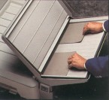
AUTOMATIC DARKROOM PROCESSORS

Slide 21
Large Automatic Film Processor
  This processor will be located in the darkroom
  The x-ray film must be inserted in the processor under safelight conditions
  Large automatic processors can be equipped with dry light loaded, eliminated the need for a darkroom

Slide 22
PROCESSING UNIT
Chemistry
Developer – 20 – 25 sec.
  Reducing agents
      Electron donner (continues latent image formation process)
      Phenidone - rapidly produces fine detail shades of gray
      Hydroquinone - slowly produces heavy densities
  activator - sodium carbonate, produces alkaline pH for other chemicals to function, swells gelatin
  Restrainer - potassium bromide, decreases reducing agent activity, prevents chemical fog

Slide 23
  Preservative – sodium sulfite, controls oxidation, buffering agent
  Hardener – glutaraldehyde, controls gelatin swelling to minimize risk of physical damage
  Solvent – water, dissolves chemicals and dilutes them to proper concentration

Slide 24
Fixer - 20 sec.
  Clearing agent - ammonium thiosulfate, removes undeveloped silver halides from emulsion
  Activator - acetic acid, provides acidic pH for other chemicals to function, stops reduction
  Hardener - potassium alum, hardens emulsion to minimize risk of physical damage
  Preservative - sodium sulfite, maintins pH
  Solvent - water, dissolves chemicals and dilutes to proper concentration

Slide 25
SIX SUBSYSTEMS
    Transport
    Replenishment
    Recirculation
    Temperature control
    Wash
    Drying

Slide 26
PROCESSING UNIT
Systems/Functions
Transport
  Purpose is to move film through developer, fixer, wash, and dryer at a controlled and consistent speed without damage.
  Three subsystems
    Racks – series of rollers held together by end plates, one per tank.
    Crossovers- smaller series of rollers to guide film from tank to tank.
    Drive assembly-motor and worm gear to rotate rollers

Slide 27
  Transport system determines the length of time film spends in each tank (along with depth of tank)
  Film should be fed crosswise whenever possible
    New chemicals are pumped into tanks based on per inch of film and assumed crosswise orientation
  Produce uniform, vigorous agitation of chemicals at film surface - promotes uniform processing
  Squeegee action of last few rollers in each section removes most residual chemicals

Slide 28
Replenishment
  Replaces chemicals in the processor depleted through reactions, oxidation, & evaporation
  Types
    Volume (for high-volume processors) activated at entrance by entrance rollers.
        Developer - 4-5 ml per inch (1.5-2.0 ml per cm) of film•
        Fixer - 6-8 ml per inch (2.5-3.0 ml per cm) of film
    Flood (for low-volume processors) - Timer-activated
  Chemicals - fixer is same & developer is same except no restrainer
  Mixing - according to recommendations

Slide 29
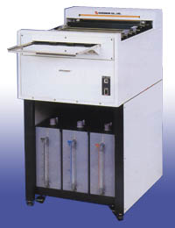
Recirculation
    Stabilize temperature
    Agitation solution
    Mix chemistry
    Filter solution

Slide 30
Temperature control
  Maintains all 3 solutions at compatible temperatures in conjunction with recirculation system
      Developer - temperature is extremely critical for proper chemical action
          92-96° F (33-35° C) for a 90 sec. processor
          83-86° F (28-30° C) for a 2 min. processor
      Fixer - not as critical - generally about same as developer
      Wash - may be internally controlled by developer solution or externally controlled by a mixing valve

Slide 31
Wash - 20 sec.
  Removes fixer & developer from film
  Temperature is generally about 5° F lower than developer temperature
  Flow rate of 1-2 gal. /minute, continuous overflow
Dry - 25-30 sec.
  Consists of blower, heating element, tubes (like a big hair dryer)
  Hot air (110-150° F) forced across both sides of film as it exits processor to set final hardening of emulsion & seal super coat

Slide 32
Thank you

