Slide 1

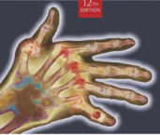
Radiographic Positioning
MeRT2122
(10 ECTS)
Hailegebriel Shiferaw, MRT, PH, MSc
Department of Medical Radiology Technology
Hawassa University
4/23/2020

Slide 2
Radiographic Positioning
UNIT SIX
SKULL
4/23/2020

Slide 3
Objectives
At the end of these lesson you should have to able to;
Given diagrams, radiographs, or dry bones, names and describe the bones of the skull.
State the criteria used to determine positioning accuracy on the radiographs of the skull, petrous portion and mastoids
Evaluate radiographs of the skull in terms of positioning, centring, image quality, radiographic anatomy and pathology.
4/23/2020

Slide 4
Skull
Radiography of the skull requires a good
understanding of all related anatomy.
Location => superior to the vertebral column
=> Rest on the 1st cervical
vertebra
It is complex structure
Composed of 22 bones
1) Cranial bones => 8
2) Facial bones => 14
4/23/2020

Slide 5
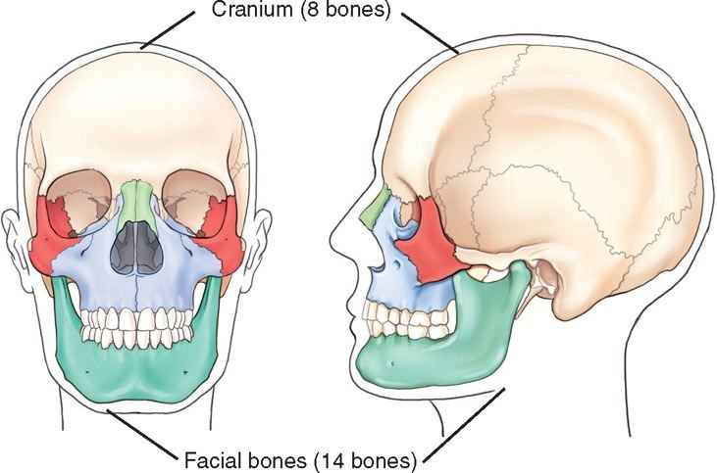
Anatomy of the skull …cont’d
4/23/2020

Slide 6
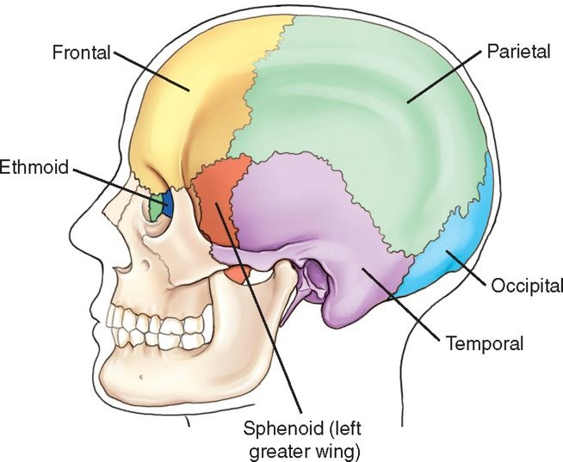
Anatomy of the skull …cont’d
4/23/2020

Slide 7
Cranial bones includes:
Frontal bone (1)
Parietal bones (2)
Temporal bones (2)
Occipital bone (1)
Ethmoid bone (1)
Sphenoid bone (1)
4/23/2020

Slide 8
Cranial bones …cont’d
Some of the functions of cranial bones are:
Encloses & protects the brain, blood vessels & nerves of the head.
Use as a brain box b/c the brain actually resides inside the cranium in the cranial cavity of fossa.
Outer serves as muscle attachments that allow for the movement of the head.
4/23/2020

Slide 9
Cranial bones …cont’d
Cranium divided in to the calvarium & floor.
1. Calvarium (skull cap) consists of 4 bones.
=> parietal bones
=> Occipital bone
=> Frontal bone
Those bones are thin, but their curved shape makes them strong.
4/23/2020

Slide 10
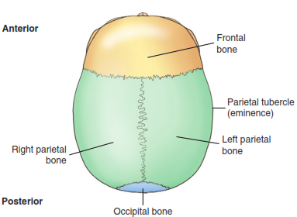
Calvarium
4/23/2020

Slide 11
Cranial bones …cont’d
2. Floor of the cranium is also formed by 4
bones
=> Temporal bones
=> Ethimoid bone
=> Sphenoid bone
They are irregular in shape
4/23/2020

Slide 12
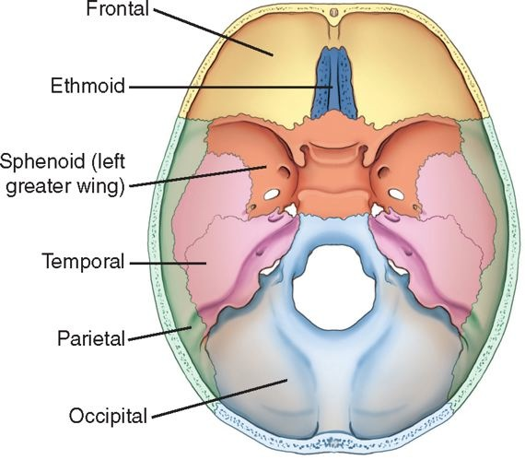
Floor
4/23/2020

Slide 13
Patient preparation
Before undertaking skull radiography, the following specific considerations should be made:
Ensure that all metal objects are removed from the patient, e.g. hair clips and hairpins.
Bunches of hair often produce artefacts and thus should be untied.
The patient should be provided with a clear explanation about the examination.
Restrict movement of the patient as well as the cassette during exposure.
4/23/2020

Slide 14
Indications for cranial bone radiograph
Fracture
Foreign Body
Osteomyelitis
Neoplasm
ETC …
4/23/2020

Slide 15
Radiographic positioning of the Skull
Lateral – erect
This position used for a cooperative patient.
Difficult to weak patient
4/23/2020

Slide 16
Technical consideration
Film size 24 X 30 cm Cross wise
Use grid
FFD 100 cm
KVP & mAS depends on machine out put and department protocol
Use gonadal shield specially for child & adults of reproductive age group.
4/23/2020

Slide 17
Position of patient and cassette
The patient sits facing the erect Bucky and the head is then rotated.
The MSP is parallel to the Bucky and the inter-orbital line is perpendicular to it.
The shoulders may be rotated slightly to allow the correct position to be attained.
4/23/2020

Slide 18
Position of patient and cassette
Position the cassette transversely in the erect Bucky, such that its upper border is 5 cm above the vertex of the skull.
A radiolucent pad may be placed under the chin for support
4/23/2020

Slide 19
Direction and centering
The X-ray tube should have been centered previously to the Bucky.
Adjust the height of the Bucky/tube so that the patient is comfortable.
Centre midway between the glabella and the external occipital protuberance to a point approximately 5 cm superior to the external auditory meatus.
4/23/2020

Slide 20
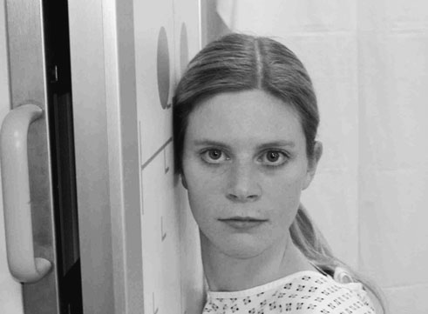
Skull- lateral view
4/23/2020

Slide 21
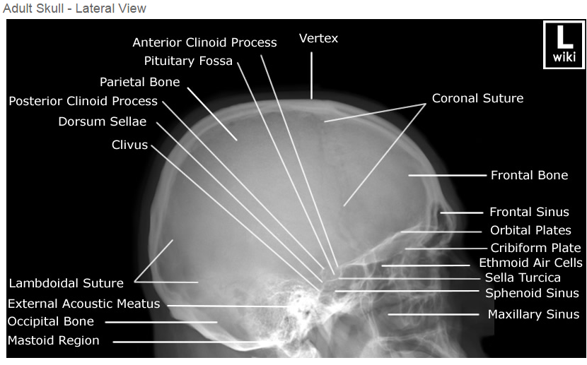
Skull- lateral view
4/23/2020

Slide 22
Notes
This projection can also be performed with the patient prone on a floating-top table.
The projection may be performed usefully on babies in the supine position, with the head rotated to either side.
An air/fluid level in the sphenoid sinus is an indicator for a base-of-skull fracture.
4/23/2020

Slide 23
Notes ….
If the patient is imaged with a vertical central ray can’t indicate air fluid level in the sphenoid sinus.
This is not relevant in young babies, as the sinus is not developed fully
4/23/2020

Slide 24
Occipito-frontal (PA)
Occipito-frontal projections can be employed with different degrees of beam angulation.
The choice of projection will depend upon departmental protocol and the anatomy that needs to be demonstrated.
4/23/2020

Slide 25
Technical Consideration
Film size 24 X 30 cm Lengthwise
Use grid
FFD 100 cm
KVP & mAS depends on machine out put and department protocol
Use gonadal shield specially for child & adults of reproductive age group.
Collimate to include the top of the head and ears.
4/23/2020

Slide 26
Position of patient & cassette
This projection may be undertaken erect or in the prone position.
The erect projection is best, as the prone projection is uncomfortable for the patient and will usually be carried out only in the absence of a vertical Bucky.
The patient is seated facing the erect Bucky, so that the MSP is coincide with the midline of the Bucky and is also perpendicular to it.
4/23/2020

Slide 27
Position of patient & …cont’d
The neck is flexed so that the orbito-meatal base line is perpendicular to the Bucky.
The nose and forehead are in contact with the Bucky.
The mid-part of the frontal bone is positioned in the centre of the Bucky.
The patient may place the palms of each hand either side of the head (out of the primary beam) for stability.
Ensure that the lead name blocker will not interfere with the final image
4/23/2020

Slide 28
Direction and centering
The central ray is directed perpendicular to the Bucky along the MSP.
A collimation field should be set to include:
=>Superiorly, the vertex
=>Inferiorly, the occipital bone and
=>Laterally, the skin margins.
It is important to ensure that the tube is centered to the middle of the Bucky.
4/23/2020

Slide 29
Essential image characteristics
All the cranial bones should be included within the image, including the skin margins.
It is important to ensure that the skull is not rotated.
This can be assessed by measuring the distance from a point in the midline of the skull to the lateral margin.
If this is the same on both sides of the skull, then it is not rotated.
4/23/2020

Slide 30
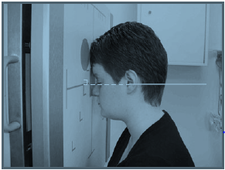
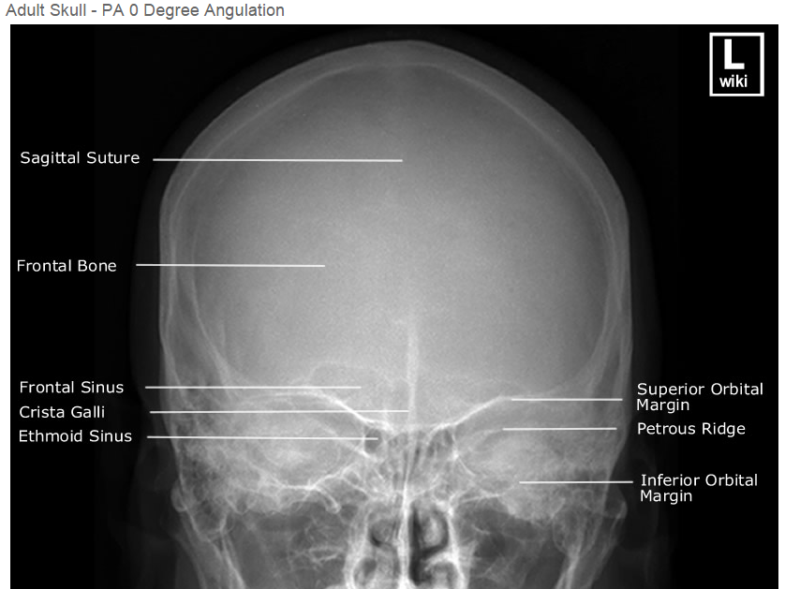
Occipito-frontal projections
4/23/2020

Slide 31
Occipito-frontal caudal angulation
10, 15 and 20 degrees angulation
The technique used for these three projections is similar to that employed for the occipito-frontal projection, except that a caudal angulation is applied.
The degree of angulation will depend on the technique, e.g. for an OF20°↓ projection, a 20-degree caudal angulation will be employed.
Ensure that the central ray is always centered to the middle of the Bucky.
4/23/2020

Slide 32
Occipito-frontal caudal angulation …cont’d
The degree of beam angulation can be evaluated from an assessment of the position of the petrous ridges within the orbit:
Occipito-frontal: the petrous ridges should be completely superimposed within the orbit, with their upper borders coincident with the upper third of the orbit.
4/23/2020

Slide 33
Occipito-frontal caudal angulation …cont’d
OF10°↓: the petrous ridges appear in the middle third of the orbit.
OF15°↓: the petrous ridges appear in the lower third of the orbit.
OF20°↓: the petrous ridges appear just below the inferior orbital margin
4/23/2020

Slide 34
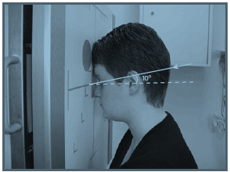
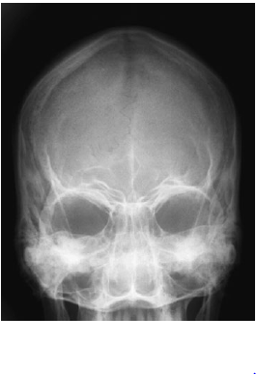
OF10°↓ skull projection
4/23/2020

Slide 35
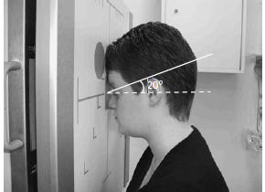
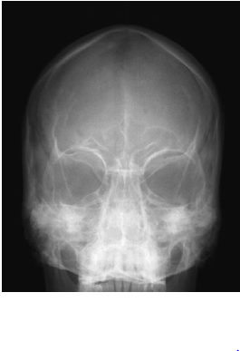
OF20°↓ skull projection
4/23/2020

Slide 36
Occipito-frontal caudal angulation …cont’d
NB:
As the beam angle increases, more of the orbital region is demonstrated and less of the upper part of the frontal bone anterior parietal bones is shown.
Thus, the site of the suspected pathology should be considered when selecting the beam angled.
e.g. an injury to the upper orbital region is best
evaluated with an OF20°↓ projection.
4/23/2020

Slide 37
Fronto-occipital (AP)
Fronto-occipital projections of the skull will demonstrate the same anatomy as occipito-frontal projections.
The orbits and frontal bone, however, will be magnified, since they are positioned further from the image receptor.
Such projections should be carried out only when the patient cannot be moved and must be imaged supine.
These projections result in increased eye dose and loss of resolution of anterior skull structures due to increased object-to-film distance (OFD).
4/23/2020

Slide 38
Position of patient and cassette
The patient lies supine on a trolley or Bucky table, or with the posterior aspect of the skull resting on a grid cassette.
The head is adjusted to bring the MSP at right angles to the film and coincident with its midline.
In this position, the EAM are equidistant from the cassette.
The orbito-meatal baseline should be perpendicular to the cassette.
4/23/2020

Slide 39
Direction & centering
The central ray is directed perpendicular to the cassette or Bucky along the median sagittal plane.
A collimation field should be set to include:
=> Superiorly, the vertex of the skull
=> Inferiorly, base of the occipital bone
=> Lateral, skin margins.
It is important to ensure that the tube is centered to the middle of the Bucky.
4/23/2020

Slide 40
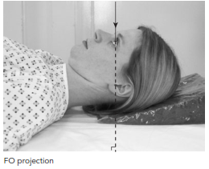
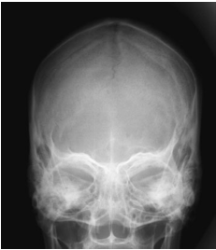
Fronto-occipital projection
4/23/2020

Slide 41
Submento- Vertical
NB: Rule out cervical spine fracture or subluxation on trauma patient before attempting this projection.
SMV is a type of special skull projection.
Clinical Indications
Advanced bony pathology of the inner temporal bone structures (skull base)
Possible basal skull fracture
Position of patient and cassette
The patient may be imaged erect or supine
If the patient is unsteady, then a supine technique is advisable.
4/23/2020

Slide 42
Submento- Vertical (Supine)
Position of the patient
The patient’s shoulders are raised and the neck is hyperextended to bring the vertex of the skull in contact with the grid cassette or table.
The head is adjusted to bring the EAM equidistant from the cassette.
The MSP should be at right-angles to the cassette along its midline.
The orbito-meatal plane should be as much as possible parallel to the cassette.
4/23/2020

Slide 43
Submento- Vertical (Erect)
Position of the patient
The patient sits a short distance away from a vertical Bucky.
The neck is hyper extended to allow the head to fall back until the vertex of the skull makes contact with the centre of the vertical Bucky.
The other positioning is as described for the supine technique.
4/23/2020

Slide 44
Submento- Vertical
Centering point
The central ray is directed at right-angles to the orbito-meatal plane and centred midway between the EAM.
4/23/2020

Slide 45
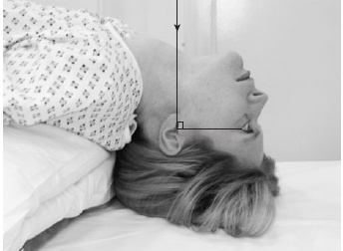
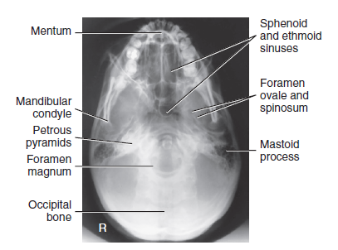
SMV Projection
4/23/2020

Slide 46
Submento-Vertical 20 degrees caudad
The jugular foramina lie in the posterior cranial fossa between the petrous temporal and occipital bones on each side of the foramen magnum.
Both sides are imaged simultaneously on a single image by undertaking a submento-vertical (SMV) 20 degrees caudad projection.
4/23/2020

Slide 47
Submento-Vertical 20 degrees caudad
Centering
Use a well-collimated beam
Central ray is angled caudally so that it makes an angle of 70 degrees to the orbitomeatal plane.
Centred in the midline to pass midway between the EAM.
NB: The position of patient is the same as SMV seen before.
4/23/2020

Slide 48
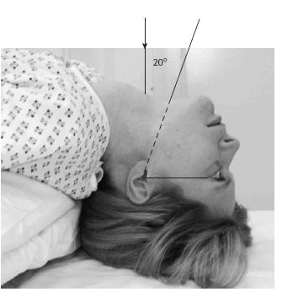
Submento-vertical 20 degrees caudad
For Jugular foramina
4/23/2020

Slide 49
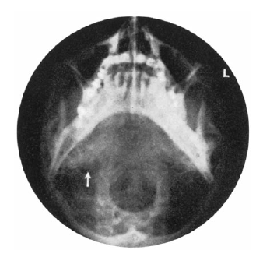
Submento-vertical 20 degrees caudad
4/23/2020

Slide 50
Sella turcica-Lateral
Position of patient and cassette
The patient sits facing the erect Bucky, then MSP is parallel to the Bucky and the inter-orbital line is perpendicular to the Bucky
The shoulders may be rotated slightly to allow the correct position to be attained
The patient may grip the Bucky for stability
A radiolucent pad may be placed under the chin and face for support.
4/23/2020

Slide 51
Centering point
Centre at 2.5 cm vertically & 2.5 cm anterior from EAM.
4/23/2020

Slide 52
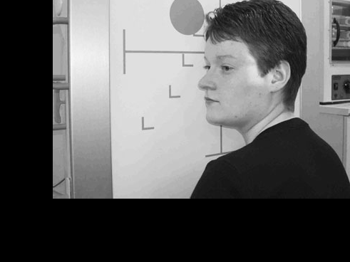
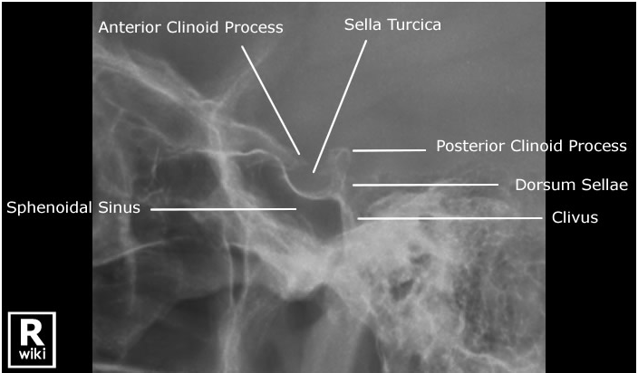
Sella turcica-Lateral
4/23/2020

Slide 53
Optic Foramina
Postero-anterior oblique
The optic foramen is a small hole in the sphenoid bone that is located posteriorly at the apex of the cone-shaped orbit.
The optic foramen allows for passage of the optic nerve (CN II), which is a continuation of the retina.
4/23/2020

Slide 54
Clinical Indications
Bony abnormalities of the optic foramen
Demonstrate lateral margins of orbits and foreign bodies within eye
Radiographs of both sides generally are taken for comparison.
CT is the preferred modality for a detailed investigation of the optic foramina.
4/23/2020

Slide 55
Position of patient and cassette
The patient lies prone or, more commonly, erect with the nose, cheek and chin of the side being examined incontact with the Bucky or cassette table.
The centre of the orbit of the side under examination should coincide with the centre of the Bucky or cassette table.
The MSP is adjusted to make an angle of 35 degrees to the vertical (55 degrees to the table).
The orbito-meatal base line is raised 35 degrees from the horizontal.
4/23/2020

Slide 56
Direction and centring
The beam collimated well, the horizontal central ray should be centred to the middle of the Bucky.
Center at a point 7.5 cm above and 7.5 cm behind the uppermost EAM, so that the central ray emerges from the centre of the orbit in contact with the table.
NB: This projection also called Parieto-orbital (Rhese) projection.
4/23/2020

Slide 57
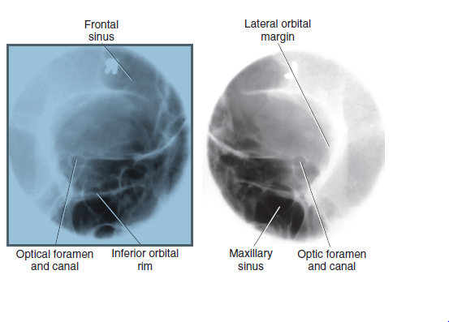
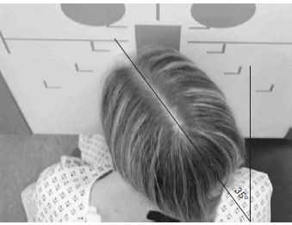
Optic Foramina
Bilateral parieto-orbital projection
4/23/2020

Slide 58
Mastoid:-Lateral oblique 25° ↓
Patient positioning
The patient sits facing the erect Bucky. The head is then rotated, such that the MSP is parallel to the Bucky and the inter-orbital line is perpendicular to the Bucky.
The shoulders may be rotated slightly to allow the correct position to be attained. The patient may grip the Bucky for stability.
4/23/2020

Slide 59
Patient positioning …cont’d
The auricle of the ear adjacent to the table is folded forward to ensure that its soft-tissue outline is not superimposed over the region of interest.
Position the mastoid process in the middle of the Bucky.
18 X 24-cm cassette is positioned longitudinally in the Bucky and is centred to coincide with the central ray and mastoid process.
4/23/2020

Slide 60
Direction and centring
A 25-degree caudal angulation is employed and centred 5 cm above and 2.5 cm behind the EAM remote from the cassette.
Collimate to the area under examination.
4/23/2020

Slide 61
Essential image characteristics
Ensure that all of the mastoid air cells have been included within the image
.
The size of these structures can vary greatly from individual to individual.
Notes
Both sides are often imaged for comparison.
Use side-marker
4/23/2020

Slide 62
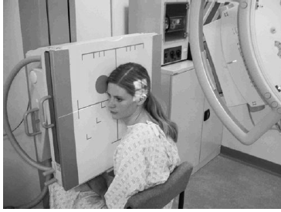
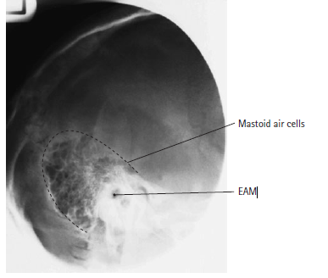
Mastoid: Lateral oblique 25° ↓
4/23/2020

Slide 63
FACIAL BONES AND PARANASAL SINUSES
4/23/2020

Slide 64
Objective
At the end of these lesson the student will be able to;
Given diagrams, radiographs, or dry bones, names and describe the bones of facial bones.
State the criteria used to determine positioning accuracy on the radiographs of the facial bones and paranasal sinuses
Evaluate radiographs of the facial bones and paranasal sinuses in terms of positioning, centring, image quality, radiographic anatomy and pathology.
4/23/2020

Slide 65
Anatomy of the Facial bones
The facial bones form in the fetus through in the process of intramembranous ossification.
They continue to grow after birth and reach full maturity around age 16.
They form the structural frame of face, which, some extent, defines a person’s facial appearance. i.e the facial structure of a female is generally more rounded and less angular than that of a male.
4/23/2020

Slide 66
Facial bones …cont’d
There are a total of 14 facial bones, which include 6 paired bones (Maxillae, zygomatic bones, nasal bones, Lacrimal bones, Palatine bones, inferior nasal conchae) and two single bones (vomer and mandible).
Assist in the formation of mouth, nasal cavity & orbit.
Also protect those structures housed with in them (eye, entrances of digestive & respiratory tract)
4/23/2020

Slide 67
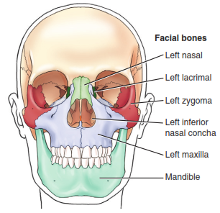
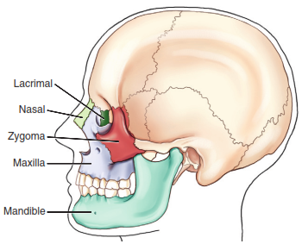
Facial bones
4/23/2020

Slide 68
Radiographic positioning of facial bones
4/23/2020

Slide 69
Facial bones …cont’d
Occipito-mental (Water’s View)
Shows :
The floor of the orbits
The nasal region
The maxillae
The inferior parts of the frontal bone
The zygomatic bone.
NB: The entire zygomatic arches can not be seen, but project out the petrous part of the temporal bone from facial bones.
4/23/2020

Slide 70
Position of patient and cassette
The projection is best performed with the patient seated facing vertical Bucky.
The patient’s nose and chin are placed in contact with the midline of the Bucky.
The head is then adjusted to bring the orbito-meatal baseline to a 45-degree angle to the cassette holder.
The horizontal central line of the Bucky should be at the level of the lower orbital margins.
Ensure that the MSP is at right-angles to the Bucky by checking the outer canthi of the eyes and the EAM are equidistant.
4/23/2020

Slide 71
Direction and centering
The tube should be centered to the Bucky using a horizontal beam before positioning is undertaken.
The cross-lines on the Bucky should coincide with the patient’s anterior nasal spine.
4/23/2020

Slide 72
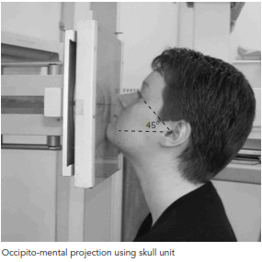
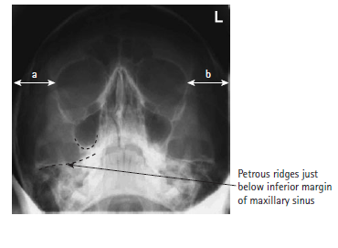
Occipito-metal
4/23/2020

Slide 73
Facial bones …cont’d
Lateral
The patient may be positioned erect or supine.
In cases of injury, this projection should be taken using a horizontal beam in order to demonstrate any fluid levels in the paranasal sinuses.
4/23/2020

Slide 74
Position of patient and cassette
The patient sits facing the vertical Bucky.
The head is rotated, such that the side under examination is in contact with the Bucky.
The arm on the same side is extended comfortably by the trunk, whilst the other arm may be used to grip the Bucky for stability.
The Bucky height is altered, such that its centre is 2.5 cm inferior to the outer canthus of the eye.
4/23/2020

Slide 75
Direction and centering
Centre the horizontal central ray to a point 2.5 cm inferior to the outer canthus of the eye.
4/23/2020

Slide 76
Essential image characteristics
The image should contain all of the facial bones, sinuses including the frontal sinus and posteriorly to the anterior border of the cervical spine.
A true lateral will have been obtained if the lateral portions of the floor of the anterior cranial fossa are superimposed
4/23/2020

Slide 77
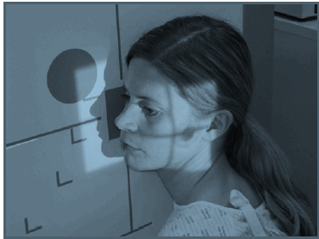
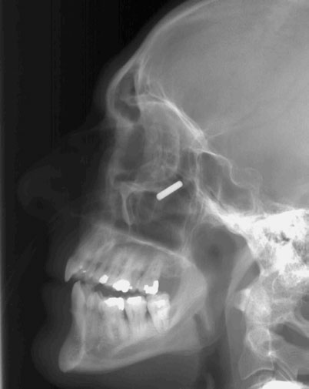
Latera Radiograph
4/23/2020

Slide 78
Zygomatic arches
ROUTINE
SMV
Oblique tangential
4/23/2020

Slide 79
Clinical Indications
Fractures of zygomatic arch
Neoplastic or inflammatory processes
4/23/2020

Slide 80
Technical considerations
Minimum FFD—100cm
Cassette size—18×24 cm, crosswise
Shielding Shield radiosensitive tissues outside region of interest.
Remove all metallic or plastic objects from head and neck.
This projection may be taken with the patient erect or supine.
The erect position may be easier for the patient.
4/23/2020

Slide 81
Part Position
The patient lies supine on Bucky table
Raise chin, hyperextend neck until orbito-meatal base line is parallel to Bucky.
Rest head on vertex of skull.
Align MSP perpendicular to midline of the Bucky
Avoid all tilt or rotation.
4/23/2020

Slide 82
Centering
Align central ray perpendicular to cassette.
Central ray midway between zygomatic arches, at a level 4 cm inferior to mandibular menti.
Collimate the beam to outer margins of zygomatic arches.
NB: If patient is unable to extend neck adequately, angle CR perpendicular to orbito-meatal base line.
This position is very uncomfortable for patients, complete the projection as quickly as possible.
4/23/2020

Slide 83
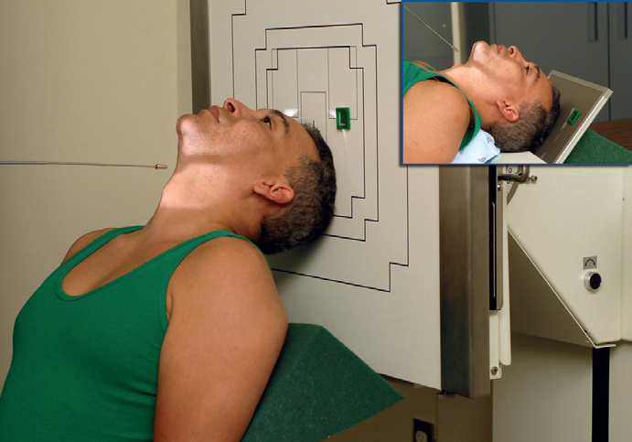
SMV projection, supine or erect
4/23/2020

Slide 84
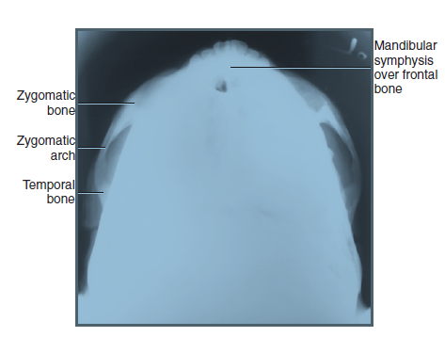
SMV projection
4/23/2020

Slide 85
Oblique infero-superior (Tangential) projection
The same with SMV projection Except the patient rotate 15 degree to wards the interest side.
Use 18X20cm cassette lengthwise
Only single zygomatic arch radiographed in a single exposure
To compare take both sides
4/23/2020

Slide 86
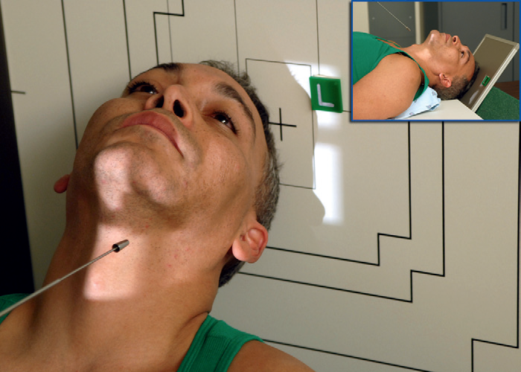
Oblique tangential, upright imaging 15° rotation
4/23/2020

Slide 87
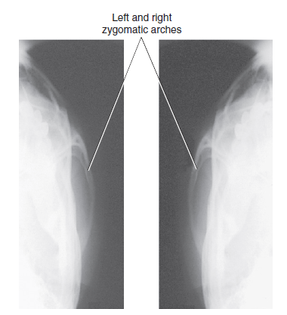
Oblique tangential
4/23/2020

Slide 88
Nasal bone
Lateral
Position of patient and cassette
The patient sits facing the stand Bucky or lie supine.
Use 18 X 24-cm cassette crosswise.
The head is turned so that the MSP is parallel with the cassette and the inter-pupillary line is perpendicular to the cassette.
Grid is not used
The nose should be roughly coincident with the centre of the cassette.
4/23/2020

Slide 89
Direction and centering
A horizontal central ray is directed through the centre of the nasal bones and collimated to include the nose.
4/23/2020

Slide 90
Radiological considerations
Nasal fracture can usually be detected clinically and is rarely treated actively.
If a fracture causes nasal deformity or breathing difficulty, then it may be straightened, but lateral projections will not help.
Considering the dose of radiation to the eye, this projection should be avoided in most instances.
4/23/2020

Slide 91
Notes
A high-resolution cassette may be used if detail is required.
This projection may be useful for foreign bodies in the nose.
A soft-tissue exposure should be employed.
In the majority of cases, severe nasal injuries will require only an occipito-mental projection to assess the nasal septum and surrounding structures.
The projection can also be undertaken with the patient supine and the cassette supported against the side of the head
4/23/2020

Slide 92
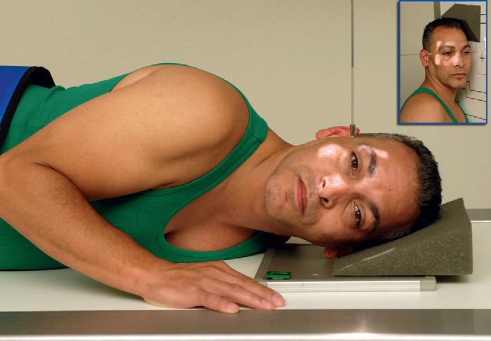
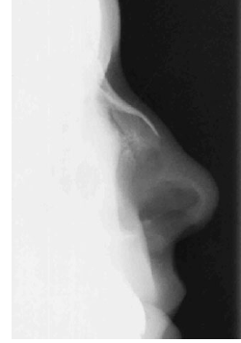
Nasal bone Radiograph
4/23/2020

Slide 93
Mandible
ROUTINE
Lateral 30° ↑
PA or AP
PA Oblique
4/23/2020

Slide 94
Clinical Indications
Fractures
Neoplastic
inflammatory processes of mandible
etc
4/23/2020

Slide 95
Mandible (Lateral 30° ↑)
Position of patient and cassette
The patient lies in the supine position.
The trunk is rotated slightly and then supported with pads.
The side of the face being examined in contact with the cassette.
The patient lies in the supine position.
The MSP should be parallel with the cassette and the inter-pupillary line perpendicular.
The neck may be flexed slightly to clear the mandible from the spine.
Use 18X 24 cm cassette lengthwise .
4/23/2020

Slide 96
Direction and centering
The central ray is angled 30° ↑.
Centered 5 cm inferior to the angle of the mandible remote from the cassette.
Collimate to include the whole of the mandible, TMJ & EAM
NB: The image should include the whole of the mandible, from the TMJ to the symphysis menti.
4/23/2020

Slide 97
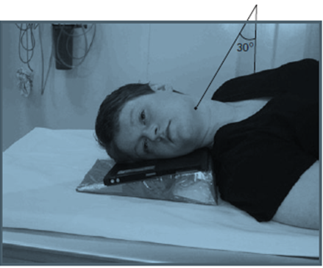
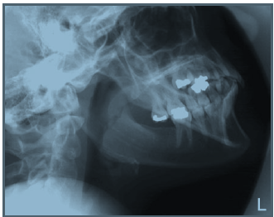
Radiograph of Mandible
4/23/2020

Slide 98
Mandible (Postero-anterior)
Position of patient and cassette
The patient sits facing the vertical Bucky.
In case of trauma, the projection may be supine on a trolley, giving an AP projection.
The patient’s MSP should be coincident with the midline of the Bucky.
The head is then adjusted to bring the orbito-meatal baseline perpendicular to the Bucky.
Check that the EAM are equidistant from the cassette.
4/23/2020

Slide 99
Centering
The central ray is directed perpendicular to the cassette and centred in the midline at the levels of the angles of the mandible.
NB: The whole of the mandible from the lower portions of the TMJs to the symphysis menti should be included in the image.
4/23/2020

Slide 100
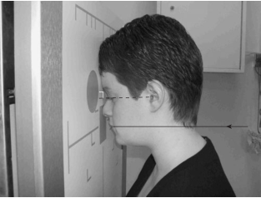
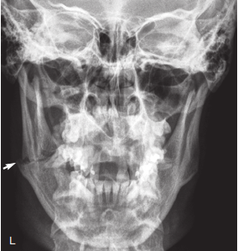
PA Image of mandible
4/23/2020

Slide 101
Mandible (PAO)
From normal PA position the head rotate 20° to either side to project out the cervical vertebrae from the mandibular menti.
NB: This projection demonstrates the region of the symphysis menti.
4/23/2020

Slide 102
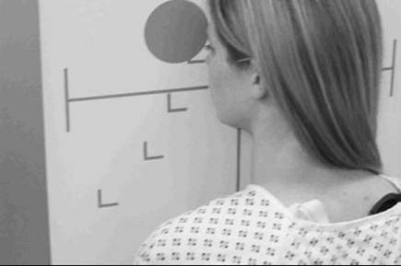
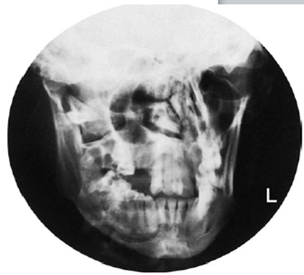
PAO image
4/23/2020

Slide 103
Temporal-mandibular joints
Lateral 25 degrees caudad
It is usual to examine both TMJ.
For each side, a projection is obtained with the mouth open as far as possible and then another projection with the mouth closed.
4/23/2020

Slide 104
Position of patient and cassette
The patient sits facing the vertical Bucky, or lies prone on the Bucky table.
In all cases, the head is rotated to bring the side of the head under examination in contact with the table.
The MSP is brought parallel to the cassette by ensuring that the inter-pupillary line is at right-angles to the table top.
The nasion and external occipital protuberance are equidistant from cassette.
18 X 24cm cassette is placed longitudinally in the cassette holder, such that two exposures can be made without superimposition of the images.
4/23/2020

Slide 105
Direction and centering
Using a well-collimated beam the central ray is angled 25 degrees caudally.
The central ray centered to a point 5 cm superior to the joint remote from the cassette so the central ray passes through the joint nearer the cassette.
4/23/2020

Slide 106
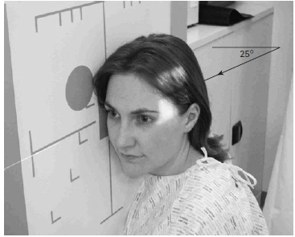
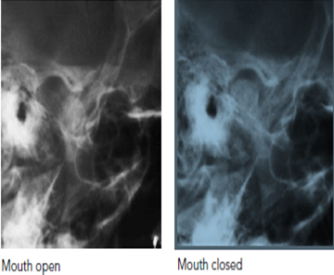
TMJ image
4/23/2020

Slide 107
NB:
TMJ nearest the cassette is visible.
Closed mouth image demonstrates the condyle within the mandibular fossa.
In open mouth position the condyle moves to the anterior margin.
Use the correct side marker.
4/23/2020

Slide 108
PARANASAL SINUSES
Large air-filled cavities in the head.
PNS are sometimes called the accessory nasal sinuses b/c they are lined with mucous membrane, which is continuous with the nasal cavity.
Divided into four groups, according to the bones that contain them:
1. Maxillary ----- Maxillary bones
2. Frontal -------- Frontal bones
3. Ethmoid ------- Ethmoid bones
4. Sphenoid -------Sphenoid bone
4/23/2020

Slide 109
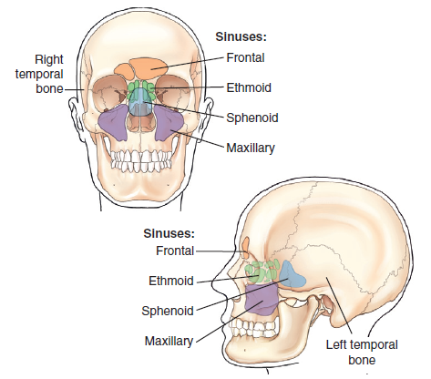
Frontal & lateral view of PNS
4/23/2020

Slide 110
PARANASAL SINUSES …cont’d
NB: All the paranasal sinus cavities communicate with one another and with the nasal cavity.
Clinical Indications:
Inflammatory conditions (sinusitis, secondary osteomyelitis)
Sinus polyps or cysts
4/23/2020

Slide 111
Radiographic positioning of paranasal sinuses
4/23/2020

Slide 112
PARANASAL SINUSES …cont’d
Basic projections:
Occipito menti ( water’s view- open mouth)
Lateral
Occipito frontal 15°↓
4/23/2020

Slide 113
Occipito menti (Open mouth)
This projection is designed to project the petrous part of the temporal bone below the floor of the maxillary sinuses .
Fluid levels or pathological changes in the lower part of the sinuses can be visualized clearly.
4/23/2020

Slide 114
Position of patient and cassette
Best performed with the patient seated facing the vertical Bucky.
The patient’s nose and chin are placed in contact with the midline of the Bucky.
The head is then adjusted to bring the orbito-meatal baseline to a 45-degree angle to the vertical Bucky.
4/23/2020

Slide 115
Position of patient and …cont’d
The horizontal central line of the Bucky should be at the level of the lower orbital margins.
The MSP is at right-angles to the Bucky by checking that the outer canthi of the eyes and the EAM are equidistant.
The patient should open the mouth as wide as possible before exposure.
This will allow the posterior part of the sphenoid sinuses to be projected through the mouth.
4/23/2020

Slide 116
Direction and centering
The tube should be centered to the Bucky using a horizontal beam before positioning is undertaken.
Check that the cross-lines on the Bucky should coincide with the patient’s anterior nasal spine.
Collimate to include all of the sinuses.
4/23/2020

Slide 117
Occipito menti …cont’d
NB:
The petrous ridges must appear below the floors of the maxillary sinuses.
There should be no rotation.
This can be checked by ensuring that the distance from the lateral orbital wall to the outer skull margins is equidistant on both sides.
Use 18x24 cm cassette lengthwise.
4/23/2020

Slide 118
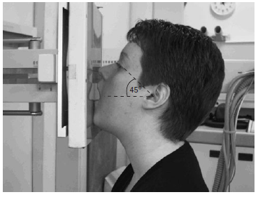
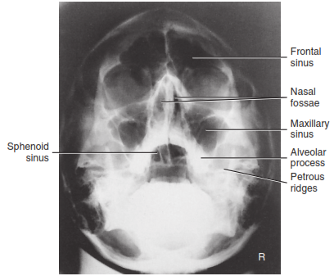
Occipito-mental projection
4/23/2020

Slide 119
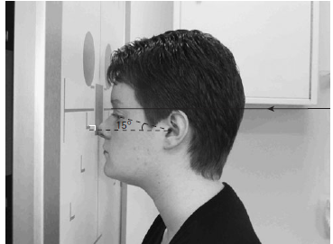
Occipito-frontal 15°↓
4/23/2020

Slide 120
Position of patient and cassette
This projection is used to demonstrate the frontal and ethmoid sinuses.
The patient is seated facing the vertical Bucky, so the MSP is perpendicular.
The head is positioned so that the orbito-meatal baseline is raised 15° to the horizontal.
An 18 x 24-cm cassette is placed lengthwise in the Bucky tray.
The lead name blocker must not interfere with the final image.
4/23/2020

Slide 121
Direction and centering
The central ray is directed perpendicular to the vertical Bucky along the MSP so the beam exits at the Nasion.
A collimation field should be set to include the ethmoidal and frontal sinuses.
The size of the frontal sinuses can vary significantly from one individual to another.
4/23/2020

Slide 122
Essential image characteristics
All the relevant sinuses should be included within the image.
The petrous ridges should be projected just above the lower orbital margin.
It is important to ensure that the skull is not rotated.
NB:
OF projection would not be suitable for demonstration of the ethmoid sinuses, as the petrous ridges would obscure the region of interest.
4/23/2020

Slide 123
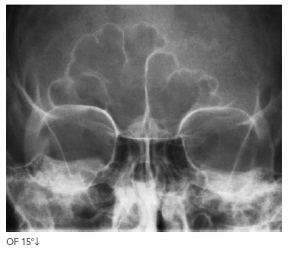
Occipito-frontal 15°↓
4/23/2020

Slide 124
Lateral
Position of patient and cassette
The patient sits facing the vertical Bucky
The head is then rotated, such that the MSP is parallel to the Bucky and the inter-orbital line is perpendicular to the Bucky.
The shoulders may be rotated slightly to allow the correct position to be attained.
4/23/2020

Slide 125
Position of patient and …cont’d
The head and Bucky heights are adjusted so that the center of the Bucky is 2.5 cm along the orbito-meatal line from the outer canthus of the eye.
Position an 18 x 24-cm cassette lengthwise in the erect Bucky, such that its lower border is 2.5 cm below the level of the upper teeth.
A radiolucent pad may be placed under the chin for support
4/23/2020

Slide 126
Direction and centering
A horizontal central ray should be employed to demonstrate fluid levels.
The central ray will be centered to a point 2.5cm posterior to the outer canthus of the eye.
4/23/2020

Slide 127


Lateral Radiograph
4/23/2020

Slide 128
Thank You !
4/23/2020

