Slide 1

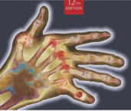
Radiographic Positioning
MeRT2122
(10 ECTS)
Hailegebriel Shiferaw (MRT, PH, MSc)
Department of Medical Radiology Technology
Hawassa University
3/17/2020

Slide 2
Radiographic Positioning
UNIT FIVE
Upper air way and The thorax
3/17/2020

Slide 3
Objectives
At the end of these lesson the student will be able to;
Given diagrams, or dry bones, name and describe the bones of the bony thorax, to include ribs and sternum.
Evaluate radiograph of the chest in terms of positioning, centring, image quality and radiographic anatomy.
State the criteria used to determine positioning accuracy on radiographs of bony thorax in terms of positioning, centring, image quality, radiographic anatomy ad pathology.
Describe the procedure for obtaining supine, prone, upright and decubitus projections of the abdomen to include patient positioning, centring and technical considerations.
3/17/2020

Slide 4
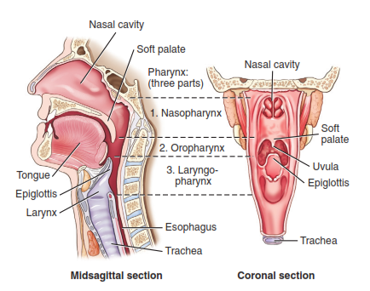
Pharynx and Larynx
3/17/2020

Slide 5
Pharynx and Larynx
Requested to investigate the presence of soft tissue swellings and their effects on the air passage.
To locate the presence of foreign bodies.
To assess laryngeal trauma.
Two projections are taken, anteroposterior and lateral
3/17/2020

Slide 6
Pharynx and Larynx …cont’d
Anteroposterior (AP)
The patient lies supine or stands erect, with the median sagittal plane coinciding with central long axis of the table.
The chine is raised to show the soft tissue below the mandible.
The cassette is centred at the level of the forth cervical vertebrae
3/17/2020

Slide 7
Pharynx and Larynx …cont’d
Centre
Direct the central ray 10° cephalad and in the midline at the level of the fourth cervical vertebrae.
Expose on forced expiration
3/17/2020

Slide 8
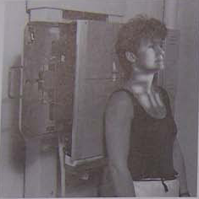
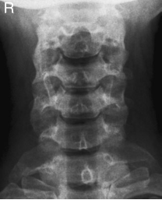
AP upper air way
3/17/2020

Slide 9
Pharynx and Larynx …cont’d
Lateral
The patient stands or sits with either shoulder against a vertical cassette
The jaw is raised slightly to avoid the superimposition of the angle of the mandible with the bodies of the upper cervical vertebrae.
Immediately before exposure, the patient is asked to depress the shoulders forcibly to include the seventh cervical spine
3/17/2020

Slide 10
Pharynx and Larynx …cont’d
Centre
Below the mastoid process at the level of the prominence of thyroid cartilage through the fourth cervical vertebrae.
Make exposure on forced expiration.
3/17/2020

Slide 11
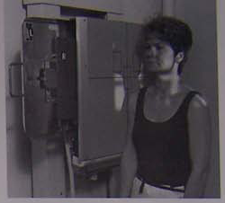
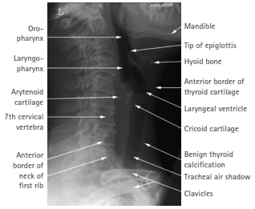
Lateral upper air way
3/17/2020

Slide 12
Trachea (Thoracic inlet)
Requested to investigate the presence of soft tissue swellings in the neck and the upper thorax and their effects on the air passage eg. the presence of retrosternal goitre
In the lateral position because of the superimposition of the thicker upper thorax high- exposure technique should be employed to demonstrate the full length of the trachea on one image.
Two projections, anteroposterior and lateral, are taken.
3/17/2020

Slide 13
Trachea (Thoracic inlet) …cont’d
Antero-Posterior (AP)
The patient lies supine or stands erect, with the median sagittal plane coinciding with central long axis of the table.
The chine is raised to show the soft tissue below the mandible.
The cassette is centred at the level of the forth cervical vertebrae
Centre
In the midline at the level of the sternal notch
make exposure on forced expiration.
3/17/2020

Slide 14
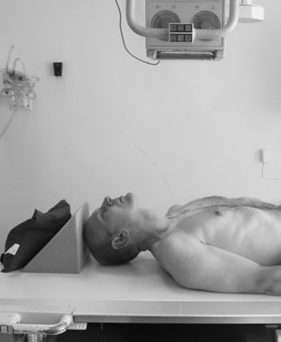
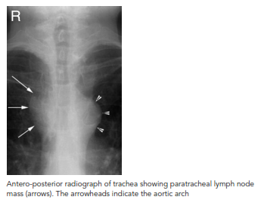
Thoracic inlet
.
3/17/2020

Slide 15
Trachea (Thoracic inlet) …cont’d
Lateral
The patient stands or sits with either shoulder against a vertical cassette.
The shoulders are pulled well backwards to enable the visualization of the trachea. This is possible by the patient clasping their hands behind the back and pulling their arms backward.
Centre
To the cassette at the level of the sternal notch.
3/17/2020

Slide 16
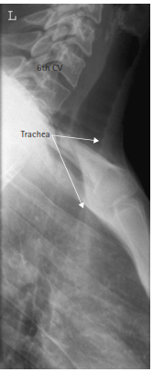
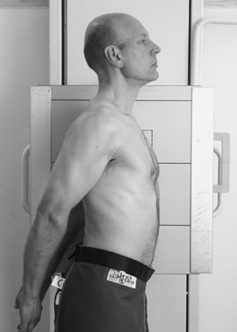
Lateral Trachea
3/17/2020

Slide 17
CHEST-Lung
ANATOMY
The lungs lie within the thoracic cavity on either side of the mediastinum
The lungs are separated from the abdomen by the diaphragm.
The right lung is larger than the left due to the inclination of the heart to the left.
The right lung is divided into three lobes , the upper, the middle and lower lobe.
The left lung is divided into two, the upper and lower.
3/17/2020

Slide 18
CHEST-Lung …cont’d
General observations
CXR examination is the vital part of the investigation of many lung and cardiac conditions, often providing a diagnosis or the clue to the next appropriate test.
CXR is a complex and not easy to read, but a high technical quality examination with appropriate exposure can provide initial detail about:-
  the heart
  Mediastinum
  thoracic cage
  the lung parencyma
  and pulmonary vessels.
3/17/2020

Slide 19
CHEST-Lung …cont’d
The amount of information available to the reader, and thereby the diagnostic usefulness of the test can be reduced by a variety of technical errors and problems:-
Inspiration-sub-maximal inspiration has several potential effects:
  The heart will swing up to a more horizontal lie and may thus appear enlarged.
  The lung bases will be less inflated , which may simulate a viriety of pathologies or cause abnormal areas to lie hidden.
  Under inflation of the lower lobes causes diversion of blood to the upper lobe vessels, mimicking the early signs of the heart failure.
3/17/2020

Slide 20
CHEST-Lung …cont’d
Supine Position
Moves the heart away from the film , thus increaseing magnificatin and reducing the accuracy of assessment of heart size.
The normal biomecanics of blood flow are different from those in the erect position , producing relative prominence of upper lobe vessels and mimicking the signs of heart vessels.
Fluid levels are not seen
It will be more diffcult to detect pnemothorax
3/17/2020

Slide 21
CHEST-Lung …cont’d
Semi-erect projection
The degree to which the patient is leaning from the vertical varies according to circumstances eg. Age, fitness and availability of assistance.
The patient may lean to one side or the head may drop over the upper chest and these will cause difficult in assessing the chest.
3/17/2020

Slide 22
CHEST-Lung …cont’d
Anteroposterior Projection
Magnification makes the heart size difficult to assess in this projection.
Rotation
Obliquity causes the side of the chest furthest removed from the film plane, whilst the other side is partially obscured by the spine and more dense.
The differing densities may simulate either abnormal density ( e.g. consolidation or pleural effusion ) on one side or abnormal lucency (e.g. emphysema) on the other.
3/17/2020

Slide 23
CHEST-Lung …cont’d
Rotation markedly affects the appearance of the mediastinum and hila. The hilum of the raised side appears more prominent and may simulate a mass. The other hilum is hidden by the spine, tending to obscure any mass that may be present.
3/17/2020

Slide 24
CHEST-Lung …cont’d
Exposure
Overexposed films reduce the visiblity of lung parechymal detail , masking vascular and interstitial changes.
Underexposure can artificially enhance the visibility of normal lung markings which leads to wrong interpretation (e.g. pulmonary fibrosis or oedema).
Underexposure also obscures the cetral areas, causing failure to diagnose abnormalities of the mediastinum, hila and spine.
3/17/2020

Slide 25
CHEST-Lung …cont’d
Collimation
Good collimation is essential to good practice and dose reduction.
Excessive collimation will exclude areas such as the costophrenic angle.
Failure to demonstrate the whole of ribs as a result of excessive collimation may lead to missed diagnosis of metastases, fructure ,etc.
3/17/2020

Slide 26
CHEST-Lung …cont’d
Postero-anterior Erect (PA erect)
Clinical Indications:
Cough of long duration
Chest pain
Trauma to the chest
COPD etc.
3/17/2020

Slide 27
CHEST-Lung …cont’d
Patient Position
Assist the patient to standing position as it helps to demonstrate the air fluid level (hemopneumothorax).
The patient is positioned facing the cassette with the chin extended and centred to the middle of the top of the cassette
The feet are placed slightly apart so that the patient is able to remain steady
3/17/2020

Slide 28
CHEST-Lung …cont’d
The shoulders are rotated forward and pressed downward in contact with the cassette . This is achieved by placing the dorsal aspect of the hands behind and below the hips with the elbows resting on the cassette.
Tell the patient to take a deep breath in and hold, then expose the film.
Centre
At the level of the 7th thoracic vertebrae, this can be assessed by using the inferior angle of the scapula.
Film size- 35x43 or 35x35 cm
3/17/2020

Slide 29
CHEST-Lung …cont’d
The image should demonstrate
Full lung fields with the scapula projected laterally away from the lung field.
The clavicle is symmetrical and equidistant from the spinous process.
It should be possible to visualize the 6th rib anteriorly or 10th rib posteriorly
The mediastinum and heart should be central.
The patient should be provided with waist fitting lead-rubber apron.
Collimate the beam to the area of interest
Film size 35 x 35 or 35 x43
FFD 150 cm ranging from (140-200)cm
3/17/2020

Slide 30
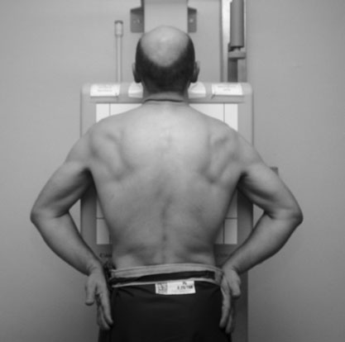
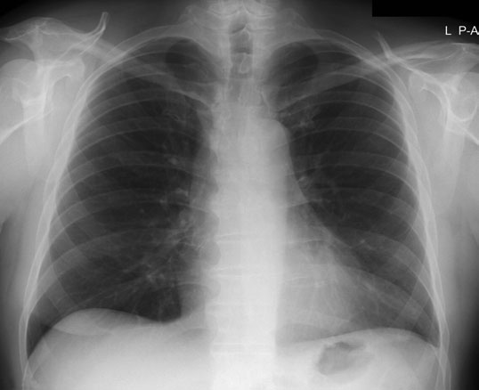
PA erect chest x-ray
3/17/2020

Slide 31
CHEST-Lung …cont’d
Lateral
The patient is turned to bring the side under investigation in contact with the cassette
Film size- 35x43 or 30X40 cm vertically
The arms are folded over the head or raised above the head.
CENTER- mid axillary line at the level of T7- inferior angle of the scapula.
Tell the patient to take a deep breath in and stop during exposure.
3/17/2020

Slide 32
LATERAL CHEST …cont’d
Image evaluation
The apices, costo phrenic angle, spine, and sternum should be included
The thorax should be in the centre of the film
The heart should be adequately penetrated
The outline of the heart and diaphragm should appear sharp, this is possible by avoinding patient motion.
Posterior ribs and lung fields should be superimposed, by positionig the patient in true lateral position.
Patient’s arms and chin should not be superimposed over the upper lung field.
3/17/2020

Slide 33
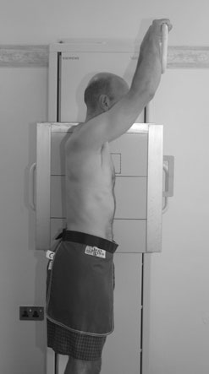
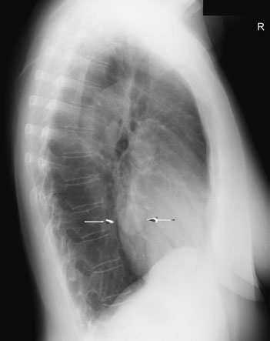
LATERAL CHEST
3/17/2020

Slide 34
Lungs apices
Apical projection:
Opacities observed in the apical region by overlying ribs or clavicular shadows may be demonstrated with the patient in anteroposterior projection and the central ray is angled 30 degree cephalad towards the sternal angle
Film size 24 x30cm.
3/17/2020

Slide 35
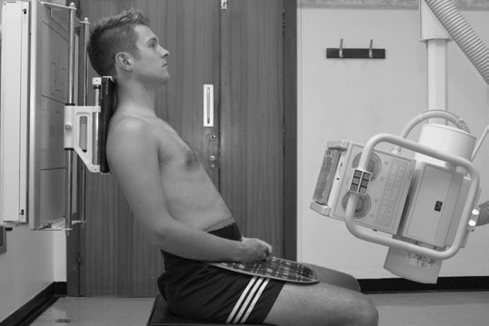
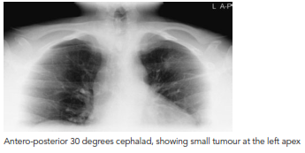
AP Apical view
3/17/2020

Slide 36
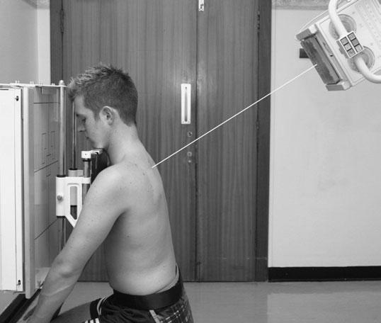
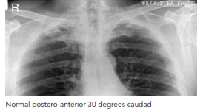
PA Apical view
3/17/2020

Slide 37
Lordotic view
This technique is used to demonstrate the right middle lobe collapse and anterior - lobar pleural effusion
Positioning
The patient is placed for the postero anterior projection
Then holds the side of the vertical Bucky, the patient bends backward at the waist (30-40) degrees.
CENTER -at the middle of the film.
3/17/2020

Slide 38
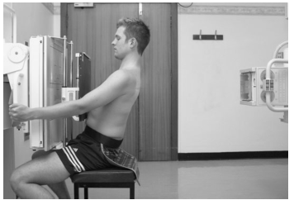
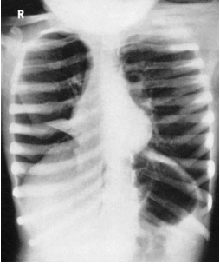
Lordotic view
3/17/2020

Slide 39
Lateral decubitus chest
Technical consideration
Film Size- 35x35/35x43cm
Grid- Yes/No, depends on the department’s protocol
Collimation –include the area of interest.
Apply gonad shield
3/17/2020

Slide 40
Lateral decubitus chest …cont’d
Patient Positioning
Assist the patient to lie on the lateral position on the affected side to demonstrate fluid level, but to demonstrate pneumothorax the patient should lie on the unaffected side.
Support the patient on radiolucent sponges.
Part Positioning:
Extend the patient’s arms above the head
The thorax should be in the true lateral position with the patient’s leg flexed for balance.
3/17/2020

Slide 41
Lateral decubitus chest …cont’d
Central Ray:
Direct the central ray horizontally to the mid line of the cassette at the level of the T7 (inferior angle of the scapula).
Breathing:
The patient should be told to take a deep breath in and hold it.
Image evaluation:
The apices, the costophrenic angles and the lateral margins of the ribs should be included.
The heart should be adequately penetrated
3/17/2020

Slide 42
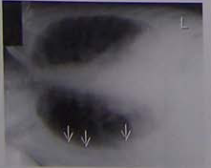
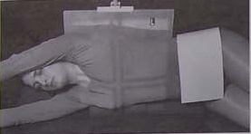
Right lateral decubitus
3/17/2020

Slide 43
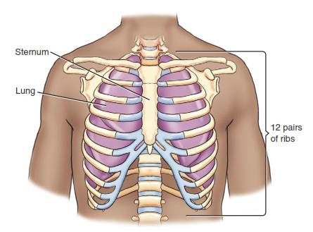
Bones of the thorax
The bony thorax consists of the ribs, sternum and thoracic vertebrae.
3/17/2020

Slide 44
Bones of the thorax …cont’d
Ribs
Each rib is numbered according to the thoracic vertebra to which it attaches
The first seven pairs of ribs are considered true ribs.
Each true rib attaches directly to the sternum by its own costocartilage.
The term false ribs applies to the last five pairs of ribs
3/17/2020

Slide 45
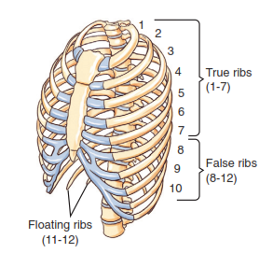
Bones of the thorax
3/17/2020

Slide 46
Bones of the thorax …cont’d
AP Ribs Below and above the diaphragm should be performed
Indications
Assessment of trauma
Rib metastasis
Technical consideration
Film size 30x40cm
Grid required
Include lateral ribs, C7 and iliac crest
Gonad shielding should be used.
3/17/2020

Slide 47
Bones of the thorax …cont’d
Patient Positioning
Assist the patient to the supine position (allows patient condition) on the radiographic table
Adjust the patient’s midsagital plane to lie parallel with the long axis of the table.
Part Positioning
Adjust the patient’s body in straight position.
Position the patient’s arms above the head.
Centring point
Direct the central ray perpendicular to the mid point of the cassette
3/17/2020

Slide 48
Image evaluation
Ribs above the diaphragm
The upper 10 ribs should be included
The distance between the lateral margin of the ribs and the spine of the side of interest should approximately be twice as great as that of the unaffected side.
The ribs should be clearly seen without over exposure through the lungs and heart.
3/17/2020

Slide 49
Image evaluation …cont’d
Ribs below the diaphragm
The lower 4 to 6 ribs and part of the iliac crest should be included.
The distance between the lateral margin of the ribs and the spine of the side of interest should approximately be twice as great as that of the unaffected side.
The ribs should be clearly seen without over exposure through the lungs and heart.
3/17/2020

Slide 50
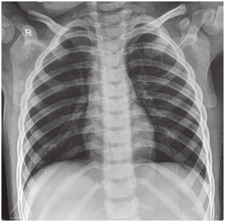
Ribs above the diaphragm
Breathing instruction for ribs above the diaphragm
The patient to take in deep breath; make the exposure
3/17/2020

Slide 51
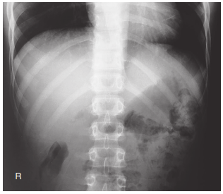
Ribs below the diaphragm
Breathing instruction for ribs below the diaphragm
The patient to take in deep breath and blow it out; make the exposure
3/17/2020

Slide 52
(RAO & LAO)/(RPO &LPO)
Technical considerations
Film size 30x40cm
Grid required
Include lateral ribs, C7and iliac crest
Gonad shielding should be used.
Patient Positioning
Assist the patient to the supine or erect position on the radiographic table
Adjust the patient’s midsagital plane to lie parallel with the long axis of the table
3/17/2020

Slide 53
(RAO & LAO)/(RPO &LPO) …cont’d
Part Positioning
Rotate the patient to 45º
Central ray
Direct the central ray perpendicular to the middle of the cassette.
Breathing Instruction:-
Ribs above the diaphragm
  Instruct the patient to take in a deep breath, make the exposure during suspended inspiration.
Ribs below the diaphragm
  Instruct the patient to take in a deep breath and blow it out make exposure during suspended deep expiration.
3/17/2020

Slide 54
Image evaluation
Ribs above the diaphragm
The upper 10 ribs should be included
The distance between the lateral margin of the ribs and the spine of the side of interest should approximately be twice as great as that of the unaffected side.
The ribs should be clearly seen without over exposure through the lungs and heart.
3/17/2020

Slide 55
Image evaluation …cont’d
Ribs below the diaphragm
The lower 4 to 6 ribs and part of the iliac crest should be included.
The distance between the lateral margin of the ribs and the spine of the side of interest should approximately be twice as great as that of the unaffected side.
The ribs should be clearly seen without over exposure through the lungs and heart.
3/17/2020

Slide 56
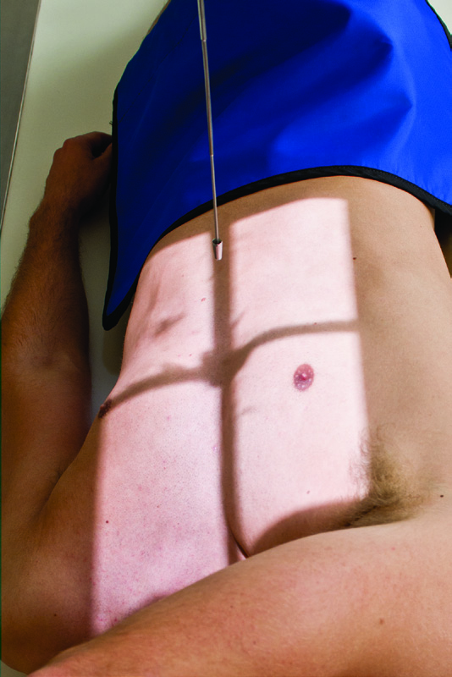
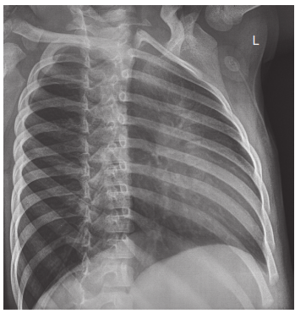
LPO
3/17/2020

Slide 57
Sternum
The adult sternum is a thin, narrow, flat bone with three divisions:
The upper portion is the manubrium
The longest part of the sternum is the body
The most inferior portion of the sternum is the xiphoid process
3/17/2020

Slide 58
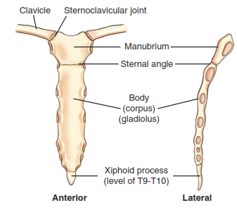
Sternum
3/17/2020

Slide 59
Sternum
RAO position
Technical Consideration
Film size: 24x30cm
Grid required
Collimate to the area of interest
Apply Gonad shield
Patient Positioning:
Assist patient to semi prone position on the radiographic table.
Adjust the patient to the middle of the table.
Align the top edge of the cassette to the level of the spinous process of C7.
3/17/2020

Slide 60
Sternum …cont’d
Part Positioning:
With the patients right arm at the side and the left arm raised with the hand near the head rotate the patient to form 15⁰ - 20⁰ RAO position. To separate the sternum and vertebral column.
Centre the sternum to the midline of table.
Central Ray:
Direct the central ray perpendicular to the mid point of the sternum.
Centre the cassette to central ray.
3/17/2020

Slide 61
Sternum …cont’d
Breathing Instruction:
Instruct the patient to breath slowly or take exposure in deep expiration.
Image Evaluation
The sternal end of the clavicle and entire sternum should be included.
The sternum should be seen separated from the vertebral column
The sternum should be superimposed over the cardiac shadow.
The right sternoclavicular joint will be open and the left will be closed
Bony detail should be clearly seen.
3/17/2020

Slide 62
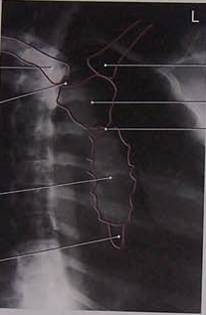
RAO sternum
3/17/2020

Slide 63
Sternum …cont’d
Lateral Sternum
Technical consideration
Film size 24x30cm
Grid required
70-80 kvp
Apply collimation
Apply Gonad shield
Patient positioning
Assist the patient to the erect ,lateral position in front of up right grid device.
3/17/2020

Slide 64
Sternum …cont’d
Part positioning
Rotate the shoulders backward and place the patient’s hands behind the back
Centre the sternum to the midline of the grid device.
Centre the cassette to include the whole sternum.
Central Ray
Direct the central ray perpendicular to the middle of the sternum or 2.5 cm below the sterna angle.
3/17/2020

Slide 65
Sternum …cont’d
Breathing instruction:
Arrested full expiration.
Image evaluation
The entire sternum should be included.
The sternal ends of the clavicles should be seen superimposed.
The sternum should be seen separated from the ribs and soft tissue of the shoulders.
Bony detail should be clearly seen.
3/17/2020

Slide 66
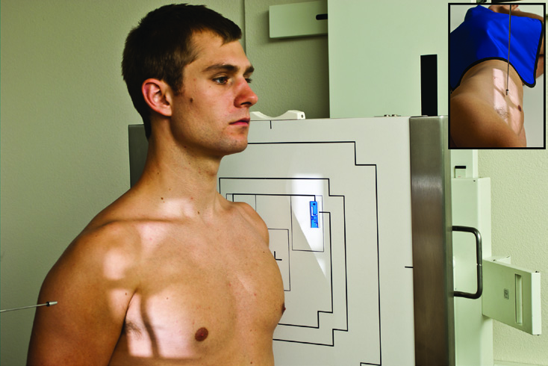
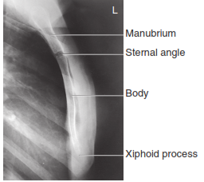
Lateral Sternum
3/17/2020

Slide 67
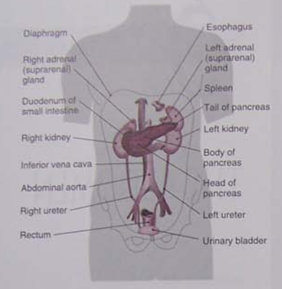
The Abdomen
3/17/2020

Slide 68
The Abdomen
Indication:
Obtained to rule out bowel obstruction
Perforation
Identify radiopaque stone in the kidney or gallbladder
Localize foreign object
Used as a control film prior to procedures
To check:
  Exposure factor
  Patient positioning
  Patient preparation
3/17/2020

Slide 69
The Abdomen …cont’d
Antero posterior(AP or KUB) Basic.
Patient preparation:
The patient should be instructed to be on a low residue diet and to take laxative drug (dulcolax, caster oil or Epsom salt) during 24 hours prior to the examination.
In the case of emergency radiography no bowel preparation is possible.
3/17/2020

Slide 70
The Abdomen …cont’d
Technical consideration
Film size
Determined by patient size
Adult- 30X 40, 35X43cm
Grid
Required
Exposure factor depends
70-85kvp
Appropriate collimation is required
Shielding
Apply gonad shield on male patient
3/17/2020

Slide 71
The Abdomen …cont’d
Patient Positioning
Assist the patient in supine position on the x ray table
Place a pillow under the patient’s head and position a small support under the knee for support.
Part Positioning
Centre the median plane of the patient body to the mid line of the table
Insure that the anterior superior iliac spine is equidistant from the table
3/17/2020

Slide 72
The Abdomen …cont’d
Central Ray
Direct the central ray perpendicular to the level of the iliac crest
Centre the cassette to the central ray
Breathing instruction
Instruct a patient to take in a deep breath, below it out, and hold it out during exposure.
3/17/2020

Slide 73
The Abdomen …cont’d
Image evaluation
The symphysis pubis and lateral margins of the abdomen should be included
The renal shadows, psoas major muscle, transvers process of the lumbar spine and inferior margin of the liver should be clearly visualized.
3/17/2020

Slide 74
AP Abdomen
3/17/2020

Slide 75
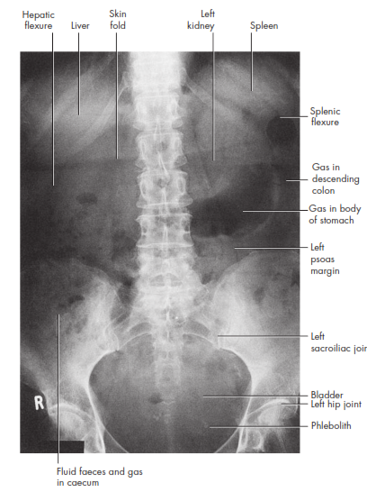
The Abdomen
3/17/2020

Slide 76
Upright AP Abdomen
To rule out
  Bowel obstruction
  Perforation
  Air fluid level
Technical considérations
Film size determined by patient size
Gird is required
SID 100cm
70- 80 Kvp, Adult
Collimate abdominal walls laterally and to the film size lengthwise
Shadow shield can be used to shield male patients whenever possible according to department policy.
3/17/2020

Slide 77
Upright AP Abdomen …cont’d
Patient positioning
Assist the patient to the erect / seating position with the back
Position the patient’s arms comfortably at the patient’s side and out the collimated area
Part positioning
Center the midsagital plane of the patient to the midline of the upright grid device
Check for the rotation of the pelvis by palpating the anterior superior iliac spines
3/17/2020

Slide 78
Upright AP Abdomen …cont’d
Central ray
Direct the central ray to a point approximately 2 to 3 in. above to the iliac crests
Center the cassette to the central ray
The top of the cassette should be at the level of axilla
Image evaluation
The diaphragm and the lateral margin of abdomen should be included in the collimated area
Air-fluid level should be adequately exposed demonstrated
Asymmetry of the iliac crest indicates rotation of pelvis
Unless pathology is present, the spine should be straight and centered to the film
3/17/2020

Slide 79
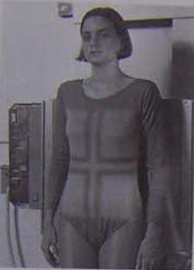
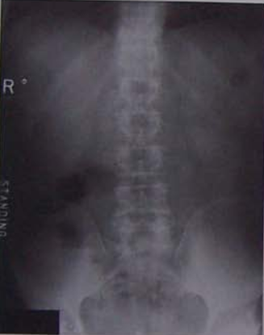
Upright AP Abdomen …cont’d
3/17/2020

Slide 80
Left lateral decubitus
This projection is used if the patient cannot be positioned erect or sitting to confirm the presense of subdiaphragmatic gas sespected seen on AP projection and also used to confirm obstruction.
To allow time for the gas to collect there, the patient should remain lying on the left side for 20 minutes before exposure is made.
3/17/2020

Slide 81
Left lateral decubitus …cont’d
Technical Consideration
Film size
Adult – 35X43, 30X40cm
Grid required
Exposure factor
Appropriate collimation
3/17/2020

Slide 82
Left lateral decubitus …cont’d
Patient positioning
Assist the patient to the left lateral position on the table, the right leg should be directly overlap the left and the right arm should be over the left.
Extend the arms upward.
Part positioning
Adjust the thorax and the pelvis to a true lateral position
3/17/2020

Slide 83
Left lateral decubitus …cont’d
Central ray.
Direct the central ray horizontally to the midline to the grid device.
Adjust the cassette so that the top edge of the cassette is at the level of the axilla.
Breathing instruction
Instruct a patient to take in a deep breath, below it out, and hold it out during exposure.
3/17/2020

Slide 84
Left lateral decubitus …cont’d
Image evaluation
The symphysis pubis and lateral margin of the abdomen should be included.
The renal shadows, psoas major muscle, transverse process of the lumbar spine and inferior margin of the liver should be clearly visualized. The spine should be straight and centred to the film unless pathology is present.
3/17/2020

Slide 85
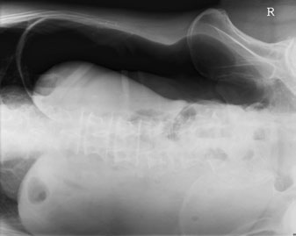
Left lateral decubitus
3/17/2020

Slide 86
Dorsal decubitus
This projection is used if the patient cannot be positioned erect or sitting to confirm obstruction.
Technical Consideration
Film size
Adult – 35X43, 30X40cm
Grid required and/or not
Patient positioning
Assist the patient to the supine position on the x ray table.
Use sponges to elevate the patient
3/17/2020

Slide 87
Dorsal decubitus …cont’d
Central ray
Direct the central ray horizontally to the midline of the grid.
Adjust the patient and cassette so that the top edge of the cassette is at the level of the axilla.
Breathing instruction
Instruct the patient to take in a breath, blow it out, and hold it out during the exposure.
3/17/2020

Slide 88
Dorsal decubitus …cont’d
Image evaluation
The diaphragm, spine and anterior margin of the abdomen should be included
Air fluid levels should be adequately exposed and demonstrated
Superimposition of the ribs indicates a true lateral position.
3/17/2020

Slide 89
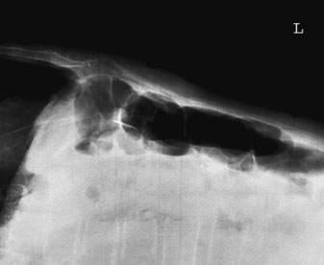
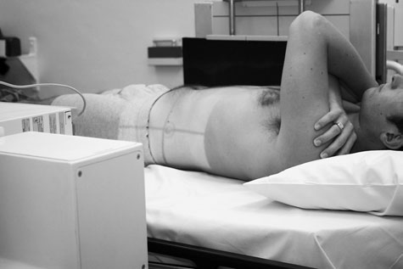
Dorsal decubitus
3/17/2020

Slide 90
Thank You !
3/17/2020

