Slide 1

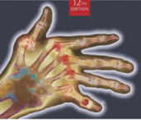
Radiographic Positioning
MeRT2122
(10 ECTS)
Hailegebriel Shiferaw, (MRT, PH, MSc)
Department of Medical Radiology Technology
Hawassa University
3/11/2020

Slide 2
UNIT EIGHT
MAMMOGRAPHY
3/11/2020

Slide 3
Objectives
At the end of these lesson you should have to able to;
Identify the most important positioning landmarks w/c are used for accurate positioning breast imaging
Describe the routine & recommended projection of breast imaging
Describe the alternate projection of breast imaging
Select the appropriate exposure factor for the breast imaging accordingly
Apply control of infection & identify sterile areas.
Evaluate the radiographs of the breast in terms of positioning, centering &image quality.
Prepare the patient for the examination
3/11/2020

Slide 4
Introduction
Mammography is radiographic examination of the breast tissue (soft tissue radiography).
No screening tool is 100% effective. Good quality mammograms can find 85-90% of cancers.
Mammography is carried out on both symptomatic women with a known history or suspected abnormality of the breast and as a screening in well, asymptomatic woman.
3/11/2020

Slide 5
Female breast anatomy
Extend from the second to the six ribs and from the lateral border of the sternum to the mid-axillary line
Composed of nipple, areola, inframammary crease, axillary tail, glandular, fibrous and fatty tissue.
Cooper’s ligament supports the entire breast weight by attachment with pectoralis major muscle.
It’s size, shape and consistency vary significantly, depending on patient’s size, shape and age.
Each breast consists of 15-20 lobes, each of which is divided in to several lobules.
3/11/2020

Slide 6
Female breast anatomy …cont’d
After menopause the glandular tissue replaced by adipose tissue(fat) and needs less Kv .
Prior first pregnancy _ fibro glandular type
After several pregnancy _ fibro glandular fatty breast
3/11/2020

Slide 7
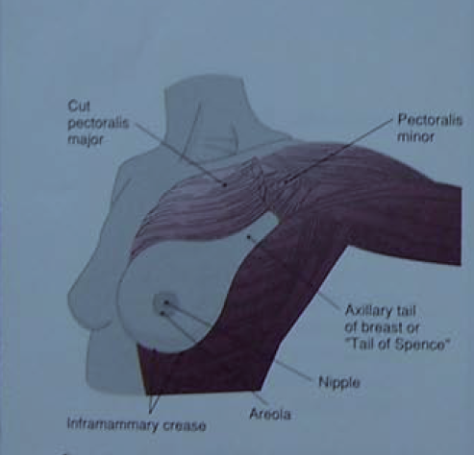
Female breast anatomy …cont’d
3/11/2020

Slide 8
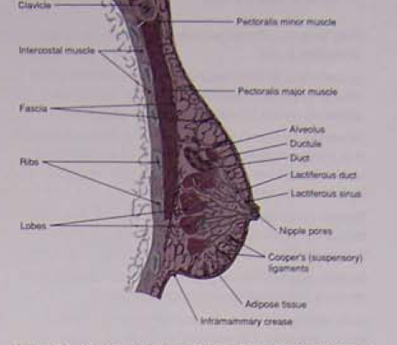
Female breast anatomy …cont’d
3/11/2020

Slide 9
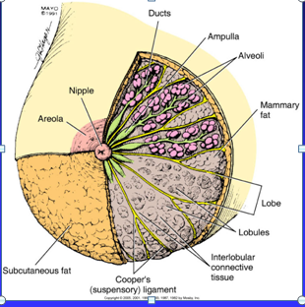
Female breast anatomy …cont’d
3/11/2020

Slide 10
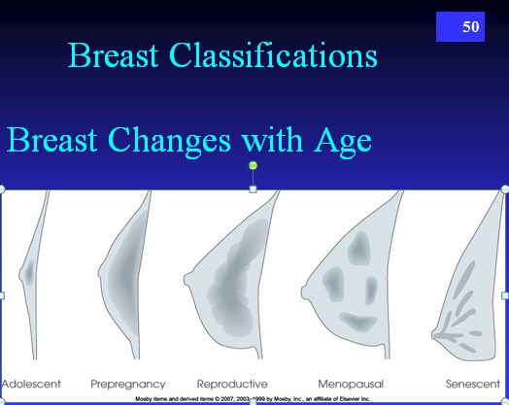
Female breast anatomy …cont’d
3/11/2020

Slide 11
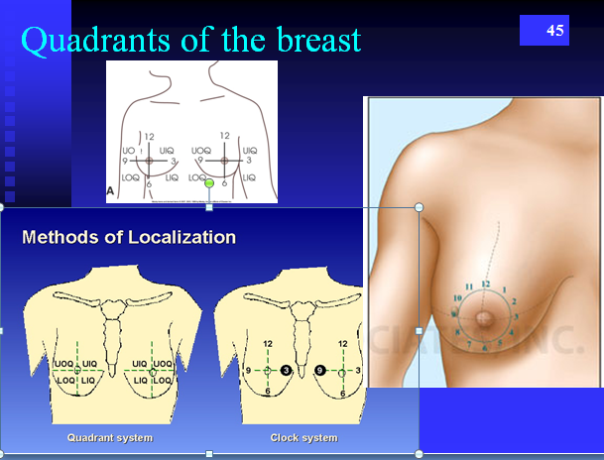
Female breast anatomy …cont’d
3/11/2020

Slide 12
X-ray equipment features
A mammography system comprises:
A high-voltage generator;
X-ray tube;
Tube filtration;
Compression device;
Reciprocating anti-scatter grid;
Image-recording system;
Automatic exposure control (AEC) system.
X-ray equipment features
3/11/2020

Slide 13
X-ray equipment features …cont’d
Low KV and high MAs techniques are used.
The out put of three phase HTG is 25 to 35 Kvp
Appropriate Kvp for d/nt projection of breast ranges from 25 to 30 Kvp
Large focal spot; up to 100-200 MA
Small focal spot; 15-50 MA
The exposure time ranges from 0.02 to 6sec.
SID of 60-65 cm is used.
The emulsion must be relatively small in grain size.
Carefully immobilization is needed.
3/11/2020

Slide 14
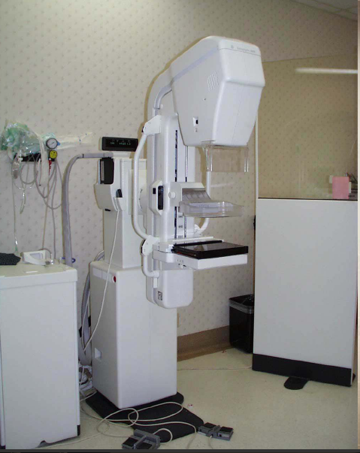
X-ray equipment features …cont’d
3/11/2020

Slide 15
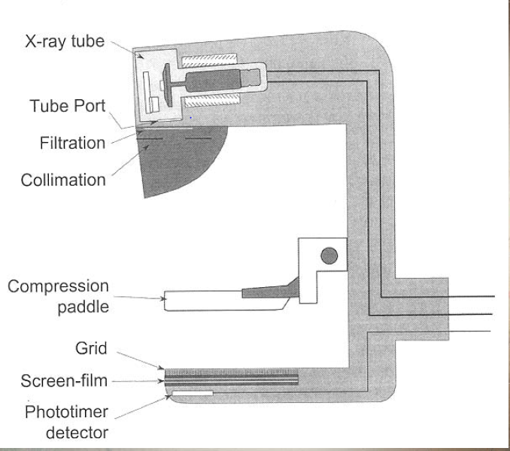
X-ray equipment features …cont’d
3/11/2020

Slide 16
Adequate breast compression
It has the following uses;
Flattens & separate breast structures
Decreases OID, so visibility of detail will improved.
Reduces radiation exposure, so contrast is improved.
Immobilizes the patient
Produce a more uniform density
3/11/2020

Slide 17
Recommended projections
Basic projections
  Craniocaudal
  45-degree medio-lateral oblique
Supplementary projections
  Lateromedial oblique
  Exaggerated CC
  Roll medial, roll lateral
  Caudo-cranial
  Medio-lateral
  Latero-medial
  Axillary tail, cleavage
  Localized
  compression/paddle
  Magnification, tangential
3/11/2020

Slide 18
Radiographic positioning of breast
Craniocaudad (CC) breast
Technical consideration
Film size: 18x24 cm or 24x30cm
Grid recommended, greater than 2 cm
25- 30 KVP
AEC usually recommended
Collimate to cassette size
3/11/2020

Slide 19
Patient positioning
Assist the ambulatory patient to the standing erect position in front of the dedicated mammography unit.
Instruct the ambulatory patient to assume a comfortable stance with the feet apart.
Adjust the unit to the level of inframammary crease when the breast is elevated.
3/11/2020

Slide 20
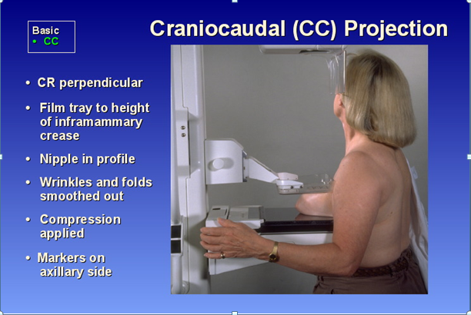
Patient positioning …cont’d
3/11/2020

Slide 21
Part positioning
Elevate the breast so the inframammary crease is at it’s maximum level.
  Adjust the level of the cassette holder
  The patient’s inframammary crease should contact firmly against the cassette's edge.
Using both hands, one bellow the breast & one above pull the breast tissue away from the chest wall & place it on the cassette
Turn the patient’s head away from the side being examined
Using one hand to smooth the lateral beast tissue to avoid skin folds & the other on the shoulder
3/11/2020

Slide 22
Part positioning …cont’d
Position the opposite breast over the corner of the cassette holder
Instruct the patient to the arm of side not being examined place it forward on the handle bar of the unit.
  The arm of the examined side should be at the side with the arm externally rotated.
CR: Direct the CR perpendicular to the breast & cassette.
3/11/2020

Slide 23
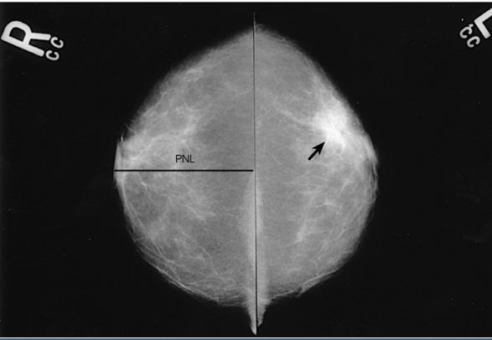
Image evaluation
3/11/2020

Slide 24
Essential image characteristics
Proper labeling should be evident
No overlying structures should be seen.
The pectoral muscle will be seen in 20% of patients.
The nipple should be centered crosswise on the film & should be in profile, if possible
The medial portion of the breast should be included on the film.
There should be no folds in the breast tissue.
Dense tissue should be adequately penetrated
3/11/2020

Slide 25
Mediolateral oblique (MLO)
Technical consideration
Film size: 18x24 cm or 24x30cm
Grid recommended, greater than 2 cm
25- 30 KVP
Collimate to cassette size
3/11/2020

Slide 26
MLO …cont’d
Patient positioning
Assist the ambulatory patient to the standing erect position in front of the dedicated mammography unit.
Instruct the ambulatory patient to assume a comfortable stance with the feet apart.
After assessing the angle of patient’s pectoral
3/11/2020

Slide 27
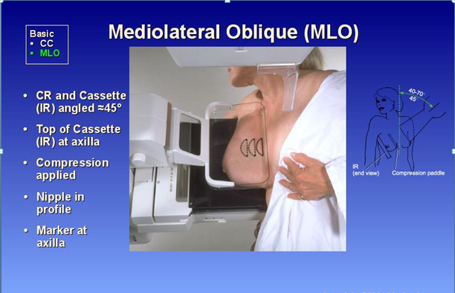
MLO …cont’d
3/11/2020

Slide 28
MLO …cont’d
Elevate the breast towards the lateral side & Adjust the angle of tube & cassette to match the muscle angle( thin /small breasted patient: 60⁰-70⁰, heavier patient with larger breast: 30⁰-60⁰ angle.
Part positioning
Elevate & gently pull the breast upward & out ward placing the lateral side of the breast against the cassette holder.
Position the axilla over the superior corner of the cassette holder.
With out letting go of the breast, lower the compression device on to the breast.
3/11/2020

Slide 29
MLO …cont’d
Use one hand to smooth the anterior breast tissue to avoid skin folds & position the other hand on the patient’s sternum to adjust the skin over the sternum
CR: Direct the CR perpendicular to the breast & cassette.
3/11/2020

Slide 30
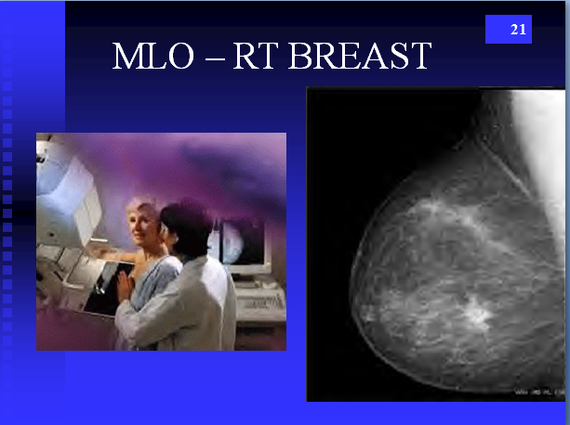
Image evaluation
3/11/2020

Slide 31
MLO …cont’d
Essential image characteristics
Proper labeling should be evident
The axilla, axillary tail, glandular tissue, pectoral muscle and infra-mammary fold should be demonstrated.
The pectoral muscle should be seen down to level of nipple on most patients.
There should be no dropping of the anterior aspect of the breast(camel nose).
Dense tissue should be adequately penetrated
3/11/2020

Slide 32
Exaggerated CC
Used when the lesion is suspected in the lateral aspect of breast.
Demonstrates the axillary tail and the upper midline portion of the breast tissue.
Position of patient and cassette
The breast-support table is horizontal and positioned slightly below the infra-mammary angle.
The woman stands close to the equipment, with her breast aligned slightly to the medial side
3/11/2020

Slide 33
Exaggerated CC …cont’d
The breast is lifted gently and placed on the table. The women is instructed to lean 15⁰-20⁰ laterally.
Compression is applied, the exposure made.
3/11/2020

Slide 34
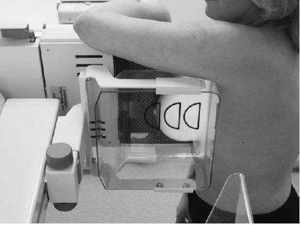
Exaggerated CC …cont’d
3/11/2020

Slide 35
Latero-medial
Obtained to complement the MLO projection
Position of patient and cassette
The breast-support table is placed against the sternum.
The arm on the side being examined is lifted up to clear the X-ray tube.
The equipment height is altered accordingly.
The breast is gently guided across and upwards.
Compression is applied while the radiographer’s hand supports the breast.
3/11/2020

Slide 36
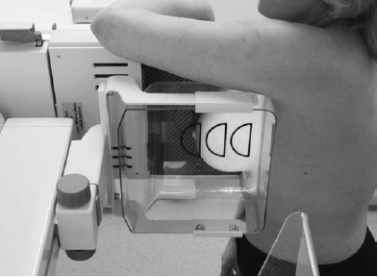
Latero-medial …cont’d
3/11/2020

Slide 37
Axillary tail
Is valuable when lymph gland involvement of a breast carcinoma is suspected.
Position of patient and cassette
The woman faces the equipment with feet are turned at an angle of approximately 15 degrees towards the midline.
The arm on the side under examination is raised and her hand placed on her head.
The equipment is at 45 degrees to the horizontal and level with the suprasternal notch.
3/11/2020

Slide 38
Axillary tail …cont’d
The woman is leant forwards towards the machine.
The radiographer pull her arm and to humeral head firmly across the top of the breast-support table.
The breast is held forward by the radiographer.
Compression is applied, the exposure made and compression released.
3/11/2020

Slide 39
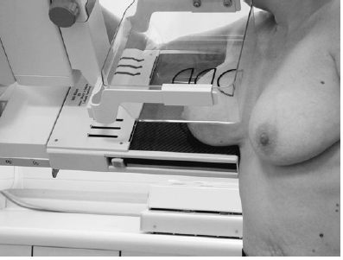
Axillary tail …cont’d
3/11/2020

Slide 40
Magnified projections
Magnification is used most commonly to examine areas of calcification.
Magnified projections are done in the CC and mediolateral projections.
A fine focus of 0.1mm2 is essential.
A specially designed platform or tower fits on to the breast support table.
No grid is used.
Small and large paddles may be utilized for magnified projections and a full-field diaphragm.
3/11/2020

Slide 41
Thank You !
3/11/2020

