Slide 1

CHAPTER 1
http://4.bp.blogspot.com/_eR7NoV1Oe6Q/TAgAp0QG0UI/AAAAAAAAM0I/qZbTAbC8A9A/s1600/gregor_mendel.jpg
FUNDAMENTALS OF GENETICS

Slide 2
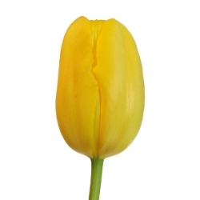
Genetics
Genetics is the study of how traits are passed from parents to offspring.
Heredity is the actual passing of traits from parents to offspring.
Thus, Genetics is the study of heredity.
A Trait is a genetically determined variant of a characteristic
Example: yellow flower
http://www.fiftyflowers.com/site_files/FiftyFlowers/Image/Product/Yellow_French_Tulip_Flower_250.jpg

Slide 3
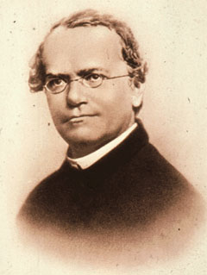
Gregor Mendel
Gregor Mendel is known as the father of modern genetics.
Mendel was an Austrian monk born in 1822.
Experimented with garden pea plants (Pisum sativum)
Presented the first paper on genetic research titled, “Experiments with Plant Hybrids” in 1866.
http://www.nndb.com/people/015/000083763/mendel-1-sized.jpg

Slide 4
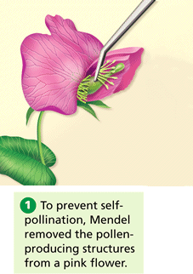
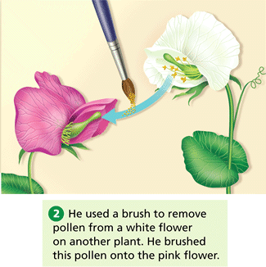
Why Pea Plants?
Pea plants usually self pollinate, producing pure plants.
Mendel found a way to easily cross pollinate plants, allowing him to select parent plants.

Slide 5
In all of Mendel’s experiments, he started with true-breeding plants
Produced by allowing plants to self-pollinate for several generations so that they are pure for a trait
Referred to them as the P generation (parent generation)
Then cross-pollinated to get the F₁ generation (first filial)
These were allowed to self-pollinate to produce the F₂ generation (second filial)
http://cooter.k12.mo.us/MrWalls/Bio2/chapter%209%20Mendel/Chapter%209%20%20Genetics%20Notes_files/image007.jpg

Slide 6
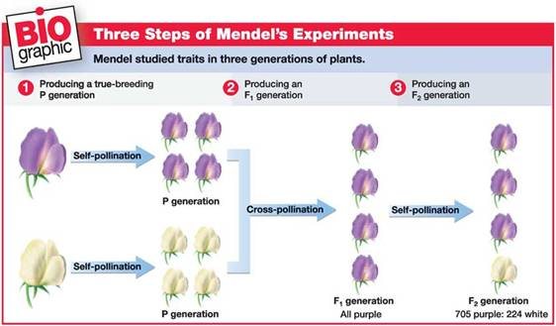
True breeding, and selfing

Slide 7
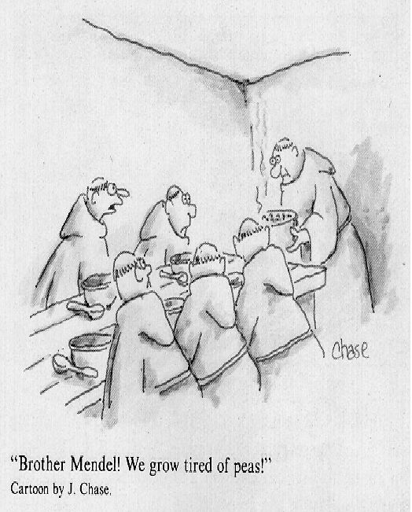
Easy to grow large numbers of plants, making his experiments statistically valid.
Many different traits could be studied.
http://mac122.icu.ac.jp/gen-ed/mendel-gifs/18-mendel-cartoon.JPG

Slide 8
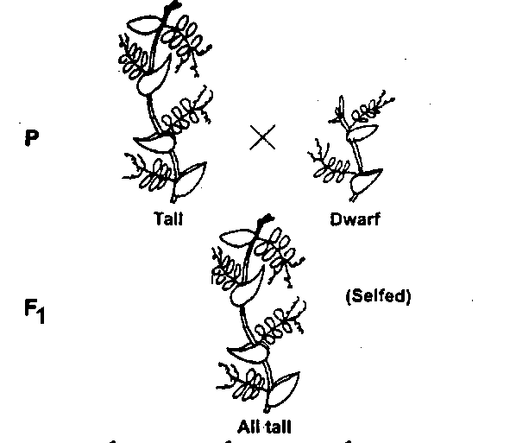
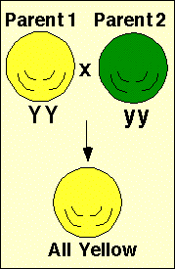
Mendel obtained true-breeding plants for all 14 traits observed. He did hundreds of crosses and documented the results.
Patterns began to emerge:
Only one of the two traits appeared in the F₁ generation
What happened to the other trait?

Slide 9
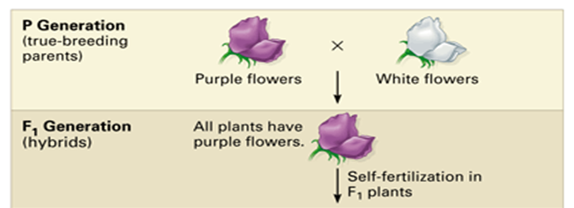

Slide 10
Mendel studied 7 characteristics:
and 14 observable traits
Plant height: tall and short
Flower position: axial and terminal
Pod color: green and yellow
Pod appearance: smooth and pinched
Seed texture: round and wrinkled
Seed color: yellow and green
Flower color: purple and white
http://www.learner.org/interactives/dna/images/genetics2.gif

Slide 11
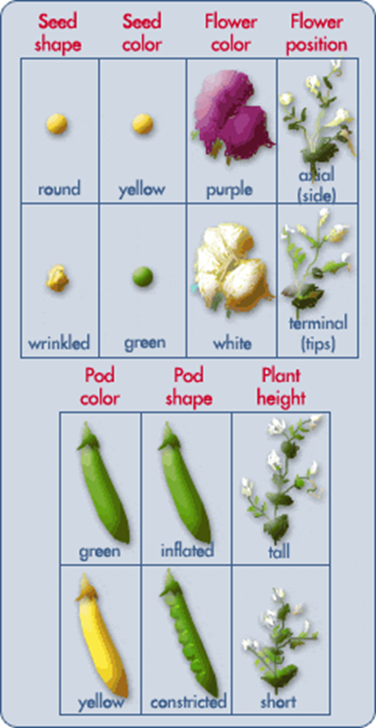

Slide 12
In all of Mendel’s experiments, he started with true-breeding plants
Produced by allowing plants to self-pollinate for several generations so that they are pure for a trait
Referred to them as the P generation (parent generation)
Then cross-pollinated to get the F₁ generation (first filial)
These were allowed to self-pollinate to produce the F₂ generation (second filial)
http://cooter.k12.mo.us/MrWalls/Bio2/chapter%209%20Mendel/Chapter%209%20%20Genetics%20Notes_files/image007.jpg

Slide 13
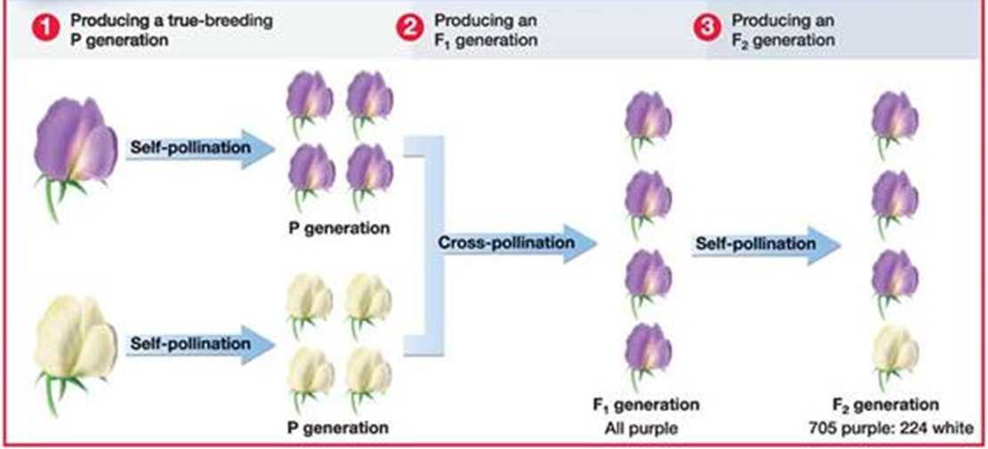

Slide 14
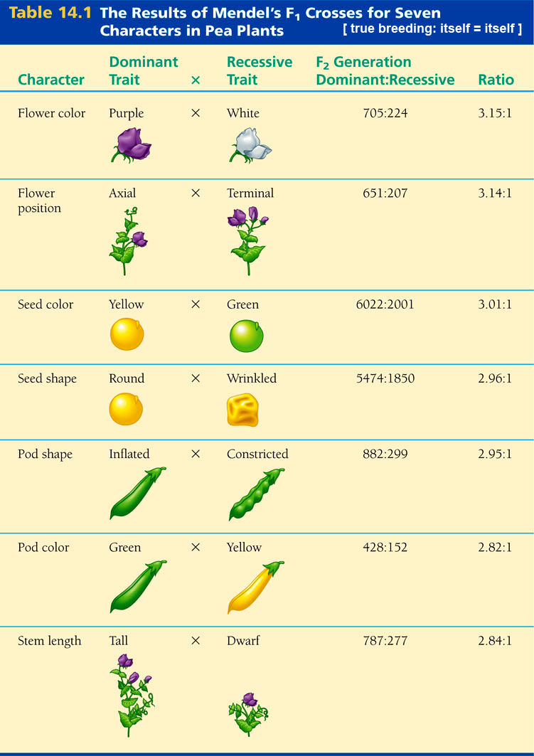

Slide 15
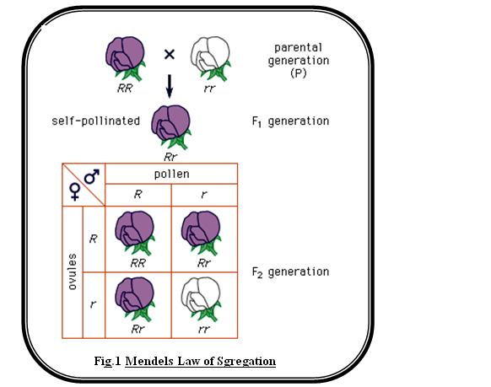
Mendel’s Laws
Law of Segregation —states that a pair of alleles is separated during the formation of gametes.
http://www.tutorvista.com/selfstudy/?id_course=59&id_lo=19194

Slide 16
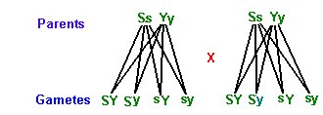
Law of Independent Assortment —factors for individual characteristics are not necessarily connected (unless they are carried on the same chromosome). Therefore, they separate independently of one another during the formation of gametes.
http://www.liftminds.com/docs/saver3/Biology/Inheritancepattern/Inherit006_files/image001.Jpg

Slide 17
Vocabulary revision
1.Genetics
2.Heredity
3.Trait
4.Pollination
5Self-pollination
6.Cross-pollination
7.True-breeding
8.P generation
9F₁ generation
10.F₂ generation
Transfer of pollen from anther to stigma
Variant of a characteristic
Study of how traits are passed from parents to offspring
Parent generation
Passing of traits from parents to offspring
First filial generation
Pollination between two different plants
Second filial generation
Pollination of one flower or flowers on the same plant
Pure plants (for a particular trait)

Slide 18
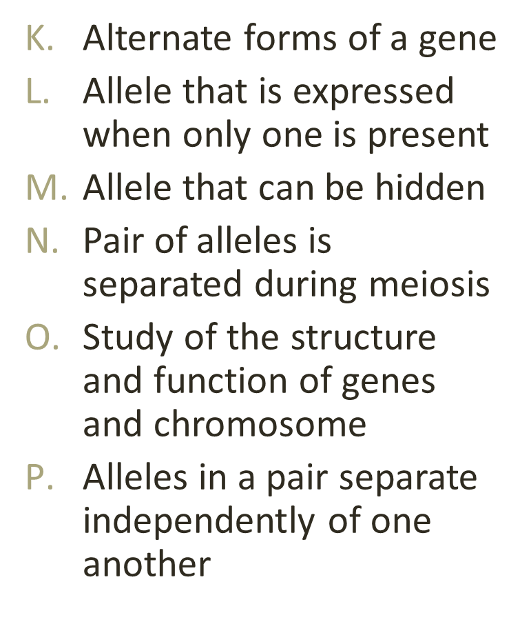
Vocabulary cont.
11.Dominant
12.Recessive
13.Law of Segregation
14.Law of Independent Assortment
15.Molecular Genetics
16.Allele

Slide 19
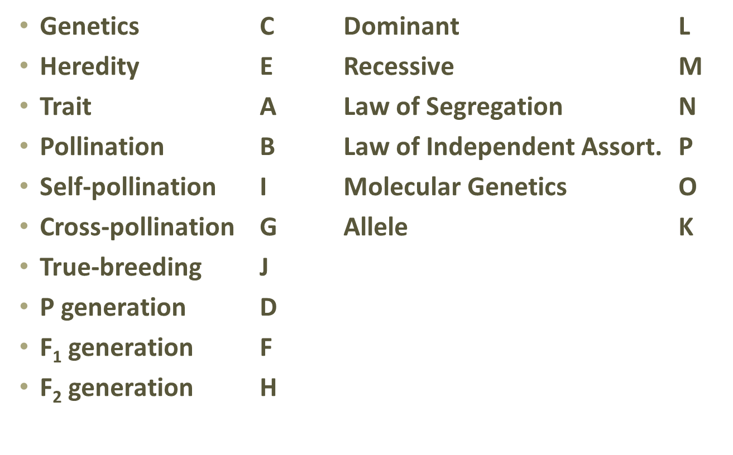
ANSWER KEY

Slide 20
Section 2.Vocabulary post test
An organism’s genetic make-up (letter code)
Two alleles are different
Two alleles are same
Tool for predicting the outcome of a particular cross
An organism’s appearance (word description)
Likelihood that an event will occur
A cross with only one characteristic
1BB : 2Bb : 1bb
A cross with two characteristics
3 Black : 1 Brown
1.Genotype
2.Phenotype
3.Homozygous
4.Heterozygous
5.Probability
6.Monohybrid Cross
7.Punnett Square
8.Genotypic Ratio
9.Phenotypic Ratio
10.Dihybrid Cross

Slide 21
Both alleles for a gene are expressed in a heterozygous offspring
One allele completely hides another
Phenotype is intermediate of the parents (blending)
Cross an unknown dominant with a homozygous recessive
11.Testcross
12.Complete 13.Dominance
14.Incomplete 15.Dominance
16.Codominance

Slide 22
Answer Key
Genotype A
Phenotype E
Homozygous C
Heterozygous B
Probability F
Monohybrid Cross G
Punnett Square D
Genotypic Ratio H
Phenotypic Ratio J
Dihybrid Cross I
Testcross N
Complete Dominance L
Incomplete Dominance M
Codominance K

Slide 23
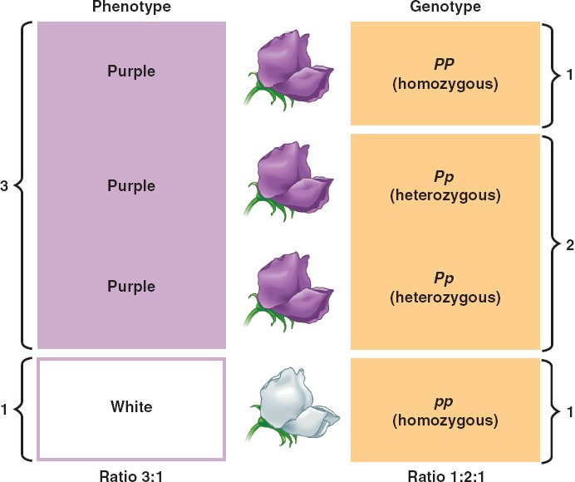
Phenotype and Genotype
Phenotype —an organism’s appearance (word description)
Phenotype for flower color: Purple or White
Genotype —an organism’s genetic make-up (letter code)
Genotype for purple flowers: PP or Pp
Genotype for white flowers: pp
http://www.nicerweb.com/bio1151/Locked/media/ch14/14_06PhenotypeVsGenotype_L.jpg

Slide 24
Probability
Probability is the likelihood that a specific event will occur.
Probability is calculated by the following equation:
Probability = # of times an event is expected to happen
# of times an event could happen
Ex: Mendel grew 705 purple plants and 224 white plants. What is the probability that a purple plant will appear in a similar cross?
705 = 0.75
929
Probability can be expressed as: a percent 75% a fraction ¾
or a ratio 3 : 1

Slide 25
Monohybrid Crosses
Monohybrid Crosses —only one characteristic is tracked
A tool used to predict the outcome of different types of monohybrid crosses is called a Punnett Square
Named for Reginald Punnett
Example: TT x tt (Pure tall plants x Pure short plants)
T
T
t
Tt
Tt
t
Tt
Tt
Result: 100% Heterozygous tall offspring
Genotype = Tt Phenotype = tall

Slide 26
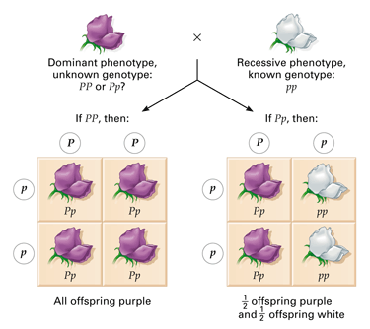
A testcross is performed when you are not sure if an
organism showing a dominant trait is heterozygous or homozygous for the trait. To find out, it is crossed with a homozygous recessive
If even one
recessive individual
appears, then
the unknown was
heterozygous.
http://proctornet.com/text/chapter10/10images/10-06.gif

Slide 27
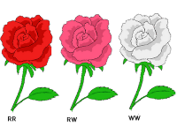
Incomplete Dominance
Incomplete Dominance occurs when offspring have a phenotype that is in between that of the two parents.
RR
Rr
rr
http://smabiology.blogspot.com/2008_11_01_archive.html

Slide 28
Punnett Squares for incomplete dominance are completed in the same manner. Except that the heterozygous individuals will have the blended phenotype.
Example: Pink Flower x Pink Flower
Rr x Rr
R
r
Results: 25% Red flowers
50% Pink flowers
25% White flowers
R
RR
Rr
r
Rr
rr
Genotypic Ratio: 1 RR : 2 Rr : 1 rr
Phenotypic Ratio: 1 Red : 2 Pink : 1 White

Slide 29
Dihybrid Crosses
Dihybrid Cross --shows two traits at the same time.
Example: RrYy x RrYy (heterozygous round and yellow seeds)
R = round r = wrinkled Y = yellow y = green
RY
Ry
rY
ry
Results:
9 round/yellow
3 round/green
3 wrinkled/yellow
1 wrinkled/green
RY
RRYY
RRYy
RrYY
RrYy
Ry
RRYy
RRyy
RrYy
Rryy
rY
RrYY
RrYy
rrYY
rrYy
ry
RrYy
Rryy
rrYy
rryy

Slide 30
Chromosome, DNA, Genes, Genetic diversity
Gene; molecular unit of hereditary material of living organisms
Sequential organization of the four nucleotides
located in a particular position within a chromosome that encodes a specific function.

Slide 31
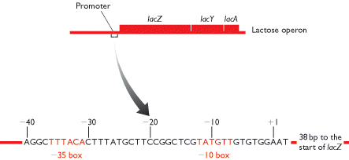
Chromosome, DNA, Genes, Genetic diversity
Brown Fig 9.17
BIOS Scientific Publishers Ltd, 1999

Slide 32
GENE
The gene unit is an encoding for a distinct protein product.
The DNA sequence of a gene is translated into the amino acid sequence which, after processing, results in a protein.
The genetic composition of an organism depends on its genotype in conjunction with environmental influences.
These genetic compositions determine its appearance and physical characteristics of that organism.

Slide 33
DNA (DEOXYRIBONUCLEIC ACID)
Deoxyribonucleic acid (DNA) is the hereditary material of a living organism.
The basic difference between a gene and DNA is that, the gene is a functional unit of nucleotide within the DNA sequence.
Nucleotides are nitrogen containing molecules that store all the genetic information about an organism.
There are four types of nucleotides; adenine, thymine, cytosine and guanine. They are represented by their abbreviation A, T, C, and G.

Slide 34
DNA (DEOXYRIBONUCLEIC ACID)
DNA is a good carrier of information and it is relatively motionless.
Each cell in an organism contains a copy of the organism’s DNA.
The genetic instructions for a living being are set in their genomes which are encoded on DNA.
Every cell has a copy of this DNA and is divided into discrete length called the chromosomes.
These chromosomes exist in the cell as pairs. These are so highly condensed that they can fit into the cell’s nucleus

Slide 35
RNA (RIBONUCLEIC ACID)
The relationship between DNA and protein, according to biochemists is: “DNA-makes-RNA- makes-protein”.
RNA is similar to DNA, but it has a slightly different chemical structure, and it carries nucleotides adenine (A), guanine (G), cytosine (C) and they are paired with uracil instead of thymine.
RNA is usually single-stranded and plays an important role in the synthesis of proteins.

Slide 36
RNA (RIBONUCLEIC ACID)
There are different types of RNA that fulfill different roles within an organism.
For example, messenger RNA (mRNA) carries the instructions for a protein construction site in the ribosome.
-Messenger RNA molecules are copies of genes, which carry instructions and act as templates for protein synthesis.
-

Slide 37
RNA (RIBONUCLEIC ACID)
Transfer RNA (tRNA) conveys an amino acid to the construction site as part of the translation process. A protein is then synthesized from the mRNA template in a process called translation.
-The amino acid sequence of the protein corresponds to the nucleotide sequence of the mRNA.

Slide 38
PROTEIN
Proteins are biologically important macromolecules that act as enzymes, hormones, signal receptors and play many other roles.
consist of chains of units called amino acids.
Virtually all cellular functions of the organism depend on proteins
-these functions include complex relationships among various proteins and thus between multiple genes.
The intricate relationship among genes, their expression patterns and their protein products, are the basis of diseases and create innovative and effective therapies.

Slide 39
GENE EXPRESSION PROCESSES, TRANSCRIPTION, TRANSLATION
gene expression simply refers to the events that transfer the information content of the gene into the production of a functional product, usually a protein.
Although there are genes whose functional product is an RNA, including the genes encoding the ribosomal RNAs as well as the transfer RNAs and certain other small RNAs,the vast majority of genes within the cell are protein-encoding genes.

Slide 40
GENE EXPRESSION PROCESSES, TRANSCRIPTION, TRANSLATION
The expression of an eukaryotic gene is a complex process involving a variety of steps prior to the actual synthesis of a protein.
These include
-the transcription of the gene into the primary RNA product,
-processing of this initial gene transcript to remove intron sequences and create the mature 3' terminus,
transport of the processed mRNA transcript to the cytoplasm, and then
-finally, translation of the messenger RNA into protein.

Slide 41
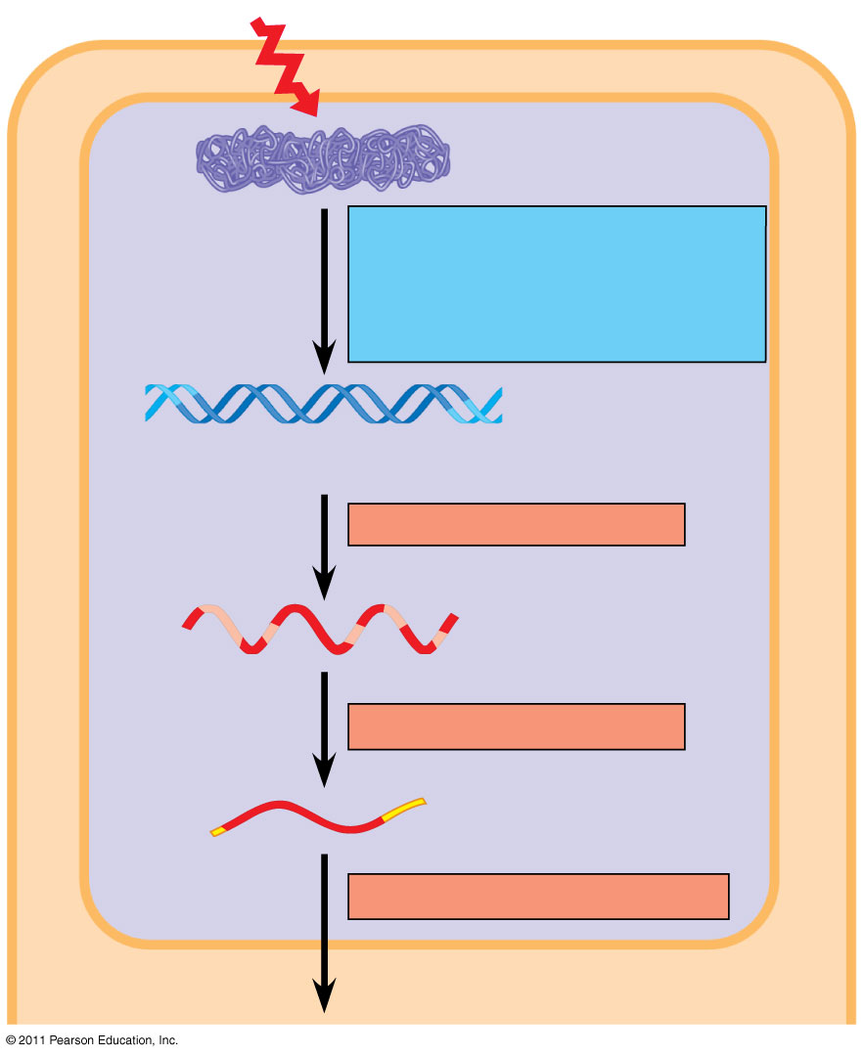
Figure 18.6a
Signal
NUCLEUS
Chromatin
Chromatin modification: DNA unpacking involving histone acetylation and DNA demethylation
DNA
Gene available for transcription
Gene
Transcription
RNA
Exon
Primary transcript
Intron
RNA processing
Tail
Cap
mRNA in nucleus
Transport to cytoplasm
CYTOPLASM
Notes:
Figure 18.6 Stages in gene expression that can be regulated in eukaryotic cells.

Slide 42
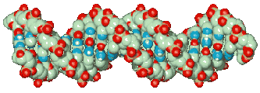
5’
3’
exon 1
intron
exon 2
intron
exon 3
3’
5’
Transcription
5’
3’
RNA splicing (remove introns)
5’
3’
Capping & polyadenylation
5’
^{7Me}G
AAAAA 3’
Export to cytoplasm
Pevsner p161

Slide 43
GENE EXPRESSION PROCESSES, TRANSCRIPTION, TRANSLATION
This complexity is in sharp contrast to the relatively simple process of gene expression in prokaryotic cells where the product of the gene is the mRNA and there is no nucleus that separates the genetic material from the machinery necessary to synthesize proteins.
-Thus, in a bacterium, protein synthesis actually begins on RNA molecule, before the synthesis of the RNA is complete.

Slide 44
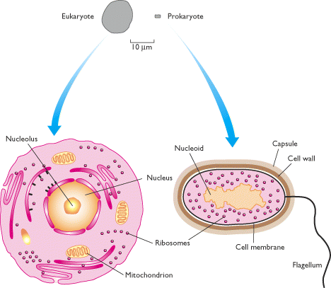
Eukaryotes vs Prokaryotes
“Typical” human & bacterial cells drawn to scale.
Eukaryotic cells are characterized by membrane-bound compartments, which are absent in prokaryotes.
Brown Fig 2.1
BIOS Scientific Publishers Ltd, 1999

Slide 45
Transcription
The initial step in gene expression is the transcription of the DNA molecule into an exact RNA copy.
the information in the gene is encoded in the sequence of nucleotides.
The transfer of information, to the ultimate synthesis of a protein, is accomplished via an RNA intermediate, the so-called messenger RNA.

Slide 46
Transcription plan
Nucleus
Gene
DNA
Transcription
messenger RNA
© 2016 Paul Billiet ODWS

Slide 47
Transcription
The mRNA molecule contains the exact same sequence of nucleotides as found in the DNA molecule (with U substituted for T).
This occurs through the process known as transcription and is carried out by an enzyme termed DNA-dependent RNA polymerase.
The product of transcription is an RNA molecule that is identical in sequence content to one of the DNA strands (the sense strand) and complementary to the other DNA strand (the template strand).

Slide 48
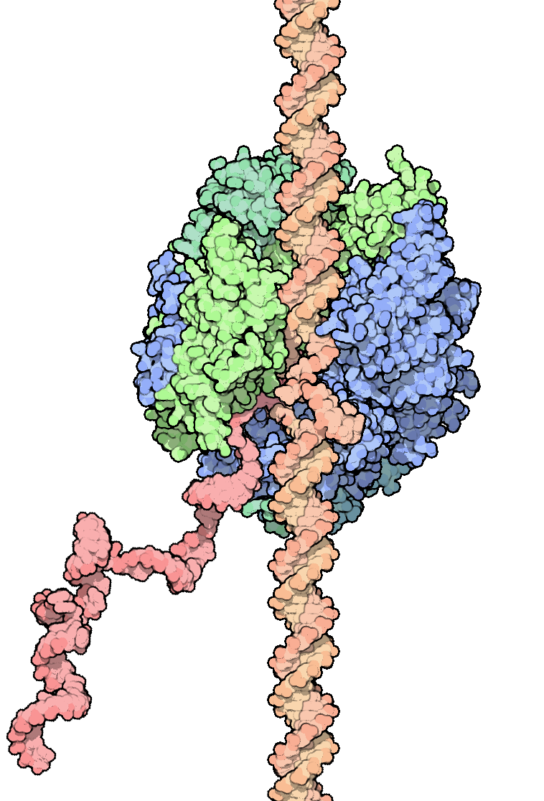
RNA polymerase
© 2016 Paul Billiet ODWS

Slide 49
Transcription
RNA differs from DNA in two respects:
First, RNA contains a hydroxyl (OH) residue at the 2' position of the sugar (ribose) whereas DNA contains an H at this position (deoxyribose).
-This changes some of the chemical properties of the two molecules.
Second, RNA replaces the base thymine with uracil.
-Although they are chemically different, their base pairing properties (complementarity to adenosine) are the same.
-Thus, in DNA, A pairs with T whereas in RNA, A pairs with U.

Slide 50
Transcription
Transcription always proceeds in a 5' to 3' direction with respect to polarity of the nucleotides in the RNA.
Thus, an unmodified primary transcription product would contain a 5' end with a triphosphate and a 3' end with an OH.
There are actually three distinct forms of RNA polymerase found in eukaryotic cells that are responsible for the transcription of three distinct types of genes:

Slide 51
Transcription
three distinct forms of RNA polymerase
-the genes encoding the ribosomal RNAs are transcribed by RNA polymerase I;
-the protein-encoding genes that produce the messenger RNAs are transcribed by RNA polymerase II;
- finally, the genes encoding transfer RNAs as well as certain other small RNA molecules are transcribed by RNA polymerase III.

Slide 52
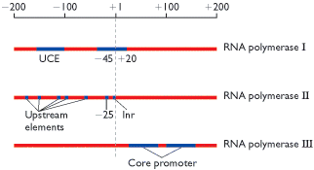
Eukaryotic genes are transcribed by 3 different RNA polymerases
Brown Fig 9.18
BIOS Scientific Publishers Ltd, 1999

Slide 53
Transcription
Transcription involves three distinct steps.
First, there must be a recognition of the gene by the RNA polymerase.
This is accomplished via the interaction of a variety of proteins called transcription factors that provide the recognition step, guiding the polymerase to the correct site.
Moreover, the interaction of these transcription factors with their DNA recognition sequences represents a rate-limiting step in the process of transcription initiation.

Slide 54
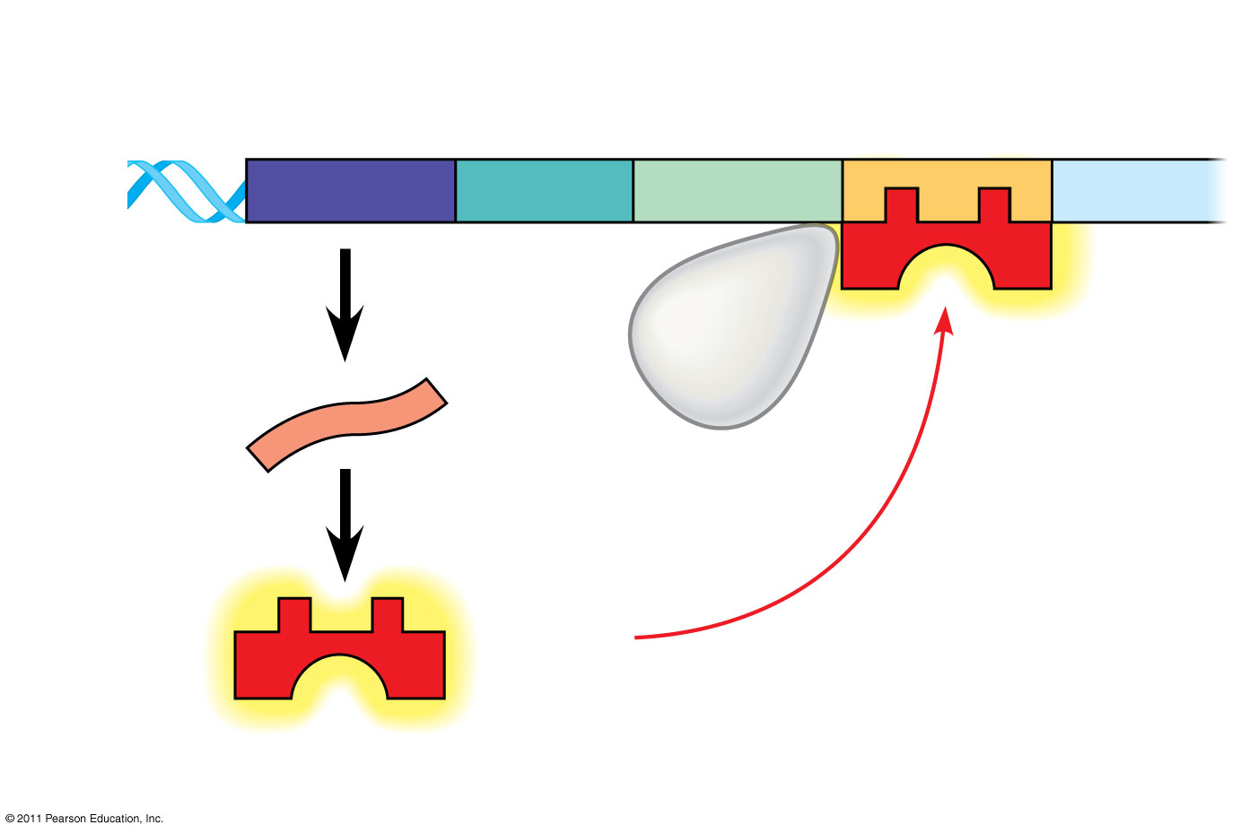
Figure 18.4a
Regulatory gene
Promoter
Operator
DNA
DNA
lacI
lacZ
No RNA made
3′
mRNA
RNA polymerase
5′
Active repressor
Protein
(a) Lactose absent, repressor active, operon off
Notes:
Figure 18.4 The lac operon in E. coli: regulated synthesis of inducible enzymes.

Slide 55
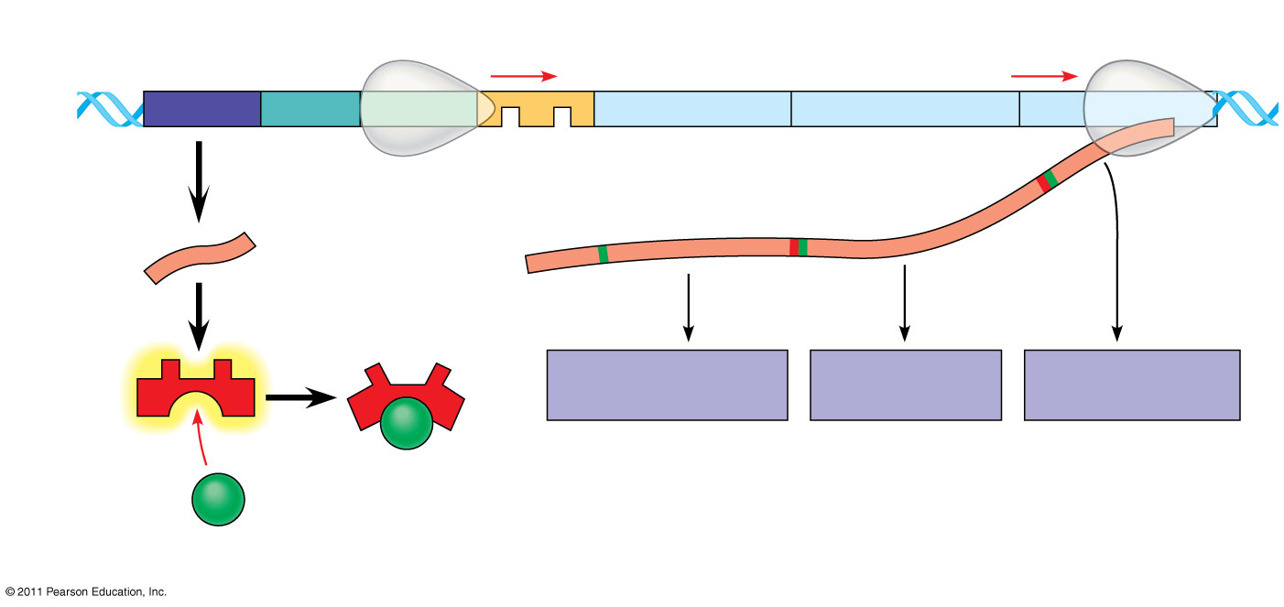
Figure 18.4b
lac operon
DNA
lacI
lacZ
lacY
lacA
RNA polymerase
3′
mRNA
mRNA 5′
5′
Protein
β-Galactosidase
Permease
Transacetylase
Allolactose (inducer)
Inactive repressor
(b) Lactose present, repressor inactive, operon on
Notes:
Figure 18.4 The lac operon in E. coli: regulated synthesis of inducible enzymes.

Slide 56
Transcription
Sequences in the DNA which are recognized by these transcription factors, and which serve as binding sites for the transcription factors, are generally upstream (5') of the start site for transcription and are called promoters.
Additional transcription factors can bind to sequence elements called enhancers that may be located further upstream or even downstream of the gene.
In either case, the DNA sequences that bind the transcription factors must be located on the same DNA molecule, thus the same chromosome, as the gene which is regulated. As such, these sequences are said to act in cis.

Slide 57
Figure 18.4a
Regulatory gene
Promoter
Operator
DNA
DNA
lacI
lacZ
No RNA made
3′
mRNA
RNA polymerase
5′
Active repressor
Protein
(a) Lactose absent, repressor active, operon off
Notes:
Figure 18.4 The lac operon in E. coli: regulated synthesis of inducible enzymes.

Slide 58
Transcription
The promoter is absolutely essential for transcription whereas the enhancer, as its name implies, increases the efficiency of transcription.
A critical component of many promoters is the sequence element TATA which is located nearest to the site of transcription initiation (about 30 nucleotides away).
The TATA element binds a general transcription factor known as TBP (TATA-binding protein) which is a component of a larger complex known as TFIID (transcription factor II D).

Slide 59
Transcription
Second the polymerase must initiate transcription. This site is dictated as a result of the interaction of the RNA polymerase at a specific site, guided by the transcription factors that have bound to the promoter and enhancer sequences.
Third, the polymerase must complete the transcription of the gene and then terminate transcription.

Slide 60
Transcription
Cis-Acting Elements: transcription is governed by DNA sequences usually located upstream (5') of the coding sequences.
These are binding sites for proteins that stimulate transcription by allowing RNA polymerase to interact.
They must be physically linked to the gene in order to have an effect and thus are said to function in cis.

Slide 61
Transcription
Trans-Acting Transcription Factors: These are the proteins that recognize and bind to the cis-acting promoter and enhancer elements.
There are usually multiple cis-acting elements, and thus multiple trans-acting factors, that are essential for transcription of a given gene.
The binding of factors to these elements facilitates the interaction of RNA polymerase and thus the initiation of transcription.
Thus, transcription initiation can be regulated by controlling the activity or the presence of these trans-acting factors.

Slide 62

Eukaryotic genes have large & complex regulatory regions
Cis-acting regulatory elements include:
Promoters,enhancers, silencers
Trans-acting regulatory factors include:
Transcription factors, chromatin remodeling
enzymes, small RNAs
Brown Fig 9.26
BIOS Scientific Publishers Ltd, 1999

Slide 63
Transcription
Transcription factors possess two essential properties - the ability to bind to DNA in a sequence specific manner and the ability to cause a stimulation of transcription.
Generally, these two properties are a function of distinct and separable domains in the proteins.
-That is, one can often identify and define a domain of the protein, the transcription factor, that is essential for DNA binding and a separate, distinct domain of the protein that functions to activate transcription once bound to the DNA.

Slide 64
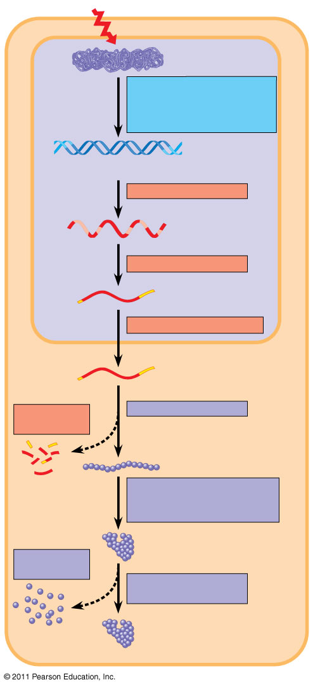
Figure 18.6
Signal
NUCLEUS
Chromatin
Chromatin modification: DNA unpacking involving histone acetylation and DNA demethylation
DNA
Gene available for transcription
Gene
Transcription
RNA
Exon
Primary transcript
Intron
RNA processing
Tail
Cap
mRNA in nucleus
Transport to cytoplasm
CYTOPLASM
mRNA in cytoplasm
Degradation of mRNA
Translation
Polypeptide
Protein processing, such as cleavage and chemical modification
Degradation of protein
Active protein
Transport to cellular destination
Cellular function (such as enzymatic activity, structural support)
Notes:
Figure 18.6 Stages in gene expression that can be regulated in eukaryotic cells.

Slide 65
The Steps Involved in Transcription Initiation
Although variations in any step of gene expression can be regulatory, by far the most frequent form of gene control is the regulation of transcription initiation.
Control of transcription involves the regulation of transcription factors that interact with the critical cis acting sequences in the promoter and enhancer that then dictate the frequency of RNA polymerase binding to the gene and subsequent transcription.

Slide 66
The Steps Involved in Transcription Initiation
The process of promoter recognition and utilization involves a stepwise interaction of a complex series of transcription factors with the promoter to create a stable DNA-protein complex that allows RNA polymerase to initiate transcription.

Slide 67
Figure 18.4a
Regulatory gene
Promoter
Operator
DNA
DNA
lacI
lacZ
No RNA made
3′
mRNA
RNA polymerase
5′
Active repressor
Protein
(a) Lactose absent, repressor active, operon off
Notes:
Figure 18.4 The lac operon in E. coli: regulated synthesis of inducible enzymes.

Slide 68
Figure 18.4b
lac operon
DNA
lacI
lacZ
lacY
lacA
RNA polymerase
3′
mRNA
mRNA 5′
5′
Protein
β-Galactosidase
Permease
Transacetylase
Allolactose (inducer)
Inactive repressor
(b) Lactose present, repressor inactive, operon on
Notes:
Figure 18.4 The lac operon in E. coli: regulated synthesis of inducible enzymes.

Slide 69
Post-Transcriptional Events of Gene Expression
Whereas the initial transcript of a bacterial gene is the actual messenger RNA, the initial transcript of a eukaryotic gene must be altered in a variety of ways before it can function. Thus, post-transcriptional processing and modification events are critical to the formation of a eukaryotic mRNA.

Slide 70
RNA Processing
The products of all three types of eukaryotic genes are processed in a variety of ways.
The most dramatic is the splicing of most of the protein coding transcripts, joining exon sequences together and removing intron sequences.
Splicing of the pre-mRNA occurs via a stepwise series of cleavage and ligation events that remove the intron sequences and bring the exons together in a precise manner.

Slide 71
RNA Processing
The initial step involves the cleavage of the RNA at the exon 3' end/intron 5' end border.
The free 5' end of the intron forms an unusual linkage with the 2' OH of an A residue near the 3' end of the intron, creating an intermediate that has a lariat structure.
Subsequently, a cleavage is made at the 3' end of the intron, releasing the lariat intron, and then allow the two exons to be ligated

Slide 72
RNA Modifications
- The 5' terminus of the transcript is capped by the addition of a modified GTP residue that forms a 5'-5' linkage.
-This probably serves to protect the RNA against degradation and it clearly serves also a role in the initiation protein synthesis by interacting with an essential factor.

Slide 73
RNA Modifications
Finally, the 3' terminus of the RNA is modified by poly adenylation.
-This poly A tail of approximately 200 adenosine residues serves as a binding site for a protein that participates in protein synthesis, likely by facilitating the formation of an initiation complex with activities that bind to the 5' end of the mRNA.
-The poly A tail also serves to protect the RNA from degradation.

Slide 74
Nucleus-Cytoplasmic RNA Transport
Unlike bacteria, the eukaryotic cell is compartmentalized.
Thus, the primary transcript is produced in one compartment (the nucleus) but it must function in another compartment (the cytoplasm).
-Therefore, the final processed product (mRNA) must be transported through the nuclear envelope to reach the cytoplasm and be engaged with the ribosomes for translation..

Slide 75
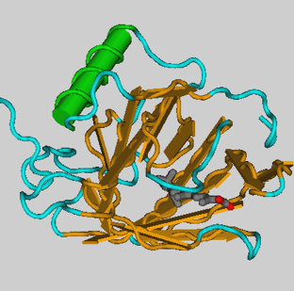
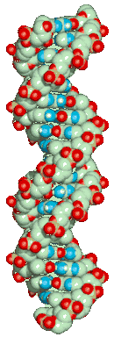
DNA
RNA
protein
Phenotype
cDNA
[1] Transcription
[2] RNA processing (splicing)
[3] RNA export
[4] RNA surveillance
Pevsner p160

Slide 76
Protein Synthesis
Upon successful transcription, processing, modification and then transport to the cytoplasm, the mRNA is finally competent to perform its function - namely, translation of the sequence encoded in the gene into the synthesis of a protein.
The genetic code is read as triplets of nucleotides.
The reading of the sequence in the mRNA to direct the synthesis of a unique protein is the process termed translation

Slide 77
The Components of Translation:
Ribosome a multicomponent RNA-protein structure that serves as the framework upon which protein synthesis takes place and which also provides the enzymatic activity for formation of the peptide bonds.
tRNA: a set of small RNAs, each specific for a given amino acid, carries the amino acid to the ribosome for insertion into the growing polypeptide chain.

Slide 78
The Components of Translation:
The anticodon in the tRNA is complementary to the codon in the mRNA.
Aminoacyl tRNA synthetases: enzymes that link an amino acid to a cognate tRNA in a two-step process.
There is a unique synthetase for each amino acid but not one for every tRNA

Slide 79
The Translation Process
Polypeptide chains are synthesized in a sequential, step-wise fashion.
Three distinct steps in protein synthesis can be defined: initiation, elongation, and termination.
Each assembly step during the elongation process involves a peptidyl transferase reaction resulting in the formation of a peptide bond.

Slide 80
Codon Recognition
Codons (base triplets) in the mRNA are recognized by tRNAs which carry the appropriate amino acid to the translation machinery.
Codon recognition involves base pairing between the codon in the mRNA and the anticodon in the tRNA.

Slide 81
The Translation Process
Initiation: Initiation of protein synthesis involves recognition of a methionine codon (AUG) in the mRNA by a special methionyl tRNA, different from the methionyl tRNA that is used for elongation.
The initiation event is accomplished through the action of several initiation factors that allow interaction of the mRNA with the small ribosomal sub unit, GTP, and the initiator met-tRNA.

Slide 82
Elongation
There are two functional sites on the ribosome that are occupied by tRNA and that facilitate peptide bond formation.
-The P site (peptidyl) and the A site (aminoacyl).
Following formation of the peptide bond, the tRNA remaining in the P site leaves and the tRNA-peptidyl complex moves to the P site.

Slide 83
Elongation
A new aminoacyl-tRNA, specified by the mRNA codon, then moves into the A site and peptide chain elongation continues.
The catalysis of peptide bond formation is a function of the large ribosomal subunit.

Slide 84
Termination:
Three codons (UAG, UAA, and UGA) do not specify an amino acid-tRNA and thus cause termination of translation.
-These codons signal the release of the peptidyl-tRNA complex when recognized by termination factors.

Slide 85
Termination
This results in the release of an uncharged tRNA lacking an attached amino acid residue as well as the completed polypeptide chain.
The ribosome then disengages from the mRNA and the subunits dissociate, ready to start the cycle over again.

Slide 86
Gene Regulation
Gene Regulation
The phenotype of a cell as well as the organism as a whole, is the consequence of the regulated expression of a group of genes.
proteins are expressed at a particular time in the cell cycle; proteins are produced in response to hormones; etc.
Clearly, an understanding of the molecular basis for the control gene expression is critical to an overall understanding of the basis for cell phenotype.

Slide 87
Mechanisms of heredity/inheritance
Friedrich Miescher discovered DNA near the end of the nineteenth century;
-he had isolated from sperm and pus
He died several decades before the function of DNA and its famous double-helical structure were uncovered.
After Miescher, other scientists tried to identify the chemical composition of sperm, reasoning that sperm must carry the genetic material to the next generation.
By the late 1940s biochemists knew that DNA was a very long polymer made up of millions of nucleotides.

Slide 88
Mechanisms of heredity/inheritance
. Each nucleotide is composed of nitrogen containing base (C,G,A &T), as well as a monosaccharide sugar called deoxyribose and a phosphate group.
The nucleotides are joined by covalent bonds between the sugar of one nucleotide and the phosphate of the next, resulting in an alternating sugar-phosphate backbone.
According to base pairing rules (A with T, and C with G), hydrogen bonds bind the nitrogenous bases of the two separate polynucleotide strands to make double-stranded DNA .

Slide 89
Mechanisms of heredity/inheritance
Adenine and guanine are purine bases, while cytosine and thymine are pyrimidines.
These nucleotides form phosphodiester bonds, creating the phosphate-deoxyribose backbone of the DNA double helix with the nucleobase pointing inward.
DNA strands have directionality and the different ends of a single strand are called the “3’ (three-prime) end” and the “5’ (five-prime) end”.
The strands of the double helix are anti-parallel with one being 5’ to 3’, and the opposite strand 3’ to 5’.
Directionality has consequences in DNA synthesis, because DNA polymerase can synthesize DNA in only one direction by adding nucleotides to the 3’ end of a DNA strand.

Slide 90
Mechanisms of heredity/inheritance
Nucleic acids composed of the three major macromolecules (sugar, nitrogen base and phosphate groups) are essential for all known forms of life.
Most DNA molecules consist of two biopolymer strands coiled around each other to form a double helix. The two DNA strands are known as polynucleotide; since they are composed of simpler units called nucleotides

Slide 91
DNA Replication
Is the process of producing two identical replicas from one original DNA molecule.
This biological process occurs in all living organisms and is the basis for biological inheritance.
DNA is made up of two strands and each strand of the original DNA molecule serves as a template for the production of the complementary strand, a process referred to as semi conservative replication.
Cellular proof reading and error-checking mechanisms ensure near perfect fidelity for DNA replication .

Slide 93
DNA replication
The Problem:
DNA is maintained in a compressed, supercoiled state.
BUT, basis of replication is the formation of strands based on specific bases pairing with their complementary bases.
∴ Before DNA can be replicated it must be made accessible, i.e., it must be unwound

Slide 94
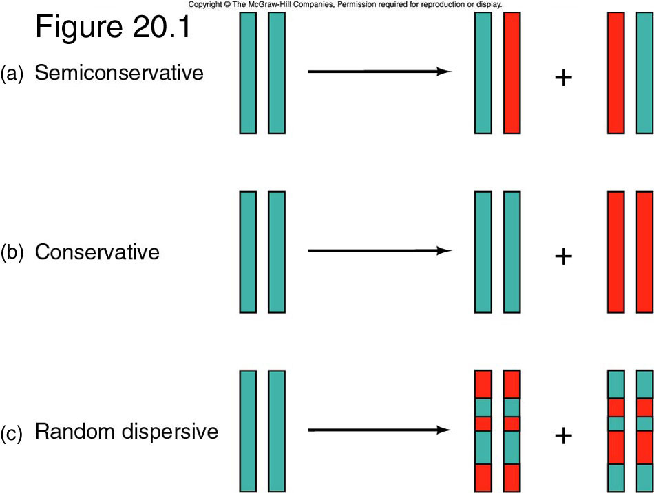
Models of Replication
THREE HYPOTHESES FOR DNA REPLICATION
Notes:
1) Semiconservative model:
Daughter DNA molecules contain one parental
strand and one newly-replicated strand
2) Conservative model:
Parent strands transfer information to an
intermediate (?), then the intermediate gets copied.
The parent helix is conserved, the daughter
helix is completely new
3) Dispersive model:
Parent helix is broken into fragments, dispersed, copied then assembled into two new helices.
New and old DNA are completely dispersed

Slide 95
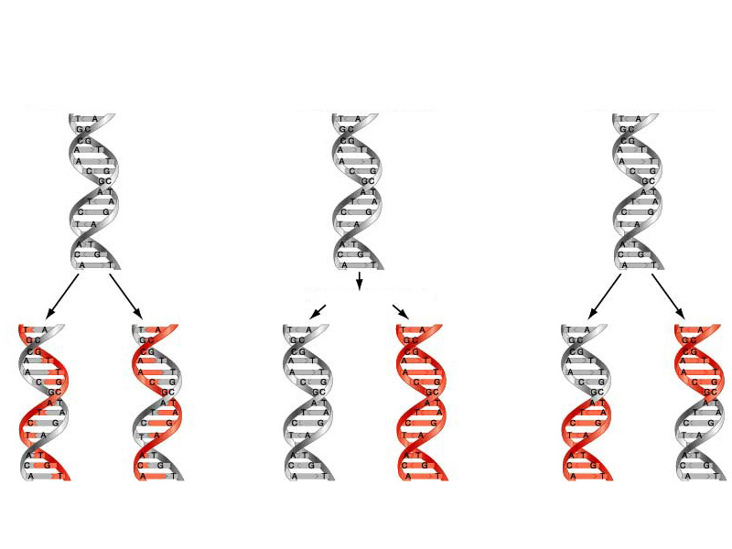
MODELS OF DNA REPLICATION
(a) Hypothesis 1:
(b) Hypothesis 2:
(c) Hypothesis 3:
Semi-conservative replication
Conservative replication
Dispersive replication
Intermediate molecule
Notes:
1) Semiconservative model:
Daughter DNA molecules contain one parental
strand and one newly-replicated strand
2) Conservative model:
Parent strands transfer information to an
intermediate (?), then the intermediate gets copied.
The parent helix is conserved, the daughter
helix is completely new
3) Dispersive model:
Parent helix is broken into fragments, dispersed, copied then assembled into two new helices.
New and old DNA are completely dispersed

Slide 97
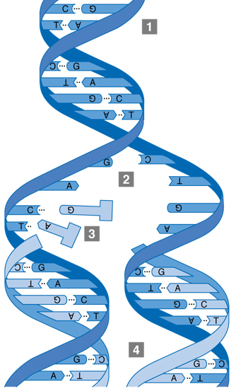
Replication as a process
Double-stranded DNA unwinds.
The junction of the unwound
molecules is a replication fork.
A new strand is formed by pairing
complementary bases with the
old strand.
Two molecules are made.
Each has one new and one old
DNA strand.

Slide 98
The replication fork
Unwinding of DNA at the origin and synthesis of new strands results in replication forks growing bidirectional from the origin. A number of proteins are associated with the replication fork which helps in terms of the initiation and continuation of DNA synthesis.
DNA polymerase synthesizes the new DNA by adding complementary nucleotides to the template strand.

Slide 99
The replication fork
Topoisomerases are enzymes that temporarily break the strands of DNA, relieving the tension caused by unwinding the two strands of the DNA helix;
topoisomerases (including DNA gyrase) achieve this by adding negative supercoils to the DNA helix .

Slide 100
The replication fork
The replication fork is a structure that forms within the nucleus during DNA replication.
It is created by helicases, which break the hydrogen bonds holding the two DNA strands together.
The resulting structure has two branching “prongs”, each one made up of a single strand of DNA.
These two strands serve as the template for the leading and lagging strands, which will be created as DNA polymerase matches complementary nucleotides to the templates; the templates may be properly referred to as the leading strand template and the lagging strand template.

Slide 101
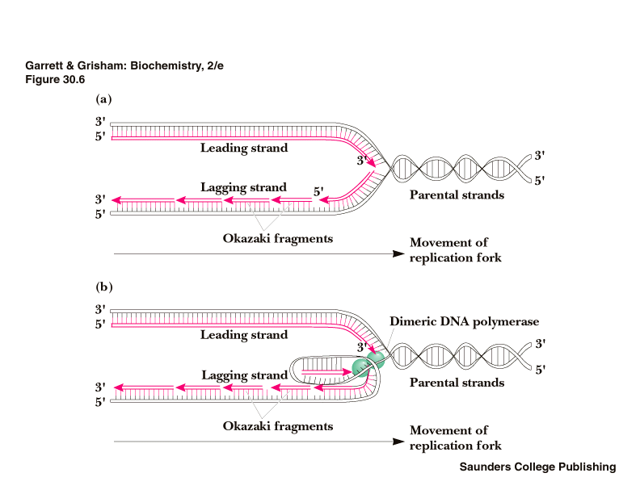
Continuous synthesis
Discontinuous synthesis
∴DNA replication is semi-discontinuous

Slide 102
The replication fork
DNA is always synthesized in the 5’ to 3’ direction.
Since the leading and lagging strand templates are oriented in opposite directions at the replication fork, a major issue is how to achieve synthesis of nascent (new) lagging strand DNA, whose direction of synthesis is opposite to the direction of the growing replication fork
The leading strand is the strand of nascent DNA which is being synthesized in the same direction as the growing replication fork.
A polymerase “reads” the leading strand template and adds complementary nucleotides.

Slide 103
Lagging strand synthesis
Is opposite to the direction of the growing replication fork.
Because of its orientation, replication of the lagging strand is more complicated as compared to that of the leading strand.
The lagging strand is synthesized in short, separated segments.
On the lagging strand template, a primase “reads” the template DNA and initiates synthesis of a short complementary RNA primer.
A DNA polymerase extends the primed segments, forming Okazaki fragments.

Slide 104
Lagging strand synthesis
The RNA primers are then removed and replaced with DNA, and the fragments of DNA are joined together by DNA ligase.
DNA polymerase III (in prokaryotes) or Pol δ (in eukaryotes) is responsible for extension of the primers added during replication of the lagging strand.
Primer removal is performed by DNA polymerase I (in prokaryotes) and Pol δ (in eukaryotes).

Slide 105
Enzyme and Function in DNA Replication
DNA Helicase Also known as helix destabilizing enzyme. Unwinds the DNA double helix at the Replication Fork.
DNA Polymerase Builds a new duplex DNA strand by adding nucleotides in the 5’ to 3’ direction. Also performs proof-reading and error correction
DNA clamp: A protein which prevents elongating DNA polymerases from dissociating from the DNA parent strand.
Single-Strand Binding (SSB) Proteins :Bind to ssDNA and prevent the DNA double helix from re-annealing after DNA helicase unwinds it, thus maintaining the strand separation, and facilitating the synthesis of the nascent strand.
Topoisomerase: Relaxes the DNA from its super-coiled nature.

Slide 106
Enzyme and Function in DNA Replication
DNA Gyrase: Relieves strain of unwinding by DNA helicase; this is a specific type of topoisomerase
DNA Ligase :Re-anneals the semi-conservative strands and joins Okazaki Fragments of the lagging strand.
Primase: Provides a starting point of RNA (or DNA) for DNA polymerase to begin synthesis of the new DNA strand.
Telomerase: Lengthens telomeric DNA by adding repetitive nucleotide sequences to the ends of eukaryotic chromosomes.

Slide 107
MEIOSIS AND MITOSIS
MEIOSIS AND MITOSIS
Cell Cycle :The sequence of events by which a cell duplicates its genome, synthesizes the other constituents of the cell and eventually divides into two daughter cells is termed cell cycle. Phases of Cell Cycle
-The cell cycle is divided into two basic phases:
1. Interphase
2. M Phase (Mitosis phase)

Slide 108
phases of cell cycle
The M Phase represents the phase when the actual cell division or mitosis occurs and
The interphase represents the phase between two successive M phases.
The interphase lasts more than 95% of the duration of cell cycle.
The M Phase starts with the nuclear division, corresponding to the separation of daughter chromosomes (karyokinesis) and usually ends with division of cytoplasm (cytokinesis).
The interphase, though called the resting phase, is the time during which the cell is preparing for division by undergoing both cell growth and DNA replication in an orderly manner.

Slide 109
The interphase is divided into three further phases:
1. G1 phase –gap
corresponds to the interval between mitosis and initiation of DNA replication.
During G1 phase the cell is metabolically active and continuously grows but does not replicate its DNA.
2.Sphase –synthesis or synthesis phase marks the period during which DNA synthesis or replication takes place.
During this time the amount of DNA per cell doubles.
If the initial amount of DNA is denoted as 2C then it increases to 4C.
However, there is no increase in the chromosome number; if the cell had diploid or 2n number of chromosomes at G1, even after S phase the number of chromosomes remains the same, i.e., 2n.
3.During the G2 phase, proteins are synthesized in preparation for mitosis while cell growth continues.

Slide 110
M PHASE-MITOSIS
The M Phase represents the phase when the actual cell division or mitosis occurs chromosomes are condensed and the nucleus and cytoplasm divide.
This is the most dramatic period of the cell cycle, involving a major reorganization of virtually all components of the cell.
Since the number of chromosomes in the parent and progeny cells is the same, it is also called as equational division.
Though for convenience mitosis has been divided into four stages of nuclear division,
1.prophase 2.metaphase 3. anaphase 4 telophase

Slide 111
MITOSIS
1.prophase
Prophase which is the first stage of mitosis follows the S and G2 phases of interphase.
In the S and G2 phases the new DNA molecules formed are not distinct but inter wined.
Prophase is marked by the initiation of condensation of chromosomal material. The chromosomal material becomes untangled during the process of chromatin condensation .
The centriole, which had undergone duplication during S phase of interphase, now begins to move towards opposite poles of the cell.

Slide 112
1.PROPHASE
The completion of prophase can thus be marked by the following characteristic events: Chromosomal material condenses to form compact mitotic chromosomes.
Chromosomes are seen to be composed of two chromatids attached together at the centromere.
Initiation of the assembly of mitotic spindle, the microtubules, the proteinaceous components of the cell cytoplasm help in the process.
Cells at the end of prophase, when viewed under the microscope, do not show golgi complexes, endoplasmic reticulum, nucleolus and the nuclear envelope.

Slide 113
2. Metaphase

