Slide 1
STRUCTURE AND PROPERTY OF WOOD (FOR2103)3Chrs
CHAPTER 1
INTRODUCTION

Slide 2
1. INTRODCTION
Wood has been used and adapted by humans since the earliest recognition that they could make use of the materials they found around them.
to meet a varying array of human needs, in peace and in war, in farming and in industry, people gradually came to understand something of the unique nature of wood.
Its properties were first understood by experience, more recently by systematic research and refined observation.
Wood is still essential to human life, but has evolved over the ages from a simple, readily available natural material to a modern industrial and engineering material, with a unique ability to contribute to human life both as a material for use and as a key element in the natural world of the forest.

Slide 3
History of Wood Use
From the earliest times, the use of wood involved consideration of quality, cost and availability, as well as the intended use of the product.
Scarcity of valuable timber led to careful and economic use.
-Boards were carefully matched and fitted;
-blemishes were removed and filled.
Early humans used wood because it was available and no elaborate tools were needed to work it.
The quality of the products depended more on the quality of the wood and the skill of the workman than on the tools available for woodworking.

Slide 4
HISTORY OF WOOD USE
The development of copper tools by about 5000 BC opened new opportunities for craftsmanship
From the tenth to the eighteenth centuries in Europe, wood was the material primarily used for buildings, tools, machines, mills, carts, buckets, shoes, furniture and barrels Etc.
The first printing press was made of wood and such presses continued to be made of wood for a hundred years.
Most of the machines and inventions to make possible the machine age were formed of wood during that period.

Slide 5
HISTORY OF WOOD USE
In Europe, wood use reached a peak during the sixteenth century, then began to diminish, not due to the limitations of wood, but due to increasing demands for fuel and materials and the expansion of agriculture into formerly forested lands.
Wood use in North America continued to expand long after the decline of use in Europe .
Many of the uses now take different forms, reflecting new product demands and new technology.

Slide 6
HISTORY OF WOOD USE
In forested zones, where timber was plentiful, solid walls were built of tree trunks or heavy timbers.
As construction with stone and concrete became common, wood was used for concrete forms and supplementary structural components such as trusses and roof supports

Slide 7
HISTORY OF WOOD USE
The architecture of the early colonists from Europe used wood intensively, adapting the concepts used in their homelands to the cultural conditions of the times and the availability of materials.
Decoration and style of furniture have evolved as part of the artistic, cultural and technical development of society.

Slide 8
HISTORY OF WOOD USE
Design and complexity were greatly enhanced by the development of copper tools.
Efficiency and economy of wood use were stimulated by the gradual depletion of fine furniture woods and increasing international trade in both furniture and the woods from which it was made.

Slide 9
HISTORY OF WOOD USE
Ply wood and veneer, like most other basic forms of wood product, can be traced back to at least 3000 BC.
The purpose until relatively recent times was to extend as far as possible the use of valuable decorative woods.
Such woods were high value items of international trade and supplies were expensive and uncertain.

Slide 10
HISTORY OF WOOD USE
Egypt, Greece, and Rome all had highly developed arts in veneered wood products.
As compared with the ancient arts of decorative plywood, made primarily from hardwoods, softwood plywood is of relatively recent origin.
Manufacture of softwood plywood began in the early 1900s in the USA and the industry is still active there, but has spread to many other parts of the world.

Slide 11
HISTORY OF WOOD USE
It was developed as an alternative to lumber by gluing together thin layers of knife-cut wood with the grain of alternate layers at right angles to each other.
The plywood industry began growing rapidly following World War I and was further stimulated by the demands of World War II and the development of weather resistant adhesives.
Production of plywood panels has increased substantially in most parts of the world during the past few decades.

Slide 12
HISTORY OF WOOD USE
The development of wood-based fused materials, mostly within the 20th century, has had a significant effect on wood use and opened new opportunities for creative and versatile products from a changing wood resource.
The capability to make engineered structural panels in a variety of forms and combinations with resins and other materials and the opportunity to economically use residues from other types of wood production `provides incentives for further development and application of the concept, of wood composites.

Slide 13
HISTORY OF WOOD USE
Wet process fiberboard was developed late in the 19th century and was commonly used for sheathing, interior paneling, and roof insulation early in the 20th.
Medium density fiberboard for core stock in furniture, mineral bonded products using wood wool and cement to make structural panels, products molded from wood particles, and composites of wood and other materials are greatly extending the wood resource and improving its utility while providing practical and economical materials for many kinds of construction

Slide 14
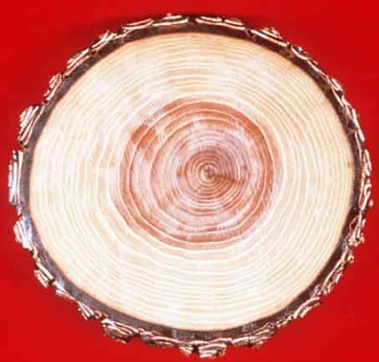
Chapter 2
TREE GROWTH AND PRODUCTION OF WOODY TISSUES

Slide 15
3.1Botanic origin of wood
The Nature of Wood
Wood is a natural product of the growth of trees, primarily composed of hollow, elongate, spindle-shaped cells that are arranged more or less parallel to each other in the direction of the tree trunk.
This makes wood basically fibrous this strongly affect properties such as strength and stiffness, as well as the grain pattern of the wood

Slide 16
The tree
A living, growing tree has two main domains, the shoot and the roots.
Roots are the subterranean structures responsible for water and mineral nutrient uptake, mechanical anchoring of the shoot, and storage of biochemicals.
The shoot is made up of the trunk or bole, branches, and leaves.
If one cuts down a tree and looks at the stump, several gross observations can be made.
The trunk is composed of various materials present in concentric bands.
From the outside of the tree to the inside are outer bark, inner bark, vascular cambium, sapwood, heartwood, and the pith

Slide 17
The tree
The interior of a tree is complex.
It reveals the complete history of the tree: its age, the conditions of growth, its structure and even some of its properties.
-Eg one year cycle is comprised of a light pale wood that grew at a start of a year and dark at the end of the year ,counting the dark ring can tell the age of a tree.
Outer bark provides mechanical protection to the softer inner bark and also helps to limit evaporative water loss.
Inner bark is the tissue through which sugars (food) produced by photosynthesis are translocated from the leaves to the roots or growing portions of the tree.

Slide 18
The tree
The vascular cambium is the layer between the bark and the wood that produces both these tissues each year.
The sapwood is the active, “living” wood that conducts the water (or sap) from the roots to the leaves.
The pith at the very center of the trunk is the remnant of the early growth of the trunk, before wood was formed.

Slide 19
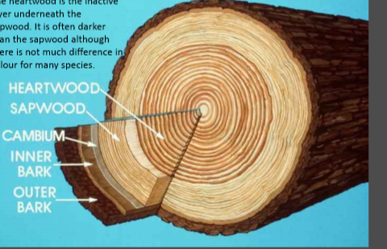
The tree

Slide 20
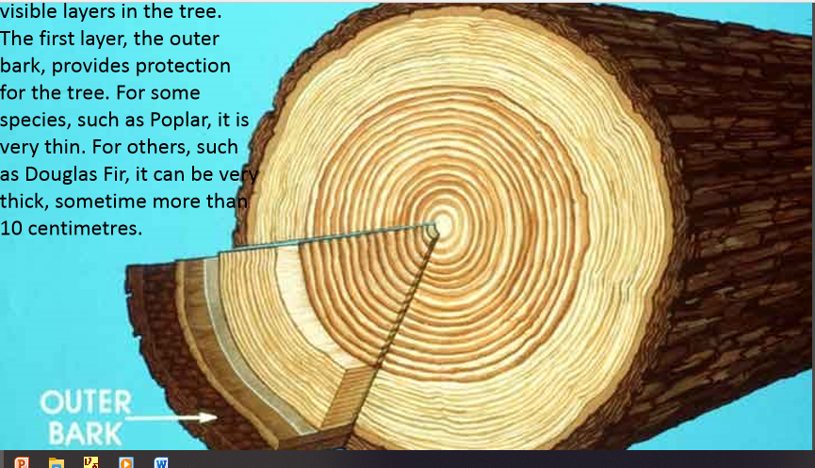
The tree

Slide 21
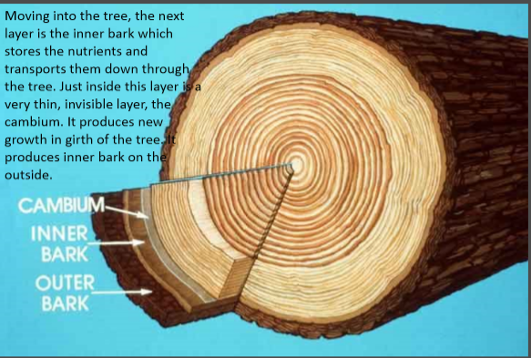
The tree

Slide 22
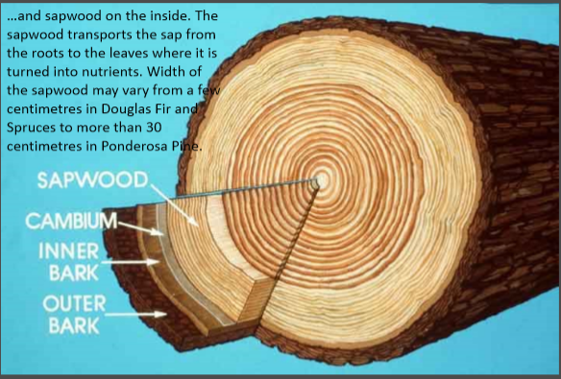
The tree

Slide 23
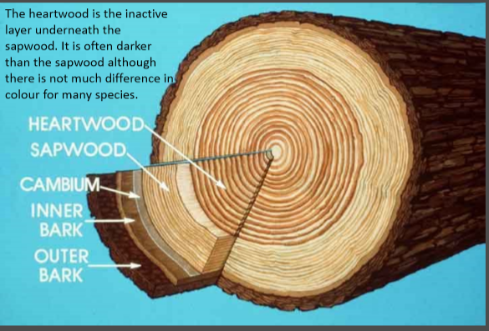
The tree...heart wood

Slide 24
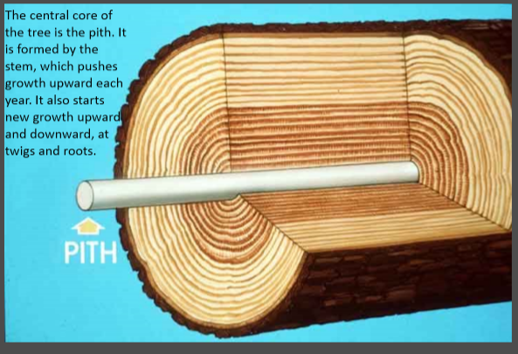
The tree….pith

Slide 25
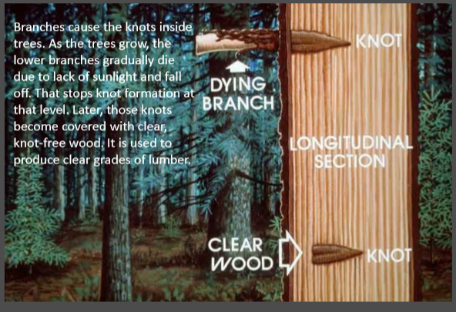
The tree …knot

Slide 26
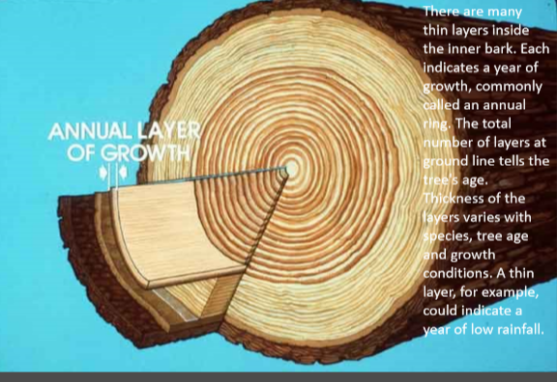
The tree…annual ring

Slide 27
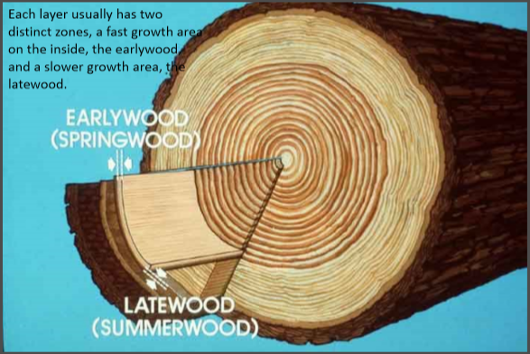
The tree …early wood and late wood

Slide 28
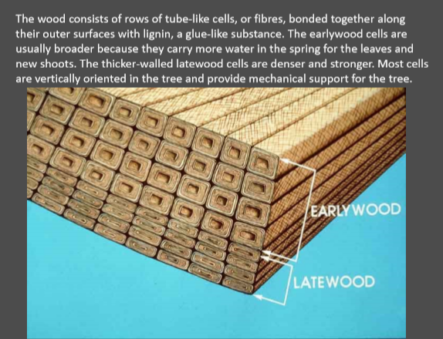
The tree …early wood and late wood

Slide 29
CLASSIFICATION OF WOODY PLANTS Botanic origin of wood (Softwoods and Hardwoods )
Despite what one might think based on the names, not all softwoods have soft, lightweight wood, nor do all hardwoods have hard, heavy wood.
softwoods are those woods that come from gymnosperms (mostly conifers), and
hardwoods are woods that come from angiosperms (flowering plants).

Slide 30
CLASSIFICATION OF WOODY PLANTS
In the temperate portion of the northern hemisphere, softwoods are generally needle-leaved evergreen trees such as pine (Pinus) and spruce whereas
hardwoods are typically broadleaf, deciduous trees such as maple, birch and oak
Softwoods and hardwoods not only differ in terms of the types of trees from which they are derived, but they also differ in terms of their component cells.

Slide 31
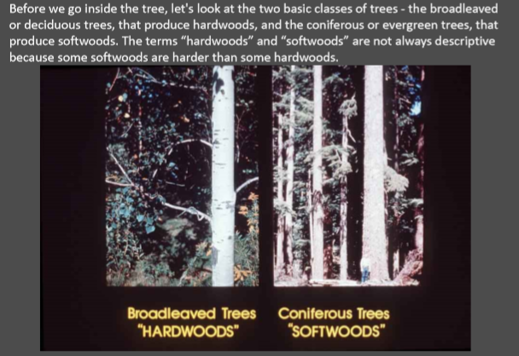
Classification of woody plants

Slide 32
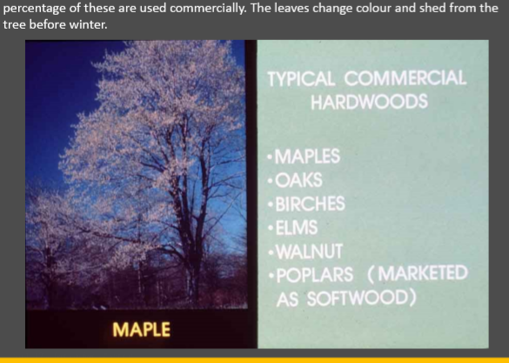
Hard wood examples

Slide 33
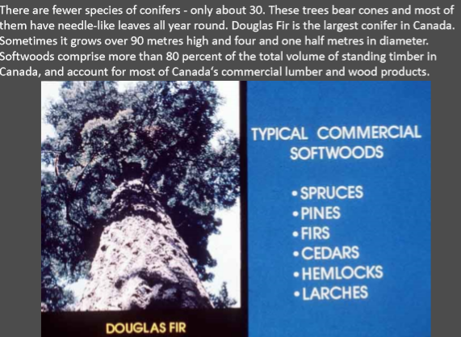
Examples of soft wood trees

Slide 34
Soft wood and hard wood
Softwoods have a simpler basic structure than do hardwoods because they have only two cell types and relatively little variation in structure within these cell types.
Hardwoods have greater structural complexity because they have both a greater number of basic cell types and a far greater degree of variability within the cell types.

Slide 35
Soft wood and hard wood
The single most important distinction between the two general kinds of wood is that hardwoods have a characteristic type of cell called a vessel element (or pore) whereas softwoods lack these .
An important cellular similarity between softwoods and hardwoods is that in both kinds of wood, most of the cells are dead at maturity, even in the sapwood.
The cells that are alive at maturity are known as parenchyma cells and can be found in both softwoods and hardwoods.

Slide 36
Basic Processes In Tree Growth (Composition Of The Vascular Cambium, Development And Growth Of Phloem And Xylem
Growth of Bark
Bark is an important element in tree growth
The outer bark ;
protects the tree from the outside world and against extreme weather elements.
It helps keep moisture in the tree during dry periods.
It further protects the tree against diseases and insects.
The inner bark or phloem
acts as the pipeline through which the food produced in the leaves passes to the rest of the living tree.
This section of cells lives for only a short time before it becomes part of the outer bark.
Between the bark and the wood is a thin layer of living cells (those that contain protoplasm) known as the cambial layer or cambium.

Slide 37
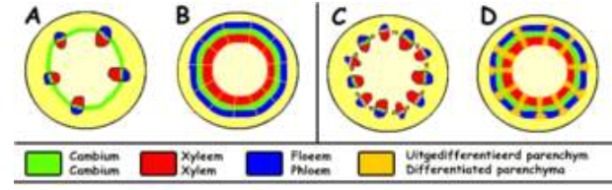

Slide 38
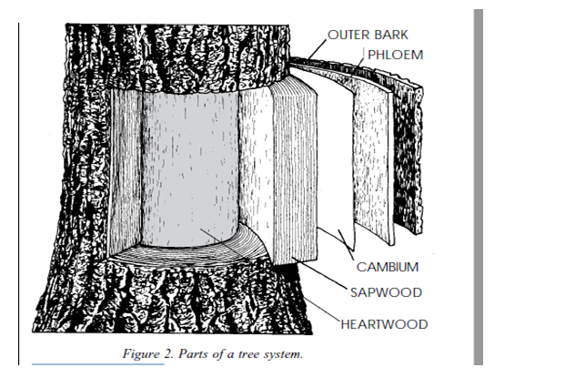

Slide 39
2.1.2 Sapwood formation
Sapwood, or new wood, provides a pipeline for the movement of water and nutrients through the trunk and into the leaves, where the process of photosynthesis occurs.
In this process, oxygen is released into the air and carbon dioxide is taken up.
Sunlight and chlorophyll, the chemical that causes leaves to have a green color, are two other important components for photosynthesis.
During this process, sugars are made that the tree uses for food.
The sap, made up of water and dissolved nutrients, carries the sugars from the leaves through the phloem to the cambium layer where the energy is used to produce new bark and wood.
As new rings of sapwood are laid on top, the older sapwood loses its vitality and turns into heartwood.

Slide 40
The cambium represents the growing part of the trunk.
Technically speaking, the cambium is only one cell thick.
cambium produces bark on one side and wood on the other. Hormones, known as auxins, are produced in leaf buds in the spring.
These auxins are transported through the phloem to the cambium.
The auxins cause the cambium cells annually to produce new bark on one side and new wood on the other.
Eight to ten times more wood is produced than bark.

Slide 41
2.1.3 Heartwood formation
Heartwood forms the central support of the tree.
Although it is made up of dead cells, it will never decay or lose strength as long as the sapwood and bark remain intact.
Accumulation of extractives gives the heartwood of many species a darker color than that of the sapwood.
Heart wood formation
cambium produces new cells which remain alive for some time.
wall thickening and lignifications results in death of most cells
Some cells remain thin walled and retain their living cytoplasm (parenchyma cells)
eventually the parenchyma cells die and their cytoplasm changes their starch and sugar to extractives.

Slide 42
GENERAL D/CE B/N HEART WOOD AND SAP WOOD
HEART WOOD
SAP WOOD
Contain extractives
Often- darker/ not always
Often greater decay & insect attack resistance
Impermeable to liquids
May have distinct odor
may have denser wood than sapwood b/c of higher weight.
May have lower moisture content.
Lower rate of moisture absorption
Contains starch and sugar
Light color
Susceptible to decay & insect attack
Permeable/ function for conduction
No distinct odor/smell
May be less denser than heart wood.
Often higher moisture content
Absorbs water readily.

Slide 43
2.1.4 GROWTH RINGS :-
Wood is produced by the vascular cambium one layer of cell divisions at a time, but we know from general experience that in many woods there are large cohorts of cells produced more or less together in time, and these cohorts act together to serve the tree.
These collections of cells produced together over a discrete time interval are known as growth increments or growth rings.
The cells formed at the beginning of the growth increment are called earlywood cells and
the cells formed in the latter portion of the growth increment are called latewood cells.
Springwood and summerwood were terms formerly used to refer to earlywood and latewood, respectively,

Slide 44
In the temperate portions of the world and anywhere else where there is a distinct, regular seasonality, trees form their wood in annual growth increments; that is, all the wood produced in one growing season is organized together into a recognizable, functional entity that many sources refer to as annual rings.
Such terminology reflects this temperate bias, so a preferred term is growth increment, or growth ring
In many woods in the tropics growth rings are not evident/clear.
However, continuing research in this area has uncovered several characteristics where by growth rings can be correlated with seasonality changes

Slide 45
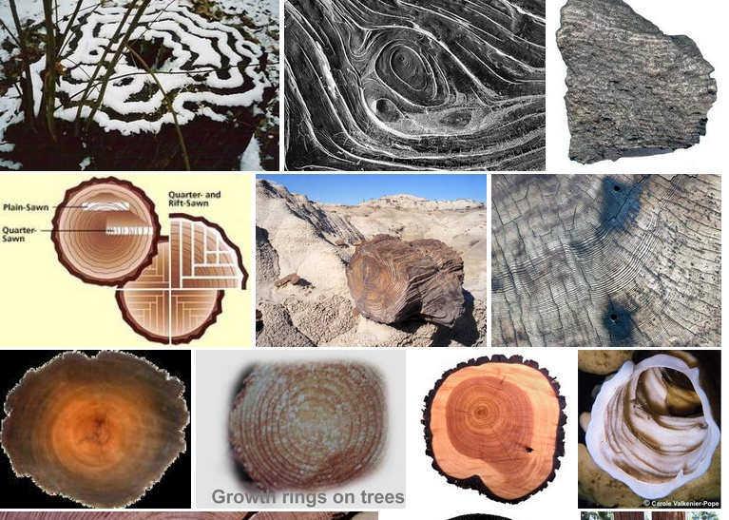
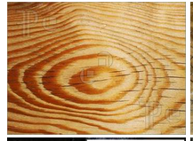
d

Slide 46
When one looks at woods that form distinct growth rings, and this includes most woods that are likely to be used for wood composites,
There are three fundamental patterns within a growth ring: -
1-no change in cell pattern across the ring,
2-a gradual reduction of the inner diameter of conducting elements from the early wood to the latewood, and
3-a sudden and distinct change in the inner diameter of the conducting elements across the ring.
These patterns appear in both softwoods and hardwoods, but differ in each due to the distinct anatomical structural differences between the two.
Many authors use the general term porosity to describe growth rings (recall that vessels and pores are synonymous.)

Slide 47
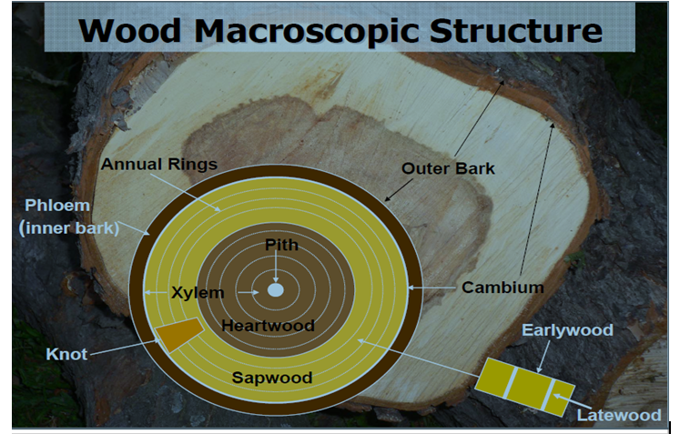
Wood macroscopic structure
ANNUAL RINGS

Slide 48
GROWTH OF XYLEM AND PHLOEM
Xylem, the principal water-conducting tissues of plants, usually contains a combination of vessels, Which are continuous tubes formed from dead, hollow, cylindrical cells (vessel members) arranged end to end, and tracheid, which are dead cells that taper at the ends and overlap one another
Primary xylem is derived from the procambium, which comes from the apical meristem.
Secondary xylem is formed by the vascular cambium, a lateral meristem that develops Later.
Wood consists of accumulated secondary xylem.
Vessel members are found almost exclusively in angiosperms.
In primitive angiosperms, vessel member Phloem, which is located toward the outer part of roots and stems, is the principal food-conducting tissue in vascular plants.
Xylem conducts water and dissolved minerals from the roots to the shoots and the leaves.
Phloem carries organic materials from one part of the plant to another.

Slide 49
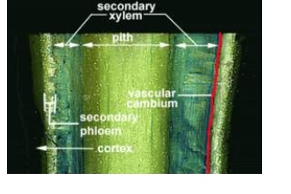
Cont..

Slide 50
Composition of vascular cambium
The axial and radial systems and their component cells are derived from a special part of the tree called the vascular cambium.
The vascular cambium is a thin layer of cells that exists between the inner bark and the wood, and is responsible for forming, by means of many cell divisions,
- wood (or secondary xylem) to the inside, and
-bark (or secondary phloem) to the outside, both of which are vascular conducting tissues .
As the vascular cambium adds cells to the layers of wood and bark around a tree, the girth of the tree increases, and thus
-the diameter and total surface area of the vascular cambium itself must increase, and this is accomplished by cell division as well.
The axial and radial systems are generated in the vascular cambium by two component cells: the fusiform initials and the ray initials (Figure 2.4B).

Slide 51
Tissues in wood;
Plants have three basic tissues, each composed of several cell types.
Dermal Tissue; This tissue forms the “skin” of the plant body, protecting it and preventing water loss.
Ground Tissue; Much of a young plant is ground tissue, which supports the plant body and stores food and water
Vascular Tissue; Special piping tissues conduct water and sugars through the plant body.
-Primary and secondary growths play important roles in establishing the basic body plan of the organism.
The vascular tissues produced by primary meristems played the same Conducting roles as they do in contemporary vascular plants..
The presence of three kinds of organs(stems, leaves, and roots) is a Property of most modern plants.
With the evolution of secondary growth, vascular plants Could develop thick trunks and become tree.

Slide 52
Tree growth; Including bark, root, and bud growth.
Trees undergo primary growth to increase length and secondary increase core cell/bark.
Plants grow from the division/separation of meristematic tissue.
Primary growth results from cell division at the apical meristem at the tip of the plant, making the shoot longer.
Secondary growth results from cell division at the lateral meristem in a cylinder encasing the shoot, and increases the shoot’s girth

Slide 53
CHAPTER THREE 3.1CHEMICAL COMPOSITION AND STRUCTURE OF CELLS IN WOOD

Slide 54
3.1 CHEMICAL COMPOSITION OF WOOD
Wood consists of 4 main chemical groups,
The cellulose and hemicellulose groups are the carbohydrates (sugar molecules) which make up the majority of the cell wall.
Lignin acts as a "glue" to bond the cells together into a stiff/strong material.
The extractives are chemicals that are deposited in the cells and provide unique properties to wood, such as the natural resistance to biological deterioration.
Woods with a high degree of natural resistance have a relatively high percentage of biocidal extractives.
The total extractive content of some species can be as high as 20 to 30%; these species generally have a high proportion of biocidal extractives.
Examples of naturally resistant wood with high extractive contents are cedars and Redwood

Slide 55
Distribution of chemical constitutes in the cell wall
All wood is composed of cellulose, lignin, ash-forming minerals, and extractives formed into a cellular structure.
The characteristics and amounts of these components and differences in cellular structures result in significant variations.
Some woods are heavier, some lighter, some stiffer, some more flexible, some harder, some softer, and some easier to work with than others.
It is these differences that make wood such a unique material.

Slide 56
1. Cellulose
Cellulose is the principal/main component of the cell walls of trees.
It also makes up the cell walls of other plants, including all the higher plants, most algae, and some fungi.
It is the most important component for its effect on the properties of wood.
Cellulose, the major chemical component of fiber wall and contributing 40-50% of the wood’s dry weight.

Slide 57
Apart from extractives, wood cells consist primarily of three substances, cellulose, lignin and hemicelluloses.
Carbon dioxide from the atmosphere is combined with water obtained from the roots to photosynthesize simple sugars.
When these sugars are conveyed/transported from the leaves to the wood cells, they are changed into more complex cellulose, hemicellulose and lignin.
Cellulose consists of thousands of glucose molecular units chained together end to end to form polymers of simple sugars called polysaccharides.
Cellulose exists in both crystalline and noncrystalline (amorphous) states.

Slide 58
2. Hemicellulose
Hemicelluloses like celluloses are polysaccharides.
They are associated with cellulose and lignin in the cell wall and are gelatinous(semi-solid) by nature.
The major hemicellulose in hardwoods is an acidic xylan and accounts for 25% ± 5% of the extractive free wood .
The main hemicelluloses of softwood are galacto gluco mannans) and arabino glucuronoxylan.
while in hardwood is glucuronoxylan
Hemi cellulose, composed of shorter molecules than cellulose, makes up a large part of wood.

Slide 59
3. Lignin
Lignin can be thought of as the glue that holds the wood (cellulose and hemicellulose) together.
Lignin is important because it gives rigidity to the cells so that a tree can grow large and tall.
Lignins are three dimensional polymers composed primarily of phenyl propane units and have a relatively high molecular weight compared with cellulose and hemicellulose of temperate hardwoods is comprised of 25% ± 3% lignin.
Lignin offers protection to the wood against microbial degradation and it also serves to reduce its Hygroscopicity (absorb moisture from the air)
Cellulose and especially hemicellulose are far more hygroscopic than lignin.

Slide 60
Lignin is categorized into three types: guaiacyl (G), syringyl (S) and para-hydroxyphenyl (H).
It is well known that the G, S and H ratio of lignin in softwoods (gymnosperms) and hardwoods (angiosperms) are different.
4. Ash
The ash content of wood is made up of inorganic minerals, primarily calcium, potassium, and magnesium.
Manganese and silica are two other common minerals. If silica is found in sufficient amounts (0.5% oven-dry1 weight), it can dull machining
5. Extractives
Common characteristics that we use to identify different woods with the naked eye come from extractives in the wood.
Without extractives, wood would have to be identified solely by its anatomical structure.

Slide 61
Extractives are made up of an extremely wide range of organic compounds.
The amounts and types of extractives help to determine the wood’s permeability to liquids and influence other wood properties such as density, hardness, and compressive strength. ???
Extractives give certain woods their resistance to insect or fungi attack.
Many useful chemicals are made from the extractives found in trees.
They also cause the odors and colors attribute.

Slide 62
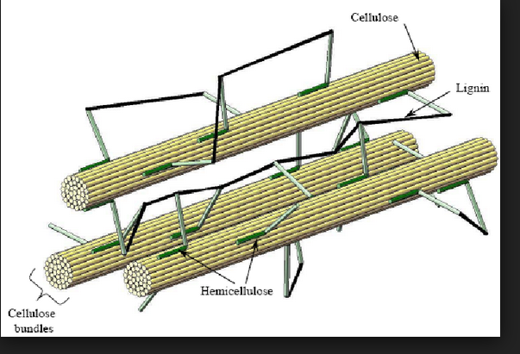
Celulose,hemi celulose &lignin

Slide 63
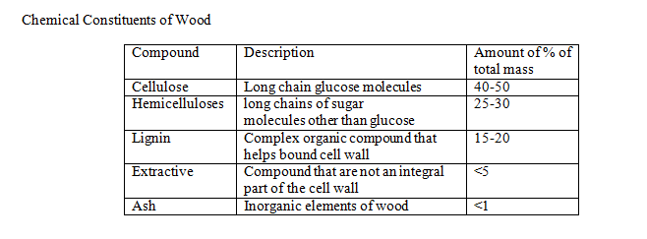
In general terms, the chemical composition of wood, on an oven-dry basis, can be summarized as follows:

Slide 64
3.2. WOOD CELL TYPES
1. Softwood - One cell type provides support and water conduction, tracheids.
Longitudinal cells
-Tracheids - Long (1/4"), thin cells that function in both water transport and support in the tree.
-Epithelial cells - These cells exude resin into longitudinal canals (resin canals);
-resin canals- helps wounded tissue to heal and provides protection against insect and decay attacks.
Radial cells (rays)
-Ray parenchyma - Their function is to store food.
-Ray tracheids - Their function is to transport water in the radial direction
2. Hardwood - Different cell types for conduction and support.
Longitudinal cells
- Vessels - Thin-walled, large lumens (pores). Function mainly in water transport
- Fibers - Thick-walled, small lumens. Function in support..
- Parenchyma - Function in food storage
Radial cells
-Ray parenchyma - Food storage

Slide 65
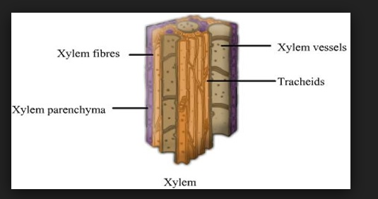
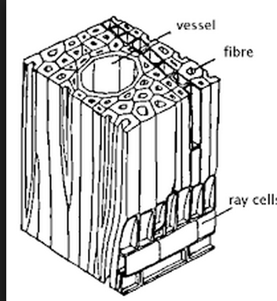
Structure of wood cells

Slide 66
In most cells in wood: there are two domains: the cell wall and the cell lumen.
The lumen is a critical component of many cells, whether in the context of the amount of space available for water conduction or in the context of a ratio between the width of the lumen and the thickness of the cell wall.
The lumen is really the void space in the interior of the cell.

Slide 67
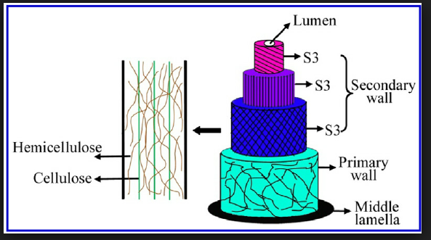
Fig 2.3 lumen
S2
S1

Slide 68
3.2.1 CELL WALL ORGANIZATION
The cell walls in wood are important structures.
Unlike the lumen, which is a void space, the cell wall itself is a highly regular structure, from one cell type to another, between species, and even when comparing softwoods and hardwoods.
Wood cell walls consist of the three major components mentioned above where cellulose is the skeleton, hemicellulose is the matrix and lignin is the adhesive substance binding the cells together and giving rigidity to the cell wall.
Wood cell walls consist of a primary wall and secondary wall.
The primary wall is the first to develop and is stretched and elongated during initial growth of the cell.

Slide 69
It consists of a thin network of randomly arranged microfibrils and is only 0.1 to 0.2μm thick (Siau 1984)
The cell wall consists of three main regions: the middle lamella, the primary wall, and the secondary wall (Figure 3.4).
In each region, the cell wall has three major components: cellulose microﬁbrils (with characteristic distributions and organization), hemicelluloses, and a matrix or encrusting material, typically pectin in primary walls and lignin in secondary walls (Panshin and dezeeuw 1980).

Slide 70
plant cells generally do not exist singly in nature; instead they are adjacent to many other cells, and this association of thousands of cells, taken together, forms an organ such as a leaf.
Each of the individual cells must be interconnected with one another to permit the movement Of bio chemicals (e.g., photosynthetic, hormones, cell signalling agents, etc.) and water.
This adhesion is provided by the middle lamella, the layer of cell wall material between two or more cells, a part of which is contributed by each of the individual cells.
This layer is the outermost layer of the cell wall continuum, and in a non-woody organ is pectin rich.
The next layer, formed by the protoplast just interior to the middle lamella, is the primary wall

Slide 71
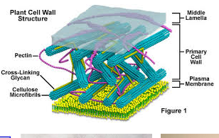

Slide 72
3.1.3 STRUCTURE OF CELLULOSE MICRO FIBRILS
Cellulose polysaccharides in woody plant cells are chained together to form extremely long crystalline microfibrils of great tensile strength.
These microfibrils are embedded in and coated by the lignin and hemicellulose to form a matrix.
Wood cell walls consist of a primary wall and secondary wall.
The primary wall is the only wall present in parenchyma cells .
The secondary wall is then laid down on the inside of the primary wall, usually after elongation of the cell has ceased.
The secondary wall is further subdivided into three layers designated S1, S2 and S3, each having different helical arrangement of its microfibrils.

Slide 73
The layer nearest the primary wall is called the S1 layer.
The S1 layer is 0.2 to 0.5 μm thick in earlywood and can reach a thickness of 1 μm in latewood.
The microfibrils of the S1 layer are orientated at an average angle of 60° to 80° to the fibre axis.
The middle or S2 layer is the thickest of the three secondary wall layers with thickness from 1.0 to 2.0 μm in earlywood and from 3 to 8 μm in latewood.
The microfibril angle of this layer also varies between the earlywood and latewood from 10° to 30° to the fibre axis respectively.
The S3 layer, lying nearest to the cell cavity or lumen, is only 0.1 to 0.2 μm thick in both earlywood and latewood.
Its microfibrils are almost transverse to the fibre axis.
Individual cells are joined together by intercellular material between their primary walls called the middle lamella.
The middle lamella is an amorphous mass, rich in lignin and low in cellulose.

Slide 74
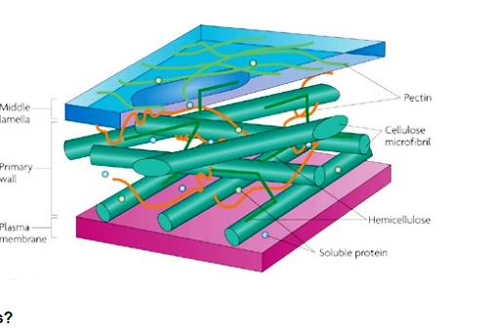
Celulose micro fibrils

Slide 75
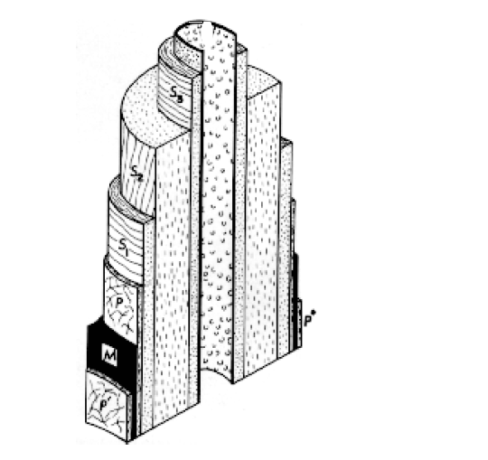
A diagram illustrating the general structure of the cell wall and the helical orientation of the cellulose micro fibrils within each wall layer. M, middle lamella; P, primary wall; S1, outer layer of the secondary wall; S2, middle layer of the secondary wall; S3, innermost layer of the secondary wall; P’,primary walls of adjoining cells.

Slide 76
3.1.4 Inorganic constitutes of wood
The inorganic constitutes in wood are various salts, of carbonates, silicates, phosphates, and oxalates (pre dominantly in bark).
They are minor constituently wood material and their total concentration measured as ash. Rarely exceed the 1% level.
The inorganic ions are normally taken up by living tree through the roots from the soil.
The mineral elements play an important role in growing process of tree.
The mode of uptake and distribution of the different elements in the living tree are largely unknown.
The inorganic compounds in the wood exist as mineral salts and as cations bound to acidic groups.

Slide 77
CHAPTER 4
4.1 MACROSCOPIC CHARACTER OF WOOD
Macro structures of wood are
Growth rings; false rings, ring boundaries
Late wood and early wood
Heart wood and sap wood
Tension wood and compression wood
Resin canals

Slide 78
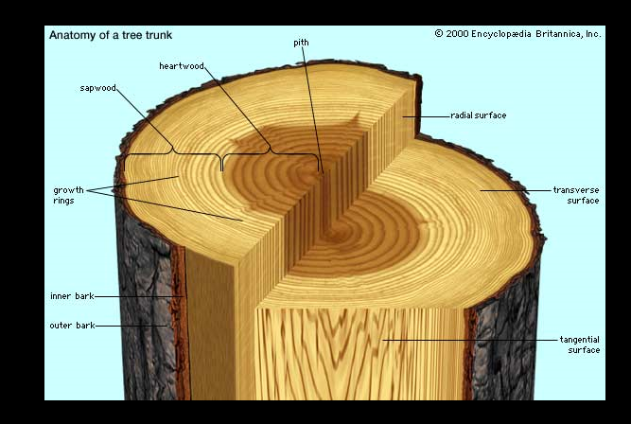
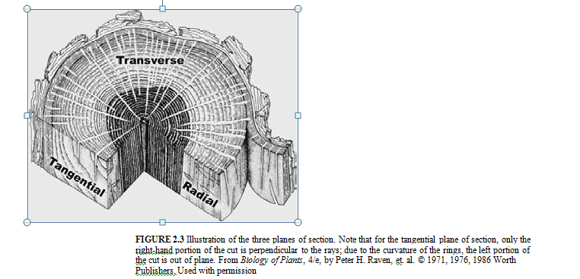
4.1.1 Three distinct surface of wood Transverse - Surface exposed by cutting across the stem (cross Section) Tangential - Surface exposed by cutting tangent to the growth rings (flat-sawn). Radial - Surface exposed by cutting across the growth rings from the pith to the bark (quarter-saw)

Slide 79
4.1.2 AXIAL AND RADIAL SYSTEMS
The distinction between sapwood and heartwood, though important, is a gross feature that is often fairly easily observed.
More detailed inquiry into the structure of wood shows that wood is composed of discrete cells that are connected and interconnected in an intricate and predictable fashion to form an integrated system that is continuous from root to twig.
The cells of wood are typically many times longer than wide, and are speciﬁcally oriented in two separate systems of cells: the axial system and the radial system.
The cells of the axial system have their long axes running parallel to the long axis of the organ (e.g., up and down the trunk).
The cells of the radial system are elongated perpendicularly to the long axis of the organ, and are oriented like radii in a circle or spokes in a bicycle wheel, from the pith to the bark

Slide 80
In the trunk of a tree, the axial system runs up and down, functions in long-distance water movement, and provides the bulk of the mechanical strength of the tree.
The radial system runs in a pith-to-bark direction, provides lateral transport for biochemical, and in many cases performs a large fraction of the storage function in wood.
These two systems are interpenetrating and interconnected, and their presence is a deﬁning characteristic of wood as a tissue.
4.1.3 PLANES OF SECTION:-
The organization and interrelationship between the axial and radial systems give rise to three main perspectives from which they can be viewed
These three perspectives are the transverse plane of section (the cross-section), the radial plane of section, and the tangential plane of section.

Slide 81
Transverse plane of section are referred to as longitudinal sections, because they extend parallel to the axial system (along the grain).
The transverse plane of section is the face that is exposed when a tree is cut down; looking down at the stump one sees the transverse section.
Cutting a board across the grain exposes the transverse section.
The transverse plane of section provides information about features that vary both in the pith-to-bark direction (called the radial direction) and also those that vary in the circumferential direction (call the tangential direction).
It does not provide information about variations up and down the trunk.

Slide 82
B. The radial plane of section runs in a pith-to-bark direction, and it is parallel to the axial system, so it provides information about longitudinal changes in the stem and from the pith to bark along the radial system.
To describe it geometrically, it is parallel to the radius of a cylinder, and extending up and down the length of the cylinder.
In a practical sense, it is the face or plane that is exposed when a log is split exactly from pith to bark.
It does not provide any information about features that vary in a tangential direction.

Slide 83
C. The tangential plane is at a right angle to the radial plane.
Geometrically, it is parallel to any tangent line that would touch the cylinder, and it extends along the length of the cylinder.
One way in which the tangential plane would be exposed is if the bark were peeled from a log; the exposed face is the tangential plane.
The tangential plane of section does not provide any information about features that vary in the radial direction, but it does provide information about the tangential dimensions of features.
All three planes of section are important to the proper observation of wood, and only by looking at each in turn can a holistic and accurate understanding of the three-dimensional structure of wood be gained.
The three planes of section are determined by the structure of wood, and the way in which the cells in wood are arrayed.
The cells are laid down in these special arrangements by a special part of the trunk.

Slide 84
4.2 Heart wood and sap wood
In both softwoods and hardwoods, the wood in the trunk of the tree is typically divided into two zones, each of which serves an important function distinct from the other.
The actively conducting portion of the stem, in which the parenchyma cells are still alive and metabolically active, is referred to as the sapwood.
A looser deﬁnition that is more broadly applied is that the sapwood is the band of lighter-colored wood adjacent to the bark.
The heartwood is the darker-colored wood found to the interior of the sapwood.
In the living tree, the sapwood is responsible not only for the conduction of sap, but also for the storage and synthesis of biochemicals.
An important storage function is the long-term storage of photosynthate.
The carbon that must be expended to form a new ﬂush of leaves or needles must be stored somewhere in the tree, and it is often in the parenchyma cells of the sapwood that this material is stored.
The living cells of the sapwood are also the agents of heartwood formation.

Slide 85
In order for the tree to accumulate biochemicals, they must be actively synthesized and translocated by living cells.
For this reason, living cells at the border between the heartwood and sapwood are responsible for the formation and deposition of heartwood chemicals, one of the important steps leading to heartwood formation
Heartwood functions in the long-term storage of biochemical of many varieties depending on the species in question.
These chemicals are known collectively as extractives.
A more modern understanding of extractives indicates that they are a normal and intentional part of the plant’s efforts to protect its wood.

Slide 86
Extractives are formed by parenchyma cells at the heartwood-sapwood boundary and are then exuded through pits into adjacent cells
In this way it is possible for dead cells to become occluded or inﬁltrated with extractives despite the fact that these cells lack the ability to synthesize or accumulate these compounds on their own.
Extractives are responsible for imparting several larger-scale characteristics to wood.
For example, extractives provide natural durability to timbers that have a resistance to decay fungi.

Slide 87
In the case of a wood such as teak (Tectonagrandis), famed for its stability and water resistance, these properties are conferred by the waxes and oils formed and deposited in the heartwood.
Many woods valued for their colored such as mahogany (Swieteniamahagoni), African blackwood (Diospyros melanoxylon), Brazilian rosewood (Dalbergianigra), and other adiowe their value to the type and quantity of extractives in the heartwood.
For these species, the sapwood has little or no value, (Aquilariamalaccensis) has been driven to endangered status due to human harvest of the extract valuable resins used in perfume making (Lagenheim 2003

Slide 88
The utility of a wood for a technological application can be directly affected by extractives.
For example, if a wood high in hydrophobic extractives is used in a composite bonded with a water-based adhesive, weak or incomplete bonding can result.
4.4 Rays
The parenchyma cells, which are usually produced in horizontal rows called rays By special ray initials of the vascular cambium, function in lateral conduction and food storage.
An initial is another term for a meristematic cell.
It divides to produce another initial and a cell that differentiates into a ray cell.
In cross-sections of woody stems and roots, the Rays can be seen radiating out from the centre of the xylem like the spokes of a wheel.

Slide 89
4.5 Slope of Grain
Slope of grain or cross grain are terms used to describe the deviation in wood fiber orientation from a line parallel to the edge of the specimen.
It is expressed as a ratio such as 1 in 6 or 1 in 14 and is measured over sufficient distance along the piece to be representative of the general slope of the wood fibres.
Slope of grain has a significant effect on wood mechanical properties, and strength decreases as the grain deviation increases.
Specimens with severe cross grain are also more susceptible to warp and other dimensional deformations because of changes in moisture content.
Two common types of cross grain are spiral grain and diagonal grain

Slide 90
4.6 knots
As a tree grows, buds develop and branches grow laterally from the trunk.
The branches produce deviations in the normal wood growth patterns that result in two types of knots when the wood is cut, intergrown knots and encased knots
Inter grown knots are formed by living branches, while encased knots result from branches that have died and subsequently have been surrounded by the wood of the growing trunk.
Knots reduce the strength of wood because they interrupt the continuity and direction of wood fibers.
They can also cause localized stress concentrations where grain patterns are abruptly altered.

Slide 91
The influence of a knot depends on its size, location, shape, soundness, and the type of stress considered.
In general, knots have a greater effect in tension than in compression, whether stresses are applied axially or as a result of bending.
Intergrown knots resist some kinds of stress but encased knots or knot holes resist little or no stress.
At the same time, grain distortion is greater around an inter grown knot than around an encased knot of equivalent size.
As a result, the overall effects of each are approximately the same.

Slide 92
Irregularities in Annual Ring Formation
False rings
- Growth interrupted by environment (e.g. defoliation)
- Slow growth may cause formation of latewood type cells
Discontinuous rings
- Cambium was dormant in one region
- One-sided crowns, suppressed, or overmature trees
Trees grown in tropical environments
- Almost continual growth can limit occurrence of rings
- In some climates, stopping and restarting of growth can give more than one growth increment in a year

Slide 93
CHAPTER FIVE 5.1 Soft wood anatomy
Longitudinal tracheids
Parenchyma cell arrangements
Resin canal complexes
pits
Ray arrangements
Epithelial cells

Slide 94
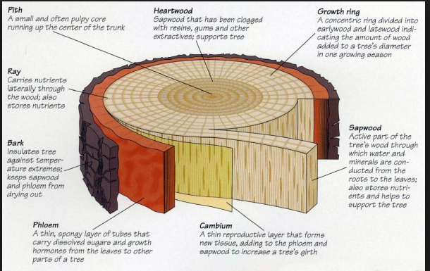
CH-4

Slide 95
5.1.1 Introduction
The fundamental differences between different kinds of woods are founded on the types, sizes, proportions, and arrangements of different cells that compose the wood.
Softwoods have a simpler basic structure than do hardwoods
Softwoods have relatively little variation in structure within these cell types.
Hardwoods have greater structural complexity because they have both a greater number of basic cell types and a far greater degree of variability within the cell types.
The structure of a typical softwood is relatively simple.
The axial or vertical system is composed mostly of axial tracheids and
The radial or horizontal system, the rays, are composed mostly of ray parenchyma cells.

Slide 96
5.1.2 Longitudinal tracheids
Tracheids are very long cells, often more than 100 times longer than wide,
Tracheids are the major component of softwoods, making up over 90% of the volume of the wood.
They provide both conductive and mechanical functions to softwoods.
In the transverse view or section, tracheids appear as square
They are slightly rectangular cells in radial rows.
Within one growth ring they can be thin-walled in the early wood and thicker-walled in the latewood.
In order for water to ﬂow between tracheids it must pass through circular bordered pits that are concentrated in the long, tapered ends of the cells.
Tracheids overlap with adjacent cells across both the top and bottom 20–30% of their length.
Water ﬂow thus must take a slightly zigzag path as it goes from one cell to the next through the pits.

Slide 97
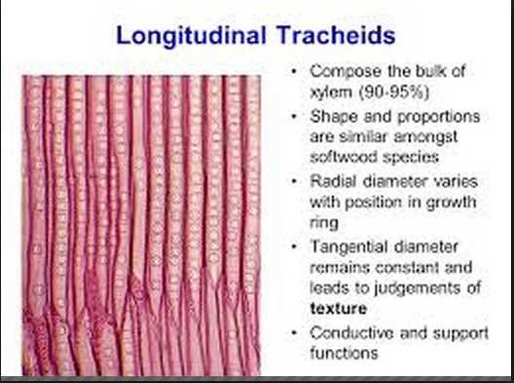
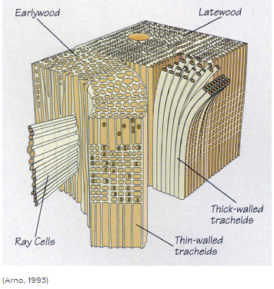
LONGTUDINAL TRACHAIDS
PITS

Slide 98
5.1.3 Pits
Any discussion of cell walls in wood must be accompanied by a discussion of the ways in which cell walls are modiﬁed to allow communication between the cells in the living plant.
Pits are thin areas in the cell walls between two cells,
Pits have three domains: the pit membrane, the pit aperture, and the pit chamber.
The pit membrane is the thin semi porous remnant of the primary wall..
The pit aperture is the opening or hole leading into the open area of the pit, which is called the pit chamber.
The type, number, size, and relative proportion of pits can be characteristic of certain types of wood.
Pits of predictable types occur between different types of cells.
pits will form in the wall of each cell separately, but in a coordinated location so that the pitting of one cell will match up with the pitting of the adjacent cell (thus a pit-pair).

Slide 99
When this coordination is lacking and a pit is formed only in one of the two cells, it is called a blind pit.
Blind pits are fairly rare in wood.
Pits occur in three varieties:- bordered, simple, and half-bordered (Esau 1977, Raven et al. 1999).
When seen in face view, bordered pits often are round in appearance and look somewhat like a doughnut, with a small round or almond-shaped hole, the pit aperture, in the middle of the pit.
When seen in sectional view, the pit often looks like a pair of V’s with the open ends of the V’s facing each other.
Bordered pits always occur between two conducting cells, and sometimes between other cells.

Slide 100
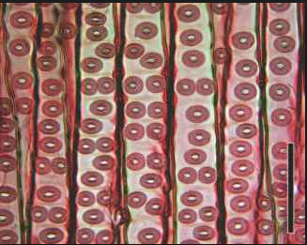
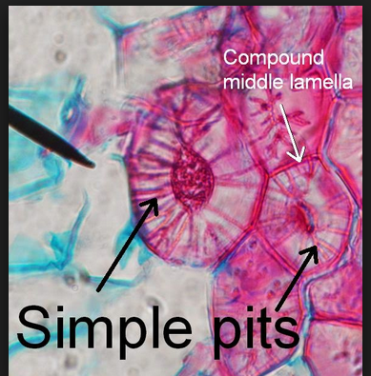
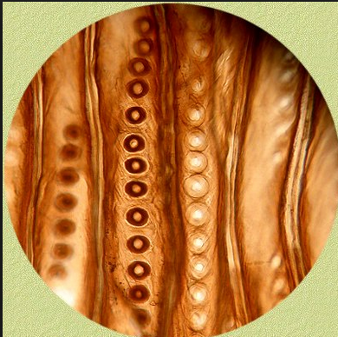
Bordered pits
Simple pits
Border pits

Slide 101
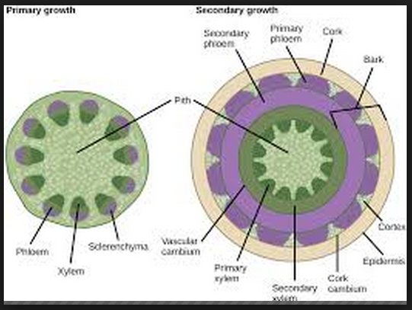
Pith , primary & secondary growth

Slide 102
5.1.4 Longitudinal parenchyma
2 Axial Parenchyma and Resin Canal Complexes
Axial parenchyma cells are similar in size and shape to ray parenchyma cells, but they are vertically oriented and stacked.
The microscopic structure of Piceaglauca, a typical softwood.
(A) Transverse section,
The bulk of the wood is made of tracheids, the small rectangles of various thicknesses.
The three large, round structures are resin canals and their associated cells.
The dark lines running from the top to the bottom of the photo are the ray cells of the rays.
(B) Radial section
showing two rays (arrows) running from left to right.
Each cell in the ray is a ray cell, and they are low, rectangular cells.
The rays begin on the left in the earlywood (thin-walled tracheids) and continue into and through the latewood (thick-walled tracheids), and into the next growth ring, on the right side of the photo.
(C) Tangential section.
Rays seen in end-view; they are mostly only one cell wide.
Two rays are fusiform rays; there are radial resin canals embedded in the rays, causing them to bulge/swell.

Slide 103
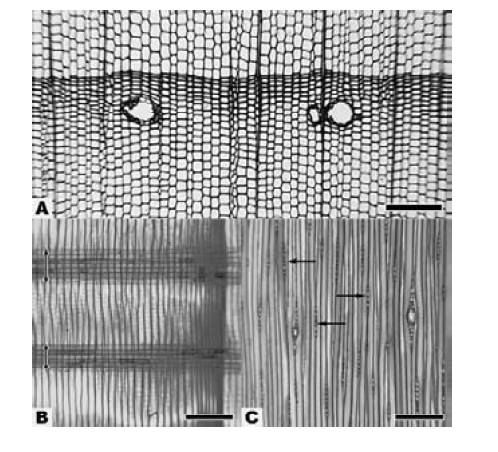
f.G 2.10

Slide 104
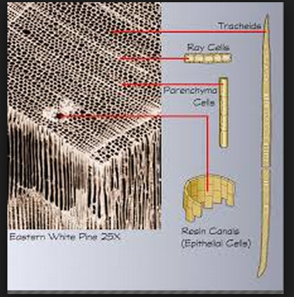

Slide 105
In species of pine, spruce, Douglas ﬁr, and larch structures commonly called resin ducts or resin canals are present vertically
These structures are voids or spaces in the wood and are not cells.
However, specialized parenchyma cells that function in resin production surround resin canals.
In pine, resin canal complexes are often visible on the transverse section to the naked eye, but they are much smaller in spruce, larch, and Douglas ﬁr, and a hand lens is needed to see them.
Radial resin canal complexes are embedded /surrounded in specialized rays called fusiform rays.
These rays are much higher and wider than normal rays.
Resin canal complexes are absent in the normal wood of other softwoods,

Slide 106
5.1.5 Epithelium
Epithelium forms the coverings of surfaces of the body.
As such, it serves many purposes, including protection, adsorption, excretion, secretion, filtration, and sensory reception.
When considering the characteristics that make a tissue epithelium, it is important to think about the following:
Polarity- Epithelium is arranged so there is one free surface (apical surface) and one attached surface (basal surface).
Cellular nature- Cells in epithelium fit closely together side by side and sometimes attach each other to form sheets of cells.
Supported by connective tissue- Attachment to a layer of connective tissue at the basal surface forms a layer called the basement membrane, an adhesive layer formed by secretions from the epithelial cells and the connective tissue cells.

Slide 107
Classification of epithelium is based on the shape of the cells and the arrangement of the cells within the tissue.(Simple, Stratified ,Transitional etc)
Typically, the arrangement of the cells is stated first, then the shape, and is followed by “epithelium”
Epithelial cells -These cells exude/give off/ resin into longitudinal canals (resin canals);
resin helps wounded tissue to heal and provides protection against insect and decay attacks.

Slide 108
5.1.6 Rays
The other cells are ray parenchyma cells that are barely visible and appear as dark lines running in a top-to-bottom direction.
Ray parenchyma cells are rectangular prisms or brick-shaped cells.
Typically they are approximately 15 µm high by 10 µm wide by 150–250 µm long in the radial or horizontal direction.
These brick-like cells form the rays, which function primarily in the synthesis, storage, and lateral transport of biochemical and, to a lesser degree, water.
In radial view or section , the rays look like a brick wall and the ray parenchyma cells are sometimes ﬁlled with dark-colored substances.
In tangential section , the rays are stacks of ray parenchyma cells one on top of the other forming a ray that is only one cell in width, called a uniseriate ray.

Slide 109
FIGURE 5.8 The microscopic structure of Picea glauca, a typical softwood.
(A) Transverse section, scale bar = 150 μm.
The bulk of the wood is made of tracheids, the small rectangles of various thicknesses.
The three large, round structures are resin canals and their associated cells.
The dark lines running from the top to the bottom of the photo are the ray cells of the rays.
(B) Radial section showing two rays (arrows) running from left to right.
Each cell in the ray is a ray cell, and they are low, rectangular cells.
The rays begin on the left in the earlywood (thin-walled tracheids) and continue into and through the latewood (thick-walled tracheids), and into the next growth ring, on the right side of the photo. Scale bar = 200 μm.
(C) Tangential section. Rays seen in end-view; they are mostly only one cell wide.
Two rays are fusiform rays; there are radial resin canals embedded in the rays, causing them to bulge. Scale bar = 200 μm.

Slide 110
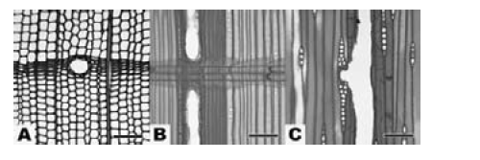
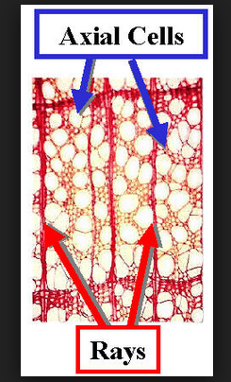
F.G 5.6 Ray parencayma cells

Slide 111
When ray parenchyma cells intersect with axial tracheids, specialized pits are formed to connect the vertical and radial systems.
The area of contact between the tracheid wall and the wall of the ray parenchyma cells is called a cross-ﬁeld.
The type, shape, size, and number of pits in the cross-ﬁeld is generally consistent within a species and very diagnostic.
Species that have resin canal complexes also have ray tracheids, which are specialized horizontal tracheids that normally are situated at the margins of the rays.
These ray tracheids have bordered pits like vertical tracheids, but are much shorter and narrower.
Ray tracheids also occur in a few species that do not have resin canals.
Alaska yellow cedar, (Chamaecyparis nootkatensis), hemlock (Tsuga), and rarely some species of true fir (Abies) have ray tracheids.

Slide 112
CHAPTER SIX 6.1 Hard wood anatomy
Vessel elements
Fibers
Longitudinal parenchyma
Rays

Slide 113
The structure of a typical hardwood is much more complicated than that of a softwood.
The axial or vertical system is composed of ﬁberous elements of various kinds, vessel elements in various sizes and arrangements, and axial parenchyma cells in various patterns and abundance/great quantity.
Alike softwoods, the radial or horizontal system are the rays, which are composed of ray parenchyma cells, but
unlike softwoods, hardwood rays are much more diverse/varied in size and shape.

Slide 114
6.2 Vessel elements
FIGURE 6.1 Vessel elements and vessel features.
Macerated cells of Quercus rubra.
There are three types of cells labeled.
There is a single vessel element (ve); it is open on both ends.
The fiber (f ) is long, narrow, and thick-walled.
The hardwood tracheid (t) is shorter than a fiber but longer than a vessel element, and it is contorted in shape.
(B) A simple perforation plate in Malouetia virescens.
There are two vessel elements (ve), and where they overlap there is an open hole between the cells, the perforation plate (arrow).
As the perforation is completely open, it is called a simple perforation plate.

Slide 115
(C) A scalariform perforation plate in Magnolia grandiflora.
This perforation plate has eight bars crossing it (the eighth is very small), and it is the presence of bars that distinguishes this type of perforation plate from a simple plate.
(D) Alternate inter vessel pitting in Hevea microphylla.
(E) Opposite inter vessel pitting in Liriodendron tulipifera.
(F) Linear (scalariform) inter vessel pitting in Magnolia grandi­flora.

Slide 116
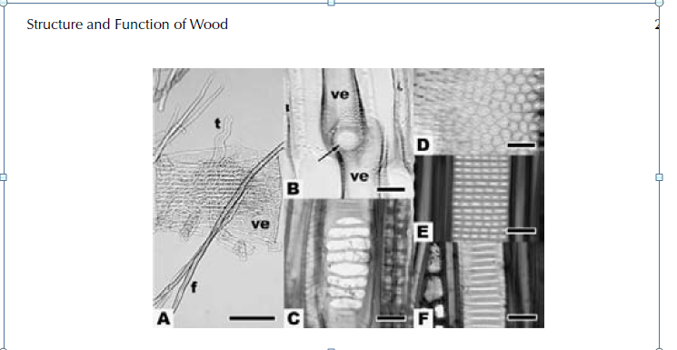
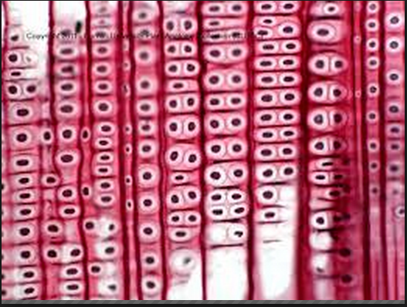

Slide 117
In hardwoods, the sap is conducted through vessels, a series of tube like cells stacked one atop other.
Support for the trunk is provided by fiber cells.
In the ring-porous hardwood shown below,
vessels are more prominent in early wood;
fibers are the predominant cell type in latewood.

Slide 118
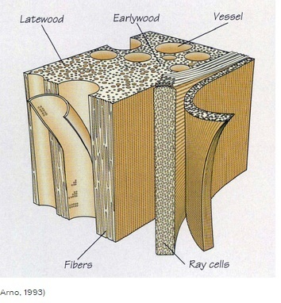

Slide 119
The unique feature that separates hardwoods from softwoods is the presence of specialized conducting cells in hardwoods called vessels elements
These cells are stacked one on top of the other to form vessels.
Where the ends of the vessel elements come in contact with one another, a hole is formed, called a perforation plate.
Thus hardwoods have perforated treachery elements (vessel elements) for water conduction,
whereas softwoods have imperforate/not hole treachery elements (tracheid's).
On the transverse section, vessels appear as large openings and are often referred to as pores.
Vessel diameters may be quite small (<30 µm) or quite large (>300 µm), but typically range from 50–200 µm.
Their length is much shorter than tracheids and range from 100–1200 µm or 0.1–1.2 mm.

Slide 120
Vessels are arranged in various patterns.
If all the vessels are the same size and more or less scattered throughout the growth ring, the wood is diffuse porous .
If the earlywood vessels are much larger than the latewood vessels, the wood is ring porous.
In addition, the individual vessels may occur alone (solitary arrangement) or in pairs or radial multiples of up to five or more vessels in a row.
At the end of the vessel element is a hole or perforation plate.
If there are no obstructions across the perforation plate, it is called a simple perforation plate.
If bars are present, the perforation plate is called a scalar form perforation plate.

Slide 121
6.3 Fiber
Fibers in hardwoods function solely as support.
Hard wood fibers are shorter than softwood tracheids (200–1200 µm) and average about half the width of softwood tracheids.
Fibers are usually 2–10 times longer than vessel elements
The thickness of the ﬁber cell wall is the major factor governing density and strength.
Species with thin-walled fibers such as (cottonwood, basswood and balsa) have a low density and strength,

Slide 122
whereas species with thick-walled fibers such as hard maple ,black locust and bullet wood have a high density and strength.
The air-dry (12% moisture content) density of hardwoods varies from 100–1400 kg/m³.
The air-dry density of typical softwoods varies from 300–800 kg/m³.
Fiber pits are generally inconspicuous/ not easily see and may be simple or bordered.
The tracheids in hardwoods function in both support and transport.

Slide 123
6.4 Longitudinal parenchyma
Axial Parenchyma cells
The axial parenchyma cells in hardwoods and softwoods is essentially the same size and shape, and they also function in the same manner.
The difference comes in the abundance and spaciﬁc patterns in hardwoods.
There are two major types of axial parenchyma in hardwoods.
Paratracheal parenchyma is associated with the vessels and
apotracheal is not associated/connected with the vessels.
Paratracheal parenchyma is further divided into
vasicentric (surrounding the vessels,
aliform (surrounding the vessel and with wing-like extensions, and
conﬂuent (several connecting patch of paratracheal parenchyma)
Apotracheal parenchyma is also divided into
diffuse (scattered/dotted),
diffuse in aggregate (short bands, and
banded whether at the beginning or end of the growth ring (marginal,) or within a growth ring .

Slide 124
FIGURE 6.3 Transverse sections of various woods showing a range of hardwood axial parenchyma patterns.
A, C, and E show woods with paratracheal types of parenchyma
(A) Vasicentric parenchyma (arrow) in Licaria excelsa.
(C) Aliform parenchyma in Afzelia africana.
The parenchyma cells are the light-colored, thin-walled cells, and are easily visible.
(E) Confluent parenchyma in Afzelia cuazensis.
B, D, and F show woods with apotracheal types of parenchyma
(B) Diffuse-in-aggregate parenchyma in Dalbergia stevensonii.
(D) Banded parenchyma in Micropholis guyanensis.
(F) Marginal parenchyma in Juglans nigra.
In this case, the parenchyma cells are darker in color, and they delimit/demarcate the growth rings (arrows).

Slide 125
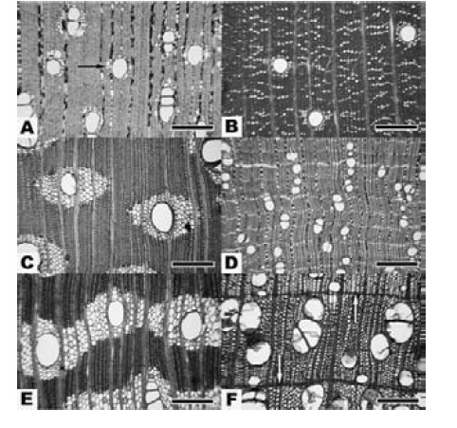
Cont…

Slide 126
6.5 Rays
The rays in hardwoods are much more diverse/varied than those found in softwood.
In some species, including willow (Salix), cottonwood, and koa (Acacia koa), the rays are exclusively uniseriate and are much like the softwood rays.
Rays in hardwoods are composed of ray parenchyma cells that are either procumbent or upright.
As the name implies, procumbent ray cells are horizontal and are similar in shape and size to the softwood ray parenchyma cells.
The upright ray cells are ray parenchyma cells turned on end so that their long axis is vertical.
Upright ray cells are generally shorter and sometimes nearly square.
Rays that have only one type of ray cell, typically only procumbent cells, are called homo cellular rays.
Those that have procumbent and upright cells are called hetero cellular rays.

Slide 127
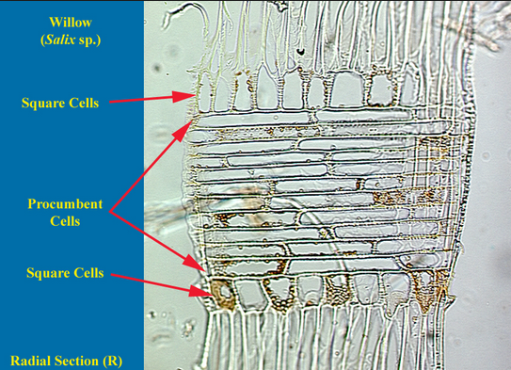
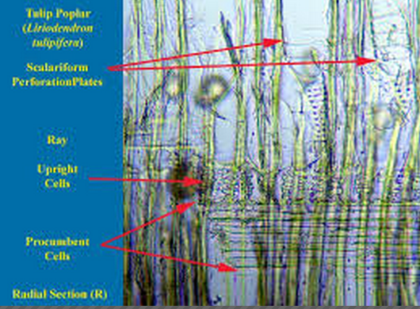
Procumbent & upright ray cells

Slide 129
CHAPTER SEVEN 7.1 Natural defects of wood
7.1.1 wood defects
No tree is perfect.
It’s subject to defects from the time it emerges as a seedling to the last stages of seasoning.
A defect is simply an abnormality or irregularity found in wood.
There are many different types of defects arising from many different causes.
For instance, there are natural and acquired defects caused by a broken limb or other injury, insect and fungal attack, or rapid tree growth.
There are innate defects caused by the natural characteristic of wood to shrink or expand in response to water vapor in the air. and,
There are artificial and mechanical defects caused by incorrect sawing or machining (conversion), improper drying (seasoning), or improper handling and storage.

Slide 130
Defects may be responsible for
reducing wood’s economic value,
lowering its strength, durability and usefulness,
marring its appearance, and
in some cases, causing its decay.
Defects in timber can affect its; strength, appearance, and durability.
Generally defects in timber are either;
1. Natural: defects that may be present in the growing tree.
2. Artificial: defects caused by the seasoning, conversion and felling process.

Slide 131
Defects may be responsible for
reducing wood’s economic value,
lowering its strength, durability and usefulness,
marring its appearance, and
in some cases, causing its decay.
Defects in timber can affect its; strength, appearance, and durability.
Generally defects in timber are either;
1. Natural: defects that may be present in the growing tree.
2. Artificial: defects caused by the seasoning, conversion and felling process.

Slide 132
1. Natural Wood Defects
During its lifetime, a tree is subjected to many natural forces that cause defects in the wood.
Wood workers are quite familiar with these defects –
knots,
splits,
ugly dark streaks or stains,
worm holes, even decay.
Some of the more common wood defects all woodworkers face include:-
A. Bark pockets – Formed when a small piece of the bark protrudes into the lumber. This area is generally considered unsound.
B. Bird pecks – Caused by birds, especially woodpeckers, which peck on trees mainly to cause panic to the insects living in or under the bark and in the wood of the tree.
This causes the insects to come out enabling the birds to eat them.
Bird pecking can cause small injuries to the tree, resulting in grain changes that later show up as various forms of figure in the wood

Slide 133
C. Burls – Burls are a deformed growth formed when a tree receives a shock or injury in its young age.
Due to its injury, the tree’s growth is completely upset and irregular projections appear on the body of the timber.
Continued tree growth follows the contour of the original burl deformity, producing all manner of twists, swirls and knots in the wood fiber.
D. Coarse grain – If the tree grows rapidly, the annual rings are widened. It is known as coarse grain timber and possesses less strength.
E. Fungal damage – Fungi generally damages timber or wood by discoloration and / or decay.
The resulting wood is generally weaker or of a different color than is typical for that species.
The more common effects of fungal damage include:
Blue stain – Common in pine, maple, and many other woods,
blue stain (also called “sap stain”) is caused by a fungus that feeds on the sap.
The bluish color (sometimes gray or dark gray) is the fungus itself, not the color of the sapwood.

Slide 134
C. Burls – Burls are a deformed growth formed when a tree receives a shock or injury in its young age.
Due to its injury, the tree’s growth is completely upset and irregular projections appear on the body of the timber.
Continued tree growth follows the contour of the original burl deformity, producing all manner of twists, swirls and knots in the wood fiber.
D. Coarse grain – If the tree grows rapidly, the annual rings are widened. It is known as coarse grain timber and possesses less strength.
E. Fungal damage – Fungi generally damages timber or wood by discoloration and / or decay.
The resulting wood is generally weaker or of a different color than is typical for that species.
The more common effects of fungal damage include:
Blue stain – Common in pine, maple, and many other woods,
blue stain (also called “sap stain”) is caused by a fungus that feeds on the sap.
The bluish color (sometimes gray or dark gray) is the fungus itself, not the color of the sapwood.

Slide 135
Brown rot – A form of wood decay found only in softwoods that destroys the wood’s cellulose, eventually causing cracks across the grain. Advanced brown rot tends to leave the wood more brown than normal. It is a precursor to dry rot.
Dry rot – After the wood infected with brown rot dries out, the cell walls of the remaining wood turns into dry powder when crushed. This is called dry rot.
Heart rot – This is formed when a branch has come out of the tree. The heart wood is exposed to an attack of atmospheric agents. Ultimately, the tree becomes weak and it gives a hollow sound when struck with a hammer.
Wet rot – Some kinds of fungi cause chemical decomposition of a wood’s timber and in doing so converts timber into a grayish brown powder known as wet rot.
Alternative wet and dry conditions favor the development of wet rot.
If unseasoned or improperly seasoned timber is exposed to rain and wind, it easily becomes vulnerable to wet rot attack.
White rot – This is just the opposite of brown rot. In this type of fungi attack, the wood’s lignin and the wood itself assumes the appearance of a white mass consisting of cellulose compounds.

Slide 136
F. Insect defects –
There are a number of insects that eat wood.
Many other insects use wood as a nesting place for their larvae which results in holes and tunnels in the wood.
The damage they cause ranges from minor to catastrophic.
Some of the more common insects include:
Wood boring beetles – Wood boring beetles, such as buprestid, powder post, ambrosia &longhorn, form tunnel through wood to deposit their larvae.
Some larvae eat the starchy part of the wood grain.
Many species attack live but usually stressed trees, while others prefer recently dead hosts.
Pin-hole borers – They damage fresh-cut logs and unseasoned lumber, but also attack weakened, stressed, dying trees, and healthy trees with bark injuries.
Termites – Termites not only tunnel through wood in various directions, but eat away the wood from the cross-section core.
They usually do not disturb the outer shell or cover.
In fact, the timber piece attacked by termites may look sound until it completely fails.

Slide 137
G. Knots –
A knot is the base of a branch or limb that was broken or cut off from the tree.
The portion of the remaining branch receives nourishment from the stem for some time and it ultimately results in the formation of dark hard rings known as knots.
As the continuity of wood fibers are broken by knots, they form a source of weakness.
There are several types of knots:
Sound (or tight knots) are solid and cannot be knocked loose because they are fixed by growth or position in the wood structure.
They are partially or completely inter grown with the growth rings.
Unsound knots (or loose knots) are knots which fall out of the lumber when pushed or have already fallen out.
They are caused by a dead branch that was not fully integrated into the tree before it was cut down.
Encased/covered knots are those which are not inter grown with the surrounding wood.
Knot hole is a hole left where the knot has been knocked out.
Spike knots are limbs which have been cut across or cut lengthwise, showing the endwise or lengthwise section of the limb or knot. These knots generally have splits and severe grain deviations near them.

Slide 138
2. Wood defects due to conversion
Conversion is the process of converting raw timber to forms suitable for woodworking or construction projects.
During this process, the following defects may occur:
A. Chip mark – Shallow depressions or indentations in the surface of a board caused by shaving or chips getting imbedded in the surface during the process of dressing. They may be formed by a planer or jointer.
B. Diagonal grain – Wood in which the annual growth rings are at an angle with the axis of a piece as a result of sawing at an angle.
In other words, rather than running parallel to the long edge of a board, the grain runs at an angle to it. Such wood is not permitted for structural
C. Torn grain – An irregularity in the surface of a board where wood fibers below the level of the dressed surface have been torn or broken out by a planer.
D. Wane – The presence of bark or the absence of wood on the corners or along the length of a piece of lumber.
E. Machine burn – A darkening of the wood due to overheating by machine knives or rolls when pieces are stopped in the machine.
F. Machine bite – A depressed cut of the machine knives at the end of the piece.
G. Machine gouge – A groove cut by the machine below the desired line.

Slide 139
3. Wood defects due to seasoning
Seasoning is the process of drying lumber (either in a kiln or air drying) to an appropriate level of moisture for woodworking and other commercial uses.
During this process, a board may become warped.
The term “warped” refers to a distorted or misshapen board.
More specific terms for warping include, twisting, bowing, crook, Check etc.
Common seasoning defects, including types of warping, include:
A. Bowing – A curvature formed in the direction of the length of timber. A bowed board is flat, but bent, like a road going over a hill.
B. Check – A check is a crack which separates the fibers of wood.
It does not extend from one end to the other.
It is usually caused by poor or improper drying processes.

Slide 140
C. Crook – Where the board remains flat, but the ends move away from the center. Another type of warp.
D. Twisting – Where the board curves in length and width like a propeller.
E. Case hardening – When lumber or timber is dried too quickly, wood shrinks much at the surface, compressing its damp interior. Extreme cases of case hardening leads to honeycombing.
F. Honeycombing – During drying, internal stresses cause various radial and circular cracks to develop in the interior portion of the wood resembling a honeycomb texture.
Honeycombing is among the worst of drying defects because it’s irreversible and usually cannot be detected by looking at the face of the lumber.

Slide 141
Therefore, Moisture is certainly the most factor affecting the performance and service life of wood and wood products.
Because moisture affects the dimensional movement of wood and wood products.
under certain conditions moisture change can lead to major dimensional change.
Seasonal changes in humidity can cause wood to shrink or swell.
Some woodworkers, however, prefer to buy green lumber and dry it themselves – either by air drying or using a solar kiln.
This can help offset the high price of kiln-dried lumber.
Depending on where wood is stored and under different conditions, wood can easily absorb or release moisture.
For that reason, all wood should be monitored regularly and certainly before use in order to avoid moisture-related problems.

Slide 142
4. Moisture-related defects
Wood is a hygroscopic material.
This means it naturally absorbs and releases water (moisture) to balance its internal moisture content with the surrounding environment.
Shrinkage and swelling may occur in wood when there are changes in humidity and temperature.
This may eventually result in cracks, gaps, and weak joints.
One major problem that occurs when drying wood is the tendency of its outer layers to dry out more rapidly than the interior ones.
If these layers are allowed to dry much below the fiber saturation point while the interior is still saturated, drying stresses are set up because the shrinkage of the outer layer is restricted by the wet interior.
Rupture in the wood tissues occurs, and consequently splits and cracks occur if these stresses across the grain exceed the strength across the grain.
The amount of shrinkage varies from species to species, but generally wood shrinks 8 to 10 % tangentially, 4 to 5 % radially, and close to zero percent lengthwise.

